Slide 1
EO laser synchronization based on MTCA.4
Bernd Steffen, DESY
11.11.2013

Slide 2
Motivation
Digital synchronization as integrated in mTCA as possible
Easier maintenance
Less space in XFEL tunnel
Adaptation from LL-RF down-converter, but without (expensive) local oscillator (LO) generation
Use 25th harmonic of the laser (1354MHz) as LO, 81MHz (1.3GHz/16) as sampling clock

Slide 3
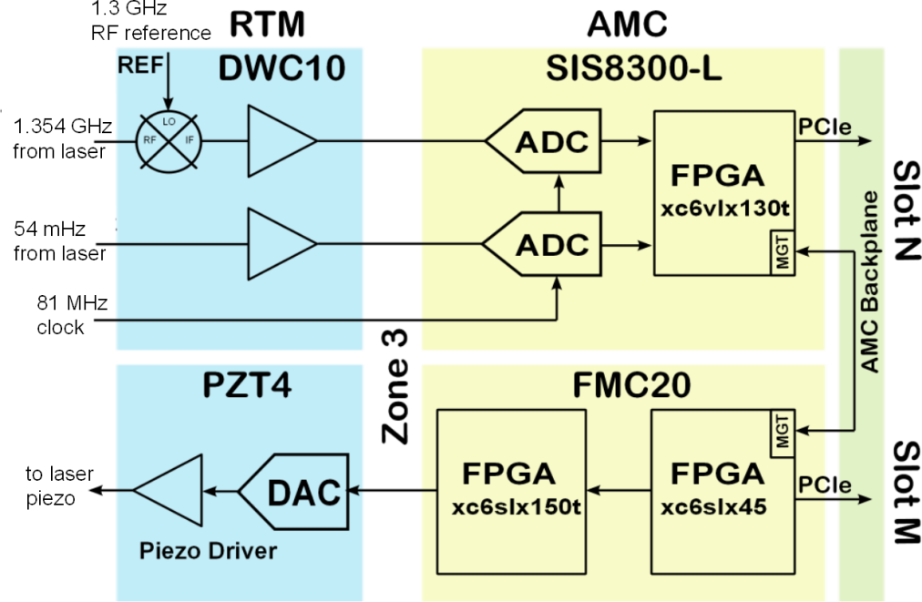
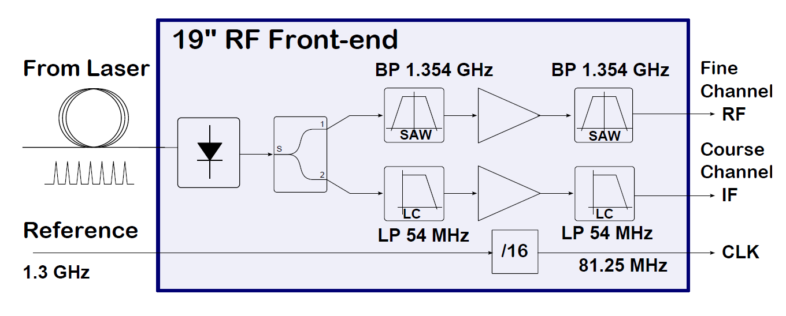
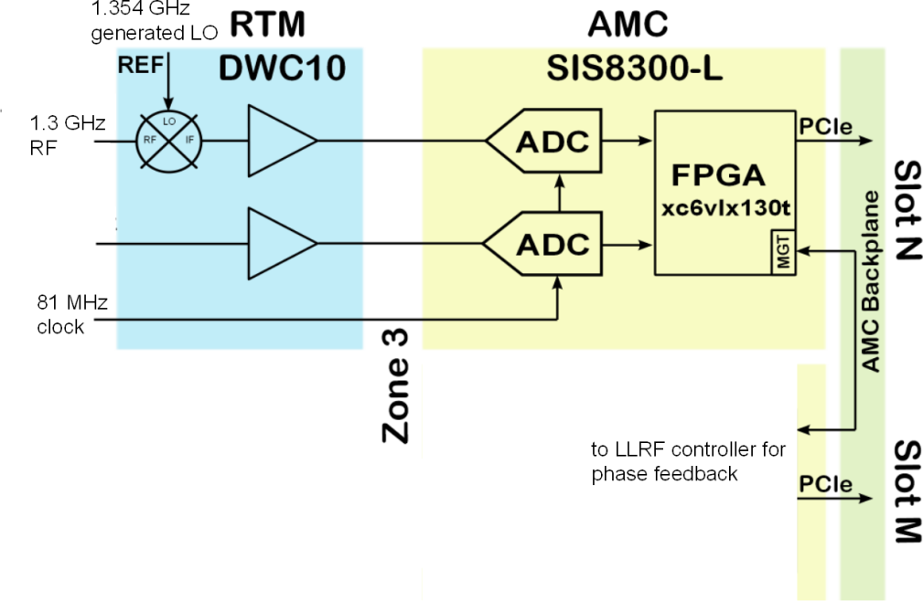

Slide 4
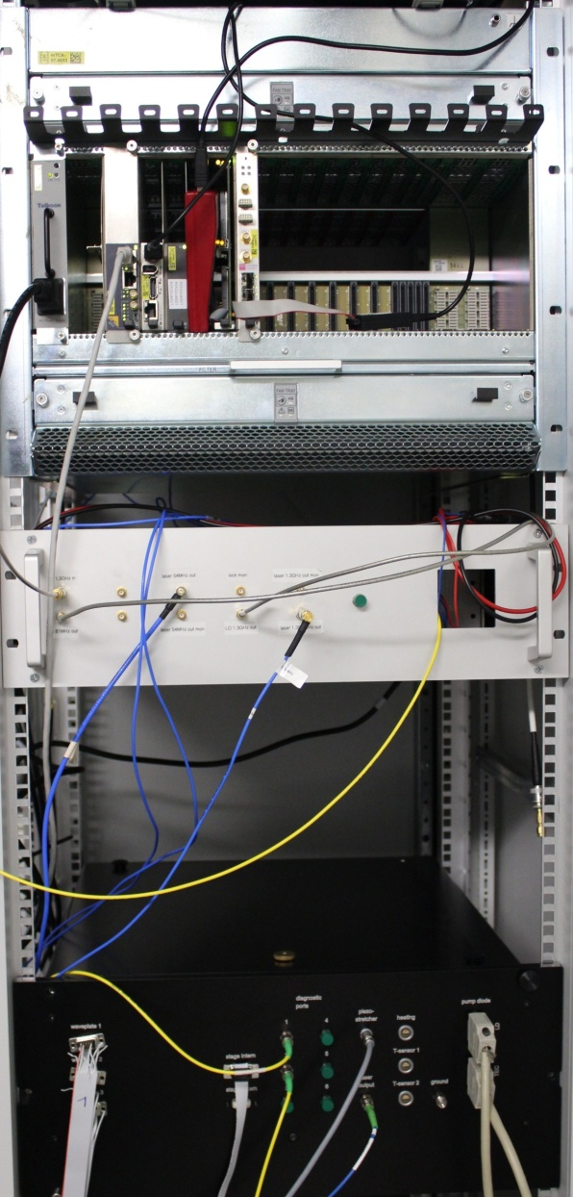
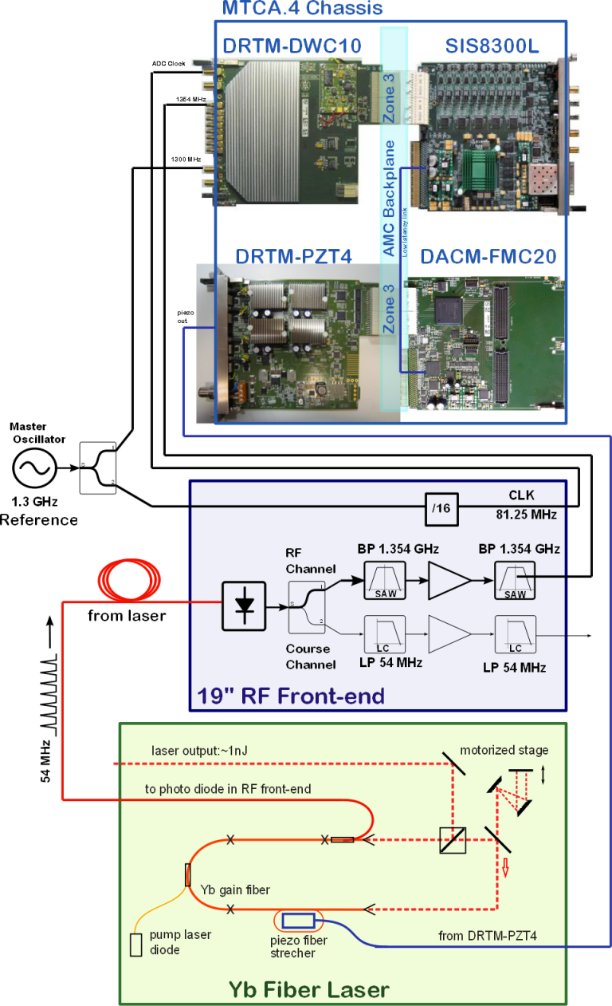
New mTCA based synchronization
MTCA.4
RF Box
Laser

Slide 5
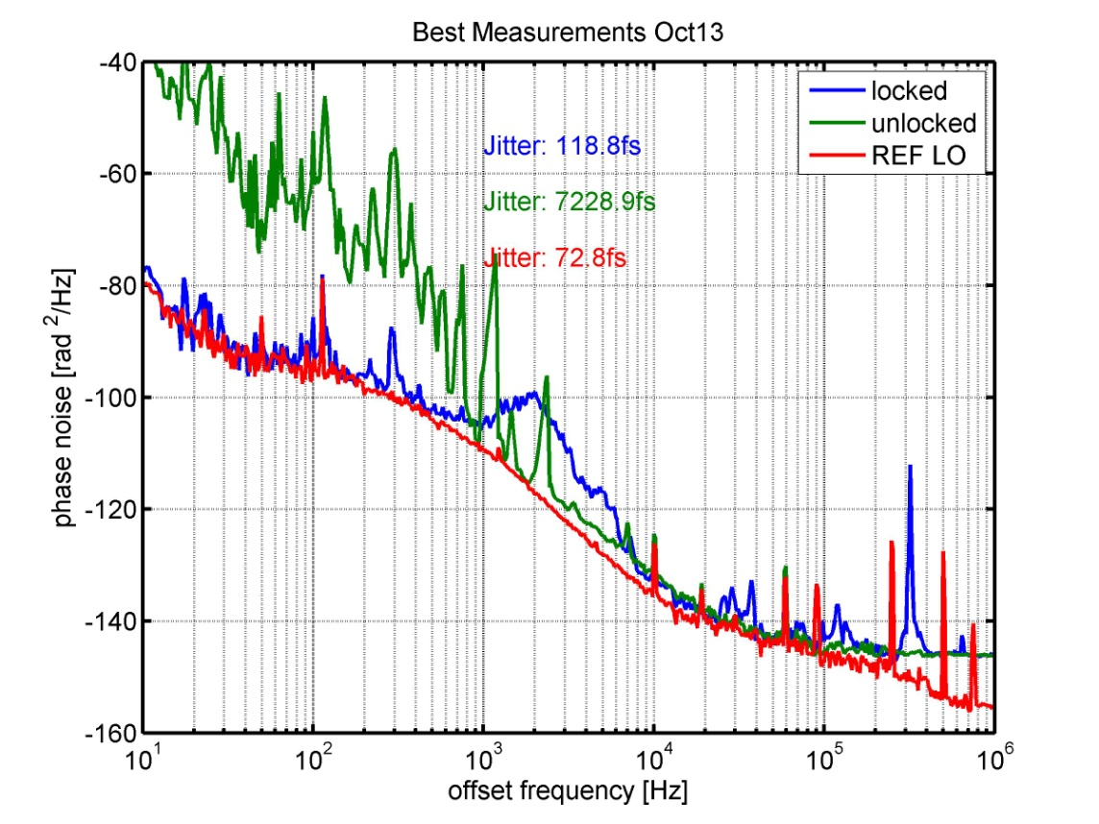
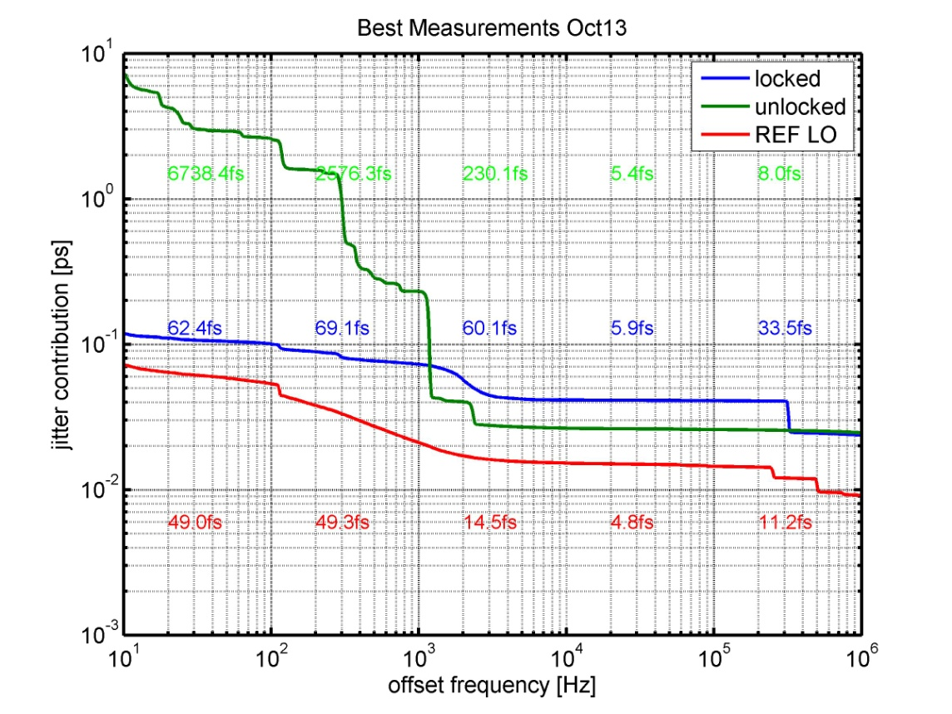
Synchronization measurements
Phase noise measurements of synchronized laser
Huge progress September to November but still some bugs to fix…

Slide 6
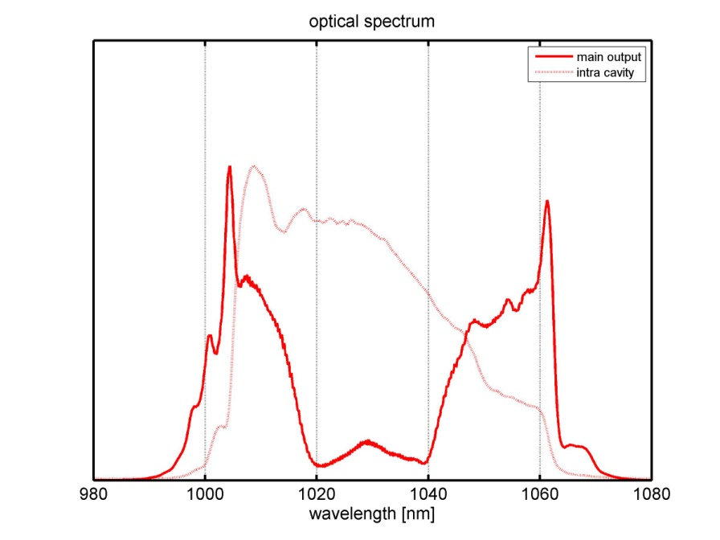
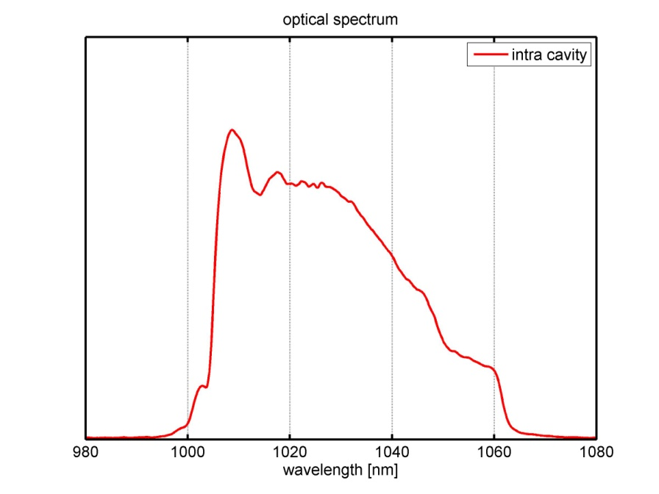
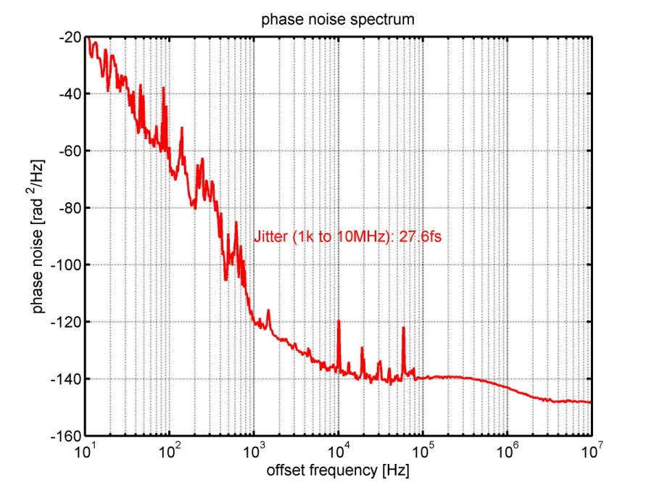
Mode lock state 1
Output (in fiber w/o compressor): 27mW
Intra cavity power: 110mW
Integrated jitter: 27fs (1kHz to 10MHz)
39.7ps (10Hz to 1kHz)
WP settings: 0, 0, 0 degrees
Pump current: 470mA

Slide 7
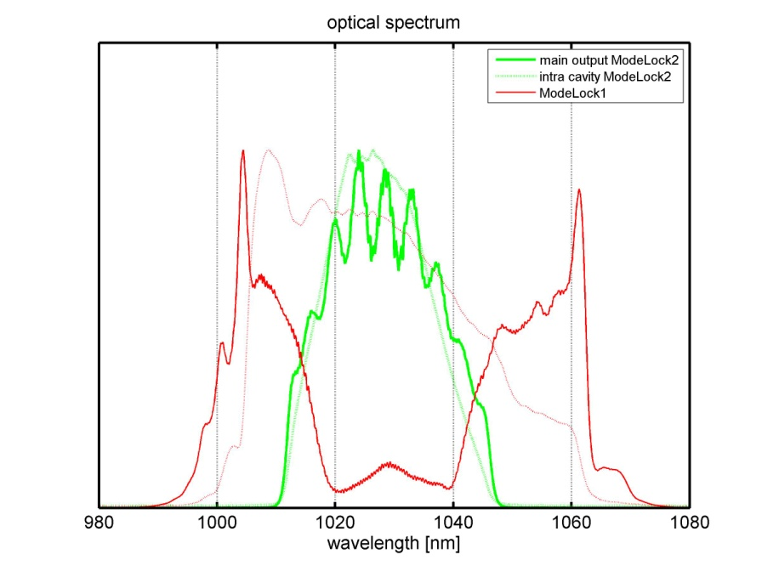
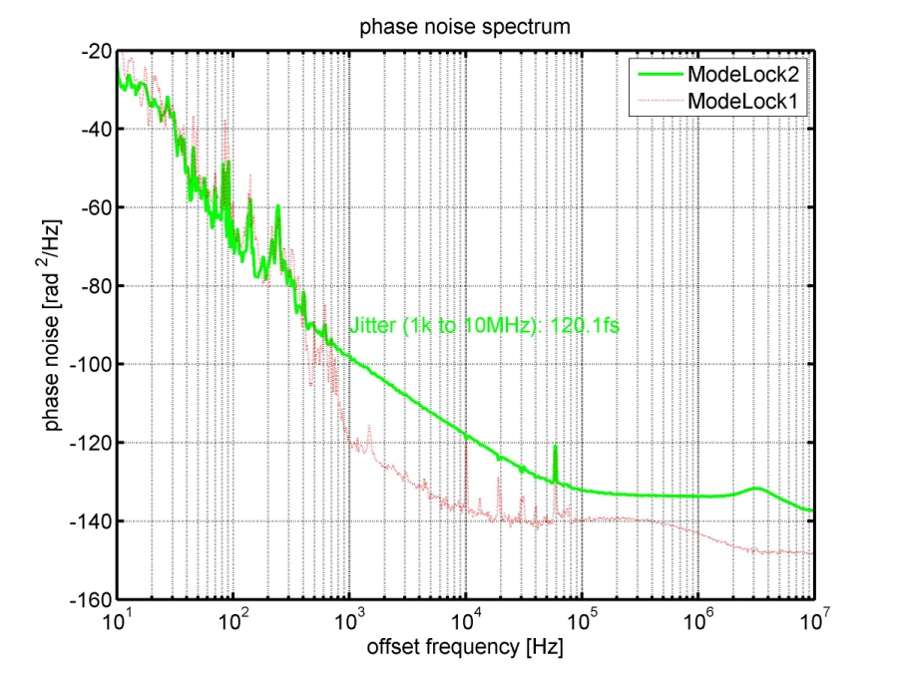
Mode lock state 2
Output (in fiber w/o compressor): 49mW
Intra cavity power: 90mW
Integrated jitter: 120fs (1kHz to 10MHz)
21.4ps (10Hz to 1kHz)
WP settings: -34, -135, -31 degrees
Pump current: 450mA

Slide 8
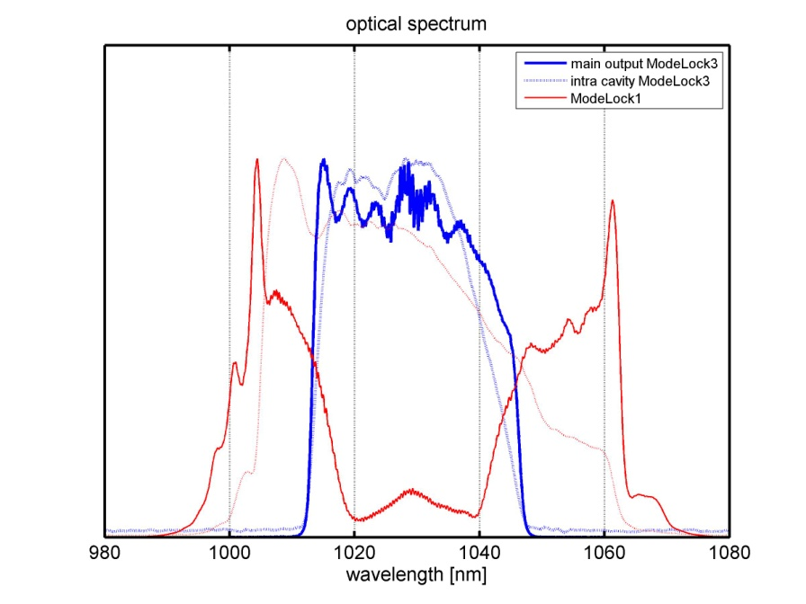
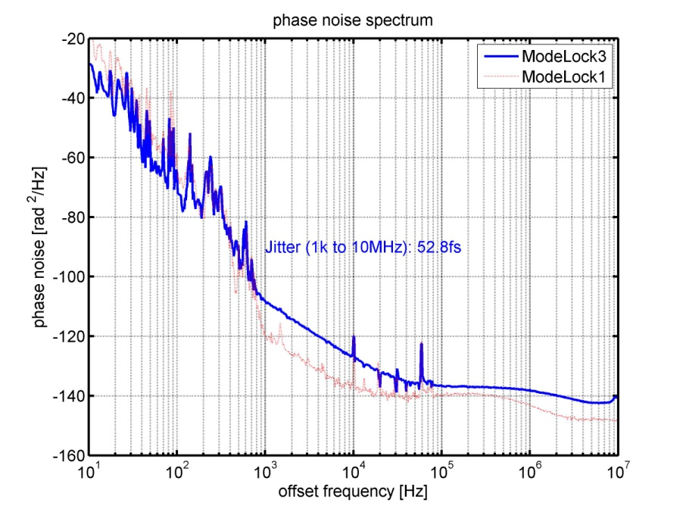
Mode lock state 3
Output (in fiber w/o compressor): 25mW
Intra cavity power: 38mW
Integrated jitter: 53fs (1kHz to 10MHz)
13.3ps (10Hz to 1kHz)
WP settings: -32, -138, -33 degrees
Pump current: 250mA

Slide 9
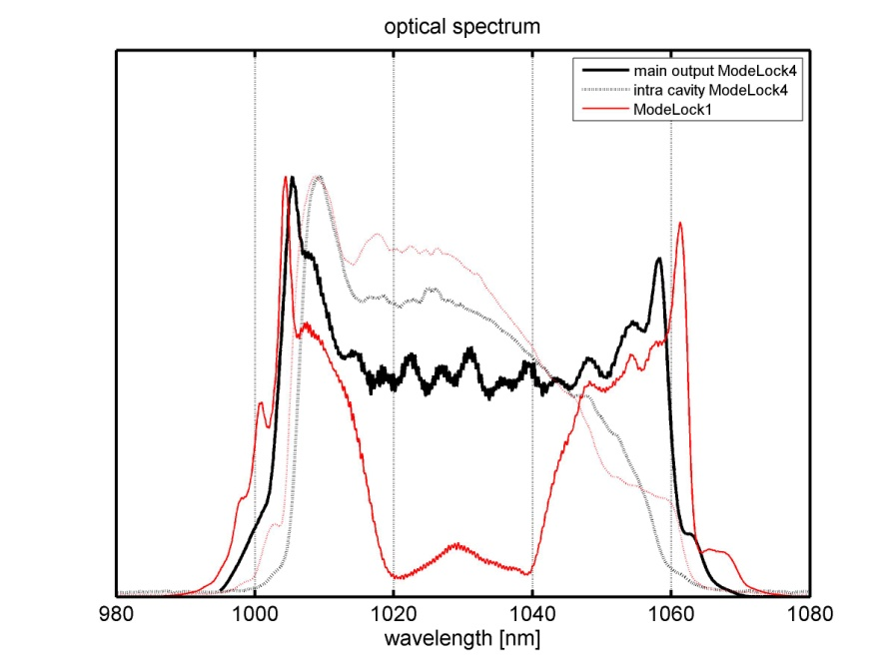
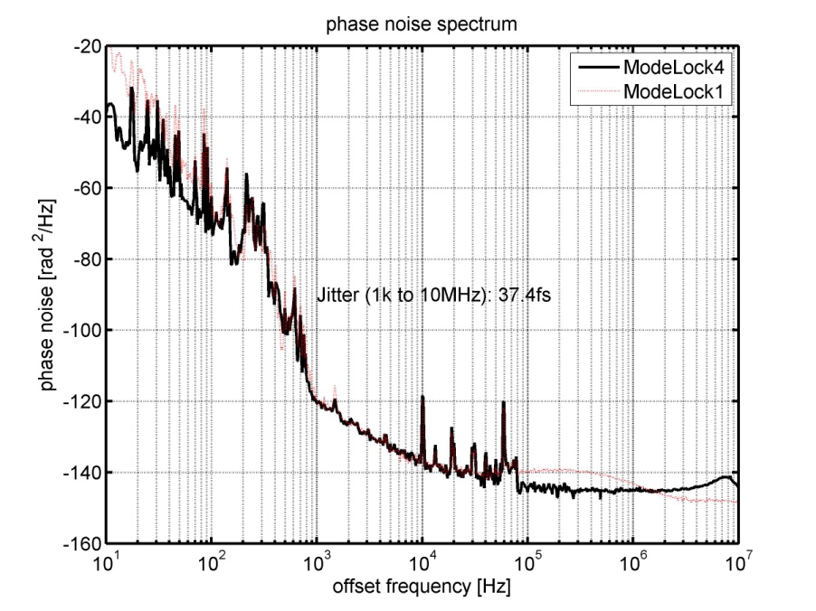
Mode lock state 4
Output (in fiber w/o compressor): 36mW
Intra cavity power: 100mW
Integrated jitter: 37s (1kHz to 10MHz)
7.5ps (10Hz to 1kHz)
WP settings: -18, -69, -11 degrees
Pump current: 480mA
Looks nice, but :instable pulse power (5%), double pulses?

Slide 10
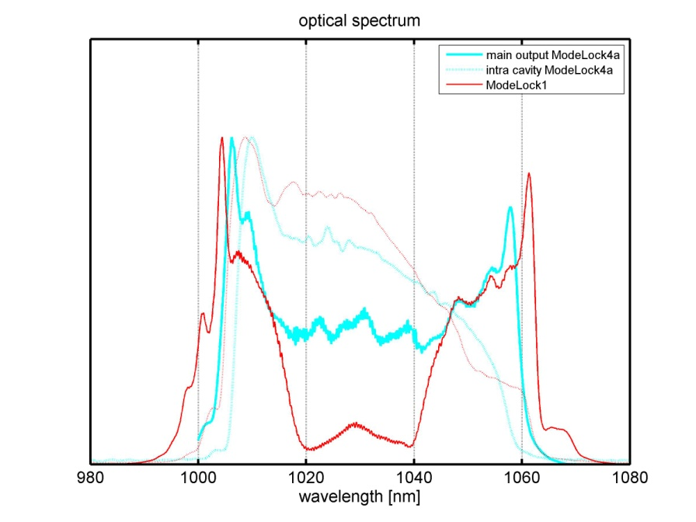
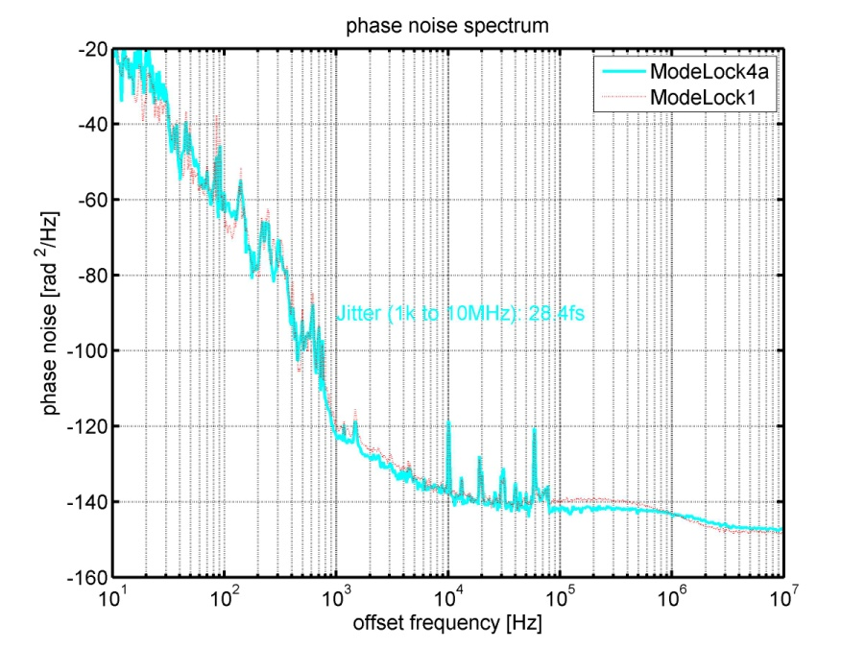
Mode lock state 4a
Output (in fiber w/o compressor): 29mW
Intra cavity power: 100mW
Integrated jitter: 28fs (1kHz to 10MHz)
45.0ps (10Hz to 1kHz)
WP settings: -20, -71, -12 degrees
Pump current: 350mA

Slide 11
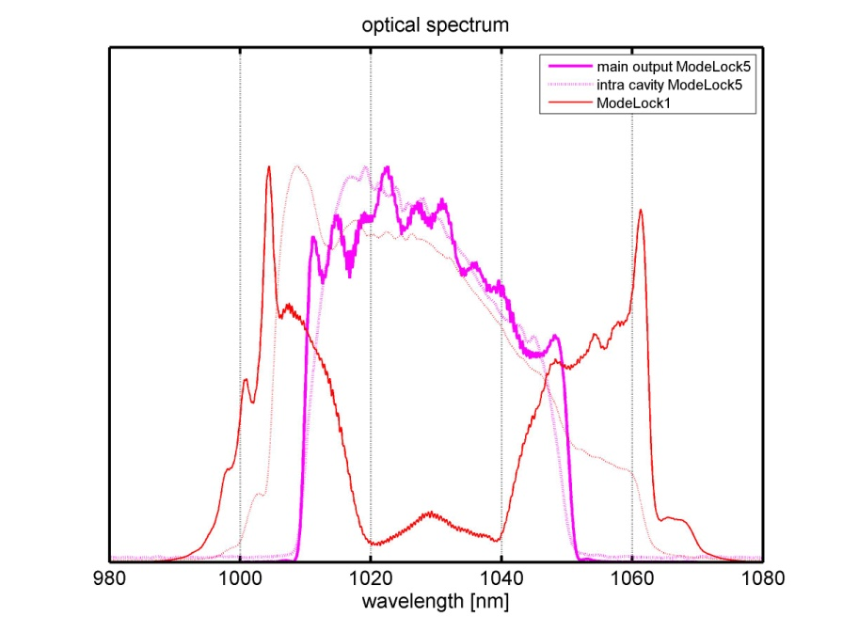
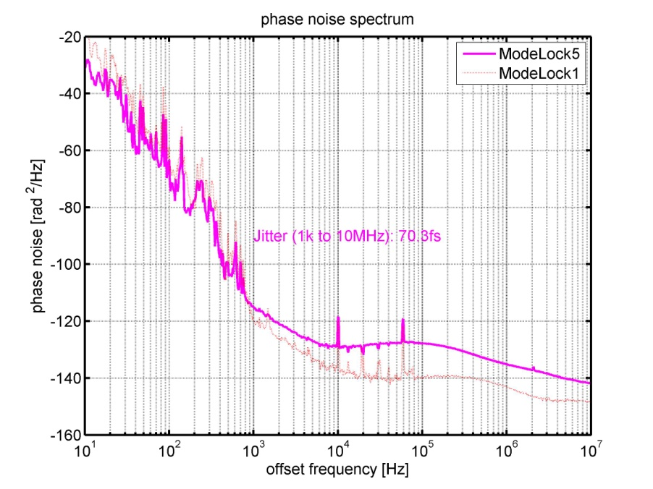
Mode lock state 5
Output (in fiber w/o compressor): 28mW
Intra cavity power: 60mW
Integrated jitter: 70fs (1kHz to 10MHz)
13.1ps (10Hz to 1kHz)
WP settings: -0, -15, 92 degrees
Pump current: 320mA

Slide 12
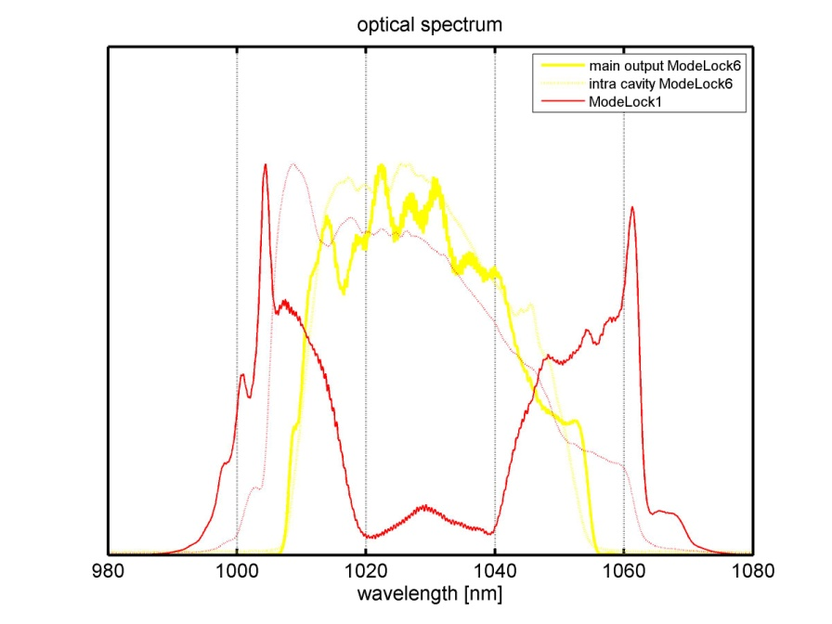
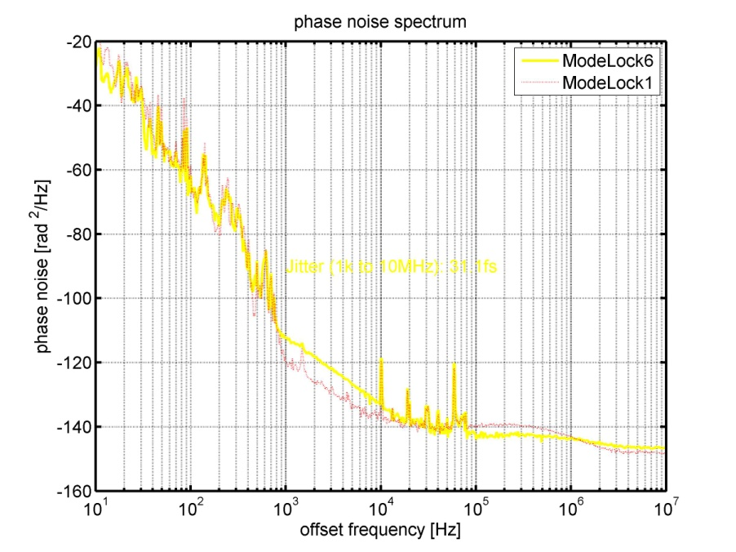
Mode lock state 6
Output (in fiber w/o compressor): 36mW
Intra cavity power: 100mW
Integrated jitter: 31fs (1kHz to 10MHz)
21.7ps (10Hz to 1kHz)
WP settings: 155, 1.5, -79 degrees
Pump current: 450mA

Slide 13
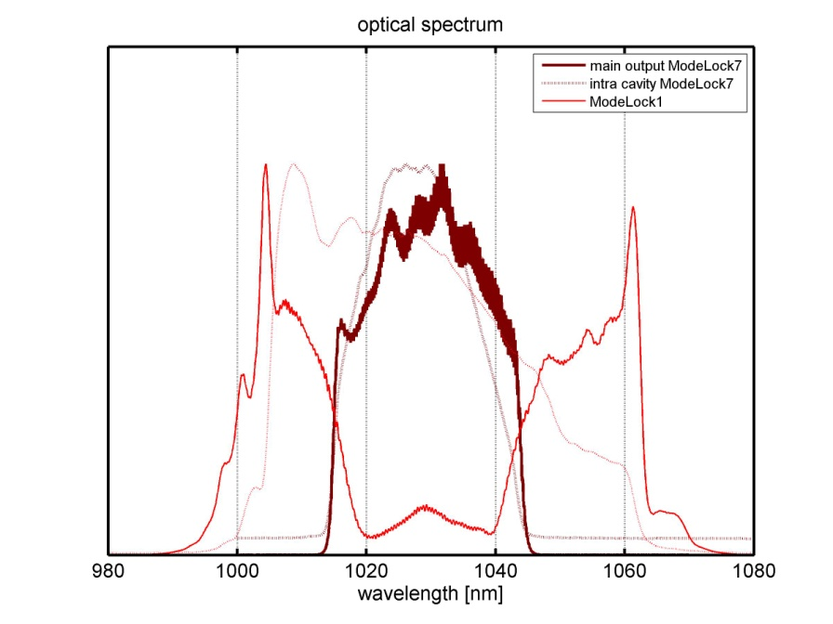
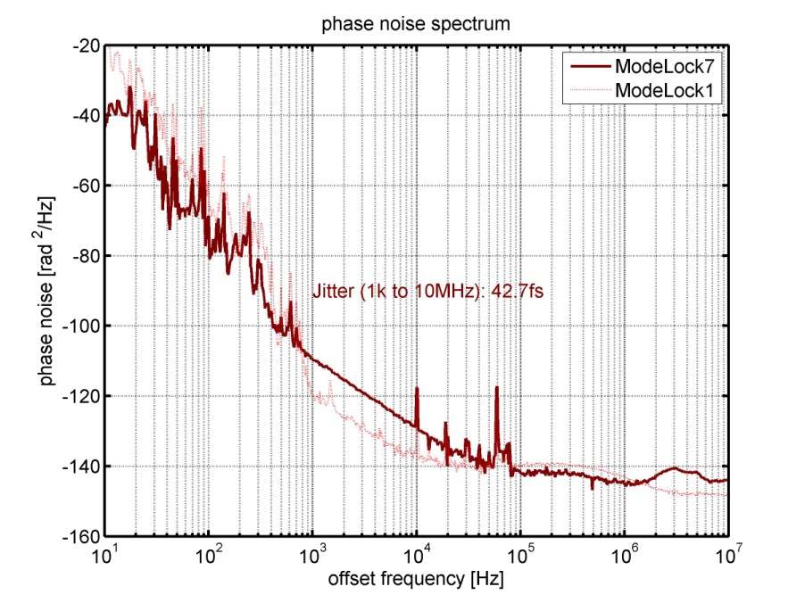
Mode lock state 7
Output (in fiber w/o compressor): 36mW
Intra cavity power: 110mW
Integrated jitter: 43s (1kHz to 10MHz)
8.2ps (10Hz to 1kHz)
WP settings: 21, -138, 122degrees
Pump current: 490mA

