Slide 1
Longitudinal Phase Space Monitor for E-XFEL
Minjie Yan
Deutsches Elektronen-Synchrotron (DESY)
2nd Mini-Workshop on Longitudinal Diagnostics for FELs
12. Nov. 2013

Slide 2
Idea: TDS + Kicker + Septum
Simulation with tracking codes: 3D and 1D
Flexibility for different operation modes

Slide 3
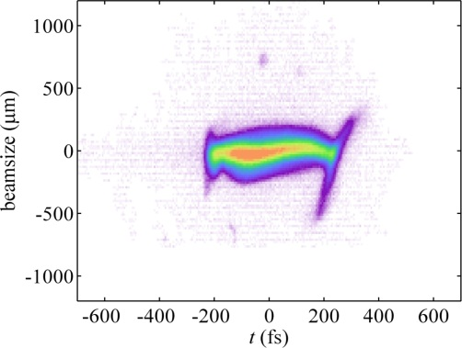
Longitudinal Phase Space Measurement
Transverse Deflecting Structure (TDS)
Longitudinal profile y ̴ z

Slide 4
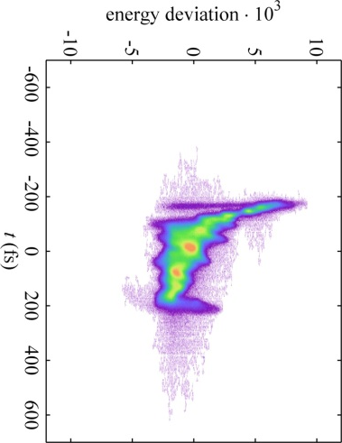
Longitudinal Phase Space Measurement
Transverse Deflecting Structure (TDS)
Longitudinal profile y ̴ z
TDS + Dipole
Longitudinal Phase Space: y ̴ z x ̴ energy

Slide 5
Experience from FLASH
Longitudinal phase space diagnostic (SDUMP) has been routinely used for machine-setup and during SASE tuning.
However
Dipole magnet has to be switched on/off (and cycled) → The operation has to be stopped
It can only be operated in single-bunch mode.
The machine behaves differently in the single- and multi-bunch mode. (FLASH is operated with 10Hz macro repetition rate, each RF macro pulse can be filled with up to 800 bunches )
No information on actual SASE level during measurements in 6SDUMP.
S. Wesch

Slide 6
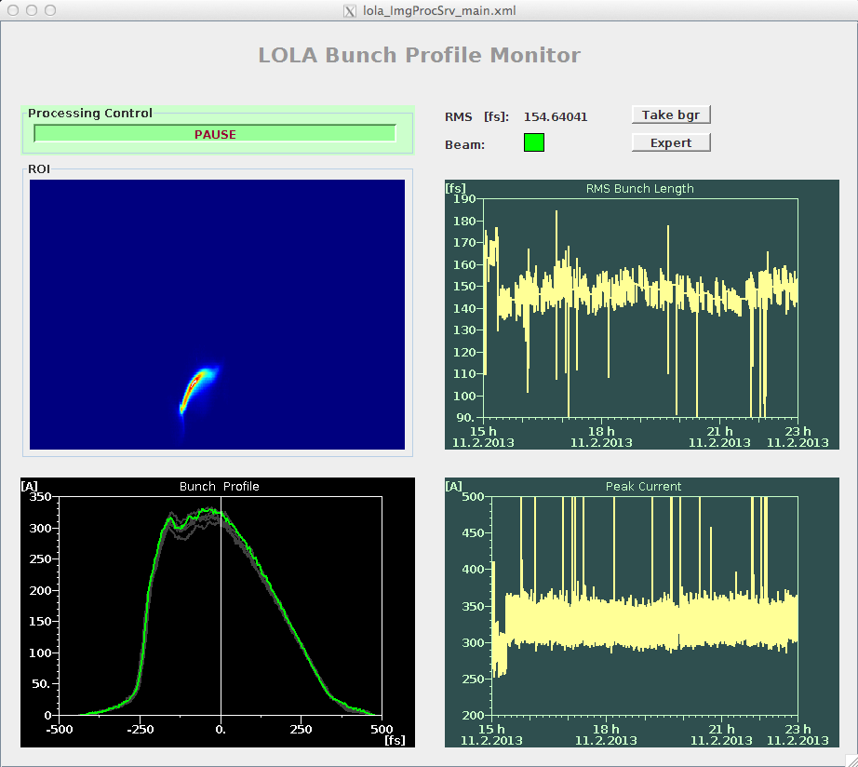
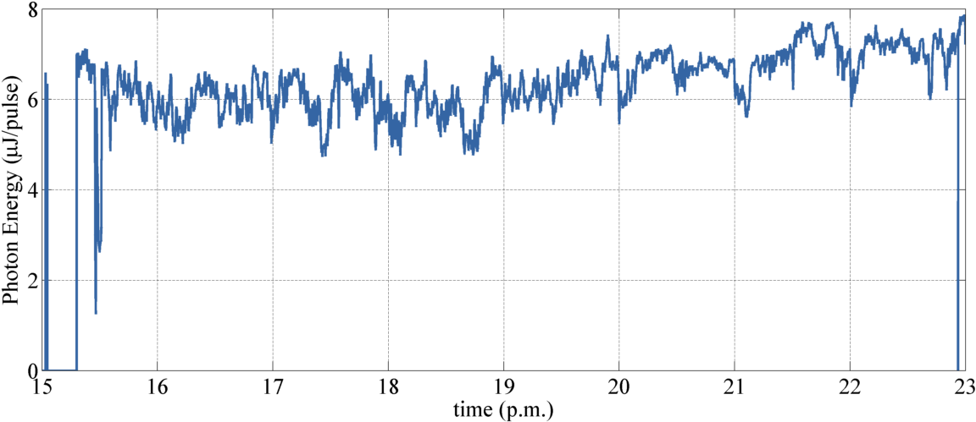
Experience from FLASH
Online bunch profile monitor at SMATCH finally working.
Delivers single-shot current profile, rms bunch length at 10Hz during SASE operation.
No information on the bunch energy.

Slide 7
Idea for E-XFEL
TDS + fast kicker magnet + Septum
Online longitudinal phase space diagnostic
Pulse-stealing mode (lost one bunch in the bunch train)

Slide 8
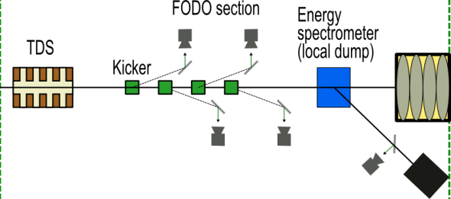
Idea for E-XFEL
Location of TDS diagnostics at E-XFEL
BC₀
BC₁
BC₂
I. Zagorodnov
with septum

Slide 9
Simulation for the scenario TDS + Kicker + Septum
Requirements on the accelerator optics
One bunch for diagnostic
Longitudinal resolution ̴ (sin(µ_{x, TDS->septum} ) * $\sqrt{\text{β}\text{x}\text{,}\text{TDS}}$ * V_{TDS}) ⁻¹
Energy resolution ̴ $\sqrt{\text{β}\text{y}\text{,}\text{screen}}$/D_{y,screen}
Reasonable kick strength of the kicker magnet
Reach 20mm offset at the entrance of the septum
Small streaked beam size at the septum
No influence of the dispersion from the kicker magnet
Simultaneous matching for the FODO section
Remaining bunches for SASE
Simultaneous matching into LINAC

Slide 10
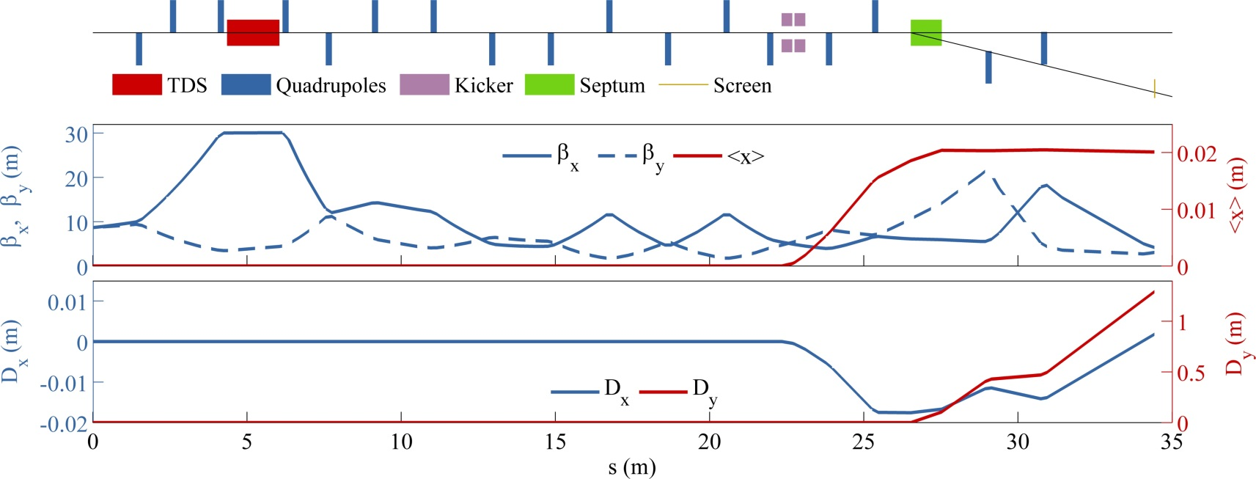
Simulation for the scenario TDS + Kicker + Septum
Example for E-XFEL: after BC1
Slice Emittance Monitor
Matching into linac
LPS Monitor
Expectations
Assumming ε_{N}=1µm and TDS operated at maximum power (24MW ~ 15MV) Time resolution: 16fs Energy resolution: 6.3·10⁻⁵ D_{x,screen} from kicker: 1.8mm

Slide 11
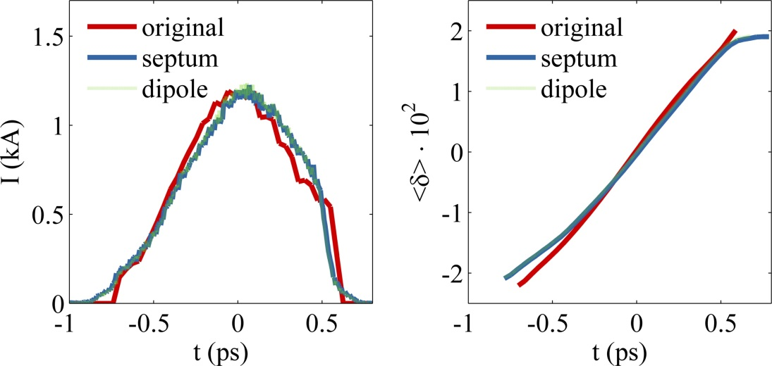
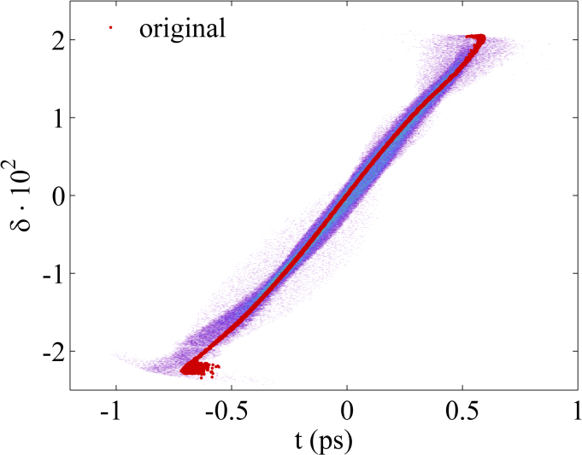
Simulation for the scenario TDS + Kicker + Septum
Simulation with elegant
Parameters
Input distribution: S2E simulation with CSRtrack + ASTRA
Tracked beamline: entrance TDS to the screen
1nC, 200k particles, 700MeV
Comparisons
‘TDS + dipole’ vs. ‘TDS + kicker magnet + septum’ with the same optics

Slide 12
Monitoring the Longitudinal Phase Space
S2E Simulation with 1D-code RFTweak from M.Dohlus
100pC, 1M particles
BC₀
BC₁
BC₂

Slide 13
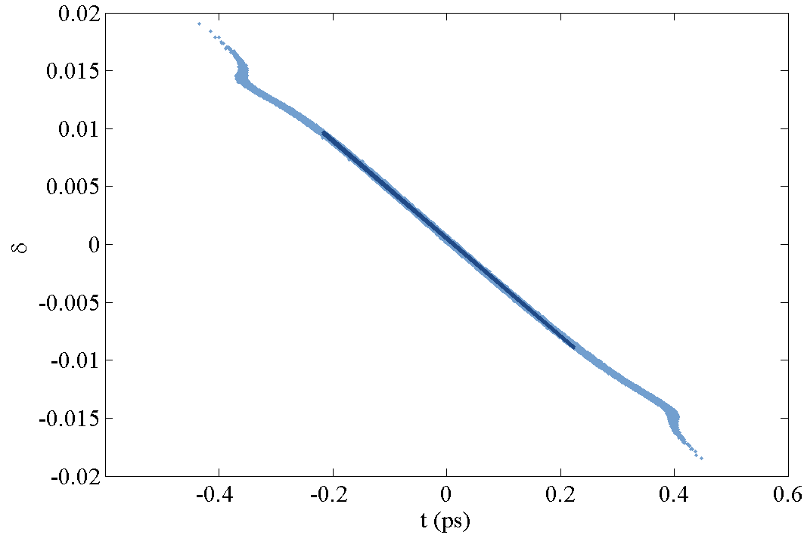
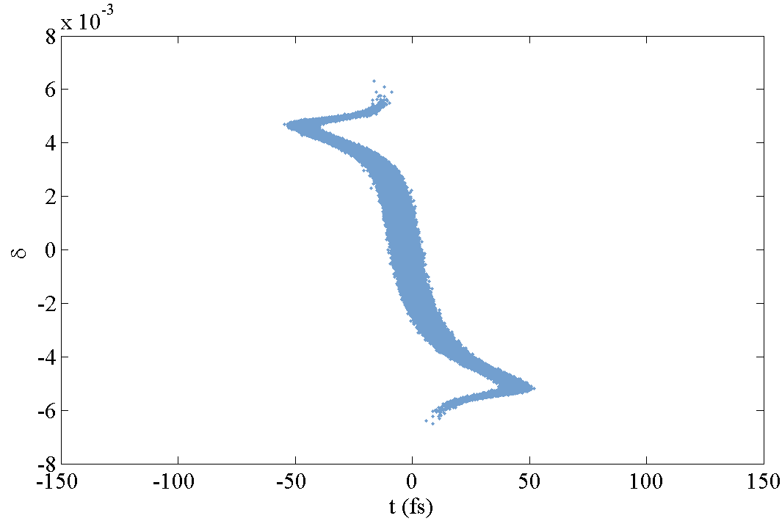
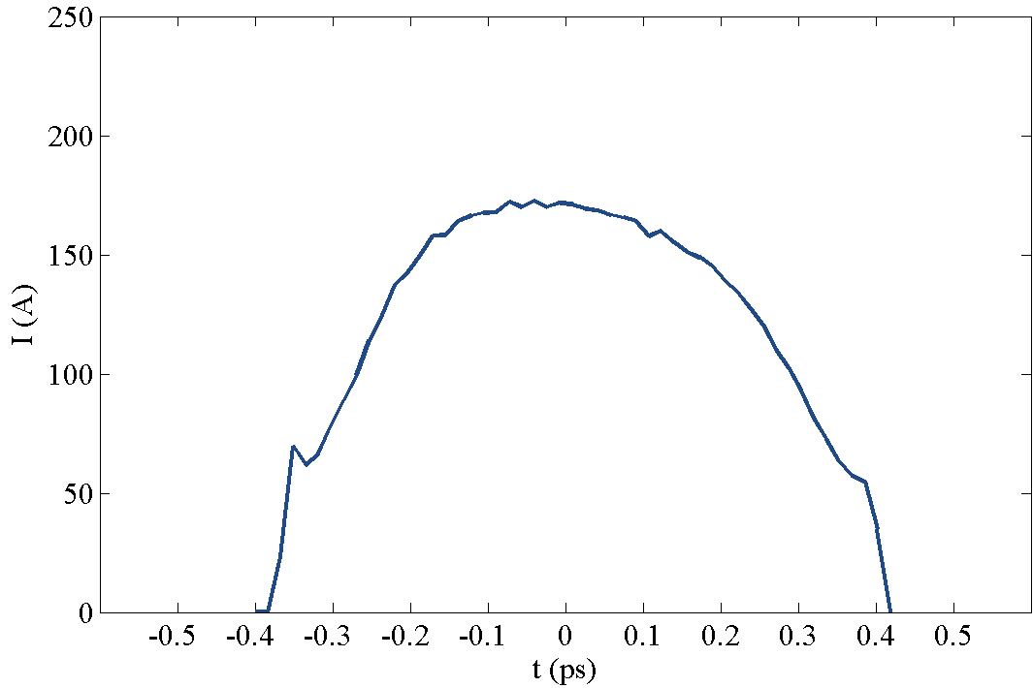
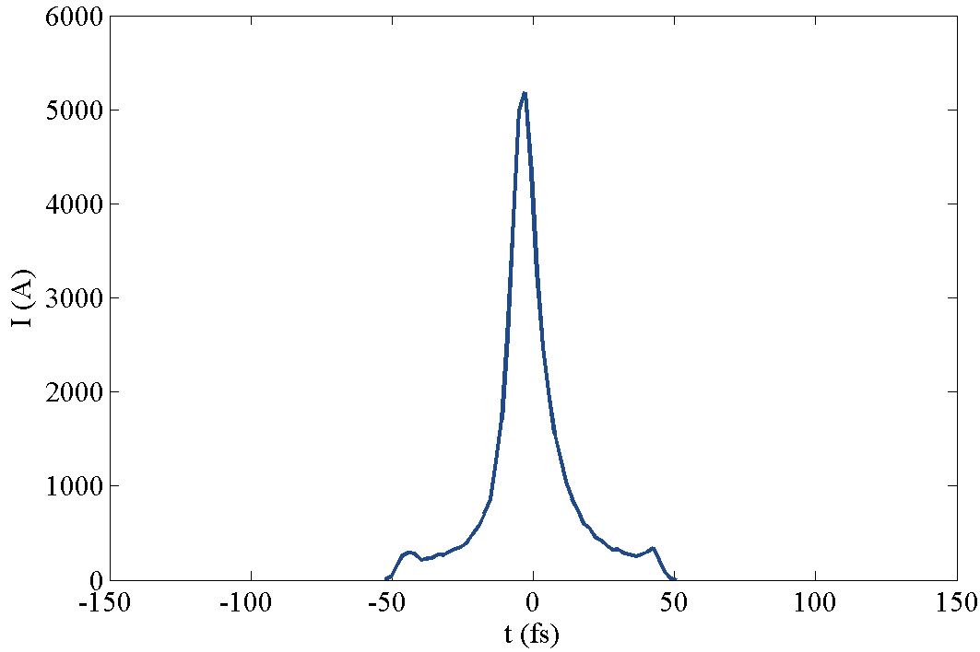
Monitoring the Longitudinal Phase Space
S2E Simulation with 1D-code RFTweak from M.Dohlus
100pC, 1M particles
 | ACC1 phase (degree)
(a) | working point
(b) | +0.35
(c) | -0.35
BC₀
BC₁
BC₂

Slide 14
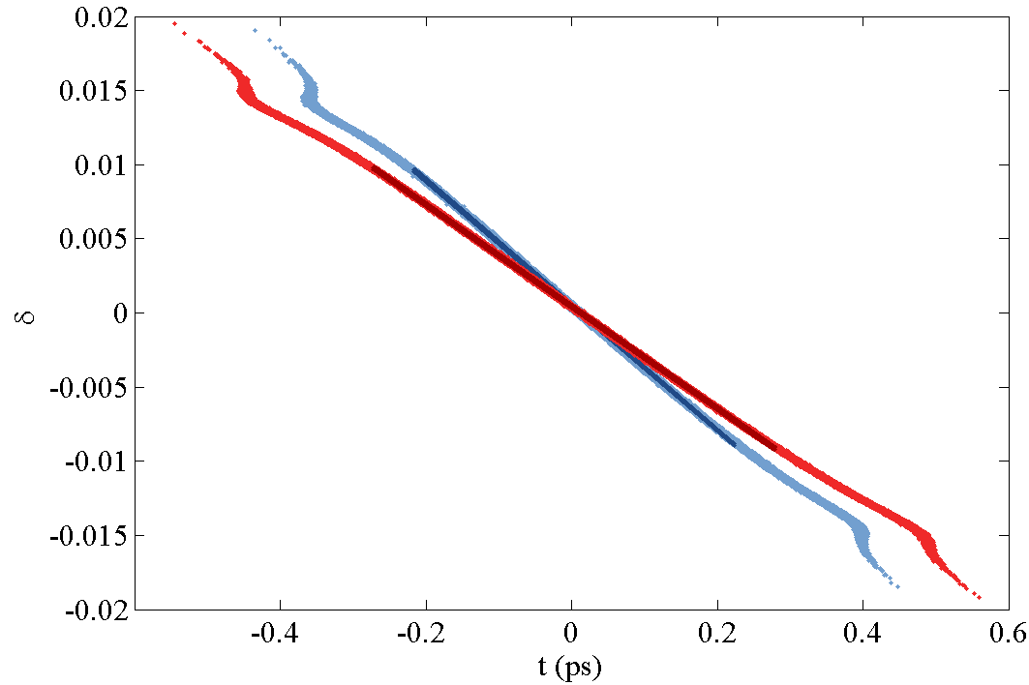
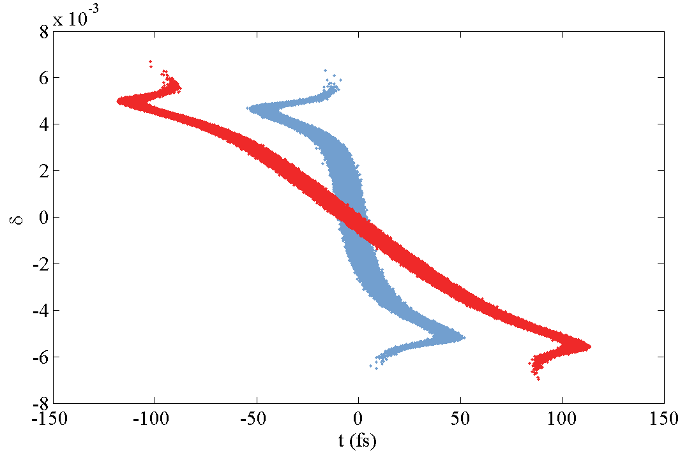
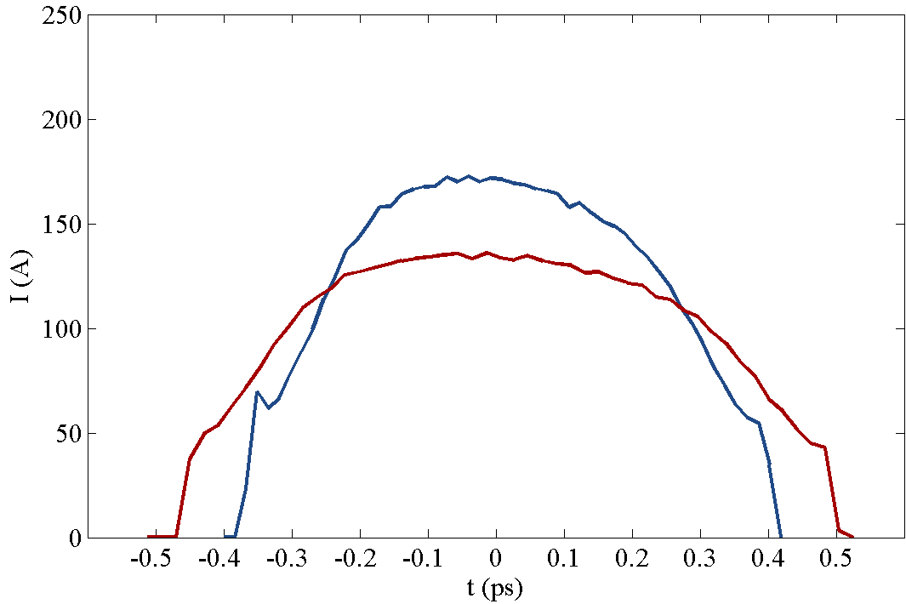
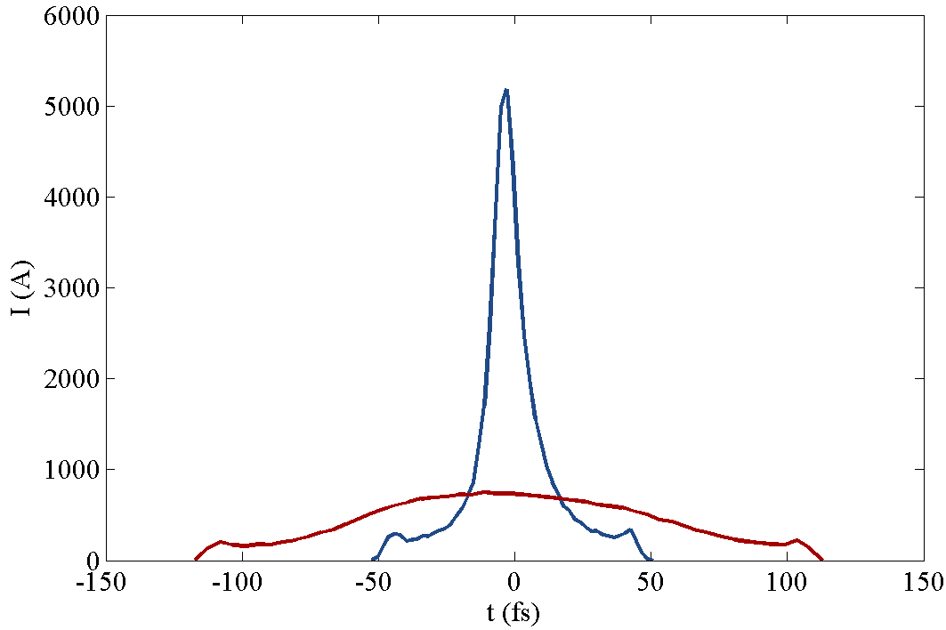
Monitoring the Longitudinal Phase Space
S2E Simulation with 1D-code RFTweak from M.Dohlus
100pC, 1M particles
 | ACC1 phase (degree)
(a) | working point
(b) | +0.35
(c) | -0.35
BC₀
BC₁
BC₂

Slide 15
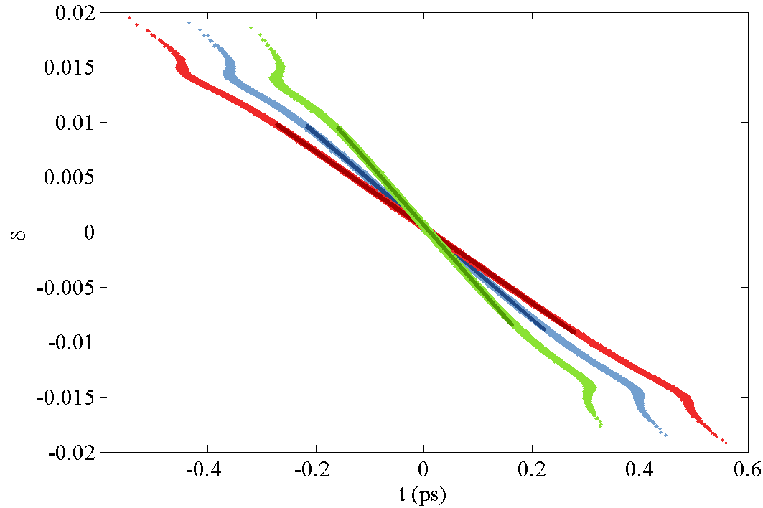
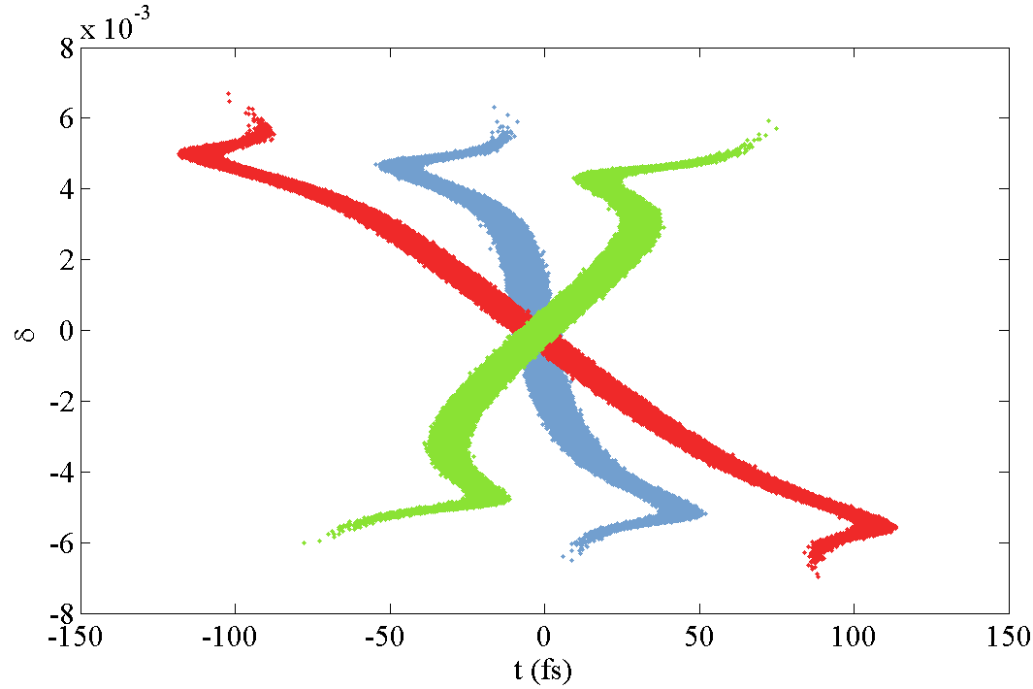
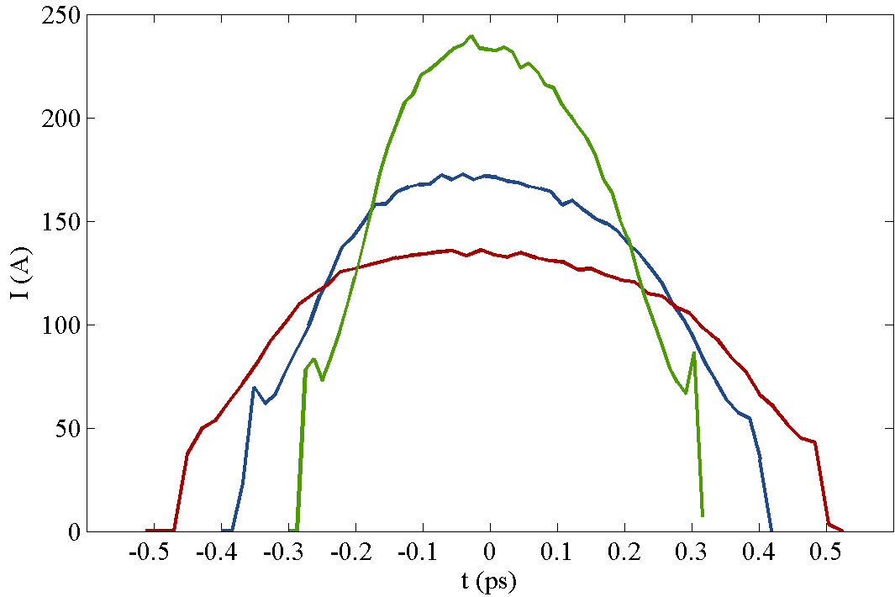
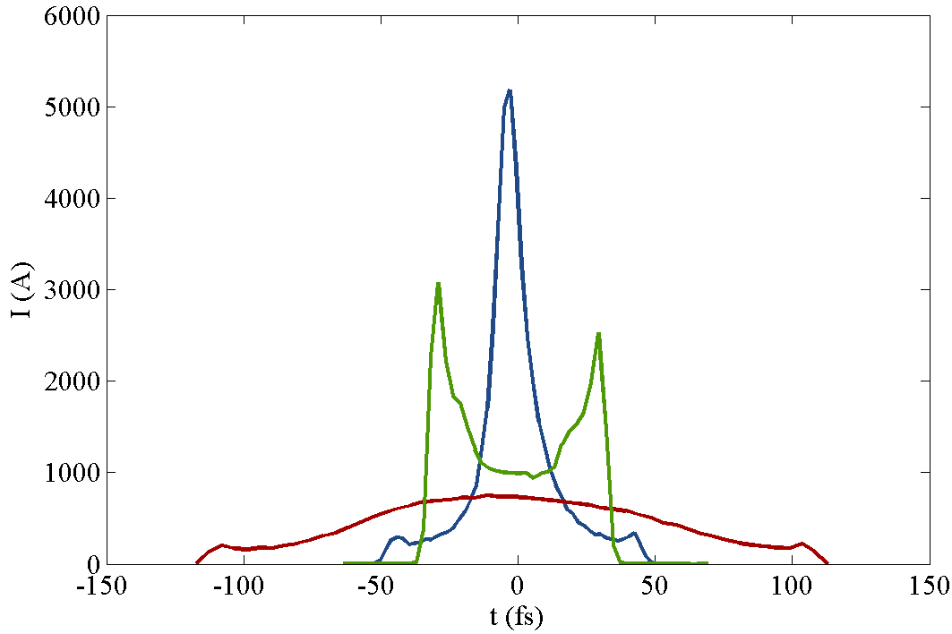
Monitoring the Longitudinal Phase Space
S2E Simulation with 1D-code RFTweak from M.Dohlus
100pC, 1M particles
 | ACC1 phase (degree)
(a) | working point
(b) | +0.35
(c) | -0.35
BC₀
BC₁
BC₂

Slide 16
Conclusion
Information on the energy spread without disturbing SASE delivery
Monitor the linear energy chirp, which is very crucial to the final compression
Could measure the longitudinal phase space after BC1 and BC2 at the same time → compression studies

Slide 17
Thanks.

Slide 18
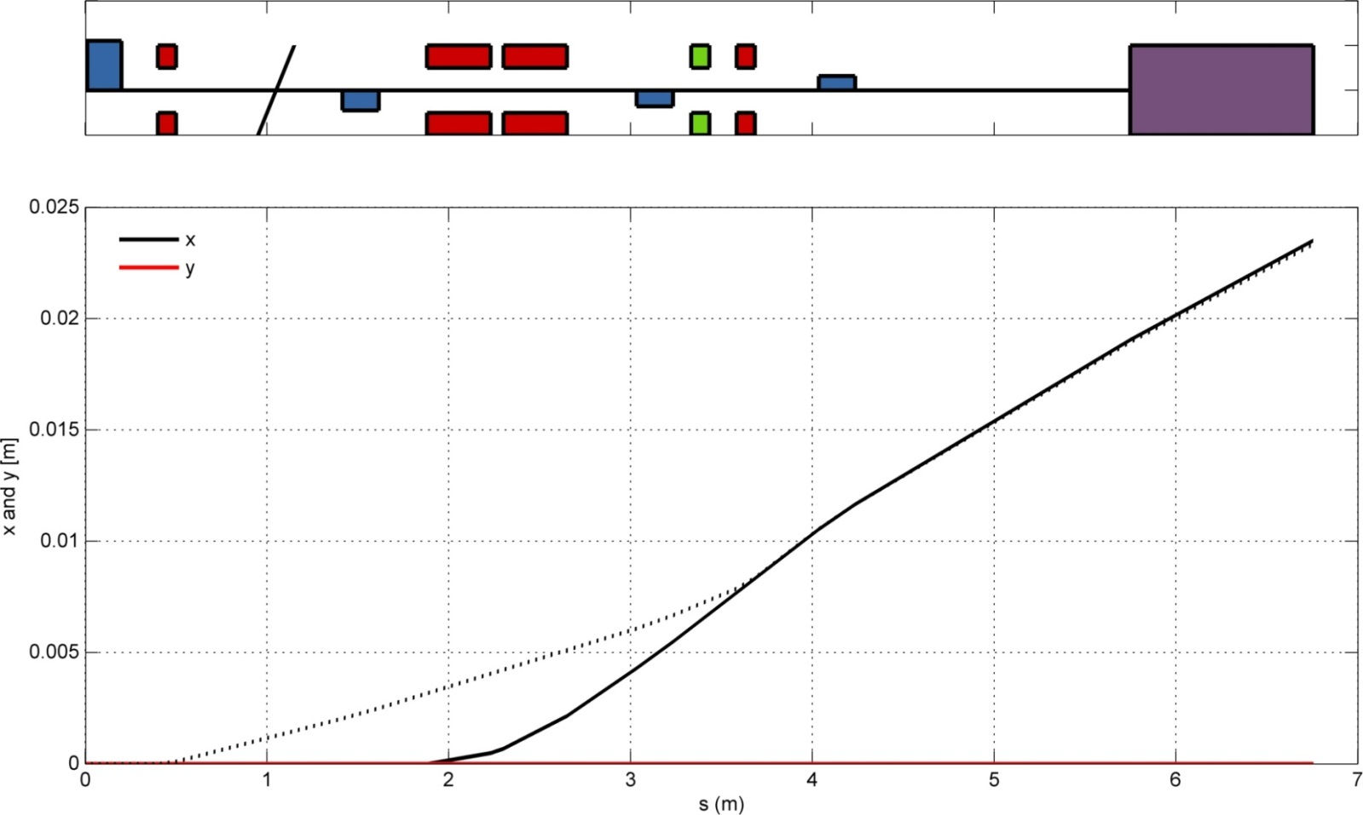
Flexibility
SASE-mode & Setup-mode
SASE-mode: use the kicker to kick one bunch out of bunch train into the dispersive section.
Setup-mode: use the steerer to direct the all bunches into the dispersive section.
Quad
Kicker
Steerer
Septum
e-beam

Slide 19
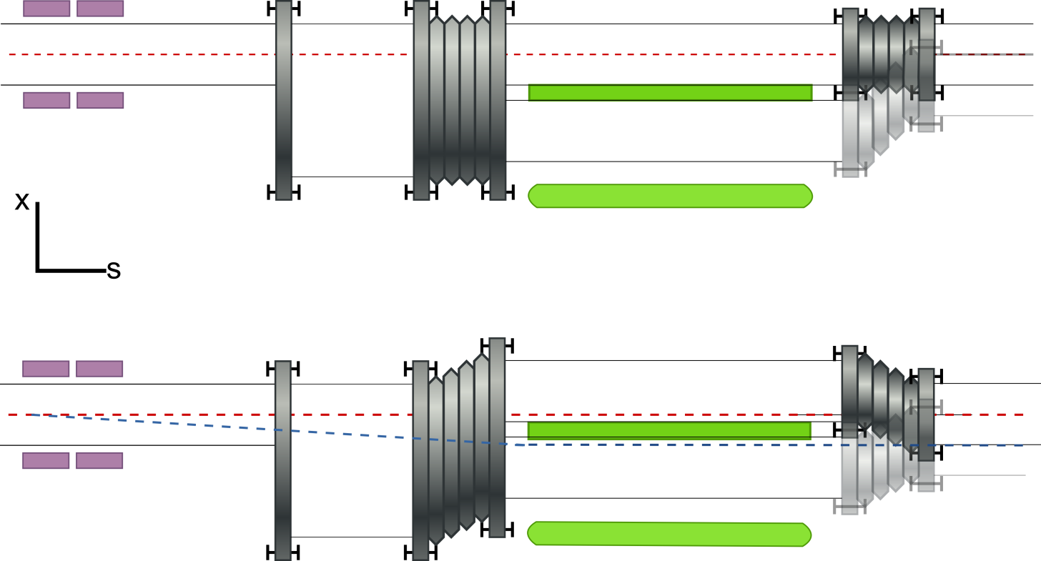
Flexibility
Septum-on & Septum-off
Septum-off the bunches should pass through in the middle of the D=40mm beam pipe
Septum-on straight-bunch and kicked-bunch are directed into two beam pipes and separated by 20mm → movable bellows
Kicker
Septum
e-beam

