Slide 1
Spatial Resolution
Lucia Bortko
Group Meeting
28.10.2013 DESY-Zn

Slide 2
BeamCal Segmentation
Y, cm
Uniform
Segmentation (US)
pad sizes are the same
Proportional
Segmentation (PS)
pads sizes are proportional to the radius
Notes:
Skazat chto vsebylo poschitano dlya Diamond??
Find number of channels for each segmentation(~ 70000 in total? And in 1 layer)

Slide 3
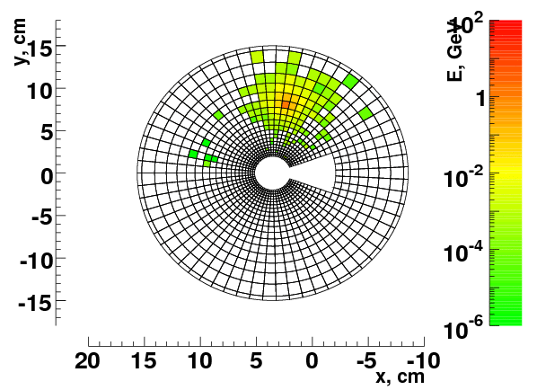
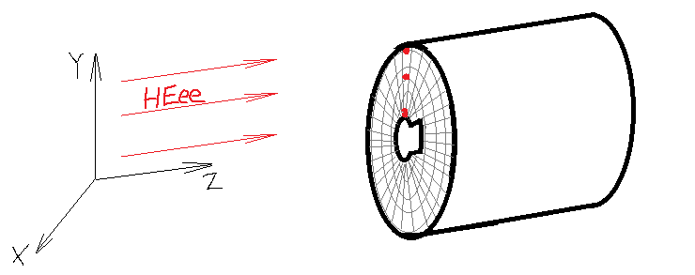
Original Coordinates
BeCaS
y
1
2
COG Coordinates
$R_{i}= R_{in}$ * $a^{i−1}$
6
0
3
$$X_{COG}=\frac{\sum_{i=0}^{6}{X_{i}E_{i}}}{\sum_{i=0}^{6}{E_{i}}}$$
$R_{i}= R_{in}$ * $a^{\left(i+\frac{1}{2}\right)−1 }$
5
4
x

Slide 4
What I want to get
Residual histo
$$σ_{R}$$
$σ_{R}= \frac{A}{\sqrt{E}}$
Gaussian fit
US:
$$σ_{R}$$
0
$R_{COG}$ - $R_{true}$
Energy of Electron
$$\frac{σ_{R}}{R}$$
$\frac{σ_{R}}{R}= \frac{A}{\sqrt{E}}$
Gaussian fit
PS:
$$\frac{σ_{R}}{R}$$
0
$$\frac{R_{COG}\text{ − }R_{true}}{R}$$
Energy of Electron
Example for one
Energy = 200 GeV:
For angle in degree,
then along arc in mm
$$σ_{R}$$
$$σ_{φ}$$
ps
ps
us
us
R
R

Slide 5
How I do this
1 - for 200GeV, PS, rad. res. -> residual histo, $\frac{σ_{R}}{R}$
- 200 GeV, US, rad.res. -> residual histo, ${ σ}_{R}$
-> comparative plot ${ σ}_{R}$ vs R for US and PS (200GeV, radial resolution)
4 - energies 50, 100, 200, 500GeV PS, rad.res. -> $\frac{σ_{R}}{R}$vs $E_{e}$, fit.formula
- 50, 100, 200, 500GeV US, rad.res. -> $σ_{R}$vs $E_{e}$, fit.formula
- steps 1-5 for Angle
Step 1. Detailed.
1.1 Take true coordinates from source files for showers
1.2 Calculate COG coordinates
1.2.1 go through reconstruction algorithm with BG -> R, Phi of COG
1.2.2 supplement part of rec.algorithm: calculate in coordinates (!)
1.3 Plot residual Histo “True-COG”, fit, get parametr “Sigma”

Slide 6
found part of reconstruction code, where changes should be done and supplement code with calculating COG coordinates in mm.
Program for spatial resolution calculating ( for now for 50 events):
Calculate COG coordinates ( go through reconstruction algorithm with my additions)
Average by 10th BG, and its RMS
SH + BG (random)
- Aver_BG
- RMS
towersearch
COG calculations > to output file
Take original coordinates (X, Y, Z, …) from source files -> get R
Take COG coordinates (R, Phi)
-------
Plot histo with , get $\frac{σ_{R}}{R}$
$$\frac{R_{COG}\text{ − }R_{true}}{R}$$

