Slide 1
eduGAIN: progress & plans
Brook Schofield, GÉANT Task Leader for eduGAIN
Project Development Officer, TERENA
LSDMA, Hamburg
Wednesday, 22 January 2014
Notes:
35 Minutes + 10 Minutes questions

Slide 2
Presentation Overview
History of identity federation and eduGAIN
How Interfederation and eduGAIN works
Facts and Figures
How to join eduGAIN via your local identity federation
Current Difficulties and Challenges
Recommendations

Slide 3

The Situation on Campus:
Lots of Applications
More and more applications for students and researchers
Many applications require authentication and authorization

Slide 4


The Problem:
Lots of Applications → Lots of Passwords
One password for each application does not scale
Tons of passwords to manage for users and service operators
Varying degree of password security
Increased helpdesk/user work due to password resets
Collaborative usage of applications is difficult

Slide 5


The Solution:
Federated Identity Management
Federation
Create an (identity) federation:
  Multiple organisations/services agree on
  common technical and legal standards => trust
  Deploy Identity and Service Providers
  Mutually trust each other's identity assertions
  Collaborate, e.g. common e-learning platform
One login name and password for users
Password entered only on login page of home organisation
First Academic Identity Federations started in mid-2000s
Many countries have national academic identity federations today!

Slide 6
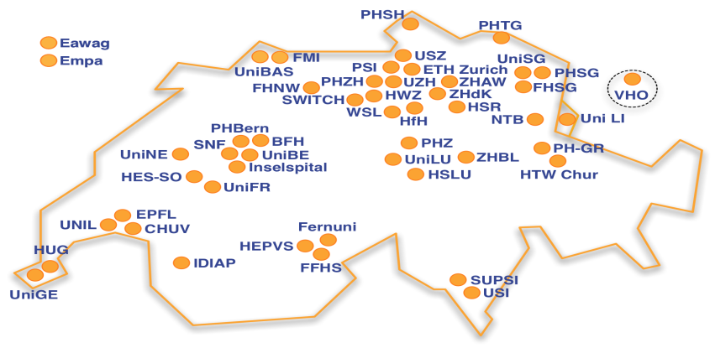
Example SWITCHaai Federation
(Switzerland)
Number of Organizations
Number of Federation-enabled accounts
Number of Resources/Services
98% coverage in
higher education

Slide 7
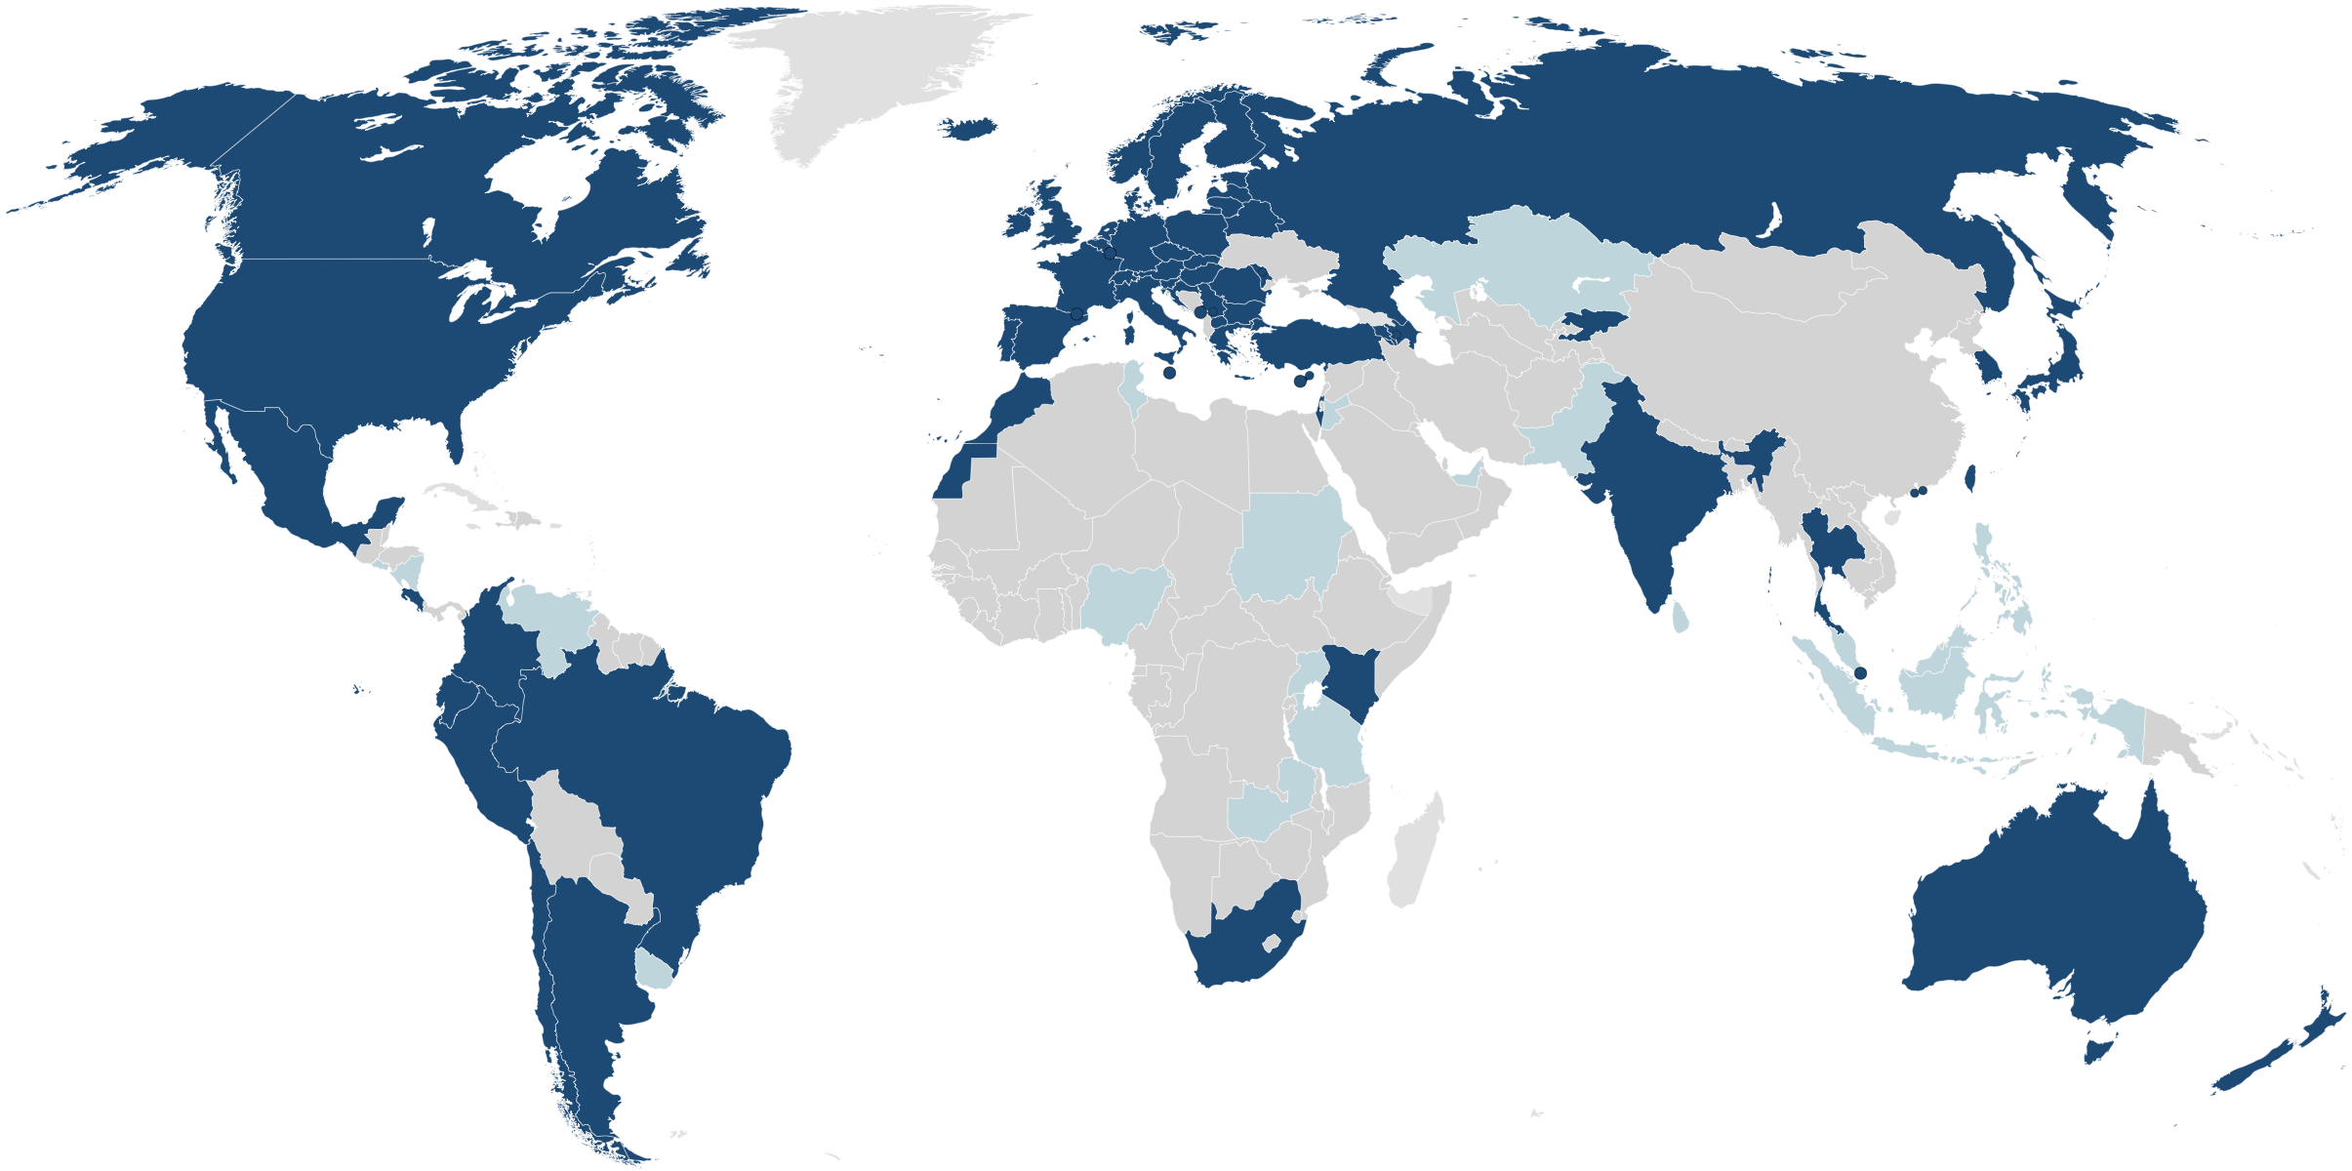
eduroam Federations
World Wide
eduroam
Pilot
:-(
last update January 2014, www.eduroam.org

Slide 8
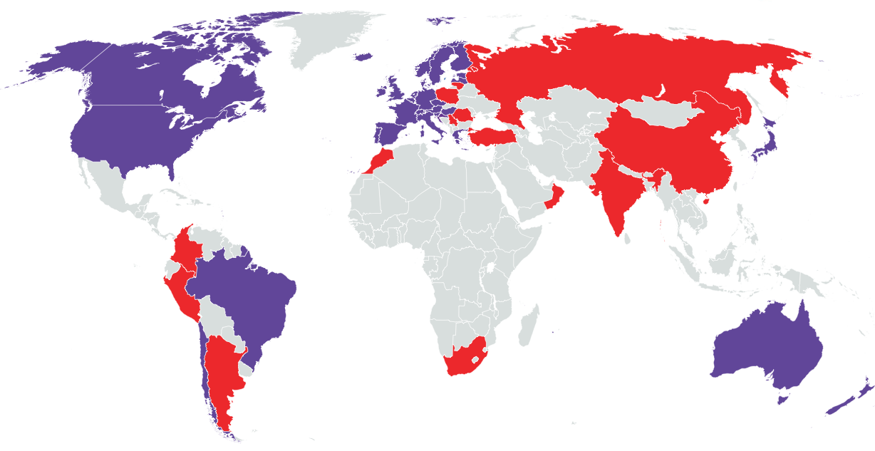

Identity Federations
World Wide
30 Identity Federations in production
12 Identity Federations in pilot
last update 14. October 2013, www.refeds.org

Slide 9
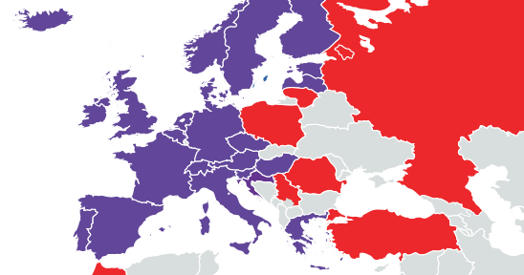
Identity Federations in Europe
Identity Federations
in production
Identity Federations
in pilot
last update 14. October 2013, www.refeds.org

Slide 10
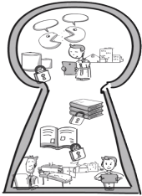
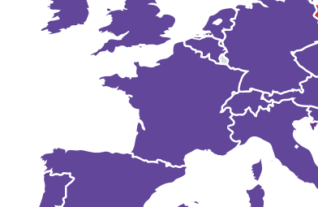
Identity Federations Are Traditionally
Limited by Country Borders
All Federations:
Support SAML2
education & research
Use same/similar
user attributes

Slide 11
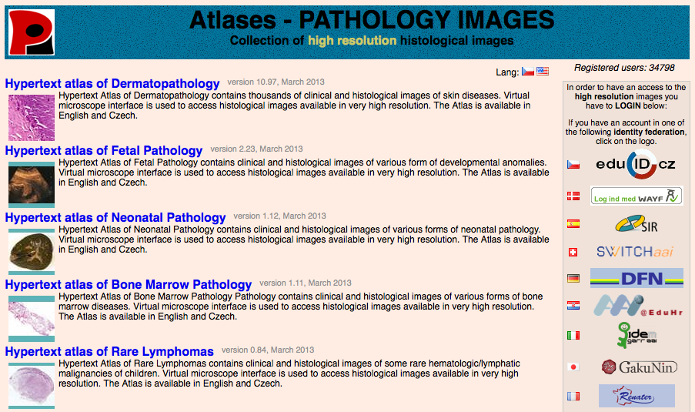
Options to Offer a Service to Users in Multiple Countries
Option A:
Provide each user a login name/password. User management effort.
Option B:
Make service join multiple federations.
Complicated, lots of paperwork and different requirements
Option C?
Service: Atlas, Federations joined: 19, URL: atlases.muni.cz

Slide 12
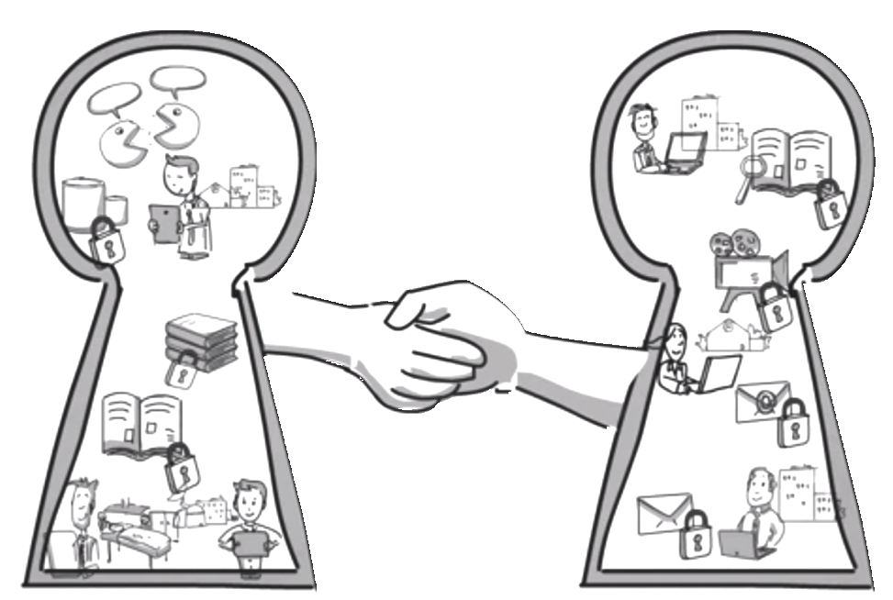
Option C, the Next Step:
Interconnect Identity Federations
Provide legal and technical frameworks to make Identity Federations interoperate = interfederate

Slide 13



Interfederation Use Cases
Researchers
Often work together in international research projects, which operate many web-based services that need authentication. Services are in different countries/federations. Thanks to Interfederation researchers can use their institution's account.
Lecturers
Can start e-learning collaborations across country borders. Create (costly) e-learning content collaboratively or easier "sell" it to other universities abroad.
Content Publishers
Companies like Elsevier/Thomson Reuters/etc. already joined multiple identity federations. Cumbersome for them and for federation operators.
Thanks to Interfederation: Join one, be connected to many!

Slide 14
Interfederation with eduGAIN
Global Authentication INfrastructure for education
An interfederation service primarily for Research & Education
Connects existing SAML-based academic identity federations
SAML2-based
Currently mostly web-based services but non-web services would be supported too (e.g. via SAML ECP)
Developed and funded by European GÉANT projects (www.geant.net)
but open also to non-European federations
Web site: www.eduGAIN.org

Slide 15
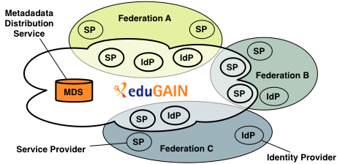
eduGAIN:
What Is it and How Does it Work?
eduGAIN provides policy framework and standards to build trust
SPs and IdPs of participating federations should opt-in for eduGAIN
MDS fetches, aggregates and republishes metadata

Slide 16
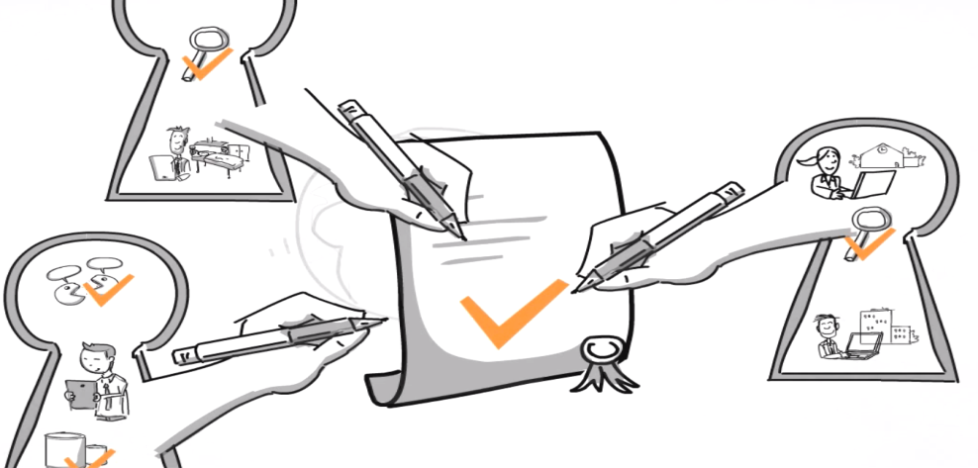
eduGAIN:
Legal Trust and Profiles
eduGAIN Declaration (3 pages)
  Signed by each eduGAIN Member Federation
  Contains 13 rules that federations promise to obey
eduGAIN Constitution (10 pages)
Profiles for SAML, Metadata, Attributes, ...
GEANT Data Protection Code of Conduct
  Declaration of Service Providers to "behave well" with user data
  Applicable in EU/EEA or similar

Slide 17
eduGAIN:
Who is Behind it and How Is it Governed?
Current Governing Structure
eduGAIN Steering Group (eSG)
Each member federation has one representative. Votes on which new federations are accepted or policy changes.
eduGAIN Executive Committee (eEC)
Approves changes to the constitution and has veto right.
Currently nominated by GEANT Executive Committee.
Other Key Persons
Operational Team (Tomasz Wolniewicz, UMK, PL)
Policy & Code of Conduct (Mikael Linden, CSC, FI)
Emerging Federations (Brook Schofield/Nadia Sluer, TERENA, NL)
FaaS (Marina Vermezovic, AMRES, RS/Valter Nordh, SWAMID, SE)
Engaging User Communities (Lukas Hämmerle/Ann Harding, SWITCH, CH)

Slide 18
eduGAIN:
Some Statistics
  April 2011: Official start of eduGAIN
  Nov 2013: 21 Federations are members (50%) , 5 joining
  Entities: 165 IdPs, 85 SPs (250 in total)
  One IdP can represent for dozens of organisations and services depending on federation architecture => actual numbers are higher
  Whole (academic) SAML landscape:
  42 Federations, 2468 IdPs, 4871 SPs (gathered from metadata)
  Not all of them need to be interfederated, e.g. many internal SPs
  Numbers from 6. November 2013
Notes:
April 2011: Official start of eduGAIN
Nov 2013: 21 Federations are members (50%) , 5 joining
Entities: 147 IdPs, 71 SPs
One IdP can represent for dozens of organisations and services depending on federation architecture => actual numbers are higher
Whole (academic) SAML landscape:
42 Federations, 2424 IdPs, 4772 SPs (gathered from metadata)
Not all of them need to be interfederated, e.g. many internal SPs
Numbers from 6. November 2013

Slide 19
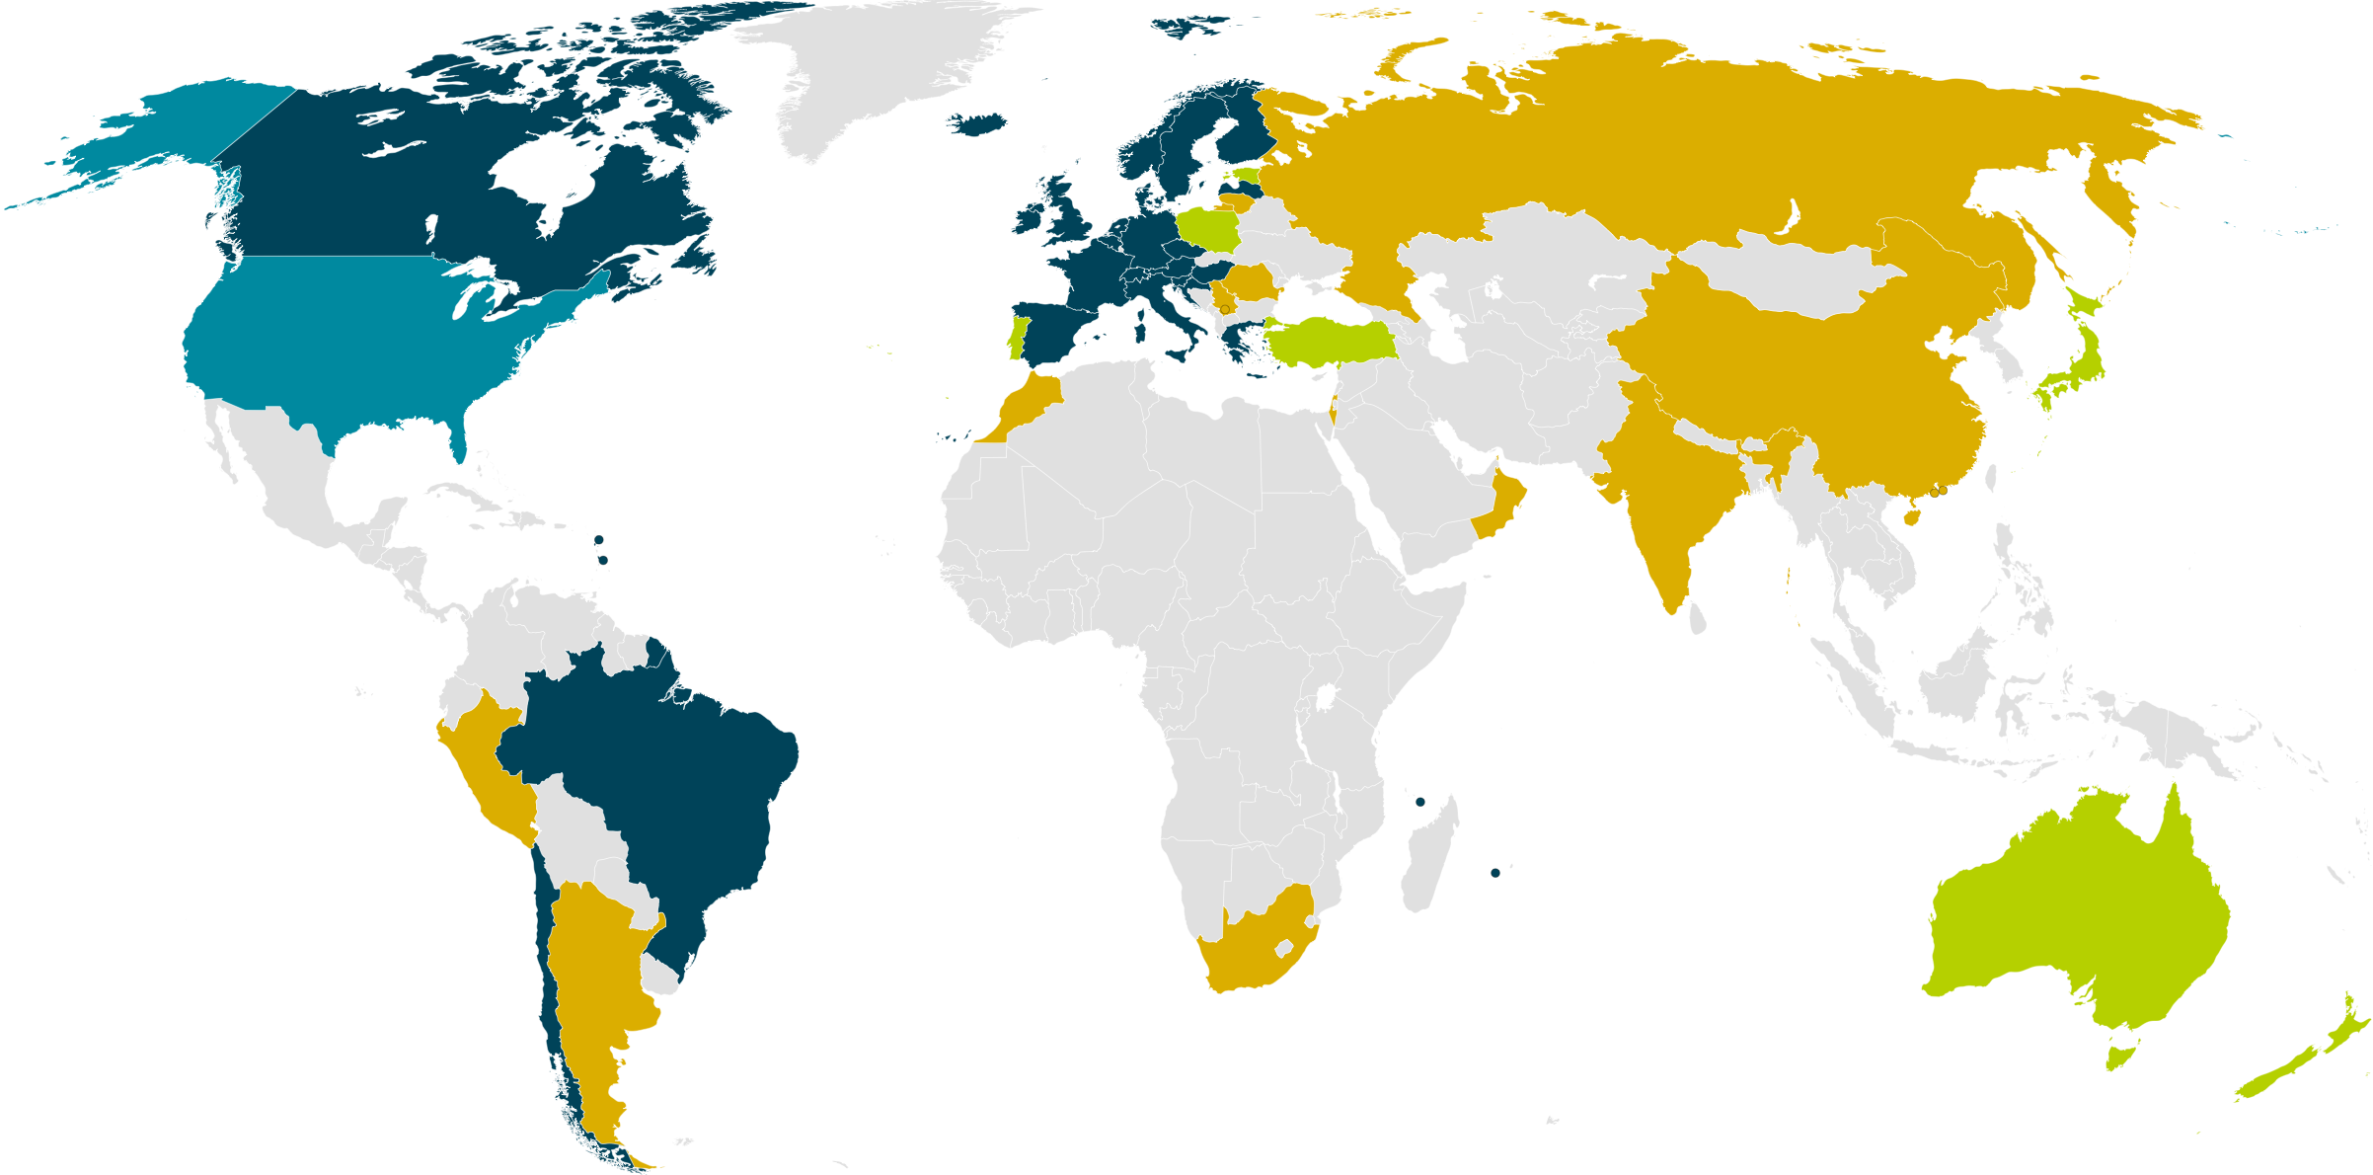
eduGAIN & Federation Status
23 eduGAIN Members
7 Joining eduGAIN
1 Candidate Federation
12 Other Federations
January 2014
Notes:
Big growth in new federations – many have aspirations to join eduGAIN and interfederate.

Slide 20
eduGAIN:
Current Difficulties and Challenges
Chicken and Egg Problem
  Many Federations joined eduGAIN but number of entities of these federations that opted-in for eduGAIN increases slowly
  More Identity Providers => more Services => more Identity Providers
  No global killer application. Critical mass has to be reached yet!
  Important that Universities and Research organisations opt-in
Attribute Release
  Manually deciding which attributes are released for which service does not scale
  Automatic release based on standard release rules managed by the federation or based on service's (entity) category
  eduGAIN recommends to support: display name, affiliation, TargetedID, PrincipalName, home organisation and type
LoA

Slide 21
#1 Chicken and Egg Problem:
Deployment and Advocacy
Federation advocacy and adoption is in hand.
  10 years of knowledge allows deployment in one year.
  FaaS supporting quicker federation deployment.
  Supporting projects all encouraging institutional identity.
  …some work on being “more” attractive to federations (without being less).
“Opt-In” is necessary (not a mistake) but we need pressure from multiple points
  eduroam Deployment in Australia → Decision makers as “have nots”
  New Academic “have” to a “have not” institution → No harm in asking!
Once an institution supports interfederation it can support multiple communities
  You might not be able to influence an institution but maybe a peer can.

Slide 22
#2 Attribute Release:
GÉANT Data Protection Code of Conduct
Significant piece of work with huge impact
  Potentially covers a large portion of the community
    30 of the 43 Federations (31 of 44 countries)
Adoption + use still required.
  Technology works with Shibboleth IdP.
  In Development for simpleSAMLphp + Federation Metadata Registry Tools.
Scalable solution for the other 14 Federations/Countries?
  Export out of Europe is the problem to be solved!
Express your attribute requirements (4871 SPs)
  3680 don’t express a single mandatory attribute
  3790 don’t express a single requested attribute (2972 also have NO mandatory)
  Taken from http://www.terena.org/~schofield/servicecatalogue/
Entity Categories as a bundle of attributes or a tag for a service.

Slide 23
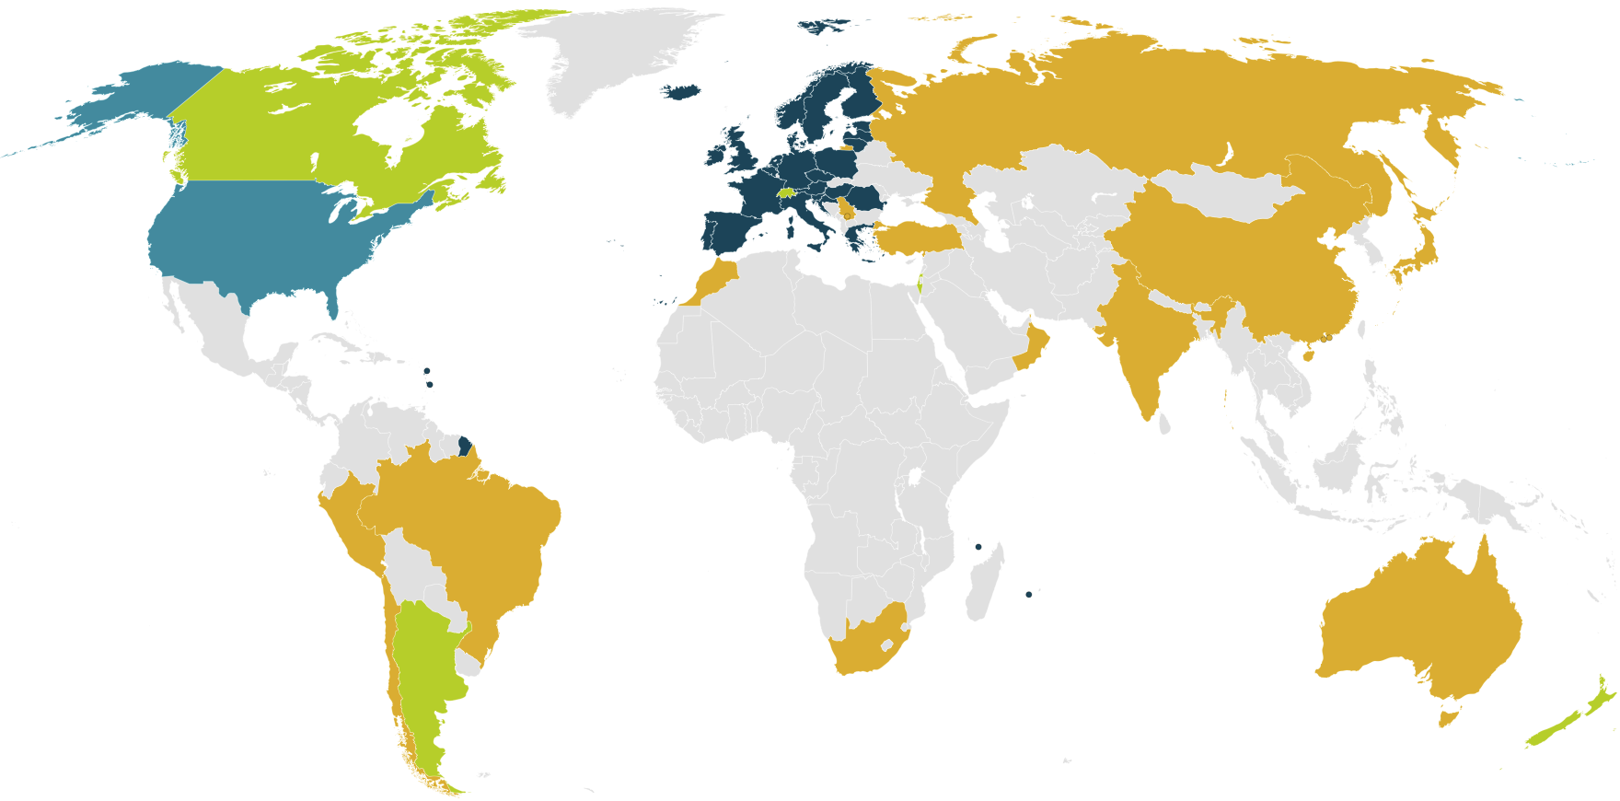
Federations & GÉANT Code of Conduct
25 EEA Data Protection
5 EEA Compatible DP
1 Safe Harbor (USA)
13 Federation outside GÉANT CoC (5 in or joining)
Notes:
44 countries above – because Iceland + Denmark supported by 1 federation.
http://ec.europa.eu/justice/data-protection/document/international-transfers/adequacy/index_en.htm
EEA Data Protection
EEA Compatible Data Protection
Some Exceptions available (Not R&E)
Federation outside GÉANT CoC
Compatible List
Andorra
Argentina
Australia (but that is flight data only)
Canada
Switzerland
Faeroe Islands (.fo)
Guernsey (.gg)
Israel (.il)
Isle of Man (.im)A
Jersey (.je)
USA (.us) - PNR + Safe Harbor
New Zealand (.nz)
Uruguay (.uy)
5 in or joining are (Brazil, Japan, Chile, Australia, Turkey)

Slide 24
#3 LoA:
More issues than just lack of Levels of Assurance.
Which levels?
  Identity Vetting LoA
  AuthN LoA
Different requirements for AuthN vs Identity Vetting
Cost
  SP paid for LoA with centralised AuthN
  With delegated AuthN does this mean distributed cost?
Step-Up-as-a-Service (SUaaS aka SURFsure) likely to be a scalable module to follow.

Slide 25
Recommendations
Organisations participating in international projects:
Enable your Identity Provider(s) for Interfederation/eduGAIN!
  Large research projects often have only very few researchers from one individual organisation. But one individual organisation often has many researchers in different research projects that could benefit from federated international authentication via eduGAIN!
  Talk to your “local” federation and to the eduGAIN team to provides instructions with the necessary steps to opt-in
Configure automatic (rule-based) attribute release for services which support the GÉANT Data Protection Code of Conduct (CoC)
Solve the LoA issue in your own community?! …or wait.
Promote your success via your community!

Slide 26

Where here to help…
edugain@geant.net edugain-integration@geant.net

