Slide 1
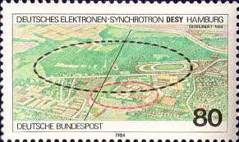
Environmental monitor of VXD DESY, Hamburg, 5th DEPFET Workshop
I. Vila,
Instituto de Física de Cantabria (CSIC-UC)

Slide 2
Outline
Monitoring volumes
Current proposal reminder
Discussion

Slide 3
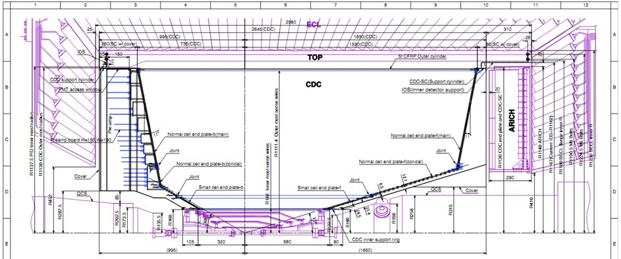
The “Dry” Volumes
„cold“ dry VXD volume
(dry air @ ~ 0°C)
„warm“
„warm“
„Docks“
„Docks“
„cold“
Narrowest space between
QCS and CDC: 24 mm.
VXD services: 21 mm
„warm“ volumes between QCS and CDC inner wall, up to CDC end wall,FWD / BWD
(flushed by dry air of ambient temperature)

Slide 4
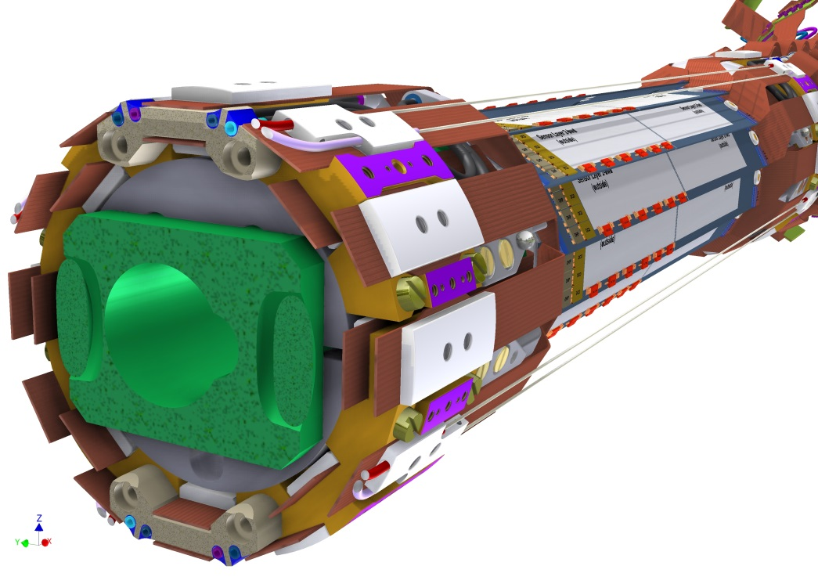
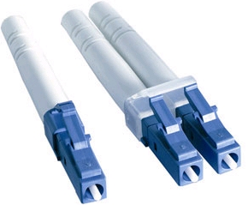
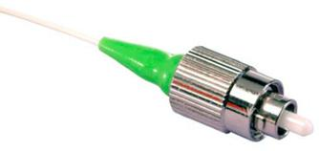
Reminder: FOS Monitor proposal
FC vs. LC connectors

Slide 5
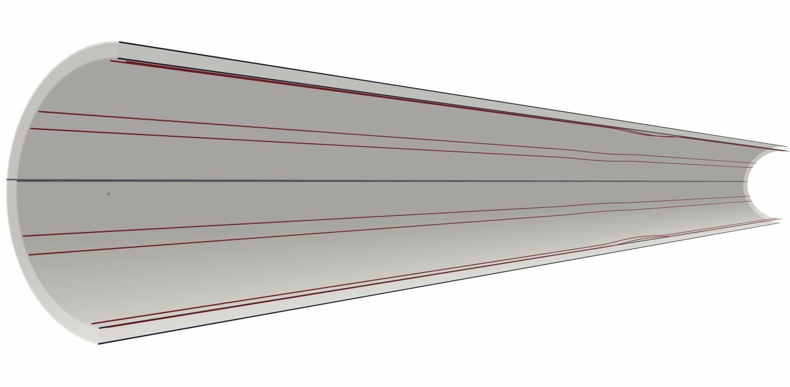
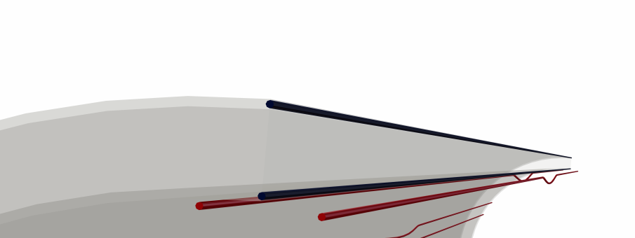
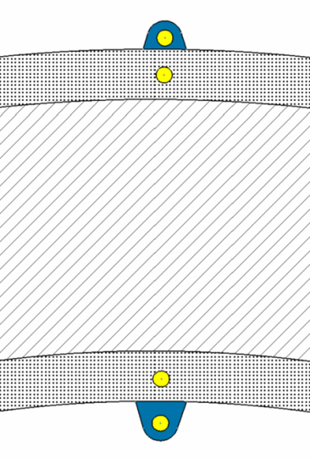
CDC/VXD Interface: Instrumentation of the CFRP cover

Slide 6
Gentle Discussion
Temperature, humidity and relative movement covered by the current proposal, to review and to update. ¿Monitoring of cooling pipes for interlocking?
Integration of temperature and %RH is well in progress, ¿Displacement sensors?
¿SVD integration of FOS? ¿Dry volume? ¿CFRP cover?

