Slide 1
Ladder Parts Production Status
Koji Hara (KEK)

Slide 2
Ladder Parts
Sensor
Pitch adapters
Origami
H-shape/C-shape
End mount, APV guard, Kokeshi pin
Rib
Airex
Hybrid board
Sil-pad
Pins/screws
Gap pad
CO2 tube clip

Slide 3
Need to clarify
Supplier
Current status
Production, check, design, …
Delivery date
Must be available by prototype assembly in Apr. in the current schedule.
Need to make inventory of delivered parts at each site
Control the parts delivery and consumption
Keep trace in the database

Slide 4
Pitch adapters
Supplier : KEK
Status : bonding pad problem
Pad width too narrow
Pull strength is not satisfactory (< 10g)
Modify the design of patterns
Check Ni thickness dependence (1um or 3-5um)

Slide 5
Etching test with modified design of PF2
Pad width : 40 um
Pad length : 200um
Clearance btw pad/line : 15um
Line width : 15 um
The width seems enough.
PF2 test sample products
will be ready by Jan. 30

Slide 6
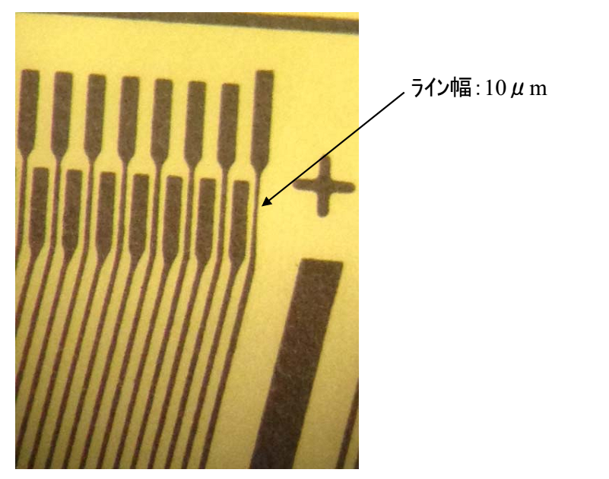
Narrowest line width 10um
Increase the width in the design
in the 2nd test design

Slide 7
Comparison of Pull Strength by Ni Thickness
Full report available on indico
Tomoko Iwashita 2014.01.21

Slide 8
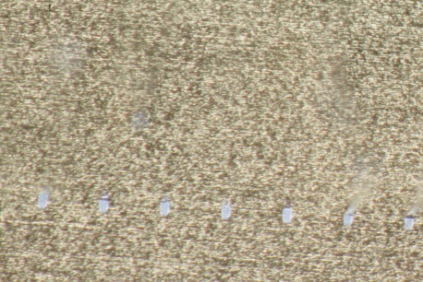
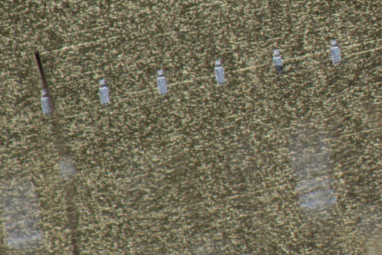
Pull strength at Ni=1μm and 3-5μm
Power (machine parameter) fixed to 60
Changing force
20 points / one parameter
Pull strength (g)
Peel/Cut
Pull strength (g)
Peel/Cut
Cut
Cut
Bond foot
Peel Peel
Bond foot
Peel Peel/Cut
Force parameter
Force parameter
Bond foot at Force 25
Bond foot at Force 25
It looks not so different.
We think we can use both.

Slide 9
Pitch Adapter Schedule
Jan. 30
modified PF2 sample delivered to IPMU
24 PF2 for each of Ni 1um and 3-5 um
Bonding test @ IPMU by Feb. 3
Feb. 13
2nd PF2 test sample (line width optimized)
(Design of other PAs are being done in parallel.)
End of Mar.
Complete of production expected
If short circuit occured by 3-5um plating, additional design modification will be necessary to adjust the clearance between patterns
→ Complete of the production will delay by ~ 1 month

Slide 10
Origami
Supplier : KEK
Ordered assembly (Taiyo + REPIC)
Origami +Z : 27
Origami CE : 66
Origami –Z : 48
Carrying case
Status
Origami FPC production : completed
Mounting surface mount parts
APV mounting (+ APV wire bonding for L4,6)

Slide 11
Origami Issues
Disconnected lines found in (at least) 2 CE
Cracks found at the bottom side connector pads
Hand-soldered
Connectors attached without H-shape for electrical test
Reflow soldering for both sides,
Equip H-shape when connectors are attached
16 CE in total are suspicious
APV not equipped. connectors, R, C are mounted.
2 APV output lines broken in the 1st Origami +Z
APV equipped, wire-bonded, pre-bended
Reflow soldering are done for 16 CE, 5 –Z after the change
Further process suspended until confirmation of the connection
Detailed check of the Origami +Z and CE/-Z after changing the assembly method in the next week.
May need additional production in Apr.

Slide 12
End Mount
KEK is responsible for the production
L4-6 FW end mount → improved design being prepared by Florian
Production ordered except for L4-6 FW end mount
L3 FW/BW bridges : 12
L3 spacers : 48
L4-6 BW end mount/APV cover/Kokeshi-pin : 75
Material : Kokeshi-pin SUS304, others A6061
L4-6 dummy FW end mount
Rev. 1.0 design (simplified : no sliding mechanism)
FW L6 APV-guard : 10
FW end mount and Kokeshi-pin : 30
For the practice of the ladder assembly
Ordered using remaining money for end mount
BW end mount cheaper than rev. 0.11. restricted usage. limit to use was Jan. 17
Finish by end of Mar. (production takes 2 months)

Slide 13
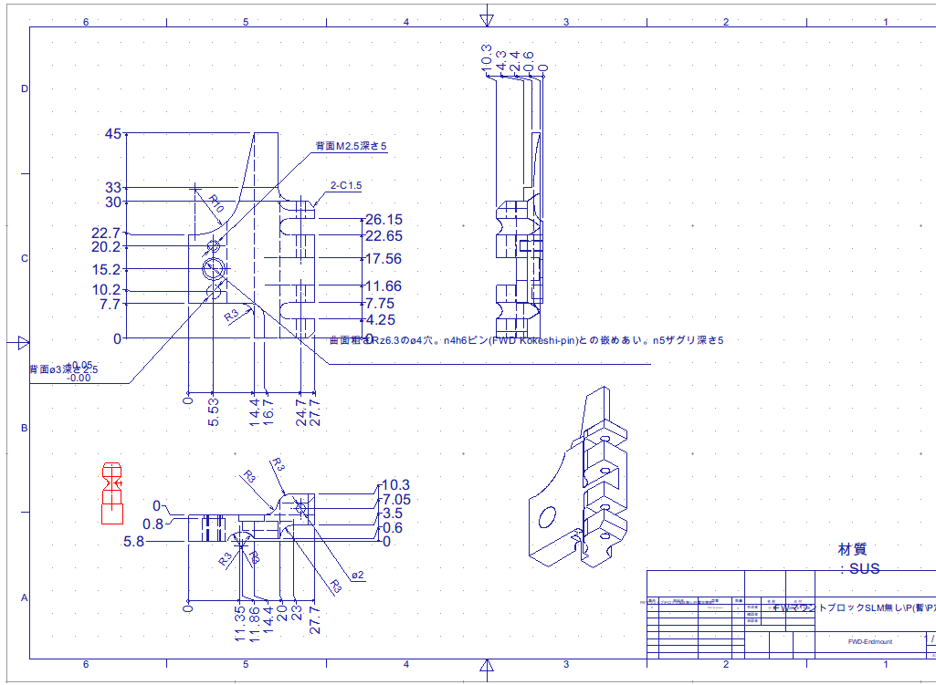

Slide 14
Ribs
Supplier : HEPHY
Production completed
Some damaged due to trouble in the water jet cutting
→ usable for mockup
Checking possibility to recover them
Enough number of good quality ribs for ladder production including spares
Expected delivery date
Already delivered to HEPHY

Slide 15
Hybrid board
Supplier : HEPHY
Status
PCB produced
Being assembled
→ Need APV chips to be transported from KEK

Slide 16
Misc. parts
Supplier : HEPHY
H-shape/C-shape
Status : produced
Already delivered to IPMU
Airex
Status : produced a part of full number for mass production
3mm Airex available at HEPHY. Need to press
Delivery : some already delivered to IPMU enough for prototype
CO2 clip
Status : produced a part of full number for mass production
Delivery : 90 clips are already delivered to IPMU
Gap-pad
Status : produced a part of full number for mass production
Delivery : enough amount for prototype already delivered to IPMU

Slide 17
Pins
Supplier : HEPHY
Already delivered to IPMU
Screws
Supplier : HEPHY
Updated list of screws for rev. 1.0 in hand at HEPHY
→ order and deliver soon

Slide 19
Ladder Parts Status
delivered
in production
open issues

Slide 20
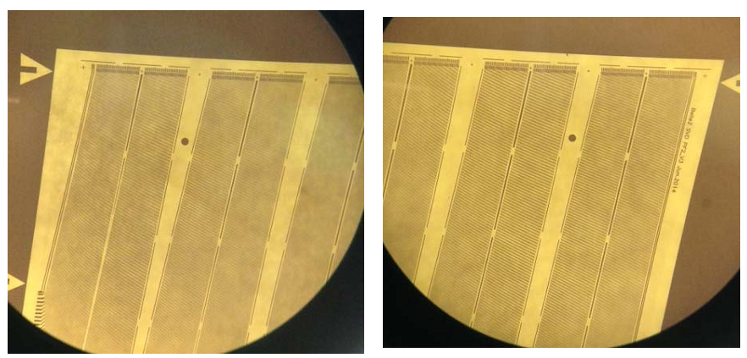

Slide 21
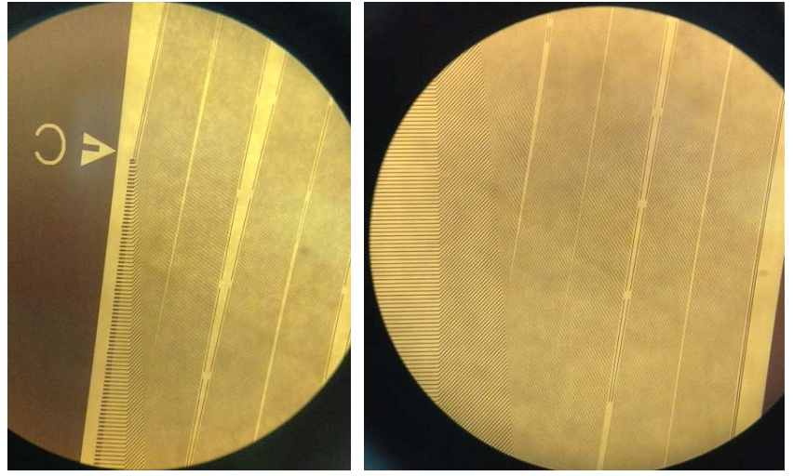

Slide 22
Main purpose
Check if the bondpad thickness of Ni affects the quality of bonding
In IPMU, we got two samples of metal sheet from Tokaidenshi.
Cu 3/5μm, Ni 1μm, Au 0.05-0.1μm
Cu 3/5μm, Ni 3-5μm, Au 0.05-0.1μm

Slide 23
Sample and parameters
Glued samples to glass plates using Araldite
Bonding parameters (other than Power and Force) are fixed
Bonding distance is 1mm
Sample
Glue
Glass plate
Bonding point
1mm
Here, power and force is machine specific parameters
Power: power of super sonic
Force: pushing force on needle
Bonding point

Slide 24
Pull test and check
At first, pull
Check the bond foot
Cut or Peel
And pull strength
Pull center of bonding point and point
Cut
Peel

