Slide 1
Procurement Readiness Review WP02 - LLRF
Software

Slide 2
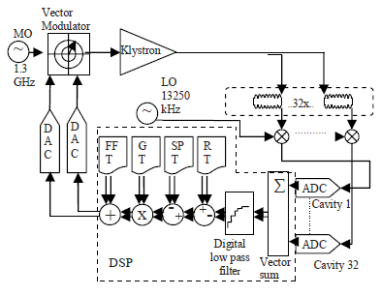
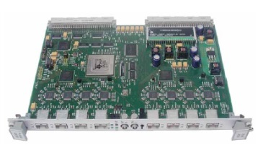
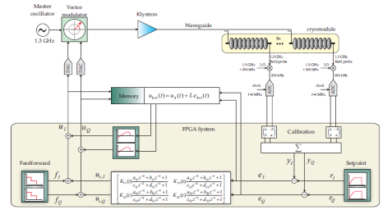
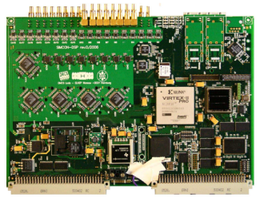
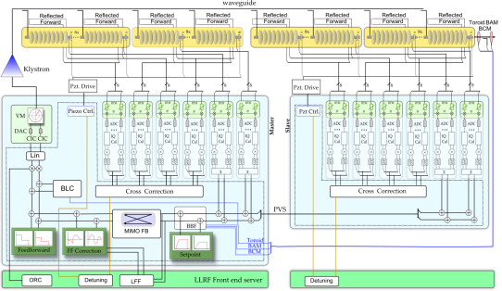
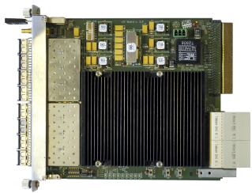
Development of digital LLRF@DESY
DSP based LLRF
Basic controller functionality
Feedback and feed forward drive
VS feedback concept
VME based LLRF
Integration complex controller structure
Beam based feedback system
Restructuring server + firmware layout
Switching to MTCA.4
Layout change (ADC + main controller)
September 2011 → test setup ACC1
Permanent FLASH operation since Aug.
Implementation of all commissioned software components from SIMCON
Known procedures, new features

Slide 3
Software Layers
Finite state machine
Sequencing operation procedures
gentle startup, change of operating points
Preprocessing and automation server
Quench detection, Cavity parameter computation
Evaluation of controller performance
Front End server / LLRF controller server
Data acquisition / manipulate controller parameters
Pulse to pulse control loops
Firmware ( FPGA implementation )
Preprocessing AMCs, master and slave controller
Fast digital data processing with 9 MHz
Direct connections to subsystems using optical links

Slide 4
Schematic Firmware Layout
RF Station
RTM Level
AMC Level
FE Server
Master
Slave
Control of external modules by AMC boards ( Drift compensation, Piezo control )

Slide 5
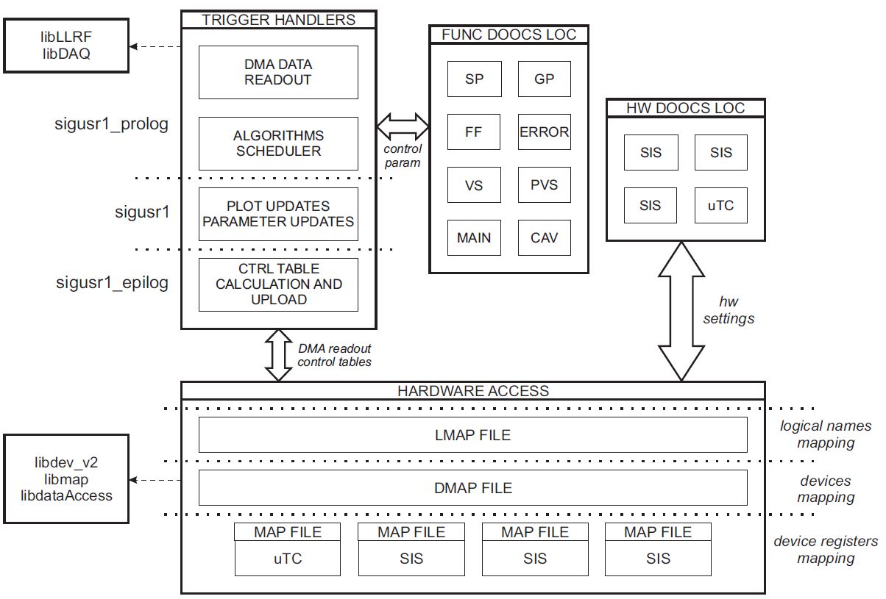
Low Level Software Integration
Driver support package
Generic hardware interface
Modular design
Master and slave configuration
Gun control interface
Remote maintenance
Programmable firmware
Frequent server updates
DOOCS compatibility
jDDD as GUI
Clear interface definition
Separate firmware and server development possible

Slide 6
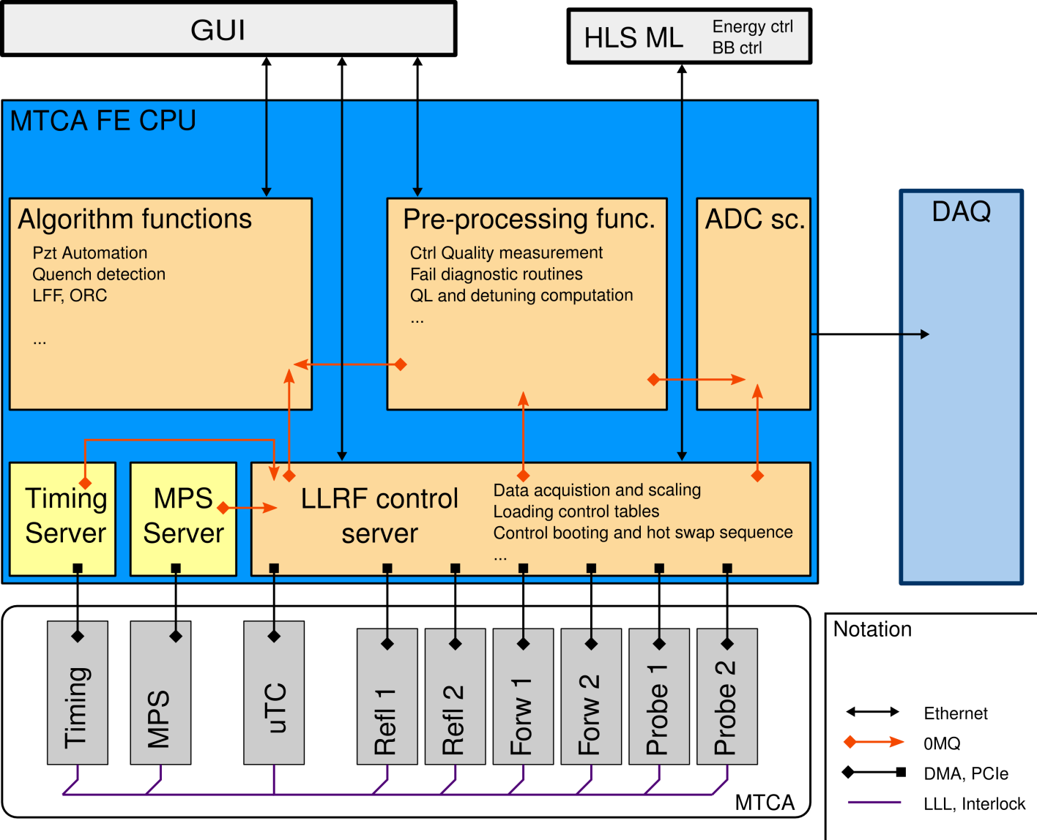
Front End Architecture
User interface
LLRF station as client
Graphical display jddd
Middle layer interface
Application functions
Internal communication protocol 0MQ
Preprocessing steps, DAQ
Performance evaluation
Front end server level
Firmware communication
Timing Information Interface
Control remote Firmware upgrade
MTCA crate of SC RF station
Inter- board communication
Main controller architecture
Separate master/slave configuration

Slide 7
Server Property Naming convention
Already being introduced with LLRF@FLASH upgrade
prepared / scalable to XFEL
Following DOOCS specific separation
Facility / Device / Location / Property
Location separation between master and slave
Specific to generic
Consistent for all facilities
Waveform is generated inside:
Server: FF_AMPL.TD
RBV from Firmware: FF_AMPL.HW
XFEL.RF
AMTF.RF
FLASH.RF
LLRF.CONTROLLER
QUENCHDETECT
LLRF.INFO
C1.M4.A9.L3
PVS.M12.A9.L3
CTRL.GUN.I1
PROBE.CAL_ROT
AMPL.SAMPLE
FB.ENA

Slide 8
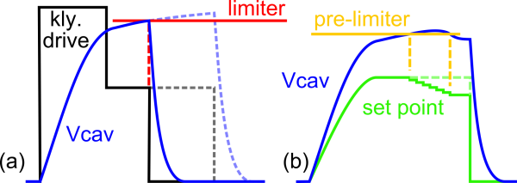
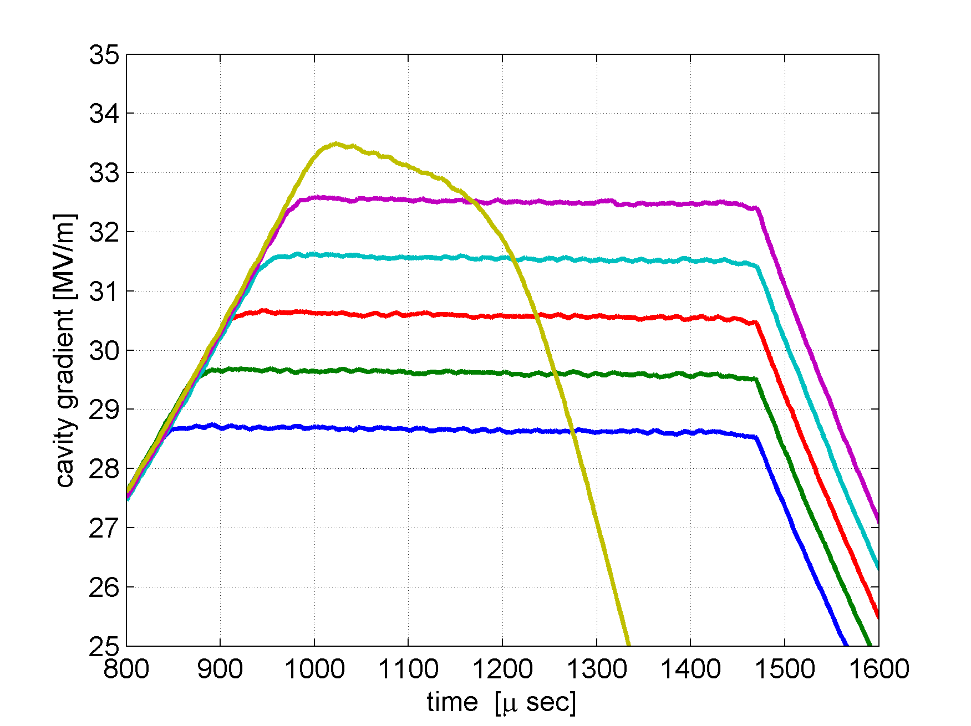
Safety and Protection of Connected Systems
Limiters, Pre-limiters triggering at defined thresholds
Separately applied for all cavities
Quench detection and protection
Measure changes in Ql and eventually stop RF
jitter -> soft quench, drop -> hard quench
Connection to fast interlock system (MPS)
RF inhibit RX/TX for LLRF system
Piezo operation cryogenic interlocks
Gun lifetime management
Monitoring of forward and reflected signals
Fast RF stop intra-pulse
Gun recovering in consecutive pulse
Outlook → merge temp control
Cavity coupler protection
Quench detection
QUENCH
Gradient ramp-up

Slide 9
Limiter Functionality
C1
Controller Input
Limiter
Controller Output
Limiter
Vector
Sum
DAC
Limit
Pre-Limit
Ctrl
…
Ampl. detection
RF pulse cut
Beam based
Feedback
Reduction
Set point
Tables
Setpoint
Correction
Tables
Feed Forward
Tables
Beam Loading
Compensation
C32
Learning Feed Forward
Limiters applied on all critical stages inside controller chain
Cavity Amplitude detection with two thresholds
Set point reduction
Fast main controller output switch
Controller input and output + set point modulation from BBF
All controller tables loaded from server
Inside
Firmware

Slide 10
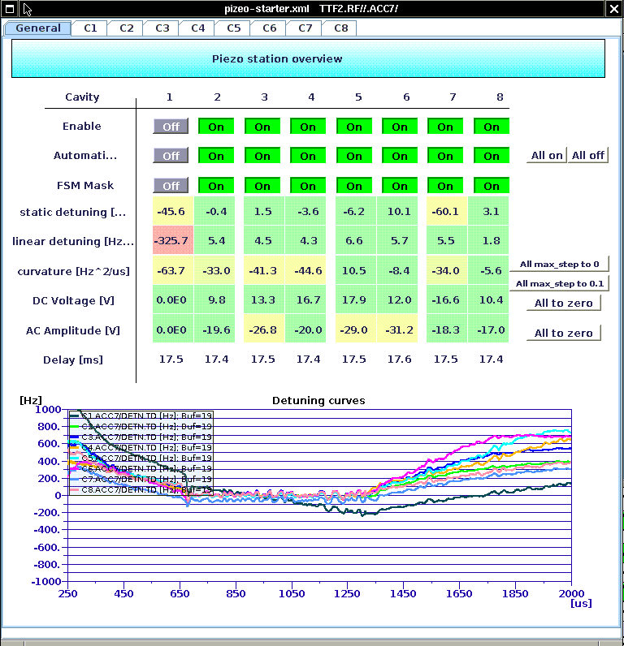
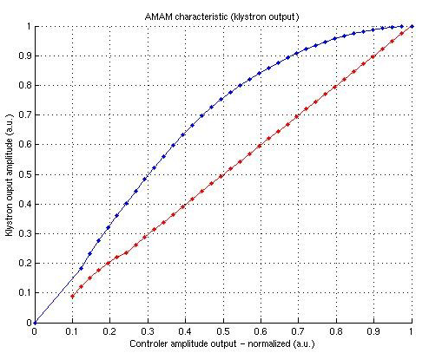
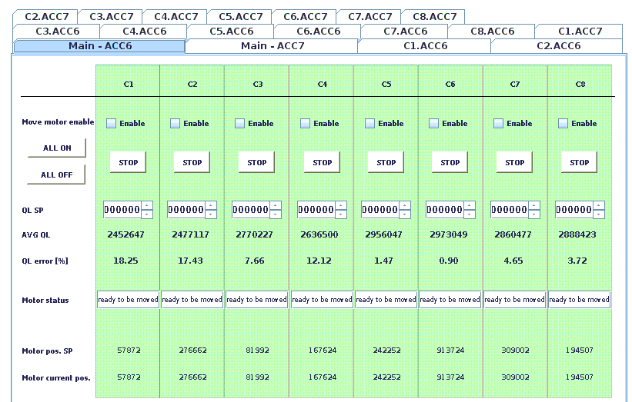
Automation Routines
Piezo actuators for resonance frequency control
LFD compensation
Adaptation to changing operating conditions
Outlook → coarse tuning using stepper motors
Loop gain and phase correction
Adjustment of desired Ql settings
Cryomodule warm up / cool down
Klystron linearization
….
Klystron Linearization

Slide 11
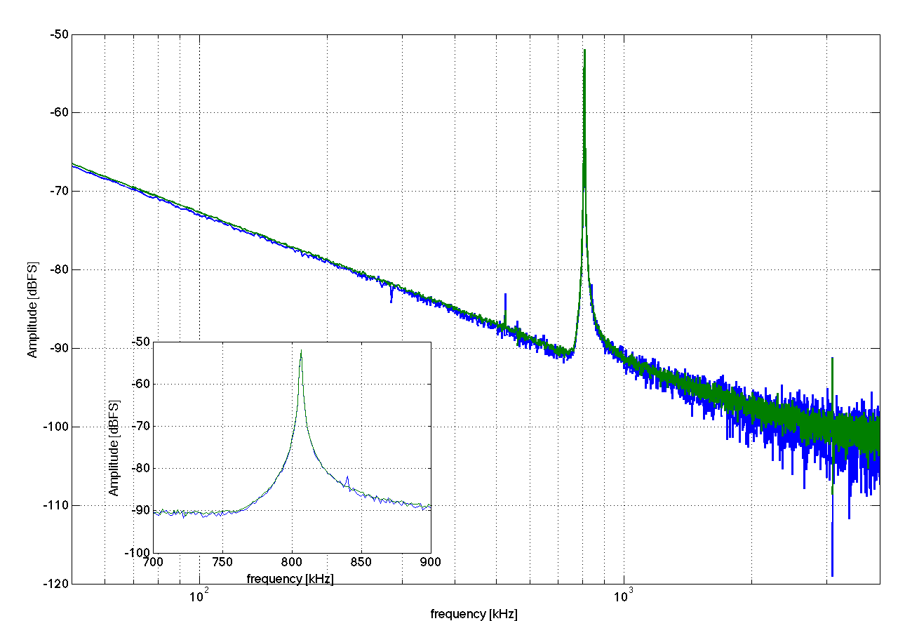
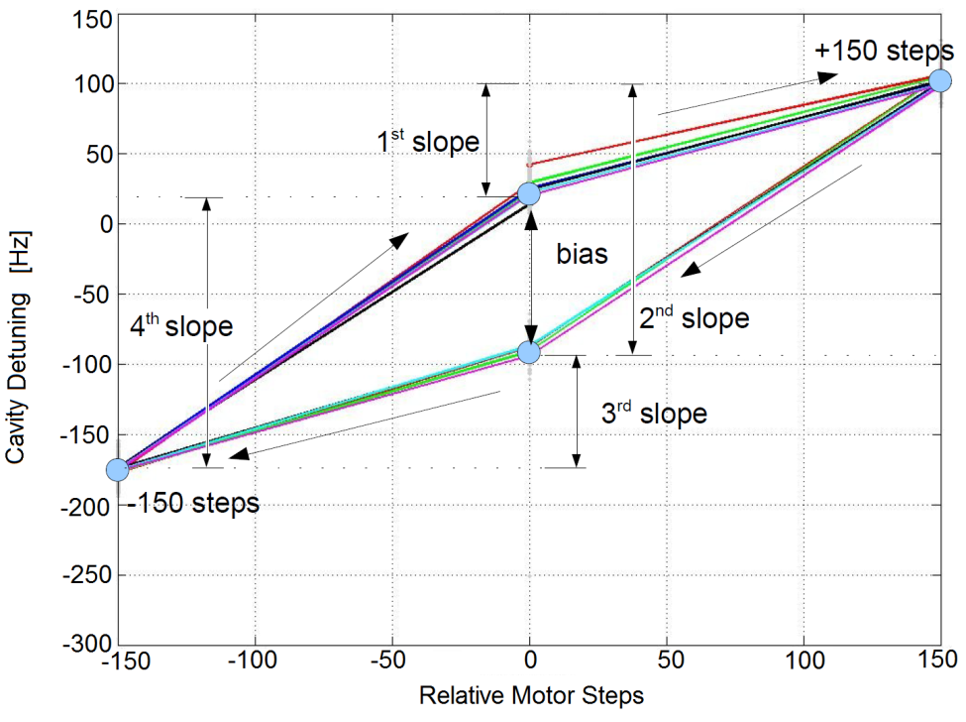
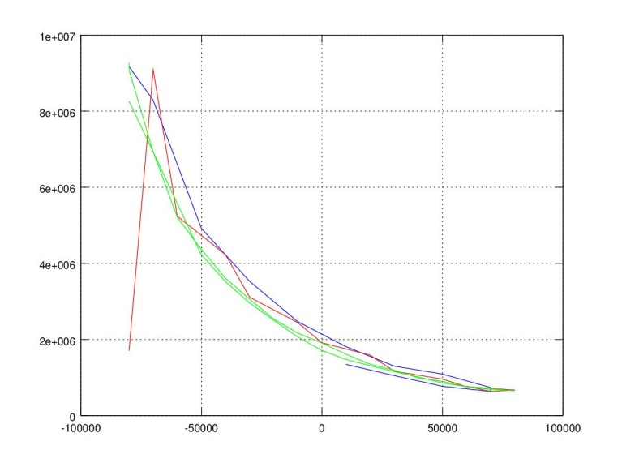
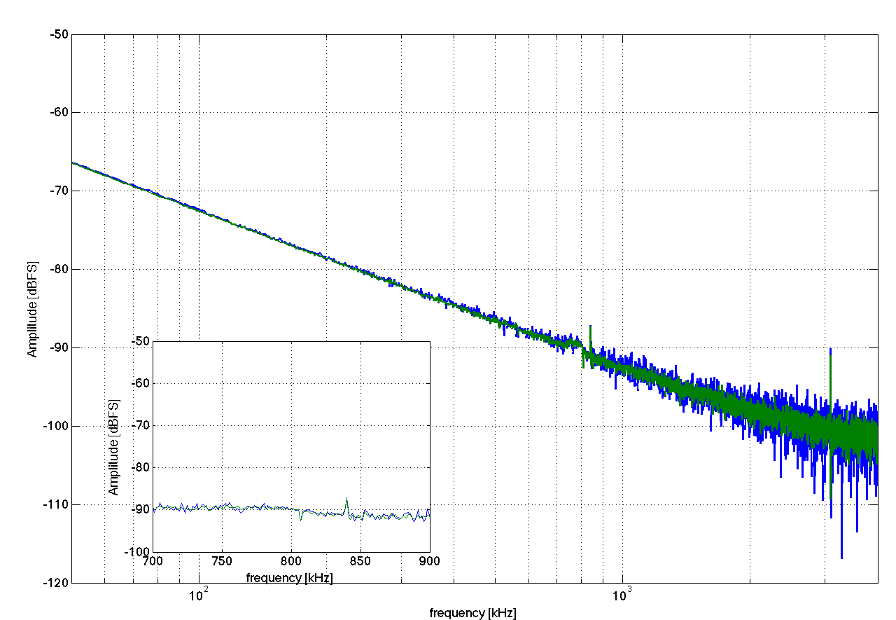
Automation prerequisites -> characterize
cavity piezos (sensor/actuator)
cavity frequency tuner
cavity coupling motor
cavity quench profile
cavity fundamental modes
cryomodule performance for nominal operation
Sub-$$ Modes Scan
Complex routines → special test server development
Frequency Tuner Scan
Coupler Motor Scan
suppression
Measured loaded Q
positive
end switch
negative
end switch
Motor position

Slide 12
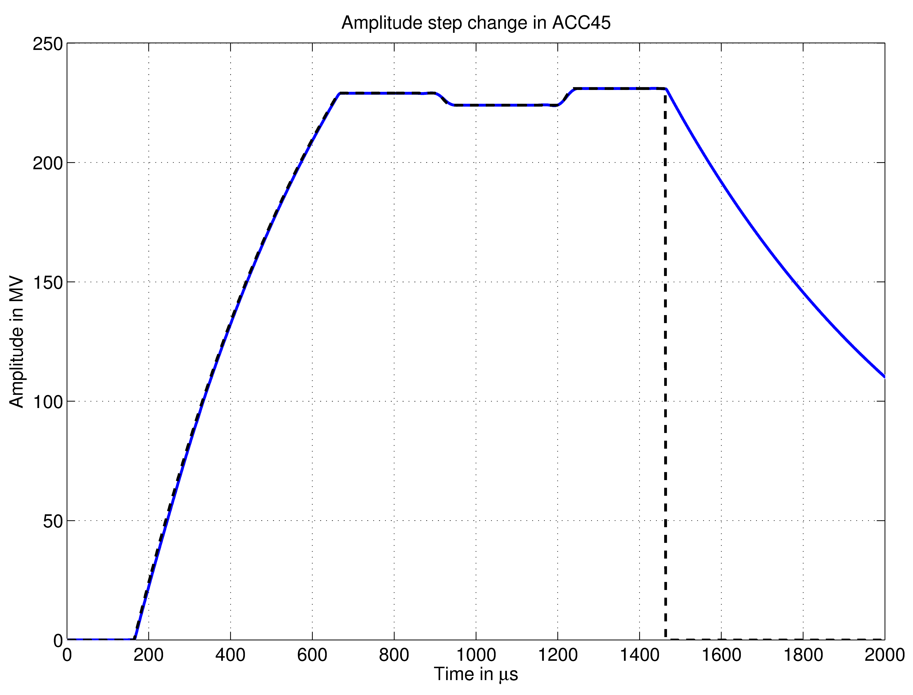
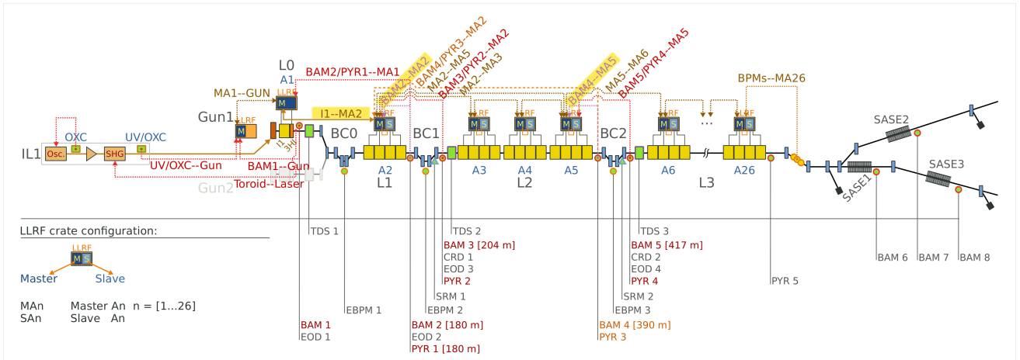
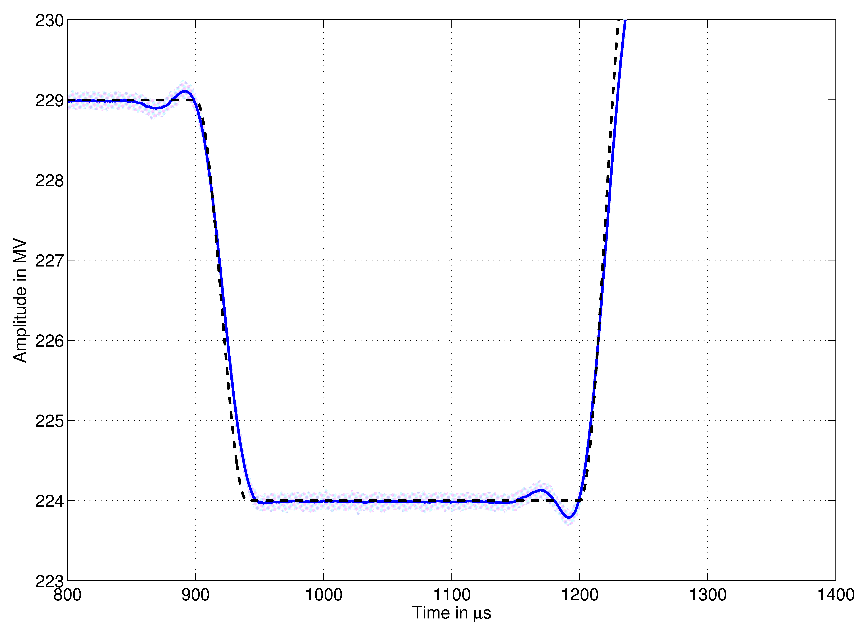
Interfaces to other Subsystems
Timing system interface (except triggering events)
A-priori distribution of pulse pattern
Multi beamline support
A-priori distribution of expected bunch pattern
Effective beam loading compensation
Receiving of beam based information's
BAM, BCM, BPM (Energy)
Charge detection with toroid system
Necessary for BBF and BLC

Slide 13
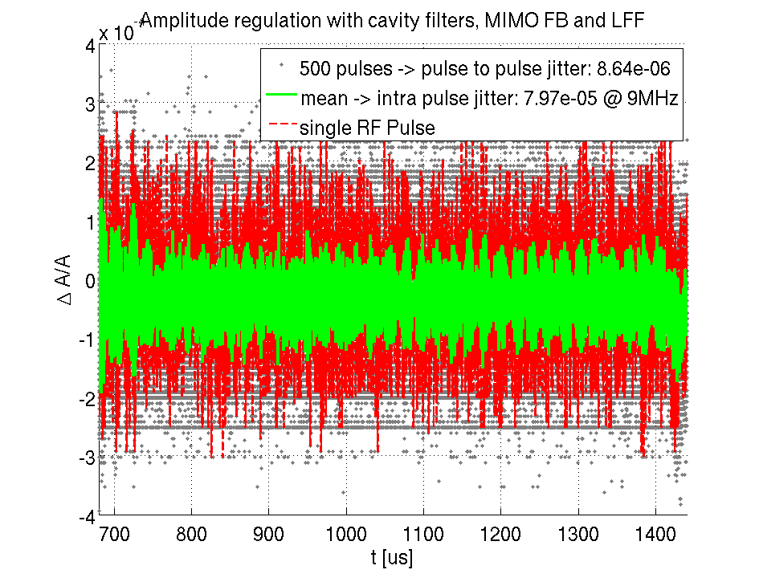
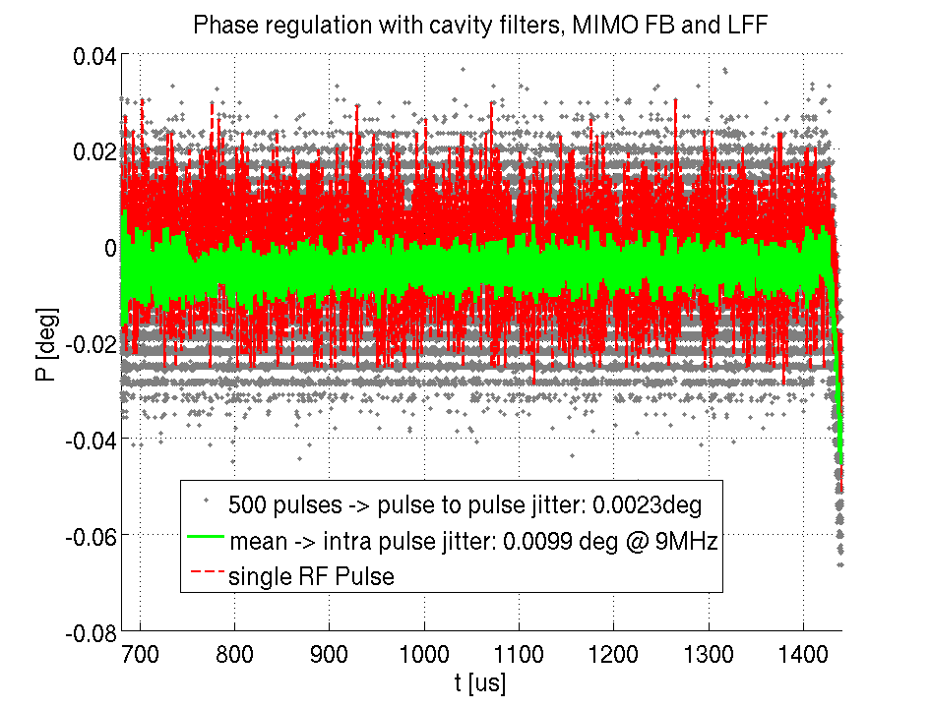
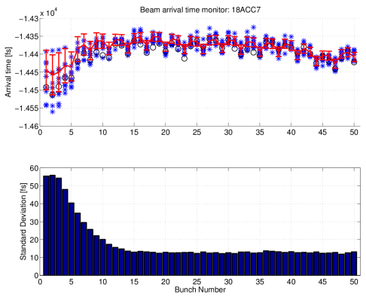
Summary
LLRF main software and control structure designed
Further improvements can be easily integrated
Hardware capability for future extension
Software had been evaluated trough last LLRF systems
Further developed and improved
New automation and protection routines
Currently implemented at FLASH/AMTF/REGAE
Also mirror platforms for bug finding and fixes
Most new functionalities can be fully tested here
Characterization of modules / LLRF automation tools
Some interfaces to be optimized
Transmission of beam based data (BAM, BCM, Toroid)
Global energy management and control

Slide 14
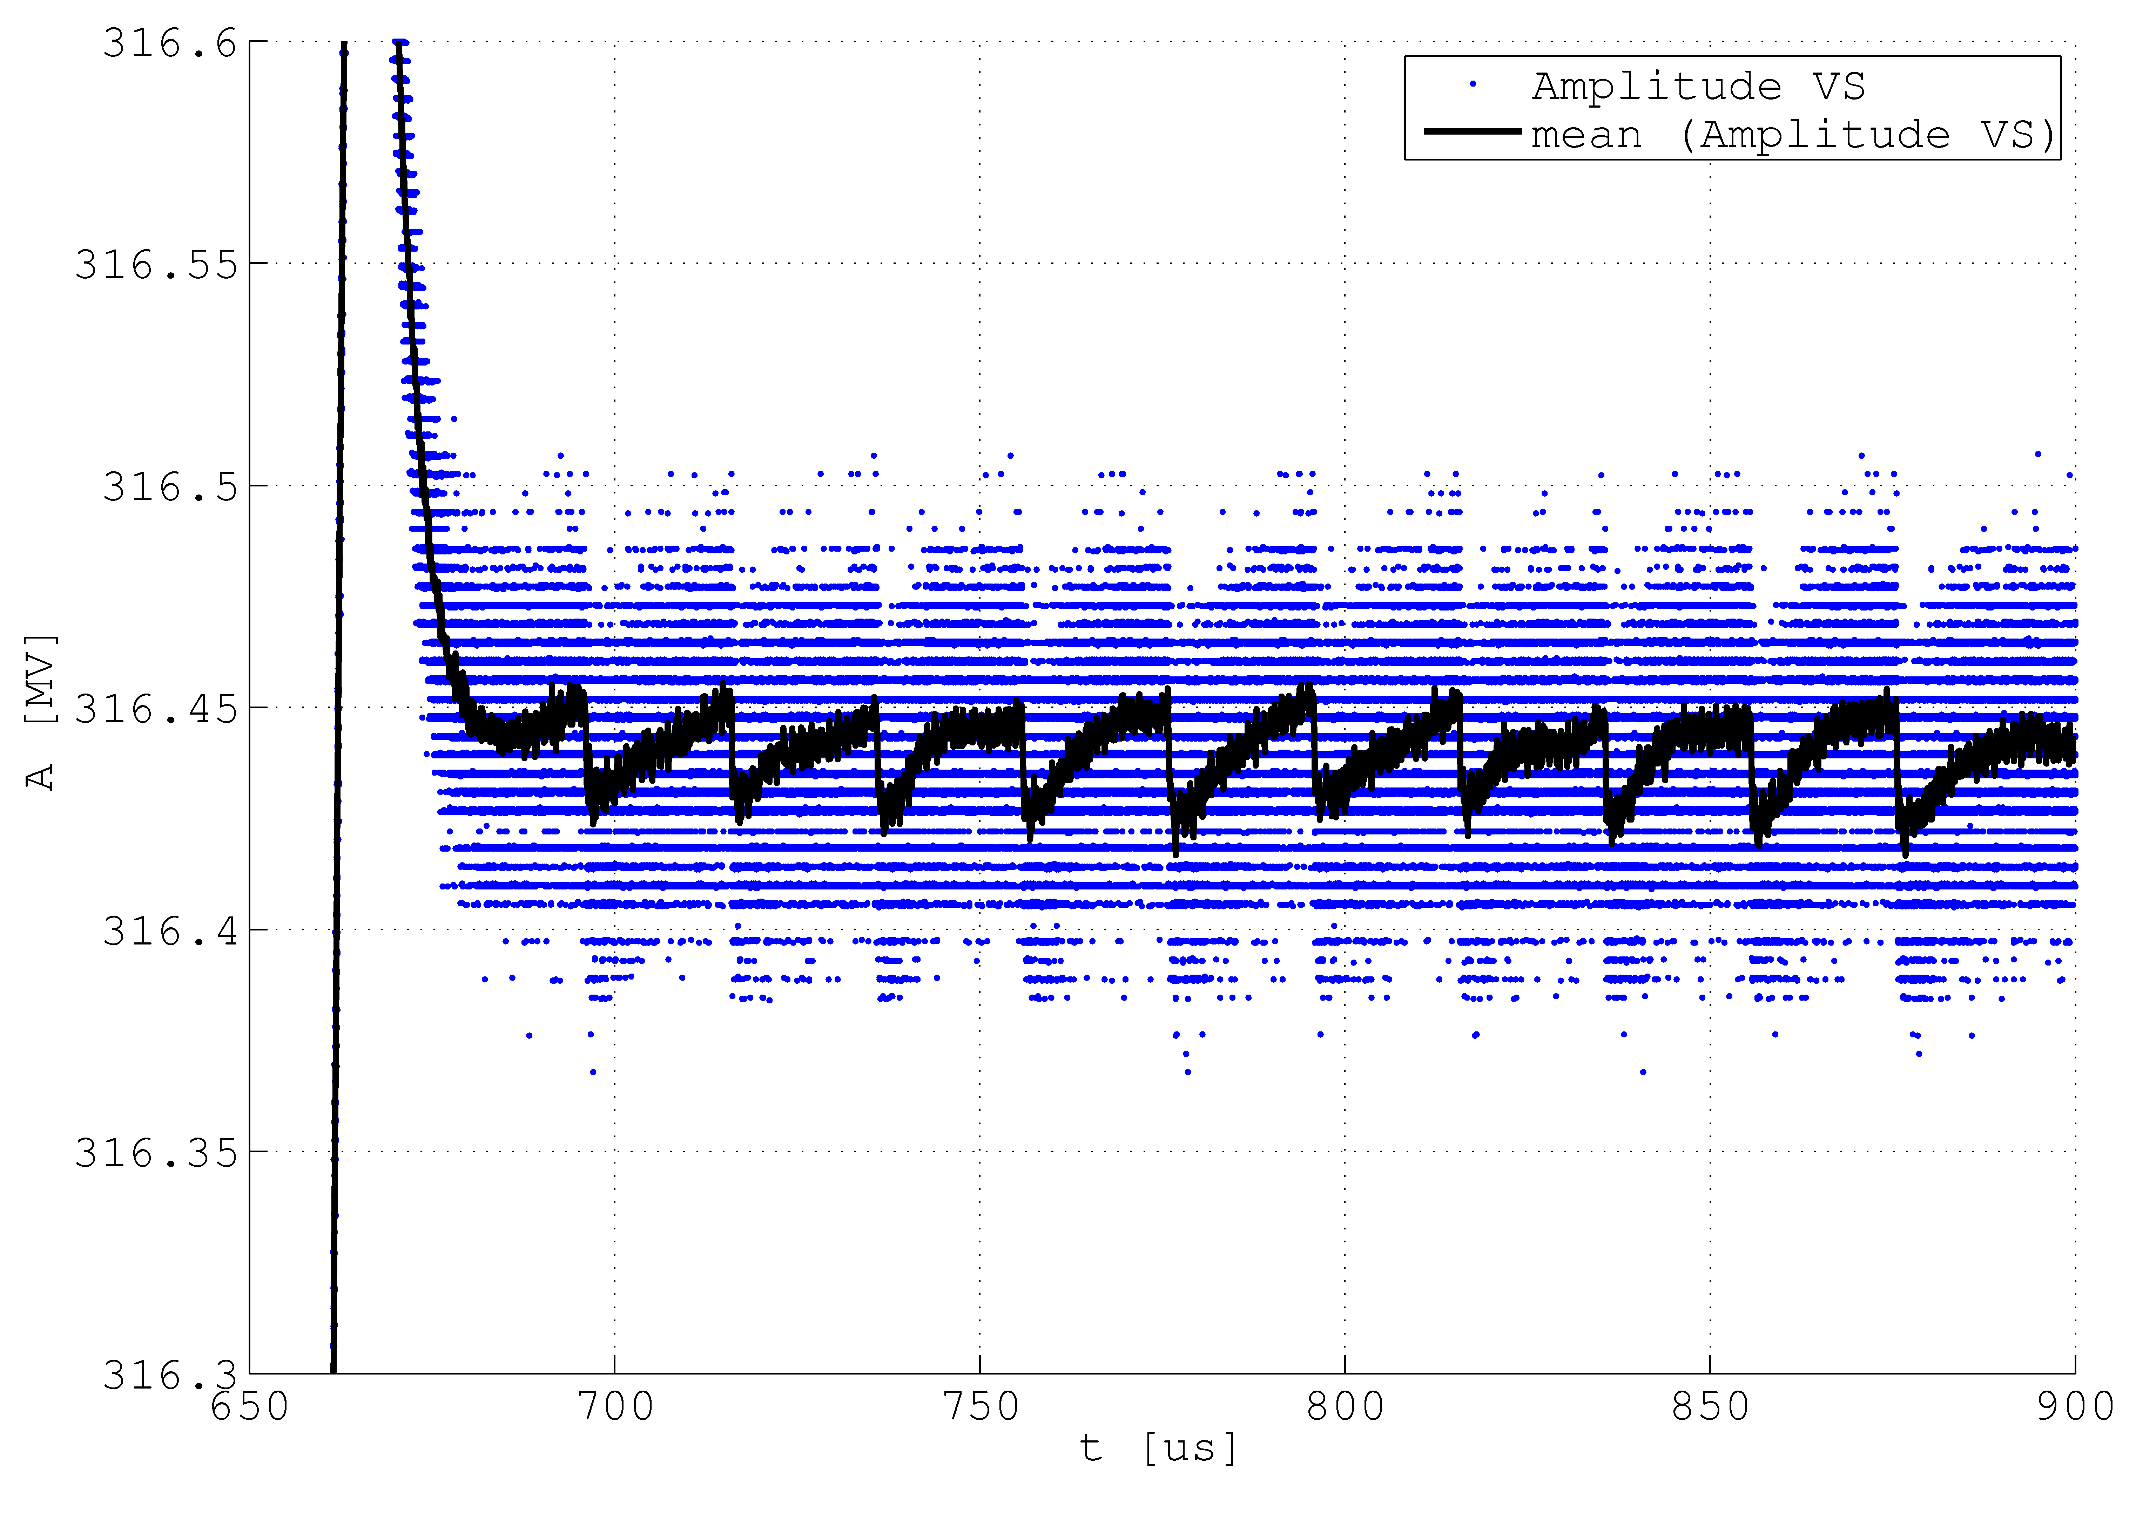
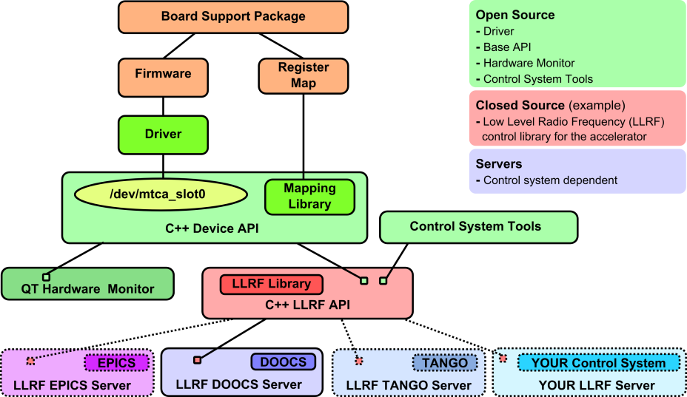
Outlook
Correction of cross coupling effects
Corrected Forward and Reflected signals
Virtual probe calculation
In suite cavity model
Observer based control methods
Real time detuning and QL measurement
Fast quench detection
Single bunch transient measurements
Optimization VS calibration
Online calibration check
Hardware is designed to support this upgrades
Firmware designed modular
Restructuring server architecture
Plain C++ / Real time capable
Multi control system capable

