Slide 1
Procurement Readiness Review WP02 - LLRF
Opening Remarks
Notes:
How to edit the title slide
Upper area: Title of your talk, max. 2 rows of the defined size (55 pt)
Lower area (subtitle): Conference/meeting/workshop, location, date, your name and affiliation, max. 4 rows of the defined size (32 pt)
Change the partner logos or add others in the last row.

Slide 2
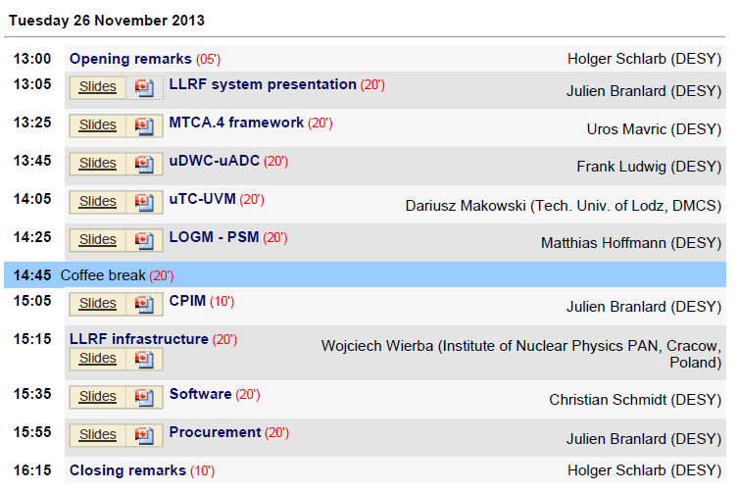
WP02 Presentations

Slide 3
WP02 PRR Goals
PRR1: focuses on basic components to build a LLRF system
MTCA.4 Platform/Modules & External Modules
Allows assembly of racks for installation (L1/L2 …L3)
Goal:
Check if critical interface is missing / open
Check if all requirements are taken into account
Start CFT where necessary (only a few module)
PRR2: advanced / supplementary modules LLRF (Feb 14)
PRR3: RF Synchronization (Apr 14)
Handover to Julien

