Slide 1


Procurement Readiness Review
WP02 - LLRF
Power Supply Module (PSM)
&
LO and Clock Generation Module (LOGM)
Notes:
How to edit the title slide
Upper area: Title of your talk, max. 2 rows of the defined size (55 pt)
Lower area (subtitle): Conference/meeting/workshop, location, date,
your name and affiliation,
max. 4 rows of the defined size (32 pt)
Change the partner logos or add others in the last row.

Slide 2
Content
PSM
  Motivation & History
  Specification
  Realization
  Quality Check & Testing
LOGM
  Motivation & History
  Specification
  Realization
  Quality Check & Testing
Notes:
Before you start editing the slides of your talk change to the Master Slide view:
Menu button “View”, Master, Slide Master:
Edit the following 2 items in the 1st slide:
1) 1st row in the violet header:
Delete the existent text and write the title of your talk into this text field
2) The 2 rows in the footer area: Delete the text and write the information
regarding your talk (same as on the Title Slide) into this text field.
If you want to use more partner logos position them left
beside the DESY logo in the footer area
Close Master View

Slide 3
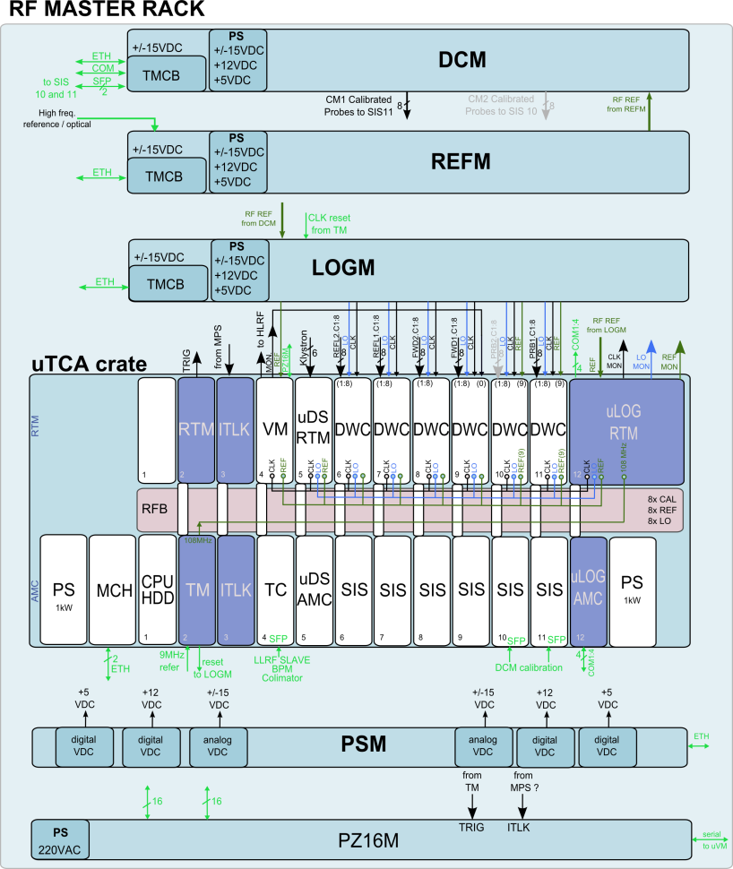
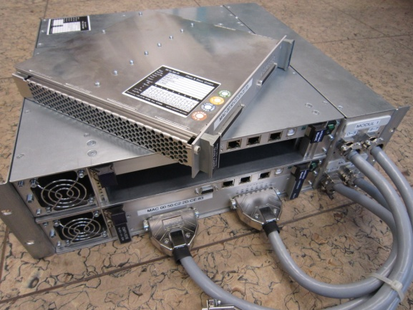
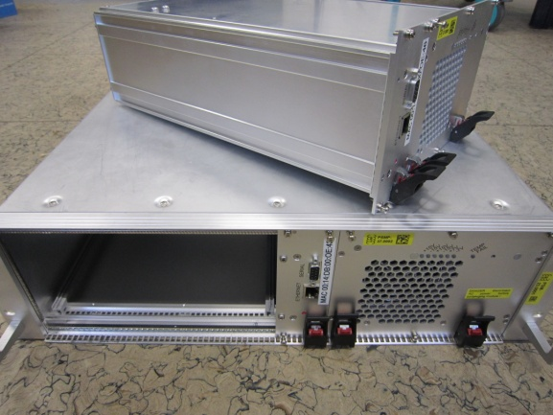
PSM – Motivation & History
Provide power for 3 external 19” modules
  Variant a): redundant PS with diagnostic in each box
  Variant b): external PS with DC voltage distribution to each box
Test of different vendors
  Two iterations with ELMA
  Two iterations with Wiener
Units are installed at FLASH, CMTB,
and AMTF
Figure of System Overview
1st Wiener Proposal
1st ELMA Proposal
Notes:
Before you start editing the slides of your talk change to the Master Slide view:
Menu button “View”, Master, Slide Master:
Edit the following 2 items in the 1st slide:
1) 1st row in the violet header:
Delete the existent text and write the title of your talk into this text field
2) The 2 rows in the footer area: Delete the text and write the information
regarding your talk (same as on the Title Slide) into this text field.
If you want to use more partner logos position them left
beside the DESY logo in the footer area
Close Master View

Slide 4
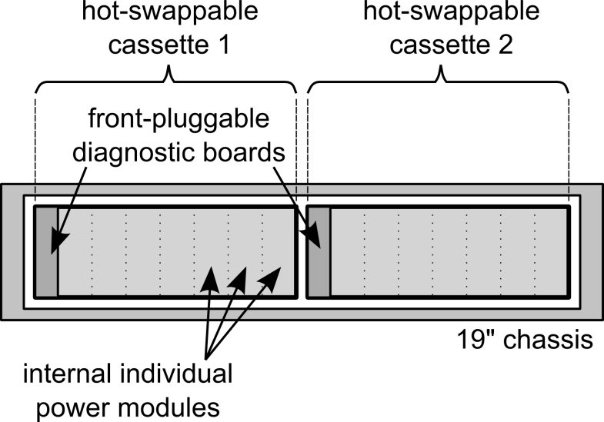
PSM – Specification
General description and functionality:
  Provide 7 voltages for external 19” modules (LOGM, DCM, REFM, Spare)
    +15V/5A, 2x +15V/8A, 2x -15V/5A, +7V/6A, -7V/6A
  19” chassis with two redundant, hot swappable voltage cassettes
    Internal individual power modules for each output voltage
    Each cassette with diagnostic and pluggable from the front
    Normal operation 50/50, to improve lifetime
  Output connectors on the back side
    4x 28pin Burndy connector
  Diagnostic
    Voltages, currents, temperature readouts
    Status LEDs on the front
    Power fail warning
    Redundant status mode detection
Proposal
Notes:
Before you start editing the slides of your talk change to the Master Slide view:
Menu button “View”, Master, Slide Master:
Edit the following 2 items in the 1st slide:
1) 1st row in the violet header:
Delete the existent text and write the title of your talk into this text field
2) The 2 rows in the footer area: Delete the text and write the information
regarding your talk (same as on the Title Slide) into this text field.
If you want to use more partner logos position them left
beside the DESY logo in the footer area
Close Master View

Slide 5
PSM – Specification
Electrical and mechanical specifications:
DC voltage modules available per cassettte. | +15V 8A, (for analog, high-power applications) +15V 5A, (for analog, low-noise applications) +15V 5A, (for digital applications) -15V 5A, (for analog, low-noise applications) -15V 5A, (for digital applications) +7V 6A, (for analog, low-noise applications) -7V 6A (for analog, low-noise applications)
Voltage stability | <20mV peak to peak ripple under full load, 20 MHz bandwidth
Output voltages | short circuit protected, each voltage with own ground internal customized backplane,
Connectivity | each voltage configuration via four 23 pin connector Burndy on the back, (see details on pin assignement section 3)
Packaging | Width: standard 19” module Height: 3U (rack units) Depth: maximum 450 mm metal shielded required magnetic shielded material desired*
Built-in redundancy | Power supply module consists of two redundant modular cassettes. Continuous operation in case of failure of one cassette Ability to hot swap a cassette
Input voltage | Two 220V, AC-power connectors, rear connected Two power switches located at rear of module
Efficiency | > 80%
Status communication | Via Ethernet See functions § for details
Cooling | Front to rear air flow, Should sustain up to 1 kW heat load Nominal ambiant temperature is 25 deg.C
Electrical security | VDE 0100 compliant CE certification
Notes:
Before you start editing the slides of your talk change to the Master Slide view:
Menu button “View”, Master, Slide Master:
Edit the following 2 items in the 1st slide:
1) 1st row in the violet header:
Delete the existent text and write the title of your talk into this text field
2) The 2 rows in the footer area: Delete the text and write the information
regarding your talk (same as on the Title Slide) into this text field.
If you want to use more partner logos position them left
beside the DESY logo in the footer area
Close Master View

Slide 6
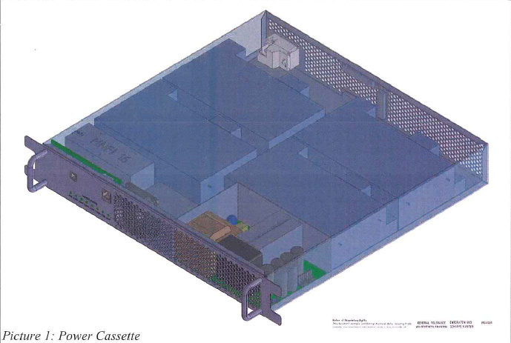
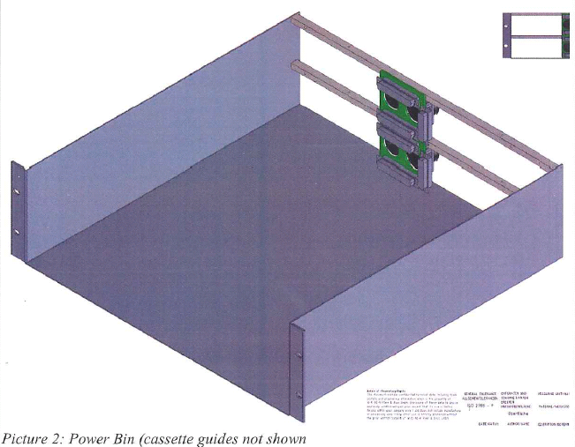
PSM – Realization
Call for Tender: Wiener gets the call
Proposal from Wiener fits to Specification
Minor changes requested
  Connector pin assignment
  Position of AC power cord and switch
  Mechanical dimension of the module
Notes:
Before you start editing the slides of your talk change to the Master Slide view:
Menu button “View”, Master, Slide Master:
Edit the following 2 items in the 1st slide:
1) 1st row in the violet header:
Delete the existent text and write the title of your talk into this text field
2) The 2 rows in the footer area: Delete the text and write the information
regarding your talk (same as on the Title Slide) into this text field.
If you want to use more partner logos position them left
beside the DESY logo in the footer area
Close Master View

Slide 7
PSM – Quality Check and Testing
Quality check and testing by manufacturer (Report):
  Basic functionality check
  Output voltage and ripple of all power outputs
    Under 25%, 50%, 75% and 100% load condition
  Ripples during hot-swapping (cassette 1 and 2)
  Expected MTBF for nominal temperature operation
  Proof of CE certification
Tests at DESY/MSK:
  VDE test
  Basic functionality test
  Complete test of selected PSM
Notes:
Before you start editing the slides of your talk change to the Master Slide view:
Menu button “View”, Master, Slide Master:
Edit the following 2 items in the 1st slide:
1) 1st row in the violet header:
Delete the existent text and write the title of your talk into this text field
2) The 2 rows in the footer area: Delete the text and write the information
regarding your talk (same as on the Title Slide) into this text field.
If you want to use more partner logos position them left
beside the DESY logo in the footer area
Close Master View

Slide 8
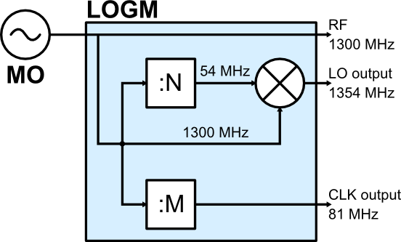
LOGM – Motivation & History
RF detection scheme based on IF sampling
  Low phase noise and synchronized LO and clock needed for precise down mixing and sampling
LO generation schemes:
  PLL based (Problem: small packaged VCO with low phase noise, expensive)
  Divide and Mixing Scheme (less flexibility, but reliable)
Facilities with LOGMs at DESY:
  2010 ACC39 at FLASH
  2011: REGAE
  2011: 1st MTCA test at ACC1/FLASH
  2012: CMTB
  2013: FLASH, XFEL RF Gun, AMTF
Divide and Mixing scheme for the LO and clock generation
Notes:
Before you start editing the slides of your talk change to the Master Slide view:
Menu button “View”, Master, Slide Master:
Edit the following 2 items in the 1st slide:
1) 1st row in the violet header:
Delete the existent text and write the title of your talk into this text field
2) The 2 rows in the footer area: Delete the text and write the information
regarding your talk (same as on the Title Slide) into this text field.
If you want to use more partner logos position them left
beside the DESY logo in the footer area
Close Master View

Slide 9
LOGM - Specification
General description and functionality:
  Generate and distribute low phase noise LO and CLK signal to uDWC
  Distribute reference MO signal to uDWC and uVM
  Coupled monitor signals (LO, CLK, MO) and power level diagnostic
  Resettable CLK divider
  Diagnostic available in control system
  19” chassis with external power supply (PSM)
LOGM for injector and L1
MTCA version for main linac (next PRR)
Notes:
Before you start editing the slides of your talk change to the Master Slide view:
Menu button “View”, Master, Slide Master:
Edit the following 2 items in the 1st slide:
1) 1st row in the violet header:
Delete the existent text and write the title of your talk into this text field
2) The 2 rows in the footer area: Delete the text and write the information
regarding your talk (same as on the Title Slide) into this text field.
If you want to use more partner logos position them left
beside the DESY logo in the footer area
Close Master View

Slide 10
LOGM - Specification
Electrical specification:
Mechanical specification:
  19” Chassis, 1U height
  RF inputs on the front
  RF outputs/DC on the rear
Reference (MO):
Number of outputs | 9 signals
Center frequency / bandwidth | 1300 MHz
Power level | 3x +10dBm
 | 6x +3dBm
 | (no amplification by additional amplifier in the reference line)
Type / Impedance / Connector | Single ended / 50Ohm / SMA
Location | Rear panel
Local Oscillator (LO):
Number of outputs | 9 signals
Center frequency / band width | 1300MHz(1+1/24) = 1354.166666… MHz
Power level | +13dBm
Type / Impedance / Connector | Single ended / 50Ohm / SMA
Location | Rear panel
Additive phase noise | <1.6fs rms @1300MHz [10Hz–1MHz]
Additive amplitude noise | <0.02% rms [10Hz–1MHz]
Amplitude drifts | <0.2% peak-to-peak [0.1s–100s]
Phase drifts | <0.2ps peak-to-peak [0.1s–100s] <1ps peak-to-peak [forever]
Clock Outputs:
Number of Outputs | 9 signals
Center frequency / band width | 1300MHz/16 = 81.25… MHz
Power level | +10dBm
Type / Impedance / Connector | Single ended / 50Ohm / SMA
Location | Rear panel
Phase jitter | <200fs rms [10Hz–100MHz] (Equivalent -160dBc/Hz)
Notes:
Before you start editing the slides of your talk change to the Master Slide view:
Menu button “View”, Master, Slide Master:
Edit the following 2 items in the 1st slide:
1) 1st row in the violet header:
Delete the existent text and write the title of your talk into this text field
2) The 2 rows in the footer area: Delete the text and write the information
regarding your talk (same as on the Title Slide) into this text field.
If you want to use more partner logos position them left
beside the DESY logo in the footer area
Close Master View

Slide 11
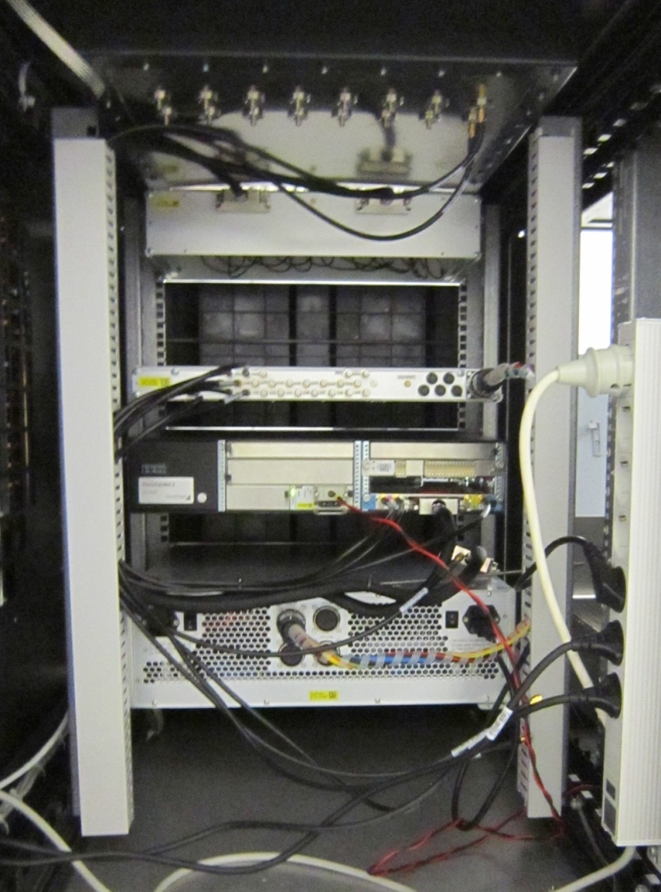
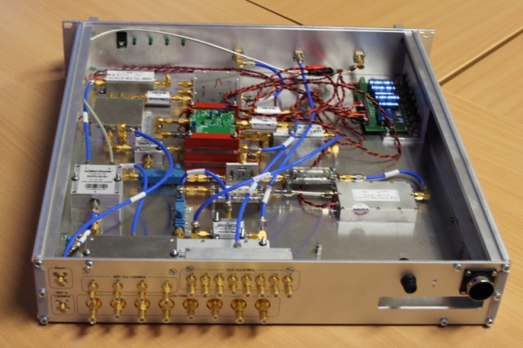
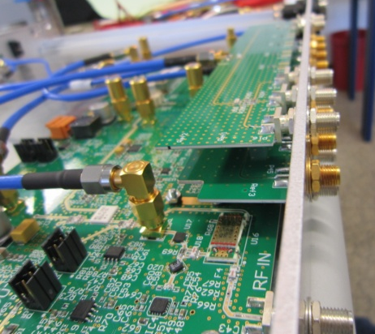
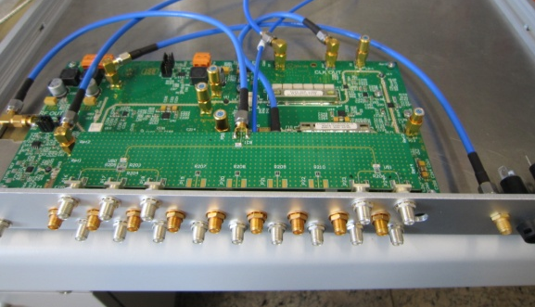
LOGM – Realization
1st Version (Prototype)
  Connectorized version
2nd Version
  PCB version
Example: Installation at XFEL Gun
DCM
REFM
LOGM
MTCA-Crate
PSM
Notes:
Before you start editing the slides of your talk change to the Master Slide view:
Menu button “View”, Master, Slide Master:
Edit the following 2 items in the 1st slide:
1) 1st row in the violet header:
Delete the existent text and write the title of your talk into this text field
2) The 2 rows in the footer area: Delete the text and write the information
regarding your talk (same as on the Title Slide) into this text field.
If you want to use more partner logos position them left
beside the DESY logo in the footer area
Close Master View

Slide 12
  LOGM – Quality Check & Testing
LOGM will be produced by external company
Company has to perform basic functionality check
  Output frequencies, power levels, matching and spurious in the spectrum
  DC tests/power consumption
  Test report
MSK/WP02 will prepare LOGM test stand
  Phase and amplitude noise characterization
  Drift performance of selected LOGMs
Notes:
Before you start editing the slides of your talk change to the Master Slide view:
Menu button “View”, Master, Slide Master:
Edit the following 2 items in the 1st slide:
1) 1st row in the violet header:
Delete the existent text and write the title of your talk into this text field
2) The 2 rows in the footer area: Delete the text and write the information
regarding your talk (same as on the Title Slide) into this text field.
If you want to use more partner logos position them left
beside the DESY logo in the footer area
Close Master View

Slide 13
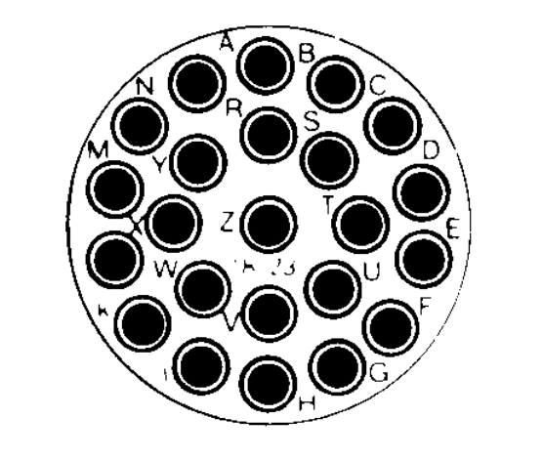
PSM - Specification
Diagnostic functionality:
  Voltages, currents, temperature readouts
  12 Bit accuracy, burst detection ability, 1Hz update rate
  Status LEDs on the front
  Power fail warning and redundant status mode detection
Connectivity:
  Burndy circular connector 23 pins
  Four connectors, labeled: OUT1, OUT2, OUT3, OUT4
  Internal connectivity should carry up to 13A per voltage
  MTBF ~10 years
Figure 2: 23-pin Burndy connector
Digital power supply: | Analog power supply:
Pin A → +15V, 5A Pin B → - 15V, 5A Pin C → GND | Pin G, H → +15V, 5A Pin K, L → GND for +15V, 5A Pin N, P → +15V, 8A Pin S, T → GND for +15V, 8A Pin E, F → -15V, 5A Pin D, V → GND for -15V, 5A Pin J, M → +7V, 6A Pin R, U → GND for +7V, 6A Pin W, X → -7V, 6A Pin Y, Z → GND for -7V, 6A
Notes:
Before you start editing the slides of your talk change to the Master Slide view:
Menu button “View”, Master, Slide Master:
Edit the following 2 items in the 1st slide:
1) 1st row in the violet header:
Delete the existent text and write the title of your talk into this text field
2) The 2 rows in the footer area: Delete the text and write the information
regarding your talk (same as on the Title Slide) into this text field.
If you want to use more partner logos position them left
beside the DESY logo in the footer area
Close Master View

