Slide 1


Procurement Readiness Review
WP02 - LLRF
MTCA.4 Infrastructure
Notes:
How to edit the title slide
Upper area: Title of your talk, max. 2 rows of the defined size (55 pt)
Lower area (subtitle): Conference/meeting/workshop, location, date,
your name and affiliation,
max. 4 rows of the defined size (32 pt)
Change the partner logos or add others in the last row.

Slide 2
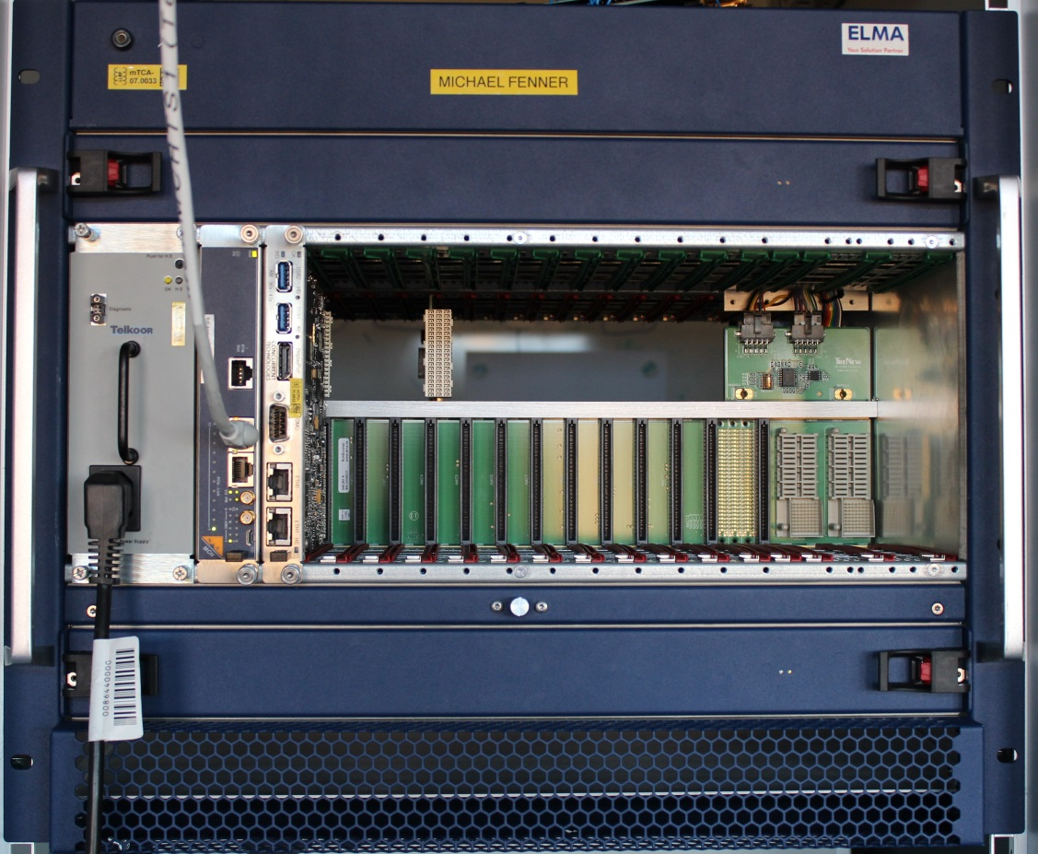


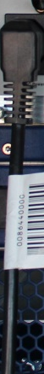
Talk Overview
  Chassis and cooling units
  Backplane
  Power Supplies
  MTCA Carrier Hub
  CPU
  System stability, reliability
Crate picture
Redundant Power Supply
Primary Power Supply
Cooling Unit
CPU
MTCA Carrier Hub (MCH)
Backplane

Slide 3

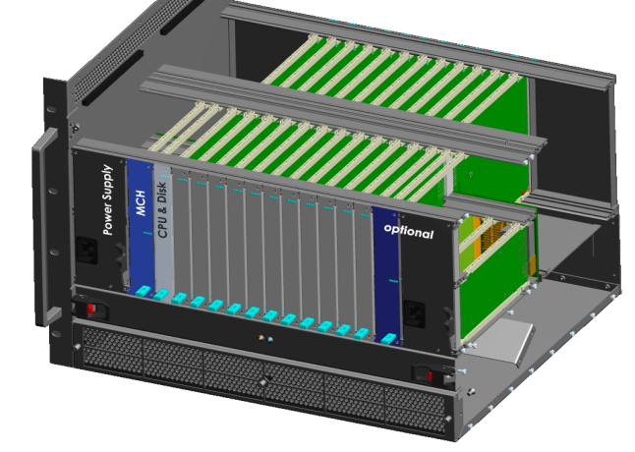
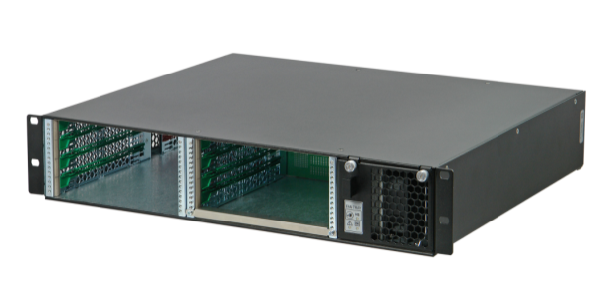
3
MTCA.4 Crate Standard
Development partnership „xTCA for Physics“ (38 partner): 03/2009
  Research Institute: SLAC, FNAL, IHEP, IPFN, ITER, DESY
  Industry: Connector-, Board-, Crate-, System Manufacturer
Ratification PICMG 2011 (http://www.picmg.org)
  Micro Telecommunications Computing Architecture .4 (MTCA.4)
  MicroTCA Enhancements for Rear I/O and Precision Timing
Cables from rear side
Modular + modern architecture
- Reusability + PCIe + Ethernet
High availability
- Redundant power, MCH and CU
- Well defined remote management
High digital performance
- Very low analog distortions (diff.lines)
- 4 lanes PCIe (Gen3): 1 GByte/s/lane
Notes:
3
Before you start editing the slides of your talk change to the Master Slide view:
Menu button “View”, Master, Slide Master:
Edit the following 2 items in the 1st slide:
1) 1st row in the violet header:
Delete the existent text and write the title of your talk into this text field
2) The 2 rows in the footer area: Delete the text and write the information
regarding your talk (same as on the Title Slide) into this text field.
If you want to use more partner logos position them left
beside the DESY logo in the footer area
Close Master View

Slide 4
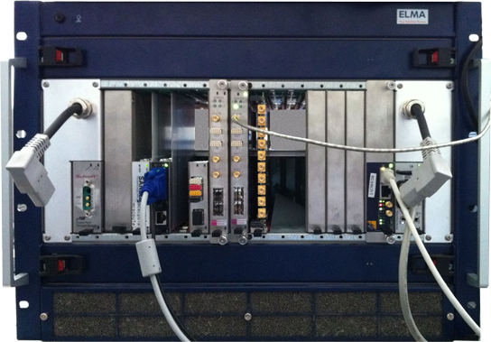
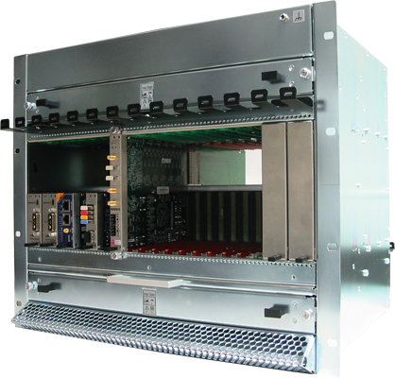
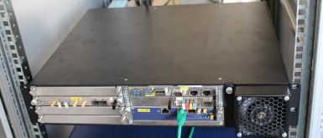
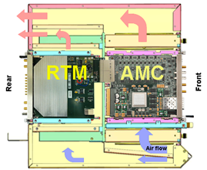
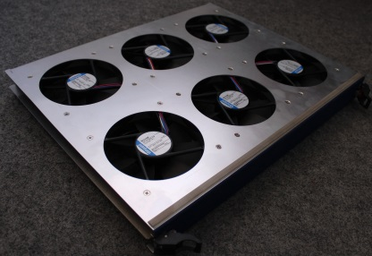
Chassis and Cooling Units
Functionality:
  To mechanically host the modules and provide environmentally stable conditions.
  To provide cooling for the modules in the chassis.
Performance:
  EMI concept defined.
  No influence of mechanical vibrations.
  Cooling capabilities are satisfying.
  Architecture designed for redundancy:
    PM
    MCH
    CU
Upgradability:
  CUs are hot-pluggable.
  Filters can be exchanged.
  Supported by industry – COTS.
  Vendors : ELMA, Schroff, PT, Vadatech
Experience
  App. 10 crates continuously in operation to gather experience.
ELMA-12 slot
Schroff-12 slot
Air-flow
Schroff-6 slot
Cooling Unit

Slide 5
EMI and Cooling Performance
EMI:
  Out-of-crate:
    Tight connection of all incoming and outgoing signals to chassis-GND -> no paint allowed!
    Crates needs a low impedance rack acting as a bypass structure for all connected signals.
    Several crates should connected on a low impedance metal structure
  In-crate:
    All inner crate distortions sources from AMC, RTM, PWS should be minimized.
    Backplane grounds and chassis should be shorted to reduce PWS distortions.
    Single-ended RTMs should have metal housings, appropriate layer stack acting as an EMI bypass.
    Number of connection should be minimized. Optical high speed separation should be used.
    No connection should be connected only on GND, always to the chassis as well.
Cooling:
  Experience from FLASH on 4 stations and XFEL RF Gun show that at 21 degC of inlet temperature, all the modules are below the uncritical threshold.

Slide 6
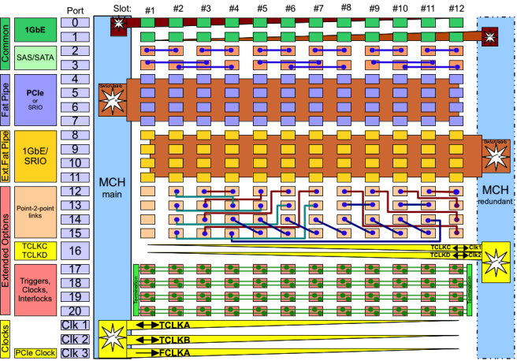
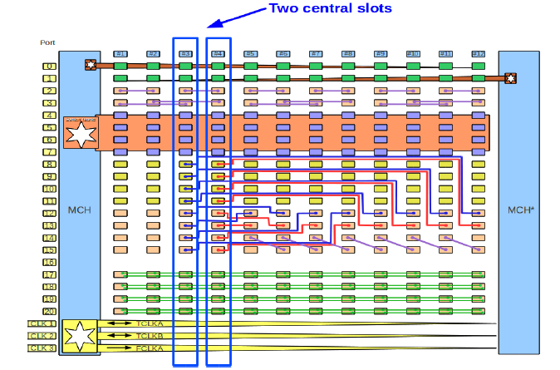
Backplane
Functionality
  For LLRF applications a special version of AMC
  Backplane will be used -> LLL port 8-15 on slot 3,4
  to all other slots
  For communication and signal distr.
  between in-crate boards:
    Ethernet
    SAS/SATA
    IPMB-L, IPMB-0 (I2C)
    PCIe links
    Point-to-point
Performance
  Speed transfer on various links LLL (10Gb/s) and
  PCIe (16 Gb/s/4-lanes)
Upgradability
  Supported by industry – COTS
  Vendors: Schroff, ELMA, PT, Vadatech
Experience
  App. 10 crates continuously in operation to gather experience.
Standard AMC BCKPL.
    Triggers
    CLKs
    3.3V, 12V
    JTAG
    MTCA specific
LLRF AMC BKCPL.

Slide 7
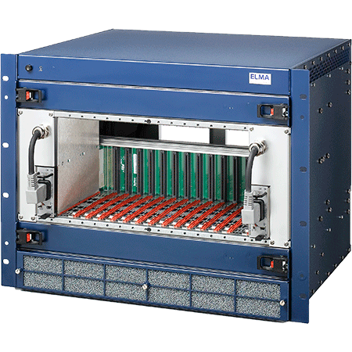
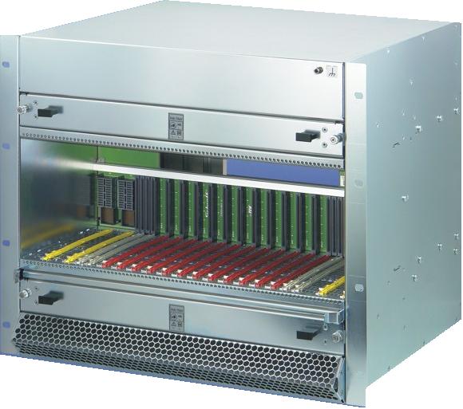
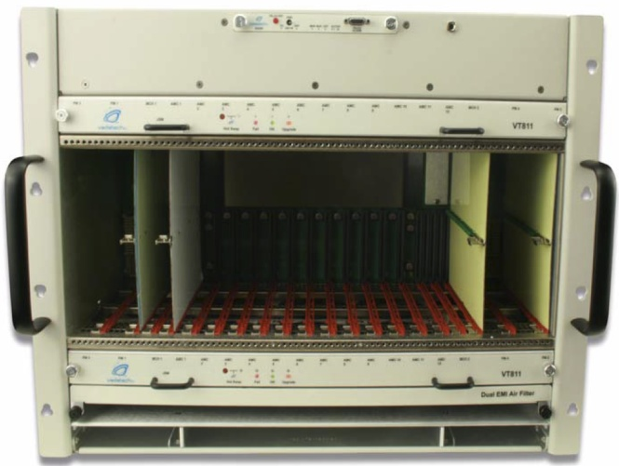
MTCA.4 Chassis Tests
ELMA, LLRF backplane
  Fat Pipe:
    PCIe gen. 3 (8 Gbps)
  Extended Region:
    LLL: ~3 Gbps (some slots 6 Gbps)
    BER: >1e-6 @ 6.5 G
Vadatech VT811, PICMG
  Fat Pipe:
    PCIe gen. 1 (2 Gbps)
  Extended Region:
    LLL: <4 Gbps
    BER: >1e-2 @ 6.5 G
Schroff, LLRF backplane
  Fat Pipe:
    PCIe gen. 3 (8 Gbps)
  Extended Region:
    LLL: 10 Gbps
    BER: <1e-15 @ 10 G (8 hours)

Slide 8
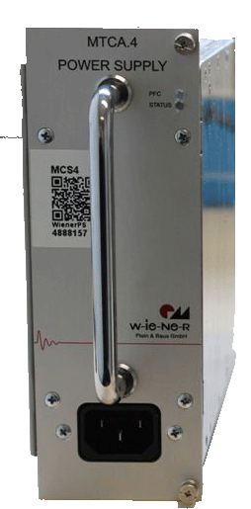
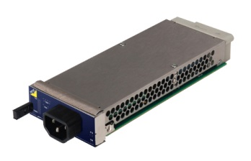
Power Supply
Functionality
  To provide PP 12V and MP 3.3V to the modules in the crate from AC power.
  Remote FW updates.
  Current, temperature and voltage readouts.
  Redundant operation.
  Low ripple < 100mVpp at max load on 12 V.
Performance
  600 W (Gun) - 1000 W (Other stations)
  Most of the PM meet the ripple specs.
Upgradability
  Supported by industry – COTS
  Various vendors (PB-Telkoor, Wiener, Vadatech, NAT)
Experience
  More than 10 various power supplies installed and running continuously to gather experience.
1kW
600W
1kW
1kW
Uros Mavric, PRR, MTCA Infrastructure 26th November, 2013

Slide 9
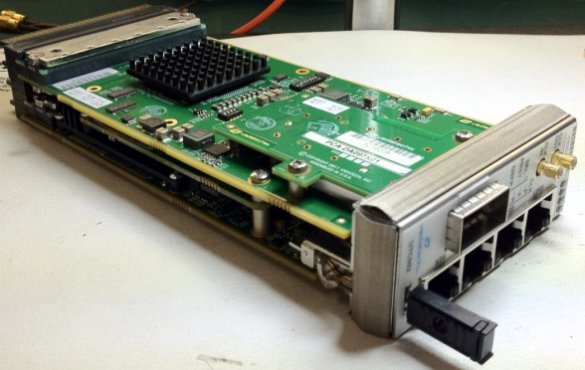
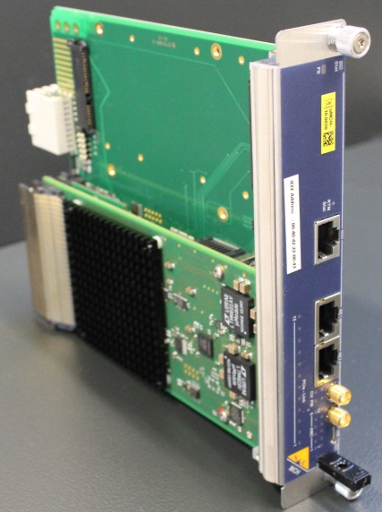
MCH – MTCA Carrier Hub
Functionality
  Host of the MCMC(MicroTCA Carrier Management Controller).
  Host of the PCIe switch : PCIe x4 Gen 3 to each unit.
  1 GbE (A)
  Centralized CLK distribution to all AMCs.
  Remote FW updates.
  Transition to rear over Z3 (COM Express, management module for the RF backplane).
Performance
  NAT-MCH (“Best Hardware Infrastructure Product” at xTCA Summit in Sept. 2012).
  Five-Nines Availability, allows complete redundancy
Upgradability
  Supported by industry - COTS
  Vendors available (NAT, Vadatech, Kontron, PT)
Experience
  More than 10 NAT-MCHs installed and running
  continuously to gather experience.

Slide 10
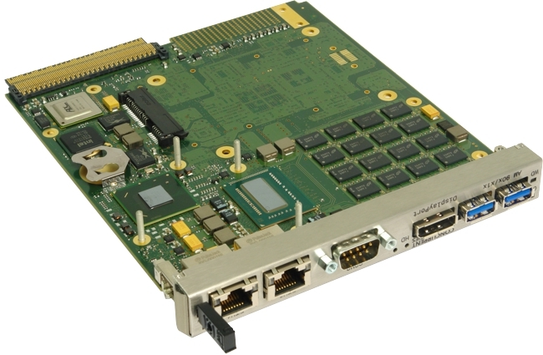
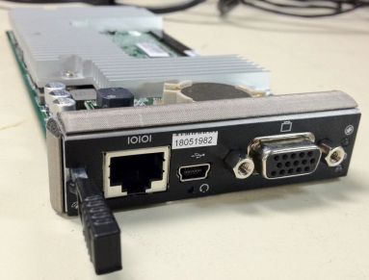
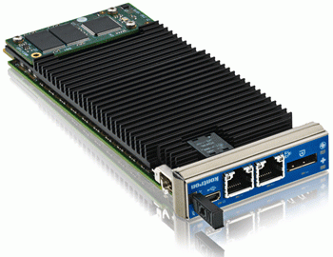
CPU
Functionality of the Concurrent AM 900/412
  2-core 2.5 GHz Intel Core i7-3555LE processor
  16 Gbytes of DDR3-1600
  X 8 PCIe Gen 3
  2 x SATA interfaces for onboard storage
  4 x Gigabit Ethernet interfaces
  2 x USB 3.0 ports via front panel
  3 serial port interfaces
  Display Port graphics interface via front panel
  Serial-over-LAN (SOL)
  Possibility to switch to a quad-core
Performance
  CPU usage 50 % with most of the servers running.
  Internal CPU Temperature during operation ~50degC.
Upgradability
  Supported by industry - COTS
  Vendors CCT, ADLink, Kontron
Experience
  More than 10 different CPUs running continuously.

Slide 11

System Improvements
Platform related problems were a major “showstopper” at the beginning:
  Platform management related (FW and HW)
    Debugging in collaboration with industry
    long debugging periods
    MTCA interoperability workshop
  Bad cooling – overheating of components
    improved cooling of crates
  Backplane connectivity
    Improved the manufacturing process
2,5 years of debugging in collaboration with industry
Tracking of bugs:
  RT (https://rt-system.desy.de/) - ~80 bugs reported and solved
  DESY Log-book (http://ttfinfo.desy.de/uTCAelog/index.jsp) – a list of bugs/solutions and procedures
Today MTCA.4 is a much more stable and reliable infrastructure

Slide 12
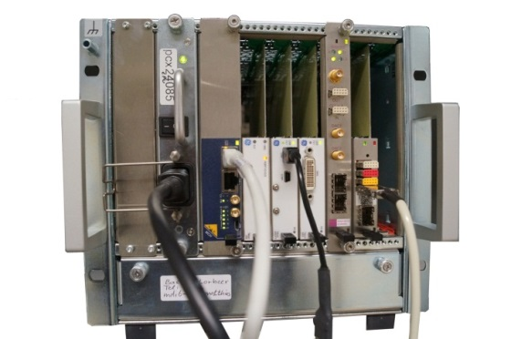
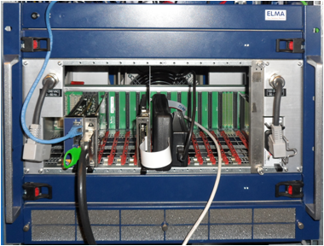
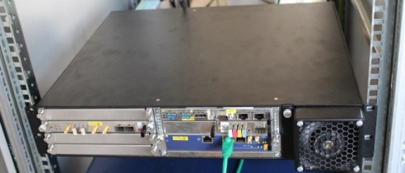
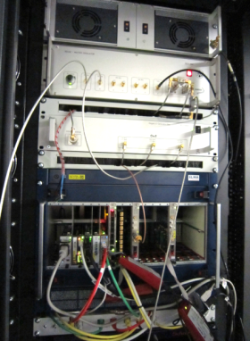
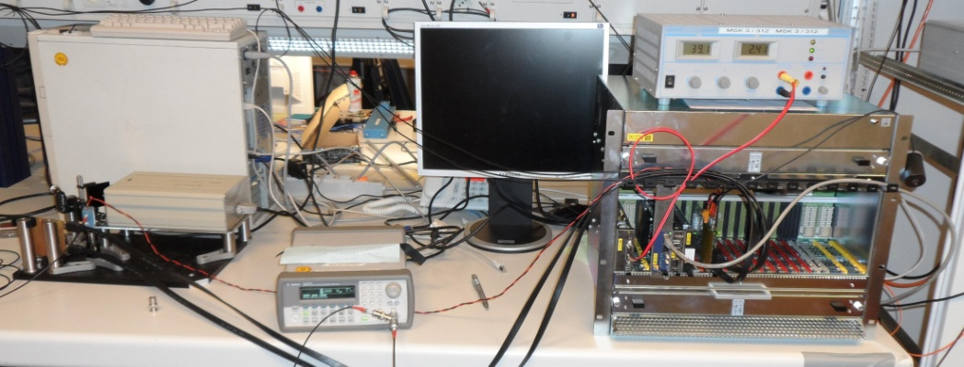
Other Applications using MTCA.4
Hosted in the LLRF crate:
  High-Order Modes Measurements
  Machine protection system
  Klystron lifetime Monitoring
  Timing
  Dark current monitors
Other applications:
  BAMs
  BPMs
  Laser Synch
  Transverse deflecting system
  ….
Low Charge BPMs
Low-Latency Camera
EBPM
Laser Synch.
Electro optical detector

Slide 13
Thank you for your attention.

Slide 14
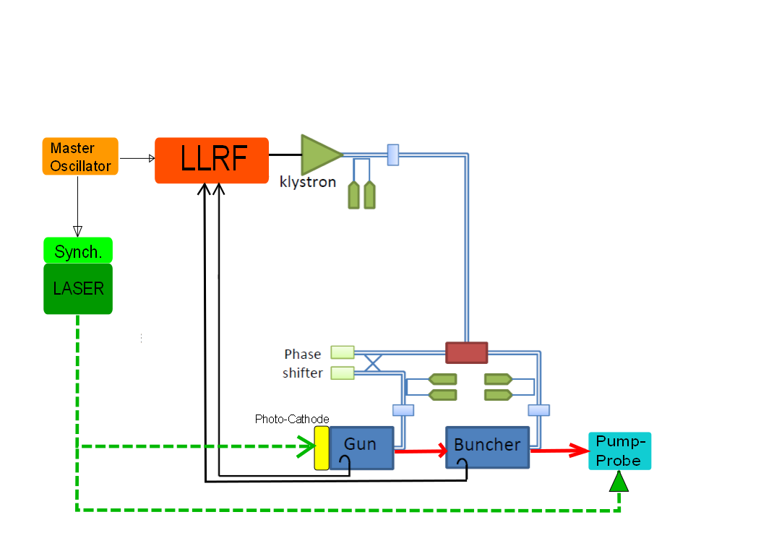
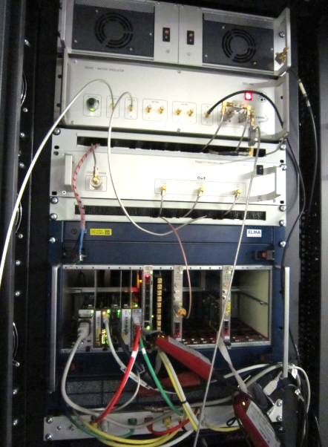
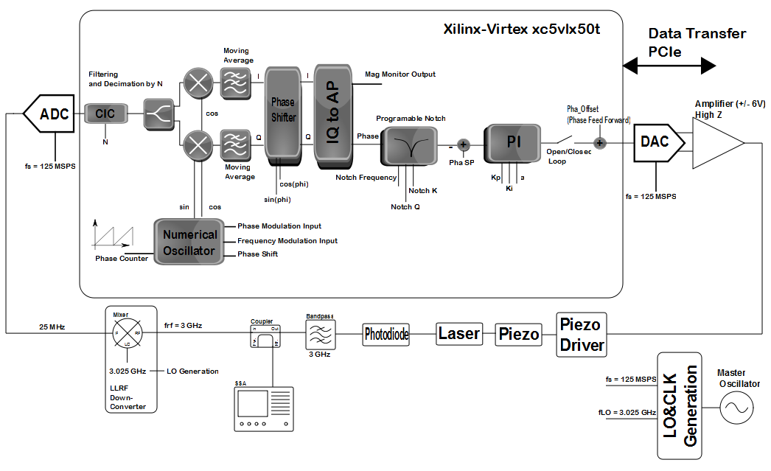
Laser Synchronization
3 GHz harmonic of laser extracted from Photo Diode → down converted to 25 MHz
Phase noise measurement shows synchronization lock in the order of 20 fs in MTCA.4
SSB Phase Noise:
~ 20 fs relative jitter
reference (green) vs. laser (red)
Courtesy of M.Felber
2nd Collaboration Meeting of the European XFEL, Hamburg 22.-25.04.13, DESY, Germany
Uroš Mavrič, DESY

Slide 15
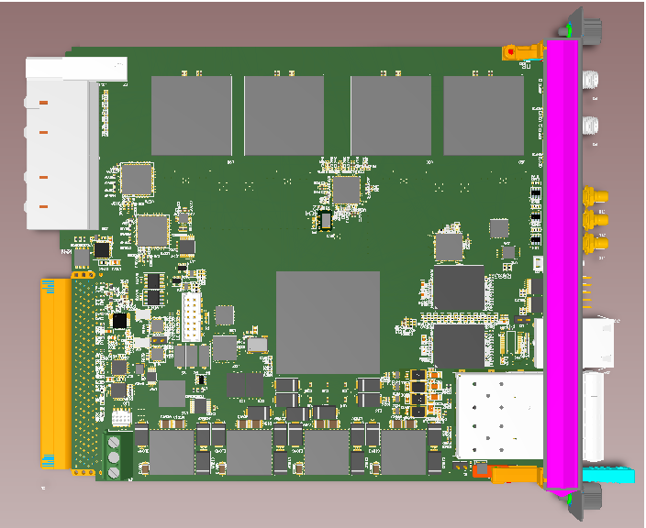


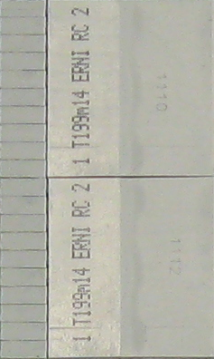
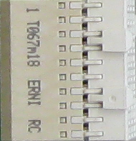
HOM-BPMs for 1.3 GHz Cavities in the XFEL
No down-conversion
DRTM-HOM
  8 channels
  1.3, 1.7 and 2.4 GHz
DAMC-DS800
  AMC Fast Digitizer Card
  No down-conversion
  8 analog channels up to 2.7 GHz @ 800 MSPS, 12-bit ADCs
HOM
FILTER
HOM
FILTER
RF1
..
..
RF8
HOM
FILTER
HOM
FILTER
REF FP
PLL
+Distr.
CLK out
REF (RF-backplane)
Courtesy of N. Baboi
2nd Collaboration Meeting of the European XFEL, Hamburg 22.-25.04.13, DESY, Germany
Uroš Mavrič, DESY

Slide 16
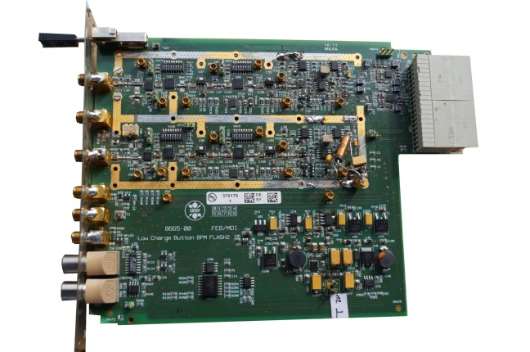
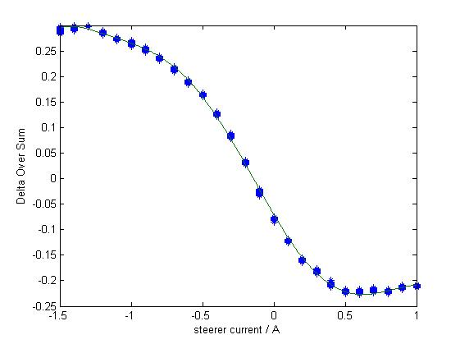

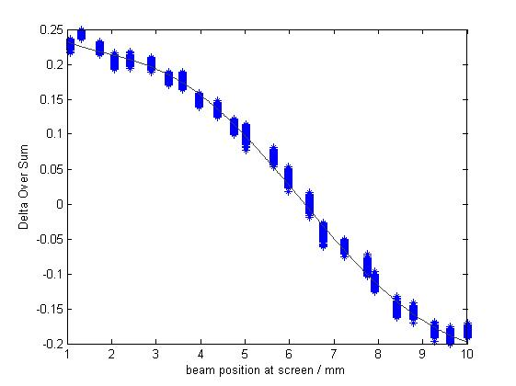
Low Charge Beam Position Monitor for Buttons and Strip-line monitors for FLASH 1+2
RTM low charge Peak detector
electronics
Strip-line BPM measured at 20pC
Rear Transition Module (RTM)
180mmx162mm
Compatible with the MTCA.4
for physics standard
Beamline
Diameter: 34 mm
Strip-line length: 200 mm
Monitor
Constant: 20mm
Measurable aperture:+/- 3.5mm
Standard deviation
at all positions: < 50μm_{rms}
MicroTCA crate
Button BPM measured at 80pC
Crate used for the tests includes:
management carrier hub (MCH)
hard disk (HD), processor (CPU)
Digitizer SIS8300
timing module x1timer
Beamline
Diameter: 34 mm
Button size: 16 mm
Monitor
Constant:12.3mm
Measurable aperture:+/- 4mm
Standard deviation
at all positions: < 80μm_{rms}
Courtesy of “B. Lorbeer“

Slide 17

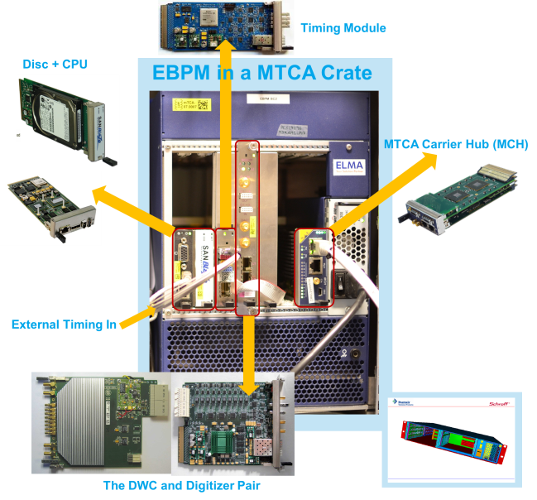
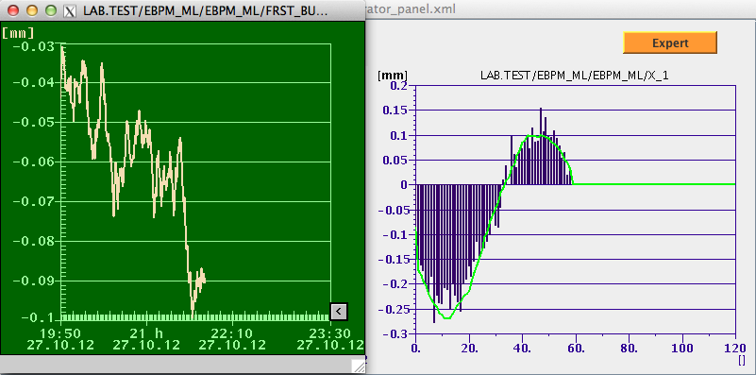
Energy BPM
Used for energy measurements of each bunch in the dispersive section of the bunch compressors. By means of time-of-flight measurements the energy can be determined.
Key Technical Features:
  < 20 um resolution
  1.3 GHz center frequency
  Absolute calibration is done with OTR screen in bunch compressor chicane
Already used on first bunch compressor at FLASH
HW Upgrade
Present EBPM
JDDD Panels
Correlation Between
1st and 2nd bunch

Slide 18
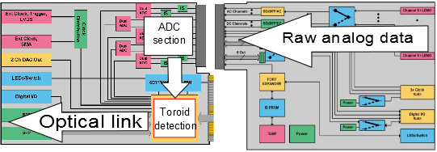
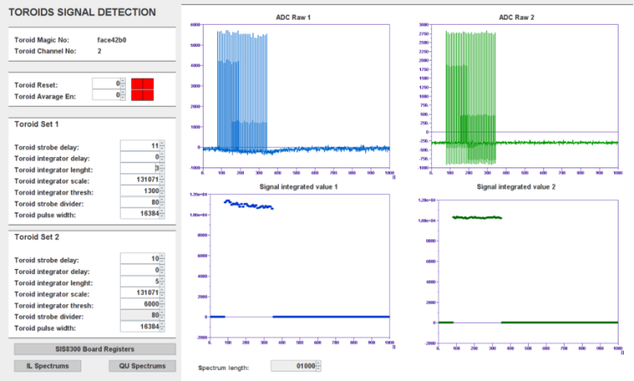
Toroid signal detecting module
Adjustable toroid detection module for SIS8300
ADC data processing rate 125 MHz, data sended with no protocol by optical link 1.25 Gbps
Intended use for Beam Loading Compenastion (BLC) and Photo Injector Laser Amplitude Stabilization with Pockels cells
Firmware for SIS8300+SIS8900 configuration and dedicated DOOCS server developed
First tests of BLC performed on 17.02.2013 failed due to mismatches in uTC firmware but detection worked correctly
Simplifield block diagram
DOOCS control panel
People involved: Tomasz Kozak, Łukasz Butkowski, Christian Schmidt and Wojciech Jałmużna

Slide 19
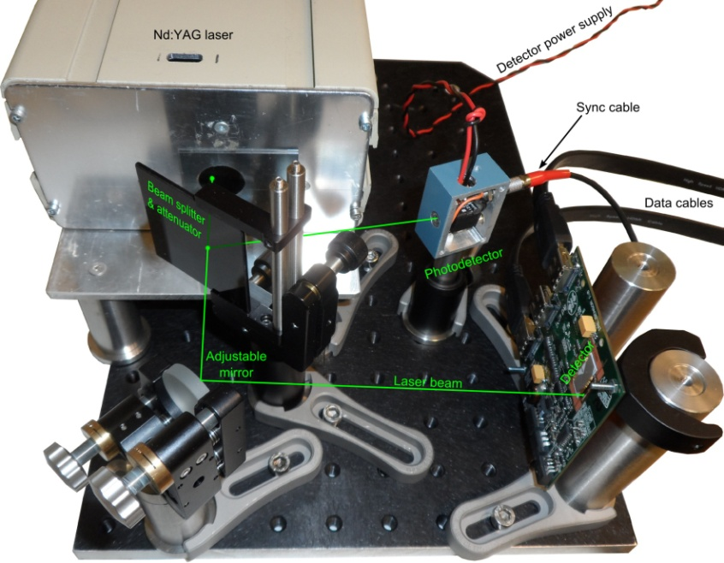
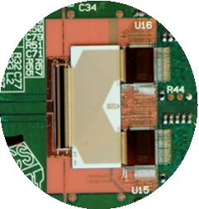
1D Electro-Optical Detector
Provides spectra or energy distribution for bunch train diagnostics for FELs
Features:
  Low-latency multichannel detector
  256-channels, UV/VIS-IR
  Sensitivity: 10⁴ photons/count
  Dynamic range: 10 bit
  Full well capacity: 10 Me⁻/pixel
  Latency (incl. data proces.) <10 µs
Application
  FLASH and E-XFEL
  Diagnostics for linac-based lasers
Current status:
  Tests with Nd:YAG laser
Courtesy of “D. Makowski, G. Jablonski, A. Mielczarek”
Courtesy of “people that should be mentioned”

Slide 20
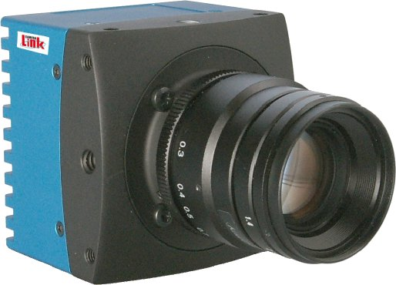
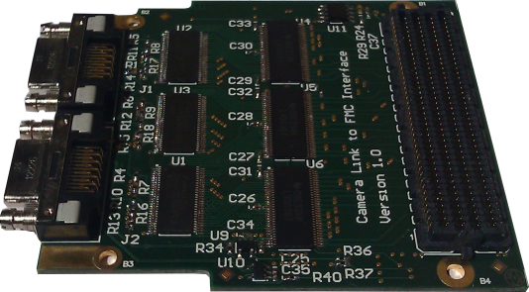
Fast, Low-latency Camera System
Provides 2D sensor for spectra or energy distribution for bunch train diagnostics for FELs
Features:
  Fast camera: 220x50 pixels@180.000 FPS
  Full-Camera Link interface
  MTCA frame grabber card
  Low-latency processing engine
Application
  FLASH and E-XFEL
  Diagnostics for linac-based lasers
Current status:
  Hardware ready for tests
  Firmware under development
Courtesy of “D. Makowski, G. Jablonski, A. Mielczarek”

Slide 21
Interoperability Problems
Symptoms such as:
  AMC/RTM boards do not power up
  Crate fans are switching off
  Power supplies are “dying”
  Overheating
  Hot-plugging problems
  PCIe connections are not established
  …
The main source of problems is related to the complexity of the management of the MTCA.4. This is making it time consuming to identify the real source of the problem.
Collaboration with industry is a must because the main platform components are from industry.
Many of the “childhood diseases” have been solved.
Tracking of all the known bugs
at https://rt-system.desy.de/
( presently there are 67 reported
and not all of them are understood )
Bottom line
The system is getting more stable.

Slide 22
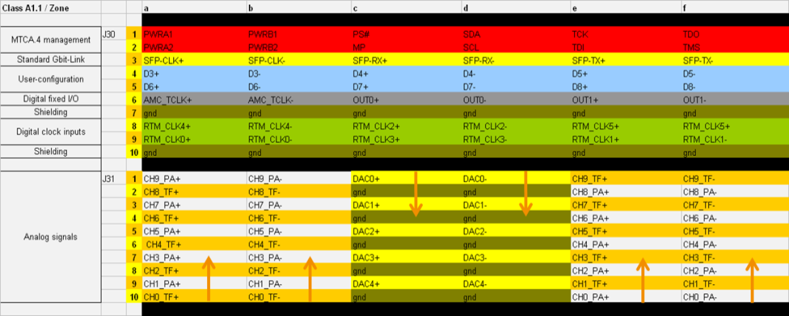
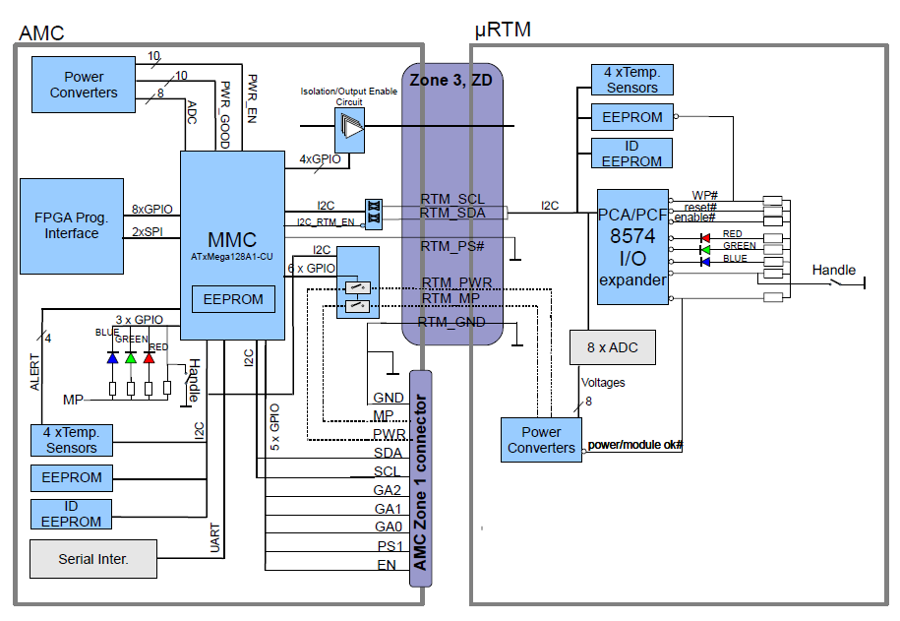
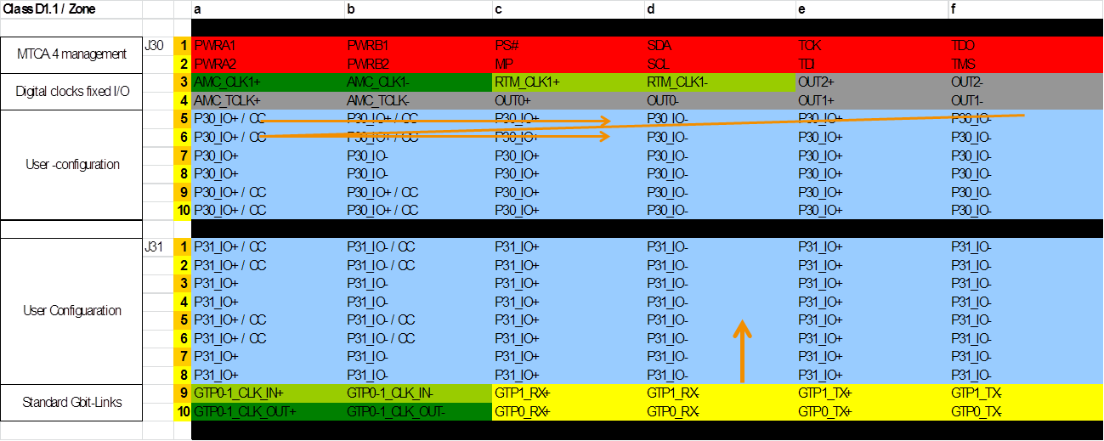
Standardizations : Zone 3 Recommendation
22
Z3 pin-assignment not standardized in MTCA.4
(AMC – RTM pairs)
-> Higher compatibility between AMC’s and RTM’s
-> Class A1.1 (analog), Class D1.x (digital)
Module Management Controller (MMC V1.0)
- Advanced Version,
- Basic (low cost) Version
- Single Firmware, PCB Templates
Notes:
Before you start editing the slides of your talk change to the Master Slide view:
Menu button “View”, Master, Slide Master:
Edit the following 2 items in the 1st slide:
1) 1st row in the violet header:
Delete the existent text and write the title of your talk into this text field
2) The 2 rows in the footer area: Delete the text and write the information
regarding your talk (same as on the Title Slide) into this text field.
If you want to use more partner logos position them left
beside the DESY logo in the footer area
Close Master View

Slide 23
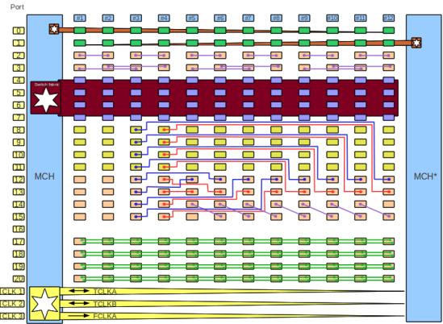
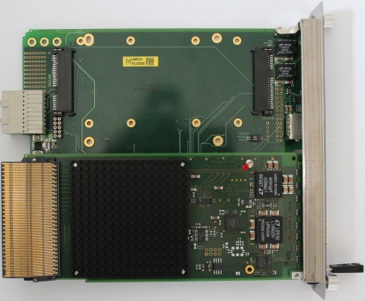
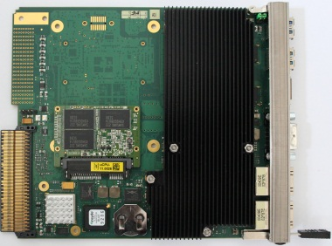
Industrial Unit Optimization
CPU
  i7, SSD, ubuntu, SoL
MCH
  Gen3 PCIe sw., 48 PCIe Lanes
PM
  Wiener : 800 W
  Telkoor : 600W, 1kW
Crates + CU
  Schroff
  ELMA
AMC backplane
Thermal optimization
Mechanics
EMI
Management
Connectivity
Functionality
Throughput
Management

Slide 24
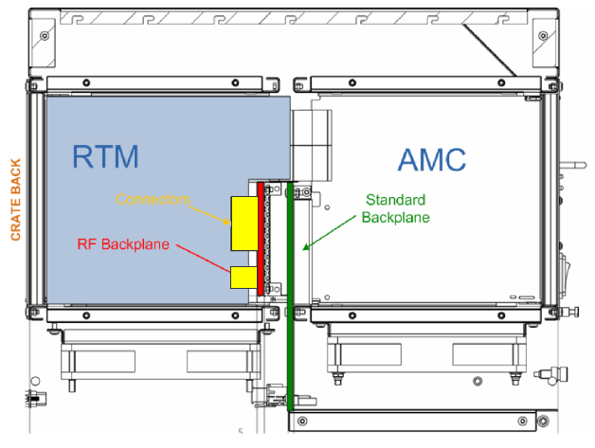

Standardizations : RF Backplane (optional)
24
Successful test of an RF-Backplane in 02/2012
- Low-jitter high-frequency signal distribution (<10fs)
- Low-jitter ADC-clock signal distribution (<200fs)
Courtesy of “K. Czuba”
2nd Collaboration Meeting of the European XFEL, Hamburg 22.-25.04.13, DESY, Germany
Uroš Mavrič, DESY
Notes:
Before you start editing the slides of your talk change to the Master Slide view:
Menu button “View”, Master, Slide Master:
Edit the following 2 items in the 1st slide:
1) 1st row in the violet header:
Delete the existent text and write the title of your talk into this text field
2) The 2 rows in the footer area: Delete the text and write the information
regarding your talk (same as on the Title Slide) into this text field.
If you want to use more partner logos position them left
beside the DESY logo in the footer area
Close Master View

