Slide 1
Procurement Readiness Review WP02 - LLRF
Infrastructure
Notes:
How to edit the title slide
Upper area: Title of your talk, max. 2 rows of the defined size (55 pt)
Lower area (subtitle): Conference/meeting/workshop, location, date, your name and affiliation, max. 4 rows of the defined size (32 pt)
Change the partner logos or add others in the last row.

Slide 2
Tasks covered by Infrastructure
3D model, placeholders, collisions checks
Racks: Injector 16U, Main Linac’s 28U, prototypes in FLASH,
Radiation shielding in XFEL Injector, prototype in FLASH,
Power dissipation and cooling units: Injector, Main Linac
Racks occupation: Injector, Main Linac
External RF cabling: cables list, cable ducts and trays, patch panels, splitters for Injector,
External FO cabling: cables list, cables pipes,
Internal rack cabling
Racks Assembly and Tests Facility
PRR 26.11.2013, DESY, Hamburg
Wojciech Wierba, IFJ PAN, Cracow, Poland
Notes:
Before you start editing the slides of your talk change to the Master Slide view: Menu button “View”, Master, Slide Master:
Edit the following 2 items in the 1st slide: 1) 1st row in the violet header: Delete the existent text and write the title of your talk into this text field 2) The 2 rows in the footer area: Delete the text and write the information regarding your talk (same as on the Title Slide) into this text field.
If you want to use more partner logos position them left beside the DESY logo in the footer area Close Master View

Slide 3
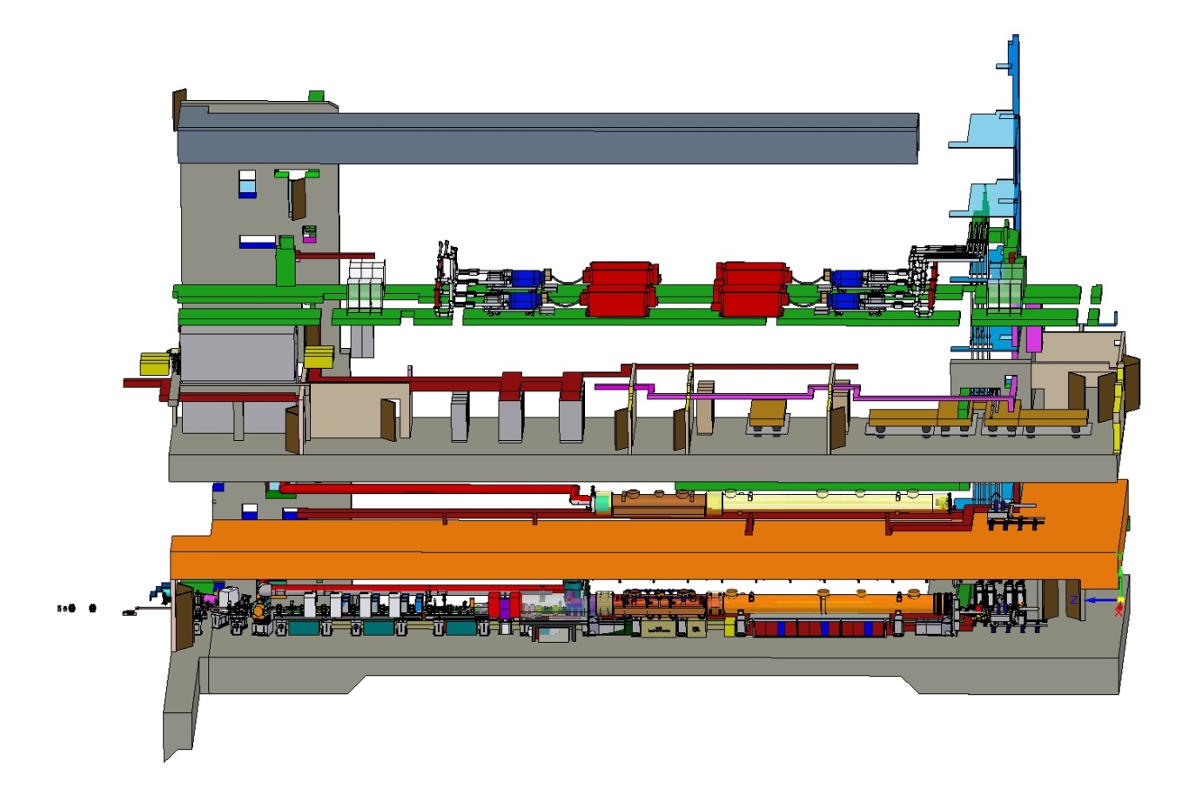
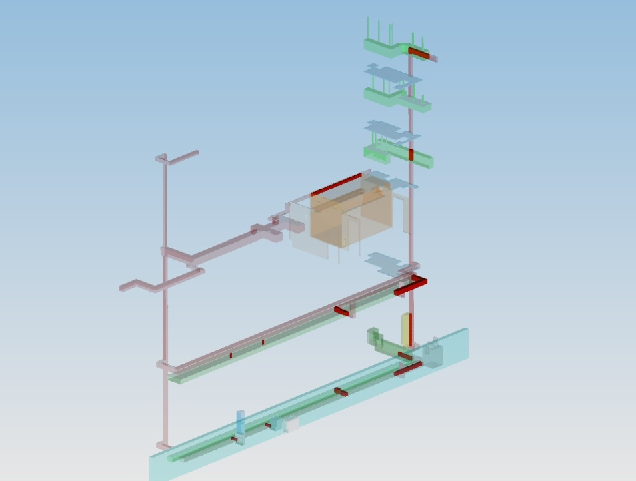
3D model
Mostly all WP02 placeholders released and implemented in model.
All collisions checked and cleared.
Finalizing details in-progress.
Notes:
Before you start editing the slides of your talk change to the Master Slide view: Menu button “View”, Master, Slide Master:
Edit the following 2 items in the 1st slide: 1) 1st row in the violet header: Delete the existent text and write the title of your talk into this text field 2) The 2 rows in the footer area: Delete the text and write the information regarding your talk (same as on the Title Slide) into this text field.
If you want to use more partner logos position them left beside the DESY logo in the footer area Close Master View

Slide 4
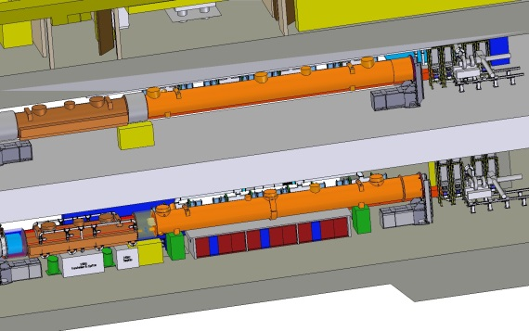
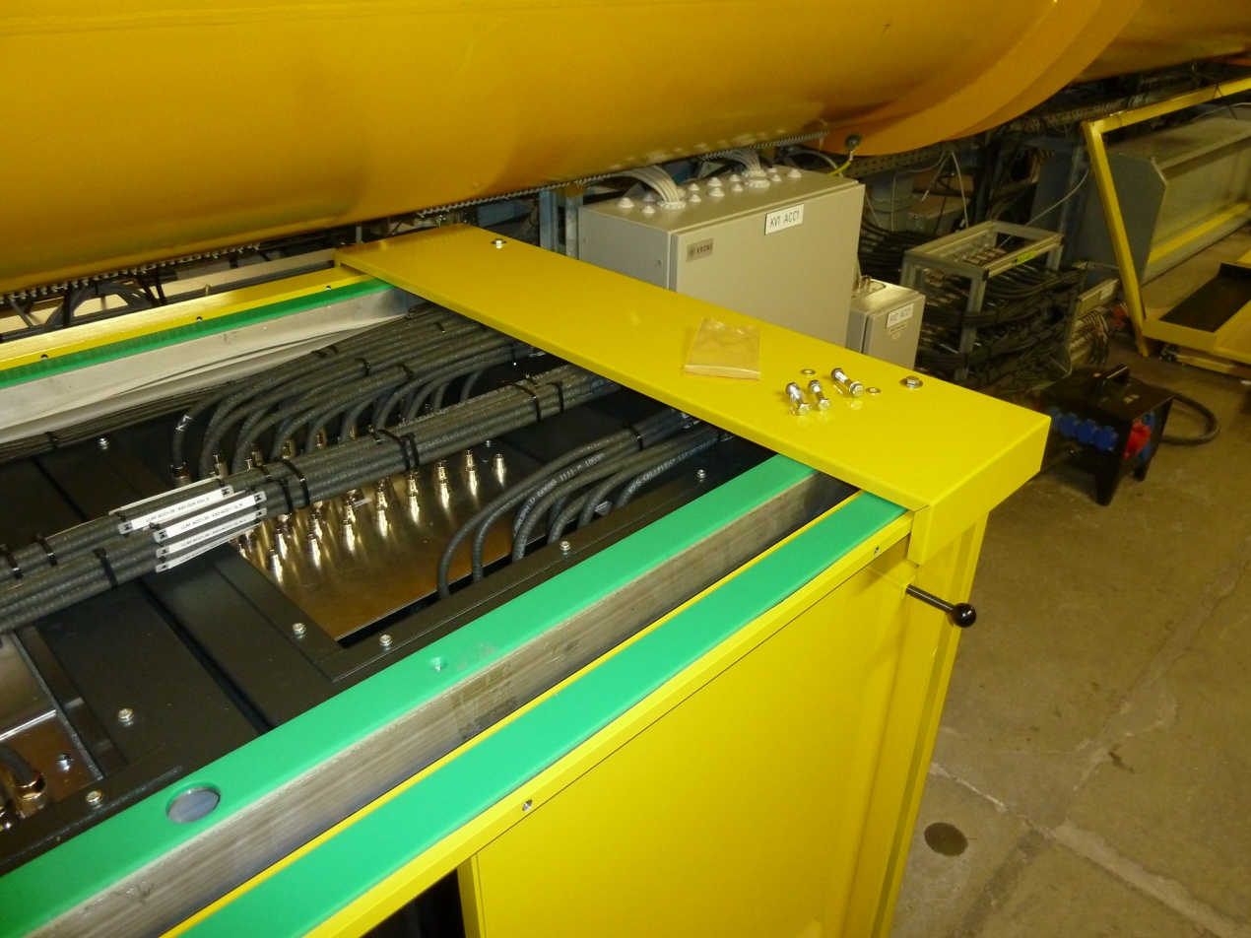
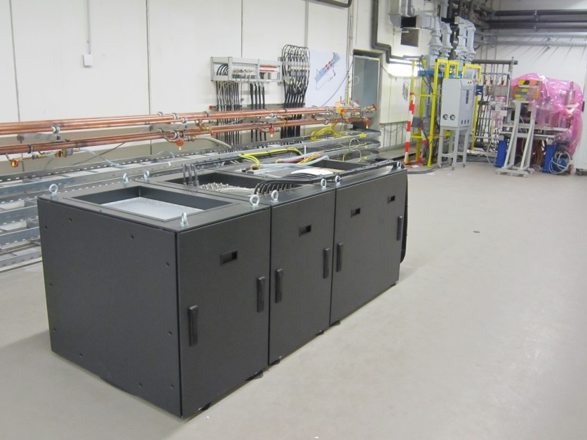
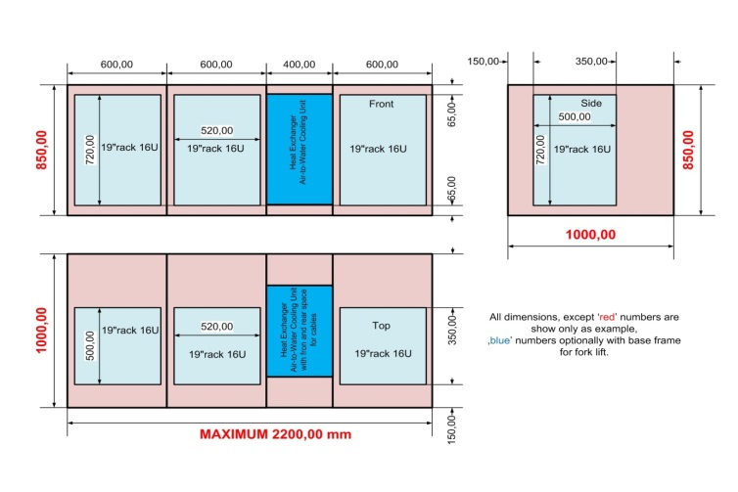
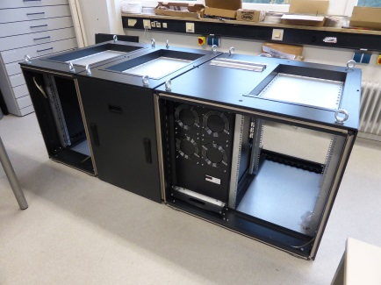
Racks in Injector
3 cabinets with 3 racks 16U under I1.
All cabinets EMI shielded.
Prototypes of racks have been tested in FLASH tunnel and are used for LLRF systems.
Final racks cabinets are ready at DESY.
One cabinet used for LLRF system for RF Gun commissioning.
Notes:
Before you start editing the slides of your talk change to the Master Slide view: Menu button “View”, Master, Slide Master:
Edit the following 2 items in the 1st slide: 1) 1st row in the violet header: Delete the existent text and write the title of your talk into this text field 2) The 2 rows in the footer area: Delete the text and write the information regarding your talk (same as on the Title Slide) into this text field.
If you want to use more partner logos position them left beside the DESY logo in the footer area Close Master View

Slide 5
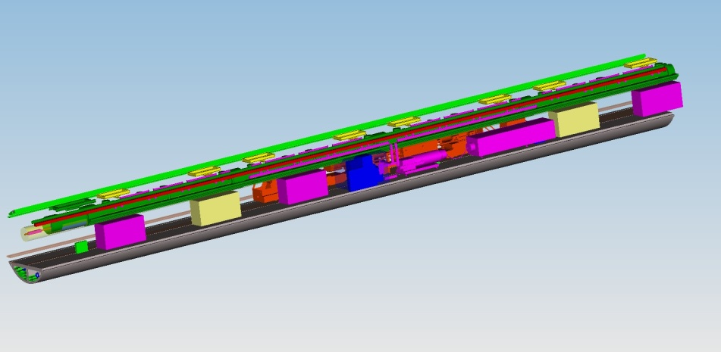
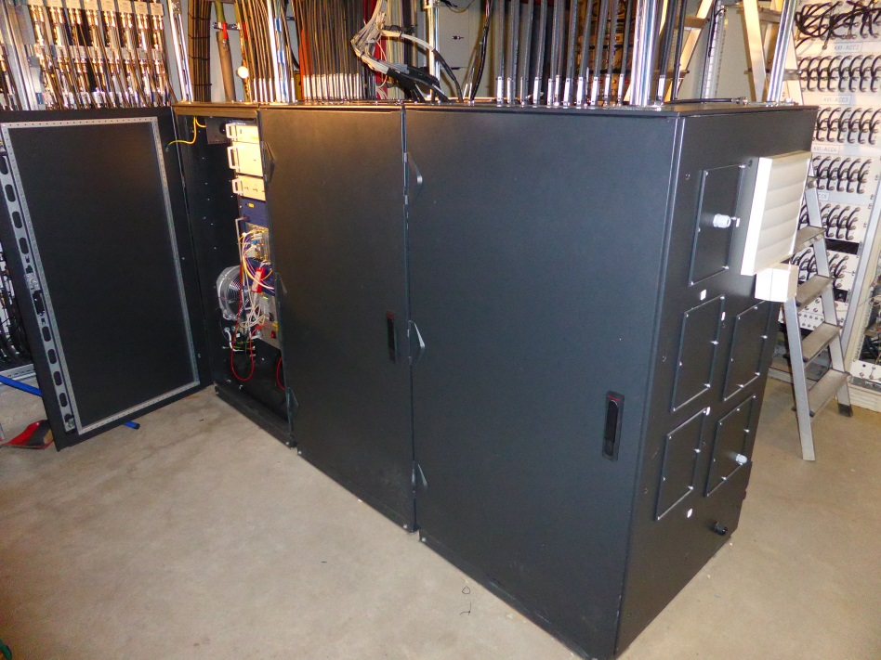
Racks in XFEL tunnel
~50 cabinets 28U (2 per one RF Station) for L1, L2 and L3.
LLRF system occupies one rack in each of two cabinets (set of 3 racks) in RF Station (marked yellow).
All cabinets EMI shielded.
Prototype of racks have been tested in FLASH for LLRF systems.
Final racks are ordered and first 5 sets will come before end of November 2013.
Notes:
Before you start editing the slides of your talk change to the Master Slide view: Menu button “View”, Master, Slide Master:
Edit the following 2 items in the 1st slide: 1) 1st row in the violet header: Delete the existent text and write the title of your talk into this text field 2) The 2 rows in the footer area: Delete the text and write the information regarding your talk (same as on the Title Slide) into this text field.
If you want to use more partner logos position them left beside the DESY logo in the footer area Close Master View

Slide 6
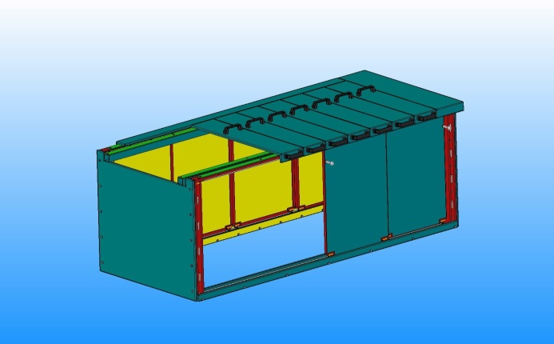
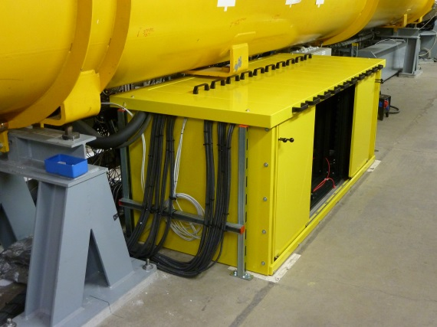
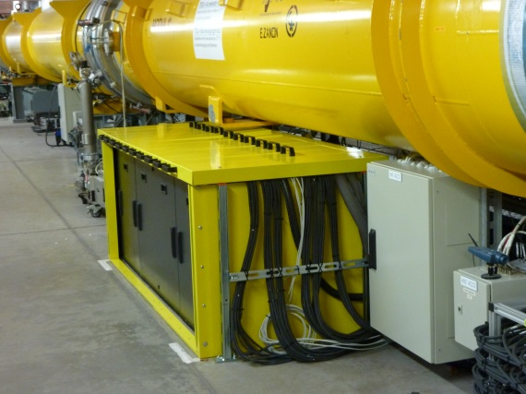
Radiation shielding in XFEL Injector
Radiation Shielding in Injector is made from 10 mm lead and 5 mm boron-added plastic plates (to stop neutrons).
Two prototypes (with sliding doors and without) successfully tested in FLASH tunnel.
Redesign for XFEL Injector will be finished before end of November 2013.
Röhr-Stolberg GmbH needs 8-12 weeks to produce radiation shielding for 3 set of racks.
Notes:
Before you start editing the slides of your talk change to the Master Slide view: Menu button “View”, Master, Slide Master:
Edit the following 2 items in the 1st slide: 1) 1st row in the violet header: Delete the existent text and write the title of your talk into this text field 2) The 2 rows in the footer area: Delete the text and write the information regarding your talk (same as on the Title Slide) into this text field.
If you want to use more partner logos position them left beside the DESY logo in the footer area Close Master View

Slide 7
Power dissipation and cooling power
Estimated power dissipation in Injector racks:
RF Gun and HOM’s – ~2.5 kW
I1 and 3H9 - ~3.7 kW
Cooling unit parameters:
Cooling power – 7 kW
Air temperature stability - ±0.2ºC
Expected cold air temperature (+18ºC cooling water, flow ~1.0 m³/h) - ~22-25ºC
Estimated power dissipation in XTL:
Master & Slave LLRF - ~2.1 kW
Cooling unit parameters:
Cooling power – 5.5 kW
Air temperature stability - ±0.8ºC
Expected cold air temperature (+18ºC cooling water, flow ~1.0 m³/h) - ~25-30ºC
Notes:
Before you start editing the slides of your talk change to the Master Slide view: Menu button “View”, Master, Slide Master:
Edit the following 2 items in the 1st slide: 1) 1st row in the violet header: Delete the existent text and write the title of your talk into this text field 2) The 2 rows in the footer area: Delete the text and write the information regarding your talk (same as on the Title Slide) into this text field.
If you want to use more partner logos position them left beside the DESY logo in the footer area Close Master View

Slide 8
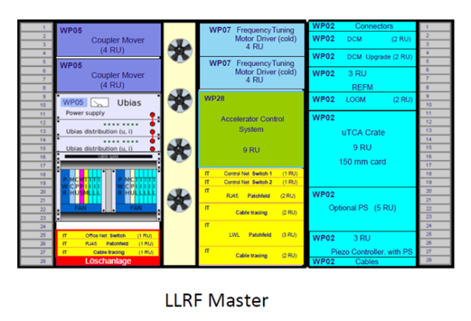
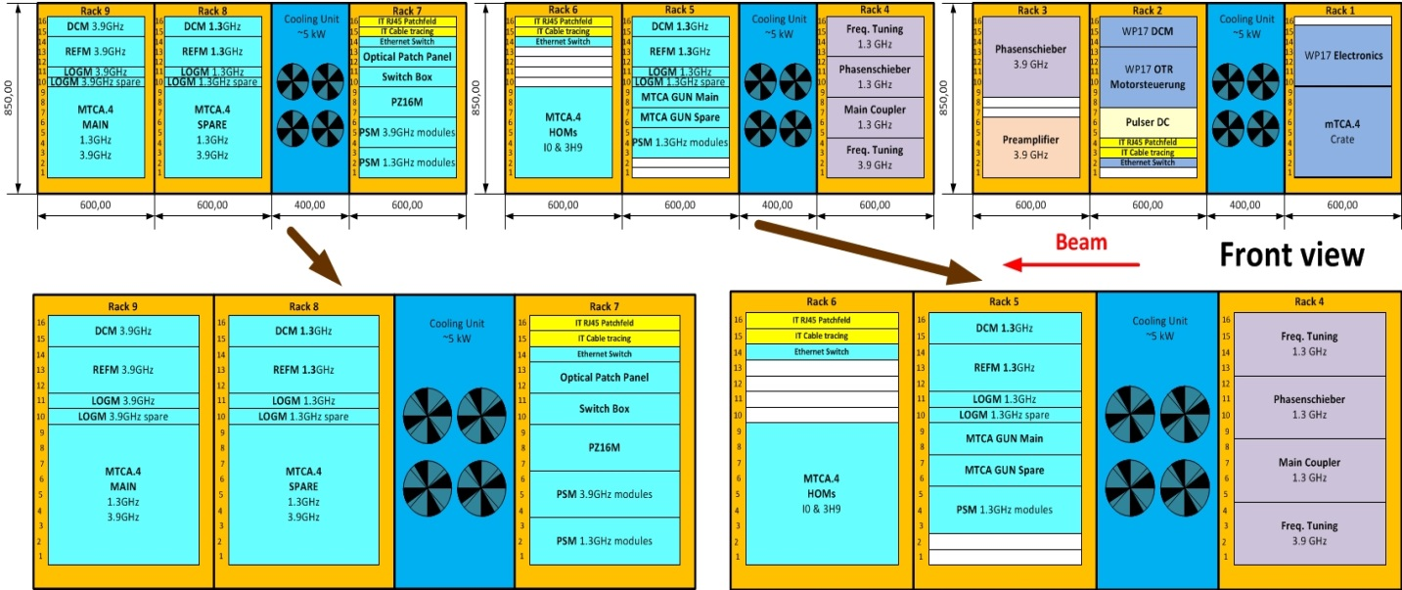
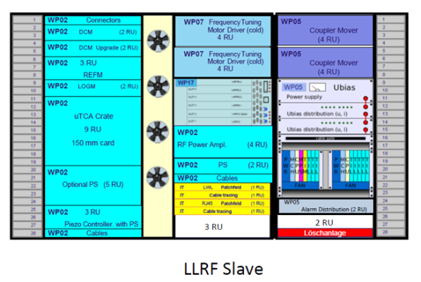
Racks occupation
The five WP02 racks in XFEL Injector (number 5-9) will contain Main and Spare LLRF Systems for RF Gun, I1, 3H1 and HOM’s electronics for I1, 3H9.
The WP02 racks in XTL will contain Master and Slave LLRF systems for each RF Station.
WP02 occupies 21 U from 28U of one rack in each of two cabinets in RF Station. This gives ~25% place for future upgrades (i.e. CW operation).
Notes:
Before you start editing the slides of your talk change to the Master Slide view: Menu button “View”, Master, Slide Master:
Edit the following 2 items in the 1st slide: 1) 1st row in the violet header: Delete the existent text and write the title of your talk into this text field 2) The 2 rows in the footer area: Delete the text and write the information regarding your talk (same as on the Title Slide) into this text field.
If you want to use more partner logos position them left beside the DESY logo in the footer area Close Master View

Slide 9
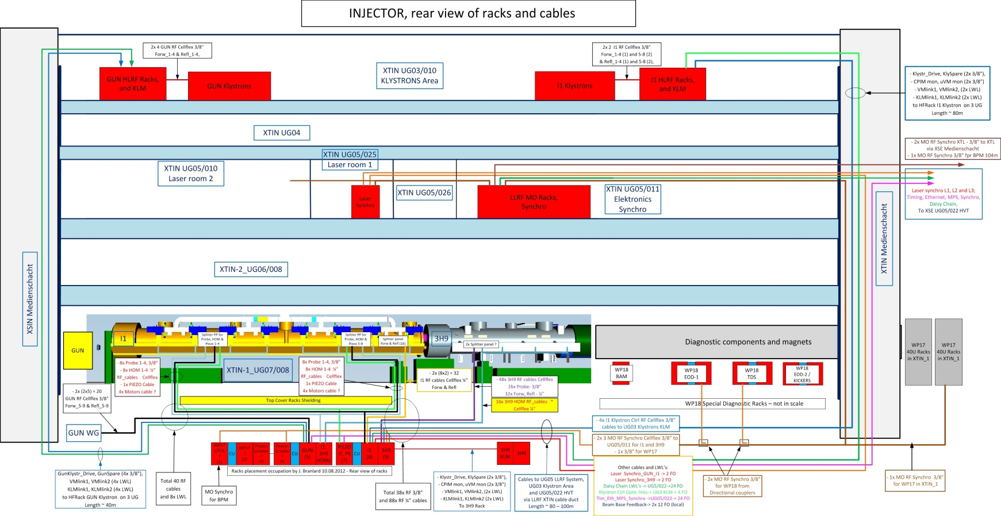
External RF cabling in XFEL Injector
RF cables selected – Cellflex ½”and ¼“, temperature cycled (preheated)
Cables trays (placeholders) implemented in 3D model, collisions checked and cleared.
~250 connections in Injector.
Cabling lists ready, implementation in KDS in progress.
Notes:
Before you start editing the slides of your talk change to the Master Slide view: Menu button “View”, Master, Slide Master:
Edit the following 2 items in the 1st slide: 1) 1st row in the violet header: Delete the existent text and write the title of your talk into this text field 2) The 2 rows in the footer area: Delete the text and write the information regarding your talk (same as on the Title Slide) into this text field.
If you want to use more partner logos position them left beside the DESY logo in the footer area Close Master View

Slide 10
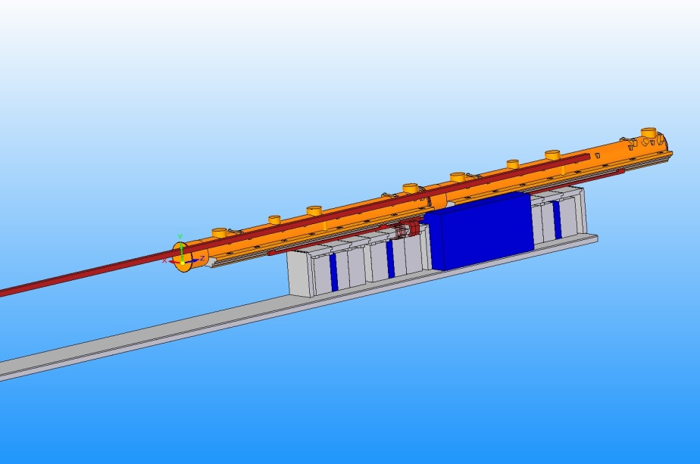
External RF cabling in XFEL tunnel
RF cables selected – Cellflex ½” (Probe) and ¼“ (FWD, REF, HOM’s), temperature cycled (preheated).
Cables trays (placeholders) implemented in 3D model, collisions checked and cleared.
~120 connections in one RF Station.
Cabling lists ready, implementation in KDS has started.
Notes:
Before you start editing the slides of your talk change to the Master Slide view: Menu button “View”, Master, Slide Master:
Edit the following 2 items in the 1st slide: 1) 1st row in the violet header: Delete the existent text and write the title of your talk into this text field 2) The 2 rows in the footer area: Delete the text and write the information regarding your talk (same as on the Title Slide) into this text field.
If you want to use more partner logos position them left beside the DESY logo in the footer area Close Master View

Slide 11
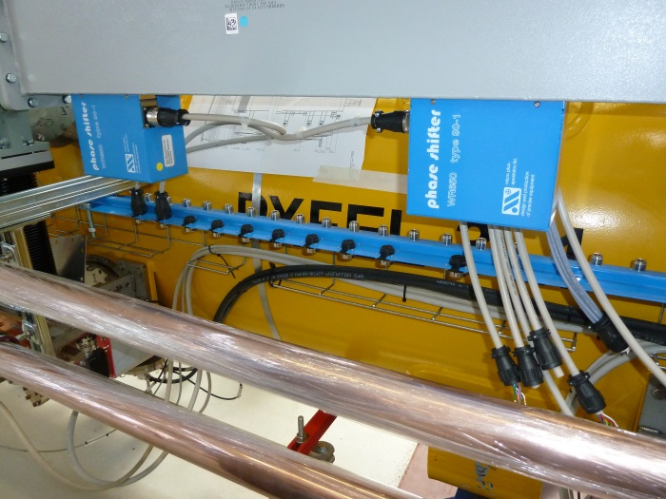
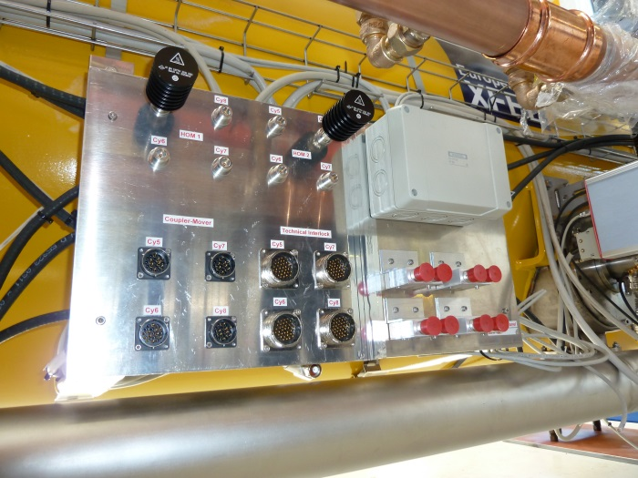
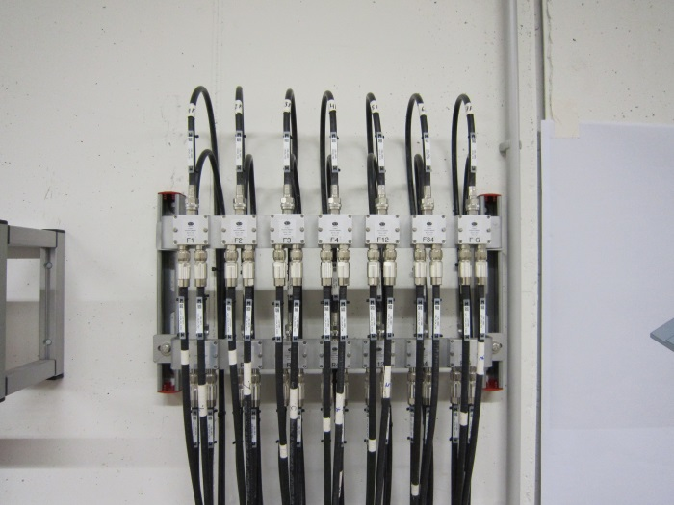
Patch panels, splitters
Design of patch panels for accelerating module are ready and prototypes have been installed on preproduction modules.
Splitter panels for Gun LLRF systems installed on UG07.
Splitter panels for I1 and L1 redundant LLRF systems are ready to install.
MECA firm, on our request, redesign splitters to achieve better phase versus temperature stability.
Notes:
Before you start editing the slides of your talk change to the Master Slide view: Menu button “View”, Master, Slide Master:
Edit the following 2 items in the 1st slide: 1) 1st row in the violet header: Delete the existent text and write the title of your talk into this text field 2) The 2 rows in the footer area: Delete the text and write the information regarding your talk (same as on the Title Slide) into this text field.
If you want to use more partner logos position them left beside the DESY logo in the footer area Close Master View

Slide 12
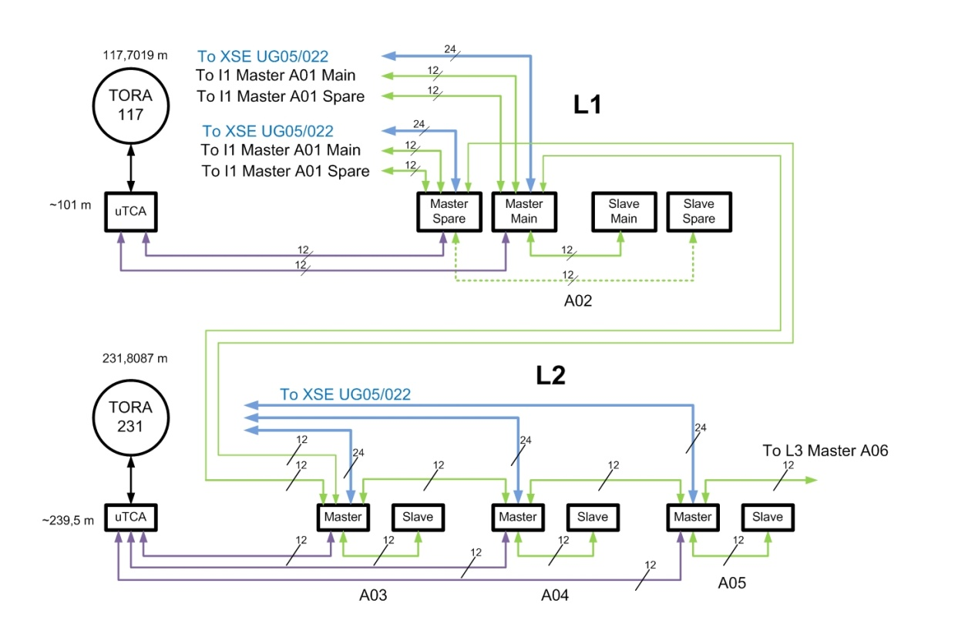
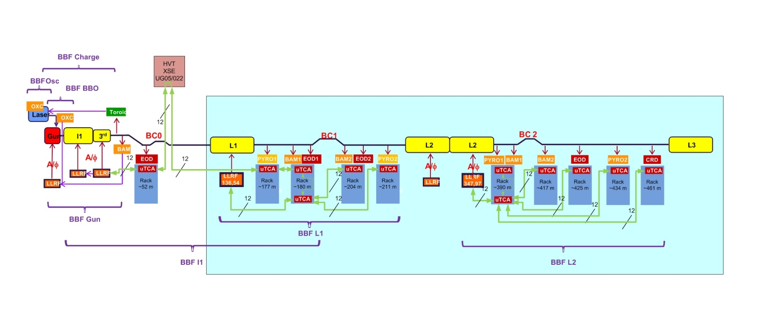
FO cabling
Master and Slave part of LLRF System connected with 12 fibers FO cable.
Neighboring stations connected with 12 fibers FO cable for Central Energy Management and feedbacks.
Signals from Toroids are distributed via FO links.
Beam Based Feedbacks use Direct Fiber Optic connections with low latency.
FO cabling lists ready and checked.
FO pipes installed in XTL.
Ready to blow in FO cables.
Notes:
Before you start editing the slides of your talk change to the Master Slide view: Menu button “View”, Master, Slide Master:
Edit the following 2 items in the 1st slide: 1) 1st row in the violet header: Delete the existent text and write the title of your talk into this text field 2) The 2 rows in the footer area: Delete the text and write the information regarding your talk (same as on the Title Slide) into this text field.
If you want to use more partner logos position them left beside the DESY logo in the footer area Close Master View

Slide 13
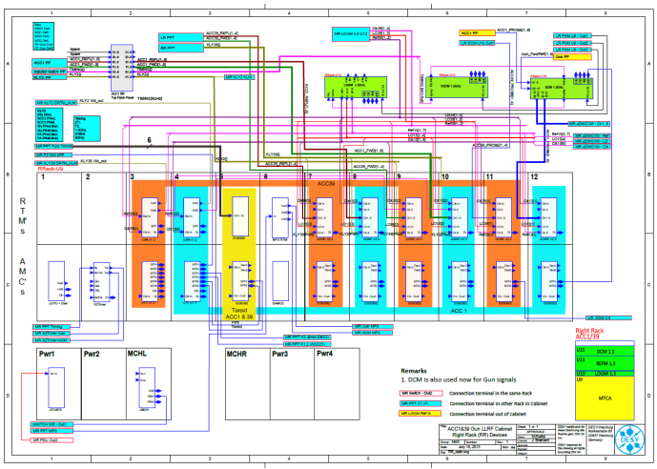
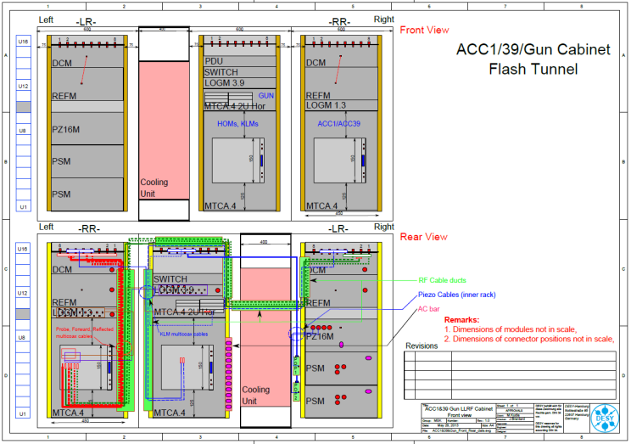
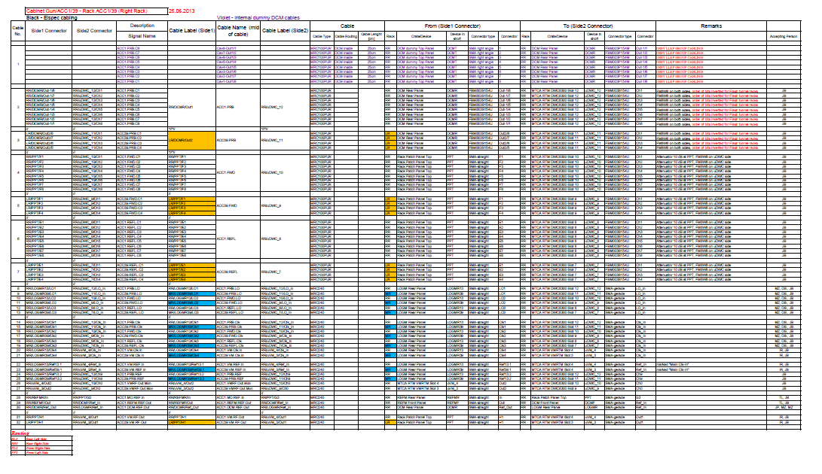
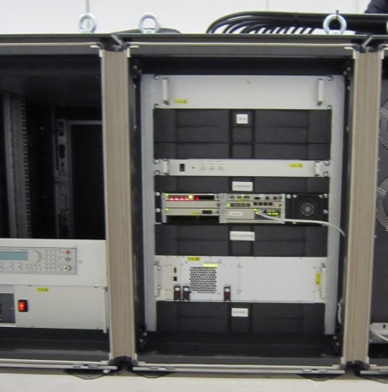
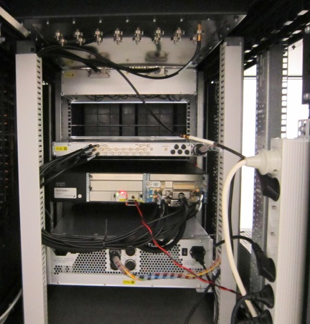
Inner rack cabling
Documentation schemes for:
Between racks cabling diagrams
Rack occupation
Inner rack cabling diagrams
Cable lists (towards work orders)
ready.
The implementation in KDS will start soon.
Inner racks cabling design for XFEL tested at FLASH (KDS documentation done).
First inner rack XFEL LLRF system cabling made for RF Gun commissioning.
Notes:
Before you start editing the slides of your talk change to the Master Slide view: Menu button “View”, Master, Slide Master:
Edit the following 2 items in the 1st slide: 1) 1st row in the violet header: Delete the existent text and write the title of your talk into this text field 2) The 2 rows in the footer area: Delete the text and write the information regarding your talk (same as on the Title Slide) into this text field.
If you want to use more partner logos position them left beside the DESY logo in the footer area Close Master View

Slide 14
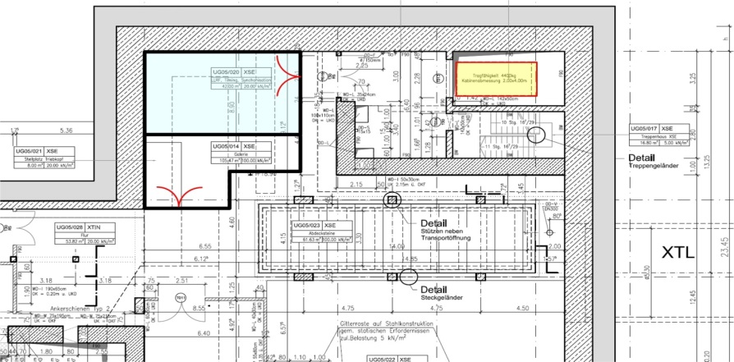
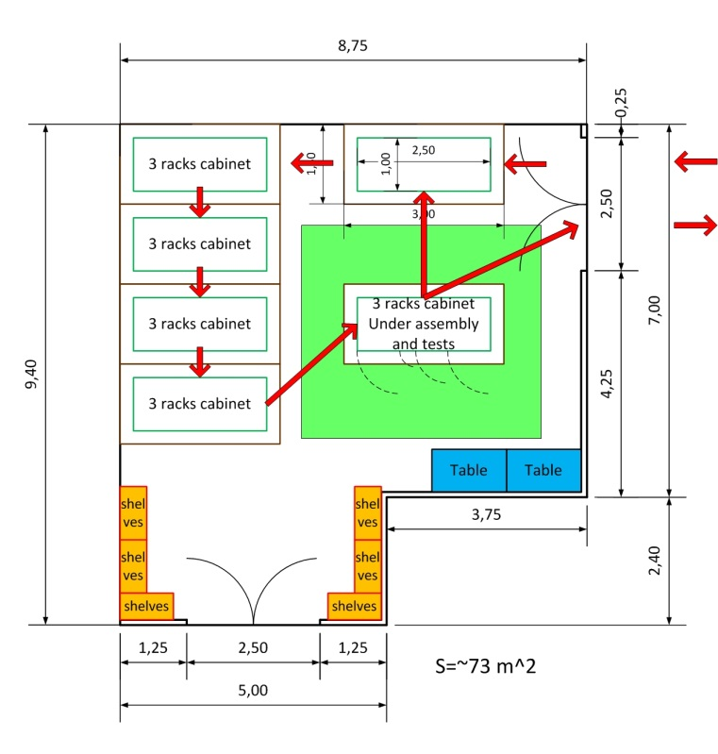
Racks assembly and test facility
Cabinets population:
Transport of cabinet from storage place (Reemtsma Hall, Halle West) to XSE/UG05 with XSE lift,
Assembly and test cabinet,
Inner room circulation,
Transport of cabinet from XSE/UG05 to XTL.
Space requirements:
The buffer storage space have to hold at least 6 cabinets,
The assembly and test space should have at least 18 m² (4.5 m x 4 m), 73 m² requested
LLRF should share space with other WP’s.
Notes:
Before you start editing the slides of your talk change to the Master Slide view: Menu button “View”, Master, Slide Master:
Edit the following 2 items in the 1st slide: 1) 1st row in the violet header: Delete the existent text and write the title of your talk into this text field 2) The 2 rows in the footer area: Delete the text and write the information regarding your talk (same as on the Title Slide) into this text field.
If you want to use more partner logos position them left beside the DESY logo in the footer area Close Master View

Slide 15
Summary
3D model – OK,
Racks in Injector – ready to install,
Racks in XTL – ordered, first set of 5 will come end of November 2013,
Radiation shielding in Injector – design will be ready end of November 2013, ready to install May 2014,
RF and FO cabling (external and inner rack), patch and splitter panels – designs, cables trays, cabling lists ready, implementation in KDS in progress,
Racks assembly and test facility designed, room adaptation works ordered.
Notes:
Before you start editing the slides of your talk change to the Master Slide view: Menu button “View”, Master, Slide Master:
Edit the following 2 items in the 1st slide: 1) 1st row in the violet header: Delete the existent text and write the title of your talk into this text field 2) The 2 rows in the footer area: Delete the text and write the information regarding your talk (same as on the Title Slide) into this text field.
If you want to use more partner logos position them left beside the DESY logo in the footer area Close Master View

