Slide 1
Procurement Readiness Review WP02 - LLRF
Coupler Processing Interlock Module
Notes:
How to edit the title slide
Upper area: Title of your talk, max. 2 rows of the defined size (55 pt)
Lower area (subtitle): Conference/meeting/workshop, location, date, your name and affiliation, max. 4 rows of the defined size (32 pt)
Change the partner logos or add others in the last row.

Slide 2
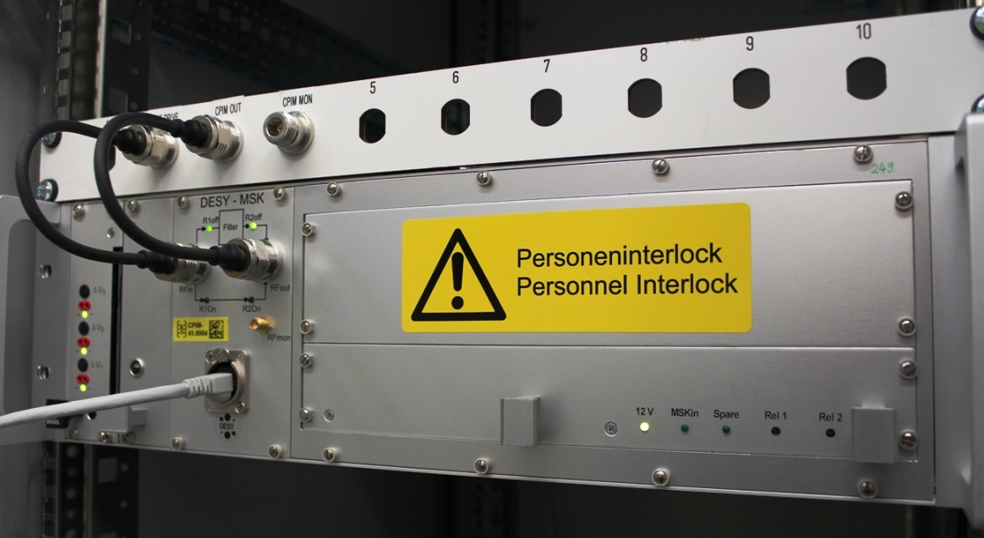
PURPOSE
Prevent from generating a field inside cavities when the cryomodule is warm
Used as part of the personnel interlock system, to allow tunnel access during warm coupler conditioning

Slide 3
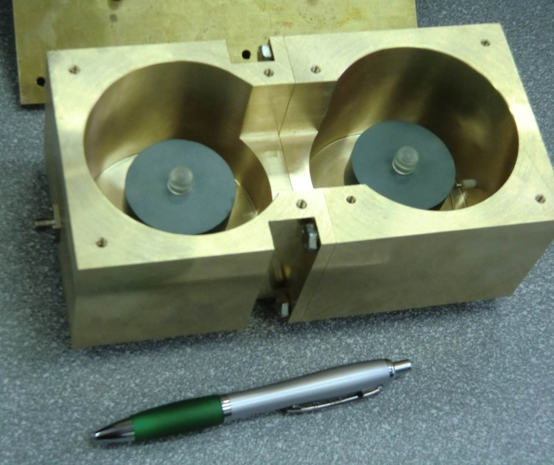
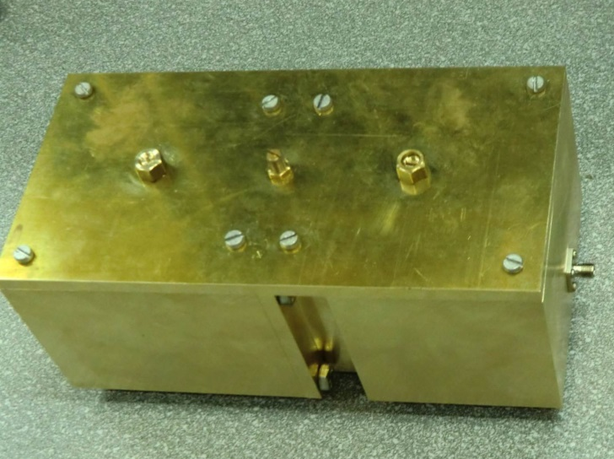
PROTOTYPE

Slide 4
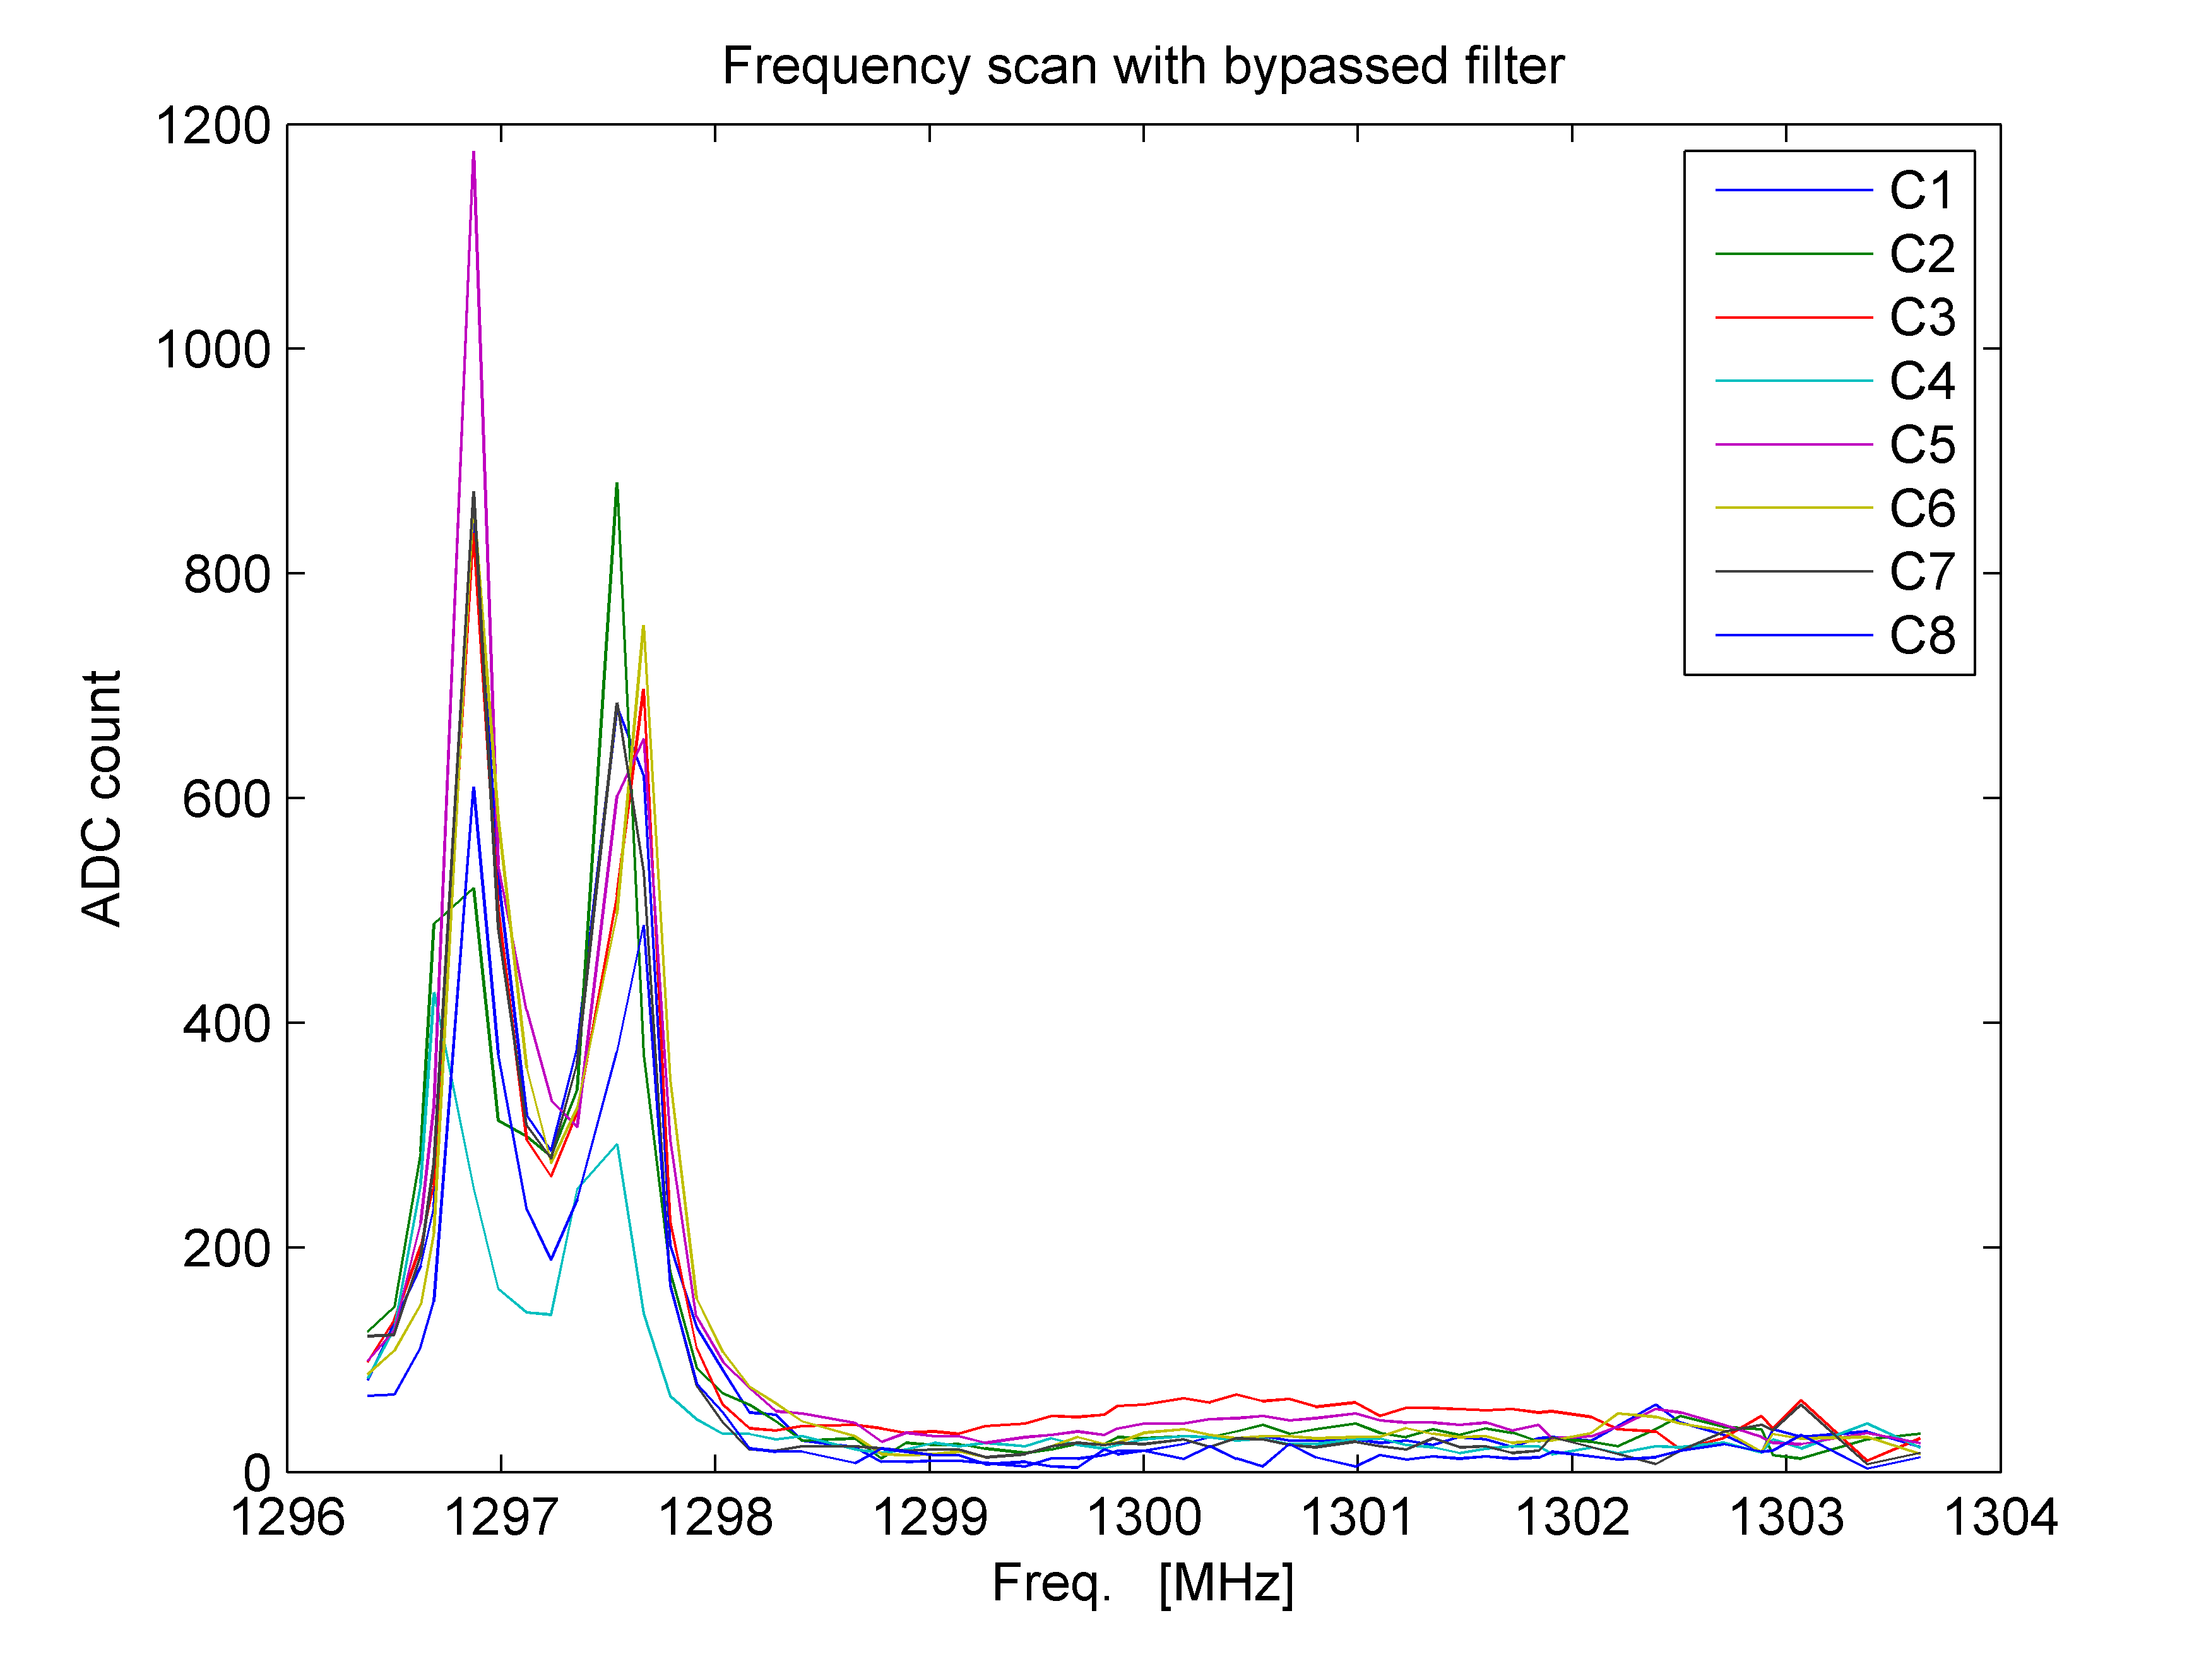
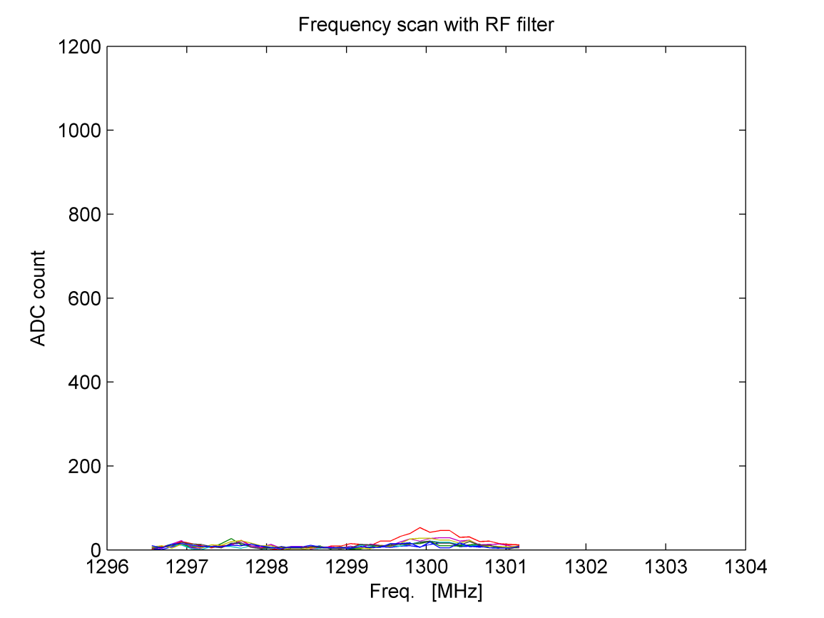
PROTOTYPE VALIDATION
Prototype testing at CMTB (Spring 2012)
8π/9
π

Slide 5
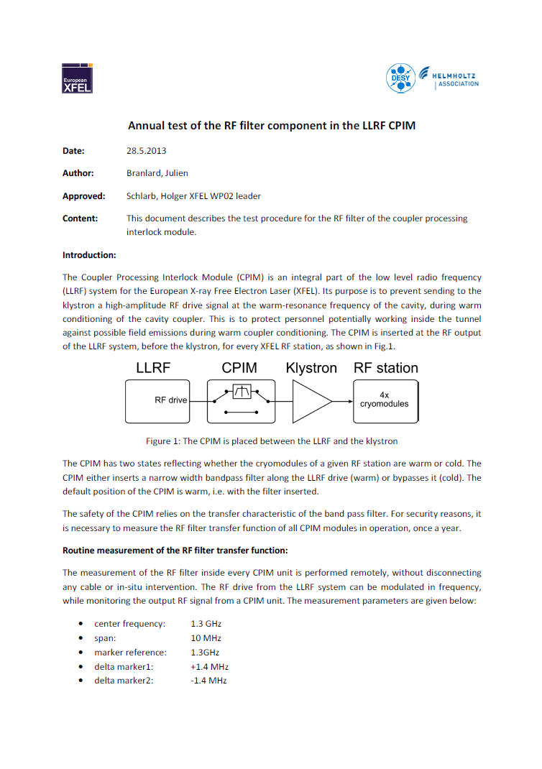
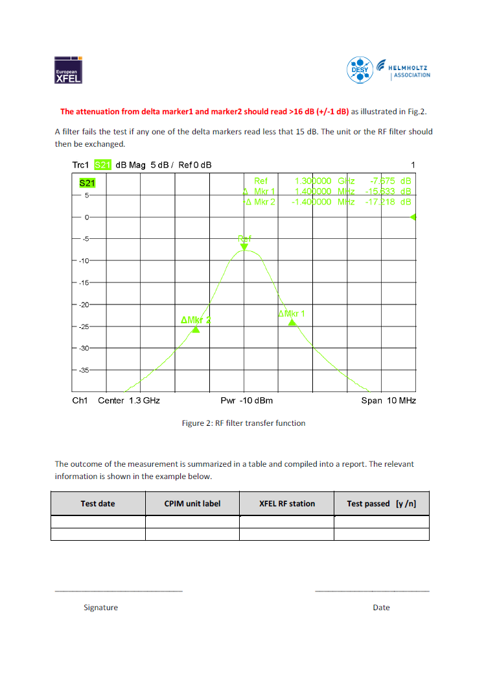
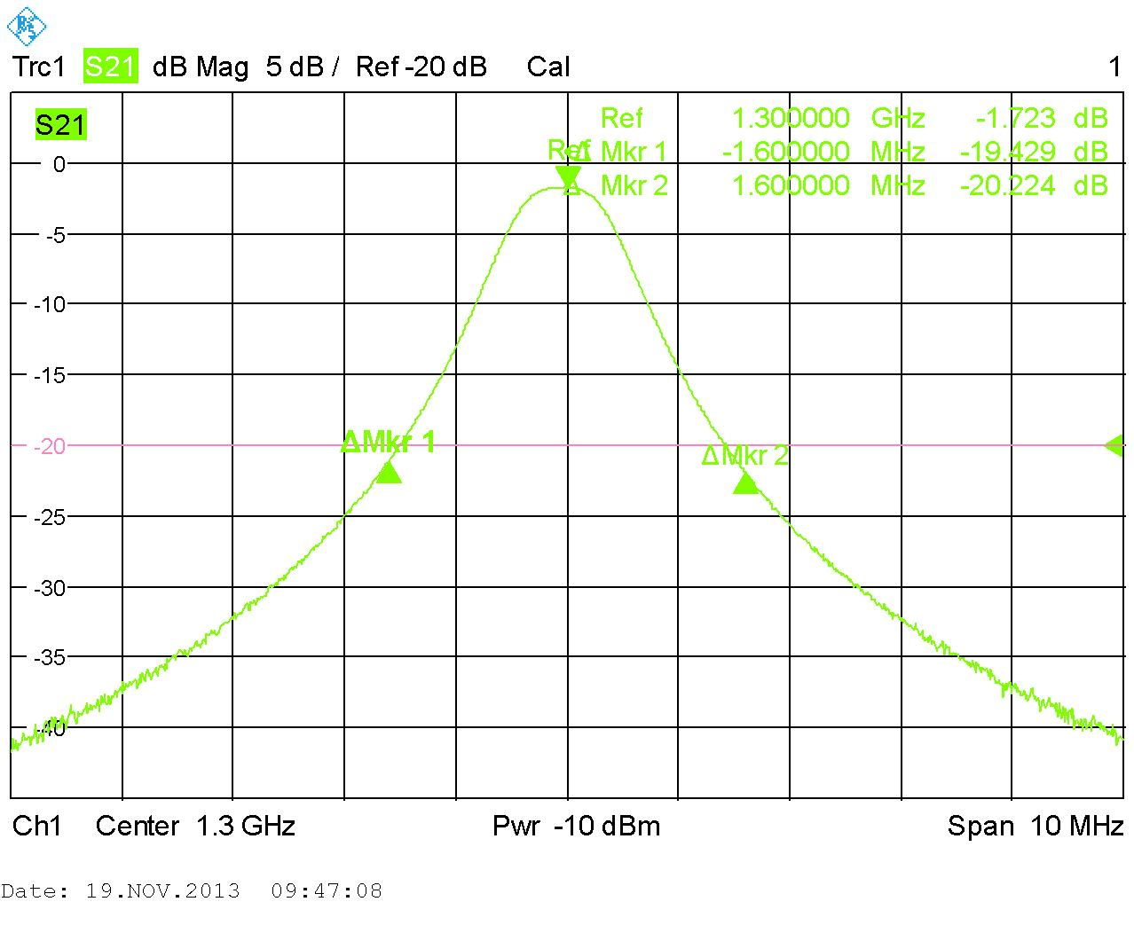
PRODUCTION for XFEL
TUEV approval (CMTB & AMTF)
Yearly checks (aging control)

Slide 6
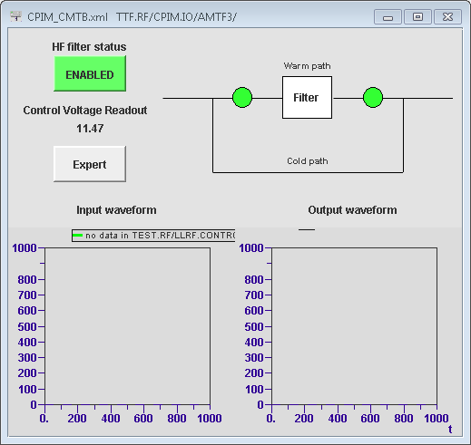
CONTROL
By default, the CPIM always has the filter inserted (power failure or control failure)
WP02 is responsible for changing CPIM mode
Module warm → filter inserted
Module cold → filter bypassed
Personnel interlock includes CPIM mode read out
Switching CPIM mode remotely done through DOOCS

