Slide 1
Data recording, management and access
Krzysztof Wrona, WP76
3rd Collaboration Meeting of the European XFEL
April 8th, 2014, Hamburg

Slide 2
Outline
  Data recording architecture & prototype
  How users can access data
  Data format
  Data calibration process
  IT infrastructure (storage, computing, etc)
  Data export service

Slide 3
Initially known data recording requirements
Support for different operation modes
  Continuous data taking mode vs. experiments requiring complex setup and feedback loops
High data rates
  Up to 10GB/s from a single 1Mpxl detector
  Multiple data sources
Real time/immediate processing
  veto, data monitoring, formatting, compression, dedicated algorithms
Fast feedback
  Data inspection using dedicated user algorithms and tools
Data storing
  Data caching, long term storage and archiving

Slide 4
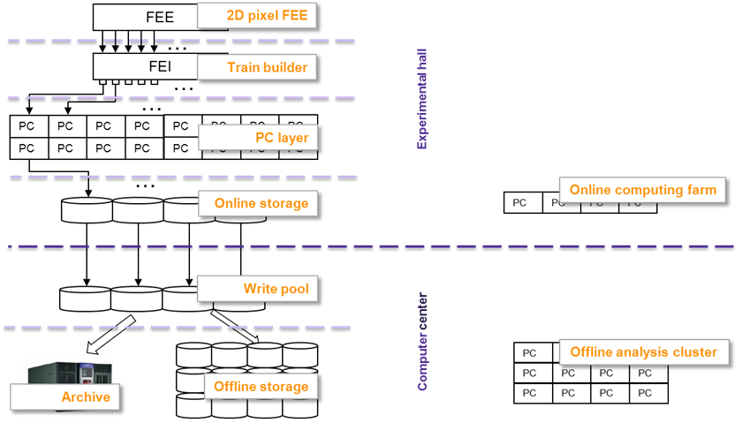
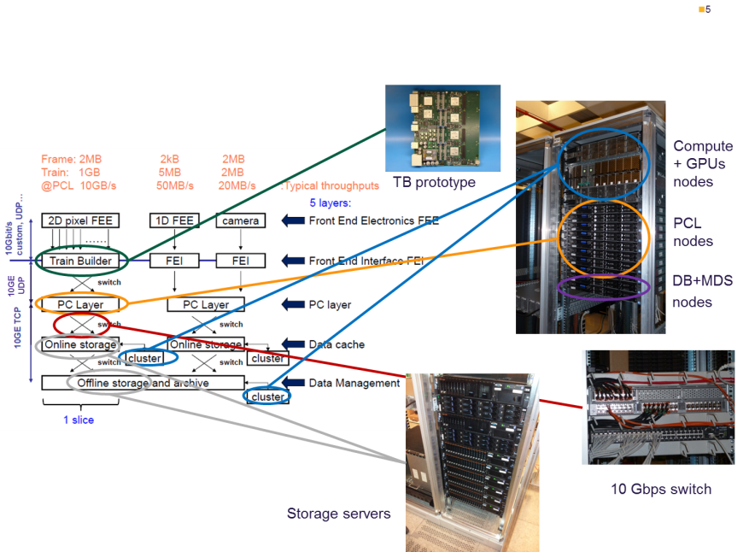
DAQ and DM overview
Layered architecture focusing on scalability and flexibility
Allows for data processing on each layer
Addresses issue of simultaneous reliable data recording and fast user access
Offline data analysis at the facility
Architecture
Demonstrated sufficient performance of DAQ chain for ½ Mpxl detector from train builder to online data storage using prototype system
Easily scalable to 1Mpxl – requires more hardware
16 streams per 1Mpx det., 1GB/s per data stream
Final acceptance tests when detectors are available
Prototype

Slide 5
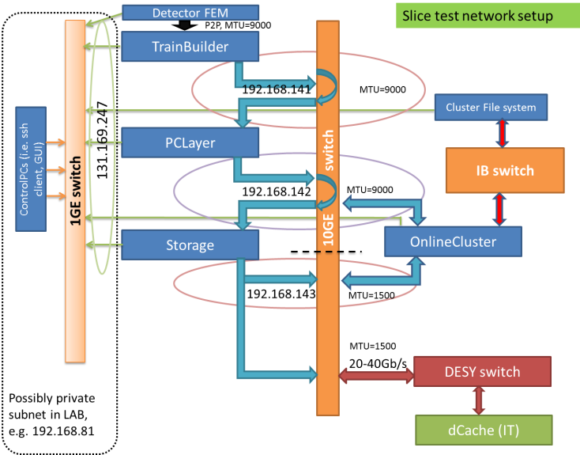
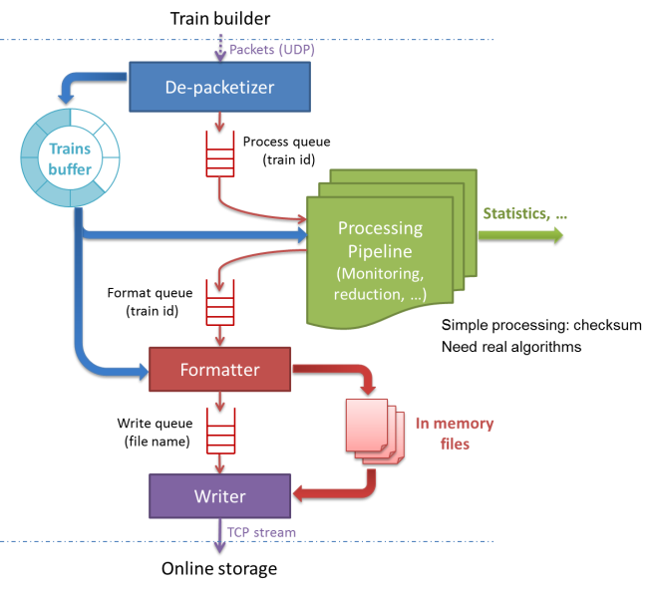
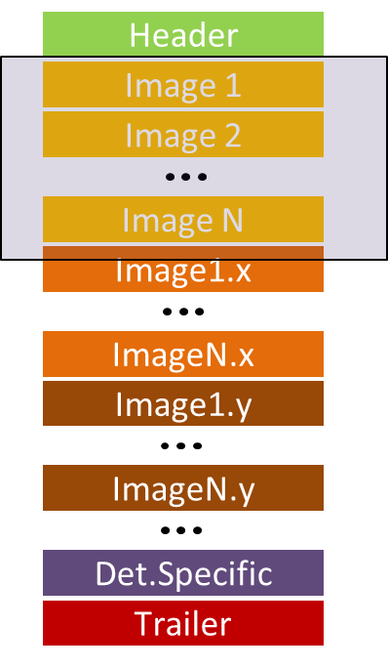
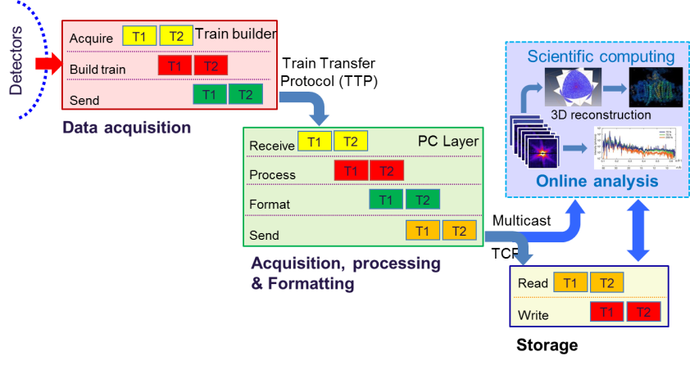
Prototype
What has been done?
  Hardware selection, configuration, installation and advanced tuning of OS, network and kernel parameters
  Design and implementation of the network
  Pure UDP and TCP tests focused on data throughput, bit error rate assessment and long term (days) stabilities
  Definition and implementation of Train Transfer Protocol (TTP) for exchanging data between train builder and PC layer
  Definition of Train Data Format for 2D detectors
  Development of dedicated Karabo based applications (devices) for emulating train builder (i.e. multichannel data sending, timing), data readout, framework for real time data monitoring and processing, data formatting to HDF5, data sending using tcp, data storing
  Performance and stability tests of the developed applications
  Data transfer to the dCache system in CC
Network setup
Data flow in DAQ
PC layer software
Data Format

Slide 6
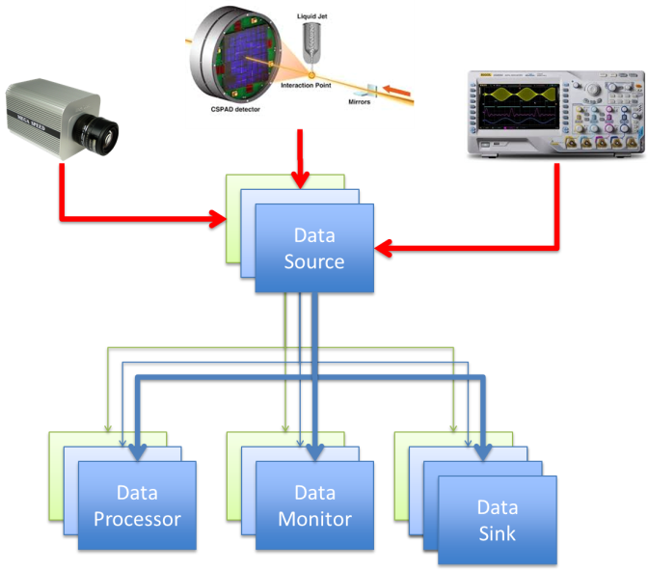
Generic data sink
Generalization of PC layer
  PC layer need to understand data format from all different data sources, not only 2D detectors
  Data format description language – formalism that allows generic tools to correctly understand the binary data content
  Provide API for encoding binary data at the data sources (tool for device developers) and decoding at data sinks
  Aggregation of data from different sources ( i.e. 2D camera, digitizer, beam position monitor)
The prove of concept has been demonstrated
  Currently starting implementation of selected concrete data sources
    2D detectors, digitizers, commercial camera
  Release data description specification and API after selected use cases are implemented and tested (expected end of Q2/2014)

Slide 7
User data access
What, when, where and how?
  What: Raw data (complete or subset), calibrated data, monitor data (aka. slow), metadata
  When: Immediate, online, offline
  Where: Directly at the experiment, in the facility server, in the desktop computer, outside of the facility
  How: From data stream, from data buffer in memory, from file, sequentially, randomly, iteratively, using facility provided tool/library, using any user tool
It is not possible to provide solution for all possible combinations
  Different requirements and constraints, i.e.:
    real time access to the raw data requires very efficient data consumer and distributed computing
    Iterative access requires appropriate size buffer to store the data

Slide 8
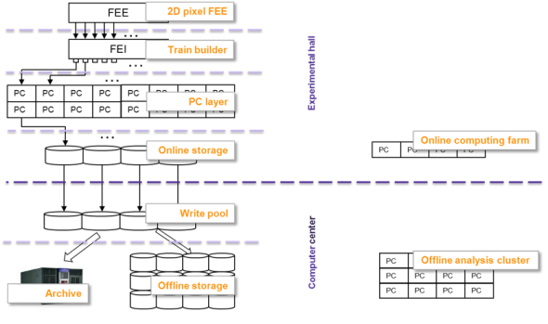
Fast feedback
Immediate access (~2 sec)
  During the data acquisition instrument or “experiment class” dedicated algorithms can be plugged to the real time data stream
    Compliant with Karabo and usage of PC layer API
    Provided or approved by beam line scientists, well tested
    Providing sufficient performance, i.e. to process 1GB/s
    No iterative algorithms, each stream processed separately
    Useful for extending data monitoring, data reduction
    Note: This algorithm can be run later in the online or offline mode at the facility
Framework is implemented – user input (concrete use cases) is required

Slide 9

Fast feedback
Online (~seconds)
  Data is sent from PC layer to the online cluster for fast feedback
    Data visualization (e.g. images, histograms, trend lines)
    Selected data streams ( e.g. all data from one stream)
    All streams for limited time (e.g. 100 000 images)
    Selected data (e.g. first image from each train)
  Data access
    Data can be pre-processed using karabo (i.e. calibration pipeline) and then passed to the user module (karabo device) or stored on disk and later accessed by user tool (i.e. python script)
    Karabo scientific computing devices or external tools
      Not all user tools will be supported
      Certain standard non-Karabo tools may be preinstalled
      Python usage is encouraged, python API to provide access to data will be supported
      Karabo or standard tools will have usually better performance and can benefit from distributed computing
Currently extending prototype by online computing farm with cluster file system

Slide 10
  Data format in files
Big question: How to organize data in file?
  Main DAQ requirements:
    Uniquely identify each data source
    Sufficient data writing speed for small and big datasets (images vs. scalar values)
    Reliability, no data corruption
    Avoid both small (~MBs) and huge (>100s GB) files
  Main User requirements
    Easily understandable structure (i.e. no cryptic names)
    Easy navigation and correlation between datasets (i.e. for a given image show me what is the beam position)
    Sufficient read performance (?)
    Partial and direct access to data (i.e. when interested in beam position read only this dataset without a need to read the whole file or list of files)
    Portability (access from python, Matlab, IDL,…)
    Must be able to export complete datasets required for analysis (i.e. all needed data in a file, no need to access 3 different databases)

Slide 11
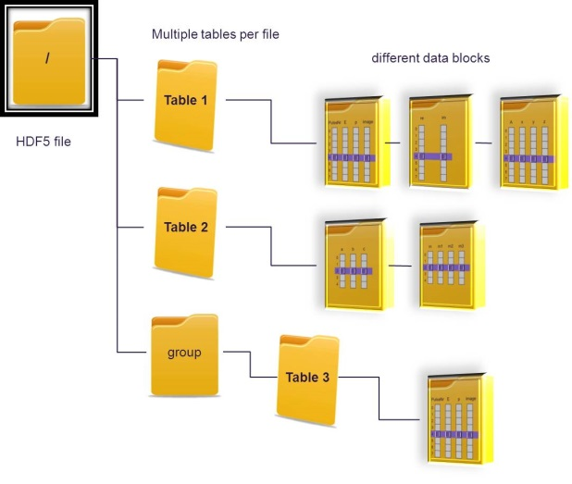
  HDF5 Data format
HDF5 is chosen as a container to store experiment data
  Structure of HDF5 file resembles the file system view with HDF5 groups and datasets corresponding to folders and files
Data within HDF5 file is organized according to the data source
  For example:
  /facility/XFEL/SPB/…
  /instrument/LPD/LPD1/data/image
  /instrument/LPD/LPD1/descriptors/trainId
  /instrument/LPD/LPD1/descriptors/pulseId
  /instrument/LPD/LPD1/descriptors/cellId
  /monitor/BPM/BPM1/data/x
  /monitor/BPM/BPM1/data/y
  …
  Provide different views to the datasets (this is not yet solved, ideas exist)
  From the user point of view the original structure is not always the best
  Different grouping, not interested in all datasets stored (i.e. detector expert vs. beamline scientist vs. end user)
Data stored as records of simple values - portability
  Easier navigation through files
Discussion with LCLS, Flash and CFEL ongoing

Slide 12
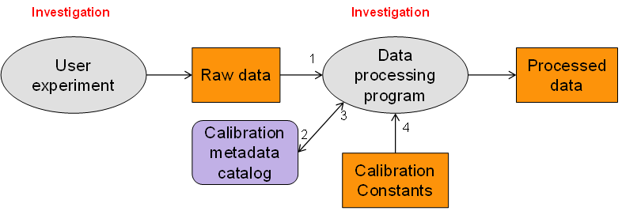
Data Calibration
  Calibration of 2D detectors is very complex task and requires expert knowledge, dedicated measurements in the lab, experiments on the beam and data analysis
  Calibration may need to be repeated and is CPU intensive process
  Result of expert analysis is stored in archive
    Calibration constants in HDF5 files (can be 100s of GB per detector)
    Metadata in database
Usage of the calibration constants:
  In the facility:
    Applied on the fly when processing data
    Requires access to the calibration database and constants
    Dedicated Karabo calibration pipeline (WP75, detector consortia)
  Outside of the facility
    Export only calibrated data
Currently developing database services needed for calibration

Slide 13
Offline data access & processing
Different storage classes
  Archive – tapes
  Raw data – commodity storage, cheap, distributed over many storage nodes, initially ~10PB, access through parallel NFS (pNFS)
  Scratch space – cluster file system, ~1-2PB, used for hot data, no backup, fast access
  Space for user data, i.e. 5TB per beamtime, backup
Offline Computing
  1000 CPU cores per 1PB is foreseen
Currently defining resources for the CC infrastructure with DESY-IT

Slide 14
Data export
Raw data will be calibrated before exporting
Raw data can be optionally reorganized/transformed before exporting
Data transfer services
  i.e. GlobusOnline or similar tool
Efficient data transfer over WAN requires enough bandwidth between two sites
  Currently ~100MB/s is achievable between large computer centers. Dedicated lines can be setup between two points but require advanced planning and extra founding
Exporting huge amount of data will be a problem – pre-processing and data reduction at the facility may be the only option for some experiment

Slide 15
Summary
Development and testing of the data recording prototype. Complex task but no show stoppers. Further tests required.
Data format – working on the API for accessing data on PC layer, HDF5 is chosen as a container for experiment data, discussion with LCLS, FLASH and CFEL
Extending slice test prototype to include online cluster for fast user feedback – ongoing
Definition of resources for the CC infrastructure in progress

