Slide 1
Commissioning of
Standard Electron Beam Diagnostics
D. Nölle, MDI, DESY Hamburg
For the WP-17 Team
Notes:
How to edit the title slide
Upper area: Title of your talk, max. 2 rows of the defined size (55 pt)
Lower area (subtitle): Conference/meeting/workshop, location, date,
your name and affiliation, max. 4 rows of the defined size (32 pt)
Change the partner logos or add others in the last row.

Slide 2
Outline
General Remarks
  Commissioning Steps
  System and Device Numbers
  Prerequisites
More detailed View
  BPM
  Screens
Summary
  Time needed for basic and advanced Commissioning

Slide 3
Commissioning of
Standard Electron Beam Diagnostics
Goal:
  Do Machine Commissioning with Diagnostics
AND NOT
  Do Diagnostics Commissioning with the Beam
Nevertheless
  It is an iterative process
  Start with poor performance, but be able to see and to improve the beam
  See signals and optimize the parameters to improve the performance of the diagnostics.
  Get both working: Beam and Diagnostics.
Therefore
  Technical Commissioning: Prepare devices, check and test interfaces and communication prior to beam operation.
  Basic Commissioning: Diagnostic guys have to join the first shifts, and support until beam operation is established.
  Advanced Commissioning: Use dedicated beam time to bring the systems to good performance.

Slide 4
Systems and component numbers in XFEL
System | Subsystem | Gun | Injektor [XTIN] | XTL | XTDs
BPM System | Button | 1 | 16 | 180 | 111
~ 480 | BPME |  |  |  | 101
 | BPMF/I |  | 3 | 19 | 5
 | BPMR |  | 1 | 30
 | Button Array |  |  | 3
 | HOM |  | 2
Charge | FCUP | 3
~ 50 | DCM | 1 | 1 | 8
 | Toroid | 1 | 3 | 16 | 15
Screens | Simple | 3
~ 75 | OTR_ABCL |  | 7 | 26 | 16
 | OTR_DE |  | 1 | 4 | 5
 | OTRS |  |  | 3
 | Beam Size Dump |  |  | 1 | 2
Wire Scanners |  |  |  | 6 | 6
12
Loss Monitors | BLM | 1 | 18 | 100 | 192
~ 320 | BHM |  | 1 | 1 | 2

Slide 5
Technical Commissioning
Needs to be done before beam commissioning
  Checking measuring cables, connections -> WP-17
    All BPM cables need to be measured! (1-2 weeks/section, only 1 team)
    Check BLMs with source
    Calibrate toroids with external pulser.
    See pictures from all calibration targets of the screens
    …
  Testing devices from tunnel to BKR -> WP-17, WP-28, (WP-02)
    All interface cabling done and tested
    Working µTCA Infrastructure
    DOOCS ( incl. Servers), Timing, and MPS systems available
    216 MHz Ref line for cavity BPMs available
    Time Estimate: Hard to say! pessimistic estimate for total time:
      1 µTCA/day -> 30 days
      2 MBU/day -> 70 days

Slide 6
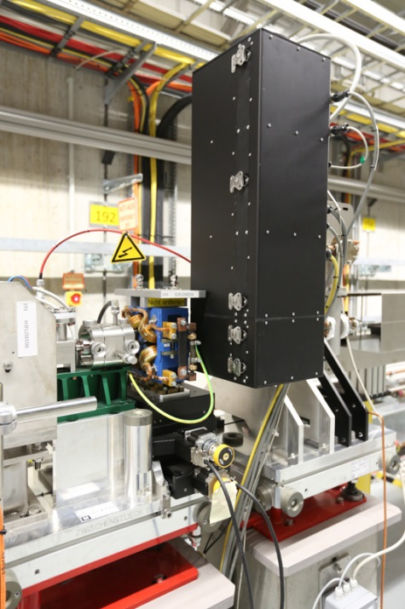
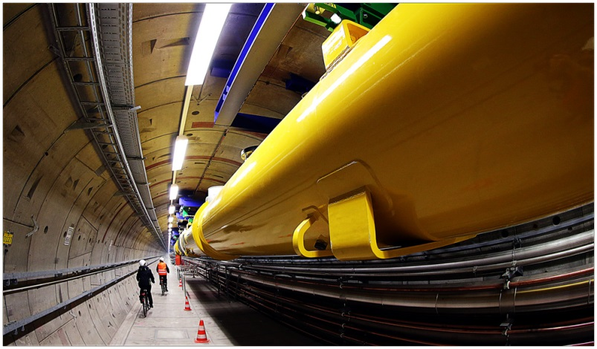
Start of Beam Commissioning
Ongoing Work: FLASH and FLASH II
  Test BPMs at FLASH
  Commissioning of 17 cavity BPMs at FLASH II
  Commissioning of 60 “XFEL” BLMs at FLASH II
Summer 2014: XFEL Gun
  3 BPMs, 1 Toroid, 1 DCM, 3 Screens and Faraday Cups
  Real environment in the XTIN
Spring 2015: XFEL Injector
  Almost all systems are installed in the injector, except wire-scanner, and some special BPMs and Screens.
  Injector will provide all XFEL beam properties except energy.
  1 year for commissioning and debugging of the main diagnostic systems
  Procedure development for a more effective commissioning of the main linac.
  This will reduce the time needed to get the diagnostics into operation for the main LINAC
Summer 2016: XFEL
  Quite some number of different devices.

Slide 7
„Requirement Matrix“
Diagnostic System |  | Section |  |  |  | Supporting Systems (must be available) |  |  |  |  | Required for/during
System | Subsystem | Gun | Injector [XTIN] | XTL | XTDs | Timing | Device Server | Motor Controls | 216 MHz | MPS | First Beam | Few bunches | Full Performance
BPM System | Button | x | x | x | x | x | x |  |  |  | x | x | x
 | BPME |  |  |  | x | x | x |  | x |  | x | x | x
 | BPMF/I |  | x | x | x | x | x |  | x | x |  | x | x
 | BPMR |  |  | x |  | x | x |  | x |  | x | x | x
 | Button Array |  |  | x |  | x | x |  |  |  | x | x | x
 | HOM |  | x | x |  | x | x |  | x |  |  | x | x
Charge | FCUP | x |  |  |  | x | x | X |  |  | x
 | DCM | x | x | x |  | x | x |  |  |  |  |  | x
 | Toroid | x | x | x | x | x | x |  |  |  | x | x | x
 | TPS | x | x | x | x | x | x |  |  | x |  |  | x
Sceens | Simple | x |  |  |  |  |  | X |  | x | x
 | OTR_ABCL |  | x | x | x | x | x | X |  | x | x | x
 | OTR_DE |  | x | x | x | x | x | X |  | x | x | x
 | OTRS |  |  | x |  | x | x | X |  | x |  | x
 | Beam Size Dump |  |  | x | x | x | x |  |  |  |  |  | x
Wire Scanners |  |  |  | x | x | x | x | X |  | x |  |  | x
Loss Monitors | BLM | x | x | x | x | x | x |  |  | x | x | x | x
 | BHM |  | x | x | x | x | x |  |  | x |  |  | x
 | Dosimeters | x | x | x | x |  | x |  |  | x |  |  | x

Slide 8
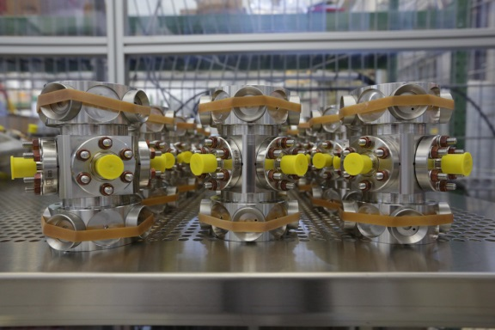
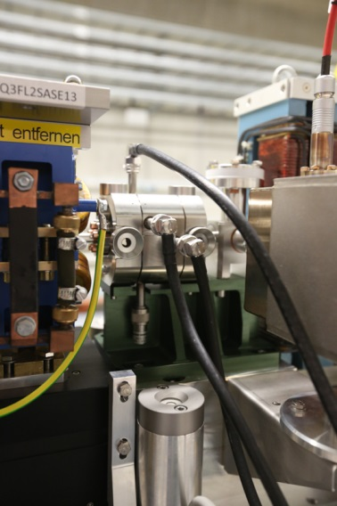
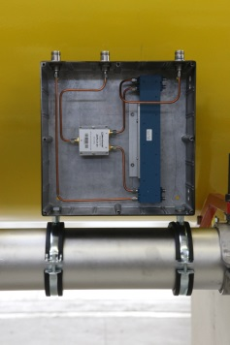
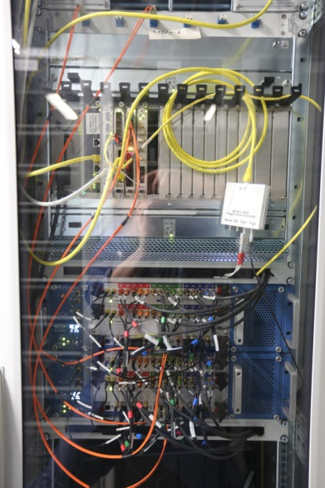
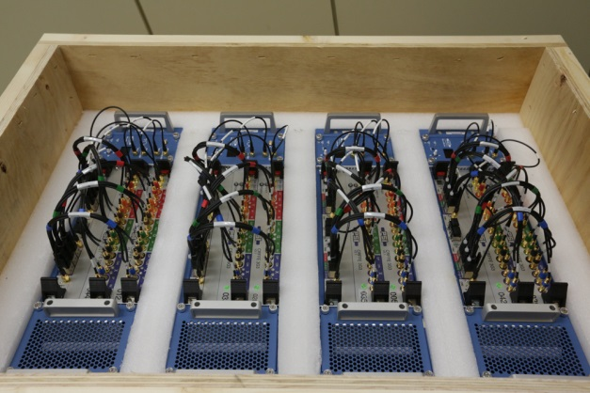
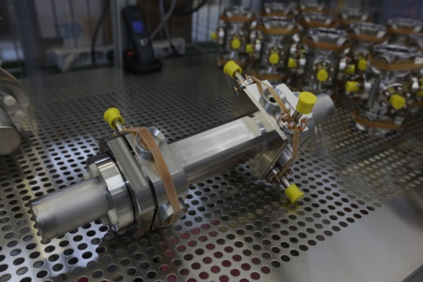
More detailed View:
BPM System
3 types of BPMs
  Button BPM for different beam pipe diameter
  Cavity BPM for 2 beam pipe diameters
  Reentrant Cavity BPM 30% of cold LINAC
Readout
  MBU (Modular BPM Unit)
    4 Button BPMs
    2 (Reentrant) Cavity BPMs,
    Cavity + 2 Buttons
  Connection to DOOCS via a FPGA-FPGA Bridge with optical fibers. Up to 4 MBU connect to 1 DAMC02 interface board.
  Timing: Decoding XFEL timing protocol (via fiber) in the MBU
  Ref. Frequency (Cavity only) 216 MHz

Slide 9
More detailed View:
Technical Commissioning BPMs
Technical commissioning in the tunnel (w/o Beam)
  Server, Timing, Ref. Line tested and working (except for cable work)
Button BPM
  Cable -> 4 RF measurements/BPM (Atten., Phase diff,,…) (Tunnel 10 BPMs/Day), 300 BPM)
  MBU -> Pre-calibrated Units (automated calibration in the lab with O(100) constants)
  Doocs ->Check Data Exchange with BPM, Store all Parameters (BKR)
  Timing-> Check connection and Data Exchange. (BKR)
Cavity BPM
  Pickup -> RF parameters -> Parameters into MBU (3 x Sensitivities) (Lab)
  Cable ->Measure Attenuation -> Parameter into MBU ( 3x Atten., Tunnel 5 days/undulator)
  MBU -> Pre-calibrated Units (automated calibration in the lab with O(100) constants)
  Doocs -> Check Data Exchange with BPM, Store all Parameters (BKR)
  Timing -> Check connection and Data Exchange. (BKR)
  216 MHz -> Check connection and Level (BKR)

Slide 10
More detailed View:
Commissioning BPMs for First Beam
Basic Beam commissioning
  Server, Timing, 216 MHz tested and working, basic orbit correction tools
Button BPM
  First beam reaches BPM ( 1 shift/main LINAC or warm sections 20 BPM/Shift)
    Determine and set trigger delay for each MBU
    Get offset (and charge) to about 20% with lab values
    Check sign with steerer (possible cable permutations)
    Proceed through the section
    Do a final check of signs using a single steerer and the orbit correction tool
    done
Cavity BPM ( 3-4 h/undulator)
  First beam reaches BPM
    Determine and set trigger delay for each MBU
    Get charge and offset amplitude to about 20% with lab values
    Try to get offset amplitude smaller -> determine the sign of the offset from steerer
    Proceed like this though undulator
    Do a final check of signs using a single steerer and the orbit correction tool
    done

Slide 11
More detailed View:
Advanced Commissioning BPMs
Advanced Beam commissioning
  Server, Timing, Ref. line tested and working, orbit correction tool, optics model
Button BPM
  For each plane and some charges and energies ( 0,5 h/ Step/Section)
    Use a single steerer and check orbit response by BPMs with optics tool box
    Calculate and Update MBU parameters
Cavity BPM
  For each plane and some charges and energies (1h/ Step/SASE undulator)
    Absolute Calibration of 1 BPM/undulator
    Use a single steerer plus optics tool to transfer the calibration to the following BPMs
    Calculate and Update MBU parameters
  Beam Based alignment not included.
  Beam based optimization of gain switching not included

Slide 12
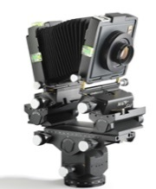
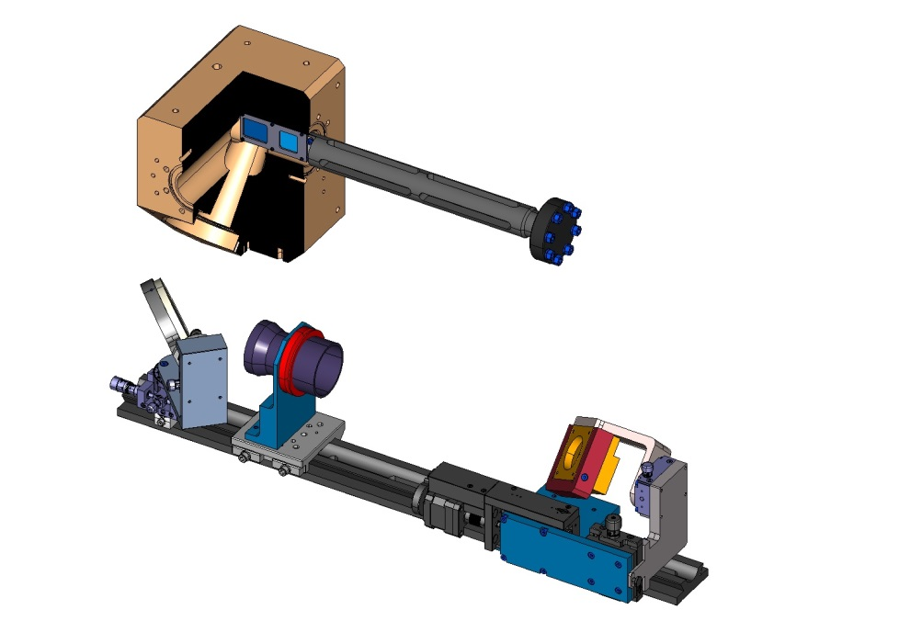
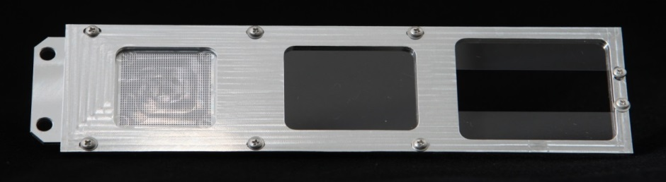
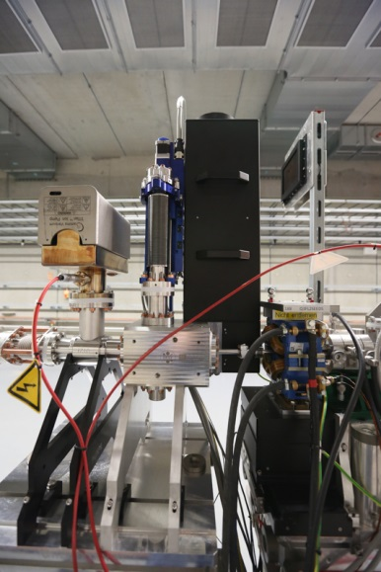
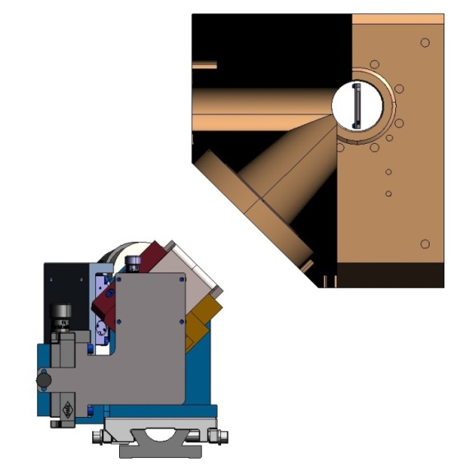
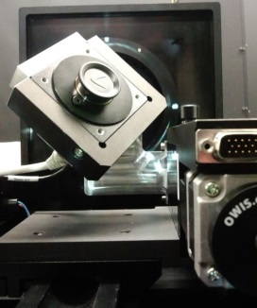
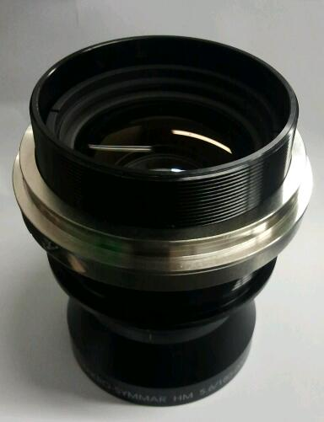
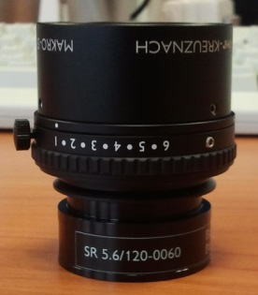
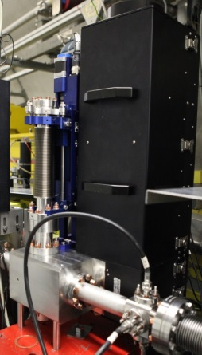

More detailed View: Screens
Optics Design Record On-Axis and Off-Axis Profiles
BEAM
Dot Grid Target(spot Ø .50mm)
200µm thick LYSO Screen (ON-Axis)
Optical Axis
1 or 2 half 200µm thick LYSO Screens (OFF-Axis)
Readout and Timing:
DOOCS, nearby µTCA System
Camera on a moving stage for focussing.
BEAM
45°
Observation
Optics Axis
Basler Aviator avA2300-25gm
2330 x 1750 pix, 5.5 µm
Monochrome, GigE
f = 180mm for 1:1
f = 120mm for 1:2
Large Area Photo Macro Lenses
from Schneider Kreuznach
BEAM
Test Setup at FLASH

Slide 13

More detailed View:
Screens
Technical Commissioning in the tunnel (0.5–1 day/station)
  Screen system with optics installed, connection to µTCA and timing available.
  Check if the (right) screen moves, limit switches and MPS contacts are correct (at the site and in the control panels)
  Define measurement positions on (different) screens
  Check camera power and illumination (switchable)
  Switch to triggered mode and check readout
  Take a picture from the calibration screen and check the calibration, do some refocussing if required.
  Take the next one

Slide 14
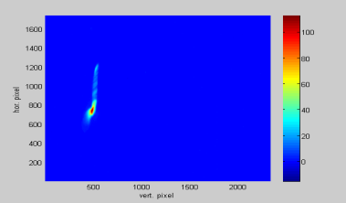
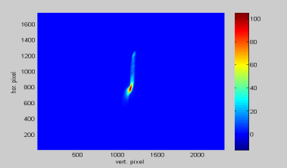
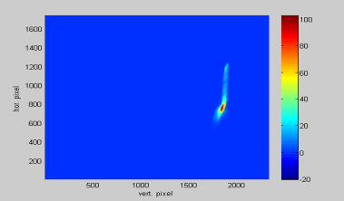
More detailed View:
Screens
Top
center
bottom
500pCOben.tif Gain330noBeam.tif
500pCMitte.tif Gain330noBeam.tif
500pCUnten.tif Gain330noBeam.tif
First beam (single bunch only)
  If technical commissioning was done well
    Find a nice picture immediately
  If not
    Move in calibration target and switch on illumination
    If you see a picture move back to screen and switch to free running mode
      Find a picture
    Else ask the operator
      If the beam should really be there
      to switch to the next screen
      or ask for temporary access

Slide 15
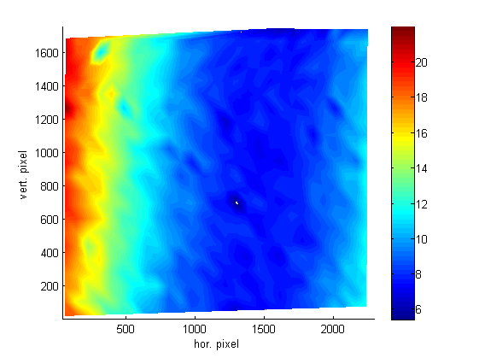
More detailed View:
Screens
System Resolution vs. Screen Position
Fine tuning of the systems
  Gain (as a function of charge)
  Exposure time
  Trigger delay
  In order to improve data rate, set region of interest.
  Check and correct calibration in ROI

Slide 16
Summary I: Time for basic commission during first beam operation
Diagnostic System |  | Section Effort [h] |  |  |  | Detekt Beam | Aid "Fädeln" | Basic Operation | Callibration to 20% Level | Advanced callibration and optimisation | Beam Based Alignment
System | Subsystem | Gun | Injektor [XTIN] | XTL | XTDs
BPM System | Button | 2 | 3 | 16 | 8 | x | x | x | x | 0 | 0
 | BPME |  |  |  | 16 | x | x | x | x | 0 | 0
 | BPMF/I * |  | 1 | 4 | 6
 | BPMR |  | 1 | 6 |  | x | x | x | x | 0 | 0
 | Button Array |  |  | 5 |  | x | x | x | 0 | 0 | 0
 | HOM * |  | 2 | 4 |  | x | x | x
Charge | FCUP | 1 |  |  |  | x |  | x | x | 0
 | DCM | 1 | 1 | 2 |  | x | x | x | x | 0
 | Toroid | 1 | 1,5 | 4 | 2 | x | x | x | x | 0
 | TPS | 0 | 0 | 0 | 0
Sceens | Simple | 3 |  |  |  | x |  | x | x | 0
 | OTR_ABCL |  | 3 | 9 | 3 | x | x | x | x | 0
 | OTR_DE |  | 1 | 3 | 2 | x | x | x | x | 0
 | OTRS |  |  | 2 |  | x | x |  |  | 0 | 0
 | Beam Size Dump |  |  | 0 | 0
Wire Scanners |  |  |  | 0 | 0
Loss Monitors | BLM | 1 | 2 | 8 | 16 | x | x | x | x | 0
 | BHM |  | 0 | 0 | 0 |  |  |  |  | 0
 | Dosimeters | 0 | 0 | 0 | 6 |  |  | x | x | 0
Sum | 146,5 | 9 | 15,5 | 63 | 59

Slide 17
Summary II:
Advanced Commissioning; dedicated beamtime
Diagnostic System |  | Duration per item [h] | Section time for full commission work (exclusive) [h] |  |  |  | Per-formance require-ment | Charge Variation | Orbit Variation | Required for/during |  | Advanced calibration and optimization | Beam Based Align-ment
System | Subsystem |  | Gun | Injektor [XTIN] | XTL | XTDs | long trains all reprates | full range jitter < 1 % | jitter < 0.5 sigma | Few bunches | Full Performance |  | needs special effort
BPM System | Button | 0,3 | 1 | 4,8 | 54 | 33,3 | partially | yes | yes | x | x | x | 0
 | BPME | 0,5 |  |  |  | 50 | partially | yes | yes | x | x | x | 0
 | BPMF/I | 1 |  | 3 | 19 | 5 | partially | yes | yes | x | x | x | 0
 | BPMR | 0,3 |  | 1 | 9,6 |  | partially | yes | yes | x | x | x | 0
 | Button Array | 4 |  |  | 12 |  | partially | yes | yes | x | x | x | 0
 | HOM | 4 |  | 8 |  |  | partially | yes | yes | x | x | x
Charge | FCUP | 0,5 | 1,5 |  |  |  |  | yes |  | x | x | x
 | DCM | 0,5 | 0,5 | 0,5 | 4 |  |  | yes |  | x | x | x
 | Toroid | 0,3 | 0,3 | 0,9 | 4,8 | 4,5 | partially | yes |  | x | x | x
 | TPS | x | 0 | 8 | 12 | 12 | yes | yes |  |  | x | x
Sceens | Simple | 0,5 | 1,5 |  |  |  | Single | yes | yes |  |  | x
 | OTR_ABCL | 1 |  | 7 | 26 | 16 | Single | yes | yes | x |  | x
 | OTR_DE | 1 |  | 1 | 4 | 5 | Single | yes | yes | x |  | x
 | OTRS | 2,5 |  |  | 7,5 |  | Single | yes | yes | x |  | x
 | Beam Size Dump | 4 |  |  | 4 | 8 |  | yes | yes |  | x
Wire Scanners |  | 4 |  |  | 24 | 24 | yes* | yes |  |  | x | x
Loss Monitors | BLM | 0,2 | 1 | 3,6 | 20 | 38,4 | yes | yes | yes | x | x | x
 | BHM | 2 |  | 2 | 2 | 4 | yes | yes | yes |  | x | x
 | Dosimeters | x | 0 | 16 | 16 | 32 |  |  |  |  | x | x
Sum | 512,7 |  | 5,8 | 55,8 | 218,9 | 232,2 | .

Slide 18
Clip board – copy and paste
Headline
first level
  second level
    third level
Headline
Text Text
Text Text
1. Keyword
2. Keyword
Keyword
Keyword
Keyword
Result Headline
Text
Text
Result Headline
Text
Text
Result Headline
Text
Text
Notes:
Copy & paste an element from the Clip Board to the particular slide:
1. Click on a box to mark it.
2. Position the mouse pointer on the box frame: Copy!
3. Click on the particular slide: Paste!
How you intend to use the elements is your choice.
You can combine the text block style with the background colour in different manner.
Insert a new slide: Home > “New Slide” and choose either "Title slide", "Title and content",
"Title only", or "No title and content". Default is "Title and content".

