Slide 1


Grounding in XHEXP1
H.Kapitza (DESY-FLA)
XFEL Collaboration Meeting
DESY, April 8, 2014
Notes:
How to edit the title slide
Upper area: Title of your talk, max. 2 rows of the defined size (55 pt)
Lower area (subtitle): Conference/meeting/workshop, location, date,
your name and affiliation,
max. 4 rows of the defined size (32 pt)
Change the partner logos or add others in the last row.

Slide 2
Purposes of Grounding
There are three reasons for grounding a facility:
protection against lightning strike
protection against electrical shock or spark-ignited fire
protection against malfunctioning of electrical equipment
Correspondingly one distinguishes
lightning protection
safety grounding
signal grounding
The priorities are totally clear, as stated by H. W. Ott:
“First make it safe and then make it work properly without compromising the safety.”

Slide 3
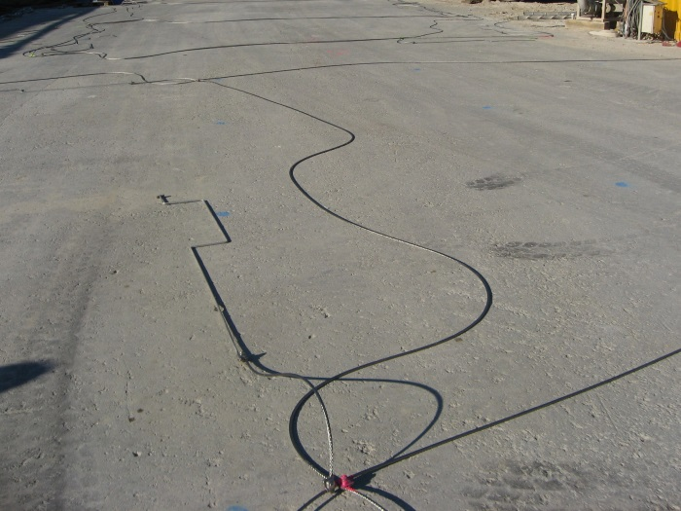
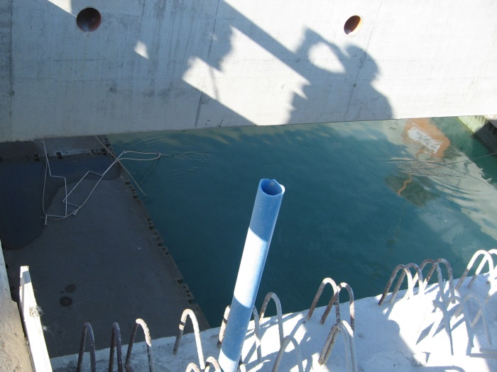
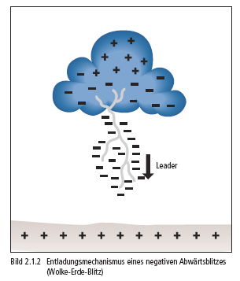
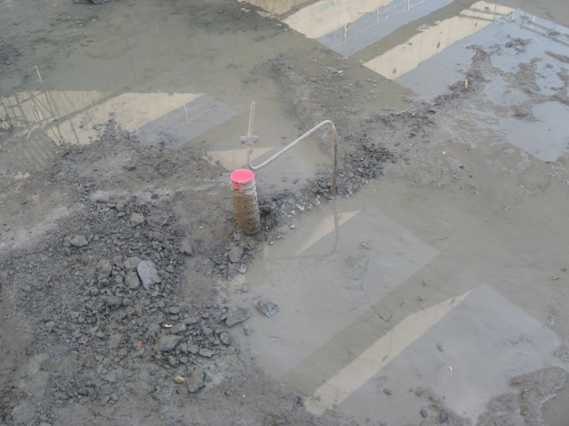
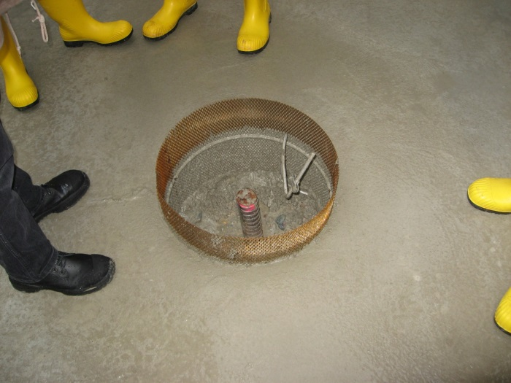
Lightning Protection
This is the only grounding purpose for which a good contact of the grounding system with the earth is essential (earth-termination grid). The lightning current dissipates in the earth and compensates
the charge induced there
by the thundercloud.

Slide 4
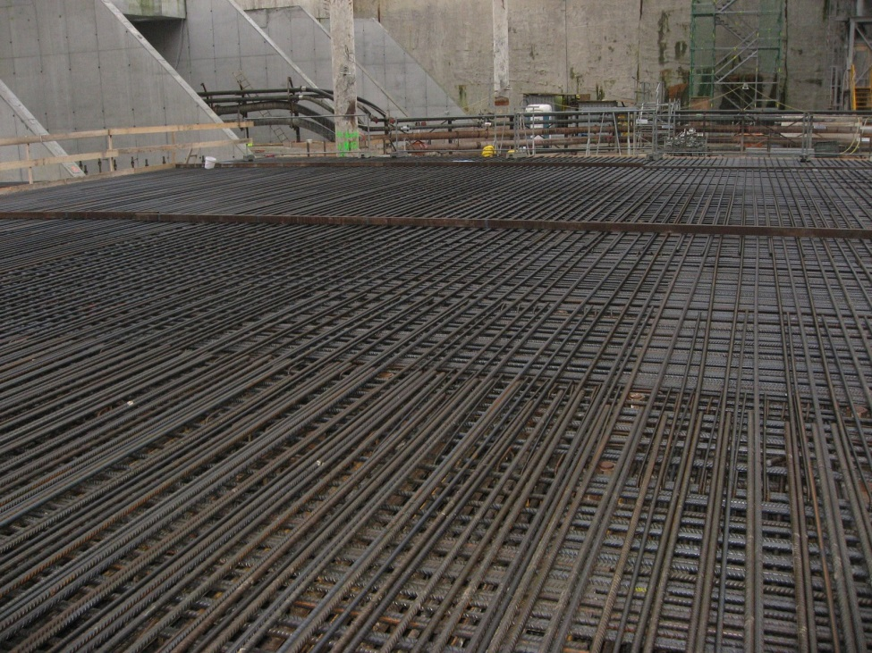
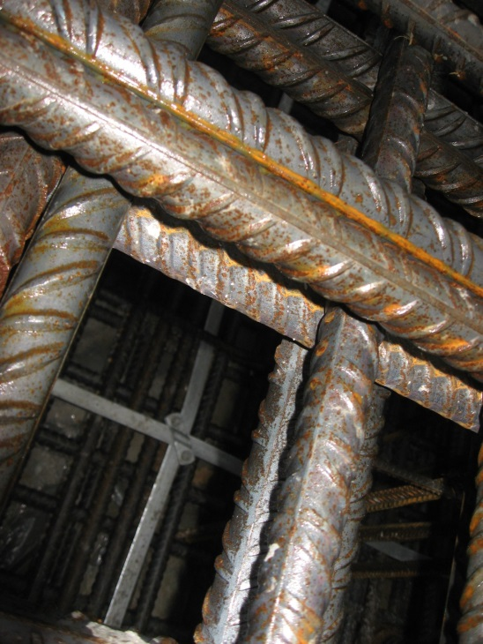
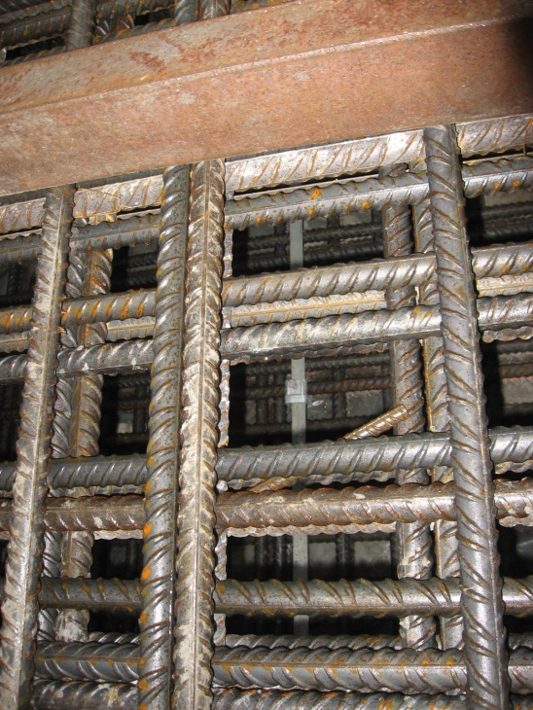
Foundation Grounding
There are thousands of tons of steel in the XHEXP1 floor plate, but to a large extent only loosely connected (gerödelt).
The guaranteed foundation grounding grid has 5 x 5 m meshes of steel band St/tZn 30 x 3.5 mm. It is connected to the earth-termination grid.
At distances ≤ 10 m there are vertical steel bands in the hall walls. They finally connect to the air-termination system on top of XHQ.

Slide 5
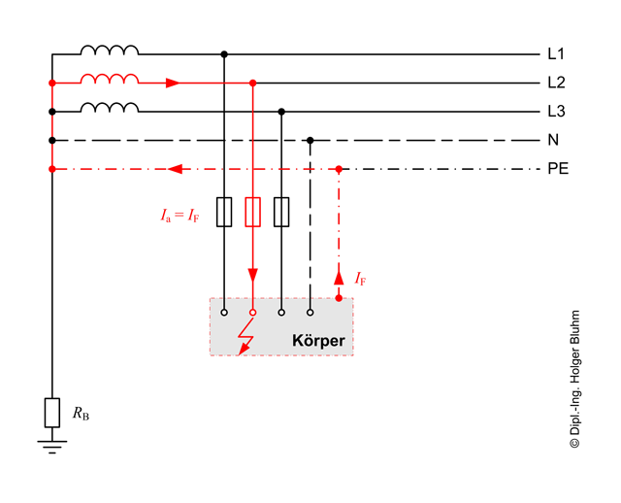
Safety Grounding
Through the protective earth (PE) conductor safety grounding is fully integrated in the low voltage supply system (400 V 3-phase AC).
At the XFEL we have a TN-S system with separate N and PE conductors for operating and fault current return, respectively. They only meet at the transformer earthing point.
For a fuse to reliably blow in case of a short to cabinet, the most important property of the PE conductor is a low impedance.
In addition, all accessible metallic parts of an installation must be conductively connected: equipotential bonding (Potentialausgleich). This prevents dangerously high touch voltages (by voltage division on L and PE) before the circuit is interrupted.

Slide 6
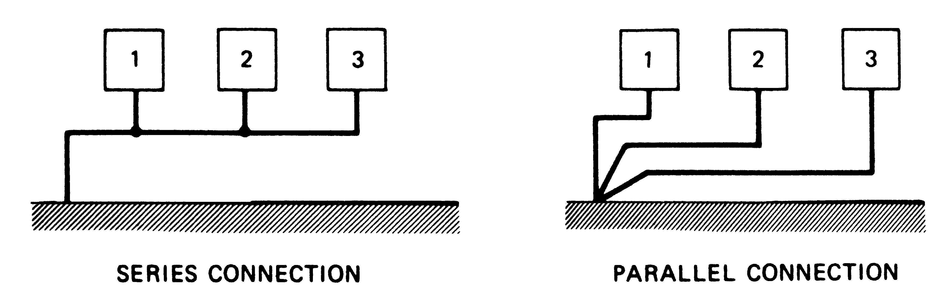
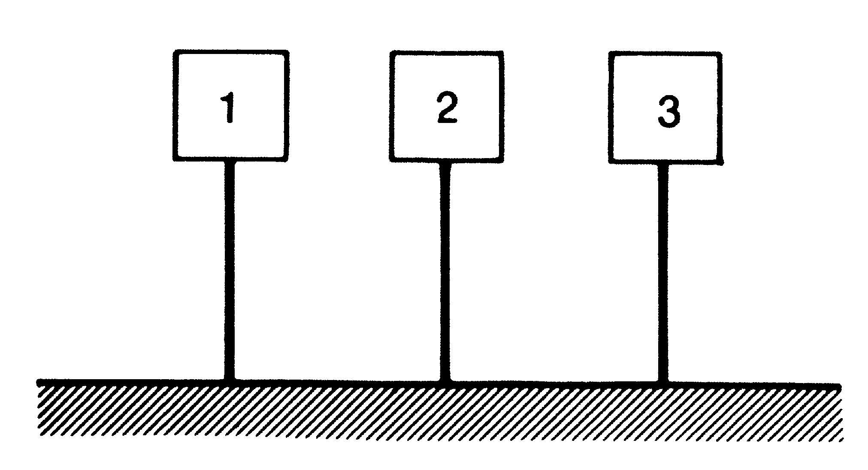
Signal Grounding
Signal grounding becomes an issue if – intentionally or not – operating currents are sent through the grounding system. Some reasons:
  coaxial cable shields grounded on both ends (return current division)
  inductive coupling into ground loops (common mode current source)
  capacitive coupling to ground (lower impedance return path)
In this context ground is a facility-wide shared electrode for returning currents to their sources. On a shared electrode current mixing will occur, thus causing EMI.
Handles against EMI are low impedance (→ low noise voltages from common impedance coupling) and topology:
Each line represents the total supply of a box: electricity, water, cooling...
l < λ/20
w < λ/50 if mesh
GROUND PLANE
Large grounding systems are structured hierarchically, internally each box may in turn have one of the three basic topologies.

Slide 7
Grounding Concepts for the SASE1 Area
On the floor plate of XHEXP1 there will be a 6 cm thick cement layer (Estrich).
Separate for each SASE area there will be a grounding grid a few cm deep inside the Estrich.
This grounding grid is made of point-welded reinforcement steel mats (15 cm mesh size) which in turn are connected every 2 m.
To which grounding hierarchy level should the Estrich grid belong?
Pipes & ducts
Hutch 1
Cable tray
Hutch 2
Hutch 1
Cable tray
Hutch 2
Racks
Racks
Racks
Racks
Estrich grid
Floor plate grid
SASE1 infrastructure on intermediate level, single-point connected to hall ground plane
SASE1 infrastructure on hall ground level, being part of the hall ground plane

Slide 8
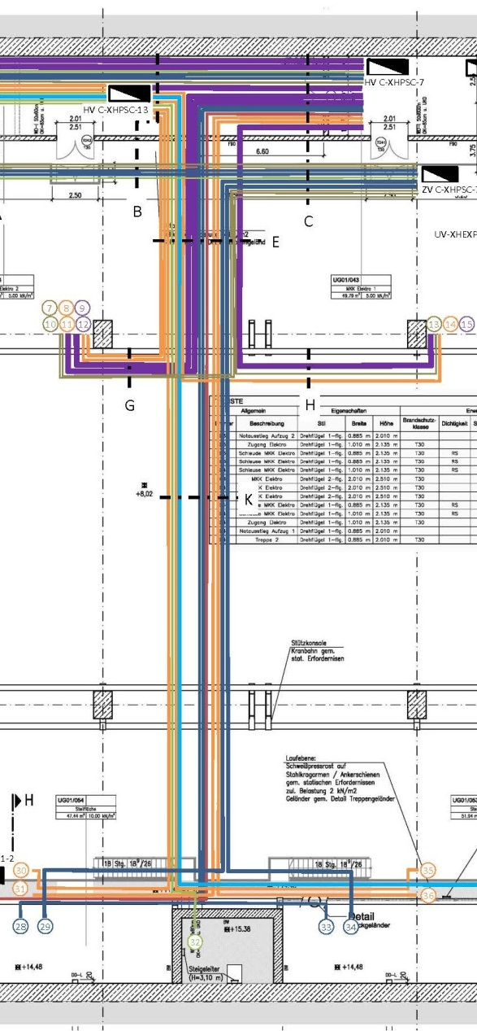
Pros & Cons of Both Grounding Concepts (1)
SASE1 infrastructure on intermediate level:
Only SASE1 currents will be flowing in the SASE1 infrastructure (at least DC & low f), making hutch planning less demanding.
Rerouting of power and signal cables – to enter the area at one point only – is expensive to impossible.
Metallic supply pipes and ducts need costly insulating inserts.
Being forbidden to bond hall and SASE1 metallic parts is a major safety concern.
Beware of unnoticed forbidden connections!
The size of the SASE1 area (50 x 17 m) might violate the λ/20 rule (→ additional capacitive entry points).

Slide 9
Pros & Cons of Both Grounding Concepts (2)
SASE1 infrastructure on hall ground level:
Non-SASE1 currents will be flowing in the SASE1 infrastructure.
Hutch owners eventually must take more measures:
  Use differential or optical signal transmission to avoid ground loops.
  Rittal has published a brochure “EMC-Compatible Enclosure Assembly – Practical Assembly Tips”. It summarizes useful tips without making too much noise about Rittal products:
  www.rittal.com/de-de/content/de/support/downloads/Downloads.jsp
  I bet, the worst enemies will be intra-SASE1 – noise bypassed on ground plane.
Cable, pipe and duct routing need not to be changed or redesigned.
Equipotential bonding of hall and SASE1 infrastructure is freely possible.
The size the of experimental hutches fits the λ/20 rule for noise currents up to a few MHz.
Despite the larger efforts required in the hutches, I favor this grounding concept for cost and safety reasons. It is similar in all other XFEL areas.

Slide 10
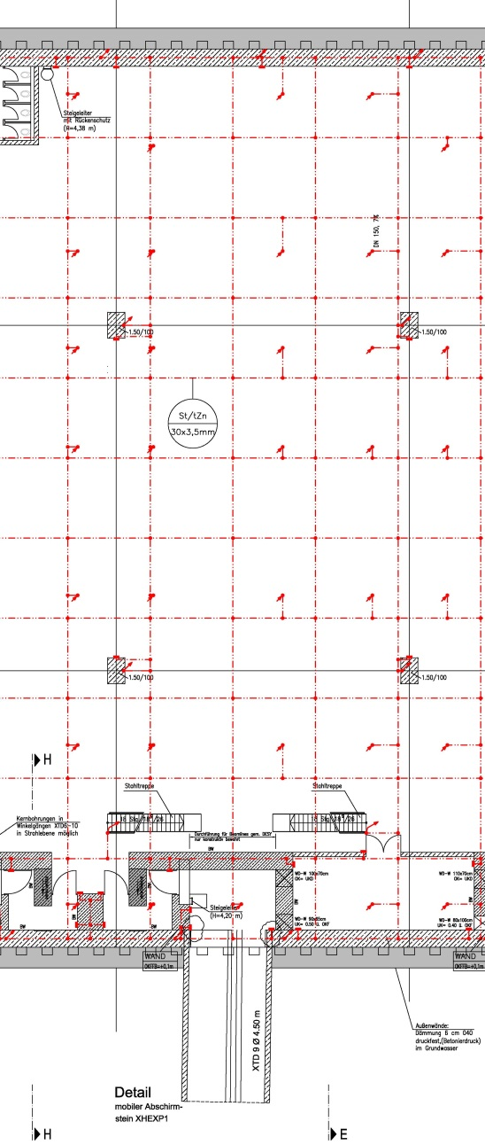
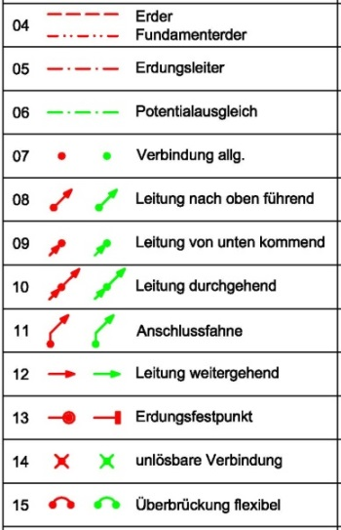
Proposed Grounding System for SASE1
The Estrich grid will be connected to the foundation ground at all available connection points. This offers a convenient way of connecting to the hall ground at arbitrary positions by means of drilling into the Estrich. Keep connections accessible for flexibility.
The vertical bars of hutches with steel structures will be connected to the Estrich grid.
Hutches with brick walls will have an internal grounding rail connected to the grid every 2 m.
Equipotential bonding bars will be installed in all hutches to connect local grounding systems of the lower level.
All metallic infrastructure must be bonded to the hall ground at the entrances to the SASE1 area.

