Slide 1
Karabo
An integrated software framework combining control, data management, and scientific computing tasks
Burkhard Heisen
April 08 2014, 3rd Collaboration Meeting
Notes:
How to edit the title slide
Upper area: Title of your talk, max. 2 rows of the defined size (55 pt)
Lower area (subtitle): Conference/meeting/workshop, location, date,
your name and affiliation,
max. 4 rows of the defined size (32 pt)
Change the partner logos or add others in the last row.

Slide 2

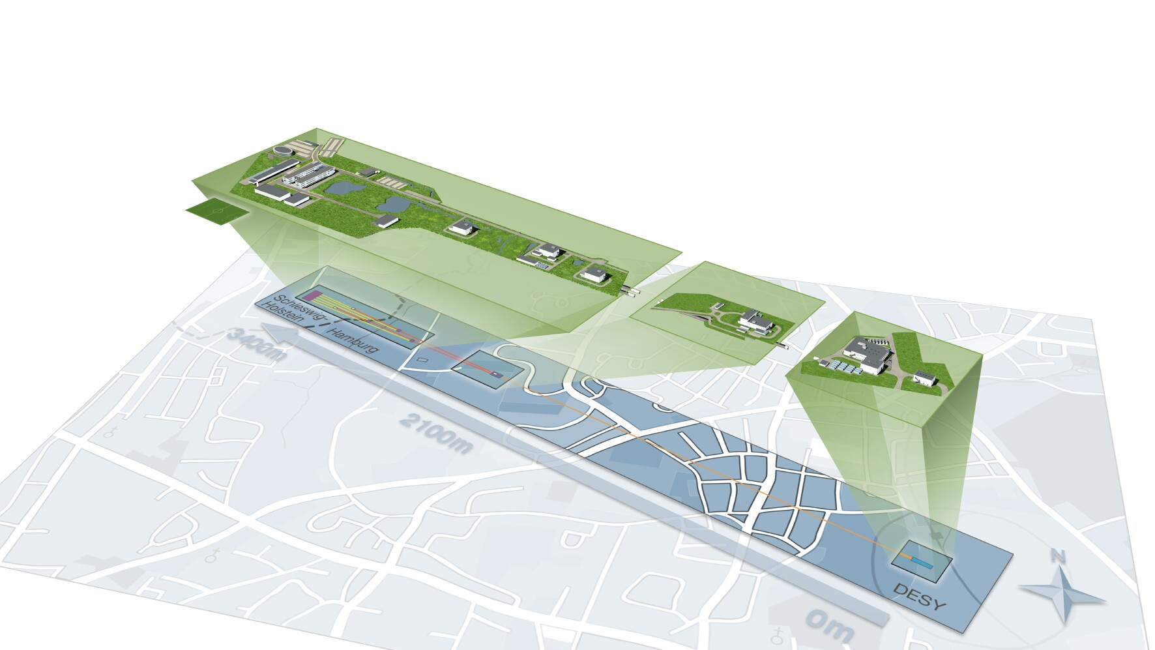

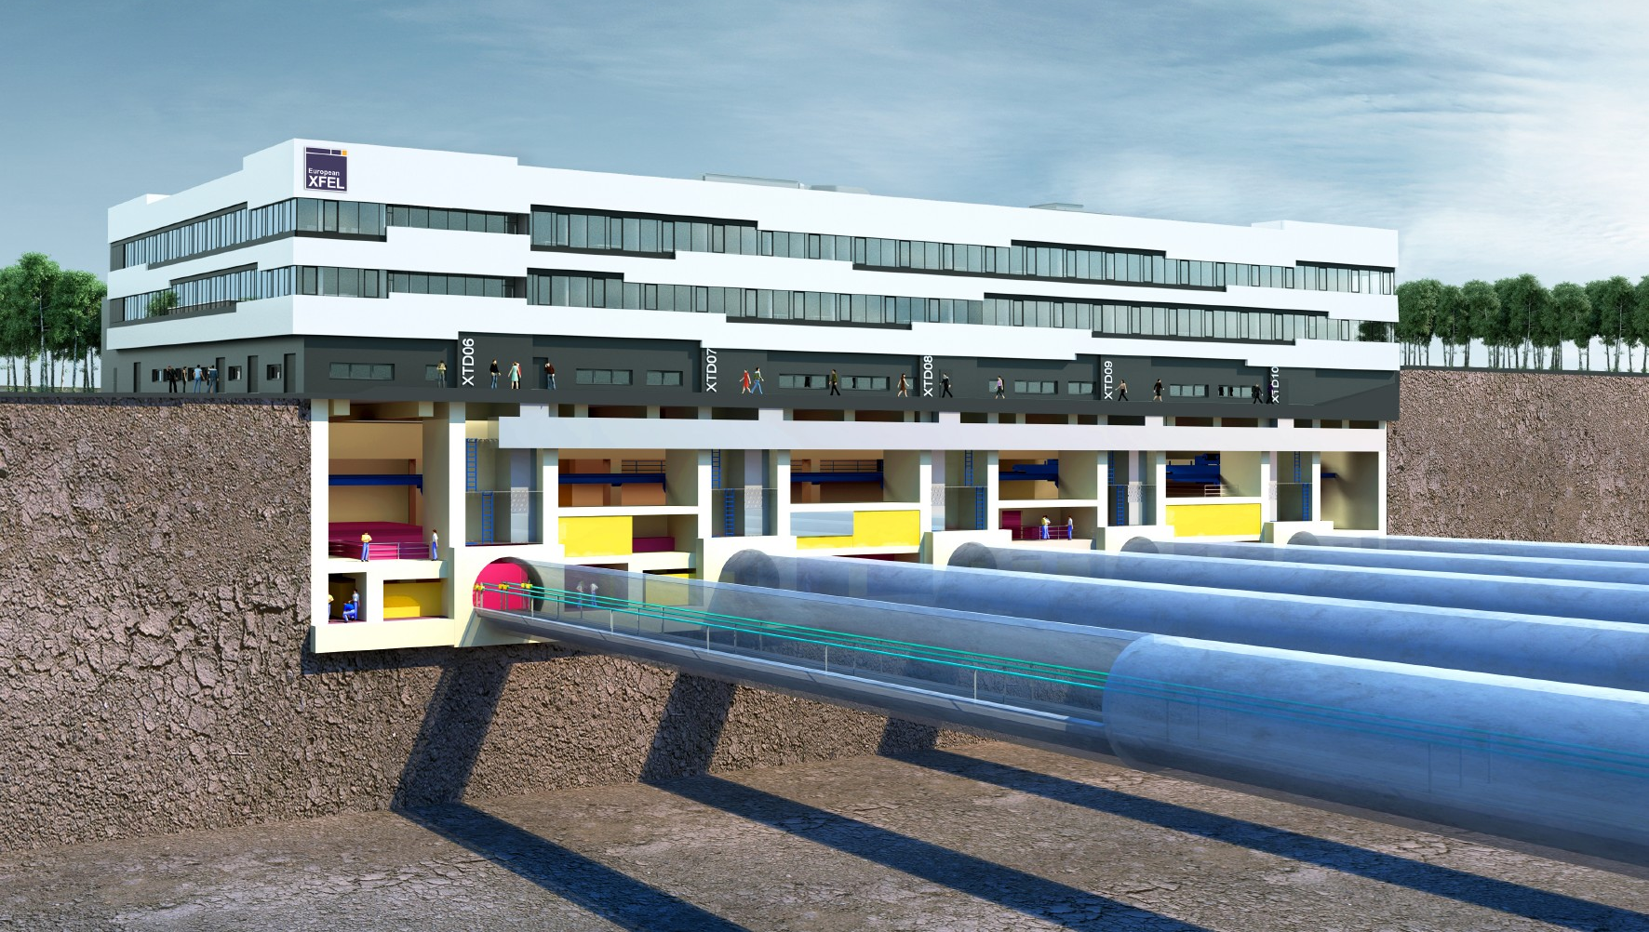
Karabo will be used for the photon beam system
Karabo
DOOCS
Hamburg
Germany

Slide 3


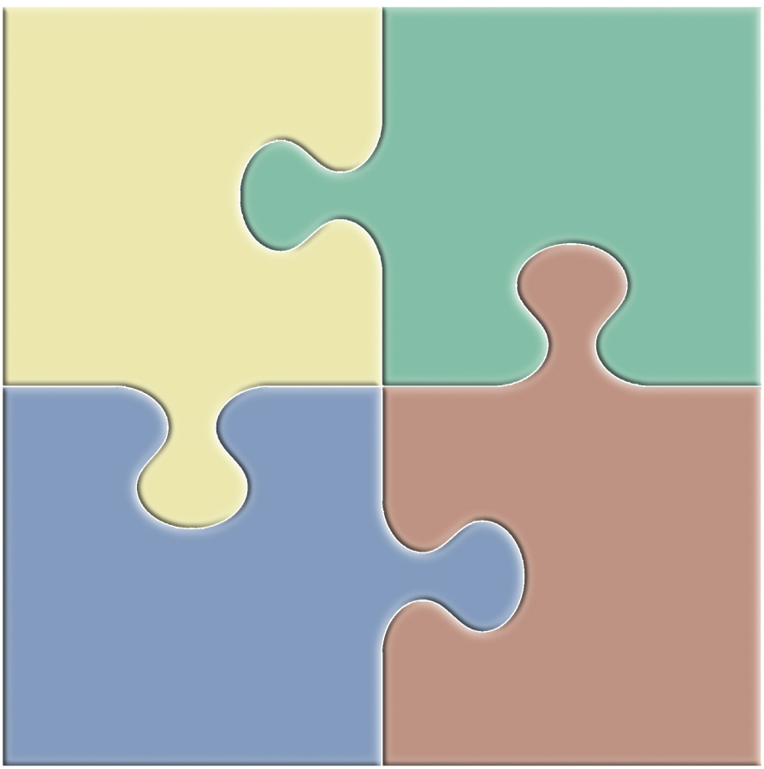
Functional requirements
A typical use case:
Control
drive hardware and complex experiments
monitor variables & trigger alarms
DAQ
data readout
online processing
quality monitoring (vetoing)
Sample Injector
allow some control & show hardware status
Accelerator
Undulator
Beam Transport
show online data whilst running
DM
storage of experiment & control data
data access, authentication authorization etc.
setup computation & show scientific results
DAQ
Control
SC
processing pipelines
distributed and GPU computing
specific algorithms (e.g. reconstruction)
DM
SC
Tight integration of applications
Notes:
In order to understand what software we need image a prospective user wanting to conduct an experiment at XFEL in 2015!
300 images per train = 1.000.000 images after 5 min 30 s
512 image per train = 1.000.000 images after 3 min 15 s
~ 4 TB dataset
Tuning means:
Visualize whether any sample get hit. Re-configure injector.
Start, stop acquisition etc…
Starting experiment means:
Get detector, injector etc. ready to go (control)
Prepare storage system for sinking data with 10 GB/s

Slide 4


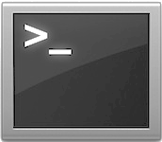
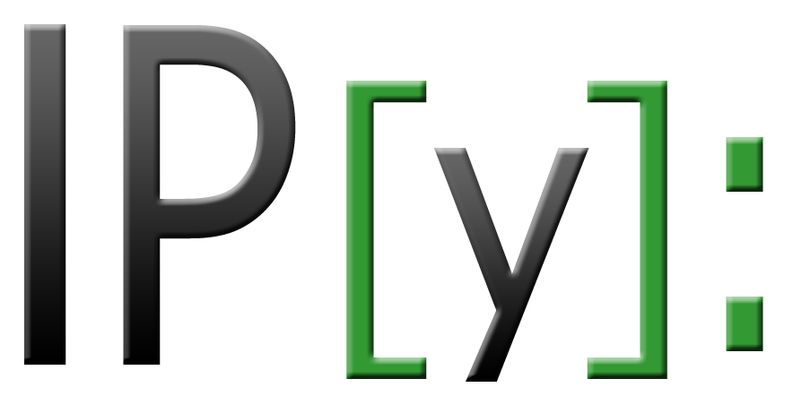
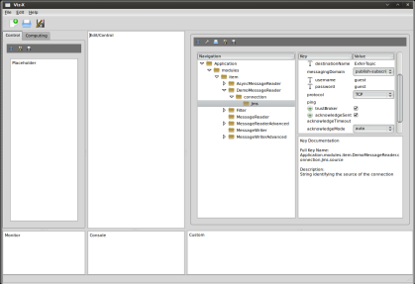
Essential components
Device Instance
Device-Server
Application
Diode
HV
Pump
Store
Message
Broker
Camera
Disk
Storage
Load
Cali-
brate1
Clustering
Simulate
Device
Sub
Control
Cali-
brate2
CLI(s)
Logger
GUI
Server
RDB
GUI(s)

Slide 5
Device – Properties and commands
  Devices are controllable objects managed by a device server
  Device classes can be loaded at runtime (plugin technology)
  Can be written in C++ or Python
  Devices completely describe themselves. Allows automatic GUI creation and auto-completion in IPython
  Runtime-extension of properties, commands and attributes is possible
  No need for device developers to validate any parameters. This is internally done taking the expectedParameters as a white-list
  Properties and commands can be nested, such that hierarchical groupings are possible
Class: MotorDevice
static expectedParameters( Schema& s ) {
FLOAT_ELEMENT(s).key(“velocity”)
.description(“Velocity of the motor”)
.unitSymbol(“m/s”)
.assignmentOptional().defaultValue(0.3)
.maxInc(10)
.minInc(0.01)
.reconfigurable()
.allowedStates(“Idle”)
.commit();
INT32_ELEMENT(s).key(“currentPosition”)
.description = “Current position of the motor”
.readOnly()
.warnLow(10)
[…]
SLOT_ELEMENT(s).key(“move”)
.description = “Will move motor to target position”
.allowedStates(“Idle”)
[…]
}
// Constructor with initial configuration
MotorDevice( const Hash& config ) { […] }
Property
Attribute
Command

Slide 6
Device – Finite state machine (FSM)
Any device uses a standardized way to express its possible program flow
  The state machine calls back device functions (onStateExit, action, onStateEntry)
  The GUI is state-machine aware and enables/disables buttons proactively
Start Stop State Machine
Initialization
none
OK
// Ok Machine
FSM_TABLE_BEGIN(OkTransitionTable)
// SrcState Event TgtState Action Guard
Row< Started, StopEvent, Stopped, StopAction, none >,
Row< Stopped, StartEvent, Started, StartAction, none >
FSM_TABLE_END
FSM_STATE_MACHINE(Ok, OkTransitionTable, Stopped, Self)
Stopped
stop
start
Started
reset
errorFound
// Top Machine
FSM_TABLE_BEGIN(TransitionTable)
Row< Initialization, none, Ok, none, none >,
Row< Ok, ErrorFoundEvent, Error, ErrorFoundAction, none >,
Row< Error, ResetEvent, Ok, ResetAction, none >
FSM_TABLE_END
KARABO_FSM_STATE_MACHINE(StateMachine, TransitionTable, Initialization, Self)
Error

Slide 7
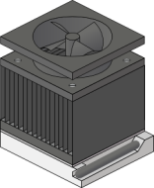

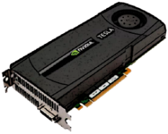
Device – As workflow module
CPU
IO whilst computing
Notification about new data possible to obtain
Pixel parallel processing
(one GPU thread per pixel)
GPU
Devices can act as modules in a scientific workflow system
Any workflow device has full access to the live control-system
Data get be streamed into pure python environment and be processed using numpy, scipy, scikit-image, etc.

Slide 8
Multi-purpose graphical user interface
Text field
Button widget
Display widget
drag & drop
Editable widget

Slide 9
The command line interface (CLI)
Main functionality:
  Exploring the distributed system topology (hosts, device-servers, devices, their properties/commands, etc.) getServers, getDevices, getClasses
  instantiate, kill, set, execute (in “wait” or “noWait” fashion), get, monitorProperty, monitorDevice
  Even polled interface will never really poll, but is event-driven under the hood
  Remote auto-completion which is access-role and state aware

Slide 10
Selected Features
Cross-network signals and slot implementation (Qt style)
  Native function calls providing native argument passing
  Runtime setup of signals, slots and connect statements
High performance dictionary object
  Fully recursive key to any value mapper (also in C++)
  Keeps insertion order and supports attributes
  Serializes to XML, Binary, HDF5, DB, JMS-Message, etc.
Event driven system throughout, incl. event driven archiving
  Archiving happens completely transparent (no extra tooling needed)
  Archiving policies are configured per property within device code
User centric, access controlled system
  Context based authentication (who, where, when)
  Kerberos is integrated
Full system available in C++ and Python
Fully functional also without master or database (good for testing/developing)
Easy install (both framework and devices) using software bundle architecture

Slide 11
Current status
Karabo is under active development, current version is 1.1.3
Karabo 1.1.x already runs several systems, e.g.
  LPD (2-tile) control, DAQ chain and calibration pipeline (+ beamtime)
  PnCCD (Proteus) test-stand (pumps, gauges, valves, motors)
  Pump probe laser test-stand (motors, digitizers, pid loops, cameras)
  Undulator control using Karabo’s Doocs interface
Feedback is very useful (thanks to all our friendly users!)
We exercise ourselves in user-support (new internal tool: Redmine)
Karabo 1.2.0 is scheduled for early June 2014
  Improved custom scene (middle GUI panel)
  Multi-platform compatibility for GUI (Linux, Win, MacOSX)
  Runtime attribute configuration
  Improved stability

Slide 12
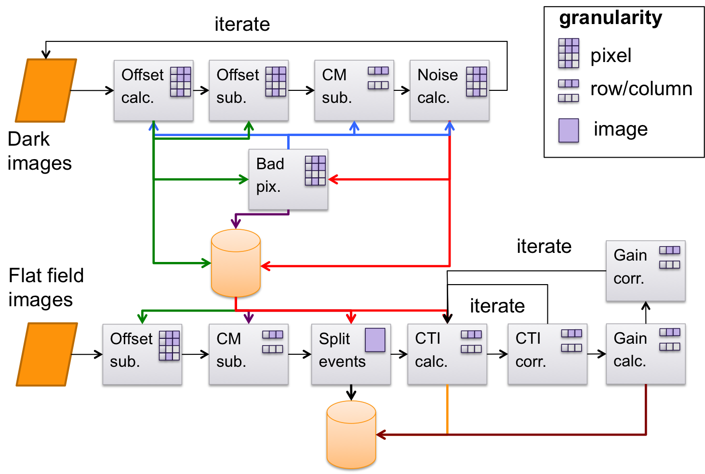
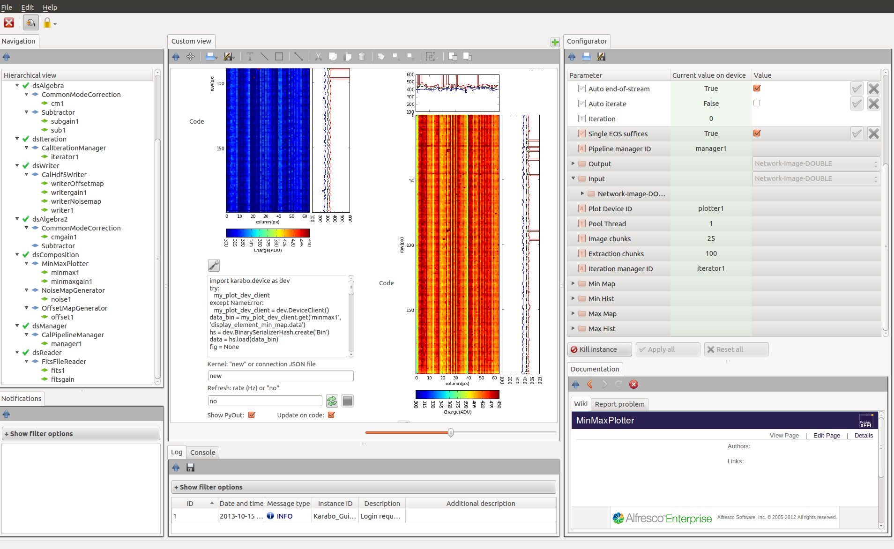
2D detector calibration pipeline
Courtesy of: S.Hauf

Slide 13
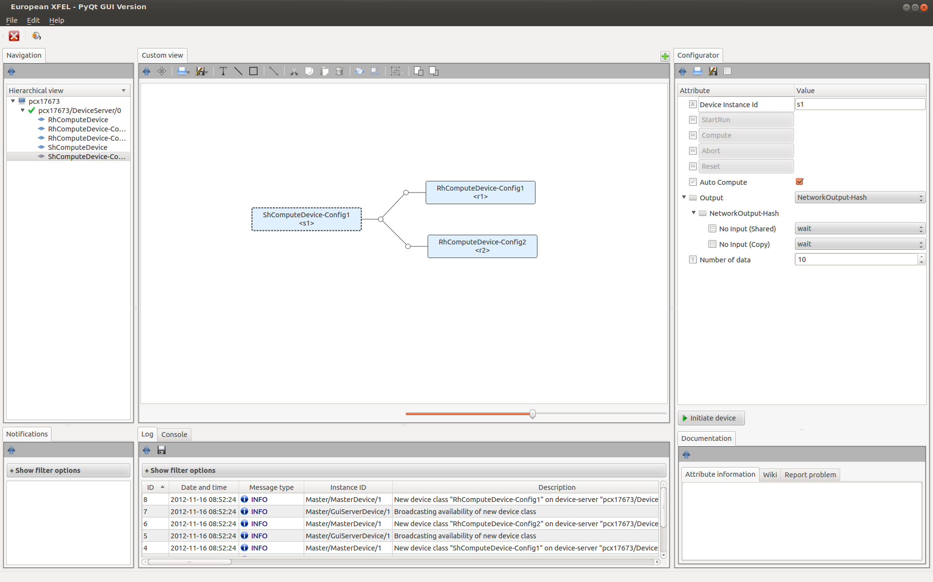
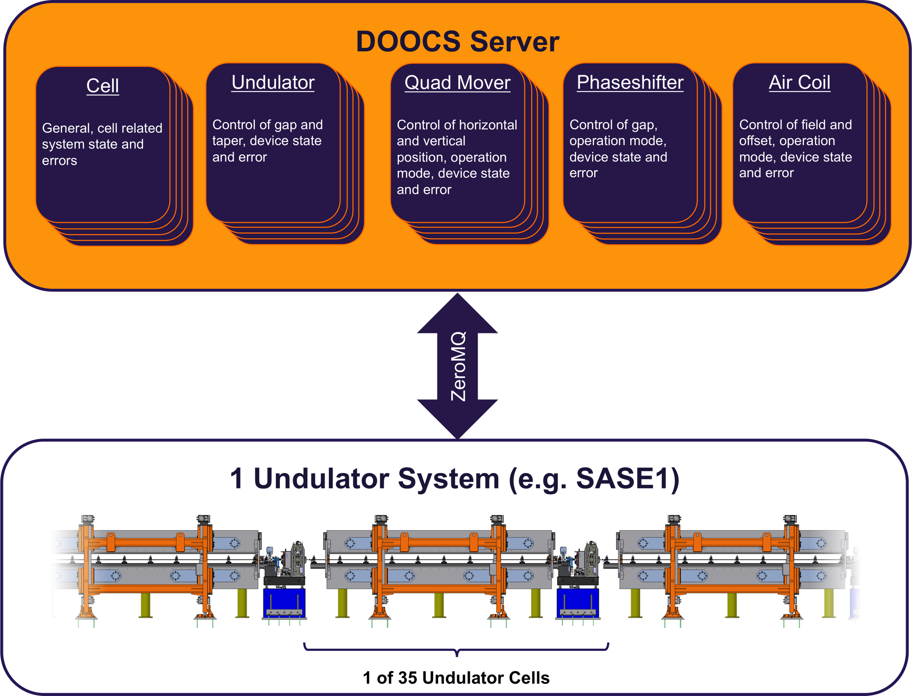
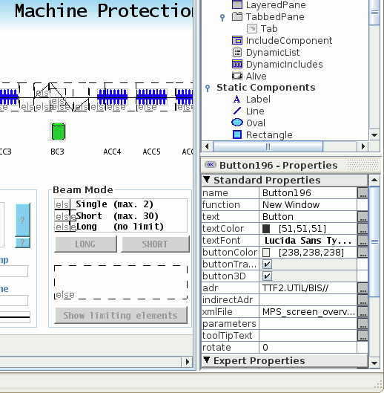
Successful Karabo / DOOCS interface in action
Karabo Server
Undulator
Gate
Karabo GUI
JDDD
Courtesy of: A. Beckmann

Slide 14
Conclusion
Starting to have a system that gets our users going
  Beckhoff integration (motors, valves, pumps, etc.)
  Electronics integration (digitizers, FPGAs)
  DOOCS integration (slow control aspects)
  2D pixel detector integration (LPD, DSSC, AGIPD)
  Commercial systems integration (cameras, HV, SCPI devices, etc.)
Lots of features and many bugs on our lists, working on that
Have to categorize user’s wishes and fix the final interfaces
  “I do not want a GUI, it must be like SPEC!”
  “What command-line? I just want to click move!”
Exercise larger systems (higher levels of abstraction)
  Installation, version compatibility (h/w, f/w, s/w), updates, maintenance, support
  Stability (months), broker clustering, fail-over strategies, backups

Slide 15
Acknowledgments
Karabo contributors (internal)
K. Wrona S. Esenov
K. Weger J. Szuba
D. Boukhelef I. Kozlova
A. Parenti L. Maia
S. Hauf M. Teichmann
P. Gessler N. Coppola
J. Tolkiehn J. Elizondo
H. Höhne A. Beckmann
C. Youngman
Karabo contributors (external)
C. Yoon (CFEL) N. D. Loh (SLAC)
T. Nicholls (LPD project) K. Rehlich (DESY / DOOCS)
M. Kirchgessner (DSSC project) I. Sheviakov (AGIPD project)

Slide 16

Thank you for your kind attention.

Slide 17
Spare Slides
Architecture in analogy
Context based authentication
Workflow concepts
Graphical workflow assembly

Slide 18
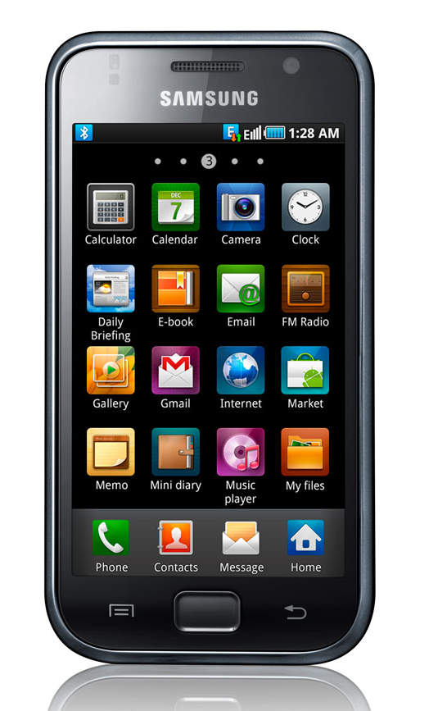



What is Karabo? - Lets draw an analogy
Karabo devices
Karabo central services
(archive, database)
Karabo framework
Karabo device-server running devices

Slide 19
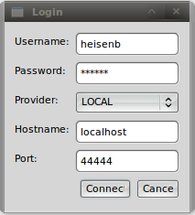
Before you even start: Login
Broker-Message
GUI or CLI
Header […]
__uid=42
__accessLevel=“admin”
GUI-Srv
Body […]
username
password
provider
ownIP*
brokerHost*
brokerPort*
brokerTopic*
userId
sessionToken
defaultAccessLevel
accessList
Locking:
if is locked:
if is __uid == owner then ok
Access control:
if __accessLevel >= visibility:
if __accessLevel >= param.accessLevel then ok
Device
Central DB
Authorizes
Computes context based access levels

Slide 20
Device – As workflow module
Devices can act as modules of a scientific workflow system
  Configurable generic input/output channels on devices
  One channel is specific for one data structure (e.g. Hash, Image, File)
  New data structures can be “registered” and are immediately usable
  Developers just need to code the compute and (optionally) the endOfStream method
  IO system is decoupled from processing system (process whilst transferring data)
  Broker-based communication transparently establishes point-to-point connection
  Any workflow device has full access to the live control-system
Memory
CPU-threads
TCP
Distributed processing

Slide 21
Device (workflow) composition
Workflow node (device)
drag & drop
Draw connection

