Slide 1




FPGA and electronics developments for experiment detector and DAQ systems
Patrick Gessler
for
Detector Developments (WP75) and Data Acquisition (WP76)
European XFEL GmbH
Notes:
How to edit the title slide
Upper area: Title of your talk, max. 2 rows of the defined size (55 pt)
Lower area (subtitle): Conference/meeting/workshop, location, date,
your name and affiliation,
max. 4 rows of the defined size (32 pt)
Change the partner logos or add others in the last row.

Slide 2
Overview
Electronics for Experiments and DAQ
Slow Control
Beckhoff PLC
Fast Electronics
Specialized Electronics
SCPI Devices
MicroTCA
ATCA
Integrated Detectors
Devices not available in MicroTCA/ATCA
Firmware Framework Development required
FPGA Developments are required for
Online processing and data reduction
Real-time feed-back and VETO based rejection

Slide 3
Overview
Electronics for Experiments and DAQ
Slow Control
Beckhoff PLC
Fast Electronics
Specialized Electronics
SCPI Devices
MicroTCA
ATCA
Integrated Detectors
Devices not available in MicroTCA/ATCA
Firmware Framework Development required
FPGA Developments are required for
Online processing and data reduction
Real-time feed-back and VETO based rejection

Slide 4
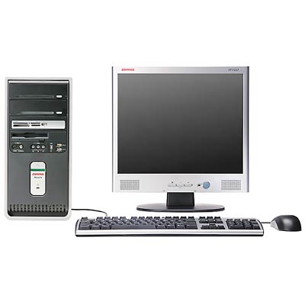
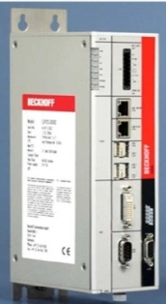
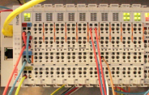
Experiment and beam line Slow Control
Beckhoff rail PLC and terminals
Commercial widely used and cost effective
PLC based solution
  deterministic: EtherCAT, 1ms cycle time
  f/w framework written, supports Interlocks, f/w block reuse, etc.
Used to control – monitor:
  motors, pumps, valves, chillers…
  gauges, temperature sensors, ADC&DAC
s/w – f/w connectivity
karabo s/w devices
Motor
Pump
Gauge
Karabo
BeckhoffCom
TCP/IP
PLC f/w
TCP server
Device drivers
SCPI
Commercial bus API: Standard Commands for Programmable Instruments
  Karabo to device interface via TCP/IP
Used to control – monitor:
  Scopes, heaters, etc.
Integration with PLC via relays, if needed
Beckhoff PLC
Serial
Digital
Analog
EtherCAT
Motor
Pump
Gauge

Slide 5
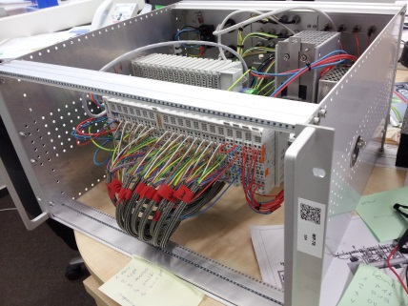
Beckhoff project status
Large variety of end user systems
Experiment: vacuum and motion control, sample injection
Beamline: pump cart, ion and differential pumping sections, gas attenuator, slit control
Diagnostic: screen camera stations, beam loss and slit monitoring cameras…
Laser: PID controlled optical delay…
Test stand crate
Electronic design and documentation using ePlan, gives
Wiring schematics of Beckhoff crates and TwinCat pin assignment which allows outsourced production
Crate to patch-panel to device cabling (routing and ~lengths based on 2.5D)
Cable labeling and colour coding
Allows production of >200 crates required by external companies
Conclusions
s/w and f/w framework in an advanced state
Preparation of Eplan usage almost complete, after which large scale production can start
No show stoppers, just a lot of work

Slide 6
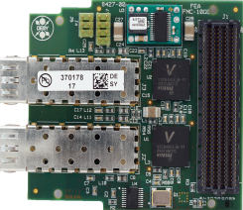
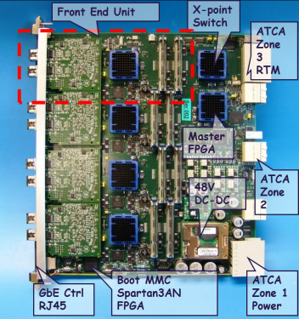
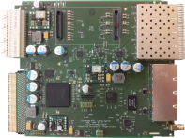
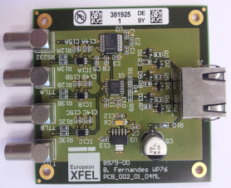
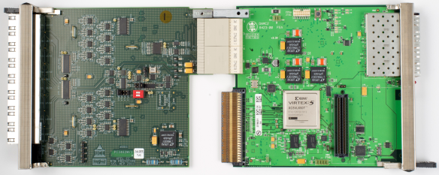
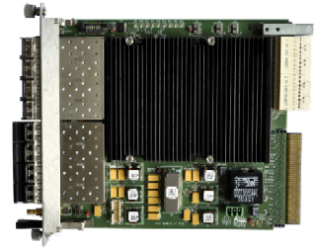

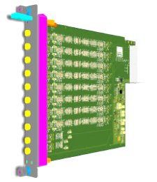
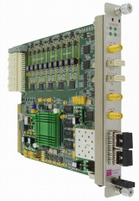
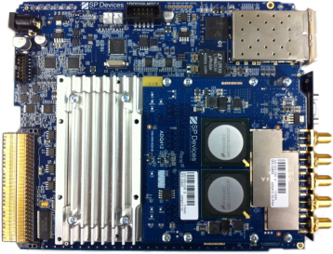
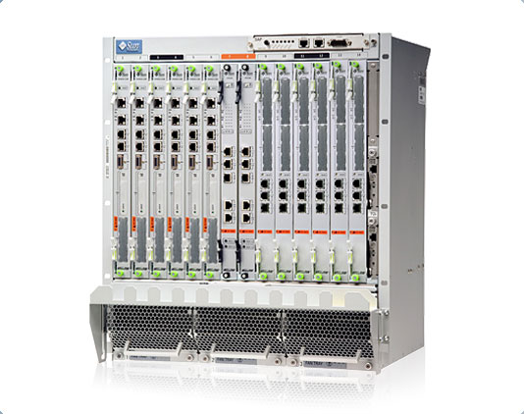

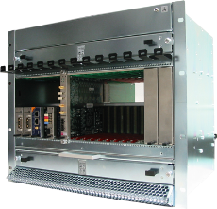
MicroTCA and ATCA building blocks
All necessary building blocks for test and final systems identified and in f/w and/or s/w integration phase
Dual 10GE FMC interface
STFC Train Builder
DESY (X2) timing board
External (ETA) Timing Adapter
UCL 2D clock & control
DESY (DAMC2) Digital board
DESY (LLRF) as VETO unit
RTM signal
shapers
Fast ADC
SIS3800
Digitizer
SP-Devices
6 to 12 slot
MTCA.4 crates
ATCA crate
If you are interested in MicroTCA, please visit http://mtca.desy.de

Slide 7
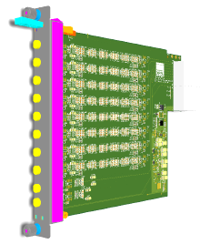


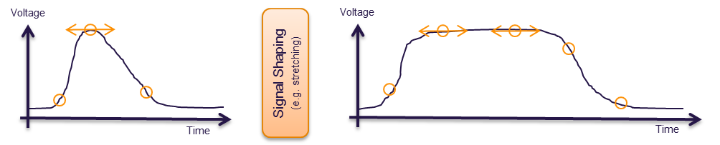
Important MicroTCA Acquisition solutions
Pulse Stretcher RTM
European XFEL
SIS8300
Struck Innovative Systems
ADQ412
SP Devices
ADC
  4 Channels / 2GSPS, 2 Channels / 4 GSPS, 12 bits
  1 Channel / 7 GSPS, 8 bits
  And others
Concept
  High resolution sampling of the signal trace
  FPGA processing for noise reduction and signal property detection
  Negative:
    Higher costs and less vertical resolution
Applications
  Avalanche Photo Diode Detection (with WP81)
  PES (with WP74)
  MCP detector and iToF spectrometer (with WP75)
  …
ADC
  10 Channels, 125MSPS, 16 bits
Concept
  To sample all important properties with limited sampling speed
  To reduce noise by oversampling and later averaging
  To reduce jitter based effects (sampling time fluctuations)
  Negative:
    Fast signal properties are lost
Applications
  Avalanche Photo Diode Detection (with WP81)
  Diamond detector (with WP74)
  MCP detector (with WP74)
  MCP Detector (with WP86)
  …

Slide 8
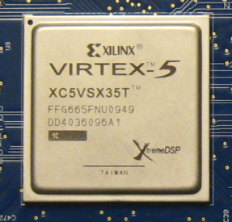
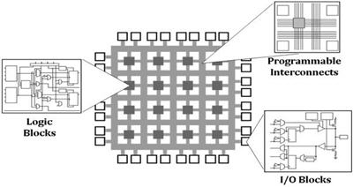
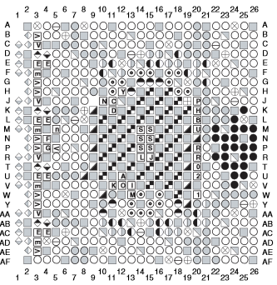
Brief introduction into FPGAs
Field Programmable Gate Array (FPGA)
  Flexible inner structure
Not shown here:
RAM
Clock Modules
Gigabit Transceivers for
  PCIe
  10GbE
DDR interfaces
CPUs
DSPs
(source: National Instruments)
A | B | AND | OR | NAND | XOR
0 | 0 | 0 | 0 | 1 | 0
0 | 1 | 0 | 1 | 1 | 1
1 | 0 | 0 | 1 | 1 | 1
1 | 1 | 1 | 1 | 0 | 0
Look-Up Table
(LUT)
MUX
FlipFlop
(FF)
“Only” 665 pins.
Largest one has 1760 pins
(source: Xilinx)
Simplified Configurable Logic Block (CLB)
Look-Up Table (LUT) examples with 2 inputs only

Slide 9
Memory Management and DMA
Clock distribution and PLLs
Top Level FPGA Project Design
10GbE
VETO/Feed-back connection
Board/Hardware related Modules
(e.g. clock, triggering, ADC readout, switches,…)
Application related Modules
(e.g. Algorithms, special interfaces, formatting…)
Hardware
Defined
Interface
Register A (e.g. Offset)
Register B (e.g. Window Size)
Memory C (e.g. Filter Coeff.)
Timing interface (Trigger and Data)
ADC Readout and configuration
PCIe Communication

Slide 10
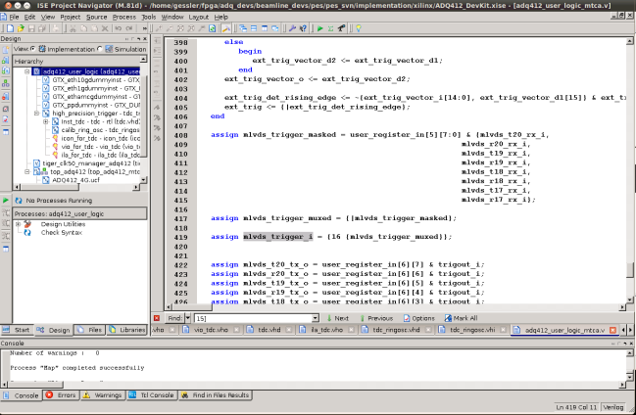
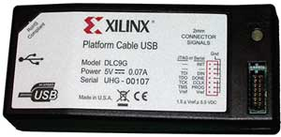

Workflow example
Programming Path
Firmware
Image
Communication Path
(e.g. PCIe, Ethernet,..)
XML FILES
  User Registers and Memories Description
  Control System Software
This system allows automatic detection of installed firmware and loads correct XML files with Register und Memory descriptions

Slide 11

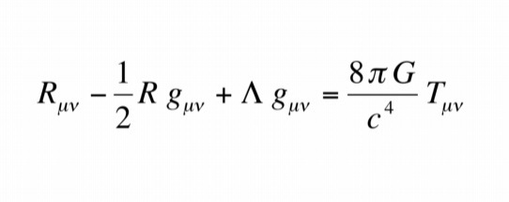
High Level FPGA Algorithm Development
The FPGA should bend time and space according to
  FPGA programming is time intensive and requires specialists, however most applications and algorithms are conceptualized by users unfamiliar with FPGA programming.
  For the European XFEL, a high level FPGA framework is being developed that allows for users with no prior HDL knowledge to develop their algorithm modules which can be integrated in a top VHDL project.

Slide 12
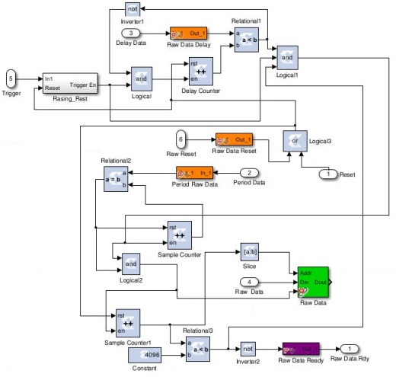
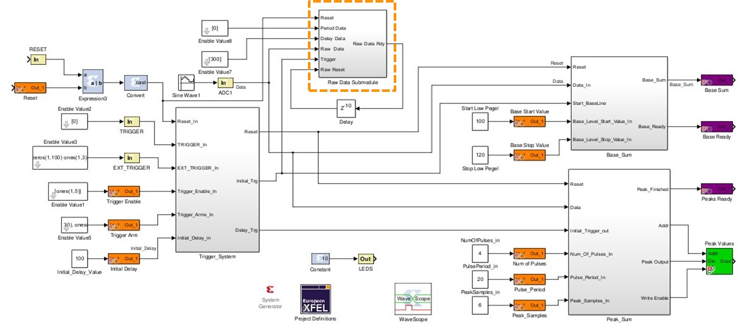
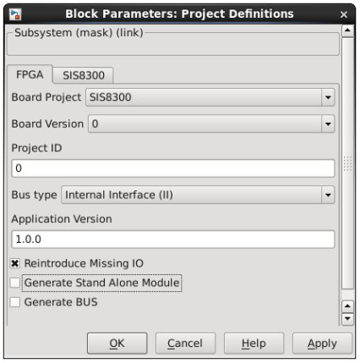
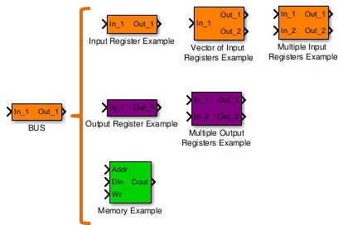
Simulink/SysGen based Framework

Slide 13
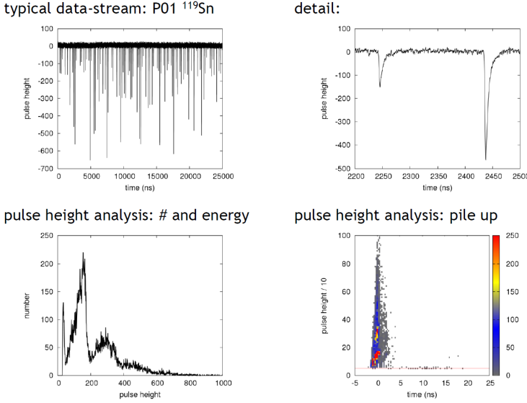
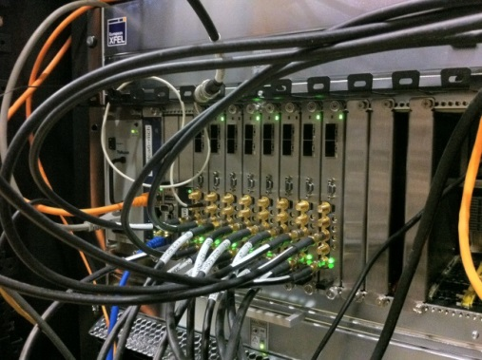
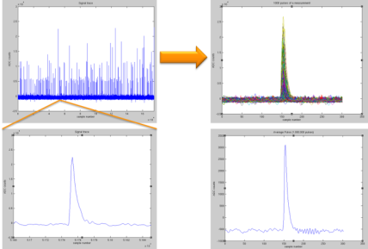
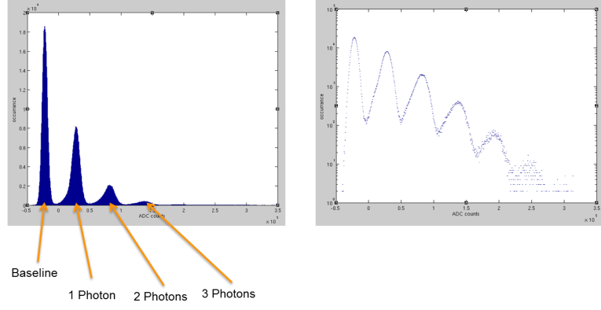
Algorithms under test and development
Time-to-Digital Conversion
Single-Shot Spectrum Compression
Pulse energy Detection
Measurements done at Petra III with P01 group and C. Strohm
Tests done at Petra III with XFEL WP81, P01 and P11 groups
Measurements done at FLASH and Fermi@Elettra
with XFEL WP74, WP85 and Petra III P04 groups

Slide 14
Conclusion
Electronic standards are defined and used in many applications
  MicroTCA.4 standard used as by the machine groups
Firmware had been developed
  Beckhoff f/w Framework in place and further features and improvements under work
  Start-up projects for all used MicroTCA modules available
  Collaboration between DESY/XFEL related to f/w and s/w interfacing
High-Level FPGA Programming based on Simulink/SysGen
  Many applications already implemented
  Release planned for late summer

Slide 15
Questions?

Slide 16
Spare Slides

Slide 17
Introduction into MicroTCA – Motivation
Limitations on existing VME based solutions
  Bandwidth: only one parallel bus
  No module replacement at run time (Hotswap)
  Remote control
  Health management
  Redundancy
  No in-crate timing distribution
VME Bus
CPU
ADC1
ADC2
TDC
DAC

Slide 18
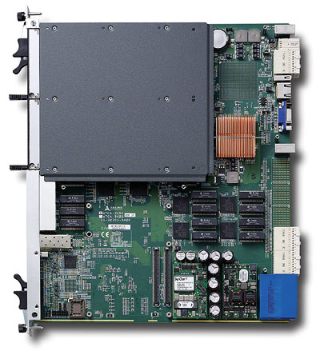
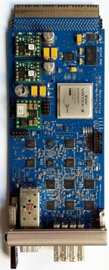
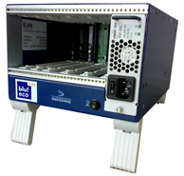
Introduction into MicroTCA – ATCA and MTCA
Advanced Telecommunication Computing Architecture (ATCA)
Advanced Mezzanine Card (AMC)
Micro Telecommunication Computing Architecture (µTCA)
Advanced Mezzanine Card (AMC)
ATCA Blade / Module
µTCA Crate
ATCA Crate

Slide 19
Introduction into MicroTCA – In-crate Timing
2 radial clocks per AMC,
Low jitter, configurable direction
8 bussed M-LVDS lines,
For triggers, clocks and interlocks
Backplane
MCH
AMC
Timing
AMC
ADC
AMC
ADC
Cross-
Point-Switch
Enc.Clock
Enc.Clock
Cross-
Point-Switch
Trigger
Trigger
Interlock
Interlock
Ethernet
PCIe
Curtsey: Kay Rehlich (DESY)

Slide 20
Brief Introduction into FPGAs - Example
I/O
I/O
I/O
Defined Program: Q = A and B
Configurable Logic Block
Configurable Logic Block
Configurable Logic Block
Configurable Logic Block
Configurable Logic Block
Configurable Logic Block
Configurable Logic Block
Configurable Logic Block
I/O
I/O
I/O

Slide 21
Brief Introduction into FPGAs - Example
I/O
I/O
I/O
Defined Program: Q = A and B
Configurable Logic Block
Configurable Logic Block
Step 1: Translate and Map
LUT
Q
Configurable Logic Block
Configurable Logic Block
B
A
Configurable Logic Block
Configurable Logic Block
Configurable Logic Block
Configurable Logic Block
I/O
I/O
I/O

Slide 22
Brief Introduction into FPGAs - Example
A (IN)
B (IN)
Q (OUT)
I/O
I/O
I/O
Defined Program: Q = A and B
Configurable Logic Block
Configurable Logic Block
Step 1: Translate and Map
Step 2: Place
LUT
Q
Configurable Logic Block
B
LUT
A
Configurable Logic Block
Configurable Logic Block
Configurable Logic Block
Configurable Logic Block
I/O
I/O
I/O

Slide 23
Brief Introduction into FPGAs - Example
A (IN)
B (IN)
Q (OUT)
I/O
I/O
I/O
Defined Program: Q = A and B
Configurable Logic Block
Configurable Logic Block
Step 1: Translate and Map
Step 2: Place
Step 3: Route
LUT
Q
Configurable Logic Block
B
LUT
A
Configurable Logic Block
Configurable Logic Block
Configurable Logic Block
Configurable Logic Block
I/O
I/O
I/O

Slide 24

VHDL Programming basic example
entity myAND is
port( A: in std_logic;
B: in std_logic;
Q: out std_logic
);
end myAND;
architecture RTL of myAND is
begin
Q <= A and B;
end;
Xilinx ISE is one tool for VHDL Programming for the FPGA

Slide 25
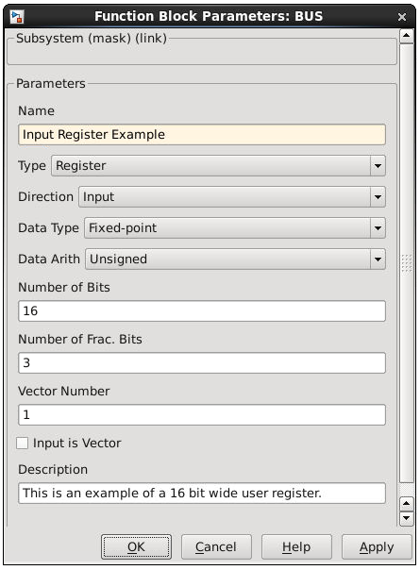

XFEL Simulink Library – BUS Block
  BUS block allows for users to define registers and memories which are later accessible by the chosen protocol

Slide 26
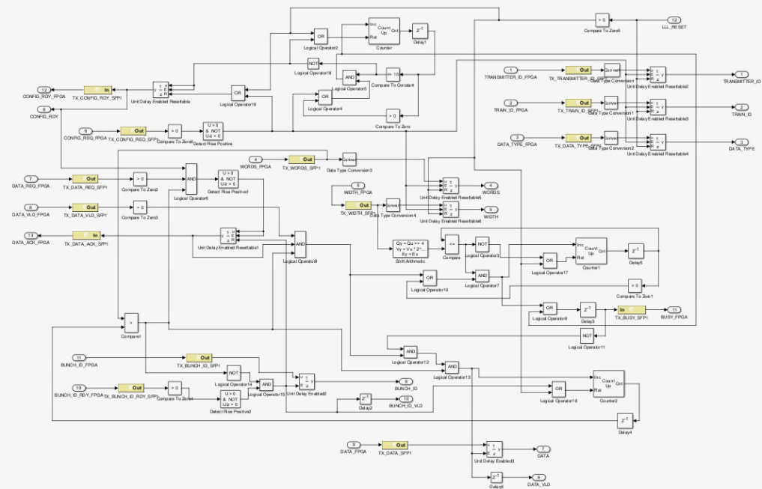
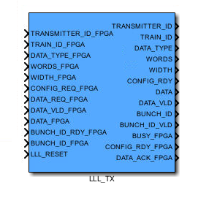
XFEL Simulink Library – Board Specific block
  Specific blocks are available on the library which will accurately simulate the behavior of features available on the board;
  In Hardware, the block is replaced with the real implementation.

Slide 27
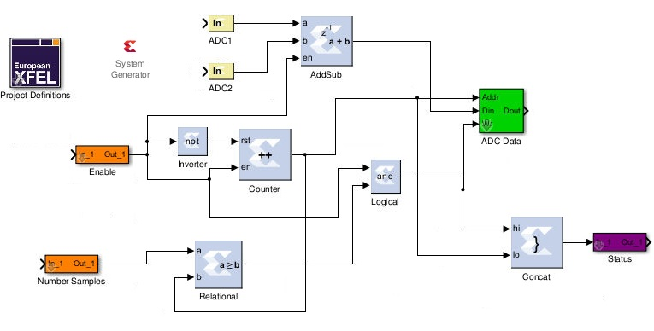
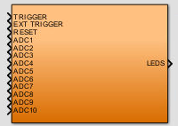
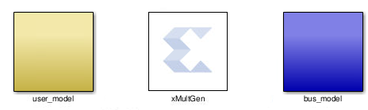
XFEL Simulink Library – Application Integration
User Application
  Standalone Module of User Application
XML FILE
  User Registers and Memories Description
Software
(Karabo)
NGCFILE
Final Design
  Bus protocol logic generated automatically
  The final Algorithm is processed to integrate the top level FPGA Project:
    Generate Final Design with bus interface logic based on defined user registers and chosen protocol;
    Netlist file of final design inserted in ISE project;
    Standalone Module of User application to share and distribute
    XML file with register information similar to the VHDL developed applications.

Slide 28
Low-Latency data transmission:
VETO System for data reduction and memory optimization
Optimize picture quality of 2D detectors
  Limited frame capacity in ASICs (~300-700 frames)
  Replace bad frames with new ones in ASIC before read out and transmission
Data reduction
  Discard useless data before transmission
Implementation
  FPGAs of diagnostics and detectors provide bunch information with low-latency
  Configurable central VETO unit per experiment decides on bunch quality
  FPGAs of detectors (maybe also diagnostics) receive the decision and react on it
  Using a common protocol with beam based feedback system
VETO Source
Avalanche Photo Diode
VETO User
e.g. Digitizer
XFEL
VETO Source
PES
Optical - 2.5Gb/s low-latency
XFEL
VETO Unit
Configurable decision matrix
…
…
UCL
Optical - 2.5Gb/s low-latency
VETO Sources
TPS
Clock and Control
2D detector
Front-end electronics
FEEs
Detector Head
DESY
UCL

