Slide 1
X-ray Photon Diagnostics (WP74)
Status 08 April 2014
Jan Grünert
European XFEL GmbH, Hamburg
3rd XFEL Collaboration Meeting

Slide 2
Status WP74
In commercial production: Pop-in monitors
In-house production at European XFEL:
2D-imager-FEL, K-Monochromator, PES, Diff.Pumps
Production by DESY: XGM, transmissive imager
Production by Dubna: MCP-based detector
Design stage: 2D-imager-SR, Exit Slit Imager, Timing Diagnostics
Perspectives until fall 2014:
  Production of XTD2 (SASE1) devices
  Gearing up for first tunnel installations (XTD2)
  Finalizing designs for a few devices or
  subsystems like 2D-imager-SR, imager optics
  More diagnostics activities (see summary)

Slide 3
WP74 devices in XTD2 (SASE1)
619.0m: Filter chamber
620.6m: Transmissive Imager (=OTR-C screen)
639.5m: K-monochromator system, incl. 2D-imager-SR
648.9m: X-ray gas monitor (XGM)
655.9m: Differential Pumping by WP74
659.2m: Photoelectron spectrometer (PES)
681.8m: 2D-imager-FEL
698.9m: MCP detector
700.4m: Pop-in Monitor Type II-45°
All z-distances given in the PD coordinate system

Slide 4
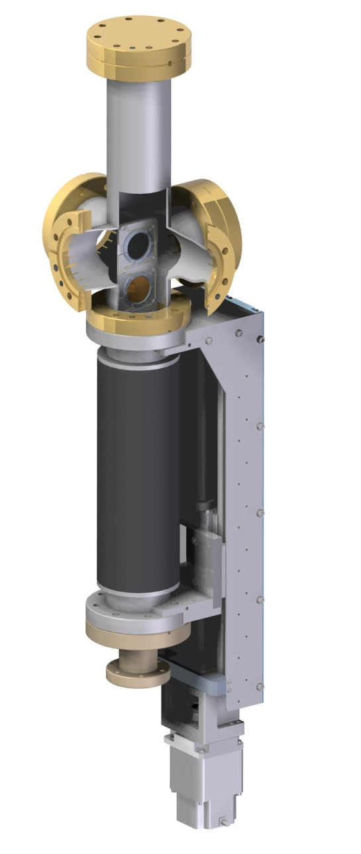
Filter chamber
Status 04/2014: all parts in house
Tunnel placement: position agreed
RFI 05/2014
T.b.d. : chamber support
N:\4all\intern\User data\wp74\Devices\31-2_K-Mono\production drawings\filter chamber

Slide 5
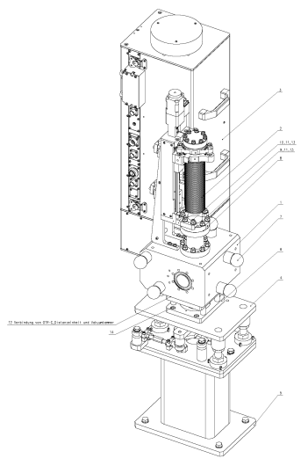
Transmissive Imager
„OTR-C“ imager = a standard WP17 device
  (only internal modification for scintillator/holder by WP74, which will be done in contact with WP17 during Q2/2014)
Tunnel placement: position agreed
Integration by WP17 as for their other screen stations
N:\4all\intern\User data\wp74\Devices\31-8_Transmissive-Imager

Slide 6
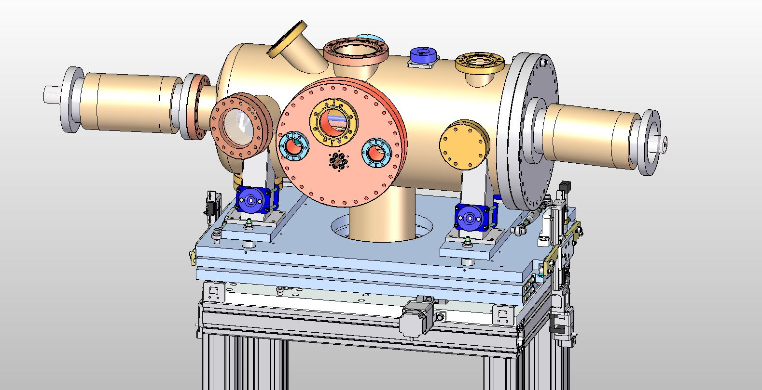
K-Monochromator
Status 4/2014: Prototype tested. DR/PRR in review.
Prototype is now being converted to SASE1 device (is in cleanroom)
RFI May 2014
Integrated in tunnel CAD model, no collisions
Control crate in production; planning of in-tunnel cabling started
2D-imager-SR as part of K-mono-system not yet designed, most likely similar to 2D-imager-FEL version concerning dimension and requirements to tunnel installation.
N:\4all\intern\User data\wp74\Devices\31-2_K-Mono

Slide 7
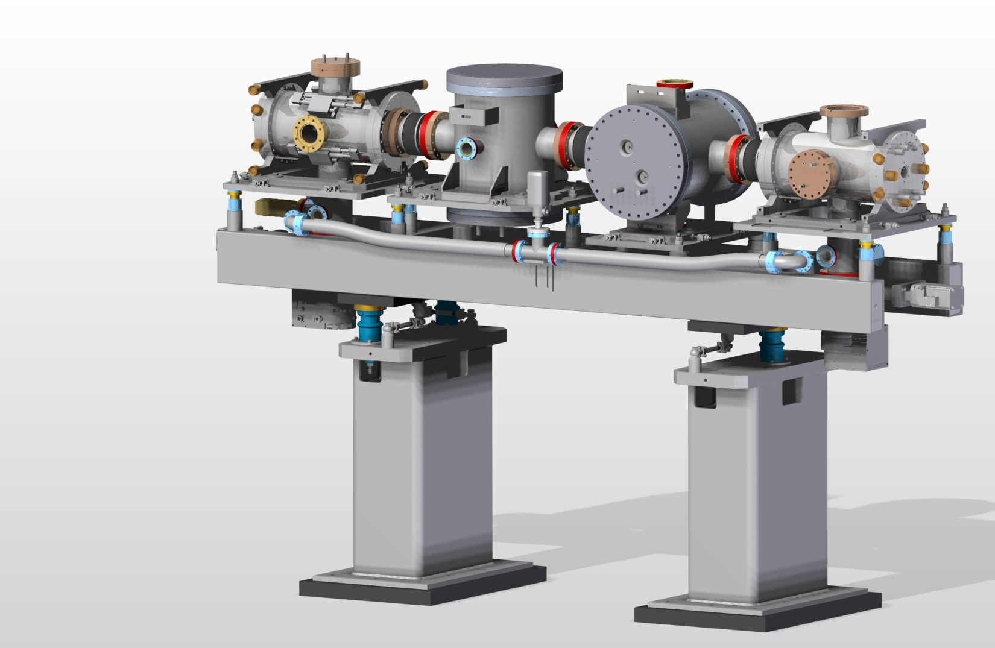
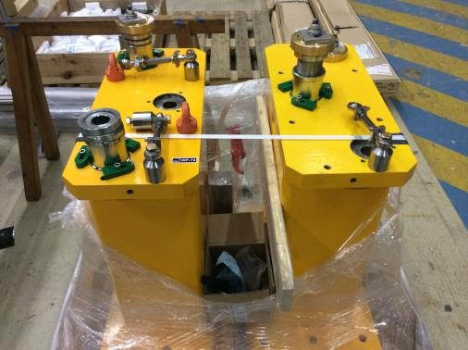
X-ray Gas Monitor (XGM)
Status 04/2014:
Chambers+interior available / in production (Tiedtke group @ FLASH), detailed design of girder and supports done
RFI XTD2/SASE1: 08/2014
(first complete XGM on girder)
Pillars already arrived (RFI)
Integrated in tunnel CAD model,
no collisions
Installation challenge
(worse if e-beamline is
already in place)
N:\4all\intern\User data\wp74\Devices\11-1_XGMD\Drawings\FEM steel base frame\support_pillar_pictures

Slide 8
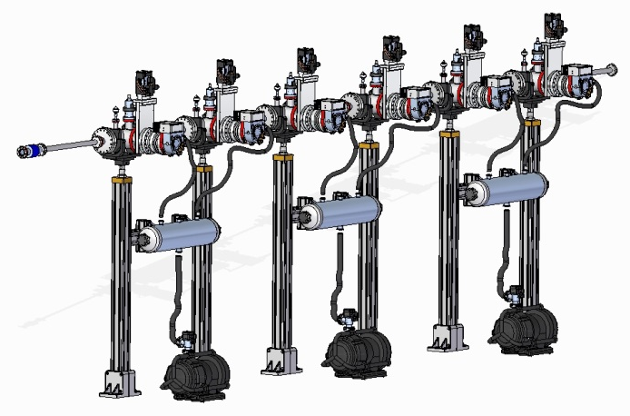
Differential Pumping by WP74
(between PES and XGM)
Status 04/2014:
Design done, mostly standard parts, simlar to WP73 systems
Ordering of vacuum components started
RFI 06/2014 (but installation might be timed with PES)
Integrated in tunnel CAD model, no collisions
N:\4all\intern\User data\wp74\Devices\11-1_XGMD\Drawings\FEM steel base frame\support_pillar_pictures

Slide 9
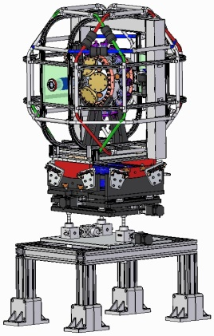
Photoelectron spectrometer (PES)
Status 04/2014:
Detailed design done (SASE3,
modifications for SASE1 required)
Design of Fully motorized support:
done, production ongoing
Most parts for SASE3 device arrived
RFI SASE3 ~10/2014
RFI SASE1 not in 2014 XTD2 installation phase
→ temporary pipe of 1.6m DN40CF,
on dedicated holder
N:\4all\intern\User data\wp74\Devices\11-1_XGMD\Drawings\FEM steel base frame\support_pillar_pictures

Slide 10
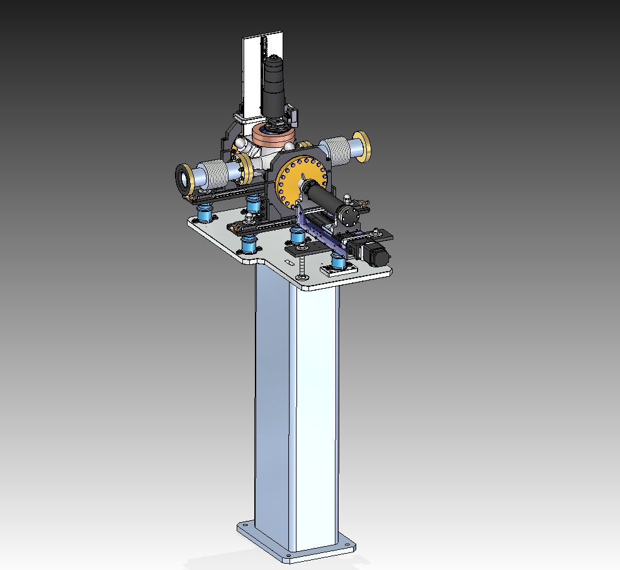
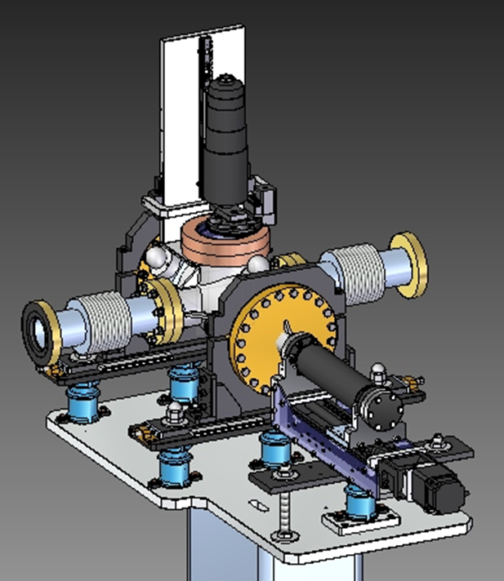
2D-imager (FEL)
Status 04/2014:
Prototype with control crate in lab
Production SASE1 device ongoing
Optics development ongoing
RFI XTD2/SASE1: 06/2014
No collisions in tunnel CAD model
..

Slide 11
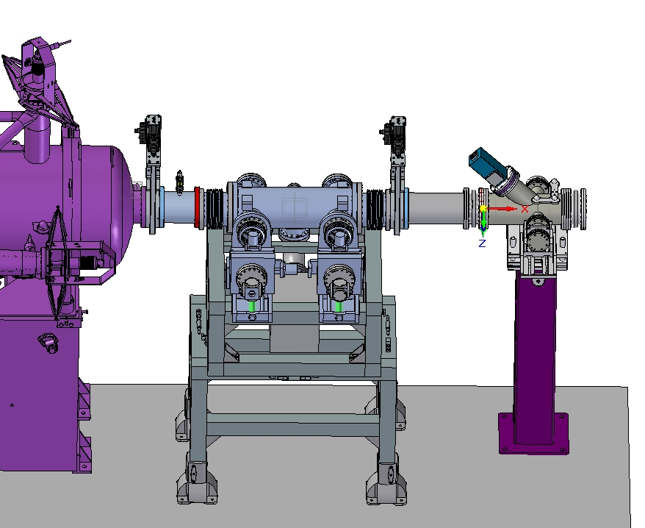
MCP-based detector (by JINR)
Status 04/2014:
CDR/TDR/PPR done, prototype at HERA-S and tested
Final supports arrived
Transformation of prototype to SASE1 device in 06/2014
Integrated in tunnel CAD model, no collisions
Design of camera optics ongoing
N:\4all\intern\User data\wp74\Devices\31-1_MCP-Detector\3D-sketches

Slide 12
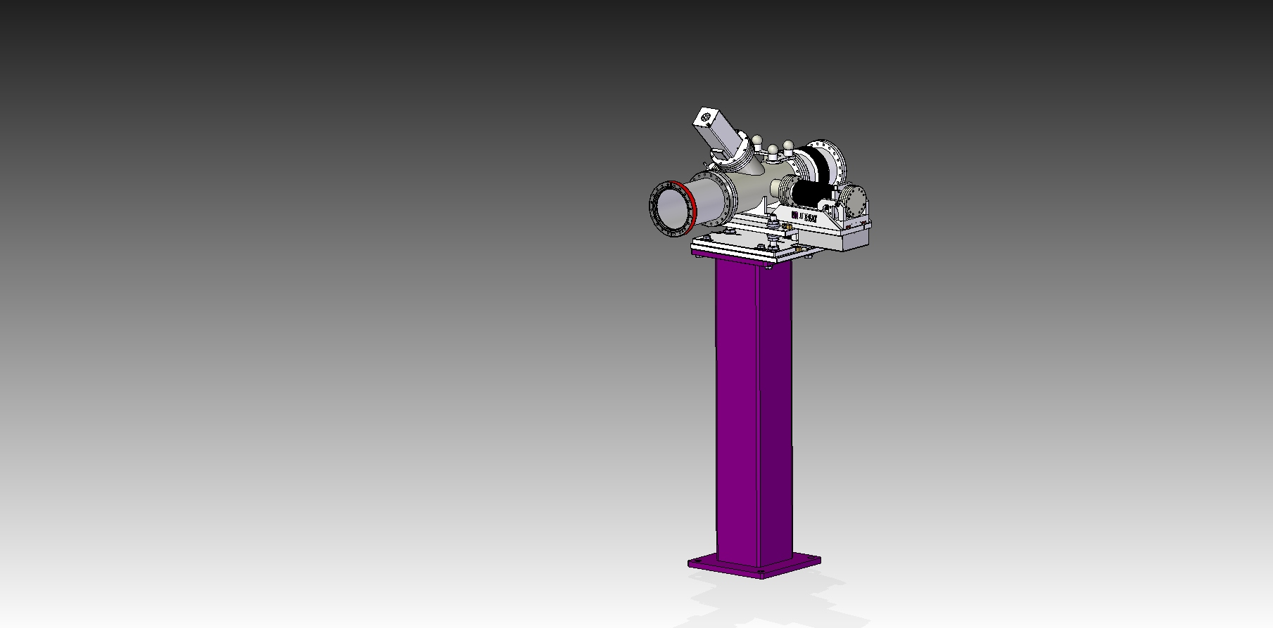
Pop-in Monitor Type II-45°
Status 04/2014
FDR/PPR done, production ongoing at JJ X-ray
Acceptance of two initial devices done 03/2014
Delivery of all devices for all tunnels in 05/2014
Integrated in tunnel CAD model, no collisions
Detailed optics implementation ongoing
N:\4all\intern\User data\wp74\Devices\31-4_Pop-In-Monitors

Slide 13
WP74 summary for SASE1 / XTD2
Device
RFI status
Filter chamber
Transmissive Imager
K-mono
2D-imager (for SR)
XGM
Differential Pumping by WP74
PES
2D-imager (for FEL)
MCP detector
Pop-in Monitor II-45°
OK
OK
OK
TBD
OK
OK
temp. solution
OK
OK
OK

Slide 14
Other current WP74 design activities
(not related to XTD2 installations)
Hard X-ray Single Shot Spectrometer (HXHRSSS)
Diamond Detectors for Intensity & Position Monitoring
Temporal Diagnostics:
THz Streaking and Spectral Encoding
Energy
Energy
600 fs
Setup of a THz-generation
setup at XFEL.EU
THz streaking
Participation in a beamtime with PSI at SACLA (2/2014)
Time
REF
Streaking principle

Slide 15
Open issues
Tunnel installation is approaching, need now more detail
in XTD2 installation plan: sequence and dates
of device vacuum installations, cabling, other infrastructure,
temporary storage in tunnels/shafts,…
XTD1 (SASE2) CAD-collisions of supports and transport
need to get clarified, this might lead to significant redesigns
of WP74 devices compared to SASE1
Coordination needed for common orders across WPs:
  Large sets of turbo pumps
  Control racks (Beckhoff)
  Cables for connecting devices to racks/crates

Slide 16
WP74 summary
SASE1 / XTD2 devices on track
Other current WP74 design activities (no time for details):
  Hard X-ray Single Shot Spectrometer
  Diamond Detectors
  Temporal Diagnostics
Need now more detailed, agreed XTD2 installation
planning for Q2+Q3/2014 (sequence and dates)

