Slide 1
Major activities in the experimental hall
2013 – 2014 – 2015
G. Wellenreuther
Notes:
How to edit the title slide
Upper area: Title of your talk, max. 2 rows of the defined size (55 pt)
Lower area (subtitle): Conference/meeting/workshop, location, date,
your name and affiliation, max. 4 rows of the defined size (32 pt)

Slide 2


The major players
Instruments
+ PP-Laser
PSPO
SR
TS
BAU
MKK
IPP

Slide 3
The major tasks
Fine-tuning of construction activities
(elevators & cranes, access & transport, surveying…)
Strengthening of the XHEXP1-roof (XHQ!)
Hall infrastructure (MKK)
Final hall floor (Instruments + WTM)
Hutches + Instrument Infrastr. SASE1 / SASE3 / SASE2
(Instruments + WTM + DERU)
Crisis management:
  Forgotten items (Rooms for safety, ...)
  Collisions (only in CAD up to now)

Slide 4
Achievements CAD
XHEXP1 CAD-model restructured & reworked
Master model in JT: S:\services\CAD\XFEL_DataExchange\XHEXP1\JT\TC
Early planning, e.g. XFEL in-house constructions:
done in SE as stand-alone add-ons to the model
Call for Tender: Preparation and as-built in AutoCAD MEP
➔ imported by WTM
➔ integrated into building model by IPP (S. Sühl, I-DEAS)
➔ exported to SE as part of the building model
Working as intended.
Still to do: Automatic upload of master model into EDMS

Slide 5
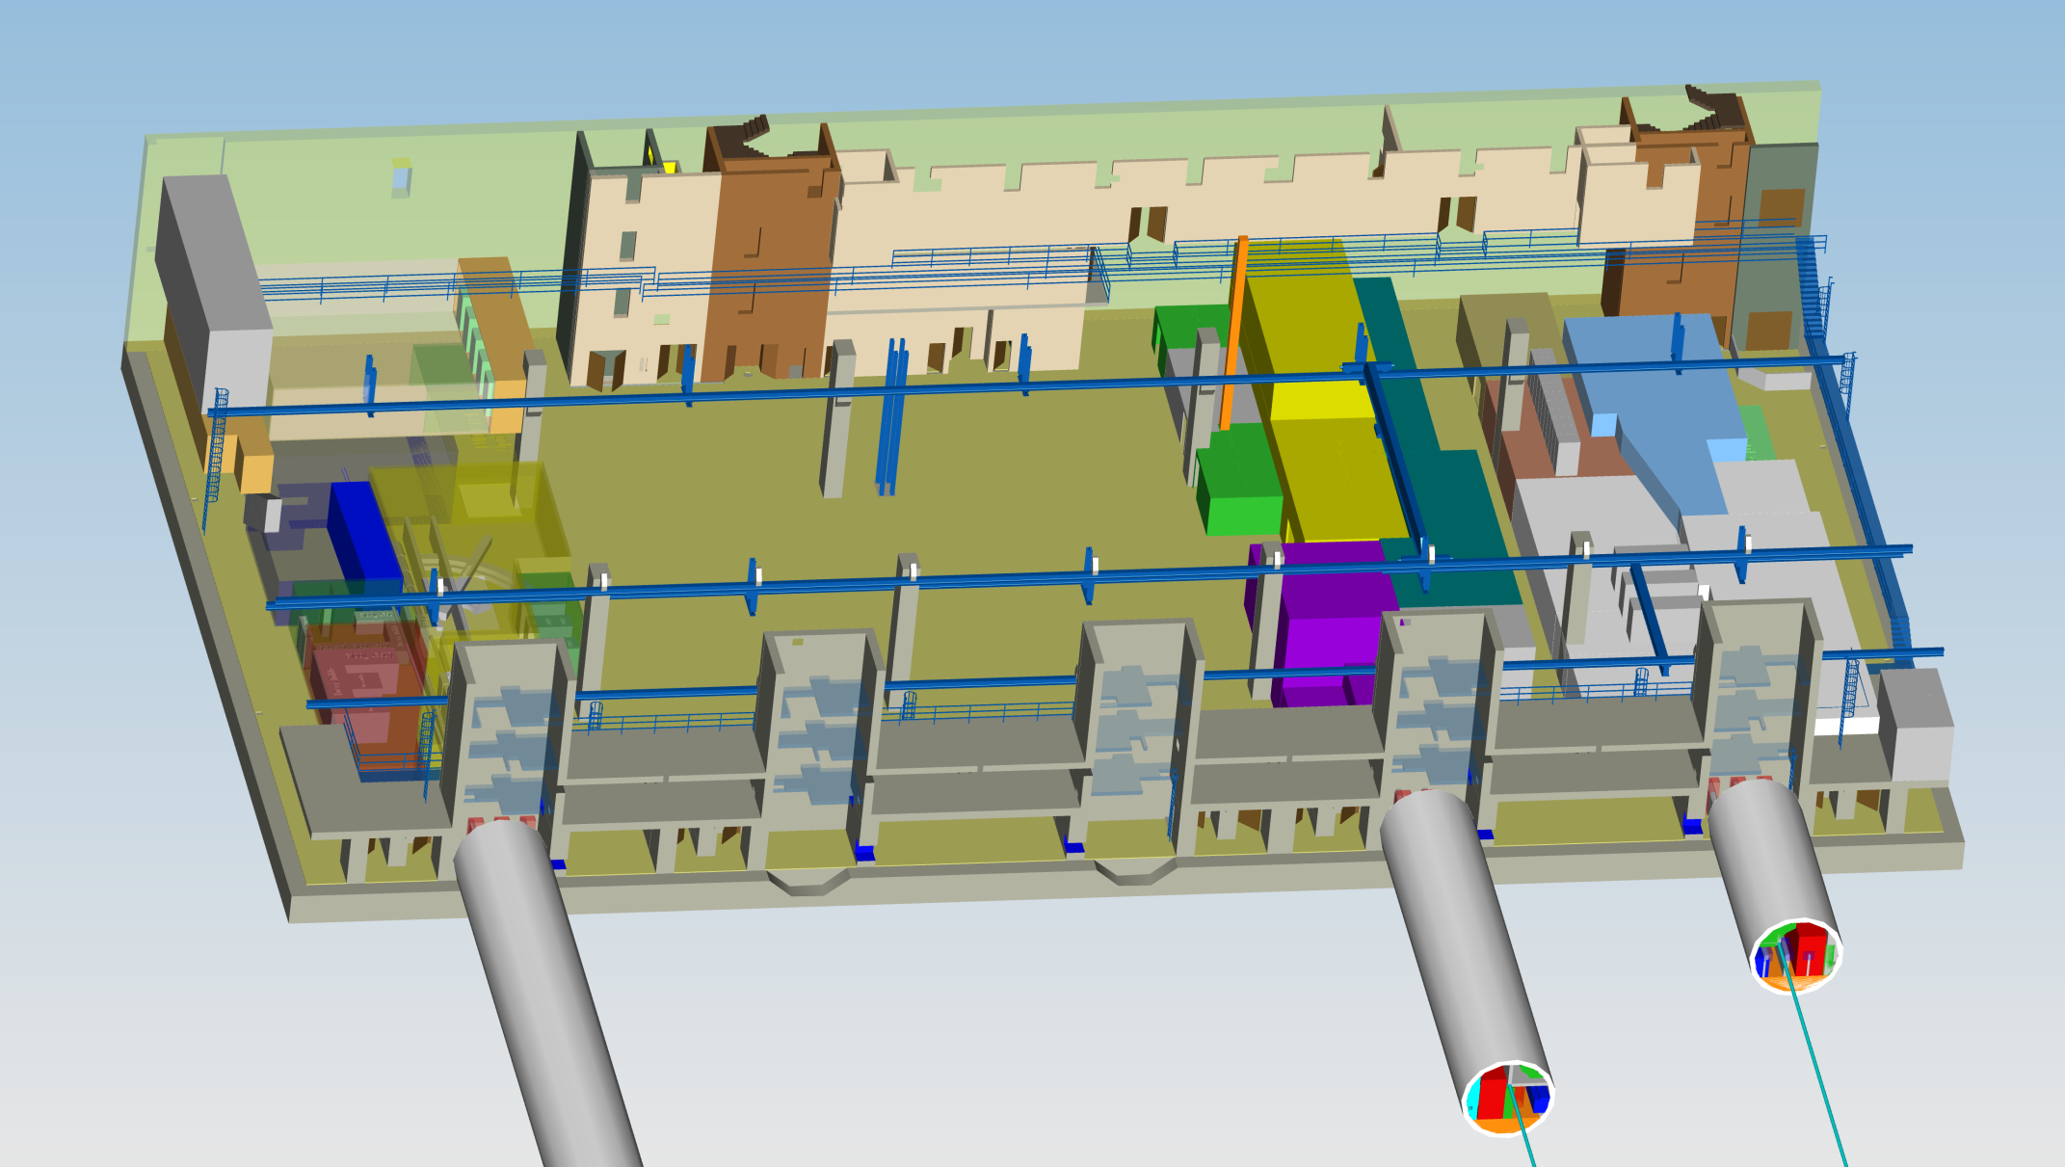
Slide stolen from last year:
„Current status of the CAD-integration model“

Slide 6
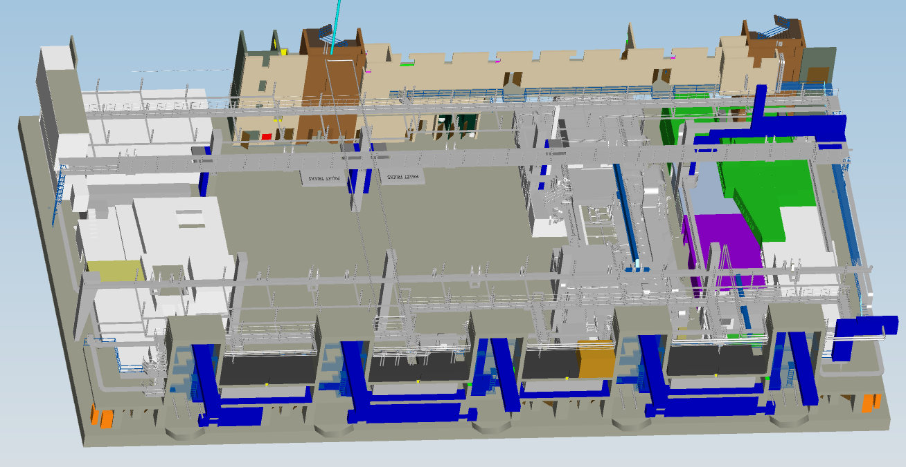
April 2014: CAD-Master model

Slide 7
Achievements in Safety and Radiation Protection
Occupational Safety and Radiation Protection
  Gathering information for access control system
  Shielding requirements for hutches defined including design of chicanes
  First outline of personnel safety system available
  Fire protection requirements for hutches clarified
Outlook:
  Continuation of Laser and Radiation Protection Concept
  Reconfirmation of shielding calculations by expert – May 2014
  Implementation of emergency off concept
  Elaboration risk assessment tool for experiments
Talk by Eric Boyd (XFEL SR)

Slide 8
Achievements Hutches
SASE 1 hutches: cardbord-box model ➔ detailed model
  Choice of preferred wall construction method
  Realistic wall thicknesses, chicanes for infrastructure etc.
Outlook:
  Prequalification-process – End of April
  Selection of qualified participants – End of May
  Submission for call for tender – End of June
  Selection of contractor & award of contract – End of July
  Execution planning – August + September
  Prefabrication – October + November
  Installation of SASE1 Hutches – ca. April 2015
In parallel: SASE3 (+3 months), SASE2 (+6 months)
SASE 1 infrastructure
  Requirements: Several iterations with instruments & DERU
  Placement on top of the hutches w/o
Talk by Per Dost (WTM)

Slide 9
Achievements Instrument Infrastructure
Instrument infrastructure
  Gathering requirements: Several iterations with Instruments, Lasers & DERU
  Placement on top of the hutches without affection NANO-E
  Space for air chicanes / alternative solutions were found
Outlook:
  Independent Review - 14th May 2014
  Execution planning phase SASE1
  Draft planning SASE3 using the concepts from SASE1
  Call for tender of infrastructure SASE1 (- November 2014)
  Execution planning phase SASE3
  Draft planning SASE2…
Talk by Ronald Steiger (DERU)

Slide 10
Achievements Grounding Scheme
Instruments:
Would like to be isolated for the purpose of signal processing
Need X-Rays, power, IT, climatization…
Separation of entire SASEs from the „outside world“
Infrastructure planner:
Cost effort for entire separation of SASEs is extremely high
Rather be careful in the experiment design
Ground SASEs to hall level / building earth
Talk by Herbert Kapitza (DESY)

