Slide 1

Progress of planning and execution in XHEXP1
Per Dost
Notes:
How to edit the title slide
Upper area: Title of your talk, max. 2 rows of the defined size (55 pt)
Lower area (subtitle): Conference/meeting/workshop, location, date,
your name and affiliation, max. 4 rows of the defined size (32 pt)

Slide 2
Overview
Additional support of the major beam
Progress steel construction for infrastructure
Experimental hall floor planning
Construction of hutches SASE1
  Special requirements
  Access and transport
  Call for tender / award the contract
  Time schedule

Slide 3
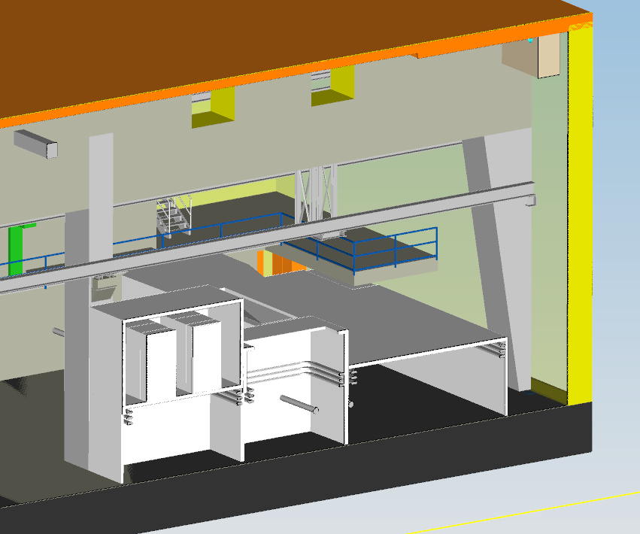
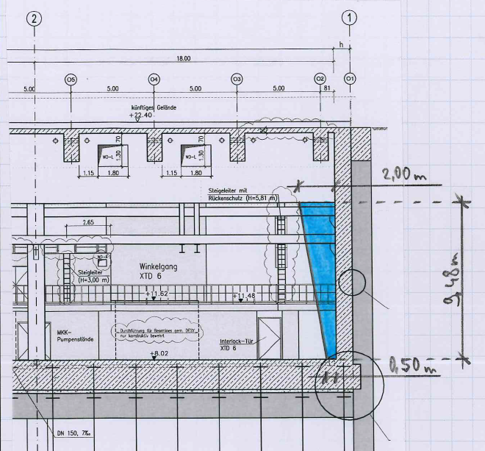
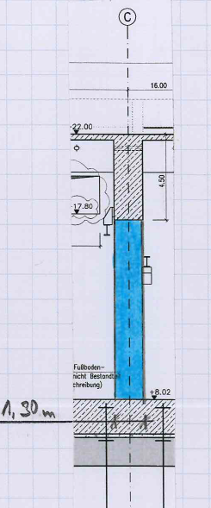
Additional support of the major beam
Additional loads of XHQ → additional Support of major beam

Slide 4
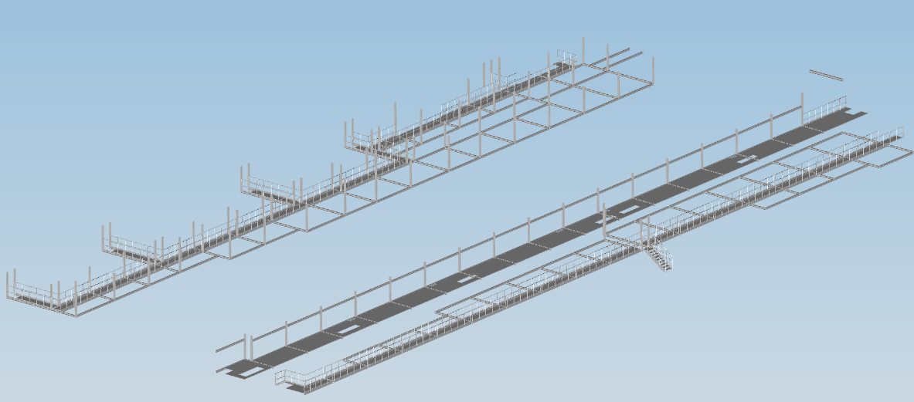
Progress steel construction for infrastructure
Planned

Slide 5
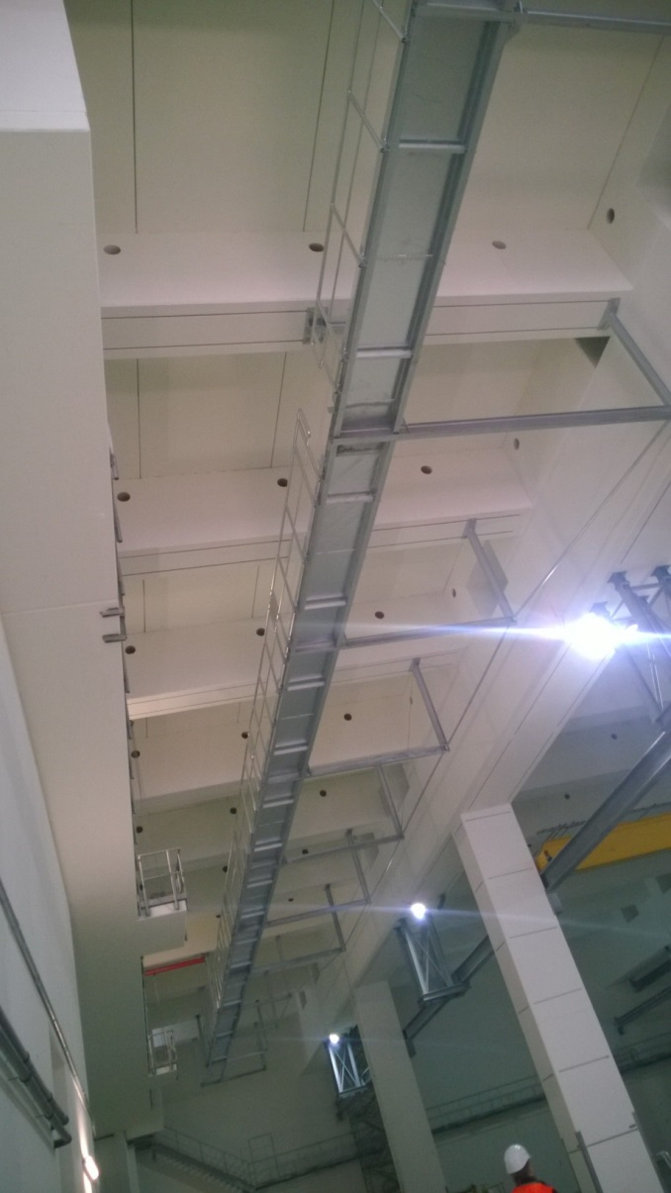
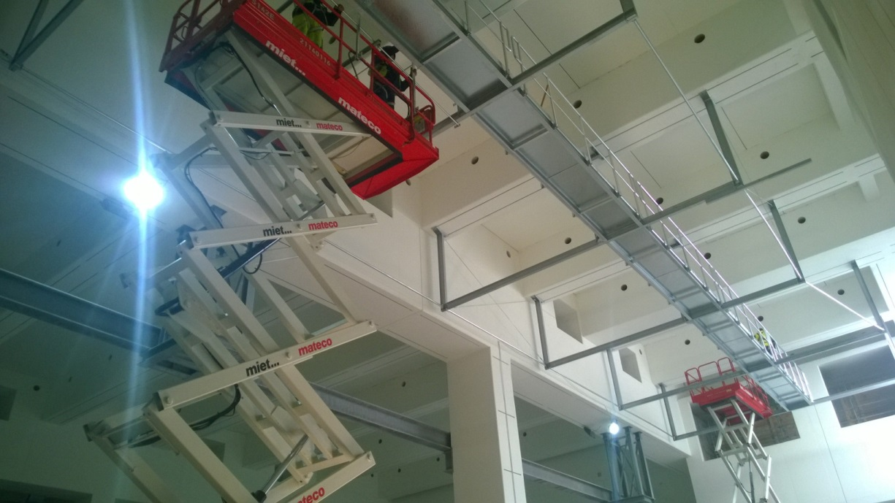
Progress steel construction for infrastructure
Current status

Slide 6
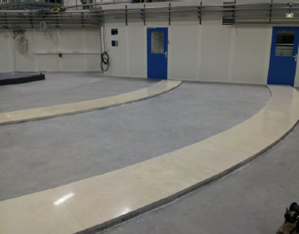
Floor planning
Requirements:
  Load capacity: 50 kN/m² (traffic load), 300 N/cm² (single load)
  Planarity: 10 mm / 10 m
  High resistance to abrasion/ easy to clean
  Reinforcement (Q-Mats) for grounding
  Some areas with floor-coating (conductivity <10⁵ Ohm)
  Cutouts for high precision granite tiles
1st step: screed with cutouts
2nd step: integration granite tiles

Slide 7
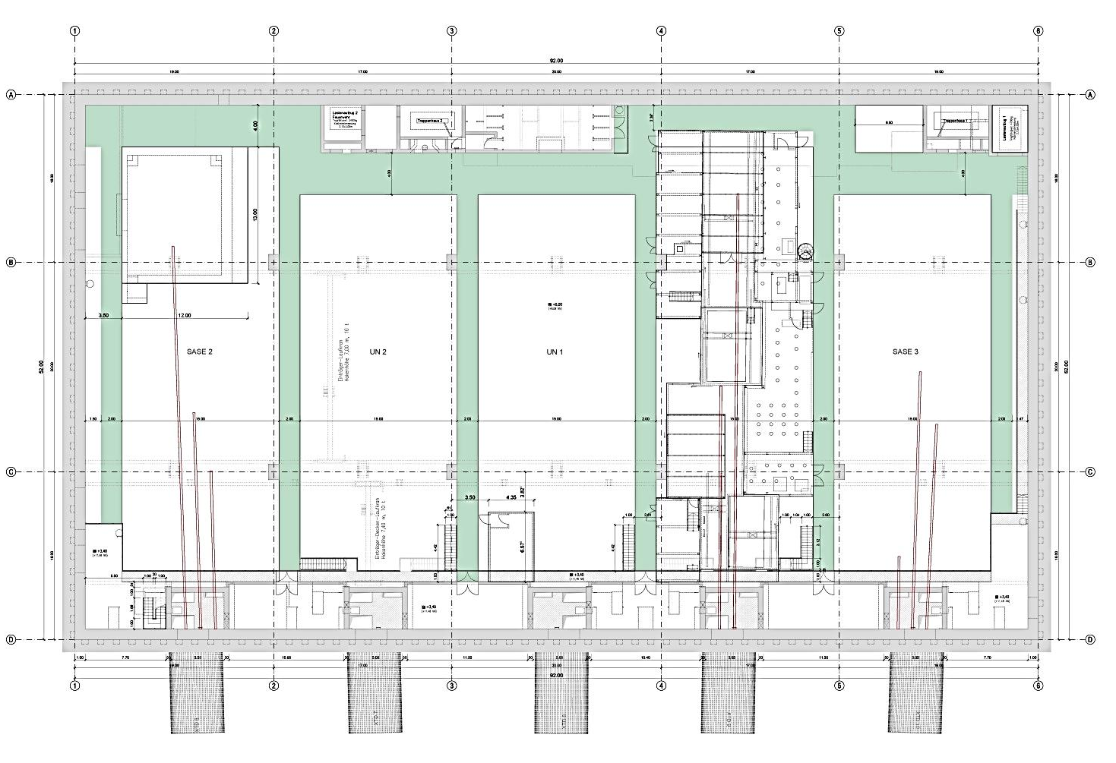
Construction of hutches SASE1
SASE2
UN2
UN1
SASE1
SASE3
XTD6
XTD7
XTD8
XTD9
XTD10

Slide 8
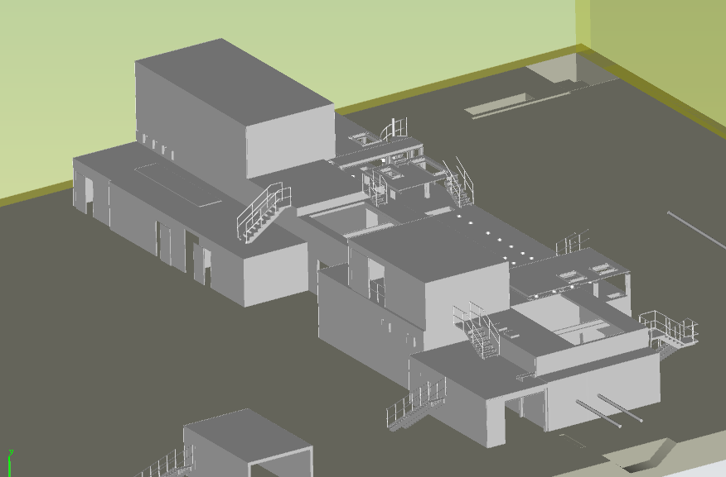
Construction of hutches SASE1
Hutches for SASE1 on two floors

Slide 9
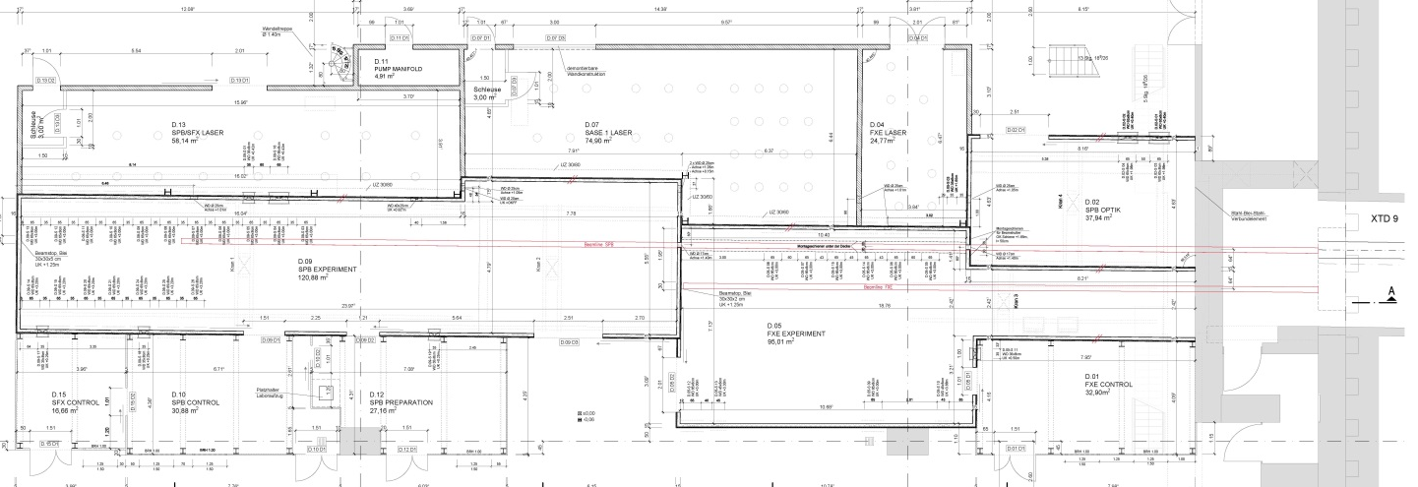
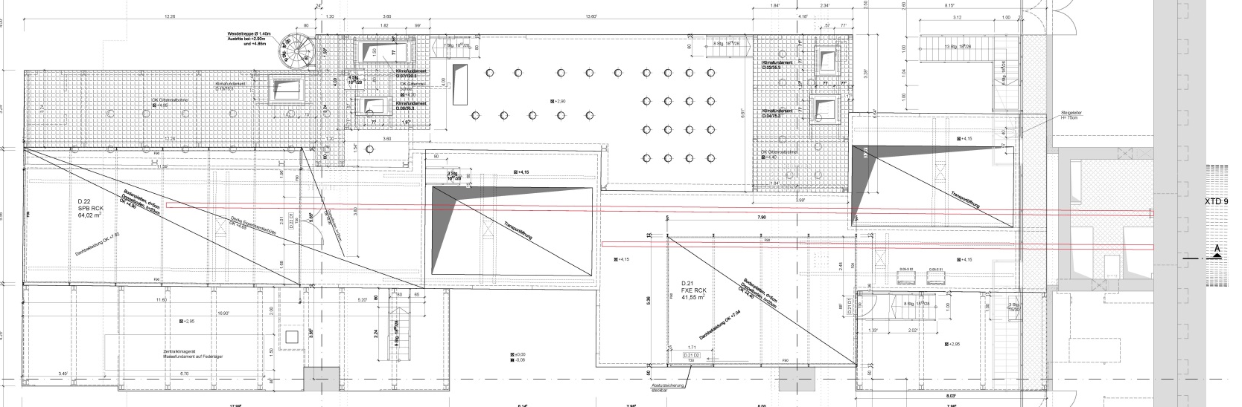
Construction of hutches SASE1
1st floor
2nd floor
Laser
Experiment
XTD9
Control/ Preparation
Rack
XTD9

Slide 10
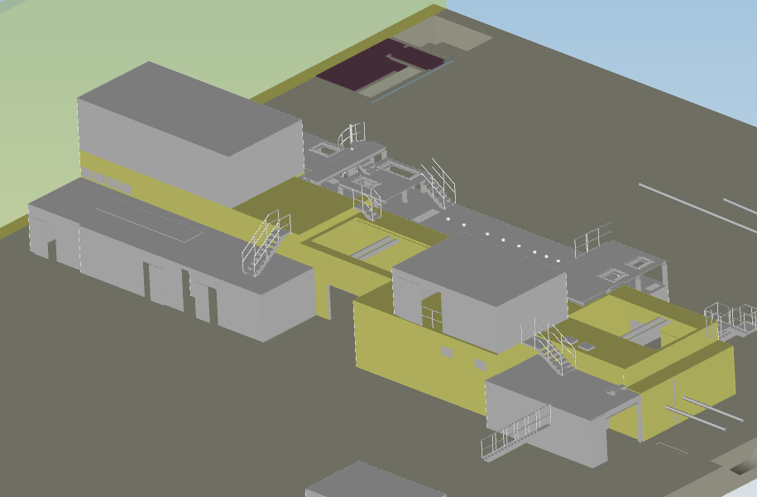
Construction of hutches SASE1
Four types of hutches because of different requirements
  Experimental hutches
  Major requirements: radiation protection
  Construction: steel-framework with lead-steel sandwich

Slide 11
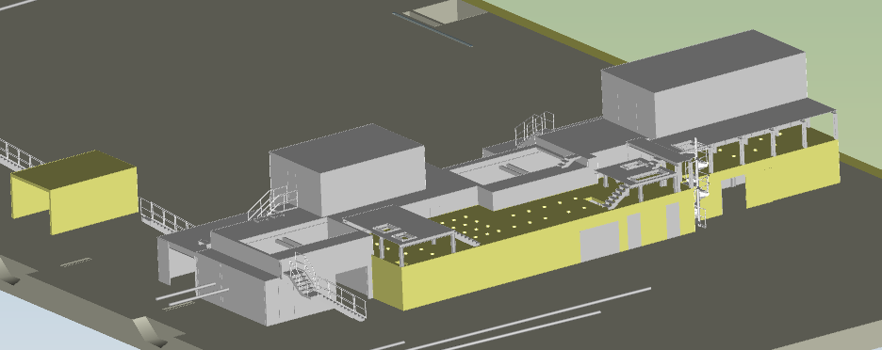
Construction of hutches SASE1
Four types of hutches because of different requirements
  Laser hutches
  Major requirements: low-vibration
  Construction: lime-sand brick wall,
              reinforced concrete ceiling

Slide 12
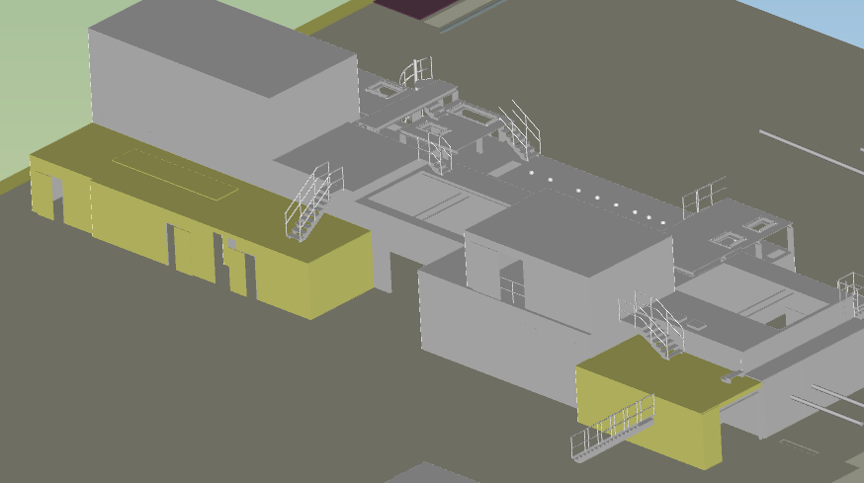
Construction of hutches SASE1
Four types of hutches because of different requirements
  Control/ Preparation hutches
  Major requirements : no special requirements
                → cost-efficient
  Construction: steel-construction with panels

Slide 13
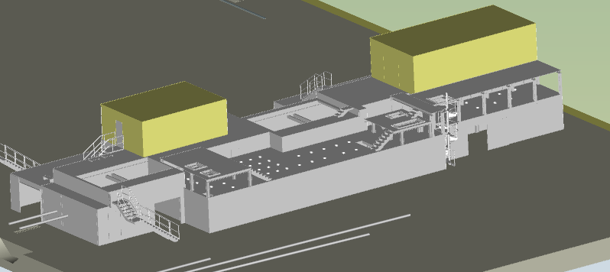
Construction of hutches SASE1
Four types of hutches because of different requirements
  Rack hutches
  Major requirements : fire resistance F90, inside to outside
  Construction: steel construction with drywalls

Slide 14
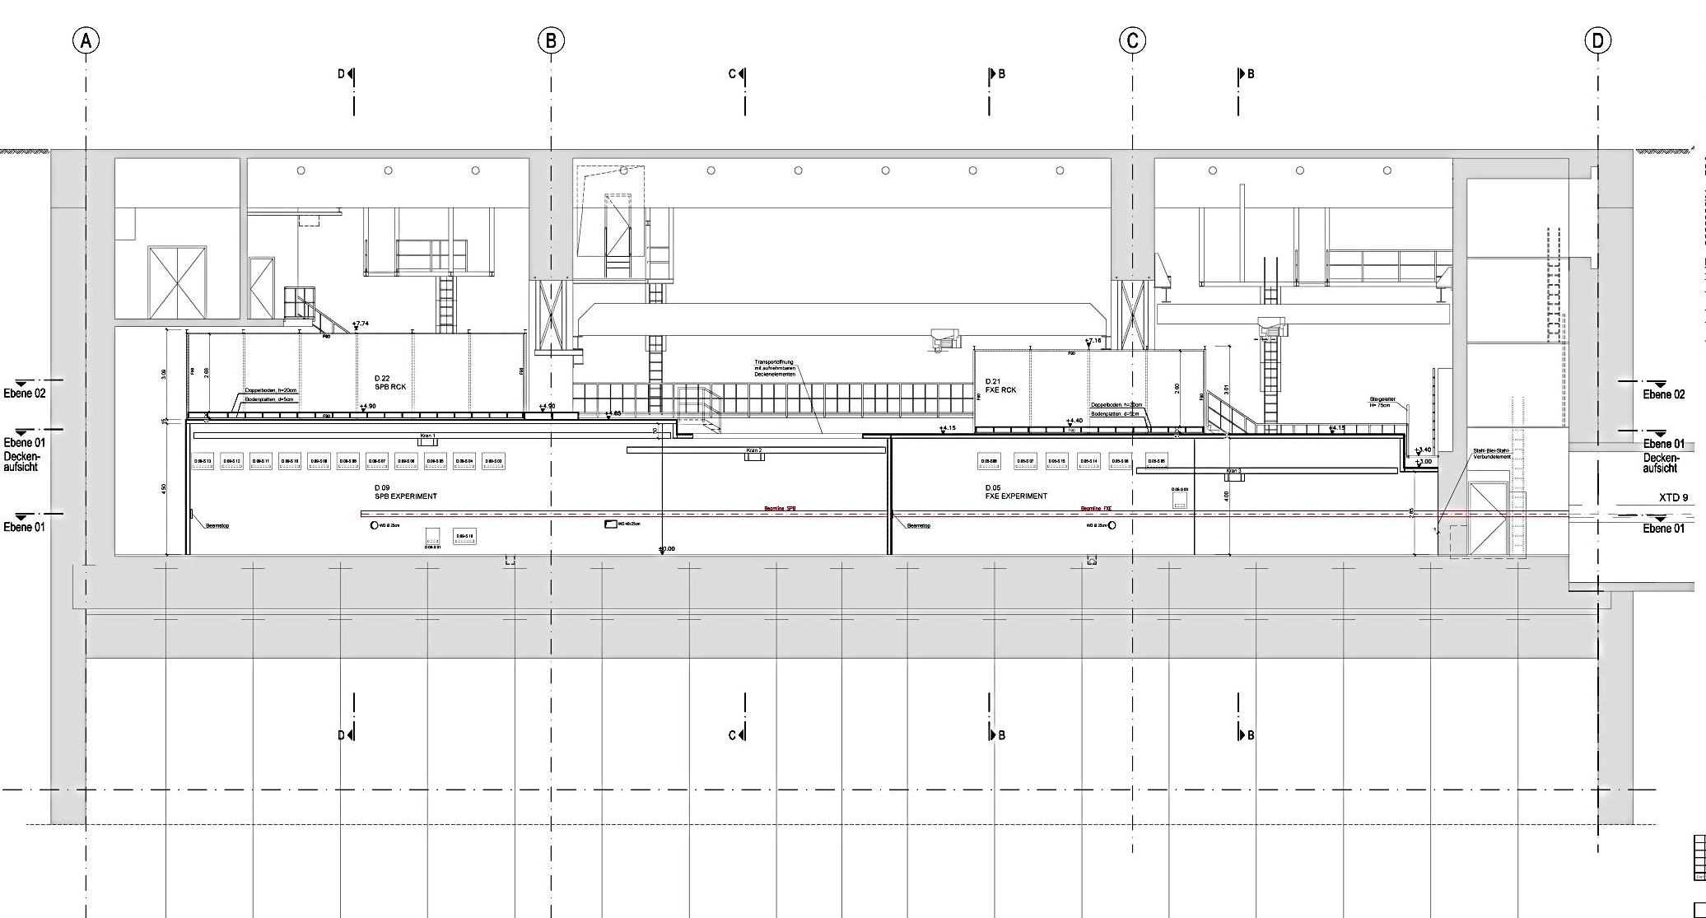
Construction of hutches SASE1
2nd level adapted to the freeways of hall-cranes
section
crane 1
crane 2
Rack
Experiment

Slide 15
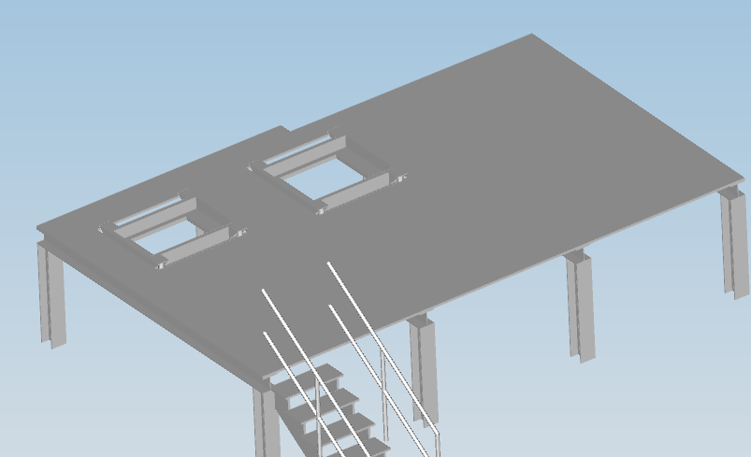
Special requirements
Cranes with a minimal construction height
  “Zwei-Träger Brückenkrane”
Vibrational damping: Heavy-weight, vibrationally isolated steel support structures for climatization devices

Slide 16
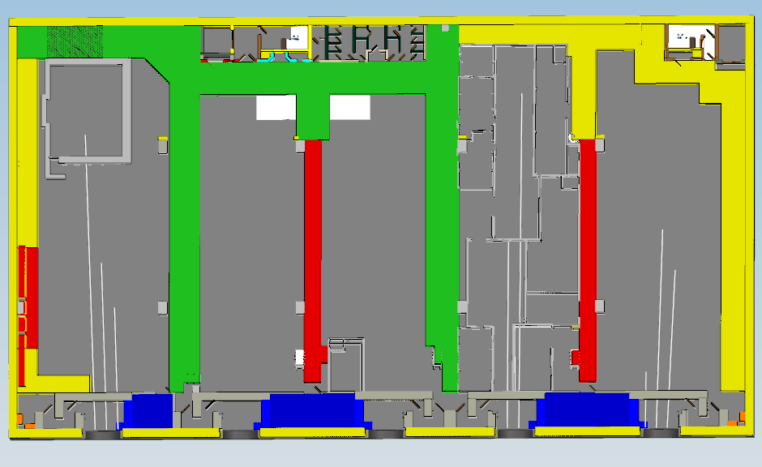
Access/ Transport
Detachable roof elements for some of the radiation protection hutches
Removable wall elements in the laser hutch SASE1
Freeway for transport with varying width
4 m
2 m
SASE2
UN2
UN1
SASE1
SASE2

Slide 17
Call for tender / award the contract
Procedure of the call for tender
  “Nicht-offenes Europaweites Verfahren mit Teilnahmewettbewerb”
  Procedure with two steps:
    Prequalification
      Selection of 3-5 companies with good qualification and experience with planning and execution of experimental hutches with lead shielding
    Call for tender
      Submission of the tender from 3-5 companies (selected companies after prequalification)
      Award the contract to the company with the best offer

Slide 18
Time schedule
Prequalification 04/2014
Evaluation the prequalification 05/ 2014
Forward the call for tender beginning of 06/2014
Submission the call for tender end of 06/2014
Evaluation the call for tender 07/2014
Award the contract beginning of 08/2014
Planning and construction until 05/2015

