Slide 1
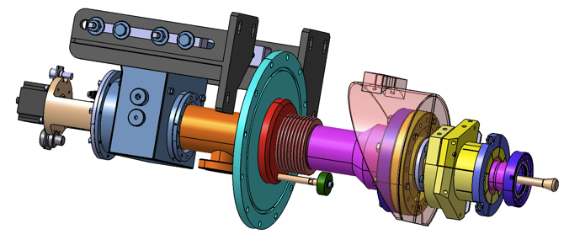
ACB Meeting- Cold LINAC: Cavities & Modules
WP05: Status of XFEL power coupler
DESY-Hamburg, April 7th 2014
Walid KAABI- LAL/Orsay
Notes:
How to edit the title slide
Upper area: Title of your talk, max. 2 rows of the defined size (55 pt)
Lower area (subtitle): Conference/meeting/workshop, location, date,
your name and affiliation,
max. 4 rows of the defined size (32 pt)
Change the partner logos or add others in the last row.

Slide 2
Status of XFEL couplers at LAL:
LAL received 138 couplers from February 2013 to date,
130 couplers were RF processed,
20 couplers were rejected (16 between September and October 2013),
Coupler deliveries from RI to LAL in 2014
Nominal rate
Couplers from RI to LAL
Ramp up phase
Week

Slide 3
Status of XFEL couplers at LAL:
In addition to 24 TTF3 couplers (for XM-3, XM-2 & XM1), 96 XFEL couplers were already delivered to IRFU (up to XM12),
A buffer of 5 modules is available at IRFU and could be increased next weeks.
Coupler deliveries from LAL to IRFU in 2014
Couplers from LAL to IRFU
Nominal rate
Ramp up phase
Week

Slide 4
Status of XFEL couplers at LAL:
Weekly inspection meetings are organized at Thales-Thonon to control parts copper plating qualities,
Some defects remains and are accepted with derogation :
Diameter of the circular spots varies from 0,1 to more than 0,5 mm,
The colour of the spots varies from copper like to light grey,
The number of spots varies from 1 to some tenth per wave,
Acceptance criteria (with NCR):
  Spots diameters must be <0,2mm,
  The number of spots per wave must be <10,
  Only the valley spots valley are concerned by this deviation, spots in the bellow hill are not accepted,
  The copper like spots are not concerned by this acceptance criteria,

Slide 5
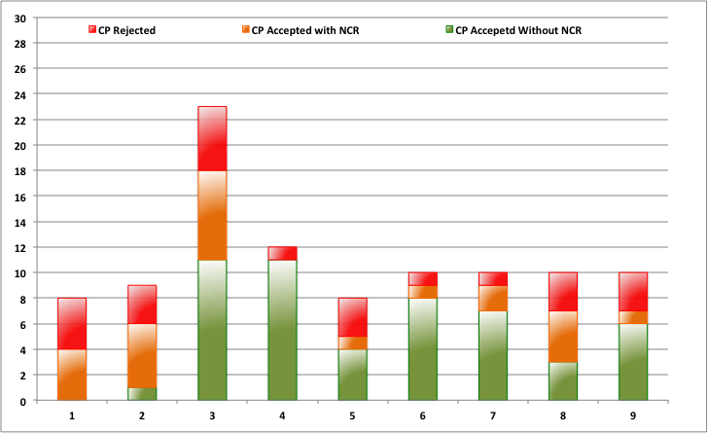
Status of XFEL couplers at LAL:
Bath change
Nbre of cold part
Air leak in the copper bath
Inspection meeting

Slide 6
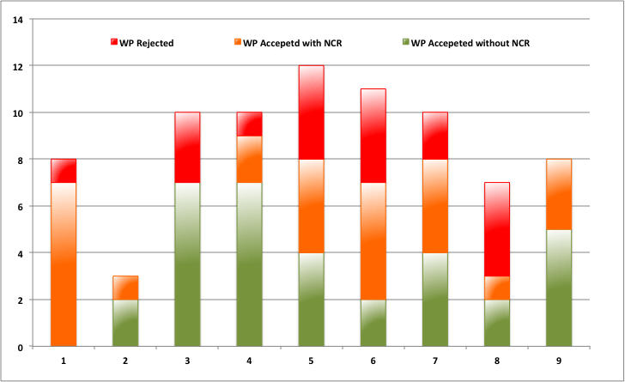
Status of XFEL couplers at LAL:
Bath change
Air leak in the copper bath
Nbre of warm part
Inspection meeting

Slide 7
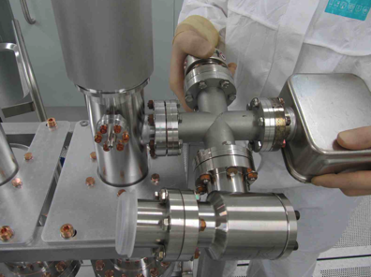
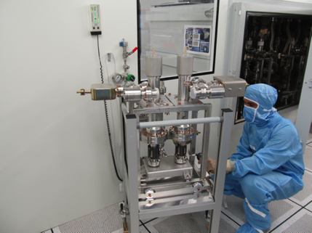
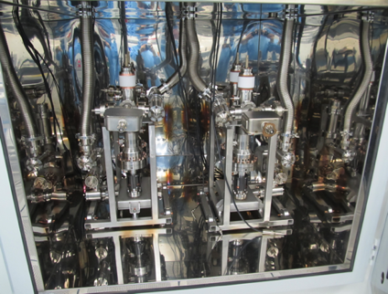
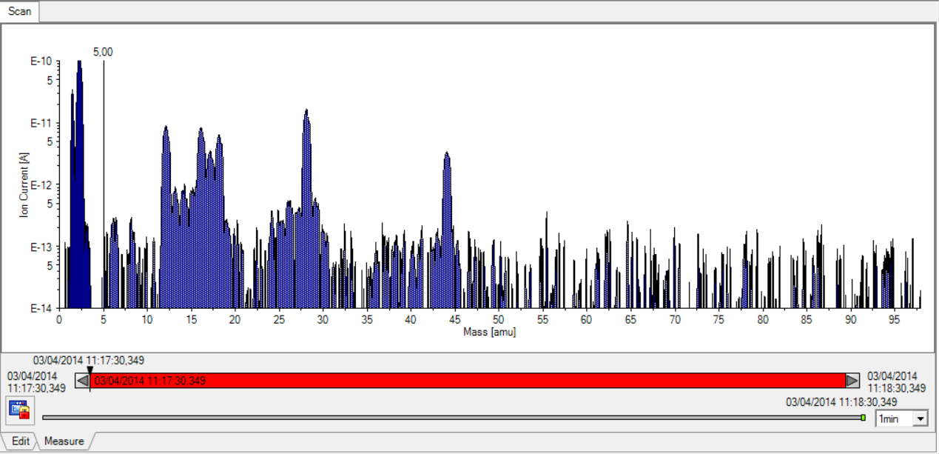
Leak test, in-situ baking & RGA recording at LAL:
Pumping groups installation
Leak test
75h baking cycle at 130°C
RGA spectrum recording

Slide 8
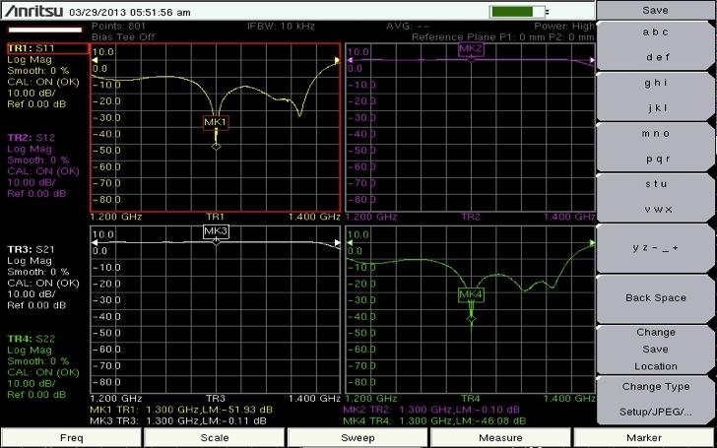
Antenna tuning:
Assembly of:
WGBs
Capacitors
Actuators
Antenna tuning

Slide 9
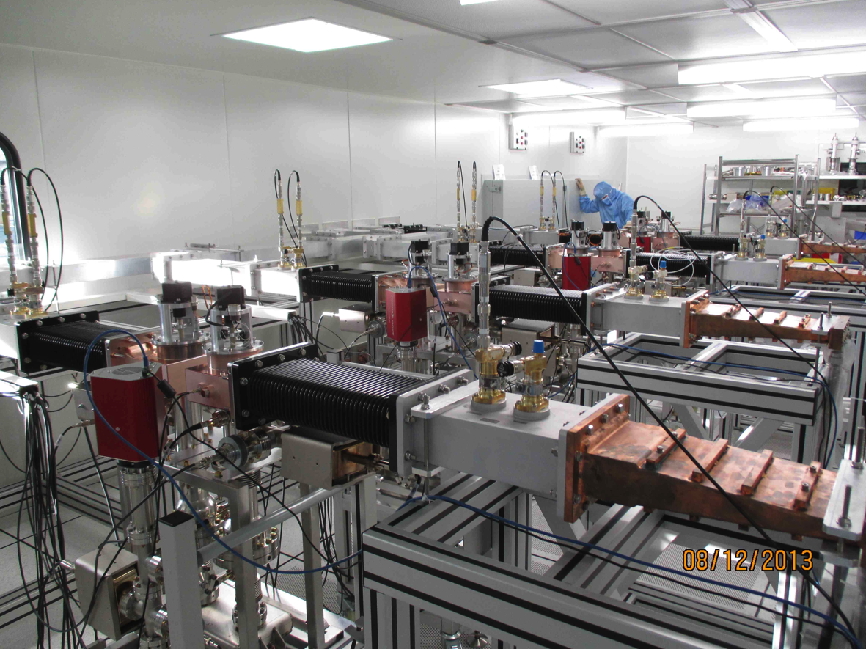
Coupler pairs installation in the RF test stands:

Slide 10
Thank you for your attention

