Slide 1
WP-06: HOMs and Pickups
Status:08-04-2014
J. Sekutowicz

Slide 2
Components delivery;
Output lines for HOMs and Pickups
Component | Amount needed | Percentage Delivered [%] | Percentage Ready for Delivery [%] | Comment
HOM feedthroughs | 1616 | 100 | - | Spare parts available
Pickup feedthroughs | 808 | 100 | - | Spare parts available
HOM Thermal Connections | 1616 | 100 | -
HOM Loads | 1616 | 100 | -
HOM and Pickups warm feedthroughs | 2424 | 100 | -
Cryomodule cable sets | 101 | 72 | 28
Notes:
Before you start editing the slides of your talk change to the Master Slide view:
Menu button “View”, Master, Slide Master:
Edit the following 2 items in the 1st slide:
1) 1st row in the violet header:
Delete the existent text and write the title of your talk into this text field
2) The 2 rows in the footer area: Delete the text and write the information
regarding your talk (same as on the Title Slide) into this text field.
If you want to use more partner logos position them left
beside the DESY logo in the footer area
Close Master View

Slide 3
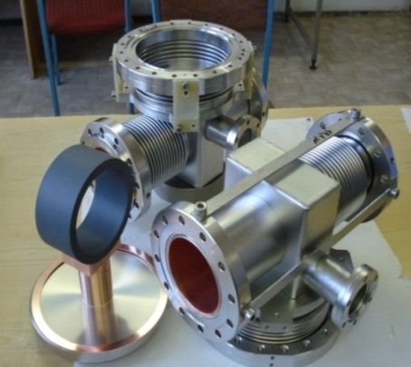
Components delivery;
Beam line absorbers
Absorbing ceramic ring
Chamber housing absorbing ring
Component | Amount needed | Percentage Delivered [%] | Percentage in Fabrication [%] | Comment
Beam Line Absorber | 108 | 26 | 19 | Problem with fabrication of ceramic rings. Previous vendor stopped production after 60 pieces were delivered. New vendor scheduled delivery of 60 ceramics for May 2014. Cleanness required improvement (caused delay of delivery). Final delivery will be on 30.09.14
BLA Thermal Connection | 108 | 100 | -
Notes:
Before you start editing the slides of your talk change to the Master Slide view:
Menu button “View”, Master, Slide Master:
Edit the following 2 items in the 1st slide:
1) 1st row in the violet header:
Delete the existent text and write the title of your talk into this text field
2) The 2 rows in the footer area: Delete the text and write the information
regarding your talk (same as on the Title Slide) into this text field.
If you want to use more partner logos position them left
beside the DESY logo in the footer area
Close Master View

