Slide 1
WP 33 –Tunnel Installation
Magnet Suspensions
Norbert Meyners, MEA1/WP33
for
Roland Platzer, Peter Talkovski, ZM1

Slide 2
Content
Where?
Why?
Solutions
Status

Slide 3
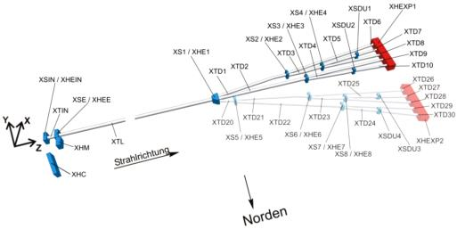
Where?
XTD2, R 13-16
XTL, R 28-36
XTL, R 37-41

Slide 4
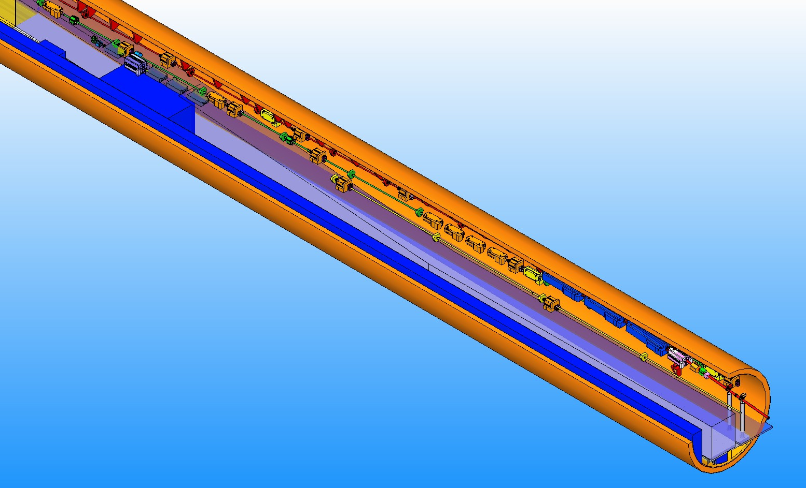
Why? In XTL R37 – 41 (and XTD2 R13 -16)
Transport way crossing below the beam lines
In XTL
(and in
XTD2)
XTL R 37-41

Slide 5
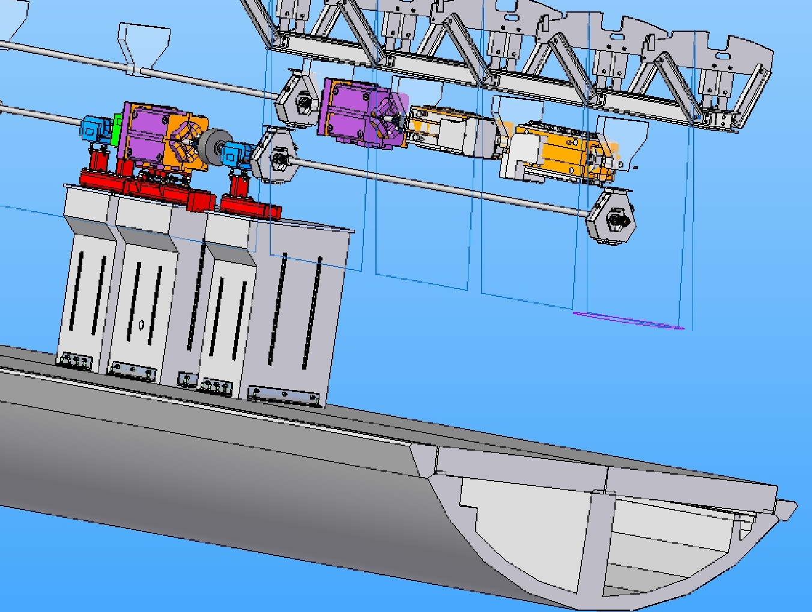
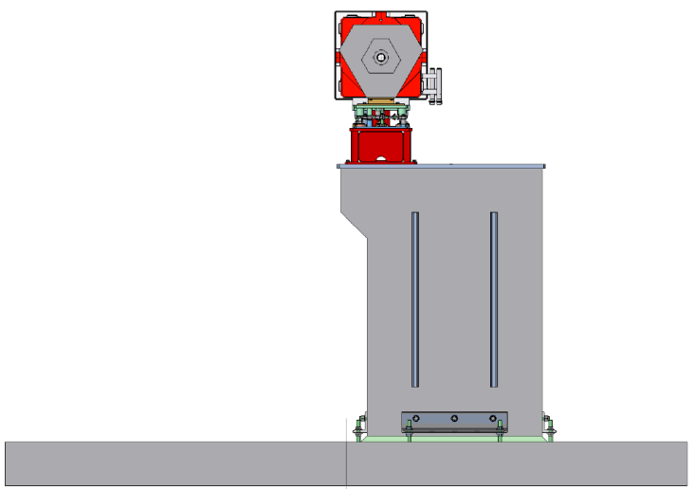
Why? In XTL R28 -36
Our standard solution
(adjustment units on
concrete columns)
did not meet the
vibration requirements!
Remark: Beam height 2.2m plus floor slabs
➔ lowest: 25Hz (Calculated; Required: > 50Hz)
Part of T4/R9

Slide 6
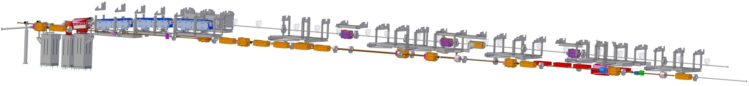
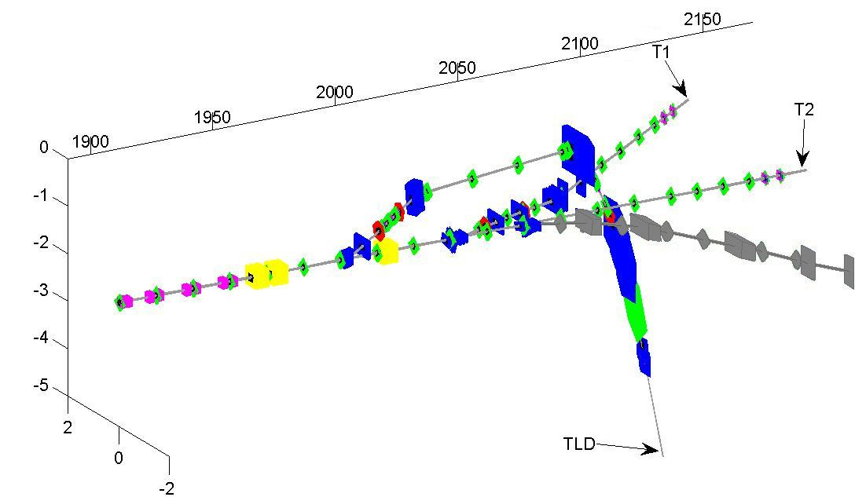
Solution
e+
Frames suspended from ceiling
Dump beam line (TLD) above with separate frames
BV magnets (TLD) hanging for
maintenance and installation reason
e+

Slide 7
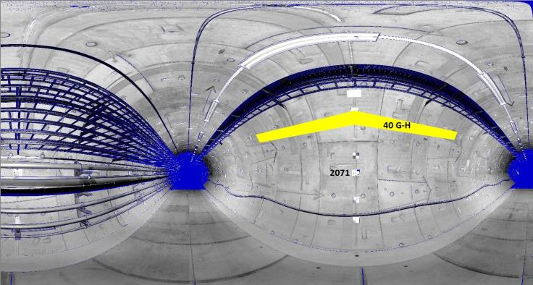
Old Position of U-Beam ./. Survey Marks
Found using laser scan data
➔ Move U-beam up

Slide 8
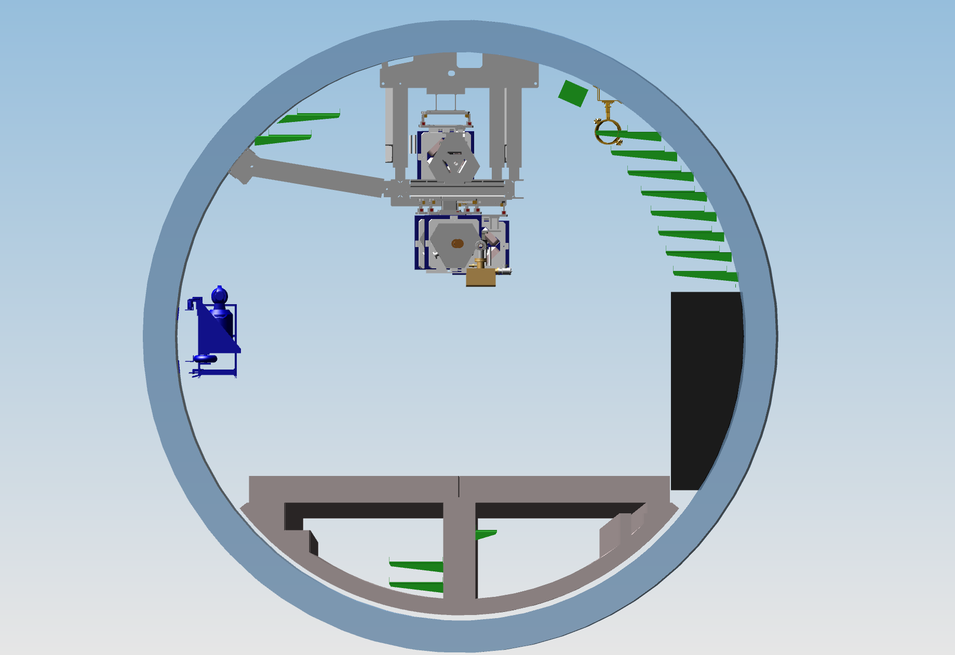
XTL R39 | front view
Horizontal and vertical Eigen frequencies >=~50Hz (calc.)
x --- TLD
T1 --- x
x --- T2

Slide 9
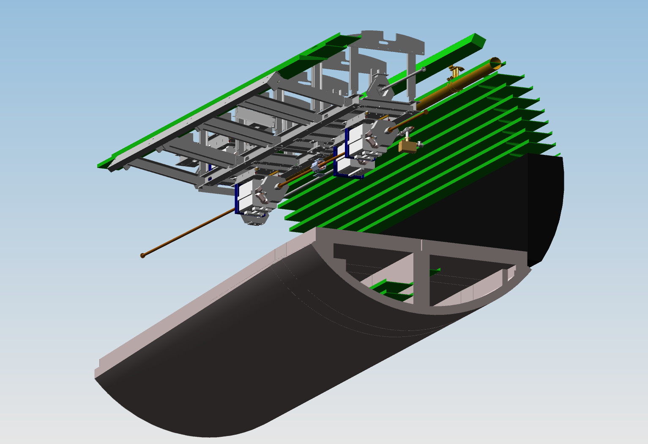
XTL R39 | mole view
TLD
T1
T2

Slide 10
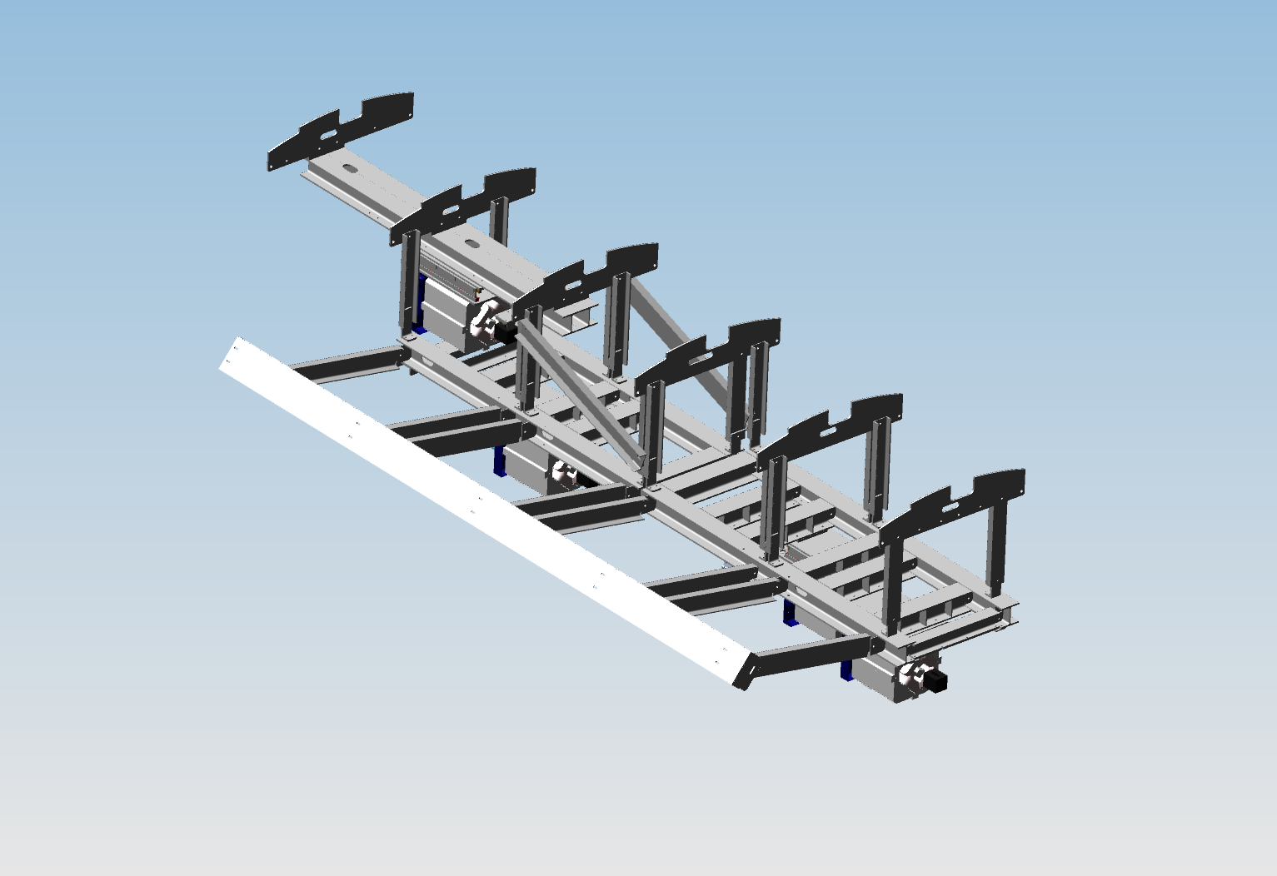
XTL R39 | frame only

Slide 11
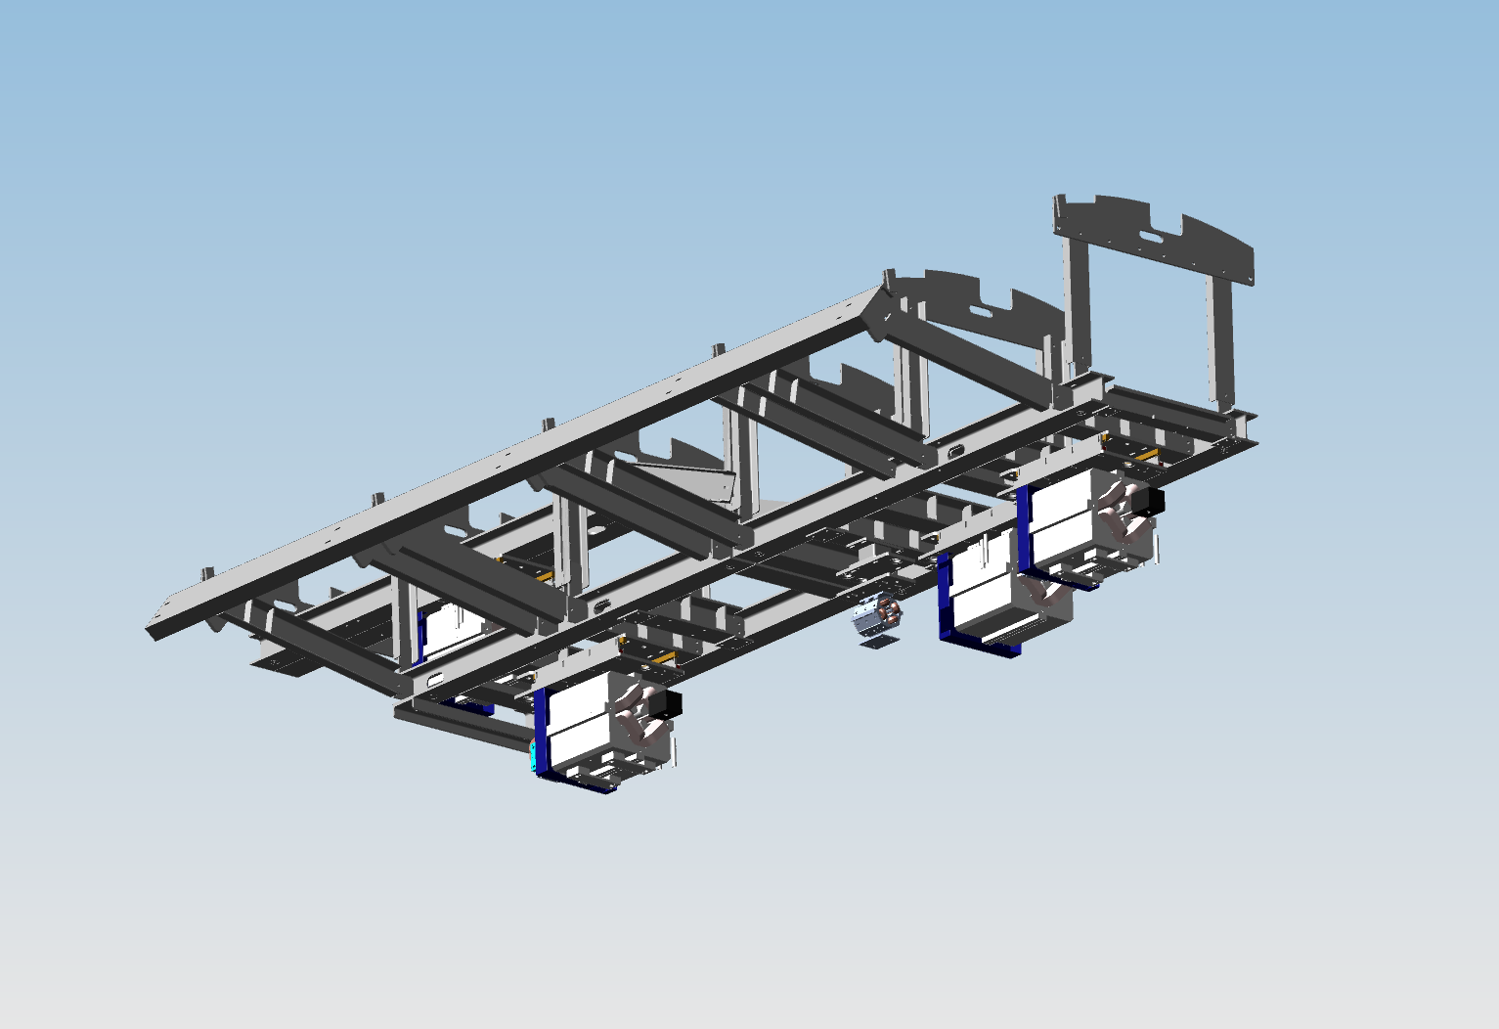
XTL R39 | frame only

Slide 12
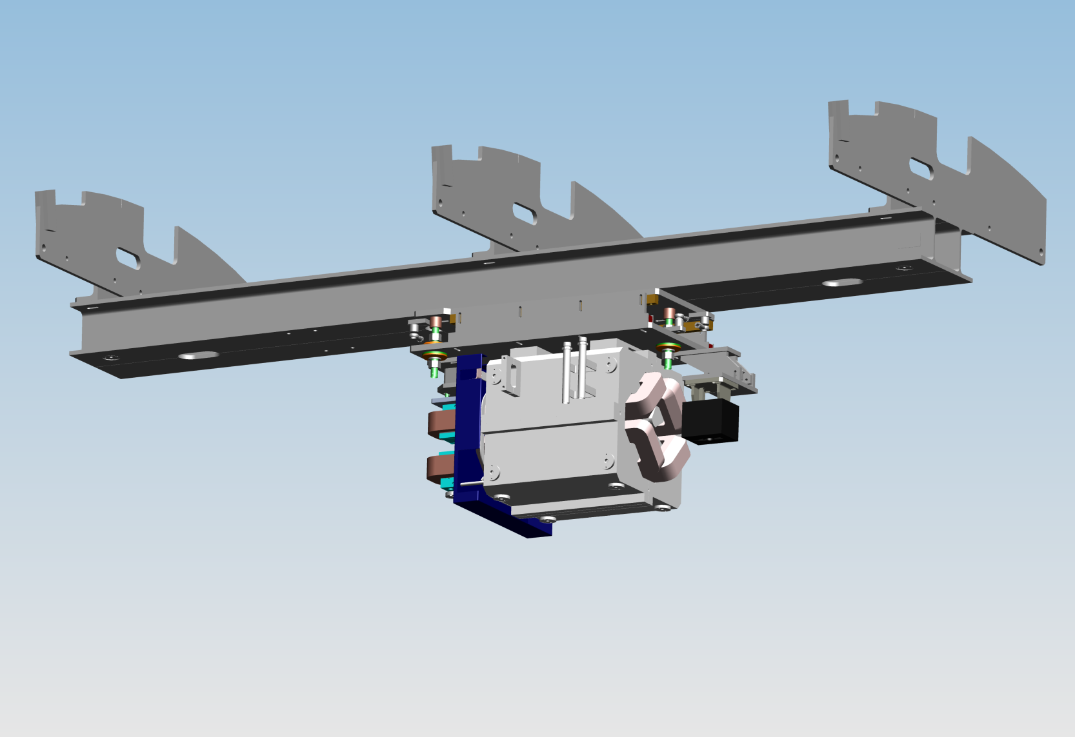
XTL R39 | TLD Quadrupole w/ BPM and Steerer
Eigen frequencies: 10 Hz (long.),
XBD (hor.): 25 Hz, XQF (hor.): 35 Hz

Slide 13
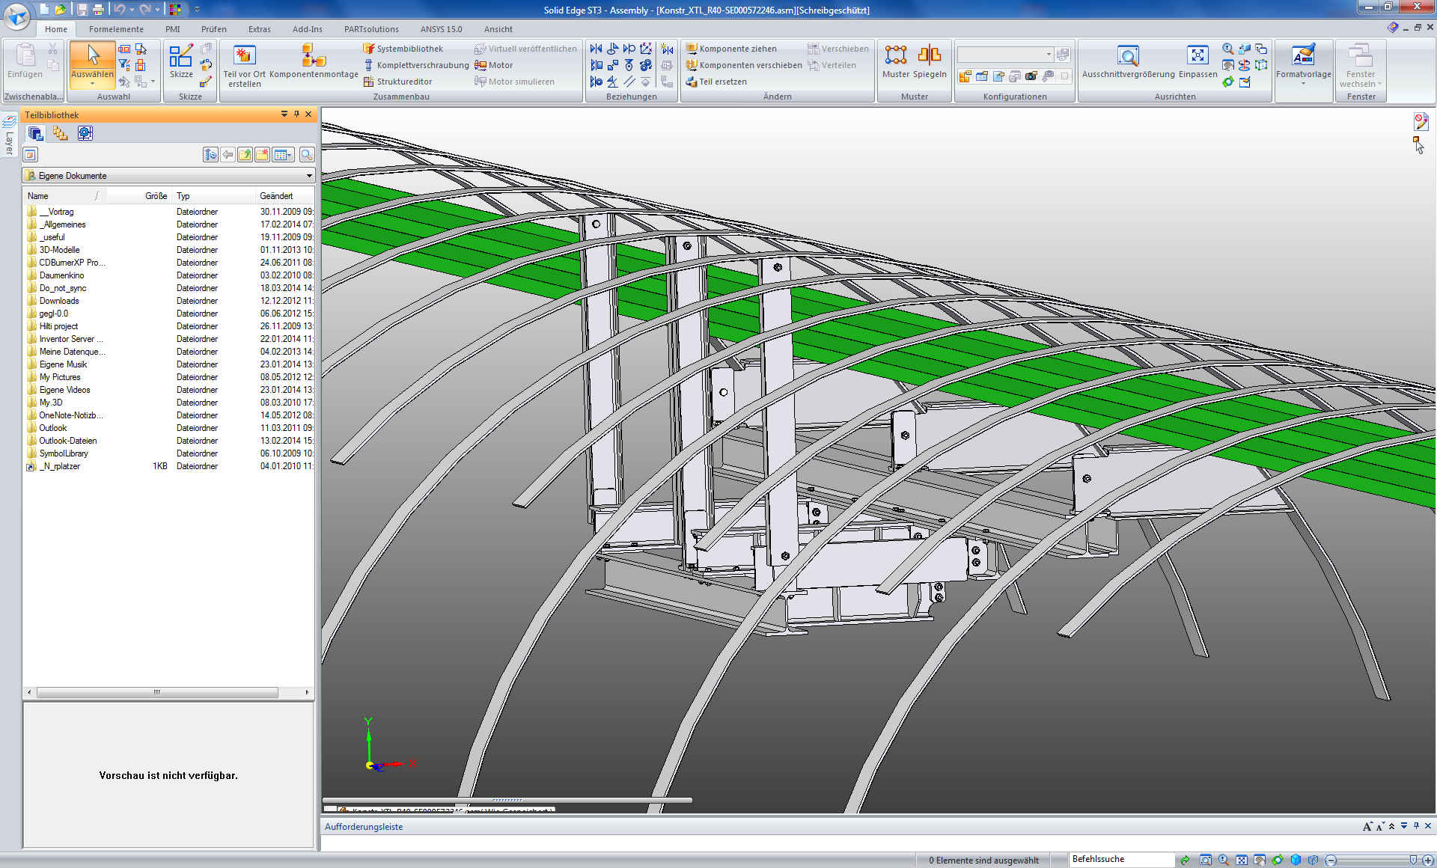
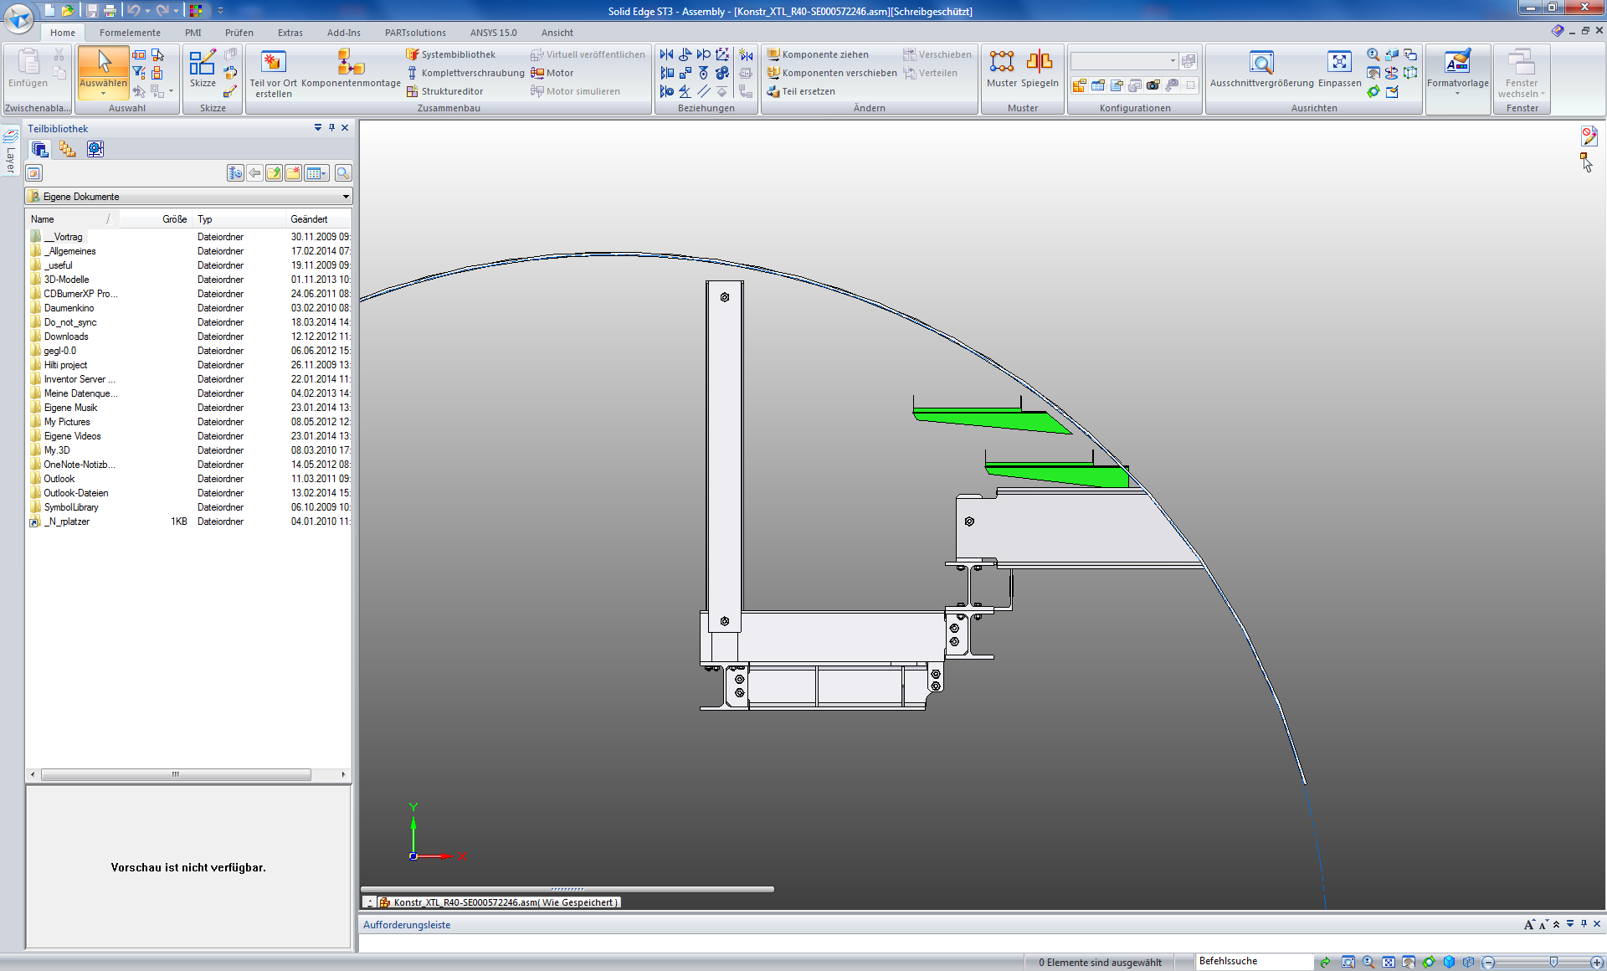
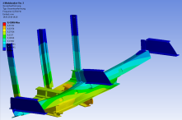
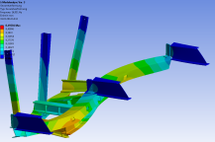
XTL R40 | Suspension BV-Magnets (TLD)
Installation by lifting from below possible
Eigen frequencies
  1. Ef 12.5Hz
  2. Ef: 16Hz
  Waiting for approval by MLC

Slide 14
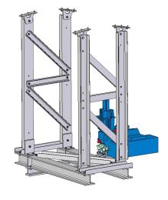
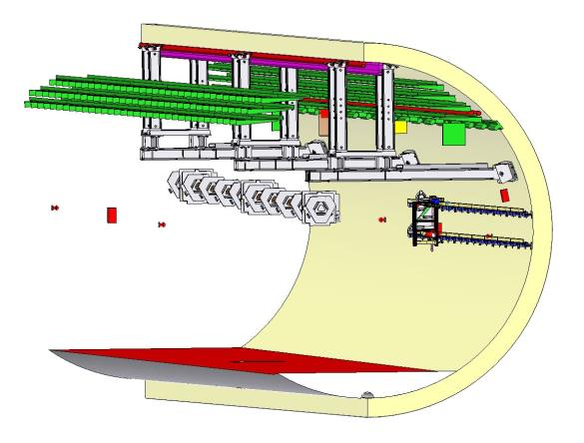
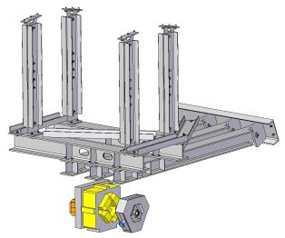
XTD2 R 13 – 16 | Proposal
XTD2_Tragrahmen_OTR
Frames bolded to in-casted rails!
XTD2_Tragrahmen_QE
XTD2 R 13 overview

Slide 15
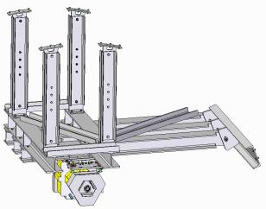
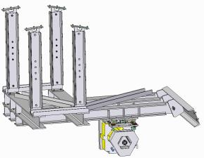
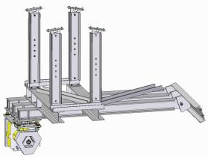
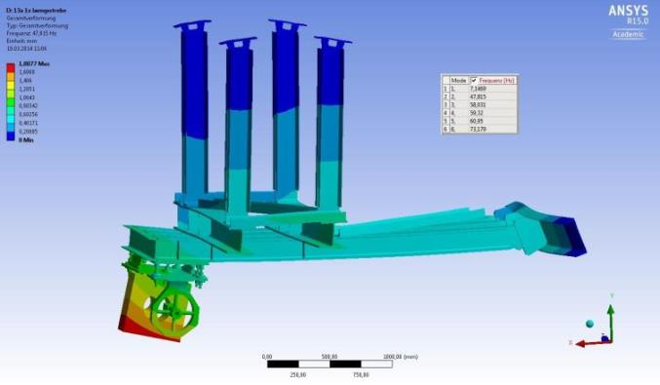
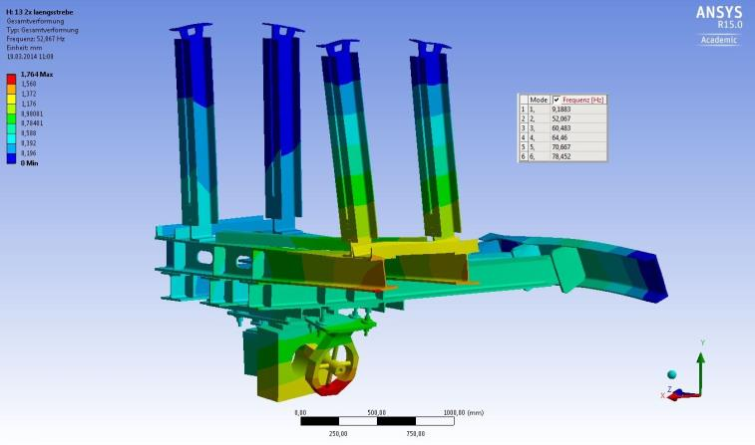
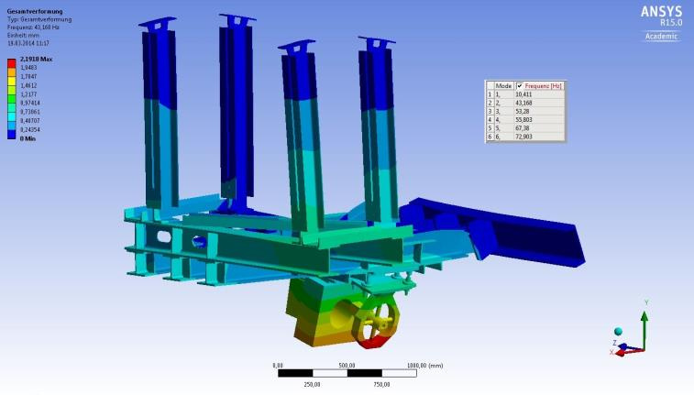
XTD2 R 13 – 16 | Eigen frequencies
Frame 13a: 1.Ef (hor.): 47Hz
Frame 13c: 1.Ef (hor.): 52Hz
Frame 16b: 1.Ef (hor.) 43Hz
Stiffer design nearly impossible (Load of screws at limit)
➔ Approval by MLC needed

Slide 16
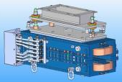
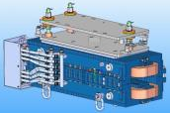
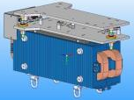
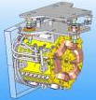
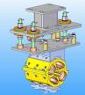
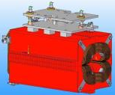
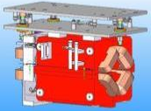
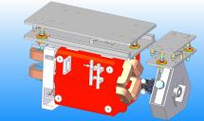
Adjustment Units
Different versions
Design: ready
Fabrication drawings: in production
BPM fixed to
adjustable
vacuum pump

Slide 17
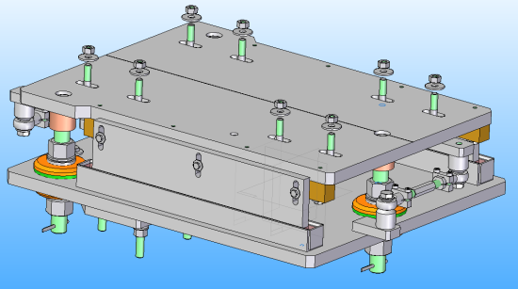
Adjustment Units | Vibration Requirements
To achieve the vibration requirements
both plates will be fixed fix glue after adjustment
Glue

Slide 18

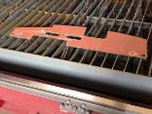

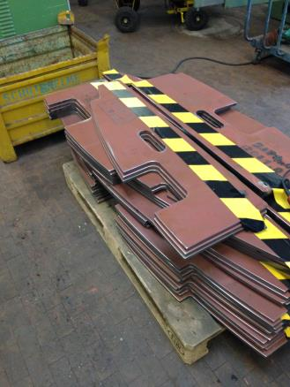
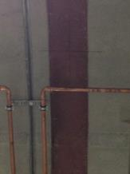
Status
XTL R 37 – 41
  Top steel plates ready for welding (in-house)
  Positions marked
  Lights needs to be move
  Call for tender (nearly) out
  Fabrication drawing under production
XTD2 R 13 – 16
  Design ready
  Vibrations need approval
XTL R28 – R36
  Design started

Slide 19
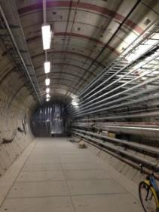
End
Thank you
for your
attention!

Slide 20

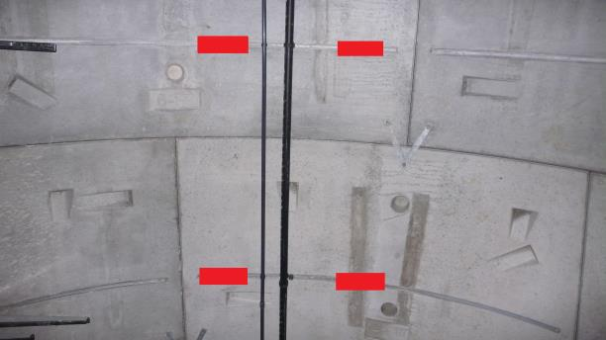
XTD2 | Feet Position
Lage der Anschraubbleche an der Tunneldecke

Slide 21

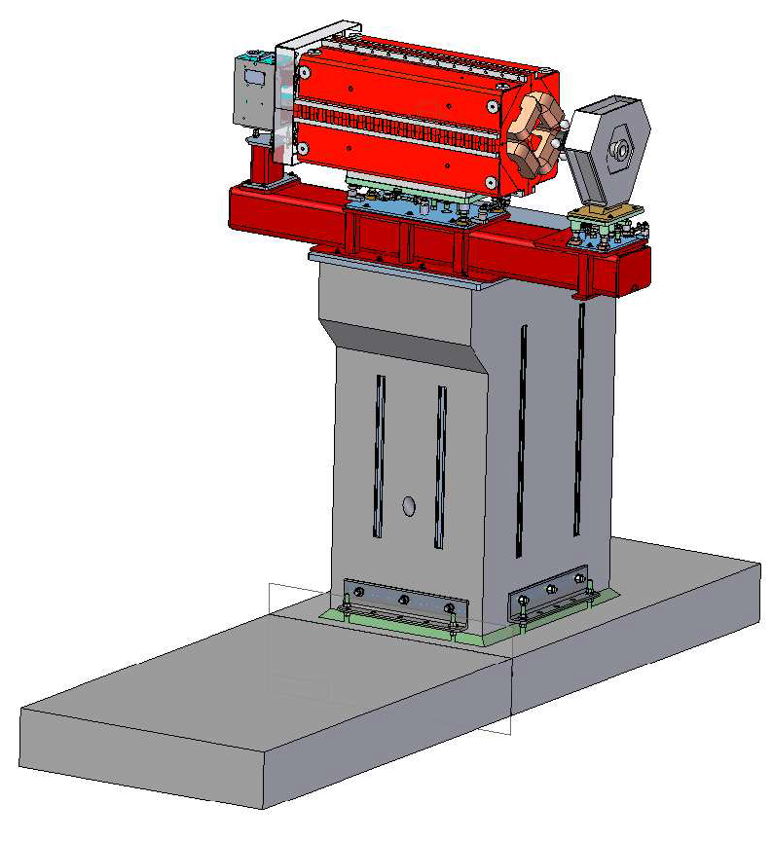
XQH w/ BPM, Pump & Steerer

Slide 22
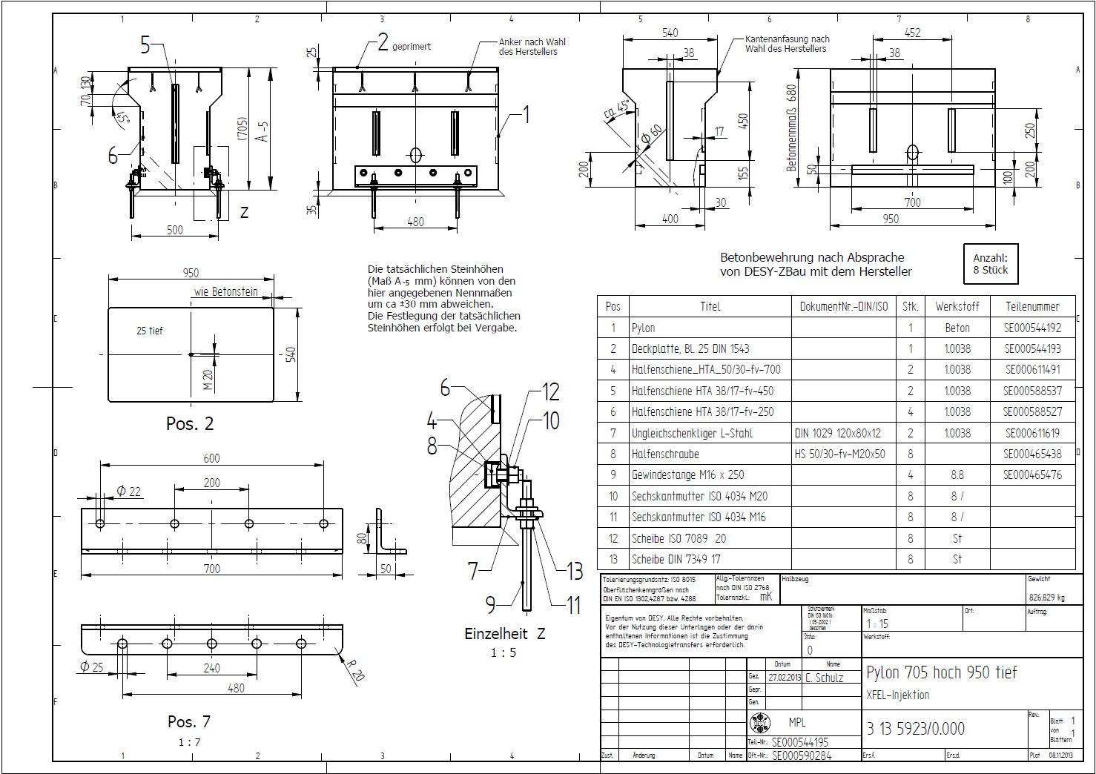
XTIN | Pylon 705 hoch 950 tief

Slide 23
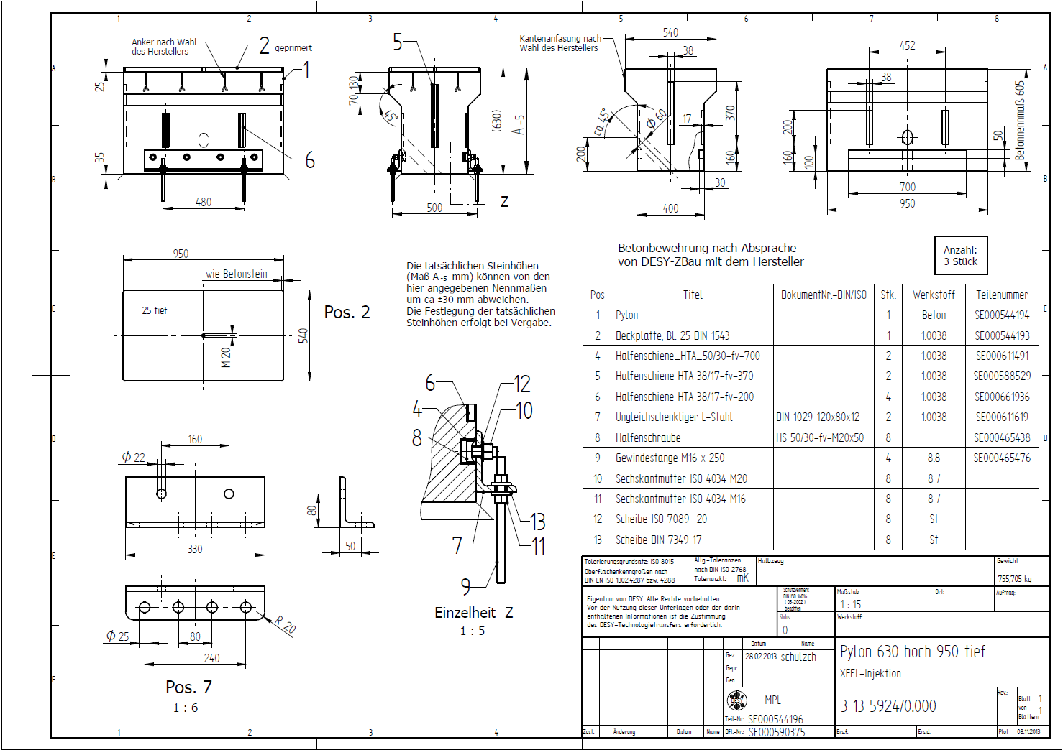
XTIN | Pylon 630 hoch 950 tief

Slide 24
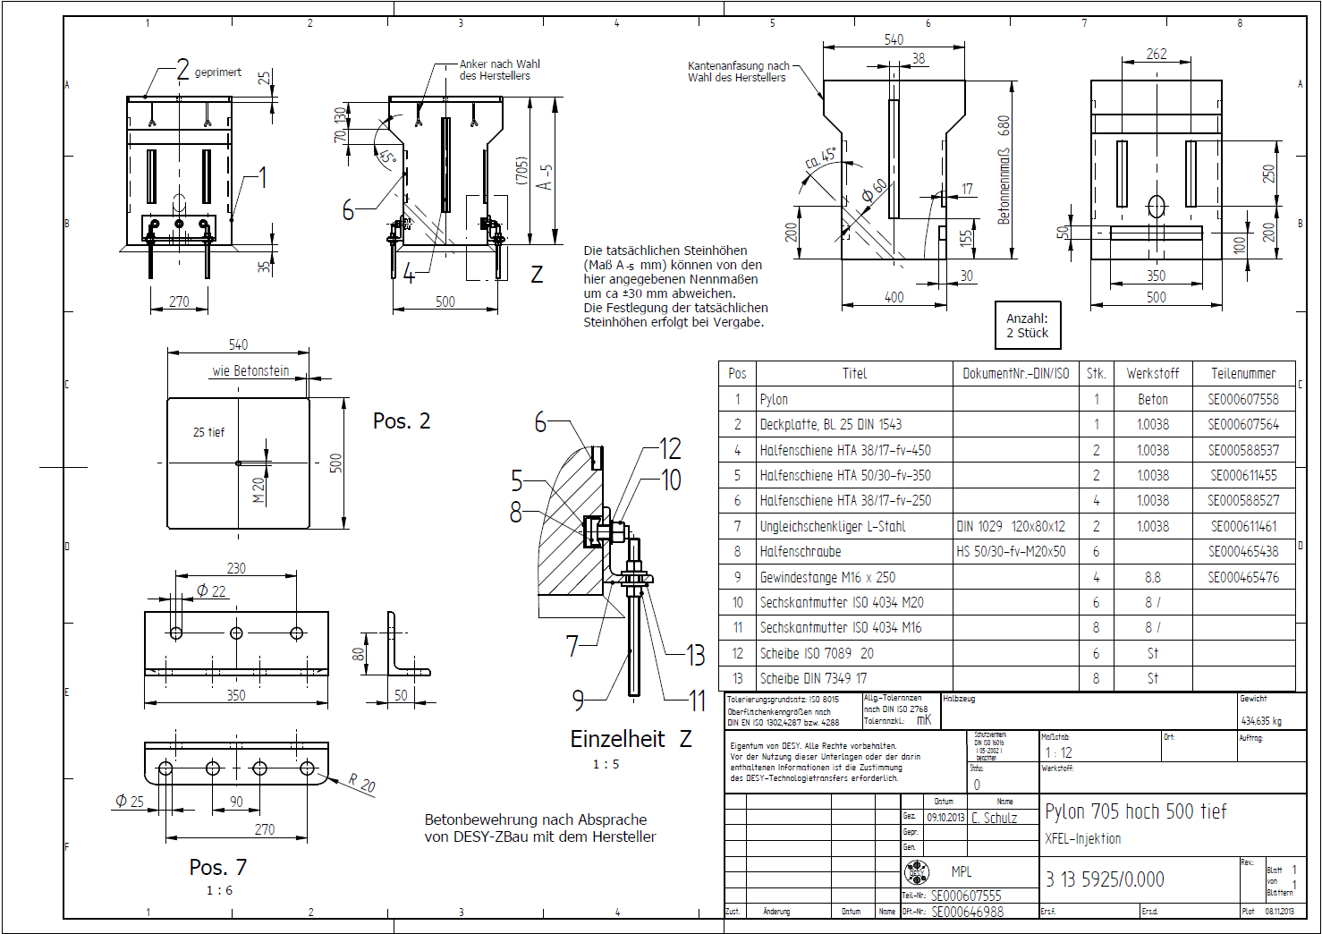
XTIN | Pylon 705 hoch 500 tief

Slide 25
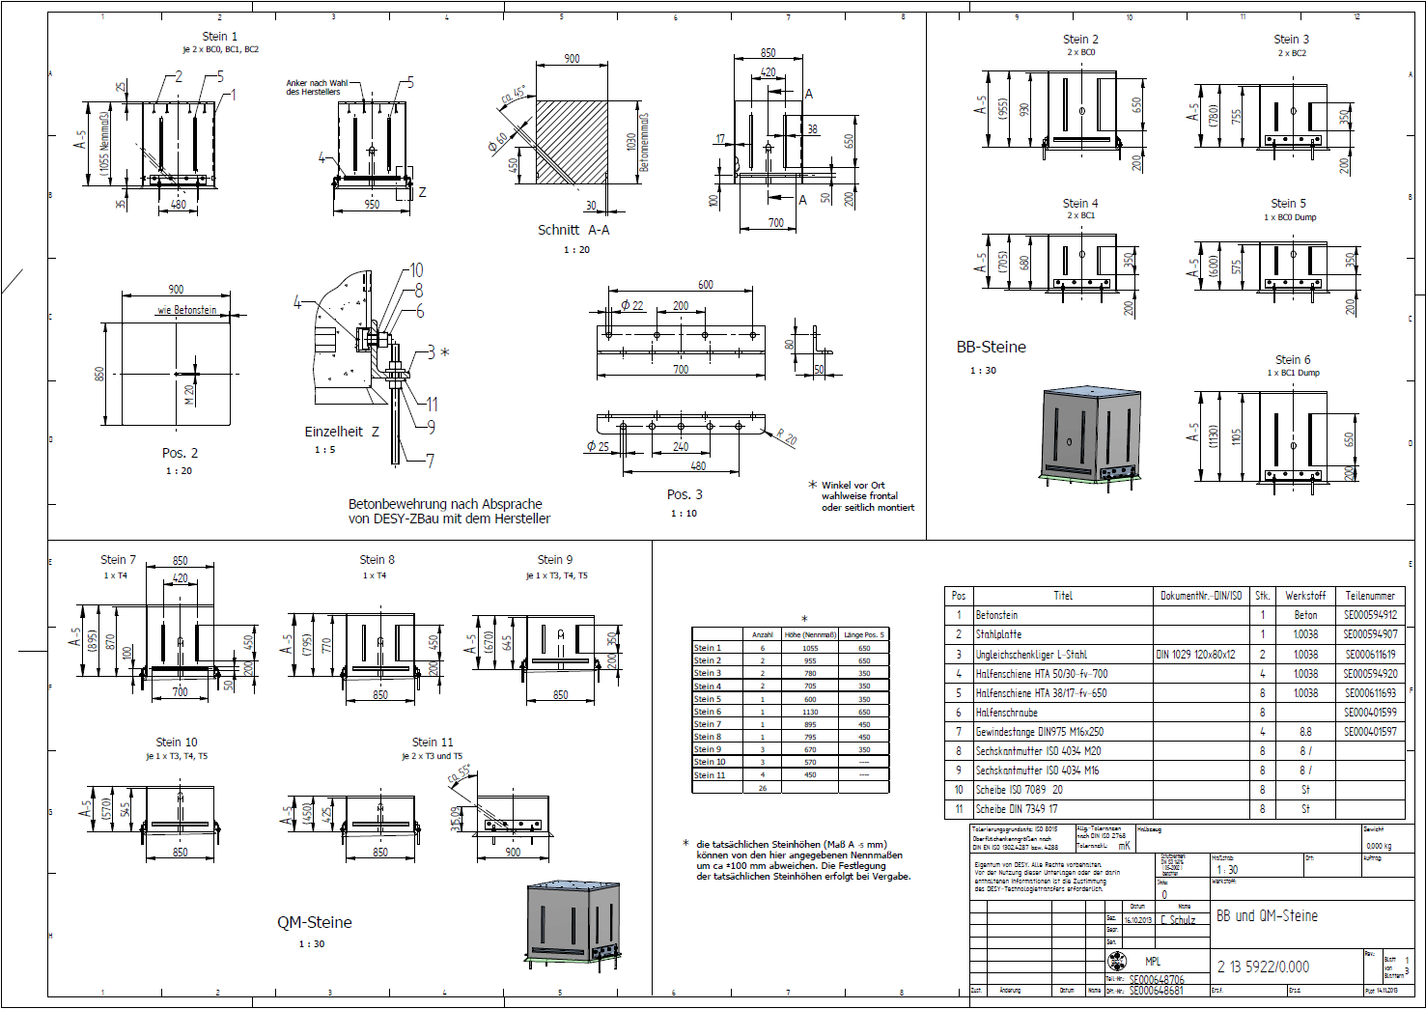
BB und QM-Stein

Slide 26
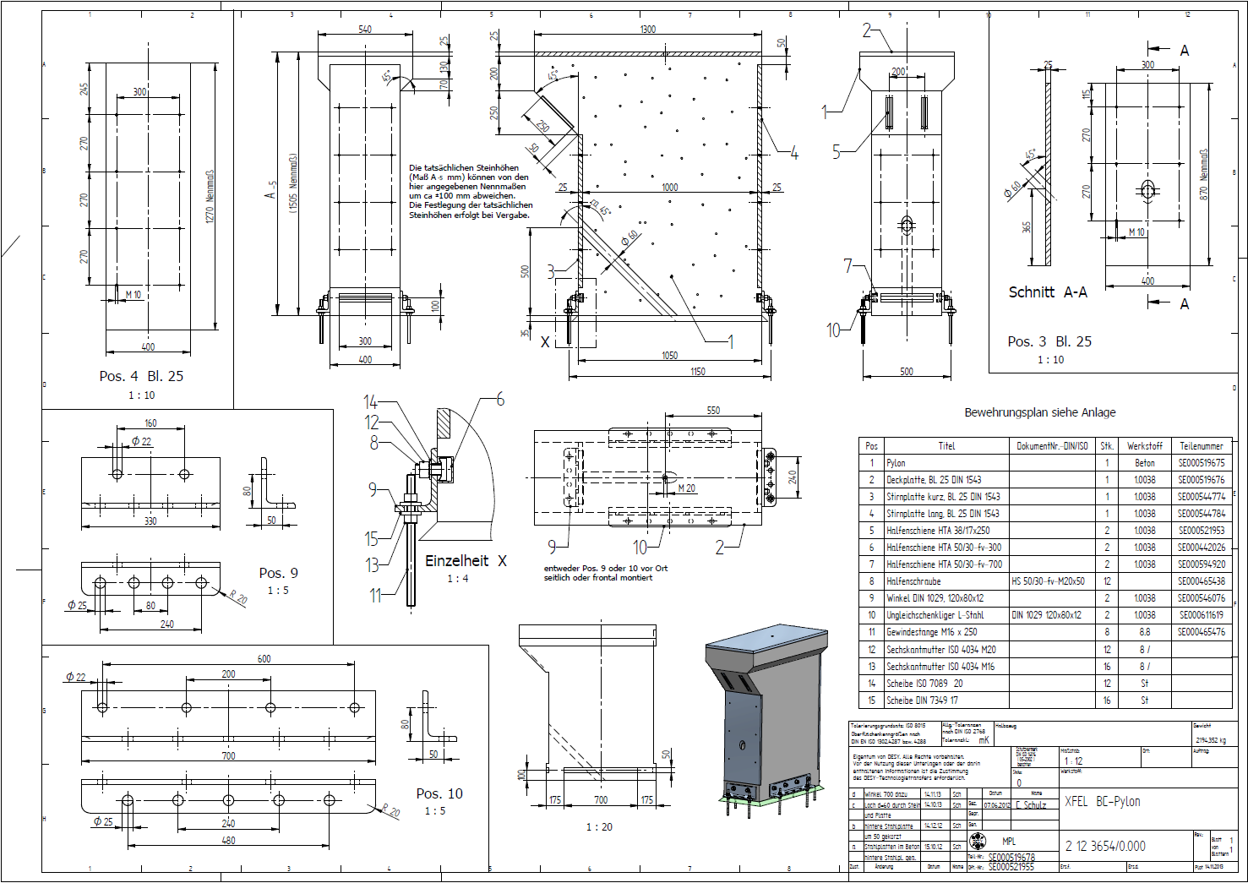
XTL | BC-Pylon

Slide 27
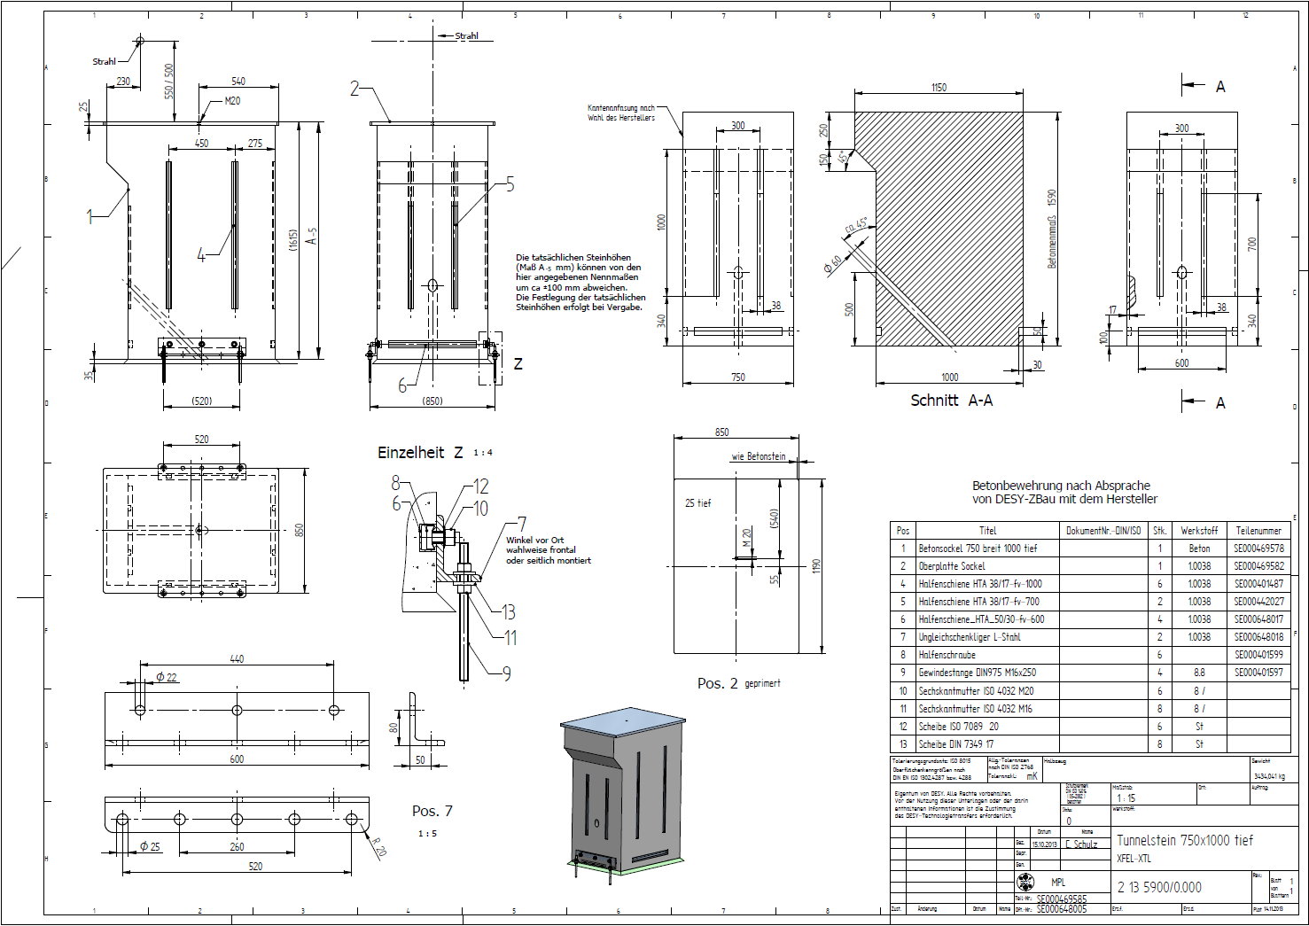
XTL | Tunnelstein 750x1000 tief

Slide 28
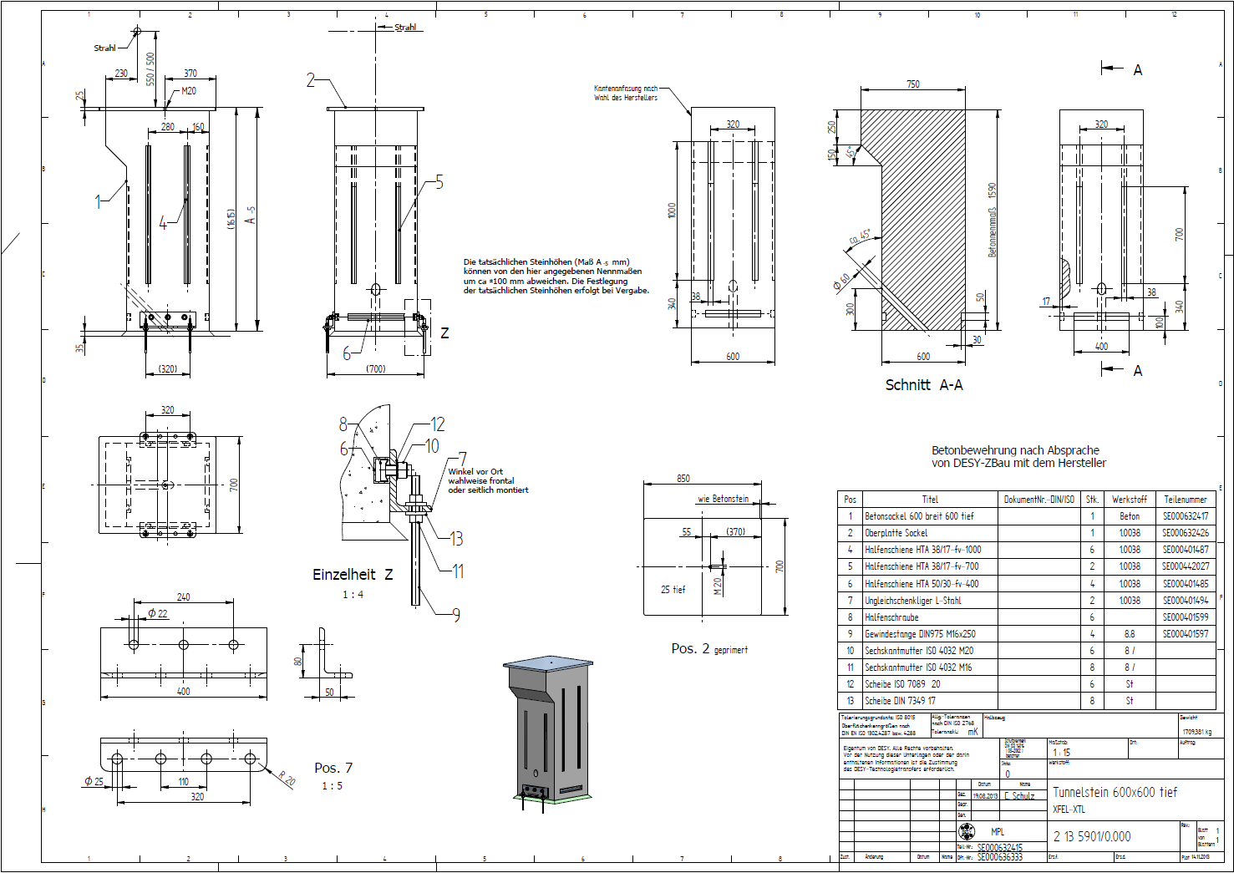
XTL | Tunnelstein 600x600 tief

