Slide 1
Update
Photon beam systems
European XFEL Collaboration Meeting
Hamburg, April 7-9, 2014
Thomas Tschentscher
thomas.tschentscher@xfel.eu
Notes:
How to edit the title slide
Upper area: Title of your talk, max. 2 rows of the defined size (55 pt)
Lower area (subtitle): Conference/meeting/workshop, location, date,
your name and affiliation,
max. 4 rows of the defined size (32 pt)
Change the partner logos or add others in the last row.

Slide 2
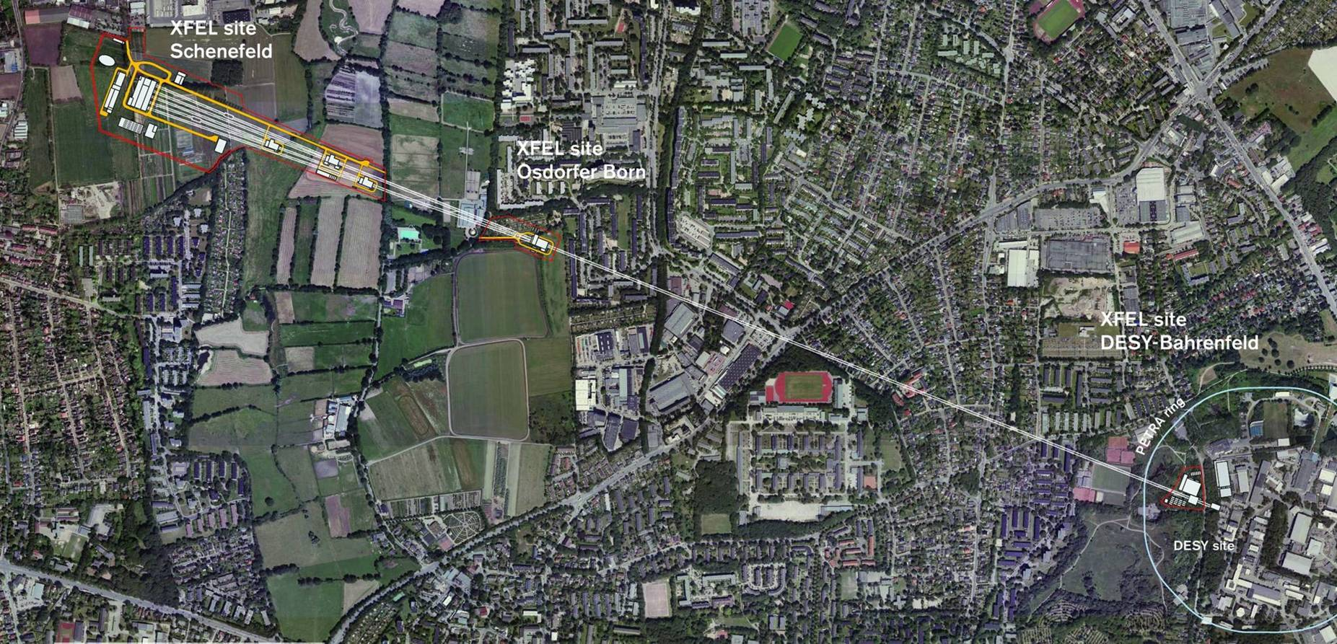
Overview

Slide 3
Overview

Slide 4
Overview
Undulators /
Theory
Instruments /
Detectors /
DAQ+controls /
Lasers /
Sample env. /
Exp. Hall Infra.
Optics /
Beam transport /
Diagnostics

Slide 5
Content
  Some general remarks
  Update photon beam system work packages
  Time planning

Slide 6
Photon energy ranges
284 eV - C K
2145 eV - P K
4038 eV - Ca K
7112 eV - Fe K
543 eV - O K
2470 eV - S K
4992 eV - Ti K
410 eV - N K
500-1300 eV
2p TM, 3d RE
12.4 keV
25 keV
water window
20 keV
Diffraction
(DAC, etc.)
500 -1300
6 -14 keV
18 - >25 keV
Hard x-ray undulators
SASE 1 & 2 (40 mm)
Soft x-ray undulator
SASE 3 (68 mm)
3.0 – ~25 keV
0.25 – ≥3 keV
Electron
energy sets
17.5 GeV
14.0 GeV
12.0 GeV
8.5 GeV
200 eV
1 keV
10 keV

Slide 7
Update photon beam system work packages
  WP-71 – Undulator systems
  WP-72 – FEL simulations
  WP-73 – X-ray optics & beam transport
  WP-74 – X-ray diagnostics
  WP-75 – Detectors
  WP-76 – DAQ & controls
  WP-78 – Optical lasers
  WP-79 – Sample environment
  WP-81-to-86 – Scientific instruments
  Experiments hall installations & infrastructure
  (non-exhaustive !)

Slide 8
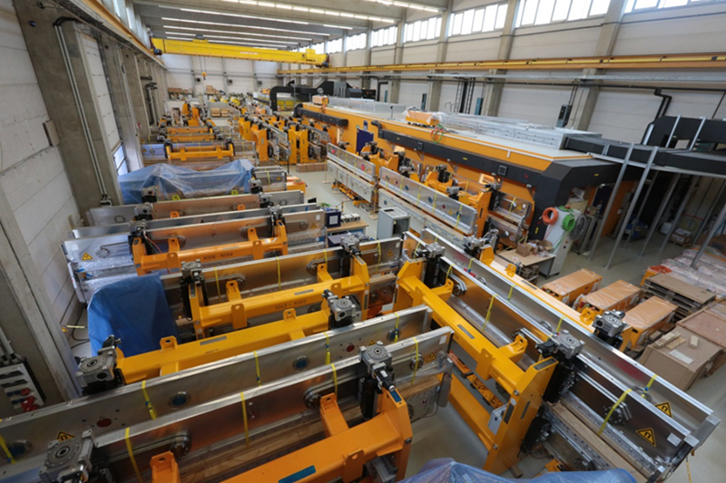
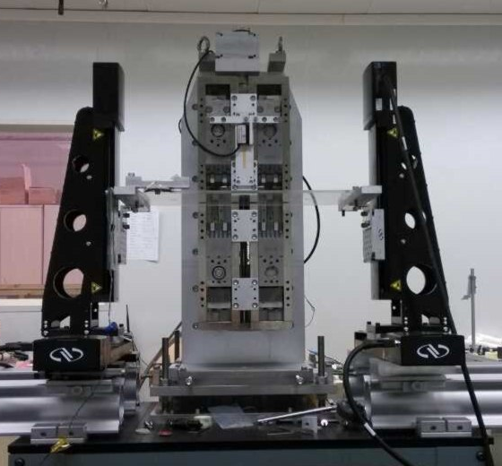
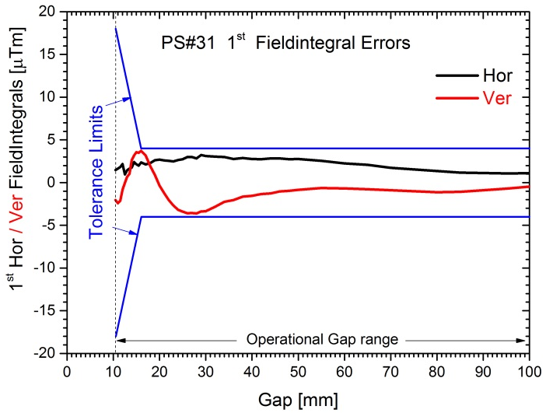
WP-71 Undulator systems
Design, construction, assembly, measurement , installation of SASE undulators, phase shifters & intersection units
Undulator assembly & measurement (Bldg 36)
Phase shifter measurement (IHEP)

Slide 9
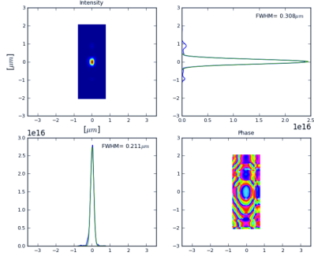
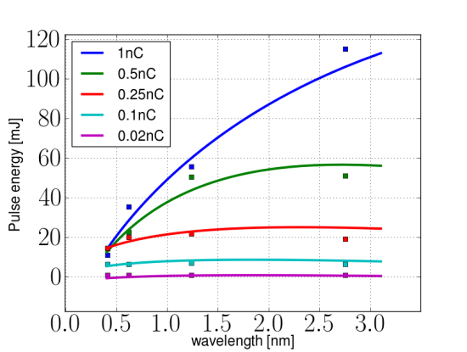
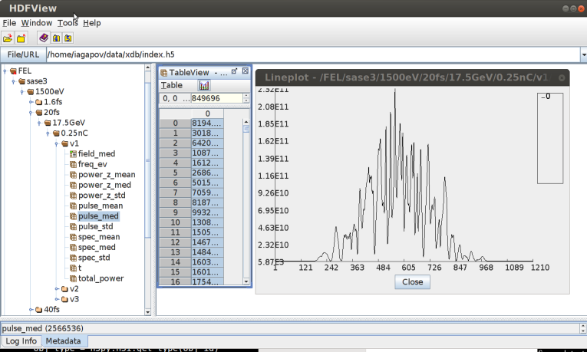
WP-72 FEL & SR simulations / theory
Seeding techniques & applications
  HXRSS (coll. with Kocharyan, Saldin, Serkez, Zagorodnov (DESY), Barty and Yefanov (CFEL))
  SXRSS (coll. with Kocharyan, Saldin, Serkez (DESY))
  Maximize FEL brilliance
  Prepare HXRSS/SXRSS implementation
FEL operation techniques
  Tapering (coll. with Kocharyan, Saldin, Serkez, Zagorodnov (DESY))
  Maximize FEL pulse energy/peak power
Software development
  Development and integration of various codes (coll. with Dohlus, Zagorodnov (DESY), Tomin (Kurchatov Inst.))

Slide 10
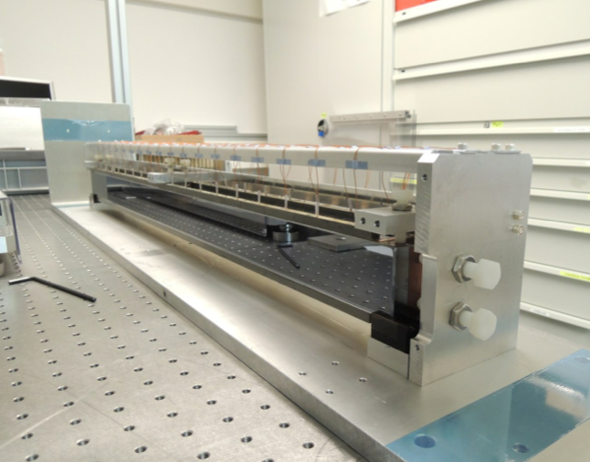
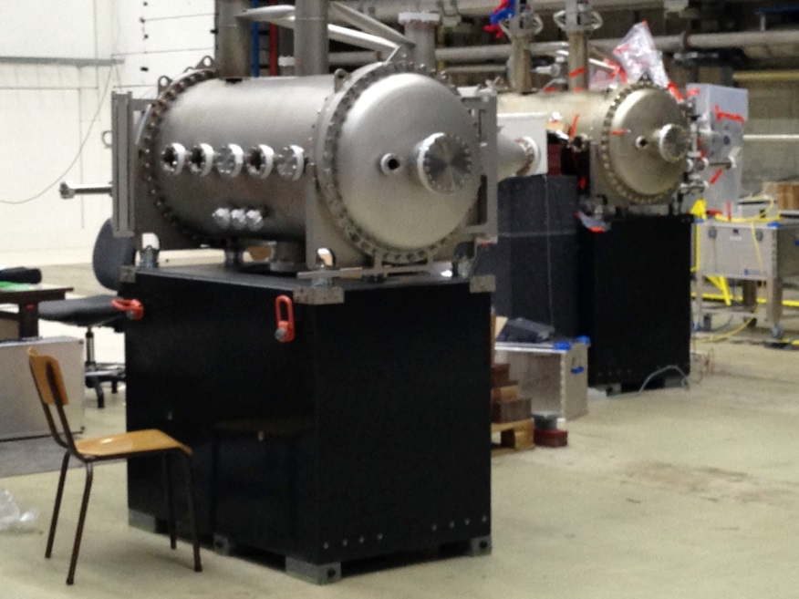
WP-73 X-ray optics & beam transport
Offset and distribution mirrors
9 flat mirrors (3 adaptive)
  Key specs: 2 nm PV
  Prototype tested
  Delivery end 2014-2016
Mirror chambers need to be extremely stable and low-vibration
  Key specs: 20 nrad rms
  First two chambers arrived

Slide 11
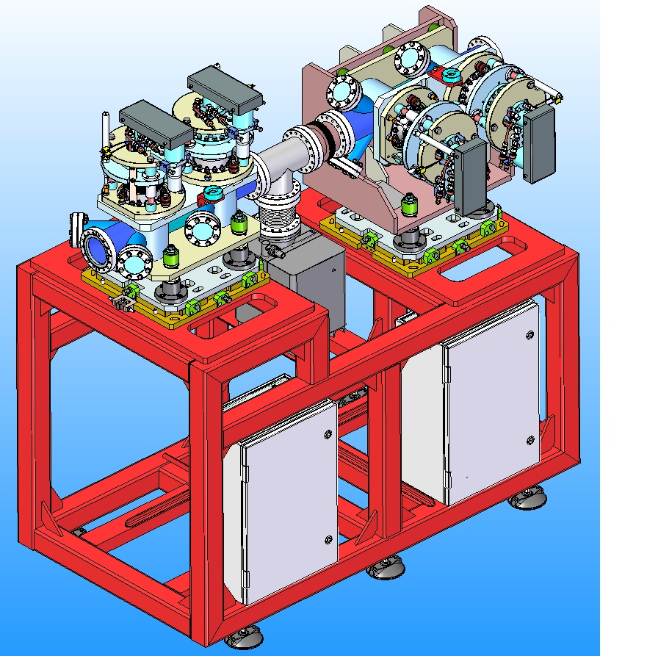
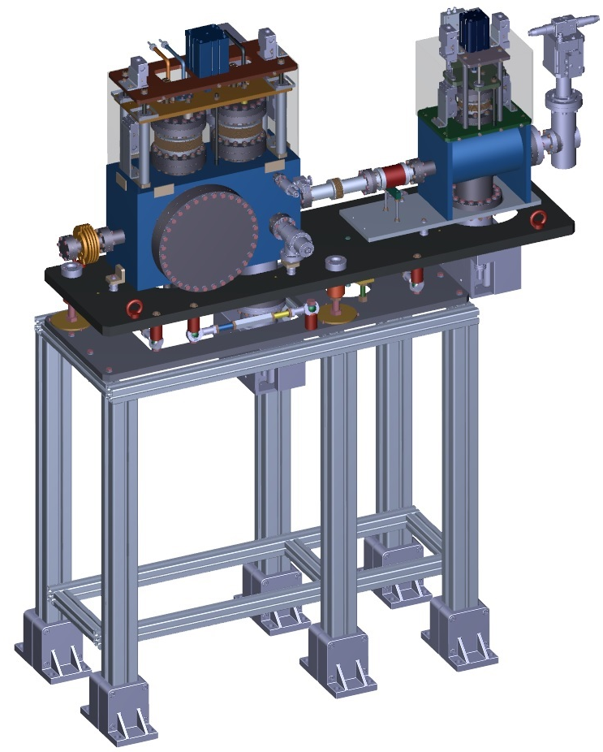
WP-73 X-ray optics & beam transport
Slits and Shutters
Delivery May 2014
Delivery June 2014

Slide 12
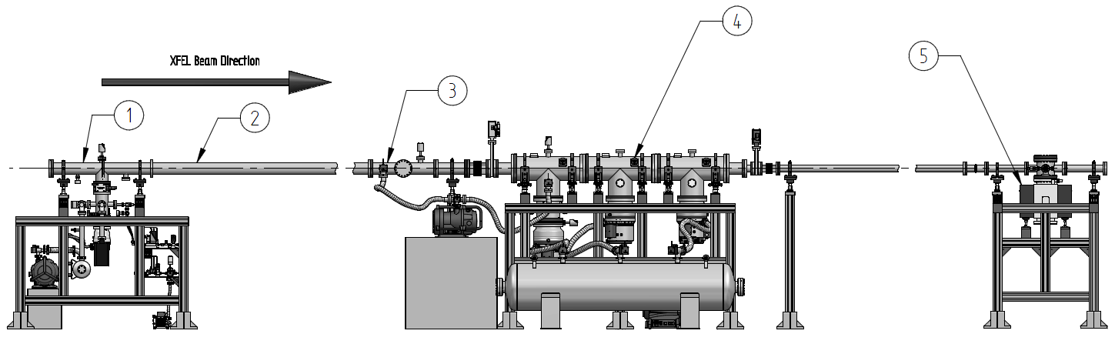
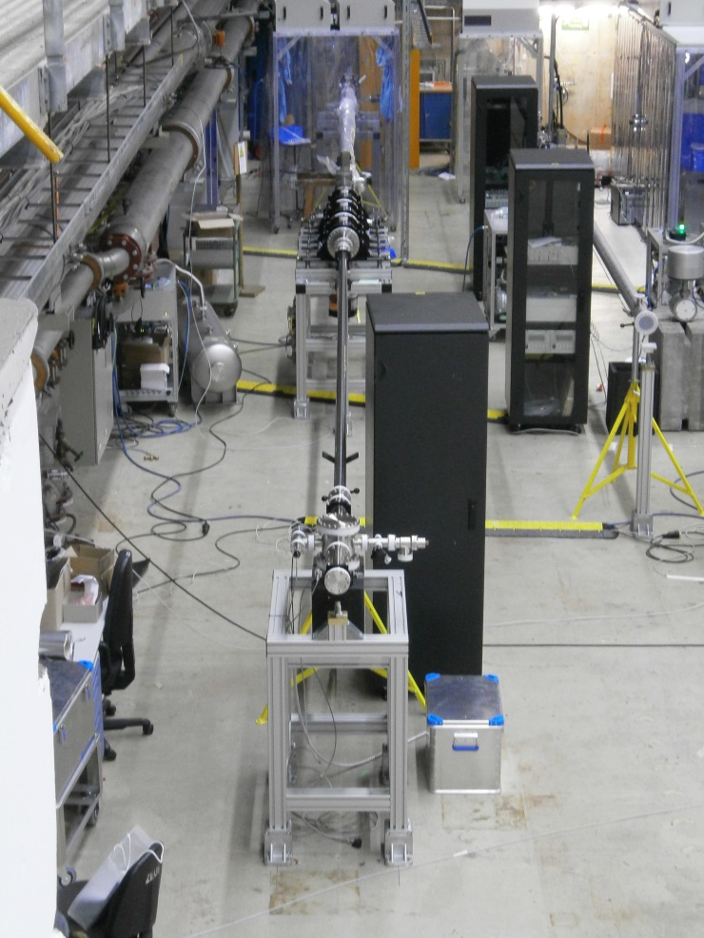
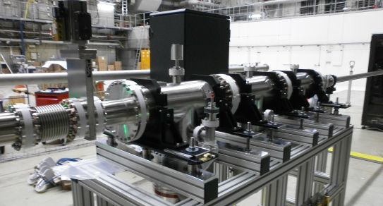
WP-73 X-ray optics & beam transport
SASE3 Gas Attenuator
15m long, N₂ (and Xe), gas pressure range 10⁻⁴ - 25mbar, aperture size 25mm, attenuation up to 10⁻⁴
Prototype (first half) now under testing

Slide 13
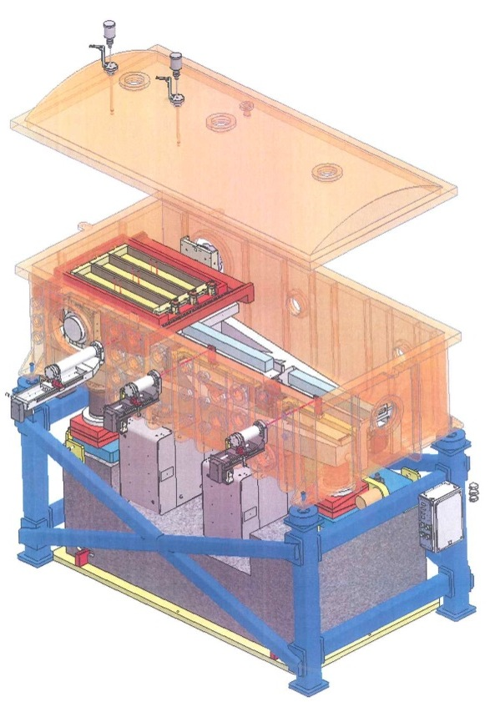
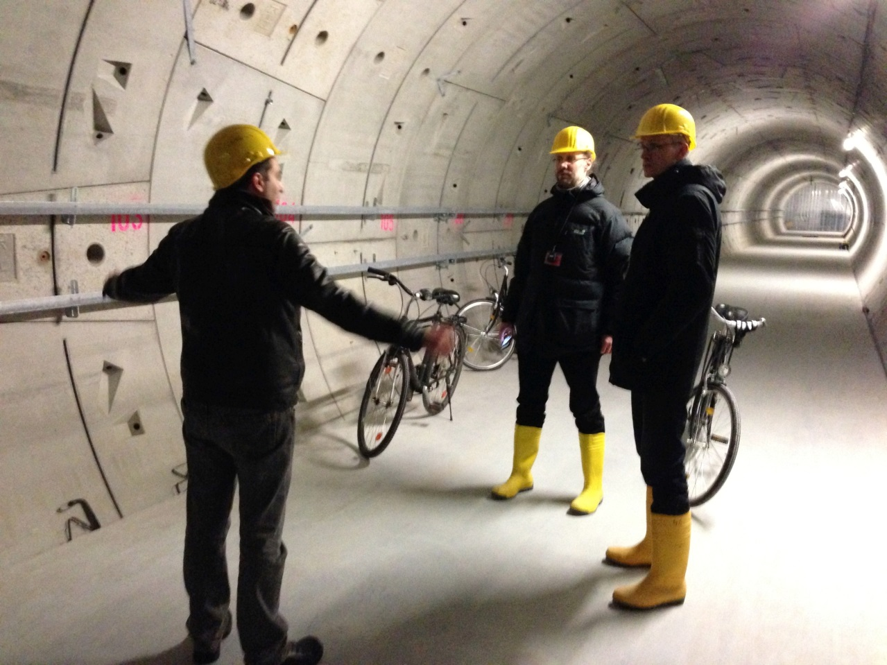
WP-73 X-ray optics & beam transport
Grating Monochromator for SASE3 beamline
Delivery March 2015 (FMB Berlin)

Slide 14
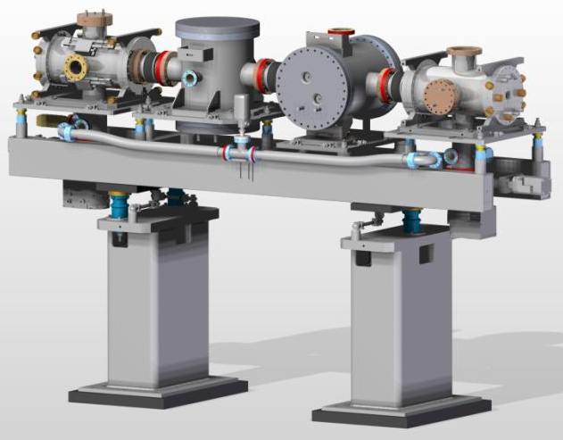

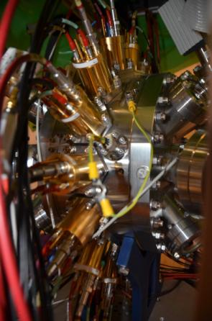
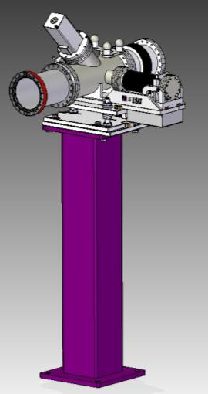
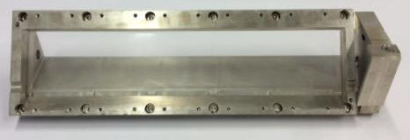
WP-74 X-ray photon diagnostics
X-ray photon diagnostics units
  XGM → measurement of x-ray pulse intensity & position
    XGMs from K. Tiedtke (DESY)
    Girder design by xfel.eu
  Tests of new methods
    Circular polarization meas. (coll. with DESY & other)
    Spectrum measurement (coll. with PSI & SLAC)
Beam transport monitors
  Technical designs complete
  Fabrication contracted

Slide 15
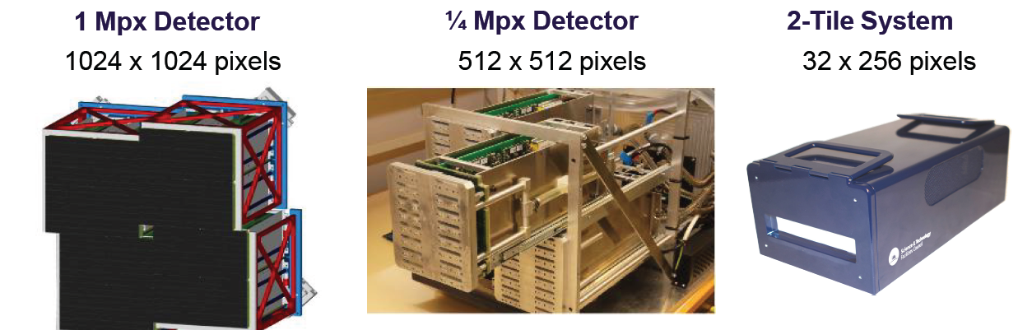
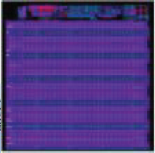
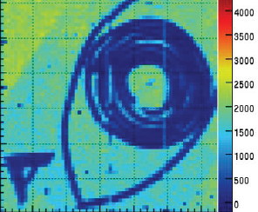
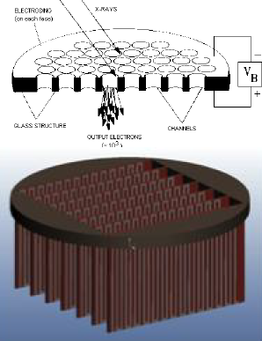
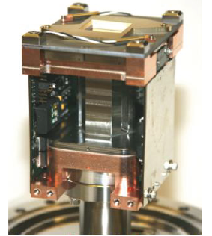
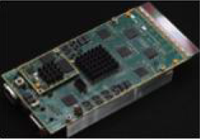
WP-75 Detectors
LPD
  First beam tests with 2-tile
  0.25 MPx system in test
AGIPD
  Full scale ASIC delivered
  First tests with beam
DSSC
  Redesign for phase-I
Other developments
  Gotthard (1D) – MHz
  MCP (2D, sX) – MHz
  Fast-CCD not yet arrived
  pn-CCD to be tested
1.0 ASIC
P-III tests
v1
MCP
Fast-CCD

Slide 16
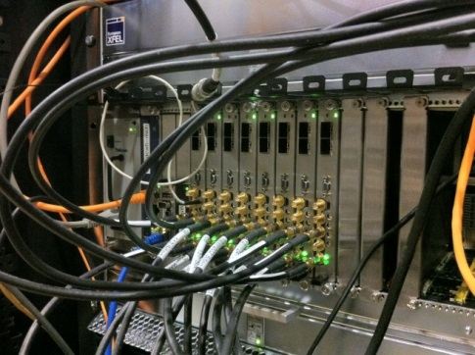
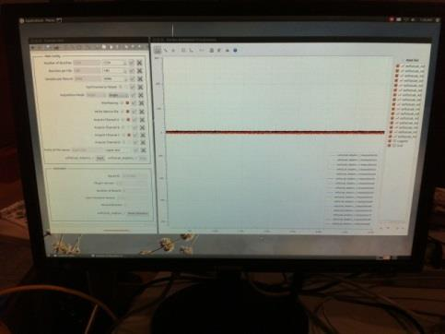
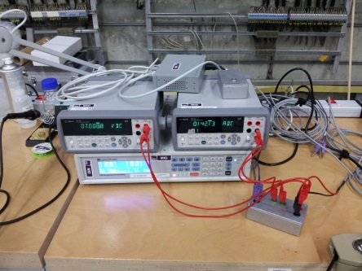
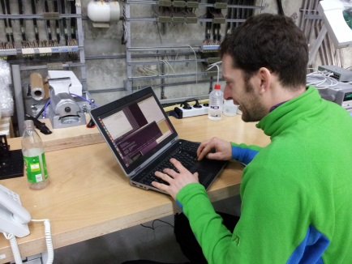
WP-76 DAQ & controls
Karabo 1.0 control and DAQ usage examples
Digitizer DAQ and control at beamlines
WP81-FXE: measurement of fluorescence yield of X-ray hitting liquid jet target (8MHz), with and without laser pump (4MHz), using an APD at PETRA-3
WP74-PES: measurement of multi-channel eTOF signal digitization at PETRA-3 and FERMI (10Hz)
Initial time scans macro for PID characterization
WP83: measurement of PID parameterization of a furnace using Lakeshore heater and Agilent DVMs
Feedback very useful
WP75 2D detector integration
Started with LPD 2-Tile system
  K0.1 control of LpdFem and DAQ to standalone Python receiver & image viewer
  July: K1.0 control and DAQ to LpdFemSink with embedded pixel reorganization and output to HDF5
AGIPD and DSSC test stand setup in progress and ¼ Mpx test stand coming soon!
Karabo is a major effort, it is converging and exposure to use cases is essential

Slide 17
WP-76 DAQ & controls
Electronics development
What WP76 gets from the joint WP75/76 electronics group in brief
FPGA framework and implementations – reduce data volume, provide VETO triggers, enable scientists…
Interface Timing and synchronization – interface machine-instruments, electrical triggers, data tagging...
Standard solutions – MTCA and ATCA crates, digitizers, CPUs, interfaces PCIe, GbE, 10GbE and VETO
Detector interfacing electronics – digital and analog, filtering and shaping, level conversion…
Detector and DAQ electronics coordination with WP75 – documentation, external projects…
WP76 projects
Name | Description | Status – since last DAC
Train builder | Build complete trains of pulse ordered data from large-2D detectors, multiplex 10GE in to out links | f/w development and K1.0 integration on-going
Clock and Control | MTCA.4 timing and synchronization board for large-2D detectors | Production boards distributed to 2D test stands.
VETO | Evaluates fast information and distributes reuse storage cell command to 2D FEE f/w | Setting up test system on DAMC2 digital board
SP-Devices digitizer family | General purpose MTCA.4 digitizer (1.6 – 8 GS/s; 14 – 8 bits; 10GE + VETO; user defined algorithms in FPGA) | Passed performance testing, small improvements requested
External Timing Adapter | X2 timing board interface adapter distributing 10Hz trigger, clocks and serial metadata | 30 boxed versions produced
Fast ADC | General purpose Fast ADC system on MTCA.4 for 0D sensors used for Diagnostics, VETO, etc. | 10 channel delay line shaper RTM sent to manufacture
FPGA framework | High-Level FPGA Programming Framework on Simulink | On-going, see P. Gessler talk
Laser FEE systems | Laser timing drift compensation | Test failed due to motor control, modifying for new test

Slide 18
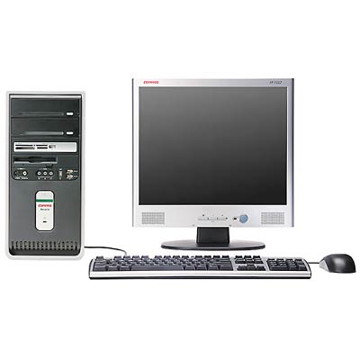
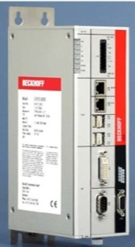
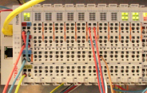
WP-76 DAQ & controls
Experiment and beam line Control status
Changes in-progress
Changes made since the last DAC
Clarification of standards
  Beckhoff PLC terminal rail system used to control motor, vacuum.
    acceptance test with WP73 as DeltaTau replacement +ve.
  Use of a single f/w framework with
    defined safety interlock, pending, etc. design
    use and interchangeability of f/w blocks from different authors
    single service implementations (communication, messaging, startup initialization, self description)
  Connectors and cable standards being defined with WP73, CIE…
  Use of E-plan for cable wiring (not KDS) with CIE
Confirmation of roles
  f/w is written and integrated with control system by WP76
  WP73 organizes building beam line tunnel crates
  WP76 builds test stand crates
  WP76 and CIE organizes experiment crate systems
More manpower and update of roles
  J.Reifschlaeger technician, cable and connector standards, crates, +
  G.Giambartolemei user-f/w-s/w glue, documentation, worrier
Overhaul of s/w
s/w – f/w connectivity
karabo s/w devices
Motor
Pump
Gauge
BeckhoffCom
TCP/IP
PLC f/w
TCP server
Device drivers
Serial
Digital
Analog
EtherCAT
Motor
Pump
Gauge
These changes are being made to ensure that “working” systems are delivered.

Slide 19
WP-78 Optical lasers
Pump-probe laser concept and status of prototype development
sync via fiber
and OBC
4.5MHz
188kHz
800nm, 0.2 … 3mJ,
4.5 ... 0MHz,
15 … 100 fs
4.5MHz
1MHz
200kHz
20W @
4.5MHz
AOM
Compressor
super-
continuum
var.
prechirp
NOPA 1
NOPA 2
NOPA 3a
NOPA 3b
1030nm
Soliton
seeder
Δτ =
0-5ns
burst-mode
all-fiber CPA
front-end
SHG
SHG
SHG
SHG
x-ray - optical
laser overlap
4W @
4.5, 1 or 0.2MHz
Yb-pre-amp
(burst-mode)
Yb-booster 1
(burst-mode)
Yb-booster 2
(burst-mode)
PC
Compressor
sub-ps
1030nm, 4 … 100mJ, 4.5 … 0MHz
sub-ns
400 W
7 kW
20 kW
Burst-mode multi-stage NOPA with 3 operating points
Burst-mode output 800nm: 15 - 80fs, 4.5MHz ↔ 0.2mJ, 1MHz ↔ 1mJ, 200kHz ↔ >3mJ
Burst-mode output 1030nm: sub-ns and/or sub-ps, 1030nm, up to 100mJ
Current status:
400W pumped 2-stage NOPA fully characterized: 15 … 75fs, up to 180µJ, 0 … 4.5MHz
20kW boosters installed
1
2
3
Notes:
Main messages:
- Sub-ps pumped multistage NOPA with 3 working points
- Also 1030nm output with sub-ps and sub-ns
Status LAC 3:
400W pumped NOPA performing as expected and fully characterized
20kW booster installed

Slide 20
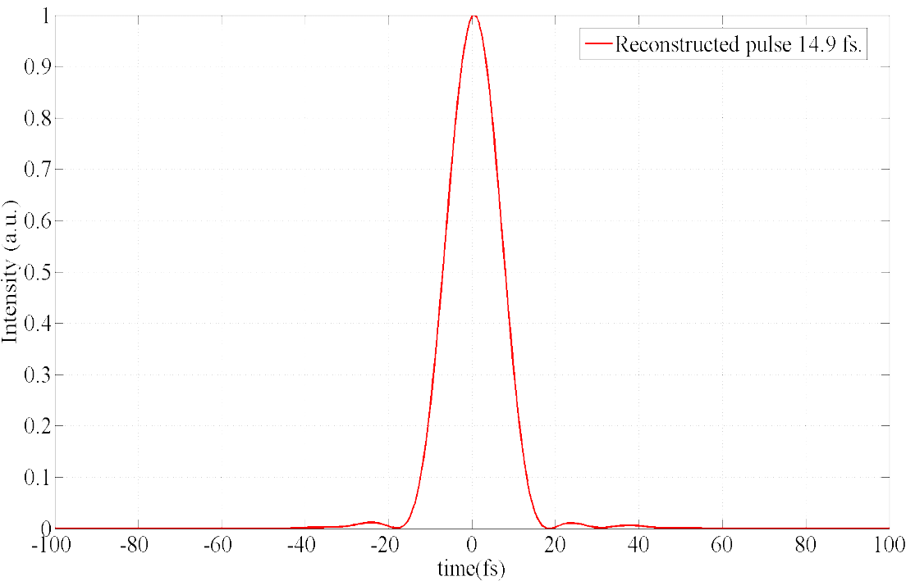
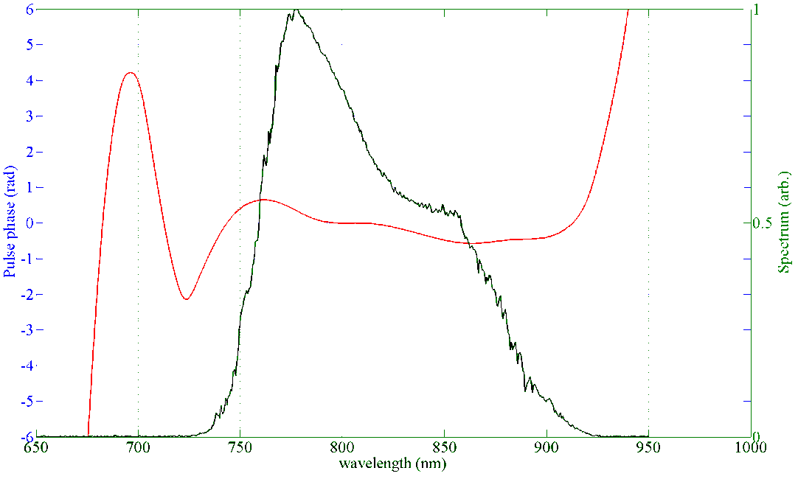
Pulse properties in short pulse mode
Compressed pulse 14.9 fs
Spectrum corresponds to
13.8 fs Fourier limited pulse
Contrast: ca. 20dB
High contrast 14.9 fs compressed pulse (SPIDER)
Pulse energy 180 uJ @ 188 kHz rep. rate
Notes:
Main message:
Clean 15fs pulses, nearly transform limited, 180µJ

Slide 21
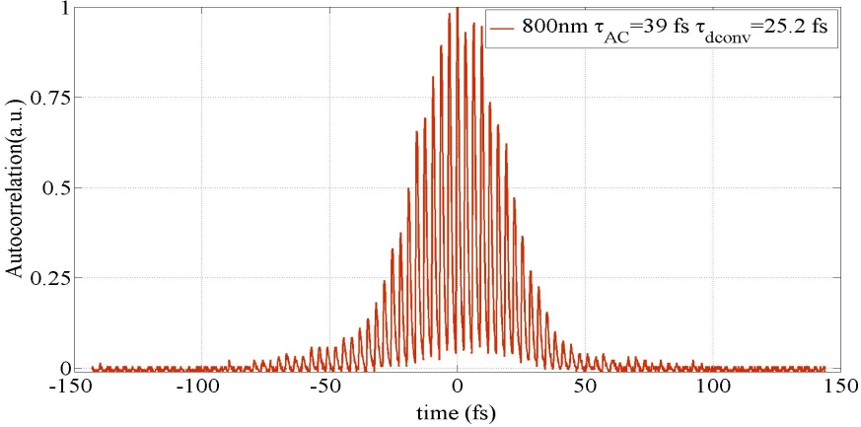
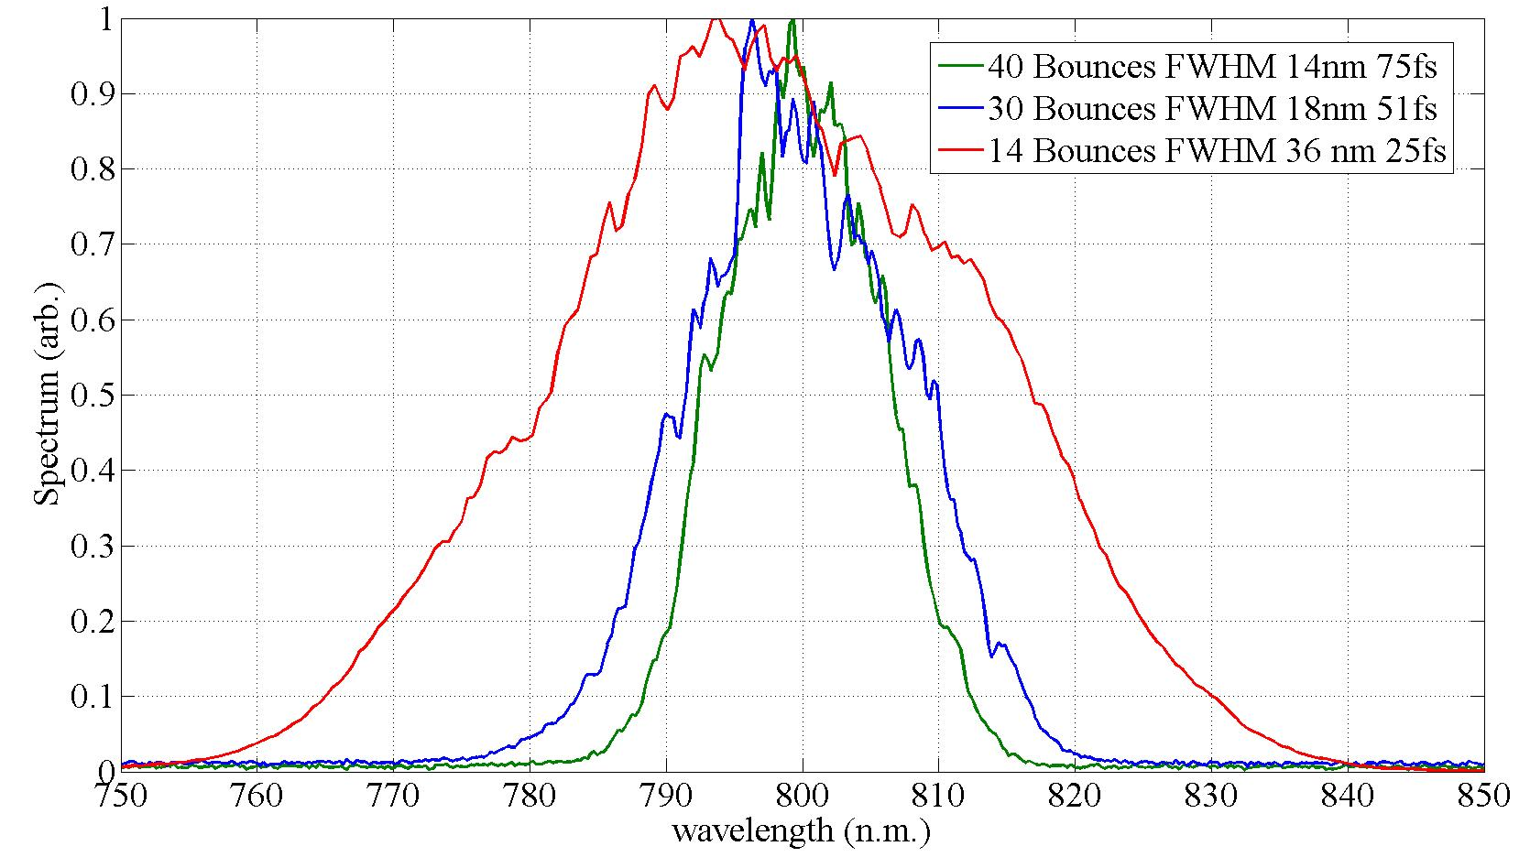
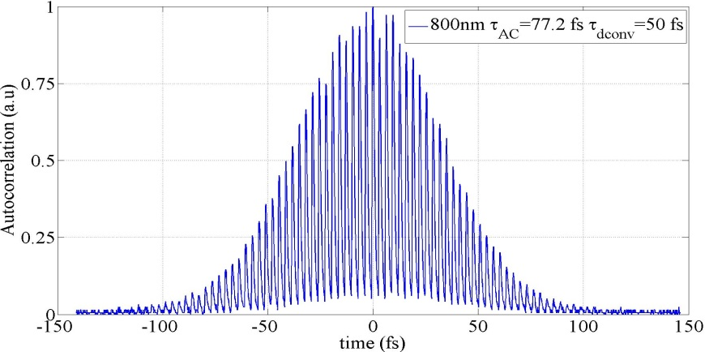
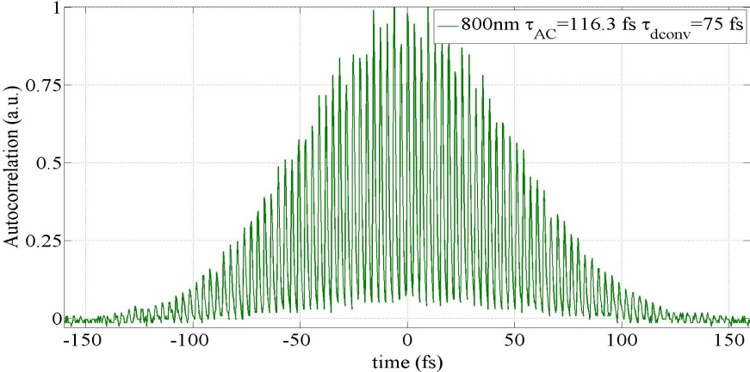
Long pulse mode
25fs
50fs
Flexible pulse duration selection
Good compressibility, close to Fourier limit for sech^2 pulses
75fs
Compressed pulses: 25 … 75fs
assuming sech²-deconvolved Autocorrelation
Notes:
Main message:
Longer pulses are possible, as demanded, close to transform limited.

Slide 22
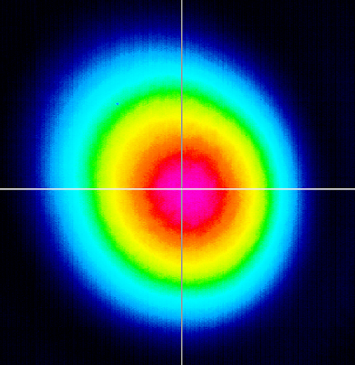

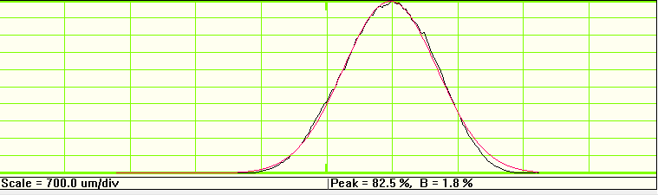
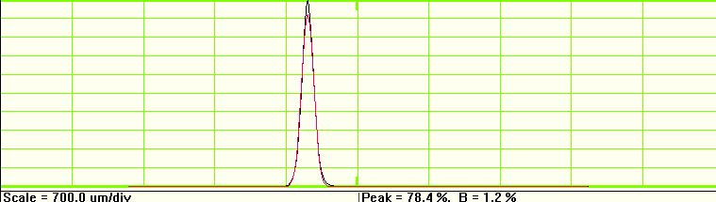
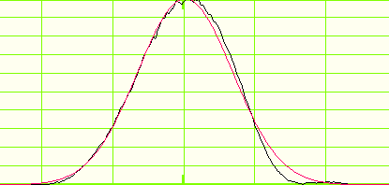
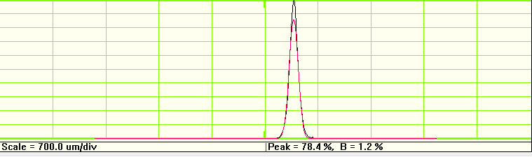
NOPA beam quality
Near field
Far field
2mm
180 um
Ellipticity 0.9
Very close to diffraction limited Gaussian beam
M²<1.15
Notes:
Main message:
Diffrection limited beam from NOPA

Slide 23
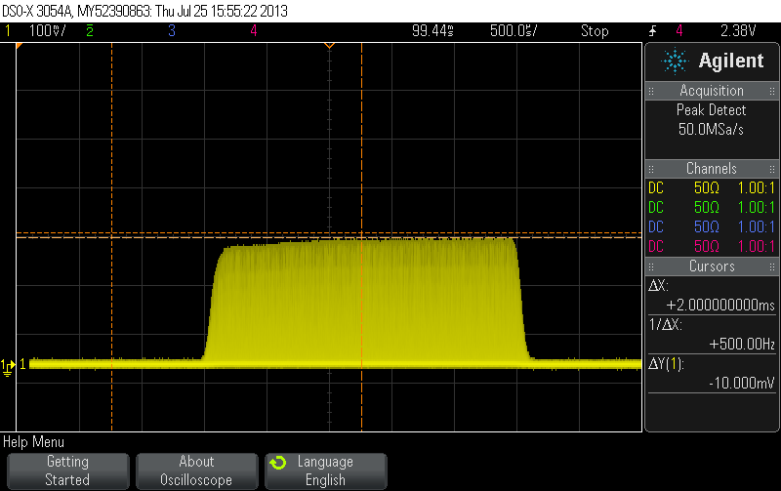
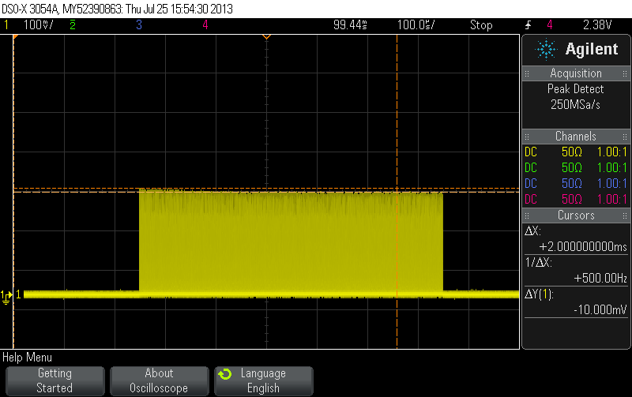
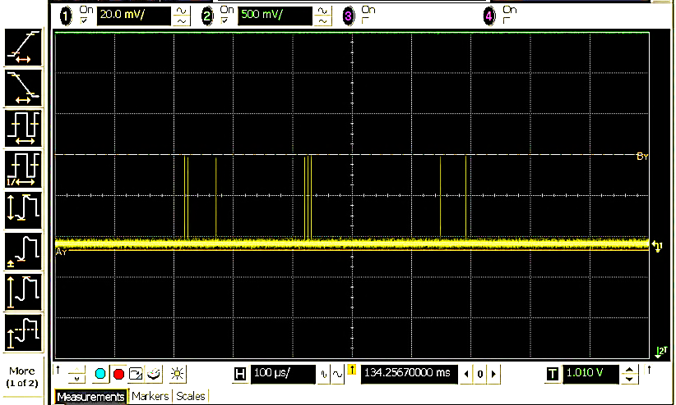
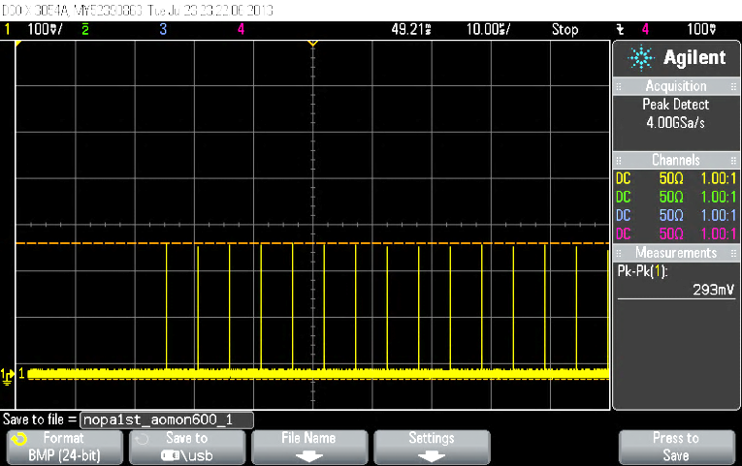
Burst and arbitrary pulse selection
Burst: 10Hz, 188kHz intra-burst , 180µJ per pulse.
Amplified burst: 10Hz, 2.5% dc
Burst: 10Hz, 600µs.
Arbitrarily selected pulses
Free of transients
Notes:
Main message:
Burst performance:
- Clean burst, no transients, arbitrary pulse selection

Slide 24
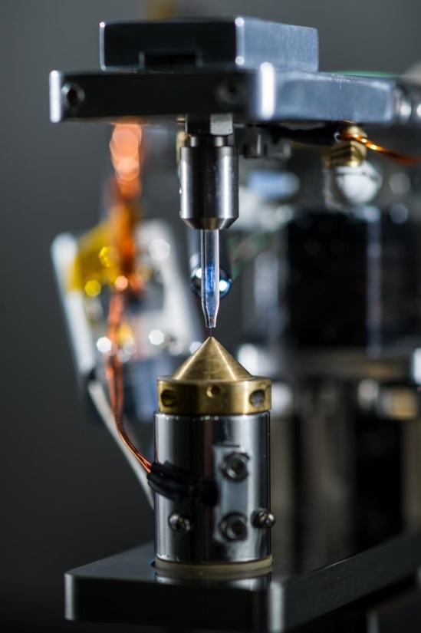
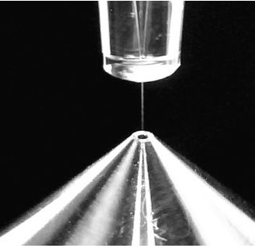


WP-79 Sample environment
Development activities
  Versatile liquid jet setup
    5 – 100 µm glass nozzles
    <1µm gas dynamic jets
    microfluidic systems for reproducibility & lab-on-the-chip approach
    Sample recovery catcher
    First tests showed that protein nano-crystals can be recovered
  Fast sample scanner
    Fast scanning (10 Hz, ~1mm)
    µm accuracy
    Add.: heat, cold, contacts
    Exchange of sample holder
    Vacuum load-lock system

Slide 25

WP-79 sample preparation laboratories in XHQ
Room for sample preparation
2x23m² chemistry wet labs
30m² X-ray lab for crystallography, SAXS, and reflectometry
30m² vacuum labs
44m² dry sample preparation
2x22m² electron microscopy and nano-fabrication lab

Slide 26



WP-81 FXE instrument
Special, as large contribution through IKC from Denmark
  Design, manufacture, installation, techn. commissioning
Collaboration with DTU, JJ X-ray

Slide 27





WP-82 HED instrument
DIPOLE laser

Slide 28



WP-83 MID instrument
Sample
chamber
Detector
arm

Slide 29



WP-84 SPB instrument – Layout
Integration of SFX User Consortium into SPB instrument
4-mirror integration
Detector arm &
SFX integration

Slide 30

WP-85 SQS instrument – Layout
Versatile end-station
Exchange of 3 chambers
- AQS: Atomic-like Quantum Systems
- NQS: Nano-size Quantum Systems
- REMI: Reaction Microscope
SQS Instrument Laser
Wavelength tuneable
2nd/3rd harmonic
THz
SQS Optical Laser
Control
PP Laser
Diagn.
KB
SASE 3 beam
Pink beam (1 μm)
Monochromatic beam
Circular polarization
NQS
Diagn.
SQS
Exp.
AQS
REMI

Slide 31




WP-85 SQS instrument – Special developments
KB focussing optics
Piezo benders (3 interaction regions)
Small surface errors (1 micron focus)
80 cm length
Extension to baseline equipment
XUV 1D Imaging spectrometer
Non-linear Phenomena
J. Nordgren, J-E. Rubensson, Uppsala University, Sweden
Reaction Microscope (REMI)
Angle-resolved electron-ion multi-coincidence
Focus in F1
R. Dörner, R. Moshammer, Uni. Frankfurt, MPI Heidelberg
Focus FWHM (μm)
100nrad slope error
50nrad slope error
Photon energy (keV)

Slide 32


WP-86 SCS instrument - Layout

Slide 33

Experiment hall installations & infrastructure
PSPO(T. Haas, G. Wellenreuther), TS(B. Becker-de-Moos), ext. companies

Slide 34

Experiment hall installations & infrastructure
PSPO(T. Haas, G. Wellenreuther), TS(B. Becker-de Mos), ext. companies
SPB/SFX Präparationslabor
Control areas

Slide 35


XHQ laboratory floor definition & infrastructure
TS(B. Becker-de Mos), ext. companies
Side view
Top view

Slide 36
Content
  Some general remarks
  Update photon beam system work packages
  Time planning

Slide 37
Critical elements in time planning
Highly specific components
  X-ray optics, in particular long, extremely flat mirrors
    First mirrors will be available for installation
    Mitigate risk by using other optics
  2D detectors
    First detectors will be available
    Mitigate risk by using ‚standard‘ detectors
  Complex mechanics
    So far no show stoppers identified
Installation sequence
  Need to build up infrastructure first (rooms, media/TGA, conditioning)
    In principle okay, but complexity can lead to delays
Resources
  Manpower to advance design, prepare procurement, follow-up, installation

Slide 38
Stagged installation
SASE 1 – FXE & SPB instruments (t₀)
  First hutch installations
  First undulator & x-ray beam transport
SASE 3 – SQS & SCS instruments (t₀ + 1 month)
  Next set of hutches
  Next undulator & x-ray beam transport
SASE 2 – MID & HED instruments (t₀ + 4 month)
  Final set of hutches
  Final undulator & x-ray beam transport
Additional instrumentation
  Detectors, DAQ & control, optical lasers, sample environment occurs in parallel and according to needs by the above listed areas

