Slide 1
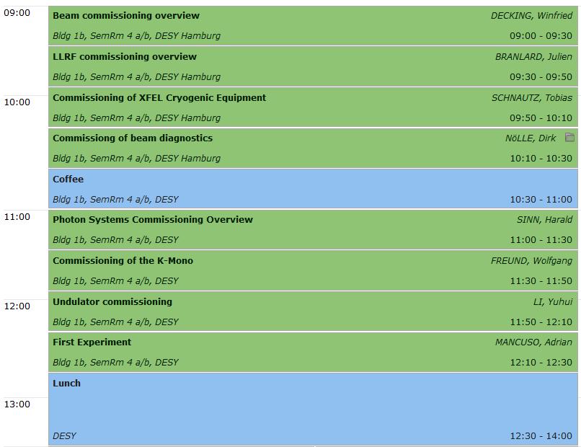
XFEL Commissioning WG - Welcome

Slide 2


(Accelerator) Commissioning
Winfried Decking (DESY)
European XFEL Collaboration Meeting
08.04.2014
Notes:
How to edit the title slide
Upper area: Title of your talk, max. 2 rows of the defined size (55 pt)
Lower area (subtitle): Conference/meeting/workshop, location, date,
your name and affiliation,
max. 4 rows of the defined size (32 pt)
Change the partner logos or add others in the last row.

Slide 3
Parameters
Quantity | Value
electron energy | 8.5/12/14/17.5 GeV
macro pulse repetition rate | 10 Hz
RF pulse length (flat top) | 600 μs
bunch repetition frequency within pulse | 4.5 MHz
bunch charge | 0.02 – 1 nC
electron bunch length after compression (FWHM) | 2 – 180 fs
Slice emittance | 0.4 - 1.0 mm mrad
beam power | 500 kW
# of modules (containing eight 9-cell superconducting 1.3 GHz cavities) | 101
accelerating gradient for 17.5 GeV | 23.6 MV/m
# of 10 MW multi-beam klystrons | 27
average klystron power (for 0.03 mA beam current at 17.5 GeV) | 5.2 MW

Slide 4
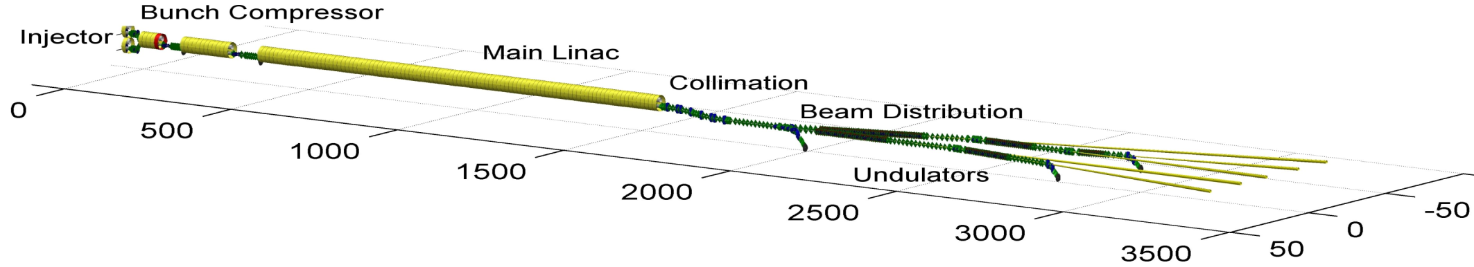
Timeline and Milestones
2014
2015
2016
2017
2018
First e-beam out of RF gun installed at XFEL
Injector cooldown
Linac cooldown
SA1
SA3
SA2
Start user operation
Full TDR performance
1st lasing possible
Injector commissioning up to full XFEL performance (varying charges and bunch patterns, laser heater, slice diagnostics, intra-train feedbacks, automated procedures)
Initial linac commissioning with reduced performance
Continued accelerator commissioning to full performance (high beam power, bunch length flexibility, multiple bunch properties per rf-pulse, full wavelength tuneability, ….)
Beam line and experiment commissioning
First user operation

Slide 5
Lessons learned from LCLS & FLASH
Thorough Pre-beam Checkout: Detailed pre-beam checkout conducted from the actual controls panels and verified in the tunnel with Hall probes, clip-on ammeters, simple tape measures, etc. ensures that the hardware and software is functioning at a fundamental level prior to beam.
Software Ready for Commissioning: Process automation and data analysis software fully prepared ahead of time to support commissioning activities
Reliable Diagnostics: Reliable diagnostics for all (or almost all) electron beam parameters throughout.
courtesy Jim Welch, SLAC

Slide 6
Lessons learned
Disciplined Planning: A uniform plan focused on getting the machine up and running reasonably well and quickly, rather than a more academic approach where many various machine and system studies are executed sequentially, leaving the machine in an unknown and constantly changing state.
Basics First: A 'layered' approach to commissioning whereby fundamentals are verified first (BPM scaling, linear optics, magnet operation, etc), before plunging into the more exciting phase of beam characterization.
Sequential Commissioning: Beam-based feedback loops implemented as the commissioning moves downstream so that upstream systems are locked in while the downstream systems are brought on line.
courtesy Jim Welch, SLAC

Slide 7
Lessons learned
Fix the Problems: Leaving as few mysteries as possible - not leaving a system until we understand what it is doing
Adequate Commissioning Time: plenty of time was available for commissioning the electron beam in stages
Dedicated Team: all these points worked because of the dedicated people who made them work...
courtesy Jim Welch, SLAC

Slide 8
Team
Coordination
Accelerator Physicists
Photon system scientists
Operators (Electron and Photon systems)
System Specialists (M- and XFEL-groups)
  organize on call duty
  organize full shift participation as needed
  organize and run development shifts
Accelerator Physics
System- specialists
Coordination
Operators

Slide 9
Accelerator control room crew
24/7 coverage:
Shift leader (1)
Operators for PETRA and FLASH (3)
Operators for power/clima/water on DESY site (2)
Cryo-plant operator (1)
Operator and Accelerator Physicist for XFEL (2)
Additional coverage
Specialists according to program needs
Photon systems staffing
Initial commissioning from DESY BKR

Slide 10
Generic Commissioning Sequence
System integration (WP/TC responsibility)
Technical commissioning of sub-systems (WP responsibility)
Beam commissioning
Pre-beam check out
Beam transport
Sub-systems commissioning to target parameters
Commissioning of section to target parameters
Consolidate operation, implement procedures, …
Continue to next section
Achieve final target parameters
(Re)-define goal

Slide 11
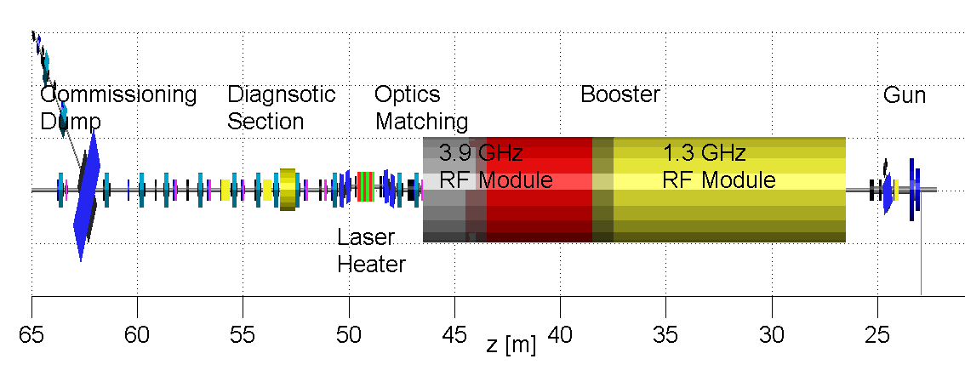
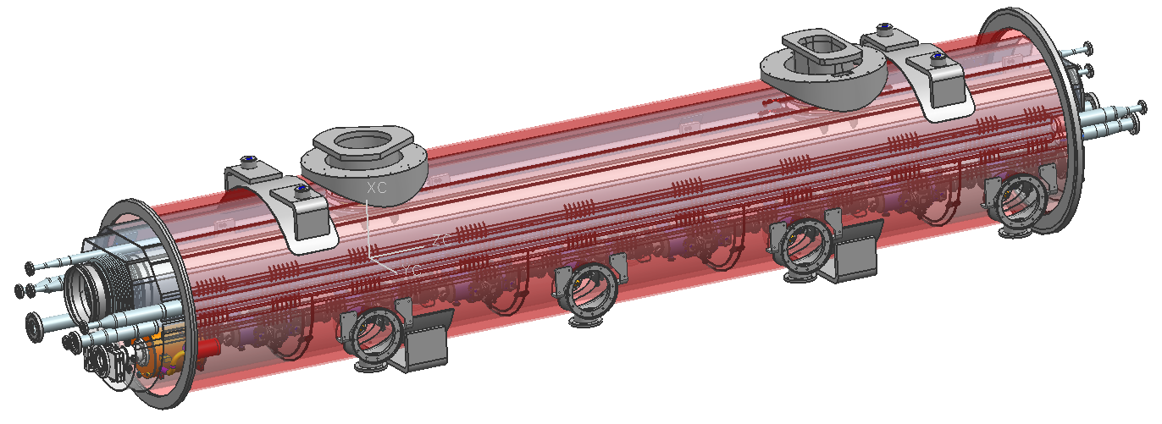
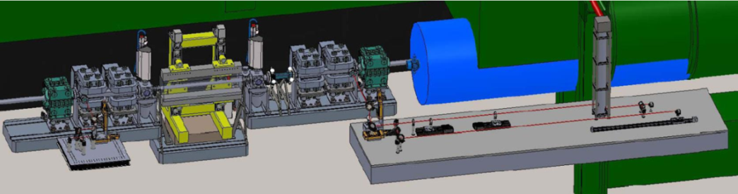
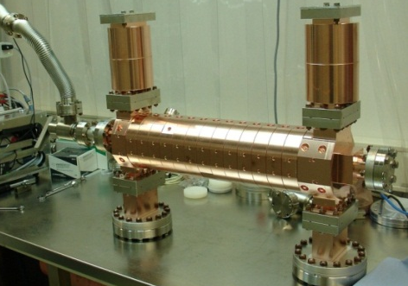
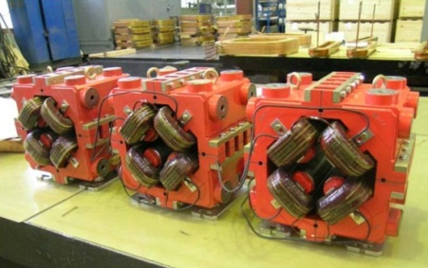
Injector

Slide 12
Injector Commissioning
Achieve all XFEL parameters
Commission sub-components like
Establish routine operation
‘Teambuilding’
Sufficient time foreseen for tests, detours, „trial and error“, …
Quantity | Value
macro pulse repetition rate | 10 Hz
RF pulse length (flat top) | 600 μs
bunch repetition frequency within pulse | 4.5 MHz
bunch charge | 0.02 – 1 nC
Slice emittance | 0.4 - 1.0 mm mrad

Slide 13
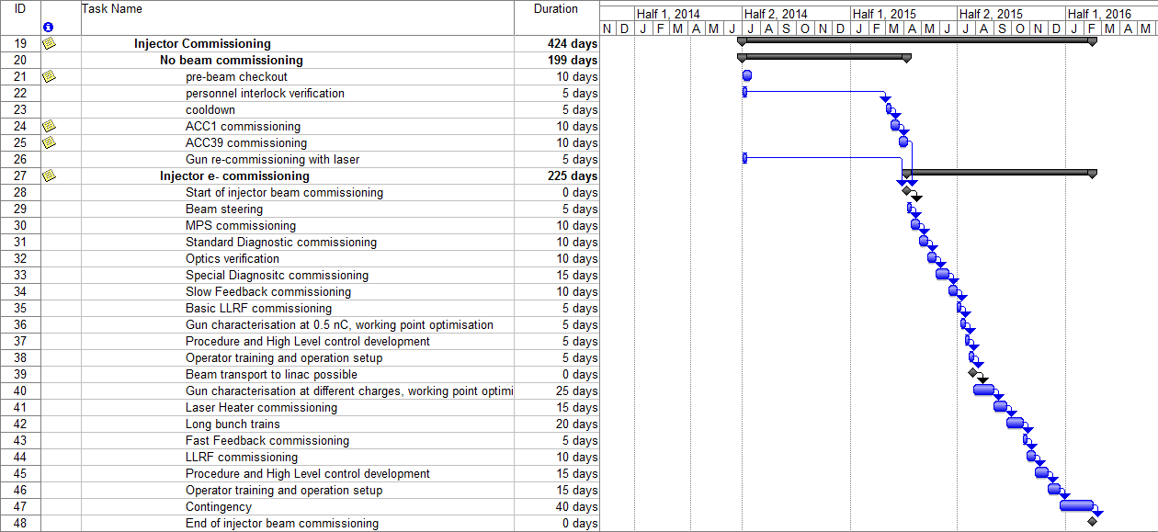
Detailed (sequential) plan - Injector

Slide 14
Milestones – Injector

Slide 15
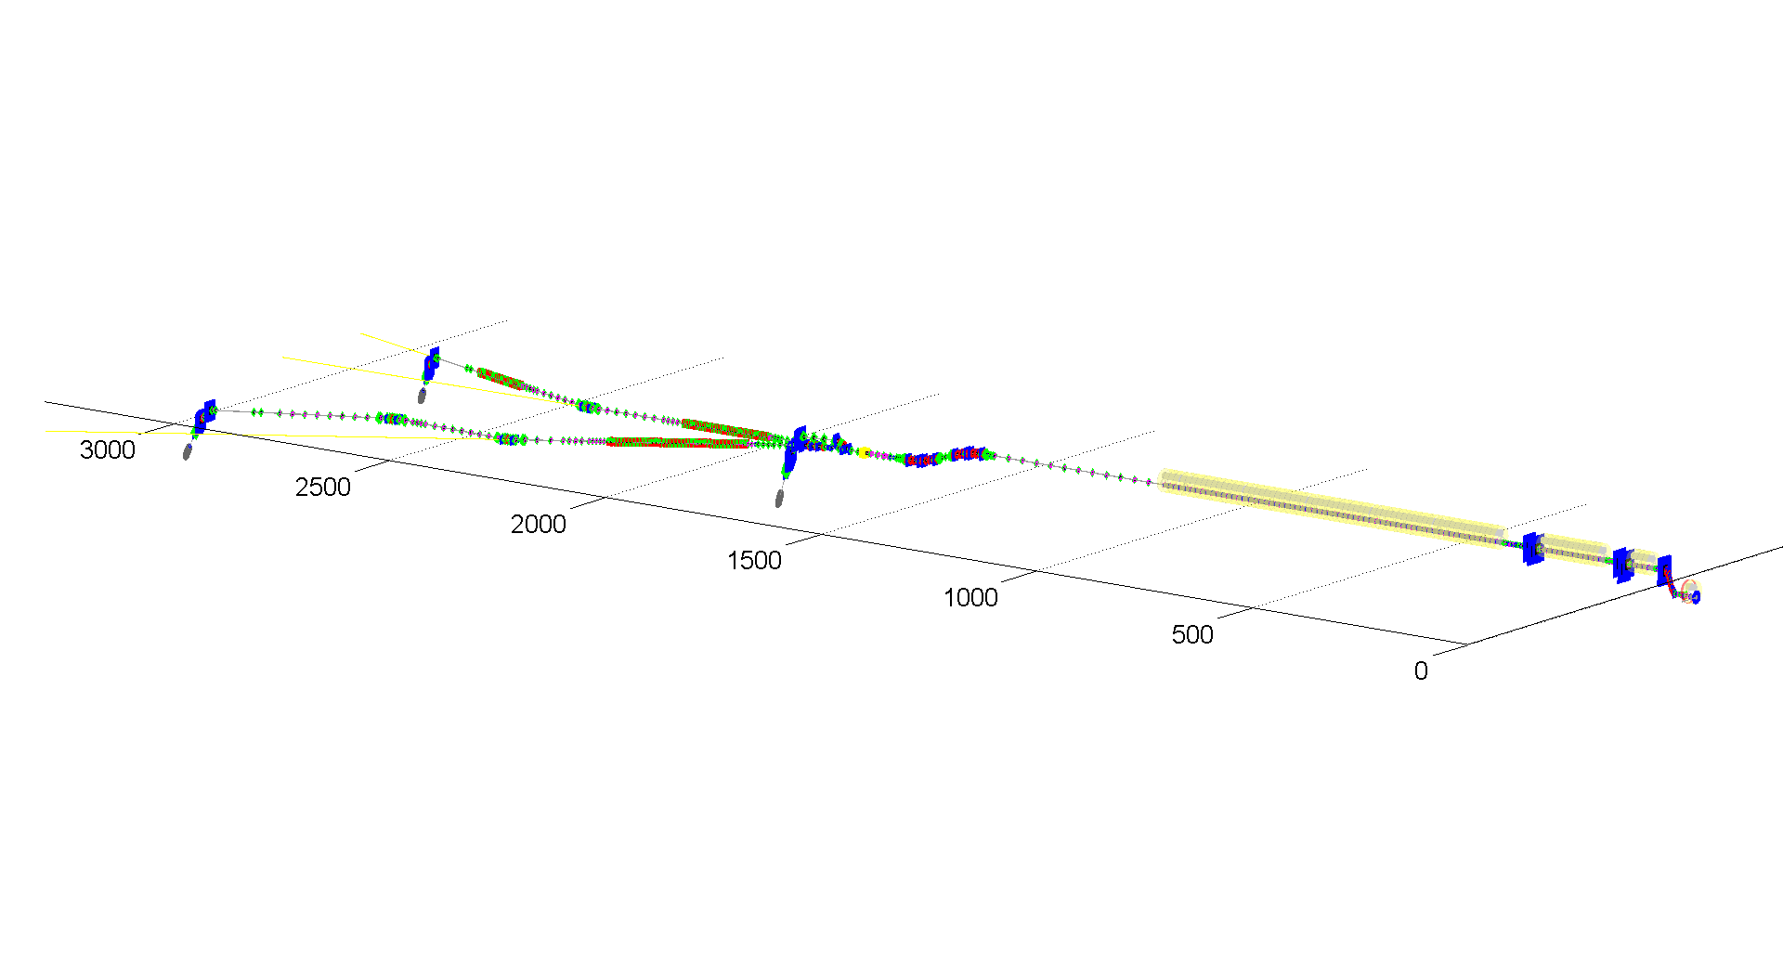
Overall Commissioning

Slide 16
Commissioning Sequence
injector dumps
130 MeV
P_{ave}= 12 kW
max. beam power
main beam dumps
up to 25 GeV
P_{ave}= 300 kW
1/2 max beam power
beam magnified
slow sweep to distribute heat
bunch compressor diagnostic dumps
0.5 and 2.5 GeV
small fraction of max. beam power

Slide 17

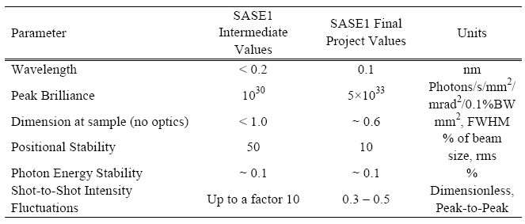
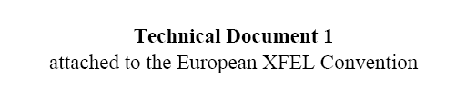
‘Start of Operation’ as defined in the European XFEL Convention

Slide 18
Initial E-beam parameters
Quantity | Value
electron energy | 8/12.5/14/17.5 GeV
macro pulse repetition rate | 10 Hz
RF pulse length (flat top) | 600 μs
bunch repetition frequency within pulse | 4.5 MHz 100 kHz
bunch charge | 0.02 – 1 nC 0.5 nC
electron bunch length after compression (FWHM) | 2 – 180 fs 90 fs
Slice emittance | 0.4 - 1.0 mm mrad
beam power | 500 kW 5 kW
Linac will be operated with several tens of bunches (not single bunch) as fast as possible
  single bunch operation is useless for LLRF diagnostics and studies
  many bunch operation is more difficult for machine protection system
beam charge around 0.5 to 1 nC
  Good for diagnostics and LLRF

Slide 19
Undulator Sequence and SASE Wavelength
  Commissioning starts with SASE1 and continues with SASE3
  beam line first to be ready
  eases initial e-beam operation
  allows parallel commissioning of SASE1 and SASE3 photon beam lines (although FLASH experience recommends to focus activities on one beam line and commission this fully to benefit from the lessons learned and not double errors)
  if no SASE is reached in SASE1, SASE3 could be put into operation with much looser tolerances to diagnose e-beam parameters
  SASE search should be performed with fully closed gaps (i.e., 0.16 nm wavelength at SASE1)

Slide 20
Milestones – Linac & Experiments

Slide 21
Detailed (sequential) plan – BC1

Slide 22
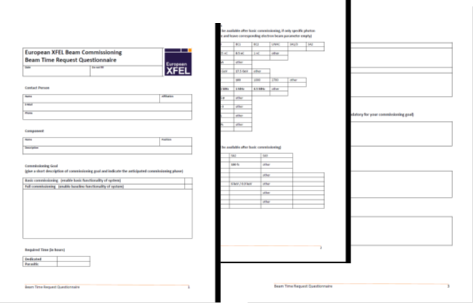
First Lasing and First User Operation
From questionnaire (not all returned):
approx. 1300 h commissioning time (accelerator & photons) to first experiment
“Conditions for 'First User Experiments'
    experiments can use x-ray beam at TDR performance, but with limited flexibility in terms of pulse pattern, pulse length and photon wavelength”

Slide 23
Further Development
Multi-bunch operation
  Pattern: up to 2700 bunches, 0.5nC, C=100
  Control: Charge, peak current, energy, trajectory and arrival time are controlled by slow and fast feedbacks.
Quasi-simultaneous operation of SASE1 and SASE2 beam line
  Pattern: 10 Hz, up to 2700 bunches, 0.5nC, C=100
  Bunch pattern control by fast switching elements

Slide 24
Further Development
Flexibility in wavelength and bunch length
  Pattern: 2700 bunches, 0.02-1nC, C=2000-50
  establish procedures to change bunch length/bunch charges
  establish procedures to change photon wavelength by changing energy/undulator gap
Seeding
  self seeding (requires considerable alterations to installed hardware)
….

Slide 25
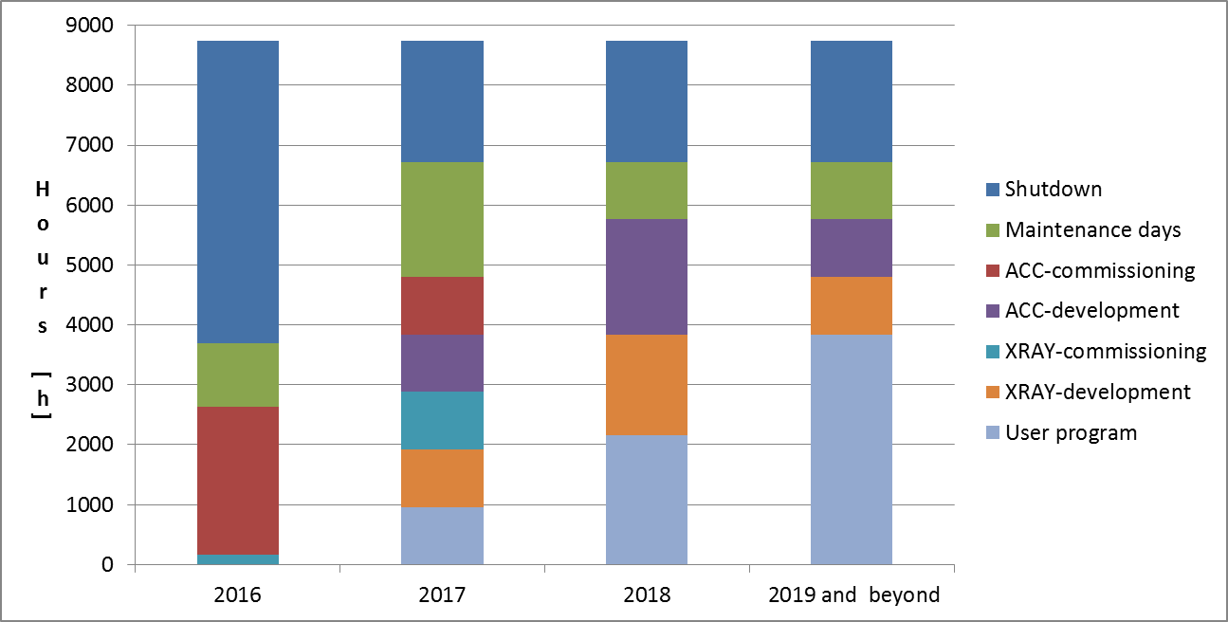
Ramp-up operation
If main accelerator commissioning starts summer 2016:
hrs | 2016 | 2017 | 2018 | >2018
Accelerator A | 2500 | 4700 | 5600 | 5600
X-ray delivery T_{x} | <500 | 2800 | 3900 | 4800
Users ΣU_{NNN} | 0 | 2 x 1000 | 3 x 2100 | 3 x 4000
Thomas Tschentscher, European XFEL,
European XFEL Users’ Meeting, Hamburg 29/01/2014

Slide 26
A year at European XFEL
Annual operation
  4800 hrs accelerator operation for generation of x-rays
    Peer-reviewed proposals [4000 hrs]
    Internal activities [800 hrs]
      Maintenance
      R&D program & management contingency
  ~5600 hrs total accelerator operation
    Dedicated machine time
      Maintenance (w. beam, short access) & tuning
      R&D
User experiments
  12000 hrs user time by operation of three instruments in parallel
  ~200 user experiments / year

Slide 27
Operating two instruments per SASE beamline
Concept
  Typical slot 5 days; start/end on machine day
  Share day with two 12 hrs shifts
  Setup /changes on machine days
  Major modifications during shutdown weeks
Optimized instrumentation
  dedicated setups
  possibility to swap entire setups (chambers or interior)
  install as many as possible instrumentation permanent
  simplify experiment setup for varying parameters
Example of 4 week slot at any instrument
Day shift (12 hrs; e.g. 10-22 hrs)
Night shift (12 hrs; e.g. 22-10 hrs)

Slide 28
Summary
High expectations in XFEL commissioning both for speed and success
Strategy is laid out
Good preparation is necessary
Goal definition for each commissioning step
Next:
  Continue sub-system commissioning (cryogenics, laser, injector, RF, ….)
  Team building
  Establish a bi-weekly ‘informal’ commissioning meeting to exchange ideas and develop concepts
  Detailed planning with different WPs both for beam and technical commissioning

