Slide 1


TC Issues and 3D CAD
Markus Hüning
3rd XFEL Collaboration Meeting
Notes:
How to edit the title slide
Upper area: Title of your talk, max. 2 rows of the defined size (55 pt)
Lower area (subtitle): Conference/meeting/workshop, location, date,
your name and affiliation,
max. 4 rows of the defined size (32 pt)
Change the partner logos or add others in the last row.

Slide 2
Installation across Sections
 | 04 | 05 | 06 | 07 | 08 | 09 | 10 | 11 | 12 | 01 | 02 | 03 | 04 | 05
Injector
BC
Linac |  |  |  | C | C | C | C | C | C | C | C | C | C | C
L3/CL
Distribution
Rm 38-40
SASE
Notes:
Before you start editing the slides of your talk change to the Master Slide view:
Menu button “View”, Master, Slide Master:
Edit the following 2 items in the 1st slide:
1) 1st row in the violet header:
Delete the existent text and write the title of your talk into this text field
2) The 2 rows in the footer area: Delete the text and write the information
regarding your talk (same as on the Title Slide) into this text field.
If you want to use more partner logos position them left
beside the DESY logo in the footer area
Close Master View

Slide 3
Section Reviews
Preparation
Integration
Documentation
 | List of stakeholders | Interface definitions | Lattice | DG3 model of the beamline | Integration model (DG2) | Collision check | List of milestones | Subsystems and responsibilities (MBOM) | Summary of cables and racks | Meeting minutes | Closed review with documentation in the EDMS
Injector |  |  |  |  |  |  |  |  |  |  | 15.04.
BC |  |  |  |  |  |  |  |  |  |  | 13.05.
Linac |  |  |  |  |  |  |  |  |  |  | 20.05.
L3/CL |  |  |  |  |  |  |  |  |  |  | 01.07.
Distr. |  |  |  |  |  |  |  |  |  |  | 16.09.
Rm38-40 |  |  |  |  |  |  |  |  |  |  | 19.05.
SASE |  |  |  |  |  |  |  |  |  |  | 05.05.
Distr. |  |  |  |  |  |  |  |  |  |  | 16.09.
Initiated | Working | Released in EDMS

Slide 4
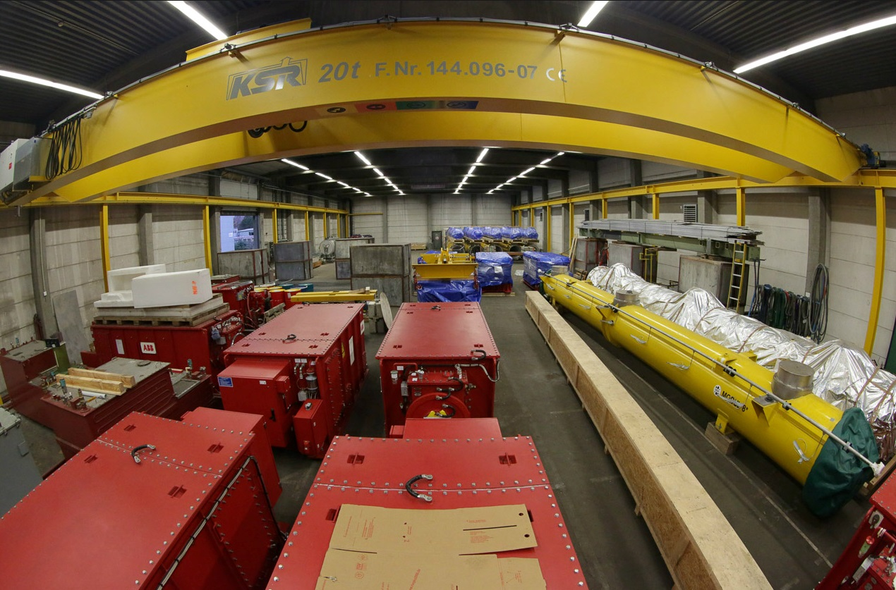
Storage of Accelerator Components
XFEL Collaboration Meeting – April 7-9, 2014
Hans Weise, DESY

Slide 5
External Storage
We reserved place in an external hall (outside Hamburg, 30min drive) by a logistics provider
This place is foreseen for equipment that needs to be stored for at least 6 (better 12) months
So far we brought racks there, pulse transformers are due this week
So far this solution is not suitable for equipment under surveillance by customs

Slide 6
3D CAD
We have a 3D CAD Master Model maintained in the EDMS (I-DEAS)
  This model consists of placeholders of reduced complexity (DG2)
  This model is binding and stays binding
For integration of beamlines (many trades in a crowded space) it is advantageous to use fully detailed (DG3) models

Slide 7
CAD Integration of fully detailed Models
The final integration step will be done with JT‘s including JT‘s of the Master Model
JT‘s of individual trades can be put in the usual CAD exchange folder for the QS to assemble the 3D overviews
These overviews will be uploaded to EDMS as well, to be found in the same place as the master model
For parts of the beamline a pre-integration is done in SolidEdge (for details see the Section Coordinators)

Slide 8


Steuerskizze
The „Steuerskizze“ is a tool to correctly place components according to their coordinates in the „Lattice List“
Lattice List
List of Variables
Chain of Containers

Slide 9
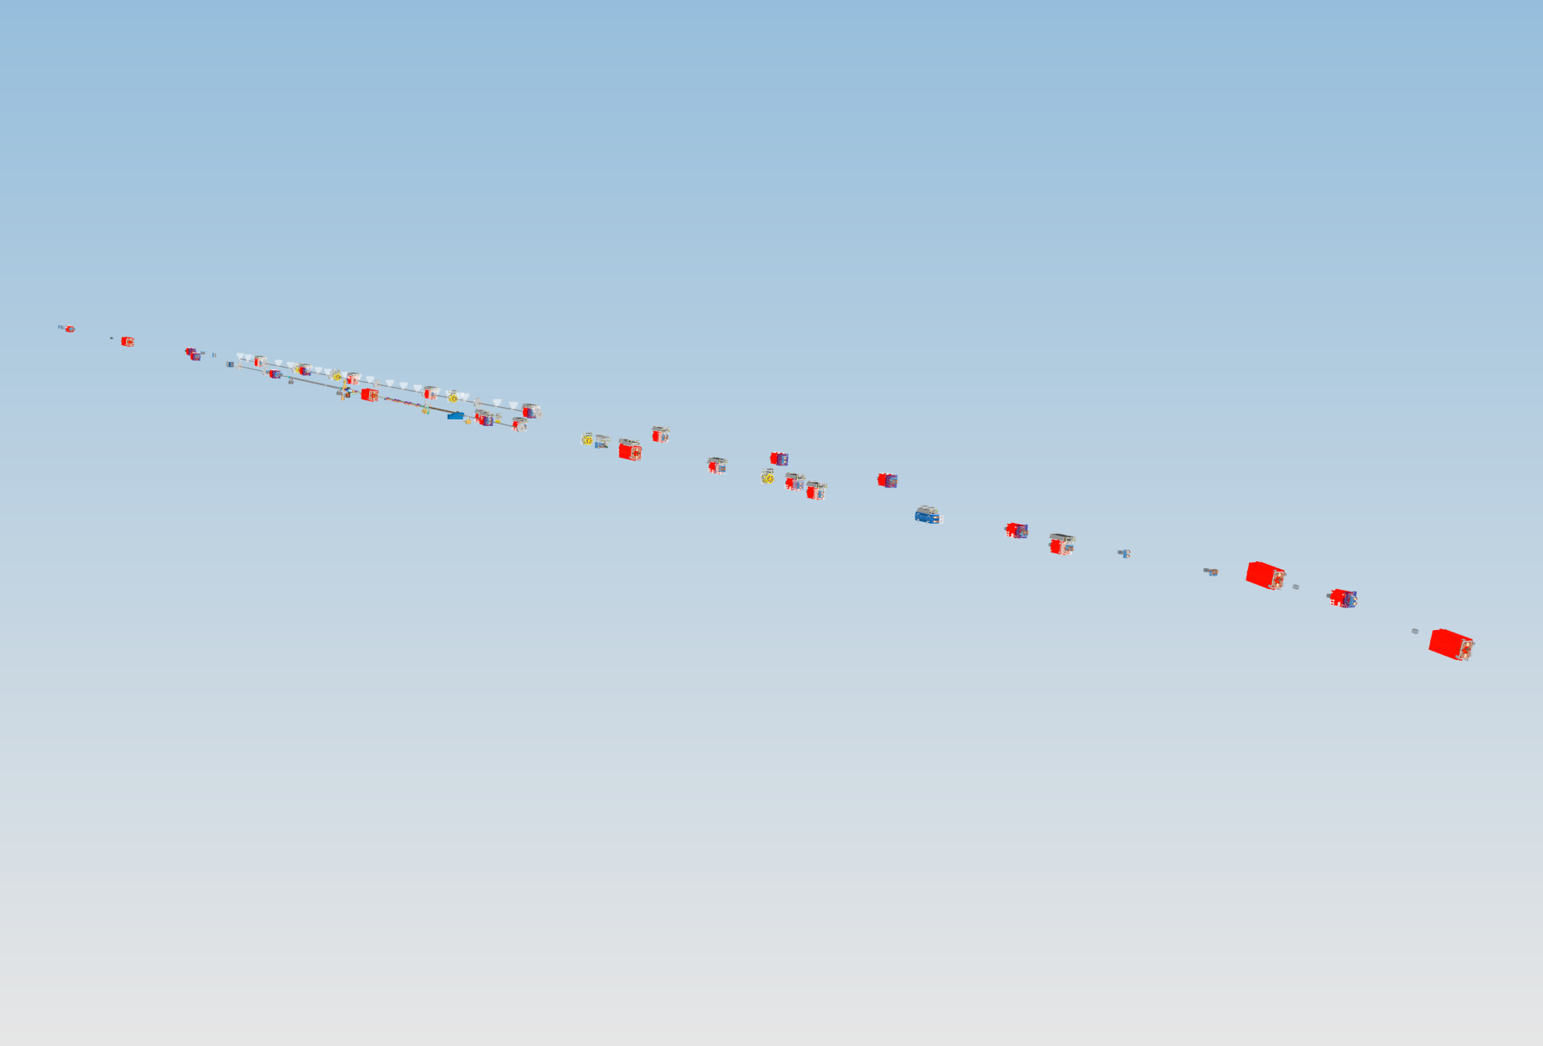
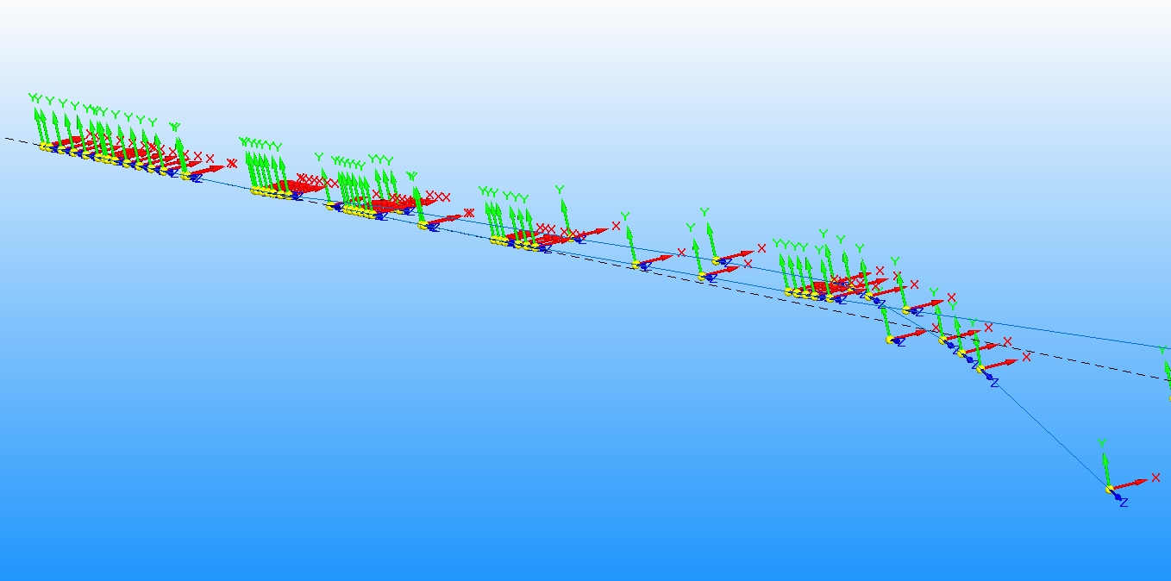
Steuerskizze

Slide 10
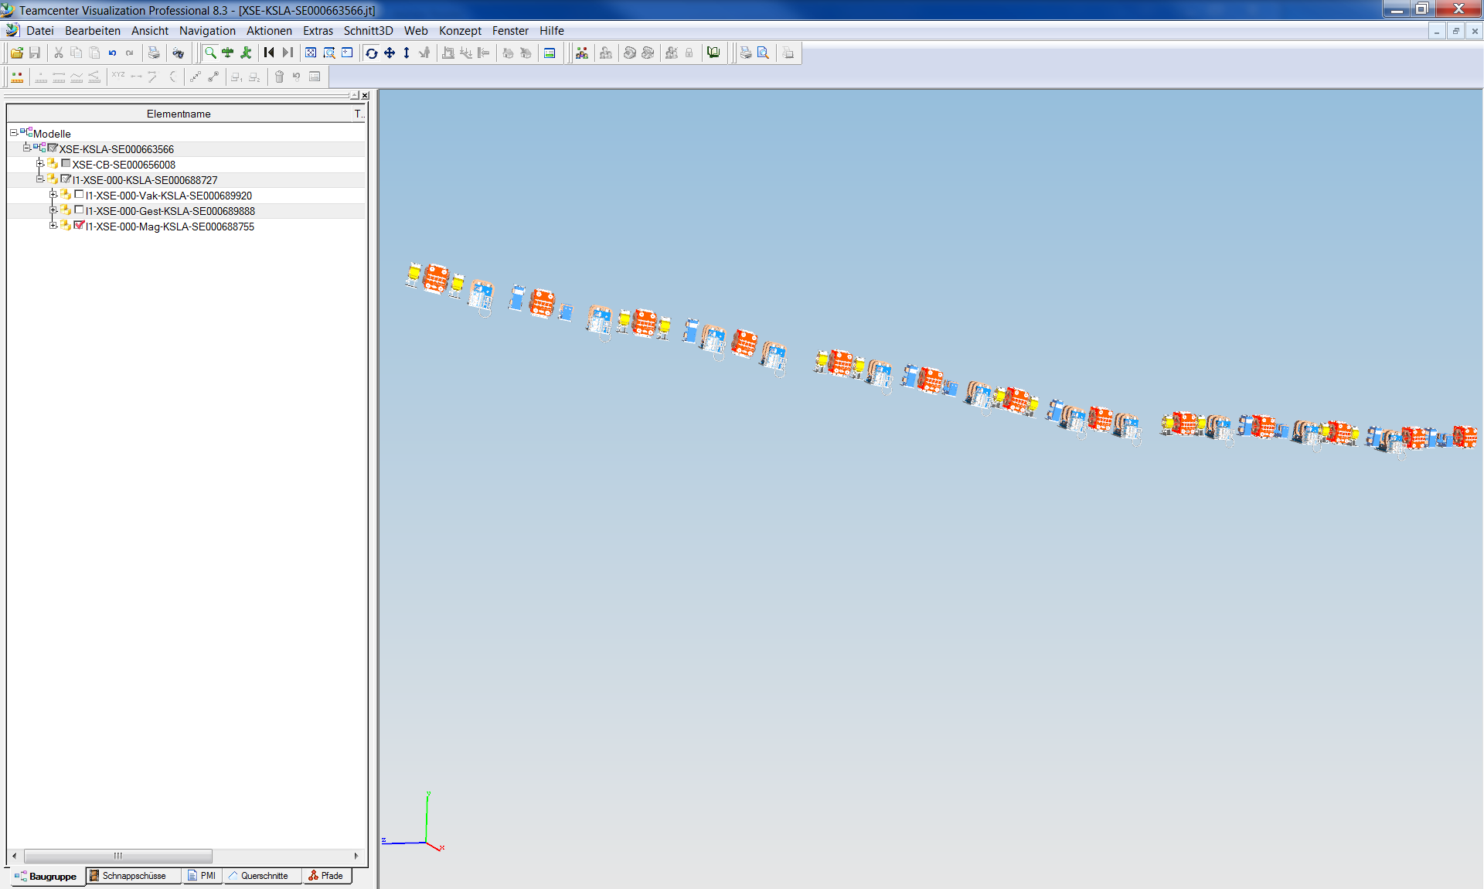
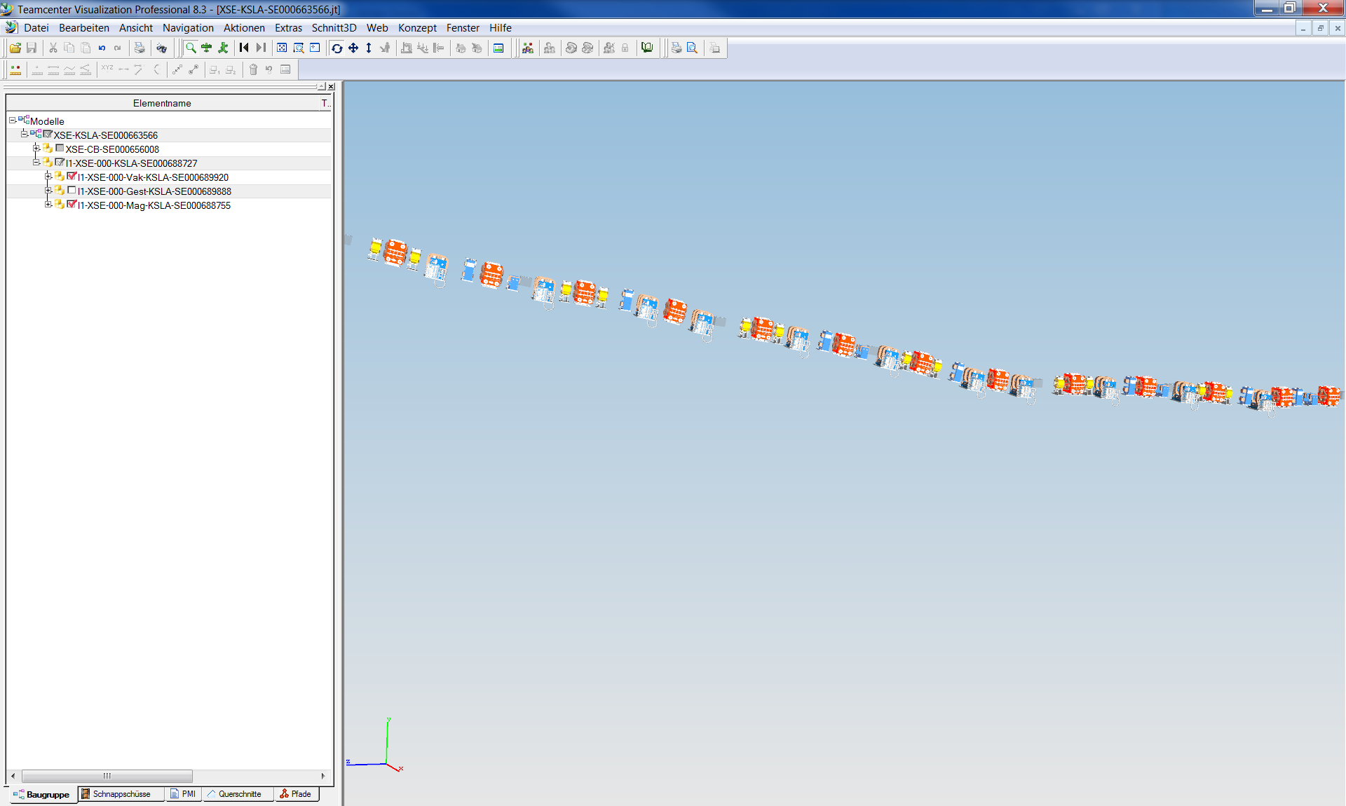
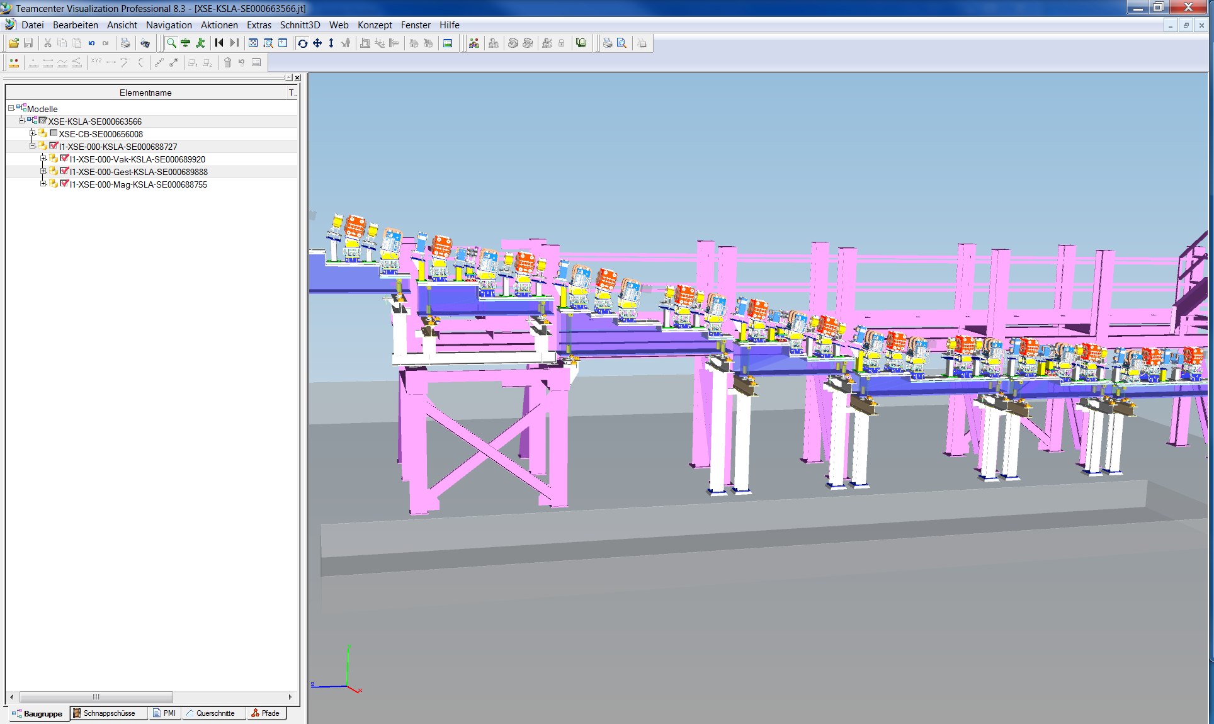
Example: XSE Dogleg

Slide 11
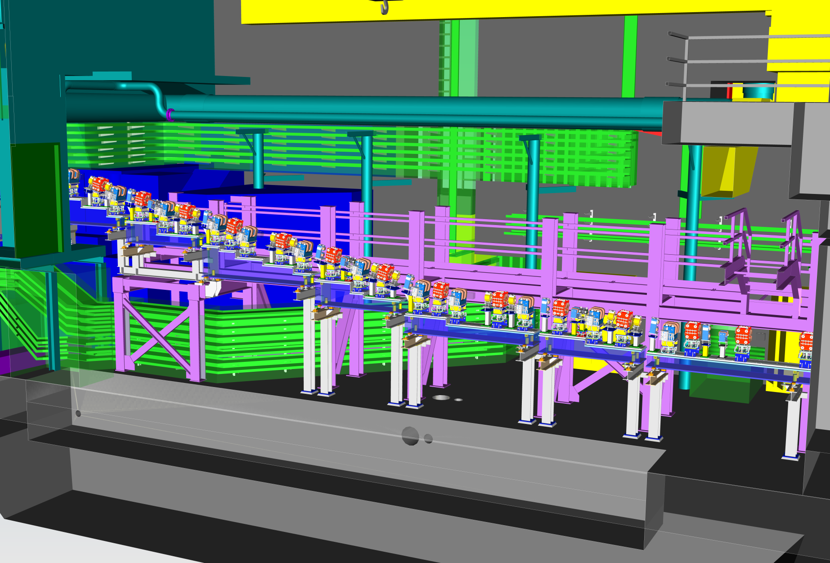
Dogleg with Surroundings

Slide 12
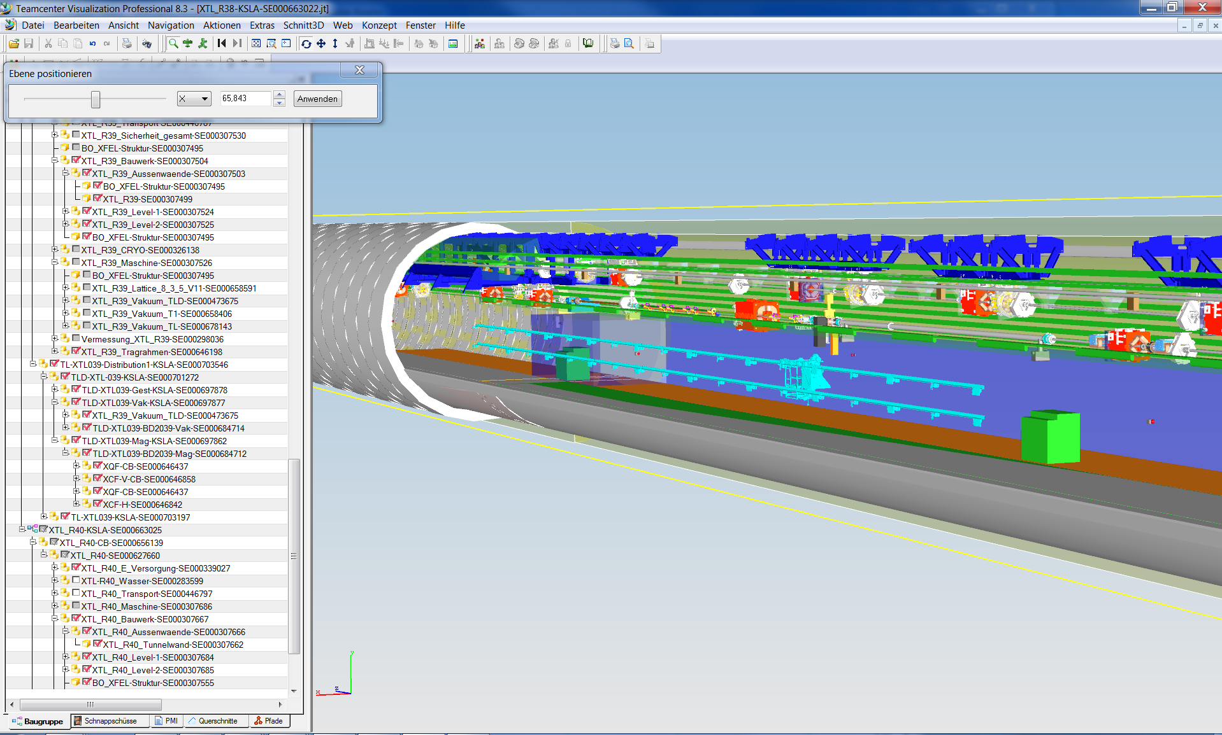
Example: XTL Rm 38-40

Slide 13
