Slide 1
Photon systems commissioning overview
Harald Sinn
3rd Collaboration Meeting
8 April 2014

Slide 2
Construction (top-down) milestones for commissioning schedule on xfel.eu
T0: Linac tunnel closed (30 June 2016 )
T0+3 month e-beam through XTL
T0+6 month First lasing possible in SASE1 (31 Dec 2016)
T0+9 month First experiments on SASE1 instruments possible
T0+10 month First experiment on SASE3 instruments possible
T0+12 month First lasing possible in SASE2
T0+16 month First experiments on SASE2 instruments possible
3 month from first lasing to user experiments
(LCS first lasing April 10, 2009
First user experiment Oct. 3, 2009 = 6 month)

Slide 3
Commissioning plan
Basic assumptions for planning:
Technical commissioning is done before
No delays through missing hardware or staff
Based on ‘commissioning proposals’
Dedicated beam time is expensive!

Slide 4
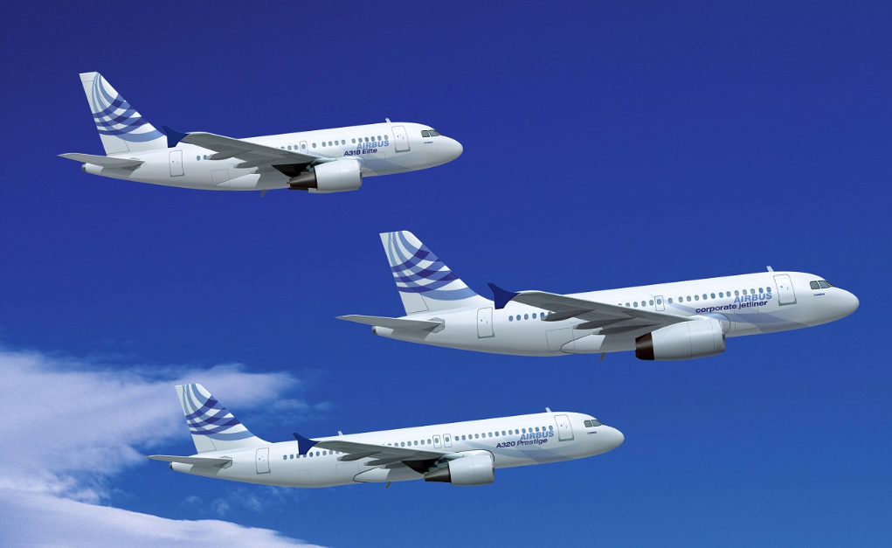

Price of commissioning
Rule for User Consortia: 24h beam time for 270 k€
(with 3 instruments running in parallel)
= price for operating one Airbus 320
Commissioning: Full facility works for you!
(3 x 270k€ = 810 k€/day = 30 k€/hour = 500 €/min)

Slide 5
Rule of thumb:
Price of commissioning should not exceed the price of the component!

Slide 6
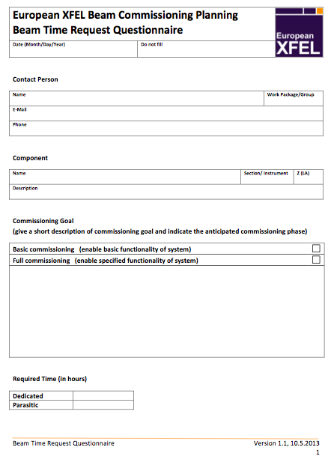
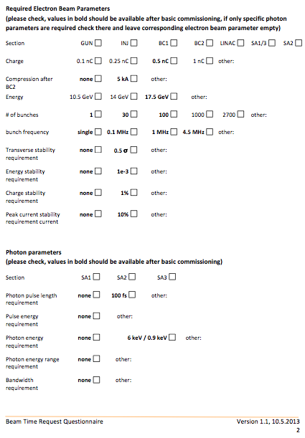
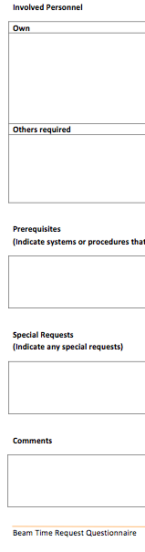
Questionnaire to Work Packages (May 2013)

Slide 7
Commissioning strategy
Initially only single beam condition:
17.5 GeV
0.5-1 nC
30-50 pulses/train (or single pulse on request)
Closed undulator gap (SASE1&2: 8.5 keV, SASE3: 1 keV)
‘One user’ operation (from e.g. machine control room)
Get beam quickly through essential optics to instruments
Come back later to commission remaining optics

Slide 8
Example: From SASE1 undulator to the Experiment Hall (fast track)

Slide 9
Components that need ‘hot’ commissioning

Slide 10
Fast track: Needed for first beam in Exp. hall

Slide 11
√
8d
8h
8h
8h
8h
8h
8h
12h
20h
5d

Slide 12
Fast track commissioning SASE1: SPB
Closed Undulators (WP71) 1 day
Search for SASE 8 days
XTD2 Optics + Diagnostics 4 days
XTD9 Beam through tunnel 2 days
SPB initial alignments 5 days
From beam in SASE1 to SPB 20 days = 4 weeks
XTD9 branch beam line 2 days
FXE initial alignments 5 days = 5.5 weeks
With 16 hours = 1 day, 5 days = 1 week

Slide 13
Further commissioning goals
Achieve same level at SASE3 (+5.5 weeks)
Next: (Limited) tunability of undulator gaps will enable commissioning of monochromators (+1 week)
First experiments SASE1 possible (=T0 + 9 months)
Next: Lasing at other working points (8.5 GeV, 12 GeV) will enable of e.g. low energy mode of soft x-ray monochromator
First experiments SASE3 possible (+ 1 month)
Next: SASE2 (start T0+12 month, need 6.5 weeks)
Simultaneous SASE operation, longer pulse trains (+2 month)
User Operation on all beamlines possible (with more commissioning interleaved) (=T0+16 months)

Slide 14
Next talks
Commissioning of the K-mono:
Wolfgang Freund, X-ray diagnostics group
Undulator Commisioning
Yuhui Li, Undulator group
First Experiment
Andy Aquilla, SPB instrument

