Slide 1


WP40:
Engineering Data Management w.r.t. Cavities and Modules
Lars Hagge for WP40
Notes:
How to edit the title slide
Upper area: Title of your talk, max. 2 rows of the defined size (55 pt)
Lower area (subtitle): Conference/meeting/workshop, location, date,
your name and affiliation,
max. 4 rows of the defined size (32 pt)
Change the partner logos or add others in the last row.

Slide 2
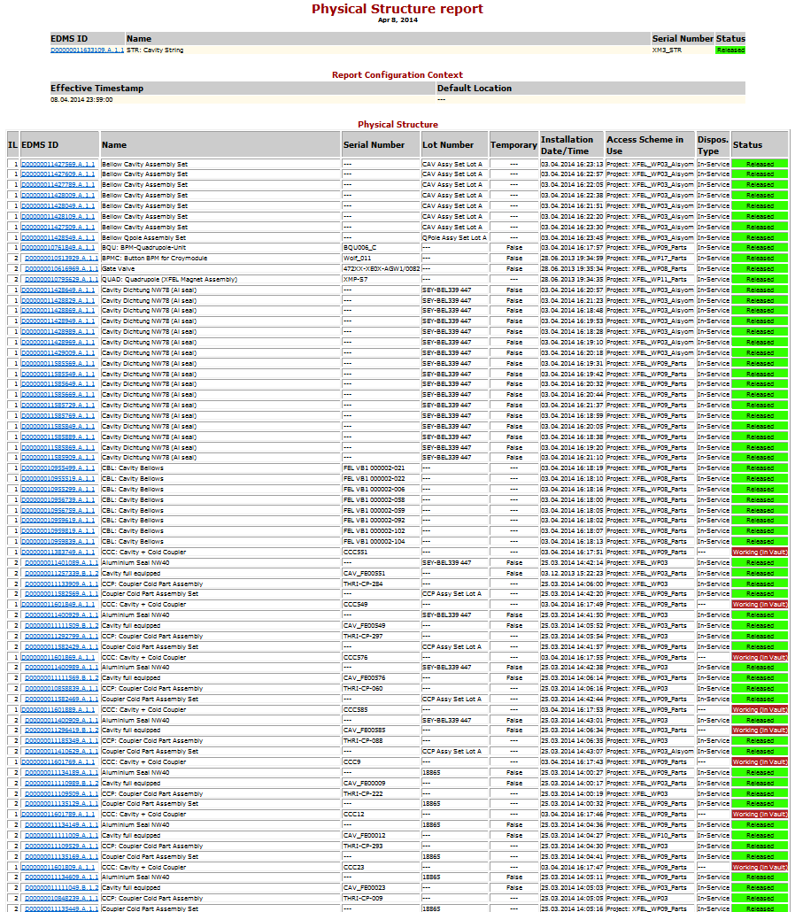
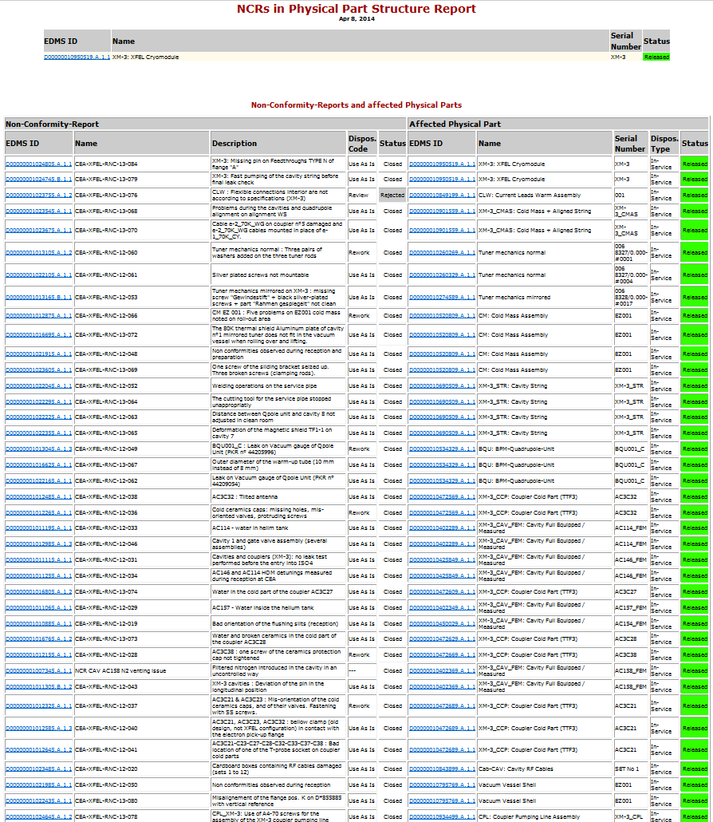
Examples: EDMS in Cryomodule Assembly
Module configuration in EDMS
NCRs occurring during module assembly
Notes:
Before you start editing the slides of your talk change to the Master Slide view:
Menu button “View”, Master, Slide Master:
Edit the following 2 items in the 1st slide:
1) 1st row in the violet header:
Delete the existent text and write the title of your talk into this text field
2) The 2 rows in the footer area: Delete the text and write the information
regarding your talk (same as on the Title Slide) into this text field.
If you want to use more partner logos position them left
beside the DESY logo in the footer area
Close Master View

Slide 3
EDMS for Cavity Production and XM Assembly
EDMS-based parts tracking in full operation (→ prev. slide)
Current open issues
  Automation – many requests for automating document upload
  Confidentiality – some documents which are needed “downstream” are kept too confidential upon check-in, will be relaxed.
  Positions – so far, positions of parts in the module have not been named and recorded. Issue is being resolved and ready soon.
  User knowledge – will start to provide dedicated training on accessing and using parts tracking information in ca. two weeks
Data actuality (strictly, this is not a WP40 issue)
  Some parts are not released in EDMS, this blocks “digital assembly”
    urgently needed configuration data is not yet available
    Need to ensure parts are released in EDMS when shipped to CEA
  Backlog of documentation in cavity production
    Should not affect cryomodule assembly
Notes:
Before you start editing the slides of your talk change to the Master Slide view:
Menu button “View”, Master, Slide Master:
Edit the following 2 items in the 1st slide:
1) 1st row in the violet header:
Delete the existent text and write the title of your talk into this text field
2) The 2 rows in the footer area: Delete the text and write the information
regarding your talk (same as on the Title Slide) into this text field.
If you want to use more partner logos position them left
beside the DESY logo in the footer area
Close Master View

