Slide 1
First Thoughts on Undulator Commissioning
Materials of undulator characters for commssioning
Aiming at FIRST lasing.
Y. Li , WP71

Slide 2
The XFEL Undulator Systems

Slide 3
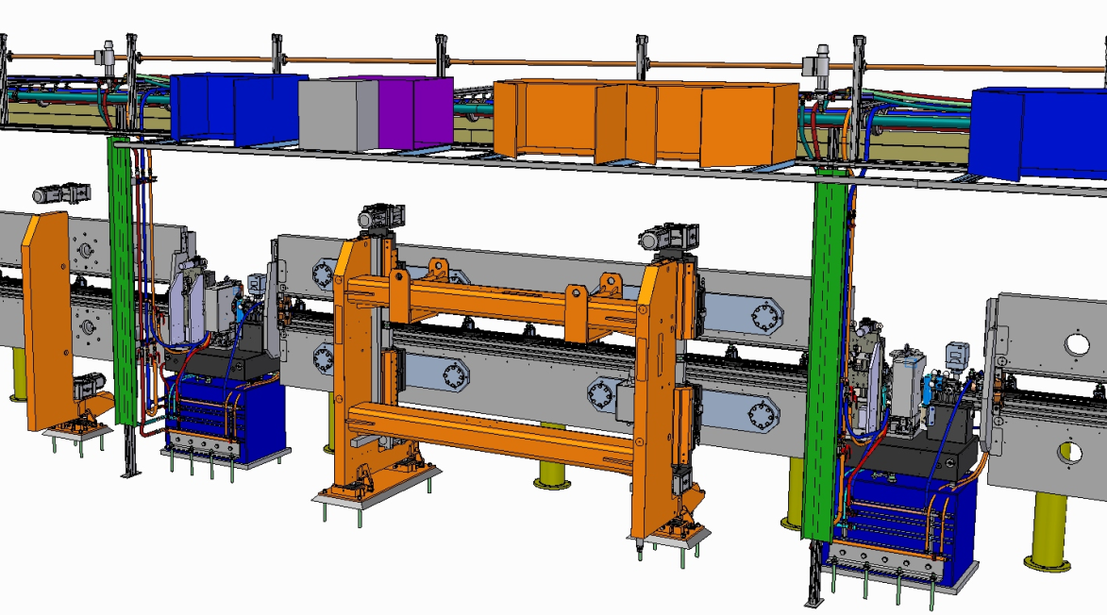
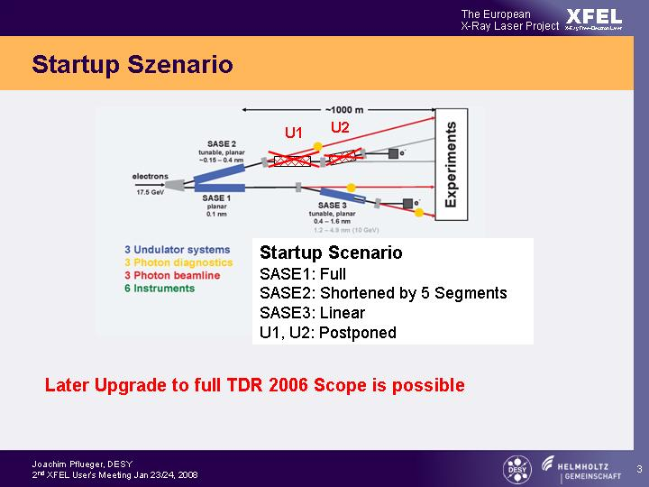
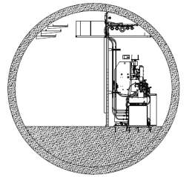
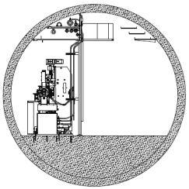
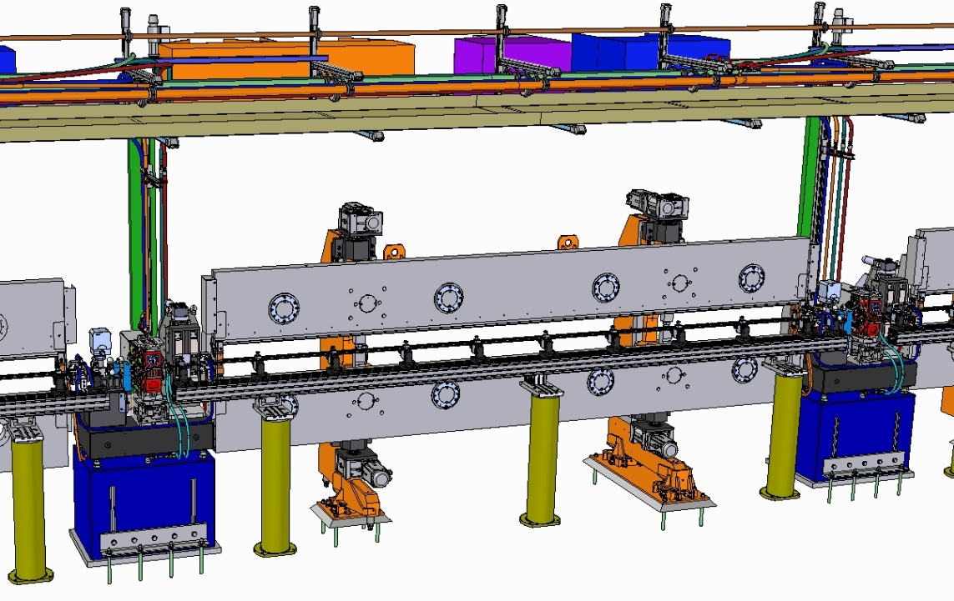
Tunnel Installation of SASE2 Undulator System – Final WP71 Deliverables
SASE2
e ⁻
Local Control Systems
e ⁻
SASE2 SASE1/3
Downstream View
 | SASE1/2 | SASE3
λ₀ [mm] | 40 | 68
Operational Gap Range [mm] | 10-20 | 10-25
K-Range | 3.9–1.65 | 9.0-4
Radiation Wavelength Range [nm]
@ 17.5 GeV | 0.147-0.040 | 1.22-0.27
@ 14.0 GeV | 0.230-0.063 | 1.90-0.42
@ 8.5 GeV | 0.625-0.171 | 5.17-1.15
# of Segments | 35 | 21
System Length [m] | 213.5 | 128.1
e ⁻
Undulator Segment 5m
Intersection
1.1 m
Undulator Cell 6.1m
W.Tscheu

Slide 4





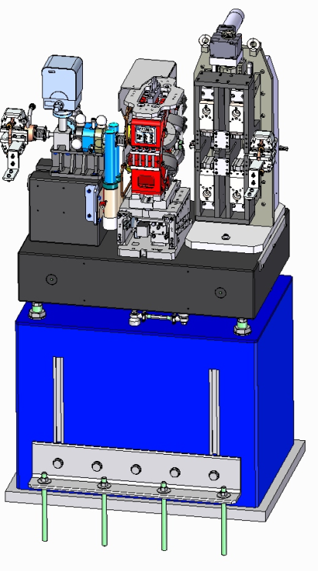






SASE2 Type Intersection
WP17
WP17
Re-entrant Cavity
BPMs+ Electronics
Beam Loss Monitors
WP71
WP19
Vacuum System
Phase Shifters
WP12
Status 4/2014:
Delivered:
  Quadrupoles, WP12
  Air Coil Correctors, WP71
  Base Plates, WP71
  Adjustors, WP71
  Concrete Pillars , WP71
In Production 91 Intersections:
  Phase Shifters, WP71
  BPMS, WP17
  BLMs, WP17
  Vacuum systems, WP19
  Quadrupole Movers, Ciemat
WP71
Air Coil
Correctors
Quadrupoles
WP71
WP71
Quadrupole Movers
Support Bases
Adjustors
Concrete Pillars

Slide 5
Plan for Day 1

Slide 6
Undulator Plans for Day One
Day One: Focus is to achieve first Lasing
  Straight Trajectory ;
  Good Phase Matching.
Install only well characterized equipment (Undulators, Phase Shifters) → Limits & reduces error sources
Trust the equipment ! Trust the magnetic measurements!
Avoid, if possible sophisticated diagnostics, which require commissioning → later
Basic controls for undulator must be available
Sophisticated controls for undulators come later,

Slide 7
Performance Criteria
Magnetic Performance
Undulators are in specs and well characterized magnetically:
  K(gap): Target accuracy: ΔK/K≈10⁻⁴
  Phase jitters are sufficiently small for all working gaps.
  Correction Tables for Air Coil Correctors, 2-Wire Corrector are well known
Phase Shifters well characterized: PI(gap_{PhaseShifter})
  Phase Shifter Settings are known: Gap_{PhaseShifter} (Gap _{Undulator})

Slide 8
Minimum Undulator Controls for Day One
Individual controls of all parameters, Status Information of any of the 35 (21) undulator segments of SASE1/2 (SASE3) via DOOCS (machine control):
  K/gap (±1μm) ΔK/K≈10⁻⁴
  Phase Shifter gap
  Air Coil settings
  Quadrupole movers (±1μm)
  Temperature measurement & compensation (±0.1°C)
  Vacuum Chamber Temperature (3-Way Value) to 0.1°C
Sychronized motion (Undulator-Phase Shifter, Air Coils,
2-Wire Correctors) using lookup tables
Static control of undulator systems:
  Set Ks/gaps using lookup tables, Taper Profiles
  Update mode for lookup tables

Slide 9
Magnetic Device Characterization

Slide 10
Magnetic Measurements
Undulator Segments:
  Evaluate from field scans at 40 gaps (Final Table)
  RMS Orbits, Straightness
  Entrance/Exit kicks
  Phase Jitter
  K-Parameter / Gaps
  Phase Integrals
Phase Shifter
  Gap dependence of 1st Field Integrals
  Evaluate from field scans at 40 gaps (Final Table)
  Phase Integral (PI)

Slide 11
Undulator Example:
U40-X046-K006 Final Table

Slide 12
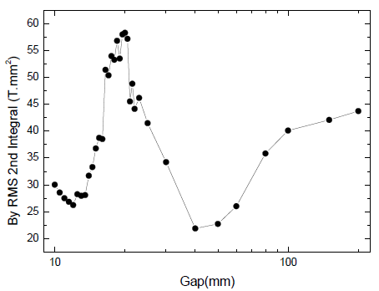
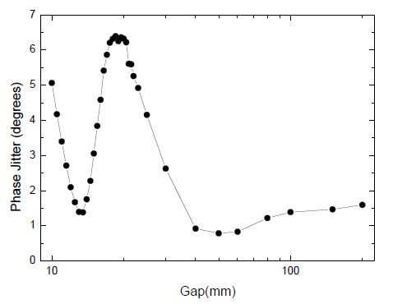
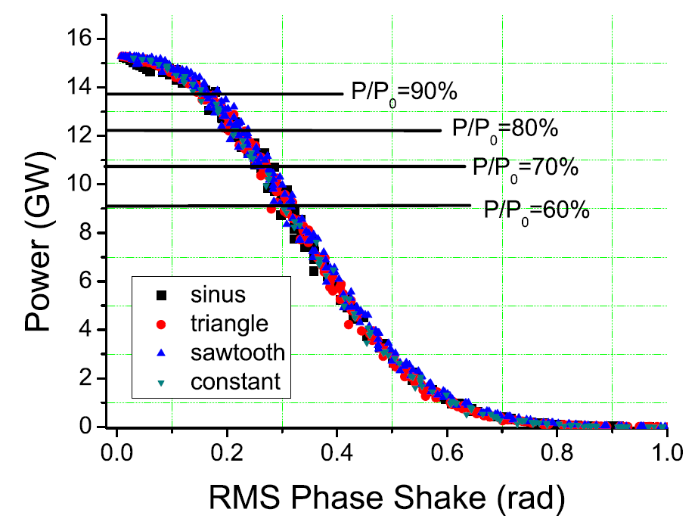
X047 RMS Error / Phase Jitter
RMS Orbit Error → Reduced transverse Overlap → reduced FEL Power
U40 Specs:
120Tmm² ÷ 2μm
Phase Jitter → Reduced longitudinal Overlap → reduced FEL Power
Specs: 8° ÷0.14rad

Slide 13
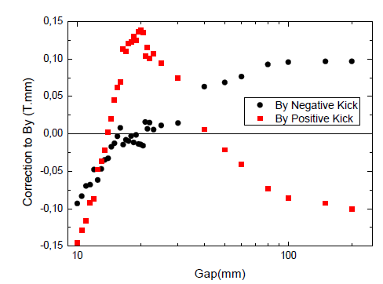
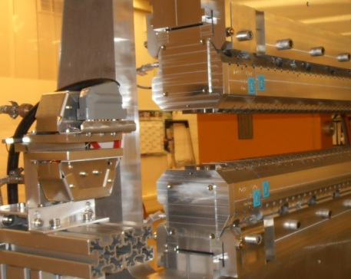

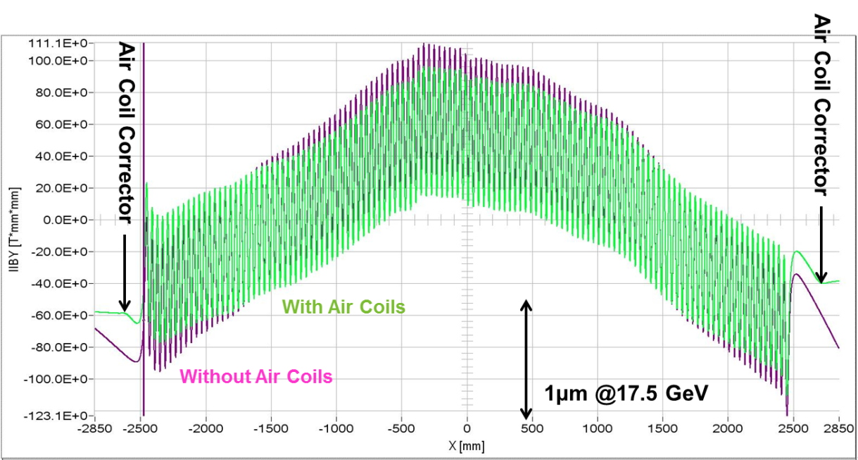
X047 Kick Errors / Air Coil Correctors
Gap dependent Kick Errors ≤±0.15 Tmm
Air Coil Correctors
Effect of Air Coils on Trajectory
M. Yakopov

Slide 14
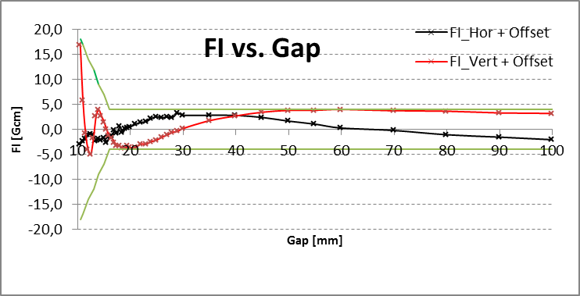
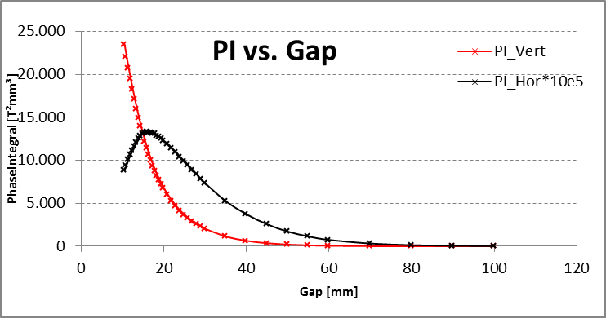
Phase Shifter Characterization
1st Field Integrals:
Important for independent
operation, no corrections
required
Phase Integrals:
Adjust Phase delay

Slide 15
Commissioning Strategy

Slide 16
Strategy ( Elletra approach)
Assumptions:
Inside Undulator, properties are accurately known :
  Internal orbit is straight within specs (RMS criterion)
  Phase Jitter is in specs
  K-Parameters are consistent within ΔK/K ≤1-2 ˣ10⁻⁴
Exact Phase Shifter settings are known from Magnetic measurements
No beam is required! Trust the magnetic measurements!
Undulator Entrance /Exit Kicks :
  Accuracy only ≈ ±0.03Tmm ÷ 30% of σ‘=1.6μrad
  XFEL specs: ±0.004 Tmm ÷ 5% of σ‘
  Needs improvement using BBA → straight orbit

Slide 17
Step 1: Global Orbit Correction
Precondition: Working BBA, well collimated beam, low losses
Establish straight large gap orbit (LGO) with Quadrupole Movers
(eventually large corrections)
Establish straight orbit in operational gap range using Air Coils (small corrections <0.15 Tmm), update look-up tables
Correctors & BPMs
Before BBA
6.1m
After BBA

Slide 18
Step 2: Set undulator segment gaps
Set Ks / gaps of undulator Segments statically trusting the magnetic measurements
Suggestion: Use tuning gaps with lowest errors
  SASE1/2 gap 14mm, K=2.7
  SASE3 gap 15mm, K=6.9
Use the Phase Shifter settings from magnetic measurements
This should be good for First Lasing

Slide 19
Outlook
Refine operation of undulator system, taper profiles,optimize laser power
Implement / make use of Hardware capabilities:
  Fully continuously synchronized gap/K changes.
  Change K while laser stays ON
Synchronize undulator with external sources (Monochromator) via EtherCAT bus

Slide 20
Summary
For 1st lasing Undulator Systems sufficiently characterized
Basic control of Undulator systems will be available
BBA alignment is essential for a straight global orbit
K parameters and Phase Shifter setting will be taken from magnetic measurements
From the undulator side this should be sufficient for
1st lasing

Slide 21
The End

