Slide 1
Status of
High Level Controls
3nd Meeting of the European XFEL
Accelerator Consortium
Raimund Kammering, DESY – MCS / WP28 –

Slide 2
Outline
Recall of the High Level Software Architecture
The dark side of flexibility – multi-beamline operation
No revolutions but constant progress
  optic, orbit, BPM servers and more
  A full featured test
The Accelerator CS UI: realization of envisioned concepts
Outlook: Control room

Slide 3
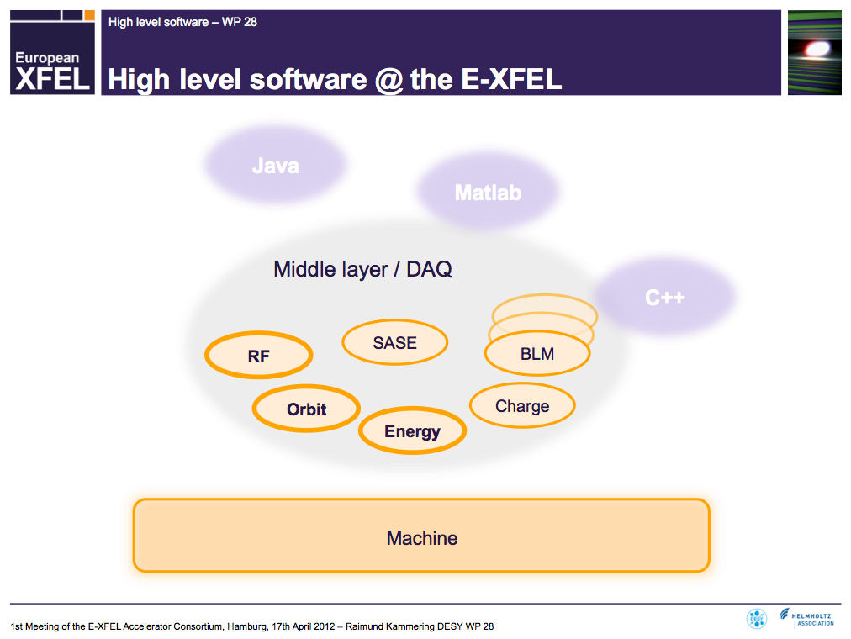
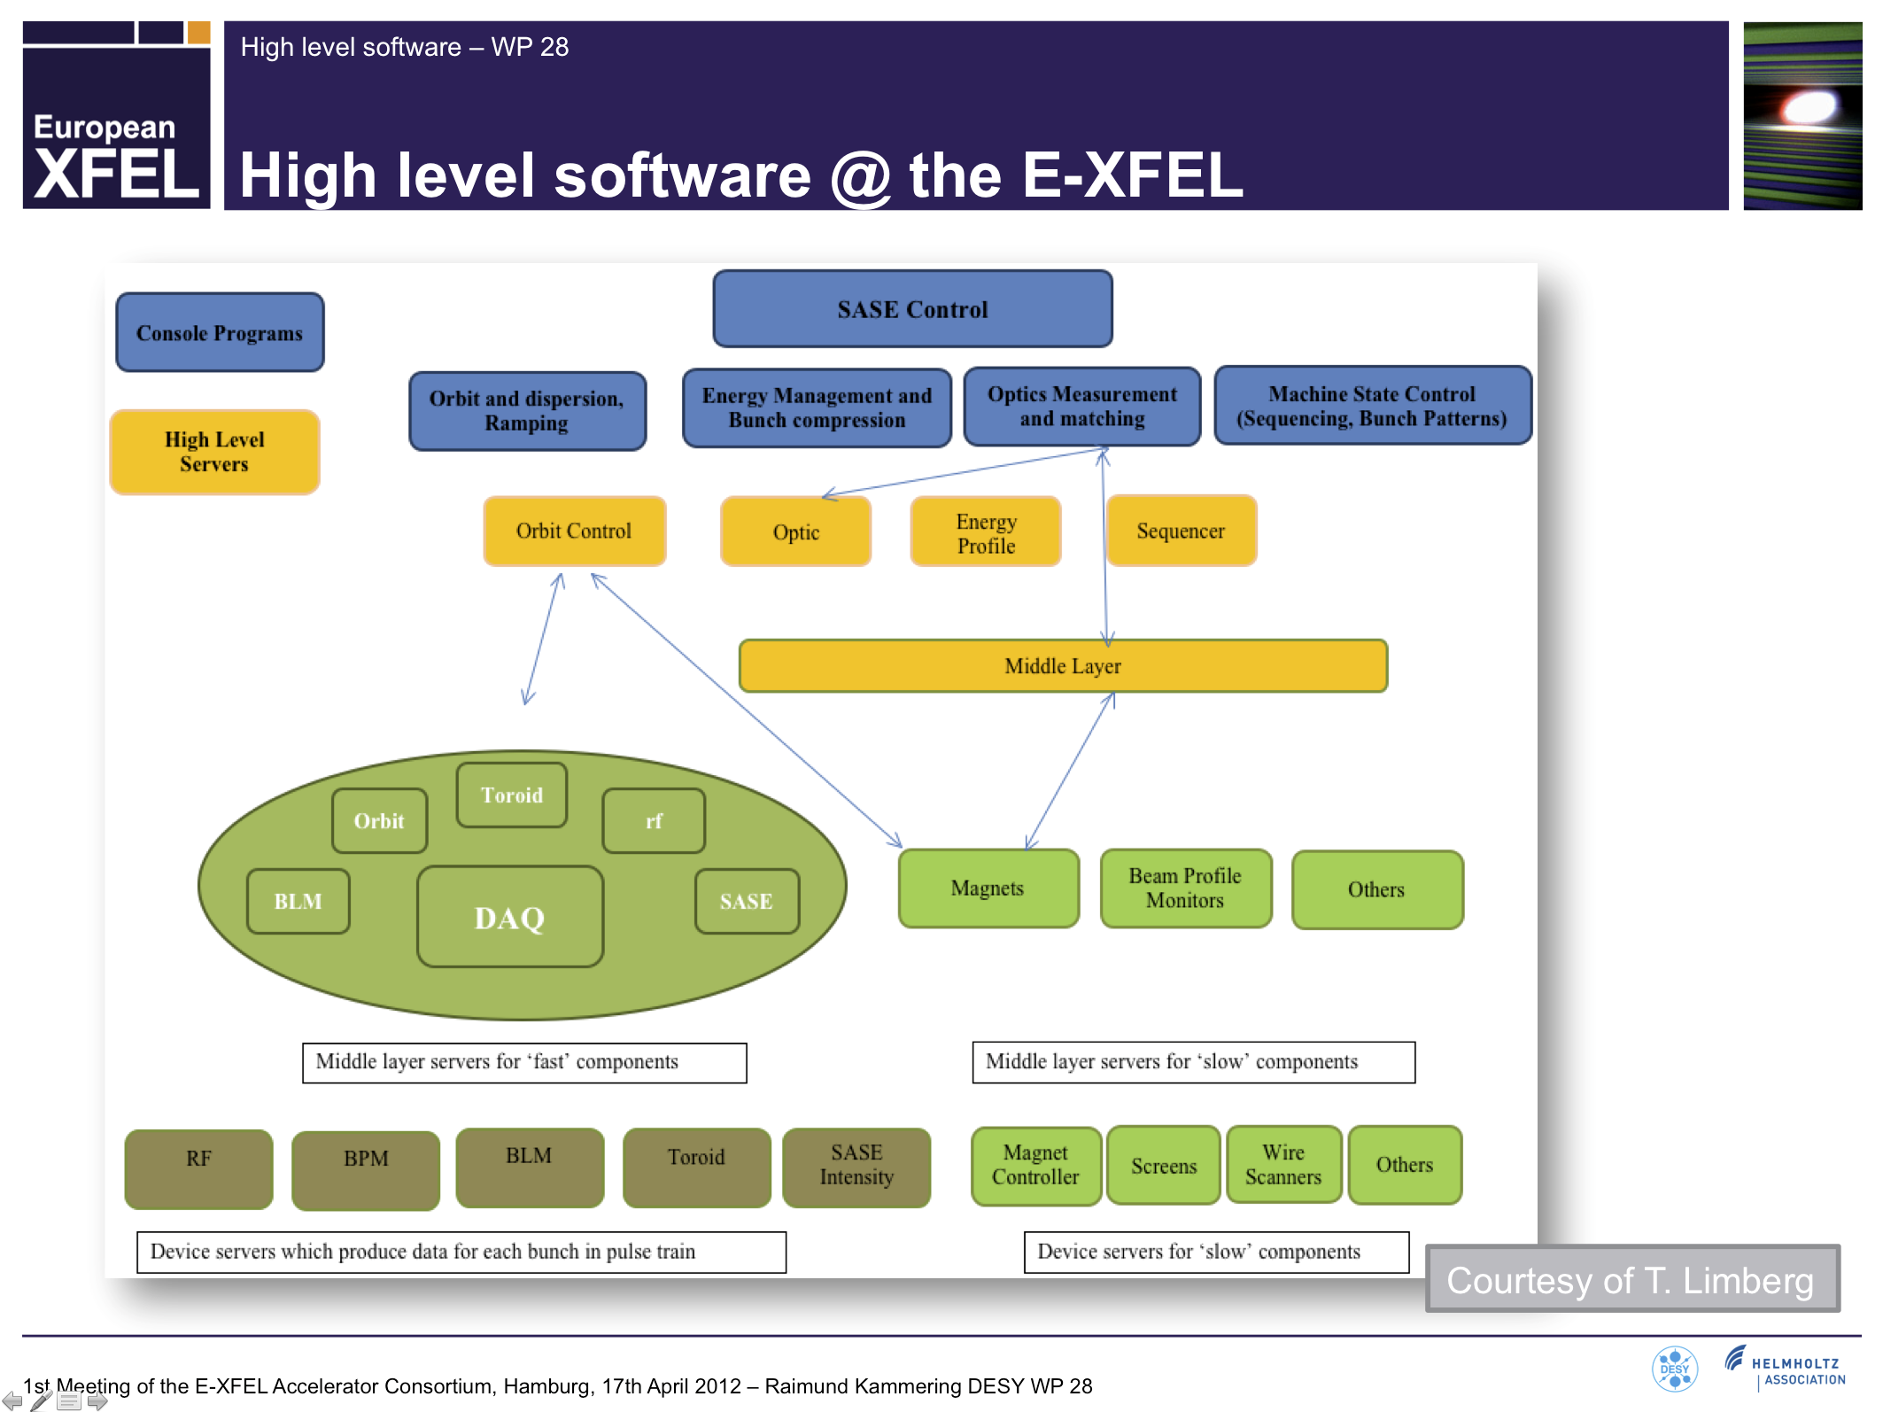
Recall of the High Level Software Architecture

Slide 4
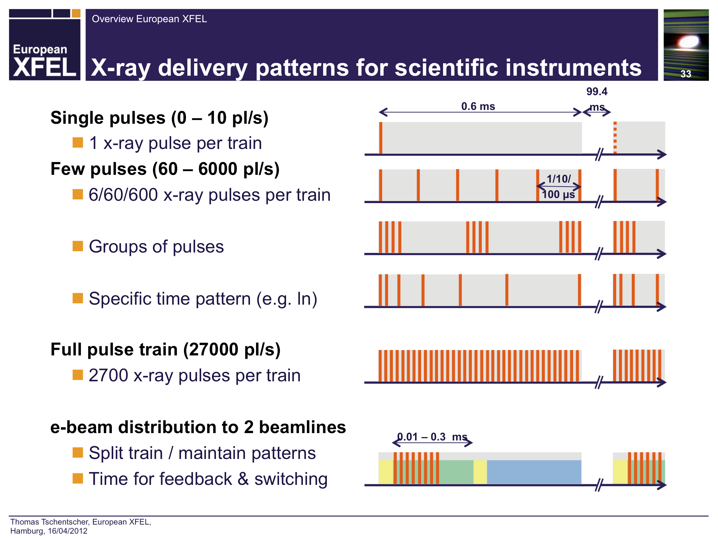
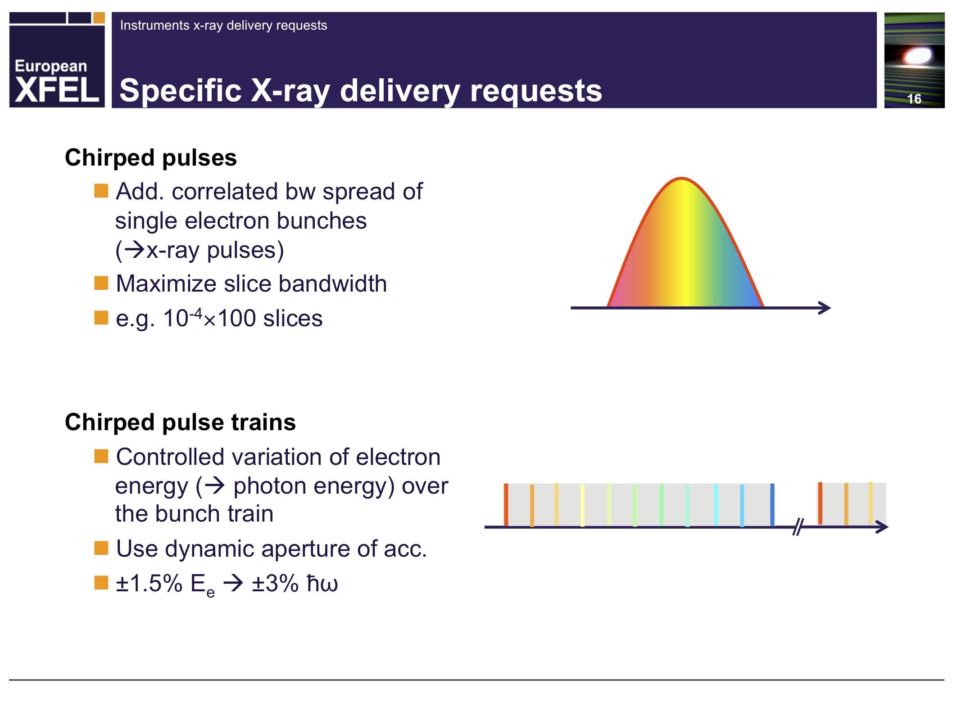
Multi-beamline operation
  Tremendous requirements from experiments side create need for sophisticated bunch train handling
  Even though
  “Baseline layout assumes constant linac and bunch compression parameters”
  we have to have the concepts right from the beginning!
  We are familiar with:
    long bunch trains (800 bunches @ FLASH1)
    gaps in train (kicked bunches, operation with two lasers)
  but not with:
    multi-beamline operation
    varying compression, energy
    chirped pulses

Slide 5

Multi-beamline operation
  DAQ will serve as abstraction layer from fine graded time level to a bunch based picture
  Sounds straight forward but the devil is in the detail
  Expect large fraction of programming + debugging to be spend on this
  FLASH(1,2) will serve as test-bed for handling of multi-beam-line operation and complex bunch patterns
  First test with e.g. Energy Server ongoing – right now

Slide 6
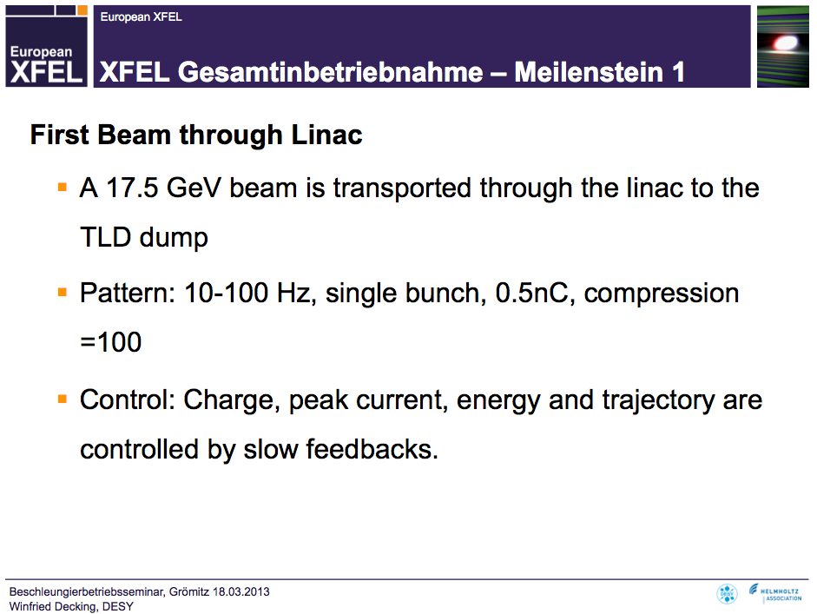
  optic, orbit, BPM servers and more
will not give detailed report on status of various servers
  optics server
  orbit server
  BPM server
  …
  1. release of MATLAB API (xcomm) available
still much to come – but near to being prepared for commissioning:
  injector commissioning:
  → charge, peak current, energy and trajectory
  beam through linac:
  → same + RF/energy control

Slide 7
  optic, orbit, BPM servers and more
Console Programs
SASE Control
High Level Servers
Orbit display, bumps
Energy Management and Bunch compression
Optics Measurement and matching
Machine State Control (Sequencing, Bunch Patterns)
Orbit Control
Peak Current Control
Optic
Energy Profile
Rf control
Sequencer
✔
✔
✔
Toroid
✔
Orbit
✔
rf
BLM
✔
DAQ
SASE
Magnets
Beam Profile Monitors
Others
✔
✔
Middle layer servers for ‘fast’ components
Middle layer servers for ‘slow’ components
✔
✔
✔
RF
BPM
BLM
Toroid
SASE Intensity
Magnet Controller
Screens
Wire Scanners
Others
Device servers which produce data for each bunch in pulse train
Device servers for ‘slow’ components

Slide 8
  A full featured test
Console Programs
SASE Control
High Level Servers
Orbit display, bumps
Energy Management and Bunch compression
Optics Measurement and matching
Machine State Control (Sequencing, Bunch Patterns)
Orbit Control
Peak Current Control
Optic
Energy Profile
Rf control
Sequencer
Toroid
Orbit
rf
BLM
DAQ
SASE
Magnets
Beam Profile Monitors
Others
Middle layer servers for ‘fast’ components
Middle layer servers for ‘slow’ components
RF
BPM
BLM
Toroid
SASE Intensity
Magnet Controller
Screens
Wire Scanners
Others
Device servers which produce data for each bunch in pulse train
Device servers for ‘slow’ components

Slide 9
  A full featured test
Orbit display, bumps
1. calculate orbit for given optic
4. Display orbit
+
modify by bump program
Optic
6. new currents to
optic server
5. write new currents
Orbit
DAQ
Magnets
3. send orbit data
to DAQ/orbit server
2. write orbit to BPM server
BPM

Slide 10
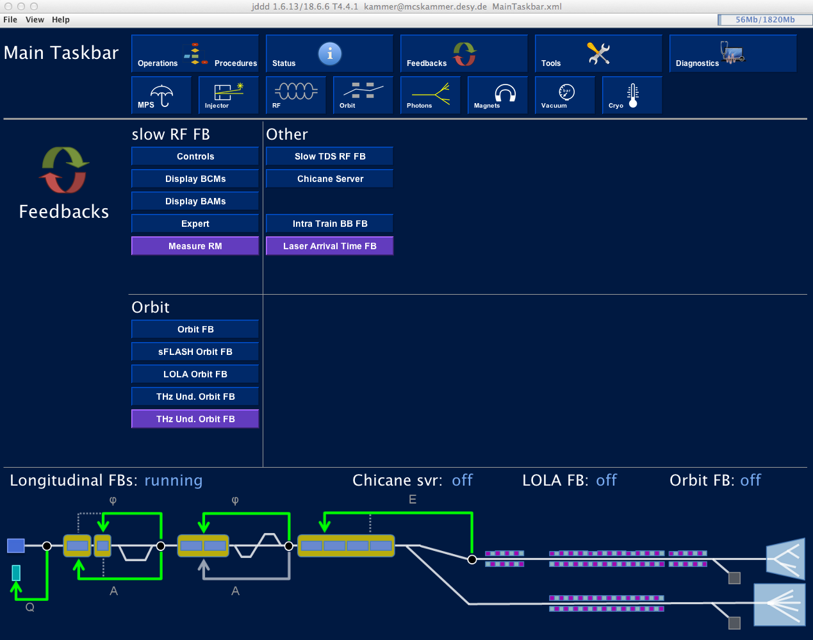
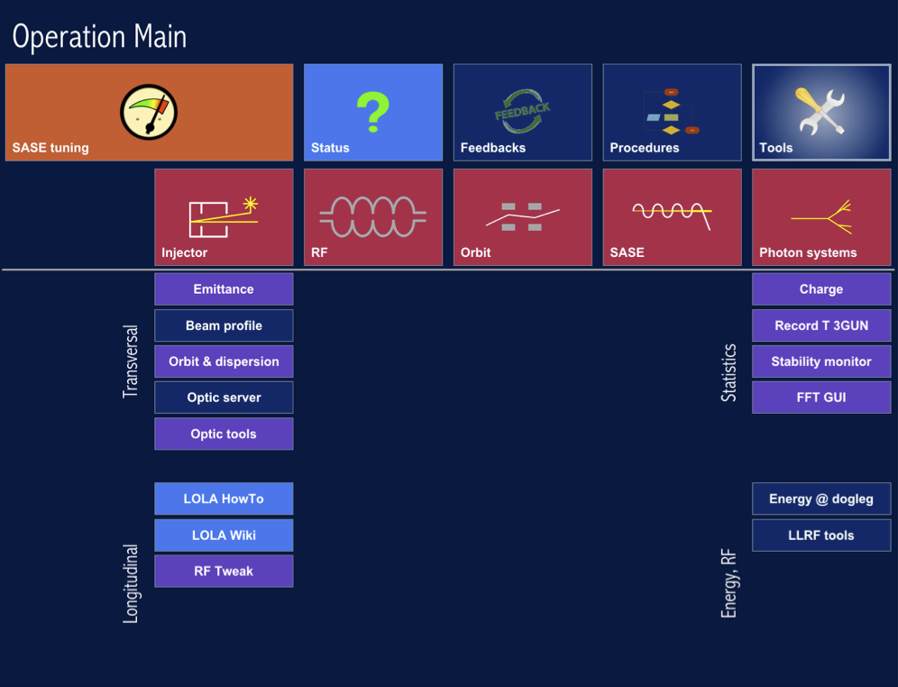
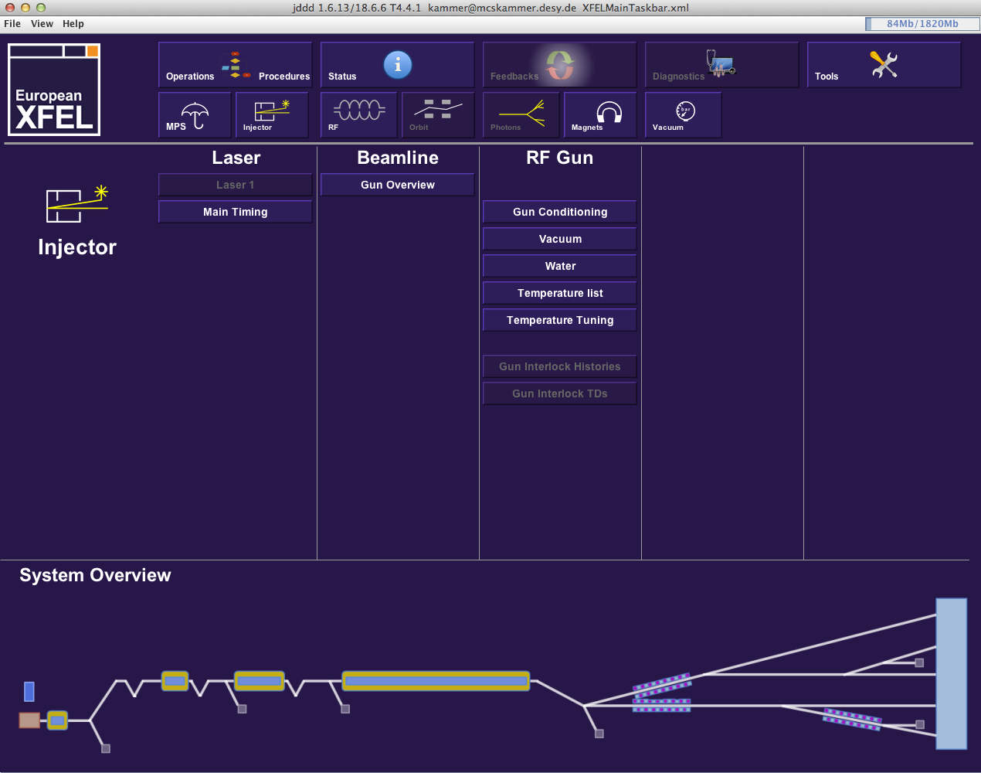
The Accelerator CS UI
2nd Meeting European XFEL Accelerator Consortium, April 2013
FLASH MainTaskbar - today
XFEL MainTaskbar – used for the GUN test 2013

Slide 11
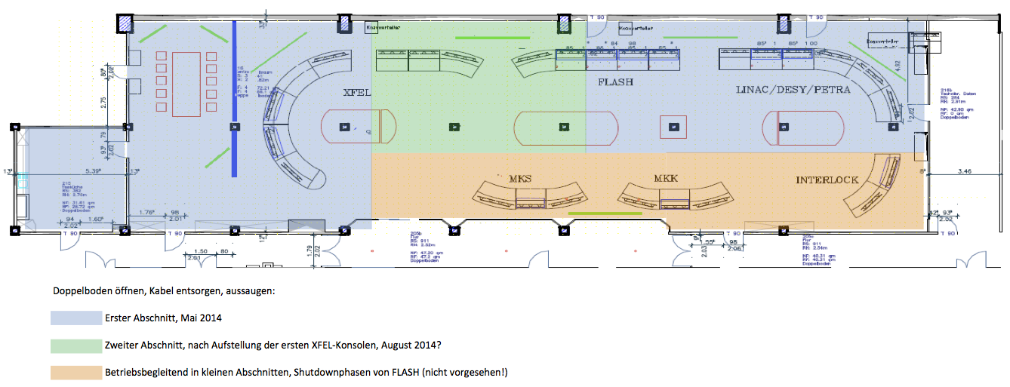
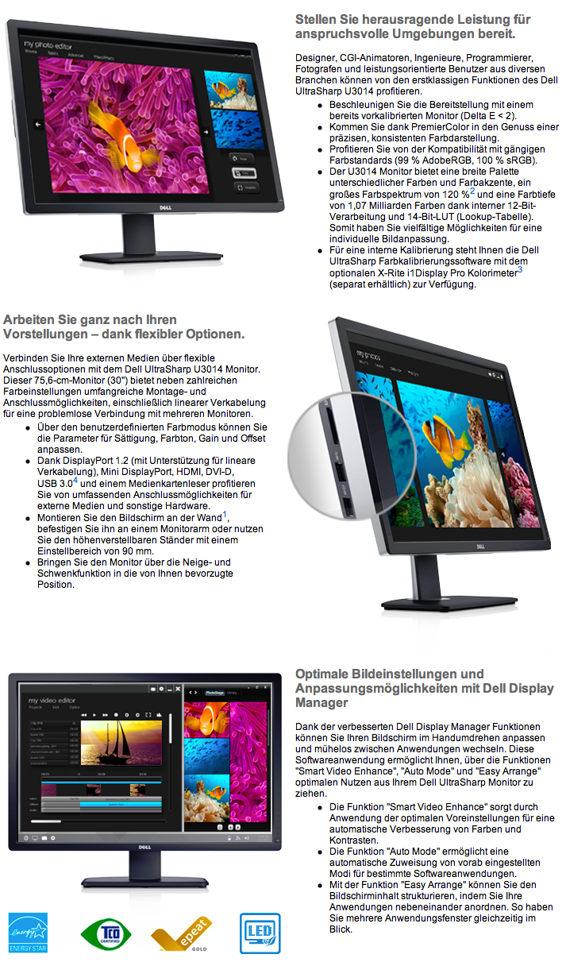
Outlook: Control room
Control room layout is fixed
rebuilding to be started in May
First tests with monitor types and layout
Final monitor selection → as late a possible (get best price/value)

Slide 12
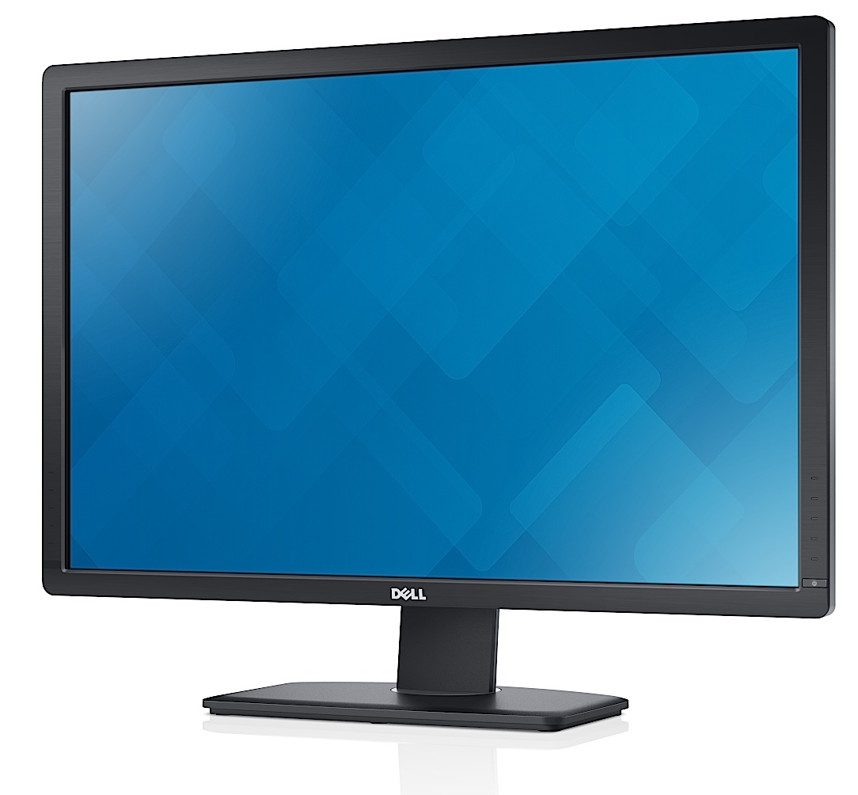
End
Thanks!

