Slide 1
Summary
Accelerator Control System
3rd Collaboration Meeting of the European XFEL, Hamburg, 7-9 April 2014
Kay Rehlich, DESY – MCS4 / WP 28 -
Notes:
How to edit the title slide
Upper area: Title of your talk, max. 2 rows of the defined size (55 pt)
Lower area (subtitle): Conference/meeting/workshop, location, date,
your name and affiliation, max. 4 rows of the defined size (32 pt)
Change the partner logos or add others in the last row.

Slide 2
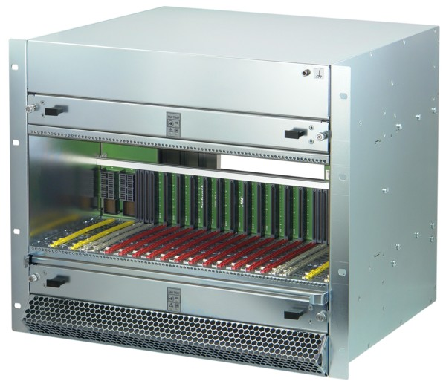
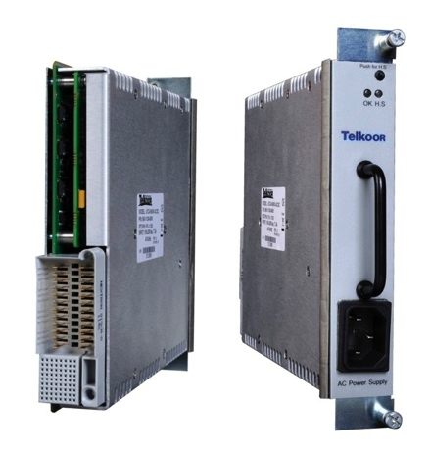
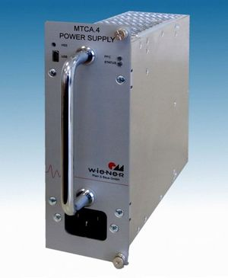
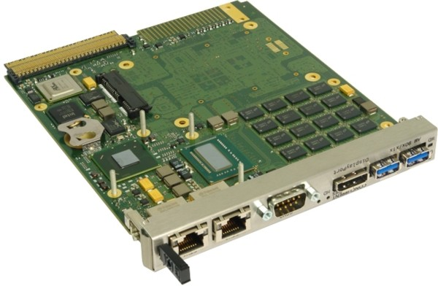
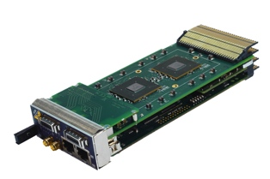
Hardware Status - µTCA Systems
>= 2 Vendors approved
Hardware
  µTCA hardware and infrastructure
    Crates for diagnostics, special diagnostics, vacuum
    and magnet support
  Crates
    Schroff or ELMA, including standard backplane
  Power supplies
    N.A.T., Telkoor, Vadatech, Wiener – many issues in design and firmware found, had to be meticulously debugged and issues found to be demonstrated to vendors, mostly OK now
  CPU (Concurrent, Kontron, N.A.T.)
    same debugging and testing efforts, especially with remote management firmware (IPMI) important for XFEL operations
    performance and evaluation tests not yet finalized.
  MCH – Management hub (N.A.T.)
    Well tested and used already
  Crates are already available for laser and gun system tests in summer
  Racks for XTL on order, available August/September, XTIN in queue

Slide 3
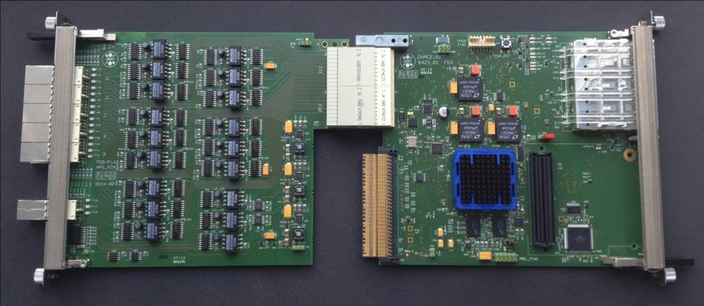
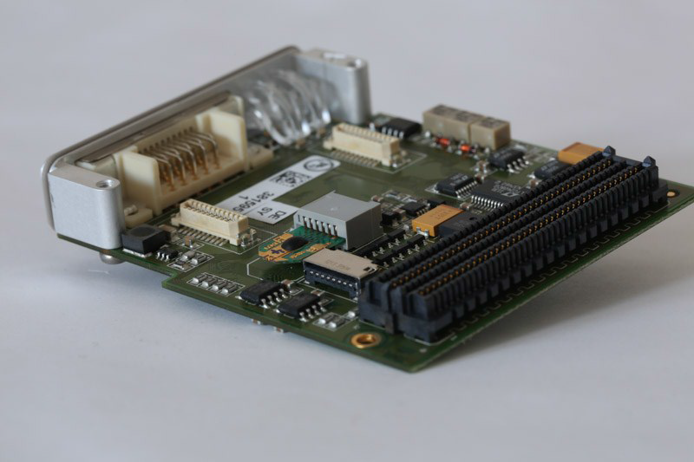
Hardware Status – Machine Protection System
Progress report given at TC meeting March 5th 2014
MPS uses two µTCA modules:
  DAMC2 board and RTM optionally with FMC
RTMs readily available (~28)
DAMC2 boards on order (750), available in summer
Pre-Series DAMC2 modules deployed at AMTF and XFEL Gun
Installed at FLASH / FLASH 2 and being tested currently
First tests of new µTCA-based FLASH Laser 2 system to MPS connection have been successful (signal flow works)
Dosimetry Module
RTM
DAMC2
Courtesy J. Jaeger
MPS and Timing controls of FLASH laser operational

Slide 4
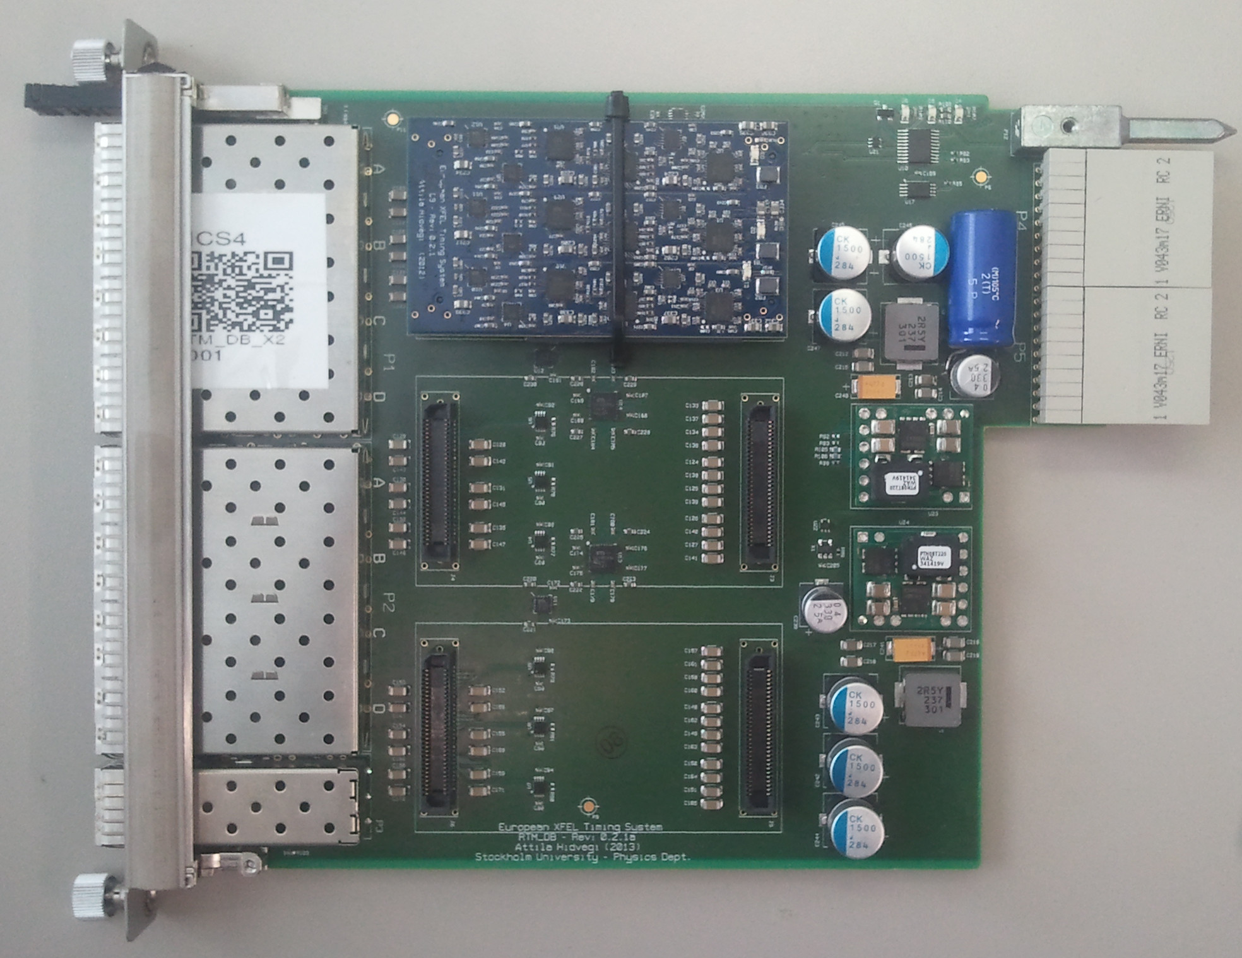
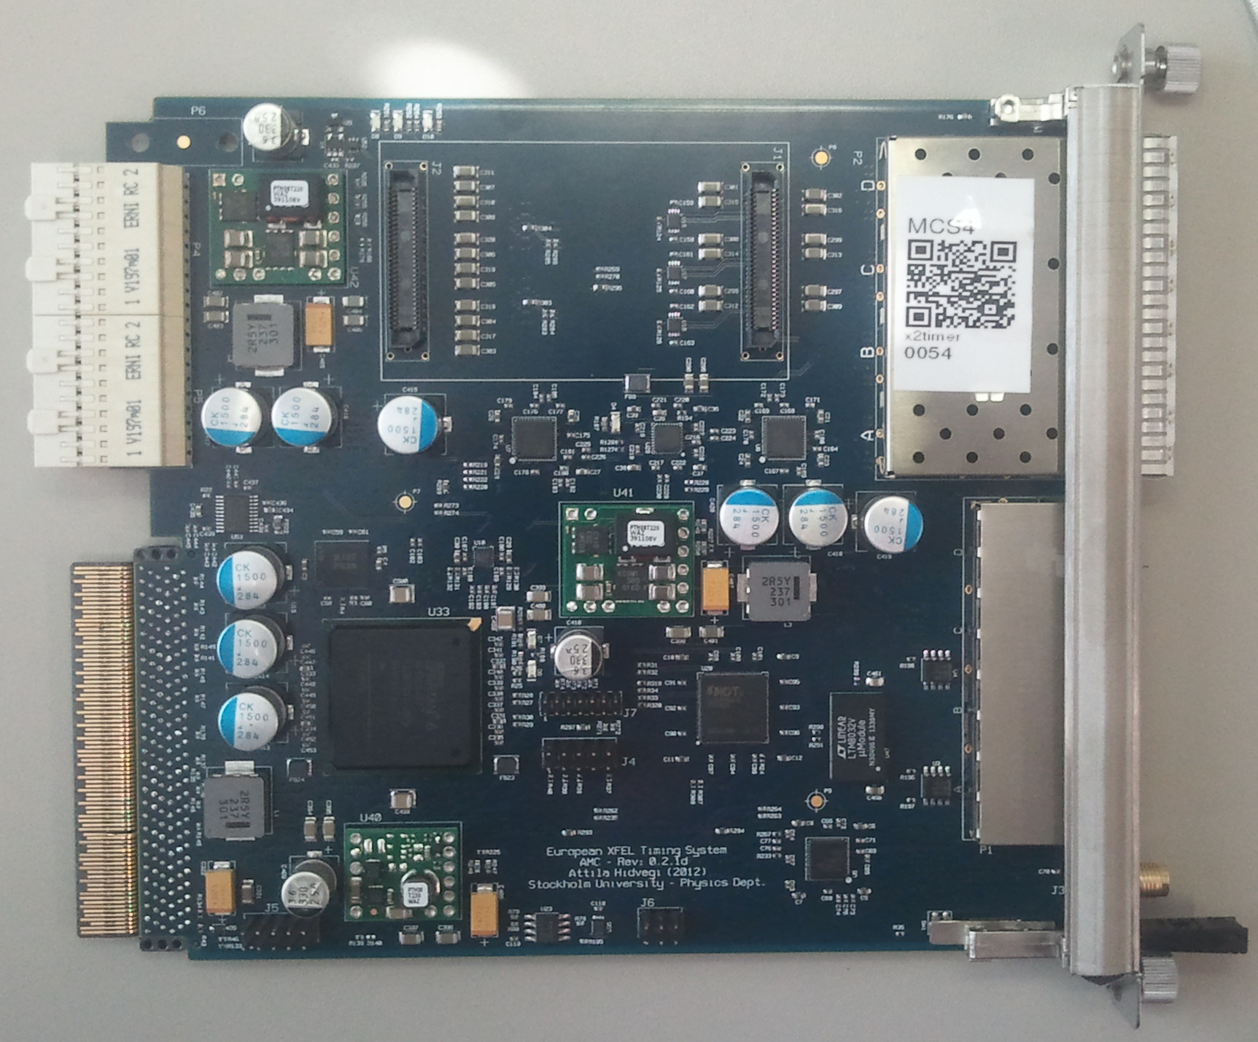
Hardware Status – Timing System
RTM
Timer Board
Courtesy C. Stechmann
80 Modules operational
Timing System Modules
  First modules had been installed at XTIN for gun test in December 2013 and at AMTF in fall 2013
  In production mode at AMTF and FLASH / FLASH 2
  Sufficient modules available for gun and laser system test this summer – more on order
  More details on how to use the timing system in the upcoming talks (O. Hensler and C. Stechmann)

Slide 5
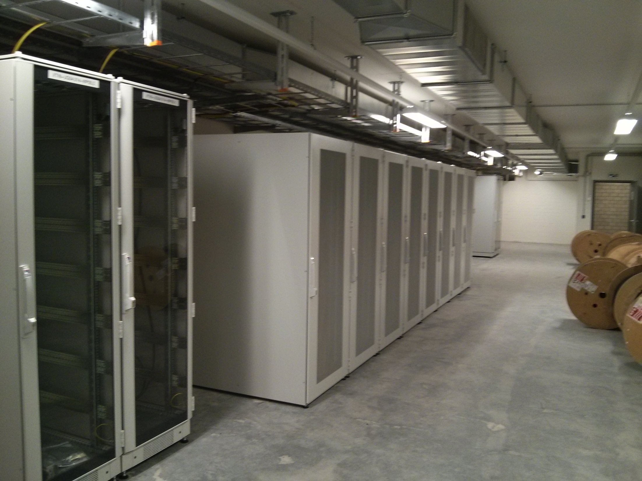
Hardware Status – Server Nodes & Network
  First server components for computer infrastructure already installed (DELL PowerEdge R520 servers) in XTIN UG04/014
  Middle layer services
  PLC systems server
  Name lookup services
  Backup services
  First data acquisition system node (middle layer services using fast shot-synchronous data) is on order
Step-by-step server installation
  Control system network (IP subnets, addresses, …) is available and being assigned to subsystems and groups
  Temporarily installed network is currently being replaced by final one (redundant XFEL control system network router, switches) - available ~ May 2014

Slide 6
Status – Subsystem Support
© Tim Wilksen
☑
RF Gun System
  Basic control system was available and being used for the XFEL gun test in December
Laser System
  Turn-key system provided by MBI, Berlin.
  Requires interface to timing system, hence µTCA is required
  Uses DOOCS on Solaris, which fits well into our known architecture
Diagnostics: BPM, toroid, BLM
  Servers for µTCA already running at FLASH / FLASH 2
  Camera support for µTCA already tested and used.
Vacuum
  Old system has been running for gun test, new system being tested and deployed currently
Operator panels already available
  had been provided for gun test, will be extended but can make use heavily from existing ones for FLASH / FLASH 2
☑ Timing ready
☑ Prototypes @ FLASH
☑
☑ Prototypes @ FLASH

Slide 7
Front-end Architecture: Example Toroid
© Olaf Hensler
Front-end s/w operational
Ethernet
DOOCS
communication
DAQ
DAQ
DOOCS
Function
Server
DAQ
DAQ
Diag Process
Toroid
Diag Process
BCM
Data driven
Channels
ZMQ callback
One D_fct
per channel
Timing
server
loc1
locN
DOOCS
Device Server
loc1
SIS8300 DMA server
s4
Macro_Pulse_Number
callback
s5
. . .
s11
Device node
SIGUSR1
Driver
Driver
Linux Driver
x2timer
SIS8300
. . .
SIS8300
µTCA/AMC

Slide 8
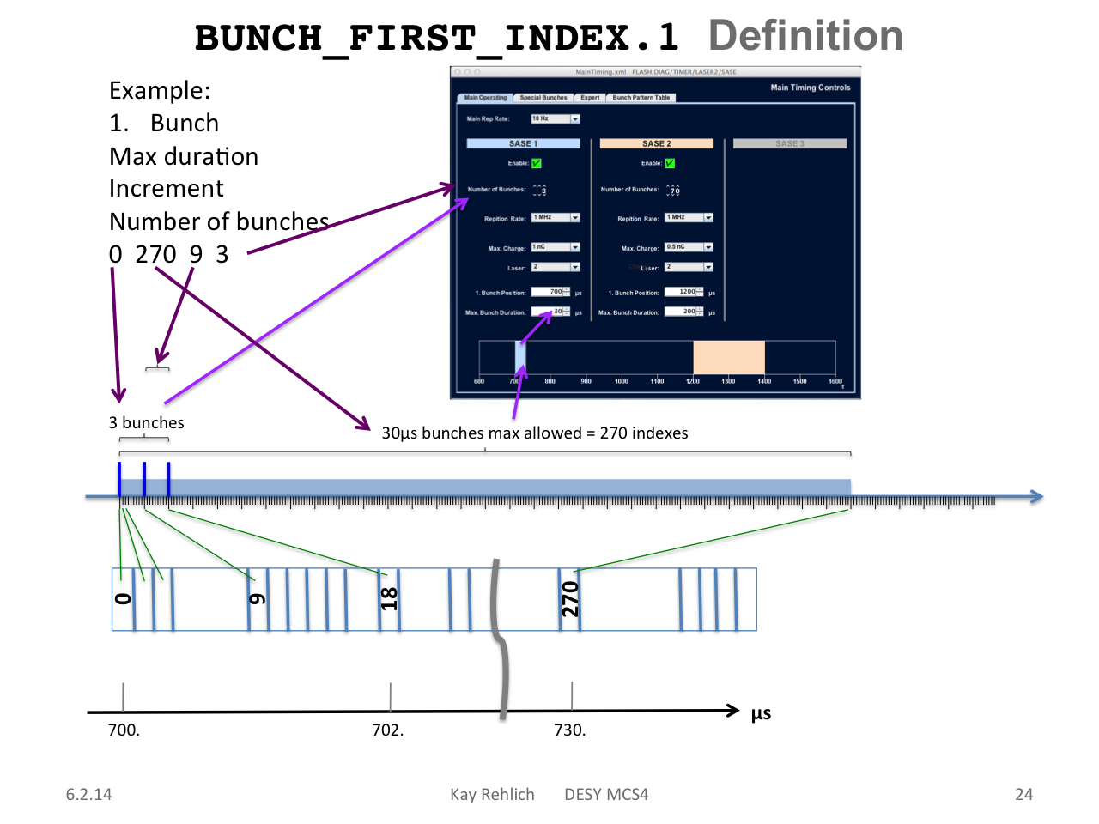
© Olaf Hensler
Operator settings → FPGA and software

Slide 9
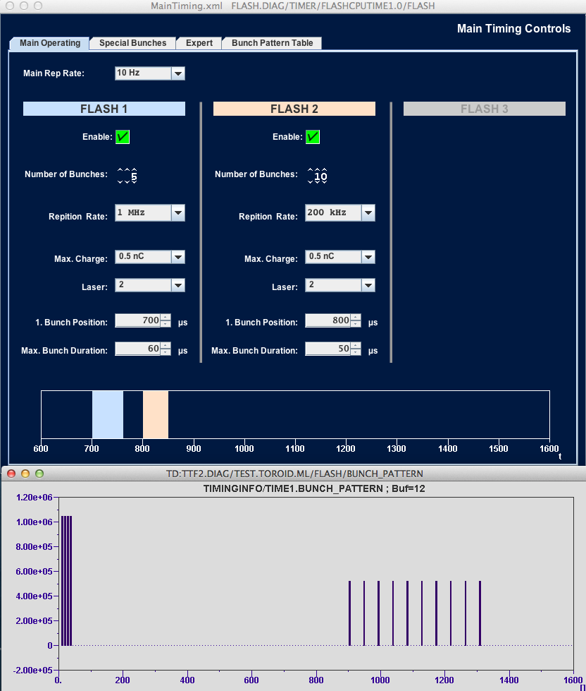
© Olaf Hensler
Inside DAQ
Toroid Middle-layer Server
provides :
Desired Bunch Pattern
Actual PulsePattern at every toroid location
NUMBER_OF_BUNCHES.* for every beamline
CHARGE and CHARGE.HIST for every beamline
Feeds the Shared Memory of the DAQ
FLASH.DIAG/TOROID.ML
Settings →
High Level Controls

Slide 10
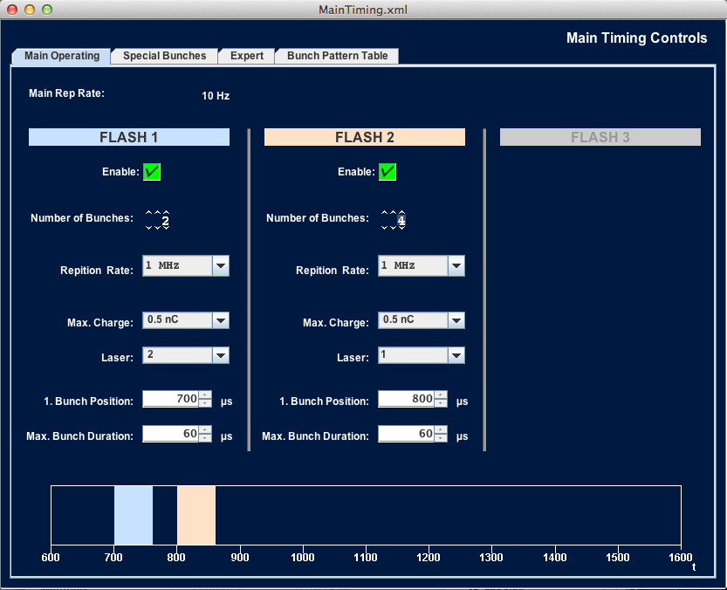
Configuration of x2timer - master
© Christoph Stechmann
Operator view

Slide 11
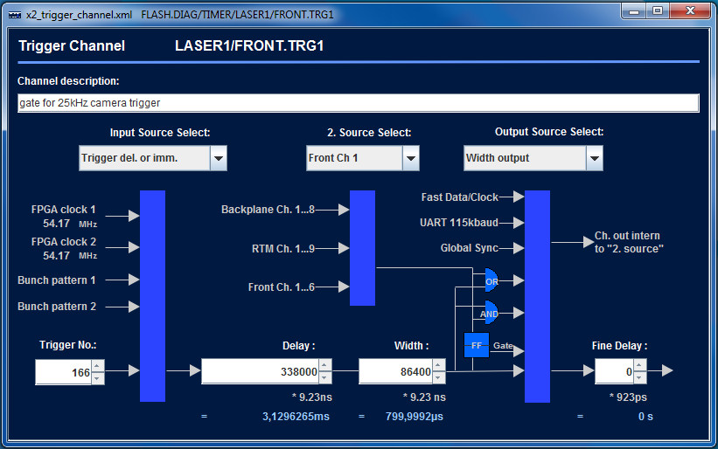
Configuration of x2timer - 2
© Christoph Stechmann
Required functions for sub-systems are implemented

Slide 12
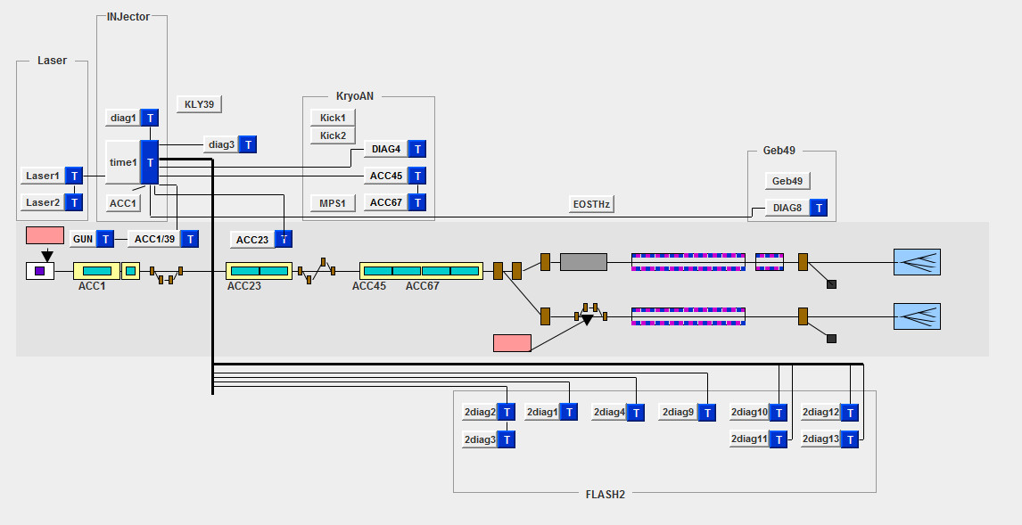
x2timers currently running in FLASH/FLASH2
© Christoph Stechmann
All LLRF stations an FLASH2 crates are equipped with new timing

Slide 13

Multi-beamline operation
© Raimund Kammering
  DAQ will serve as abstraction layer from fine graded time level to a bunch based picture
  Sounds straight forward but the devil is in the detail
  Expect large fraction of programming + debugging to be spend on this
  FLASH(1,2) will serve as test-bed for handling of multi-beam-line operation and complex bunch patterns
  First test with e.g. Energy Server ongoing – right now
Operations with 2 “virtual” Accelerators just started

Slide 14
  optic, orbit, BPM servers and more
© Raimund Kammering
Console Programs
SASE Control
High Level Servers
Orbit display, bumps
Energy Management and Bunch compression
Optics Measurement and matching
Machine State Control (Sequencing, Bunch Patterns)
Orbit Control
Peak Current Control
Optic
Energy Profile
Rf control
Sequencer
✔
✔
✔
Basics operational
Still a lot of work …
Toroid
✔
Orbit
rf
✔
✔
DAQ
SASE
BLM
Magnets
Beam Profile Monitors
Others
✔
Middle layer servers for ‘fast’ components
Middle layer servers for ‘slow’ components
✔
✔
✔
✔
RF
BPM
BLM
Toroid
SASE Intensity
Magnet Controller
Screens
Wire Scanners
Others
Device servers which produce data for each bunch in pulse train
Device servers for ‘slow’ components

Slide 15
  A full featured test
© Raimund Kammering
XFEL Simulation setup planned end May
Orbit display, bumps
1. calculate orbit for given optic
4. Display orbit
+
modify by bump program
Optic
6. new currents to
optic server
5. write new currents
Orbit
DAQ
Magnets
3. send orbit data
to DAQ/orbit server
2. write orbit to BPM server
BPM

Slide 16
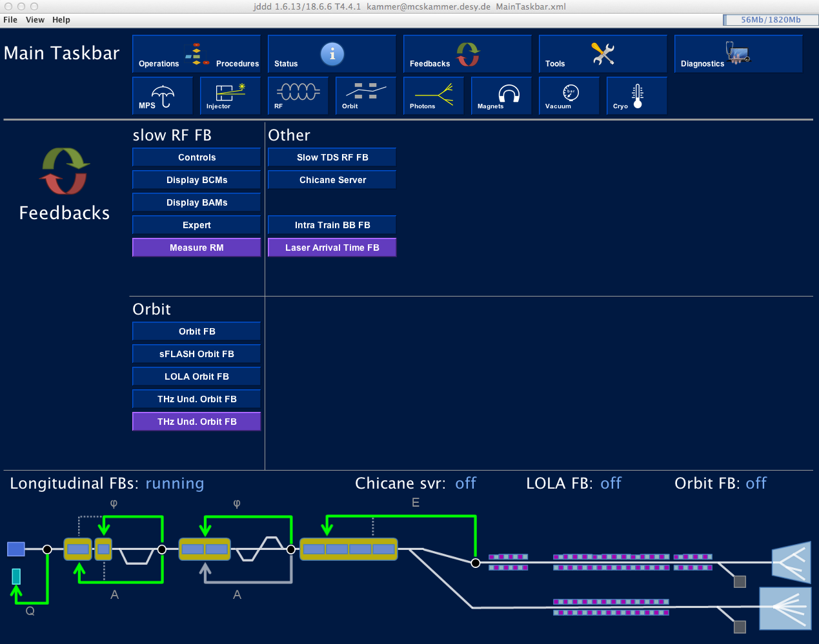
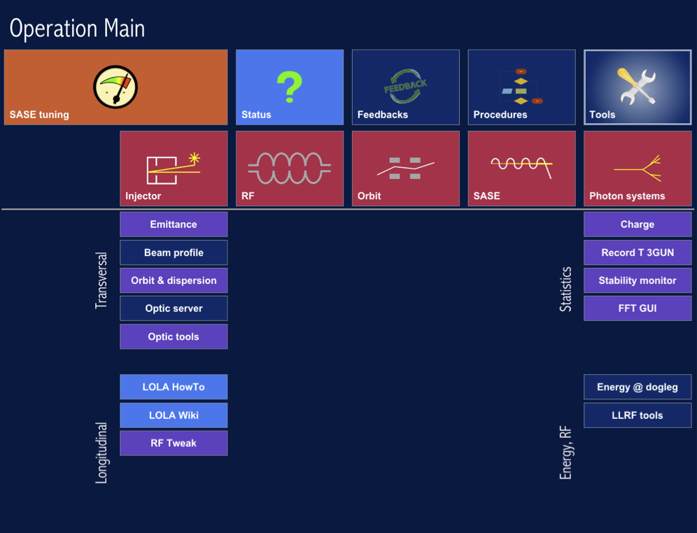
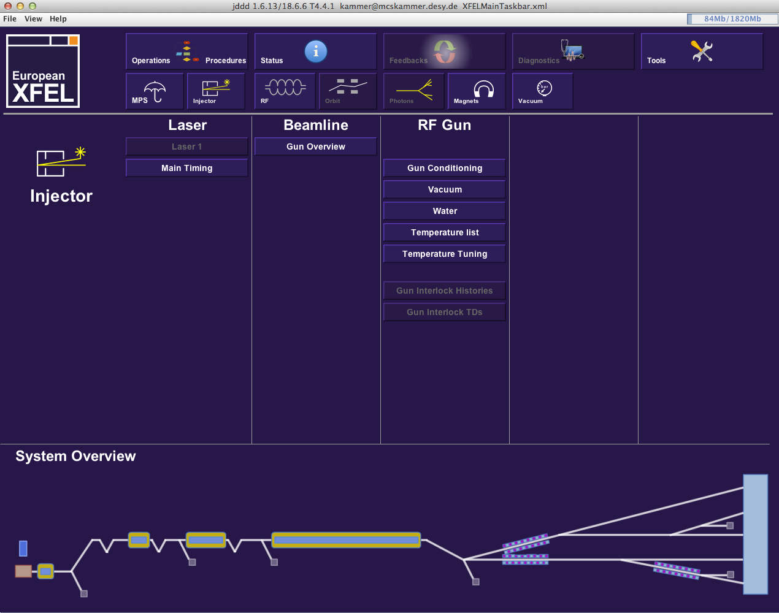
The Accelerator CS UI
© Raimund Kammering
2nd Meeting European XFEL Accelerator Consortium, April 2013
FLASH MainTaskbar - today
XFEL MainTaskbar – used for the GUN test 2013
With contributions from many groups …

Slide 17
Accelerator Control System Status – Summary
Σ of Summary
  XFEL Gun-Test this summer
    Hardware and software is mostly ready
  MicroTCA
    >= Two vendors evaluated
    Call for tender in preparation
  Front-end software
    Basics are available
    Tests and improvements ongoing at FLASH, soon at XFEL
  Middle and high level software
    A lot can be tested at FLASH 1/2
    Simulation servers at XFEL are in preparation

