Slide 1
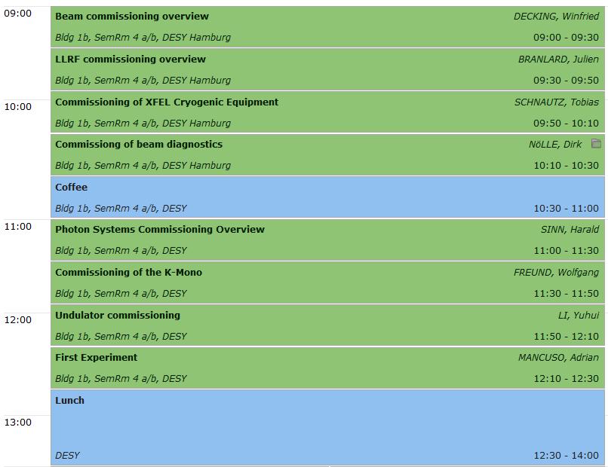
XFEL Commissioning WG - Welcome

Slide 2
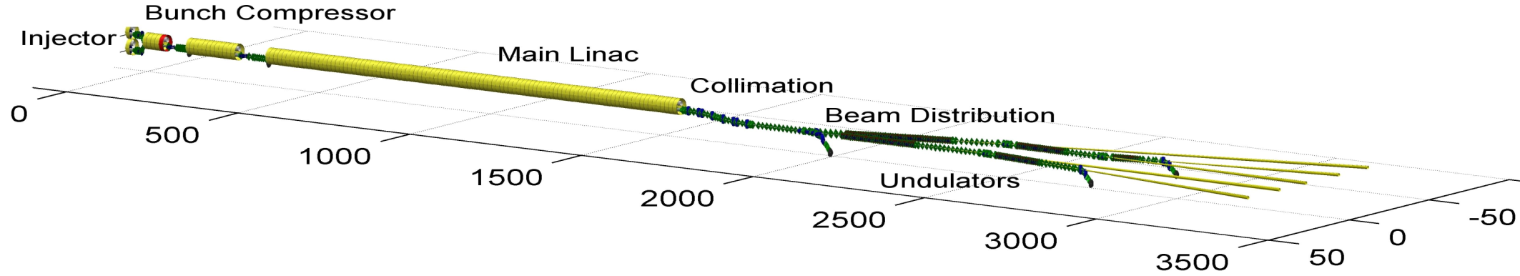
Timeline and Milestones
2014
2015
2016
2017
2018
First e-beam out of RF gun installed at XFEL
Injector cooldown
Linac cooldown
SA1
SA3
SA2
Start user operation
Full TDR performance
1st lasing possible
Injector commissioning up to full XFEL performance (varying charges and bunch patterns, laser heater, slice diagnostics, intra-train feedbacks, automated procedures)
Initial linac commissioning with reduced performance
Continued accelerator commissioning to full performance (high beam power, bunch length flexibility, multiple bunch properties per rf-pulse, full wavelength tuneability, ….)
Beam line and experiment commissioning
First user operation

Slide 3
Generic Commissioning Sequence
System integration (WP/TC responsibility)
Technical commissioning of sub-systems (WP responsibility, TC/MC)
Beam commissioning
Pre-beam check out
Beam transport
Sub-systems commissioning to target parameters
Commissioning of section to target parameters
Consolidate operation, implement procedures, …
Continue to next section
Achieve final target parameters
(Re)-define goal

Slide 4



OVERVIEW
Pre-commissioning now
Warm commissioning June 2014- June 2016
Cold commissioning
    no beam
    low beam
    full beam
Post-commissioning
3 months
> 2016

Slide 5
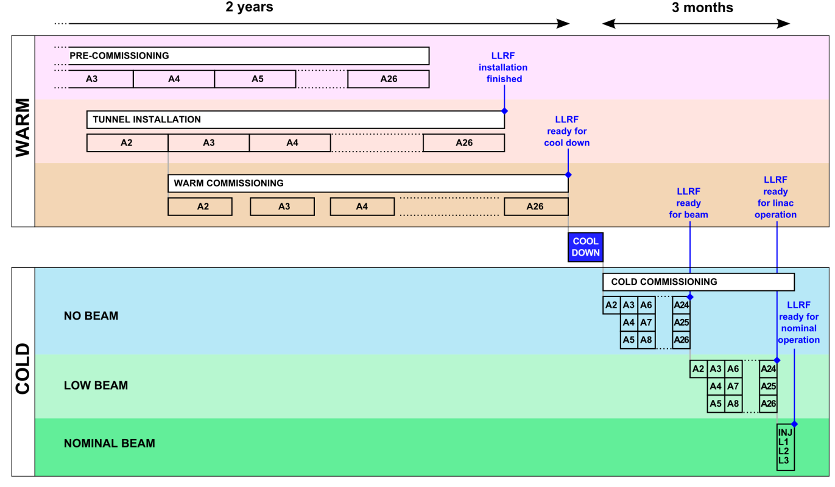
SUMMARY
Experience from FLASH
Time, man power, schedule

Slide 6
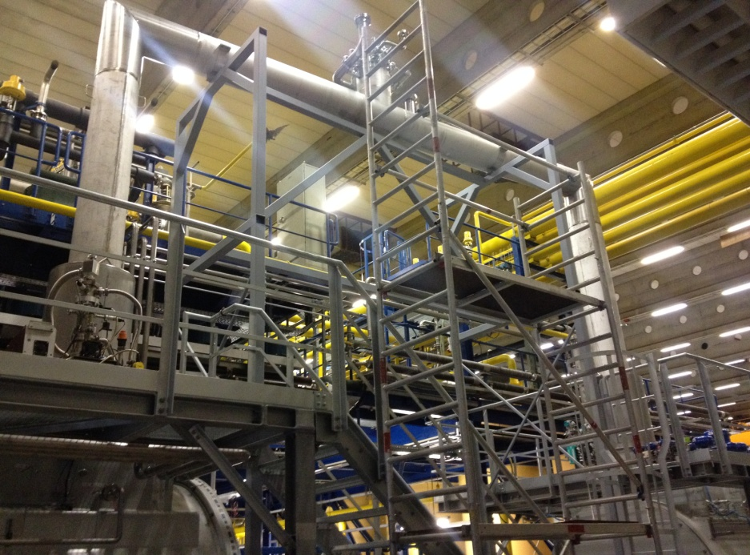
Commissioning of XFEL Cryogenic Equipment
Building 54
XRTL
SC
SC
SC
SC
SC
SC
Distribution Box
DB54
SC
SC
Contributions:
LINDE KRYOTECHNIK
BINP
DEMACO
CXRTL
CB 41
CB 43
CC Box
CB44
XFEL
Refrigerator
Now – September 2014
Pre-commissioning of XFEL refrigerator with CB44 in building 54
Partial compensation of delayed XRTL

Slide 7
Commissioning of XFEL Cryogenic Equipment
Building 54
XRTL
SC
SC
SC
SC
SC
SC
Distribution Box
DB54
SC
SC
Contributions:
LINDEKRYOTECHNIK
BINP
DEMACO
CC Box
CB44
CB 41
CB 43
XFEL
Refrigerator
November 2014
Installation of transferline XRTL
November 2014 – December 2014
Final commissioning of XFEL refrigerator with CB44 in XSE

Slide 8
Commissioning of XFEL Cryogenic Equipment
Why is the commissioning of the crygenic equipment that time consuming?
Just some examples:
Damaged components (e.g. turbines)
Leak tests
Operation of ‚new machines‘ like cold compressors
Complexity of cryogenic system
671 control valves
2647 temperature sensors
800 pressure sensors
212 flow sensors
207 level sensors
433 regulation loops
> 22000 records (description of process parameters)
> 220000 properties (set values, critical values, scanrates, calculation codes, etc.)

Slide 9
Summary
The HERA cryo plant is modified and upgraded with a cold compressor system (→ XFEL cryo plant) to operate XFEL
Commissioning of complete cryo installation is time consuming
Operation of ‚new components‘ (cold compressors)
Dependency on delivery of ‚critical components‘ (e.g. XRTL)
Complexity of cryogenic system (e.g. number of properties to be defined, calculated, checked, etc.)
Target time for first cool-down of
Injector: March 2015
XFEL-Linac: June 2016
9

Slide 10
Commissioning of
Standard Electron Beam Diagnostics
Goal:
  Do Machine Commissioning with Diagnostics
AND NOT
  Do Diagnostics Commissioning with the Beam
Nevertheless
  It is an iterative process
  Start with poor performance, but be able to see and to improve the beam
  See signals and optimize the parameters to improve the performance of the diagnostics.
  Get both working: Beam and Diagnostics.
Therefore
  Technical Commissioning: Prepare devices, check and test interfaces and communication prior to beam operation.
  Basic Commissioning: Diagnostic guys have to join the first shifts, and support until beam operation is established.
  Advanced Commissioning: Use dedicated beam time to bring the systems to good performance.

Slide 11
Summary I: Time for basic commission during first beam operation
Diagnostic System |  | Section Effort [h] |  |  |  | Detekt Beam | Aid "Fädeln" | Basic Operation | Callibration to 20% Level | Advanced callibration and optimisation | Beam Based Alignment
System | Subsystem | Gun | Injektor [XTIN] | XTL | XTDs
BPM System | Button | 2 | 3 | 16 | 8 | x | x | x | x | 0 | 0
 | BPME |  |  |  | 16 | x | x | x | x | 0 | 0
 | BPMF/I * |  | 1 | 4 | 6
 | BPMR |  | 1 | 6 |  | x | x | x | x | 0 | 0
 | Button Array |  |  | 5 |  | x | x | x | 0 | 0 | 0
 | HOM * |  | 2 | 4 |  | x | x | x
Charge | FCUP | 1 |  |  |  | x |  | x | x | 0
 | DCM | 1 | 1 | 2 |  | x | x | x | x | 0
 | Toroid | 1 | 1,5 | 4 | 2 | x | x | x | x | 0
 | TPS | 0 | 0 | 0 | 0
Sceens | Simple | 3 |  |  |  | x |  | x | x | 0
 | OTR_ABCL |  | 3 | 9 | 3 | x | x | x | x | 0
 | OTR_DE |  | 1 | 3 | 2 | x | x | x | x | 0
 | OTRS |  |  | 2 |  | x | x |  |  | 0 | 0
 | Beam Size Dump |  |  | 0 | 0
Wire Scanners |  |  |  | 0 | 0
Loss Monitors | BLM | 1 | 2 | 8 | 16 | x | x | x | x | 0
 | BHM |  | 0 | 0 | 0 |  |  |  |  | 0
 | Dosimeters | 0 | 0 | 0 | 6 |  |  | x | x | 0
Sum | 146,5 | 9 | 15,5 | 63 | 59

Slide 12
Summary II:
Advanced Commissioning; dedicated beamtime
Diagnostic System |  | Duration per item [h] | Section time for full commission work (exclusive) [h] |  |  |  | Per-formance require-ment | Charge Variation | Orbit Variation | Required for/during |  | Advanced calibration and optimization | Beam Based Align-ment
System | Subsystem |  | Gun | Injektor [XTIN] | XTL | XTDs | long trains all reprates | full range jitter < 1 % | jitter < 0.5 sigma | Few bunches | Full Performance |  | needs special effort
BPM System | Button | 0,3 | 1 | 4,8 | 54 | 33,3 | partially | yes | yes | x | x | x | 0
 | BPME | 0,5 |  |  |  | 50 | partially | yes | yes | x | x | x | 0
 | BPMF/I | 1 |  | 3 | 19 | 5 | partially | yes | yes | x | x | x | 0
 | BPMR | 0,3 |  | 1 | 9,6 |  | partially | yes | yes | x | x | x | 0
 | Button Array | 4 |  |  | 12 |  | partially | yes | yes | x | x | x | 0
 | HOM | 4 |  | 8 |  |  | partially | yes | yes | x | x | x
Charge | FCUP | 0,5 | 1,5 |  |  |  |  | yes |  | x | x | x
 | DCM | 0,5 | 0,5 | 0,5 | 4 |  |  | yes |  | x | x | x
 | Toroid | 0,3 | 0,3 | 0,9 | 4,8 | 4,5 | partially | yes |  | x | x | x
 | TPS | x | 0 | 8 | 12 | 12 | yes | yes |  |  | x | x
Sceens | Simple | 0,5 | 1,5 |  |  |  | Single | yes | yes |  |  | x
 | OTR_ABCL | 1 |  | 7 | 26 | 16 | Single | yes | yes | x |  | x
 | OTR_DE | 1 |  | 1 | 4 | 5 | Single | yes | yes | x |  | x
 | OTRS | 2,5 |  |  | 7,5 |  | Single | yes | yes | x |  | x
 | Beam Size Dump | 4 |  |  | 4 | 8 |  | yes | yes |  | x
Wire Scanners |  | 4 |  |  | 24 | 24 | yes* | yes |  |  | x | x
Loss Monitors | BLM | 0,2 | 1 | 3,6 | 20 | 38,4 | yes | yes | yes | x | x | x
 | BHM | 2 |  | 2 | 2 | 4 | yes | yes | yes |  | x | x
 | Dosimeters | x | 0 | 16 | 16 | 32 |  |  |  |  | x | x
Sum | 512,7 |  | 5,8 | 55,8 | 218,9 | 232,2 | .

Slide 13


Price of commissioning
Rule for User Consortia: 24h beam time for 270 k€
(with 3 instruments running in parallel)
= price for operating one Airbus 320
Commissioning: Full facility works for you!
(3 x 270k€ = 810 k€/day = 30 k€/hour = 500 €/min)

Slide 14
Example: From SASE1 undulator to the Experiment Hall (fast track)

Slide 15
Components that need ‘hot’ commissioning

Slide 16
Fast track: Needed for first beam in Exp. hall

Slide 17
Fast track commissioning SASE1: SPB
Closed Undulators (WP71) 1 day
Search for SASE 8 days
XTD2 Optics + Diagnostics 4 days
XTD9 Beam through tunnel 2 days
SPB initial alignments 5 days
From beam in SASE1 to SPB 20 days = 4 weeks
XTD9 branch beam line 2 days
FXE initial alignments 5 days = 5.5 weeks
With 16 hours = 1 day, 5 days = 1 week

Slide 18
Further commissioning goals
Achieve same level at SASE3 (+5.5 weeks)
Next: (Limited) tunability of undulator gaps will enable commissioning of monochromators (+1 week)
First experiments SASE1 possible (=T0 + 9 months)
Next: Lasing at other working points (8.5 GeV, 12 GeV) will enable of e.g. low energy mode of soft x-ray monochromator
First experiments SASE3 possible (+ 1 month)
Next: SASE2 (start T0+12 month, need 6.5 weeks)
Simultaneous SASE operation, longer pulse trains (+2 month)
User Operation on all beamlines possible (with more commissioning interleaved) (=T0+16 months)

Slide 19
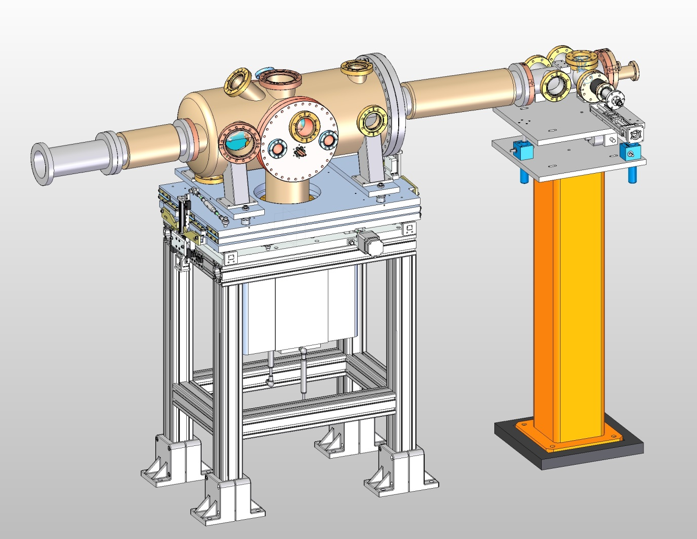
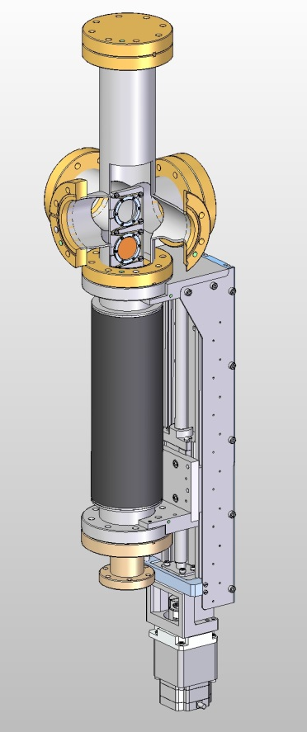
K-Monochromator system
Position in beamline: after SRA but before limiting apertures (gas section, offset mirror) and after beam separation and collimator (see list of components: EDMS Nr.: D00000002629421)
Filter chamber upstream of K-Mono
(e.g. nickel K-edge at 8333eV)
K-Mono
SR-2D-imager / PIN diode

Slide 20
Device commissioning
Without beam / after installation and vacuum tests
Adjustment in tunnel / fiducialisation
Test of control crate and connections: motors, encoders, sensors
Test of detector function with LED / adjustment of optics
With beam
Find central beam, geometric adjustment with adjustment stage
Calibration of monochromator energy
  First stage: calibration with energy filter
  Second stage: find 4-bounce beam

Slide 21
Electron beam requirements
For full tests of all measurement types we need to control some parameters of the electron beam and undulator
Undulator gaps: gap adjustment and gap scan (on the fly)
Intersection: quadrupole mover / magnets / phase shifters
Bunch compressor: reduce energy chirp
E-beam: energy scan > +/- 1%
We need:
As many pulses per train as possible (makes life easier for imaging)
Max. bunch charge (1nC)
Variation of e-beam energy (e.g. 10, 14, and 17.5 GeV)
Electron beam energy jitter < 2x10⁻⁴ (within one bunch train)
Energy chirp < 2x10⁻⁴ (reduced setting of bunch compression)
Electron energy measurement resolution < 2x10⁻⁴ (bunch / averaged):
high relative accuracy / high reproducibility
Beam position jitter / pointing stability
minimum requirement: 30 µm / 0.5 µrad

Slide 22
Undulator Plans for Day One
Day One: Focus is to achieve first Lasing
  Straight Trajectory ;
  Good Phase Matching.
Install only well characterized equipment (Undulators, Phase Shifters) → Limits & reduces error sources
Trust the equipment ! Trust the magnetic measurements!
Avoid, if possible sophisticated diagnostics, which require commissioning → later
Basic controls for undulator must be available
Sophisticated controls for undulators come later,

Slide 23
Strategy ( Elletra approach)
Assumptions:
Inside Undulator, properties are accurately known :
  Internal orbit is straight within specs (RMS criterion)
  Phase Jitter is in specs
  K-Parameters are consistent within ΔK/K ≤1-2 ˣ10⁻⁴
Exact Phase Shifter settings are known from Magnetic measurements
No beam is required! Trust the magnetic measurements!
Undulator Entrance /Exit Kicks :
  Accuracy only ≈ ±0.03Tmm ÷ 30% of σ‘=1.6μrad
  XFEL specs: ±0.004 Tmm ÷ 5% of σ‘
  Needs improvement using BBA → straight orbit

Slide 24
Step 2: Set undulator segment gaps
Set Ks / gaps of undulator Segments statically trusting the magnetic measurements
Suggestion: Use tuning gaps with lowest errors
  SASE1/2 gap 14mm, K=2.7
  SASE3 gap 15mm, K=6.9
Use the Phase Shifter settings from magnetic measurements
This should be good for First Lasing

Slide 25
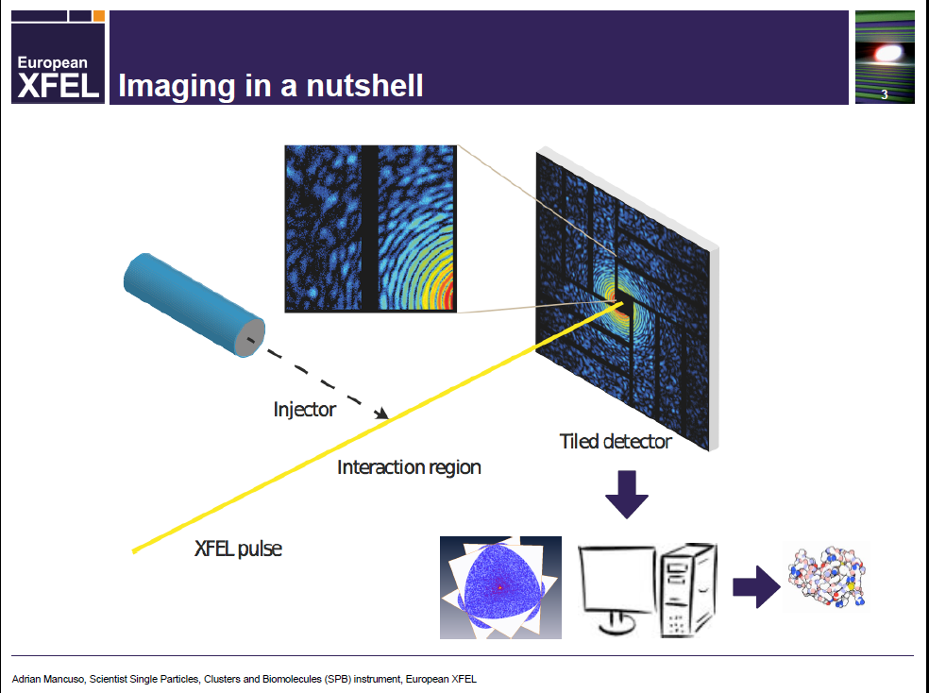

Slide 26
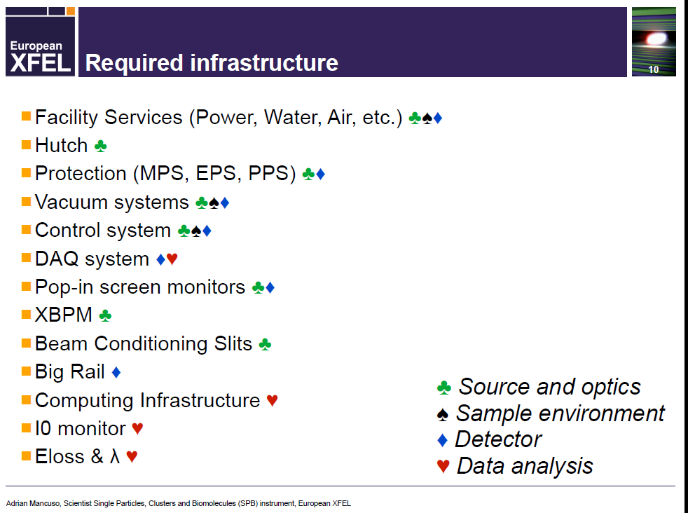

Slide 27
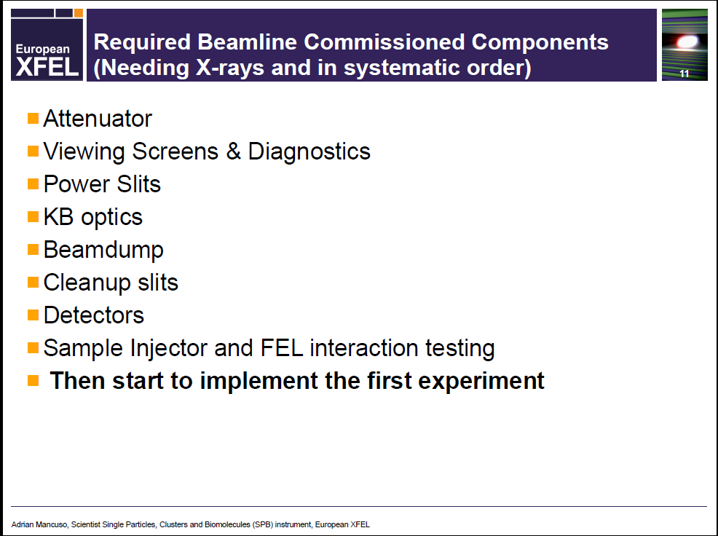

Slide 28
