Slide 1
XFEL Meeting
8 April 2014
String and Module Assembly Status
(WP03 + WP09)
O. Napoly (CEA)

Slide 2
Status of Assembly

Slide 3
Status of Assembly
With the current schedule, assuming 1 module/week delivery rate,
XM100 will be delivered beginning of May 2016.

Slide 4
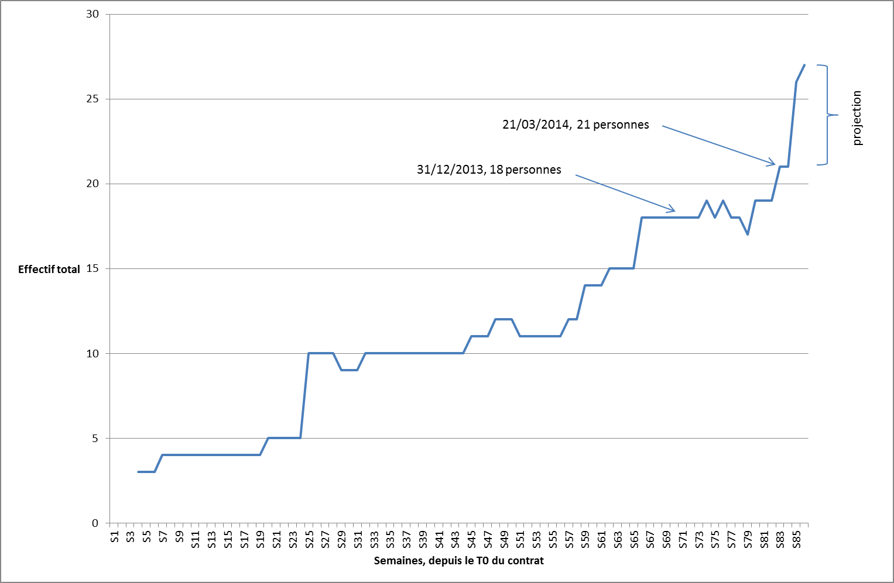
Alsyom Staffing (SEIV not included)
14/04/2014, 26 persons (+3—1)
01/04/2914, 24 persons
Start of observation phase
Start of production phase
Start of training phase
2012
2013
2014
Project Weeks

Slide 5
Alsyom Staffing (SEIV not included)
14/04/2014, 26 persons (+3—1)
01/04/2914, 24 persons
XM6
XM5
17/03
XM4
24/02
Start of production phase
XM3
06/01
Start of training phase
21/11
XM2
23/09
XM1
23/04
Start of observation phase
04/09
26/03
XM-1
XM-2
01/07
27/02
02/04
07/08
Project Weeks
XM-3
17/09
24/04
w38
w1
w11
w21
w31
w41
w51
2012
2013
2014

Slide 6
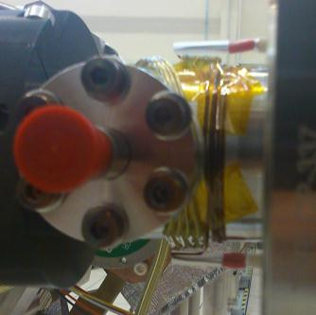
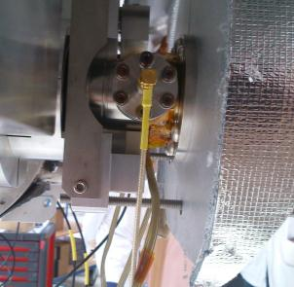
Problems with coupler PT1000 sensors
Control of PT1000 thermal sensors after observation of two damaged sensors on XM-1 (4A), XM1 (6B)
Current solution (with XFEL Cold part + XFEL 4K shield) leads to collision with the PEEK support when coupler cold part is moved in (range = +- 10 mm). This solution is implemented on XM-1 !
Fixing the coupler thermal sensors problem started today after coupler 4K shield removal, and new routing/winding solution is approved
A
A
PEEK support
B
B

Slide 7
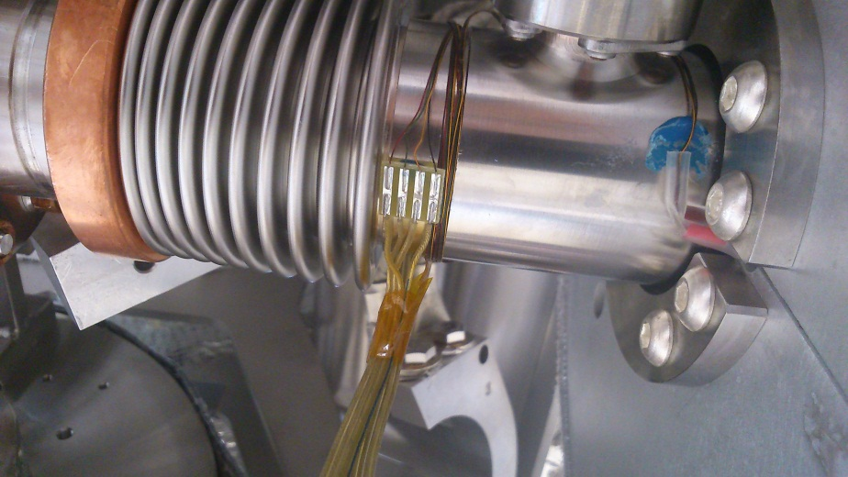
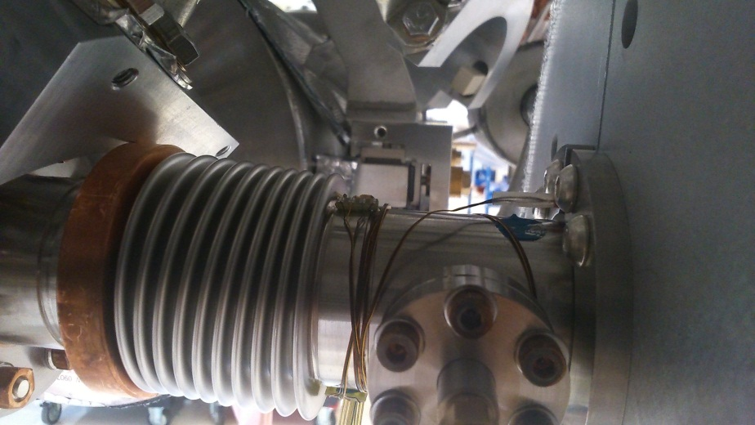
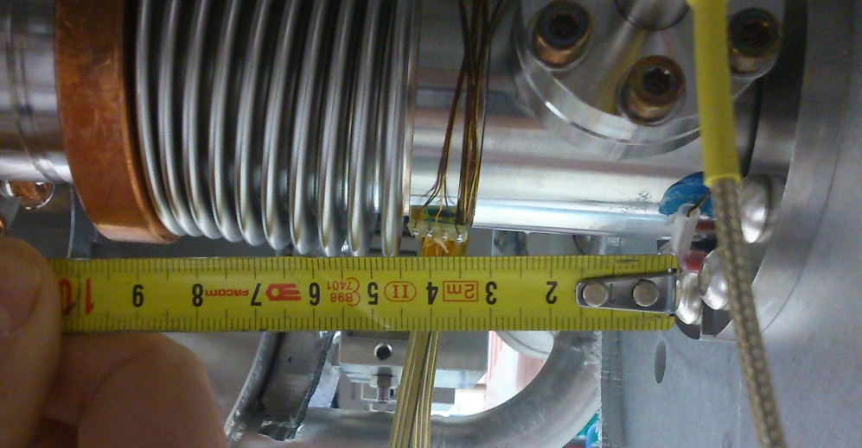
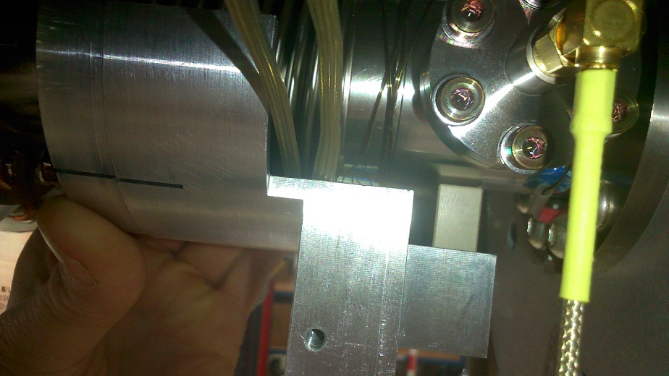
Corrective action on PT1000 routing
New solution (with XFEL Cold part + XFEL 4K shield) avoids to collision with the PEEK support when coupler cold part is moved in (range = +- 10 mm)
Approval by WP05 obtained
A
B
A
N.B.: blue stycast left-over from preceding assembly
B
B

Slide 8
Status on 2-phase line welding
XM5 welds reached level 3 (pores ≤ 0.8 mm) but 4 welds did not reach level 2 (pores ≤ 0.6 mm)
This is a huge disappointment since XM5 cavities had seamless tubes and US-cleaned bellows.
The only possible explanation would be mishandling by the SEIV welder, a certified welder working for XM5 .
The four welds have been repaired last week and will be X-rayed to-morrow (09/04/2014)
Derogation submitted to DESY for the X-Ray of the SS 42mm tube

Slide 9
Status on X-Ray Radiography at Saclay
X-Ray Campaign follwo-up

Slide 10
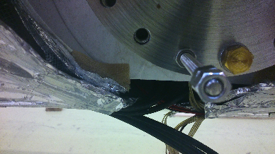
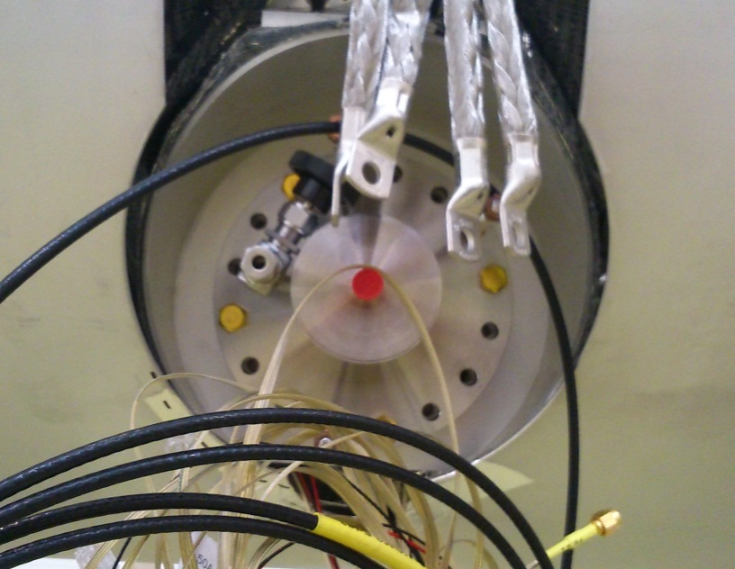
Problems with 80 shields collision
Collision between the 80 K coupler and cryostat thermal shields:
The ‘round’ shape of the cryostat shields is very sensitive.
XM-1, coupler n°8
XM3, coupler n°6

Slide 11
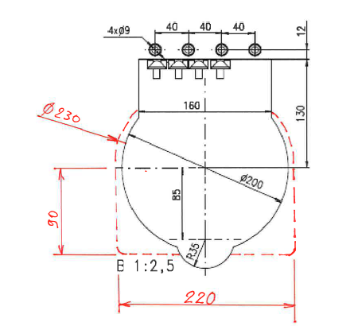
Problems with 80 shields collision
CEA proposal for a wider cut-out, starting with XM2.

