Slide 1
Jet substructure on the back of an envelope
Mrinal Dasgupta
Muenster workshop on Parton Showers, Event Generators and Resummation, June 10-12, 2014
Based on published work with Gavin Salam, Simone Marzani, Alessandro Fregoso and Alex Powling and work in progress with Andrzej Siodmok and Alex Powling.

Slide 2
Jet substructure at the LHC
Since 2008 a vibrant field has emerged based on using jet substructure to discover highly boosted new particles at the LHC. Exploits a situation when p_{T} >> M_{X.}
Seymour 1993, Butterworth, Davison, Rubin and Salam 2008
Well over 100 papers in the last 5 years and its own dedicated conference.
Note: Registration is now open for BOOST 2014 at UCL
http://www.hep.ucl.ac.uk/boost2014/

Slide 3
Jet substructure for signal vs background
2 main handles to play with
Backgrounds favour asymmetric splittings while signals do not. QCD radiation is enhanced in soft and collinear regions.
For colour singlet signals soft large-angle radiation is cut off due to angular ordering. This suggests cutting on wide-angle emissions will beat down backgrounds without affecting signal.
Numerous ways to achieve these goals. 10-20 methods have been invented and tested against MC results.

Slide 4
Substructure methods
Commonly studied methods include : mass-drop, pruning and trimming techniques, N subjettiness, template overlap, energy correlation functions, shower deconstruction, planar flow and several others.
For a review see : BOOST 2012 proceedings arXiv:1311.2708 and references therein.
Introduce several new parameters (energy/angular cuts) in addition to those already inherent in jet finding. Appear at first sight to be complex sophisticated tools.
Questions that arise can include:
Potential duplication and redundance?
Issues of robustness ,dependence of results on parameters, jet algorithms, kinematics etc ?
Calculability, IRC safety etc ?
Performance – is there a “best” tagger? How do we compare tools meaningfully?

Slide 5
MC vs analytic studies
The easiest way to test statements on taggers is via Monte Carlo.
These studies do not always bring the required insight. Hard to run for all parameter combinations across huge range of kinematics from few hundred Gev to multi-Tev and R=0.4 to R ~ 1.
The Monte Carlo findings discussed above indicate that while pruning, trimming and filtering have qualitatively similar effects, there are important differences. For our choice of parameters pruning acts most aggressively on the signal and background followed by trimming and filtering.”
Boost 2010 report

Slide 6

Analytical approach?
Can we describe action of taggers with pQCD calculations?
If not should we be using them?
Don’t want to rely on 1 GeV physics to make discoveries at TeV scale.
If yes do we need fixed-order or parton-showers/resummation?
Can we resum logs for such complicated observables?
Schwartz, Boost 2012
grooming
Precision QCD

Slide 7
Definitions (MDT)
Break the jet j into subjets j₁ and j₂ such that m _{j1} > mj2
If there is a mass-drop and not too asymmetric splitting
tag the jet j else recurse to j₁
Note that we modified the tagger to follow higher p_{t} branch - more amenable to resummation. Modified mass-drop tagger.
Butterworth, Davison, Rubin, Salam 2008
Dasgupta, Fregoso, Marzani, Salam, 2013

Slide 8
Definitions (pruning, trimming)
Pruning sets a radius R_{prune} ~ m/p_{t} and reclusters the jet such that if 2 objects are separated by angles larger than this and then the softer object is discarded.
Trimming uses a fixed radius R_{trim.}

Slide 9
Current understanding
Analytical studies have paved the way for a sophisticated understanding of this sub-field.
MD, Fregoso, Marzani, Salam, Powling, 2013
Post analytics we can do the “right” MC studies too.

Slide 10
Taggers look similar

Slide 11
But only over limited mass range
How do we understand these shapes? Position of kinks, peaks etc? Needs analysis and calculation.

Slide 12
Analytical Results for QCD jets
Trimming MC vs analytical
Dasgupta, Fergoso, Marzani, Salam 2013

Slide 13
Analytical results for QCD jets
Pruning has a more complicated/interesting structure. LO result is single logarithmic
LO (First term of Y pruning)
NLO (First term of I pruning)

Slide 14
I pruning vs Y pruning
I pruning eliminated by demanding that at least one emission is tested and passes the pruning cut. Y pruning has one log less but benefits from a double log suppression.
MD, Fregoso, Marzani and Salam 2013

Slide 15
Analytical results for QCD jets
mMDT has a unique single log structure. Can produce a flat background. No non-global logs. May even be a good variable for strong coupling extraction!
The mass drop tagger seems not to depend on mass drop !
MD, Fregoso, Salam, Marzani 2013

Slide 16
What about signal processes?
Let us take in V+H production as an example and work in the narrow width limit.
Taggers exhibit similarities and differences already at tree level in cases.
Then one has to analyse the response to ISR and FSR
Shall impose a mass window

Slide 17
Signal processes tree level
We shall initially work in the formal limit
but shall extrapolate our results to R ~ 1.
For plain mass

Slide 18
Signal processes tree level
Mass drop and pruning
Trimming
Can we adjust parameters so as to lower background while maintaining signal? Also need to study radiative corrections from ISR and FSR.

Slide 19
ISR effects for plain jet mass
Compute the probability of staying within the mass window constraint
ISR contribution can be resummed with neglect of non-global logarithms for Cambridge Aachen R ~ 1. Delenda, Appleby, Banfi, Dasgupta, 2006
(fixed-coupling approximation)

Slide 20
Plain jet mass
We can also do corresponding calculation for FSR. For m/p_{t} << R, angular ordering property suppresses radiation at large angles. Negligible contribution.

Slide 21
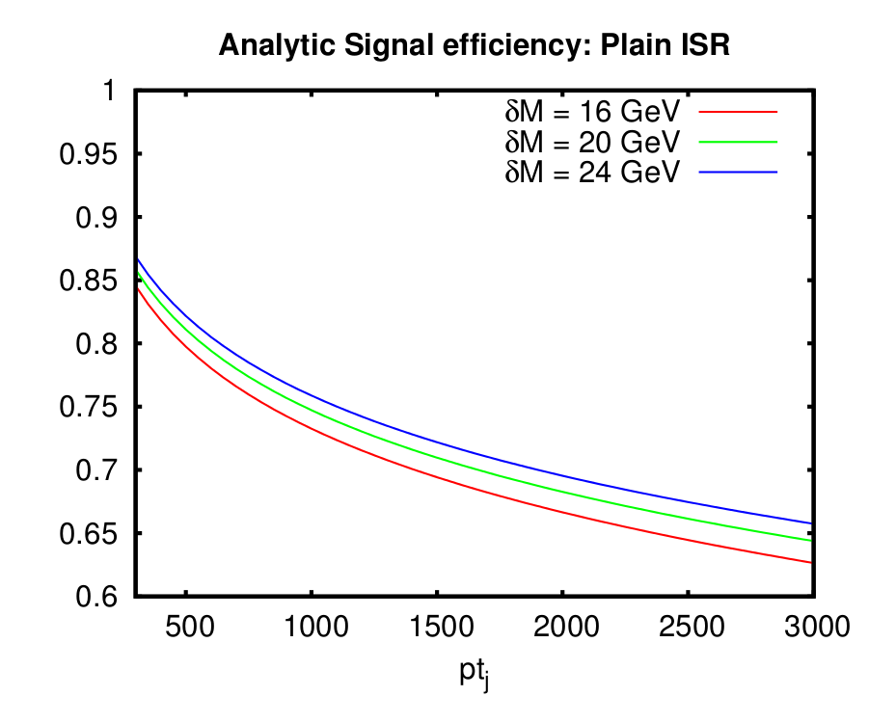
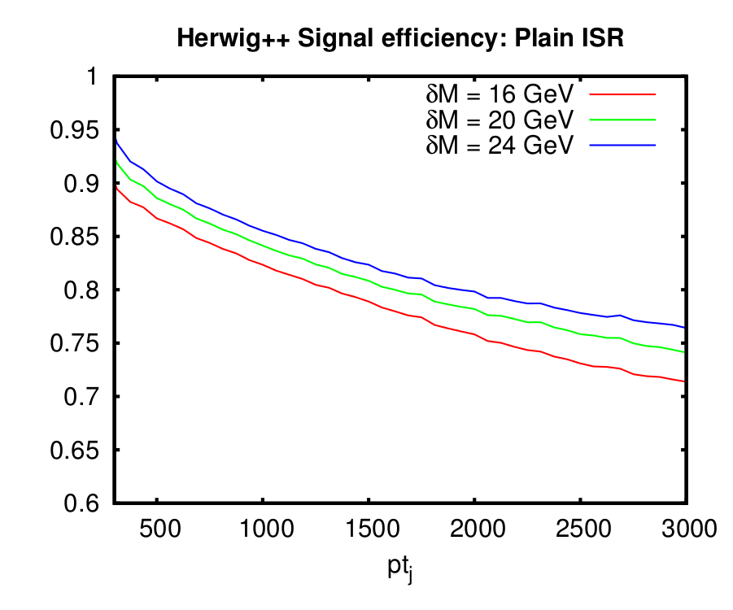
Plain mass results
Agreement with MC at the expected level. FSR minimal as expected. UE is dominant for R=1.

Slide 22
ISR for taggers
mMDT
At high p_{T} result goes as
At lower p_{T} there will be a transition to the plain mass or a dependence on the mass drop parameter. One may also resum logs of y_{cut.}

Slide 23
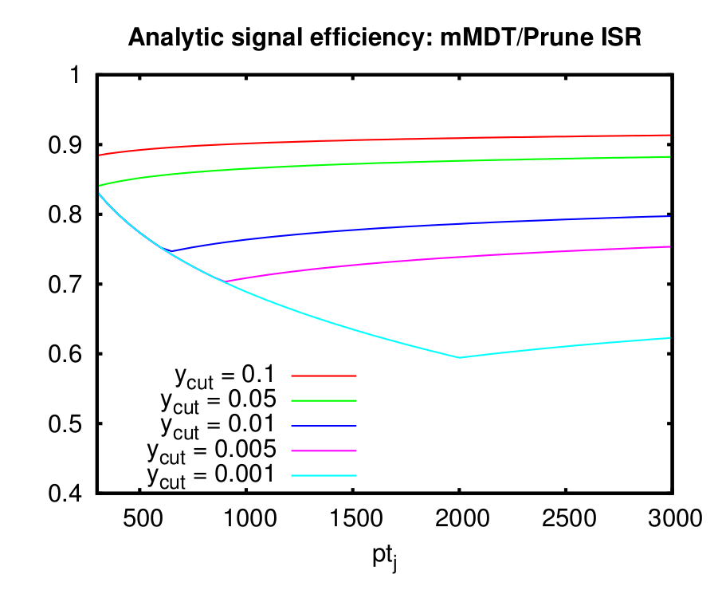
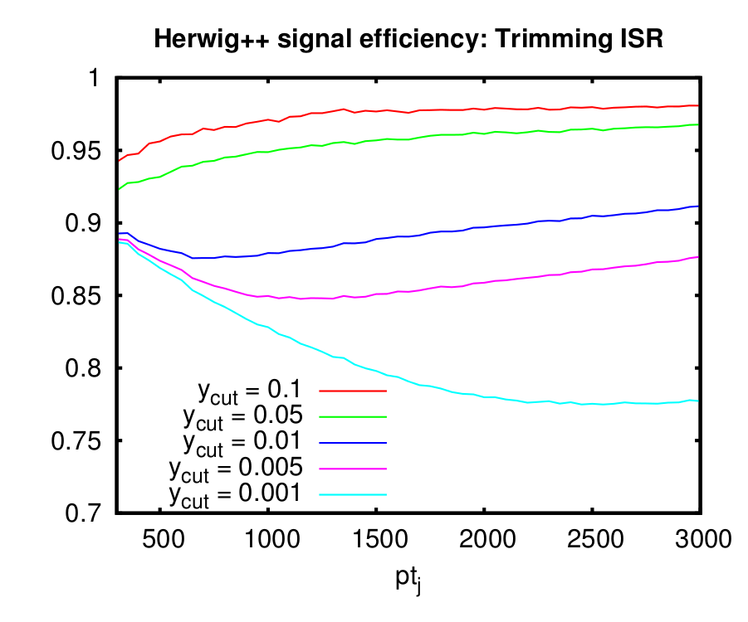
Other taggers
Pruning and trimming produce a very similar result for ISR. In reasonable agreement with MC.

Slide 24
Y pruning
ISR gluon can set R_{prune} and change Y pruned to I pruned
Predicts loss of signal at high p_{T}

Slide 25
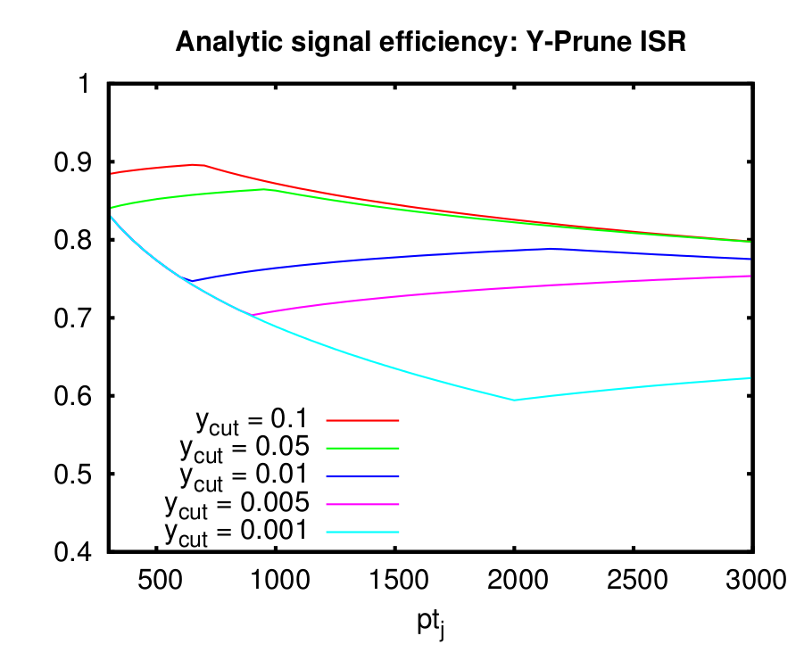
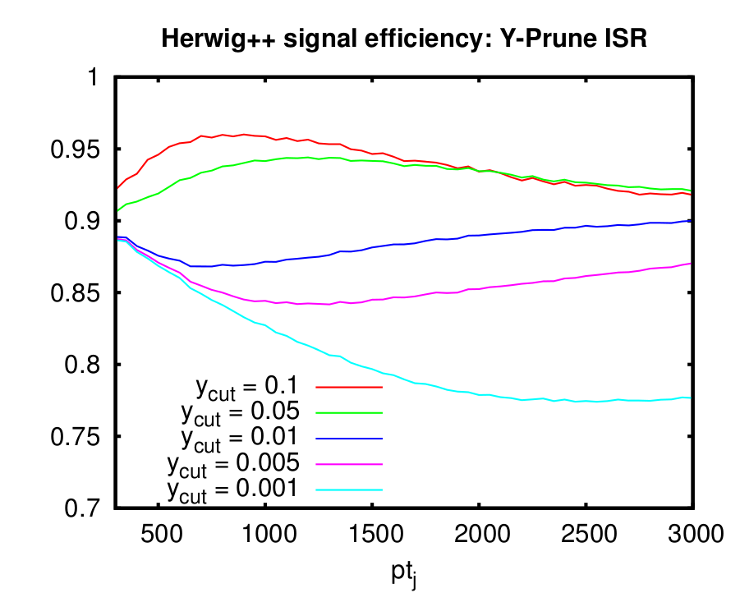
Y pruning
Again this feature agrees with HERWIG++

Slide 26
Final state radiation
Contributes when emissions are removed by the taggers. Emissions are softer than y_{cut} p_{T} , emitted outside some angular region around the hard partons.
for trimming
for pruning
for mMDT
The latter 2 are genuine soft large-angle corrections not described by angular ordering approximation

Slide 27
FSR results
mMDT, pruning and Y pruning all take the form
with arising from from angular and z integrals. For mMDT ~ 0.6 with a small p_{T} dependence.
For pruning and Y pruning .
For trimming the angular integral produces a
collinear enhancement.

Slide 28
Optimal values
How to use all this information? We have seen effects that push as in different directions e.g. minimising ISR shifts us to larger y_{cut} but this increases the FSR loss.
In general want to achieve a large
Can use analytical formulae to dervive optimal parameter values.
Work in progress with A.Siodmok and A.Powling

Slide 29
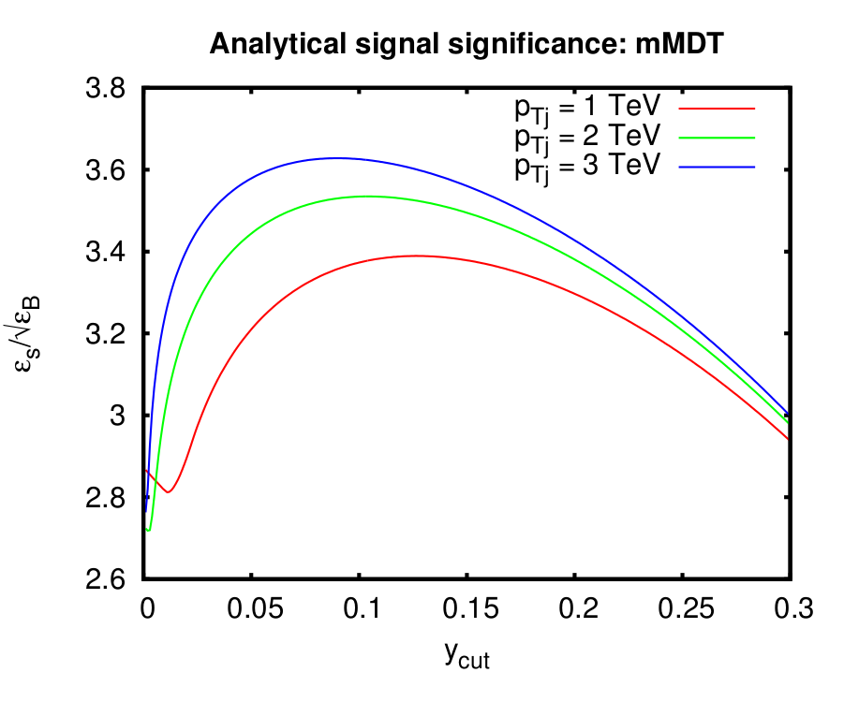
Some preliminary work for mMDT
As a first approximation switch off radiative corrections in signal and work with tree level result.
Maximising this gives
One can deduce the optimal y_{cut} for various p_{T}

Slide 30
Summary and outlook
Task for theorists is to really understand taggers which has begun.
For the taggers we studied here signals relatively stable against radiative corrections (modest effects unless one makes extreme parameter choices).
Optimal values probably dictated significantly by background. But for other taggers e.g. N subjettiness this is no longer the case.
Good understanding of signal also important for taggers that perform similarly on background (Ysplitter, Ypruning)
Ongoing task is to use all this to design the best taggers. In this context tagger combinations appear promising.

