Slide 1
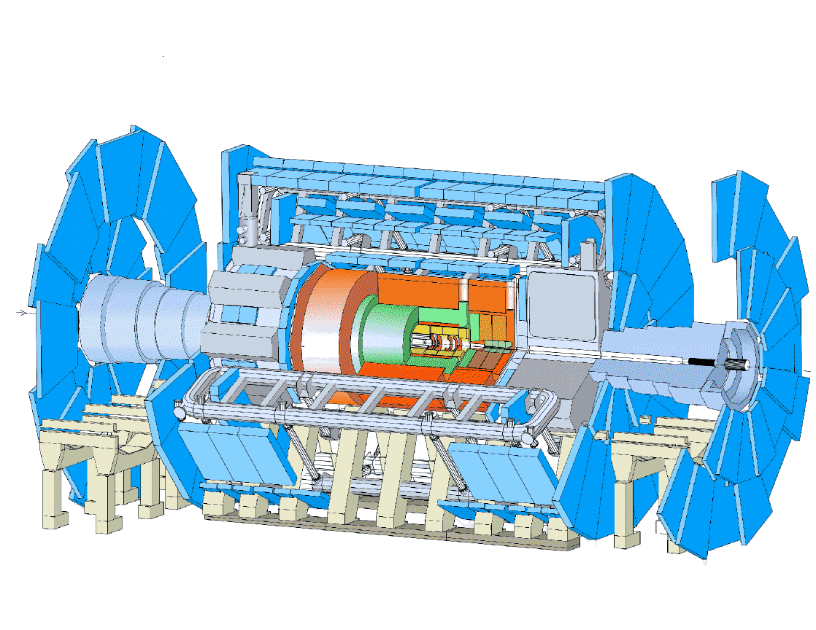
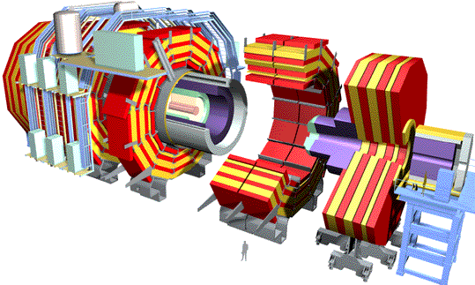
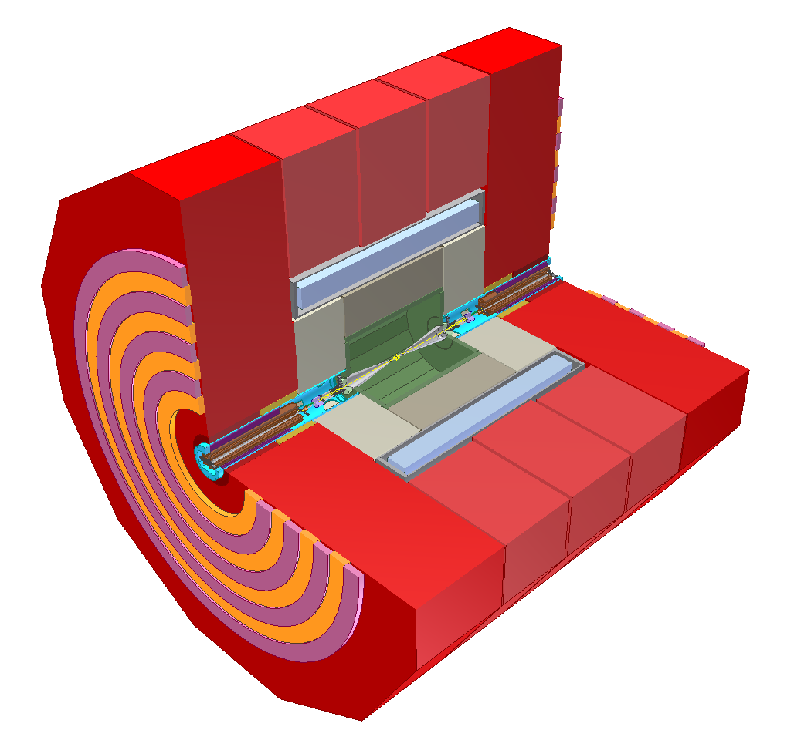
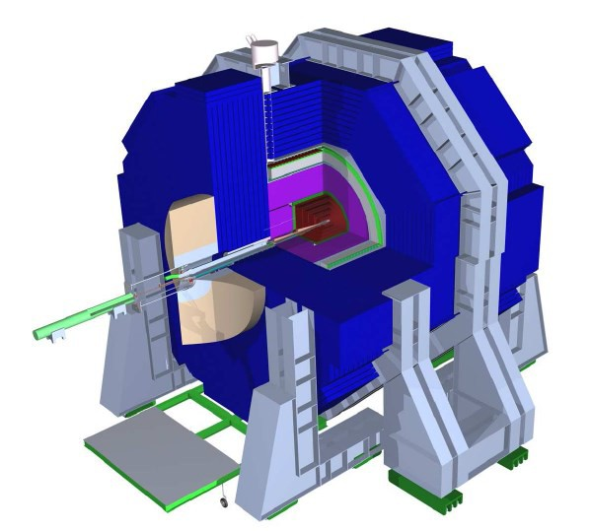
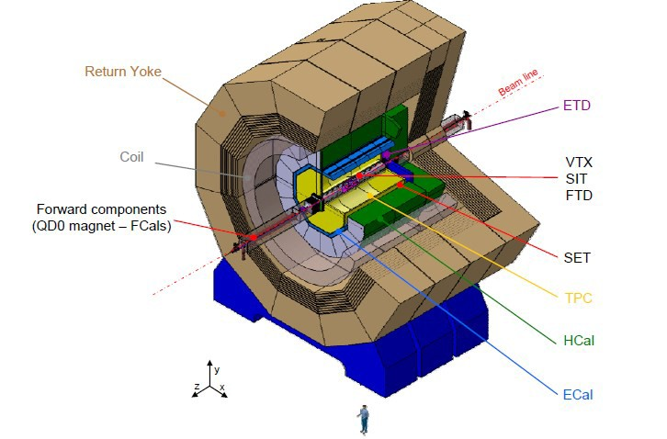
Detector Concepts
CMS
ATLAS
CLIC
ILD
SiD

Slide 2
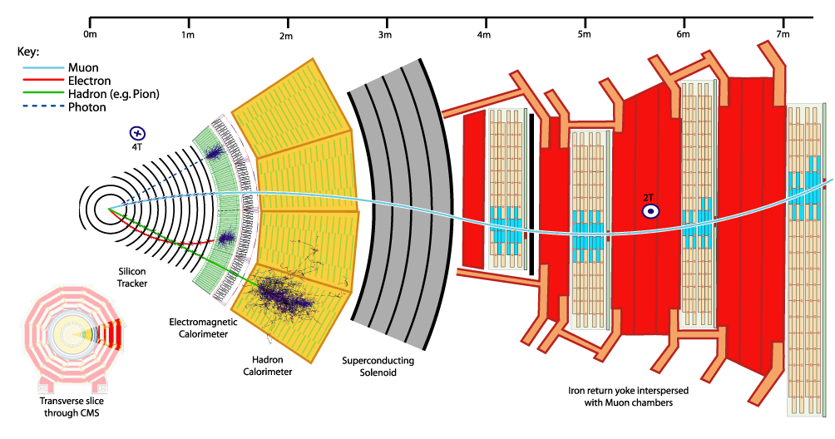
A typical Particle Detector
Cut-away view of CMS
Tracker
p
Calorimeter
E
Coil
Muon Detector and iron return yoke
muon identification + p for muons

Slide 3
High Energy Collider Detectors
Tracking Detector (or Tracker) = momentum measurement
  closest to interaction point: vertex detector (often silicon pixels)
    measures primary interaction vertex and secondary vertices from decay particles
  main or central tracking detector
    measures momentum by curvature in magnetic field
Calorimeters = energy measurement
  electro-magnetic calorimeters (light particles: e⁻, e⁺, γ)
    measures energy of light EM particles (electrons, positrons, photons) based on electro-magnetic showers by bremsstrahlung and pair production
    two concepts: homogeneous (e.g. CMS) or sampling (e.g. ATLAS, ILD, SiD, CLIC)
  hadron calorimeters (heavy hadronic particles: π, K, p, n)
    measures energy of heavy (hadronic) particles (pions, kaons, protons, neutrons) based on nuclear showers created by nuclear interactions
Muon Detectors = momentum measurement for muons (more precise)
  outermost detector layer, basically a tracking detector

Slide 4
Detector Challenges at LHC
High energy collisions
  sufficiently high momentum resolution up to TeV scale
High luminosity (high interaction rate)
  high rate capabilities, fast detectors (25 ns bunch crossing rate)
High particle density
  high granularity, sufficiently small detector cells to resolve particles
High radiation (lots of strongly interacting particles)
    radiation mainly due to particles emerging from collisions, not machine background
  radiation-hard detectors and electronics (have to survive ~10 years)
LARGE collaborations!!!
  ~O(3000) physicists for ATLAS and CMS each
  communication, sociological aspects
    exponential raise of meetings, phone + video conferences...

Slide 5
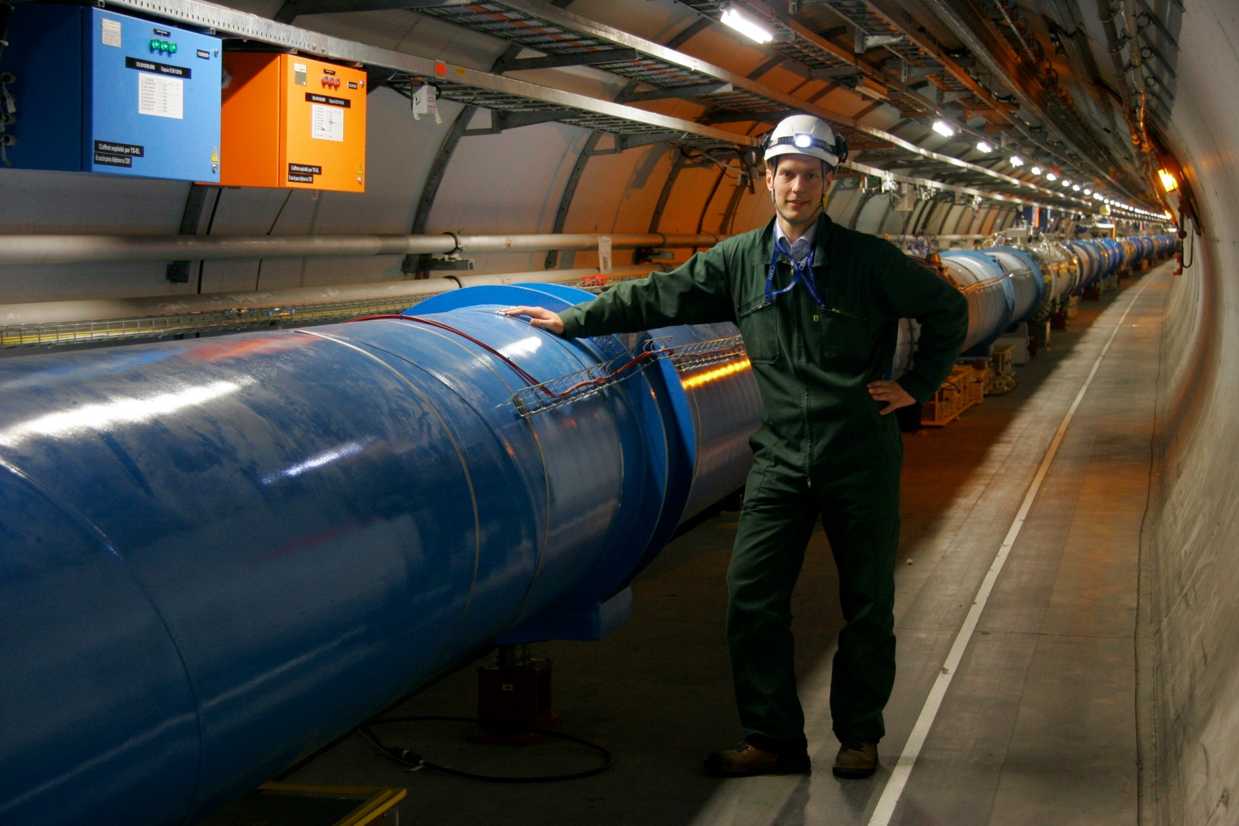
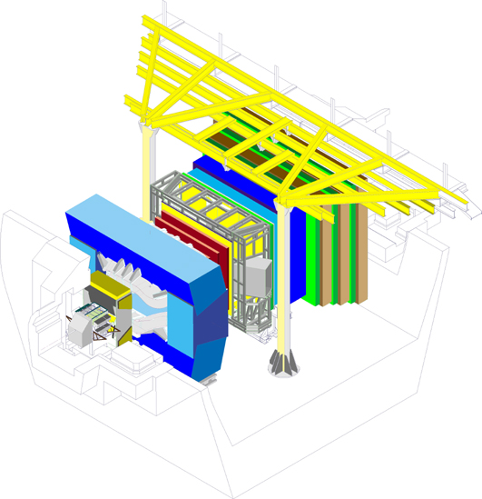
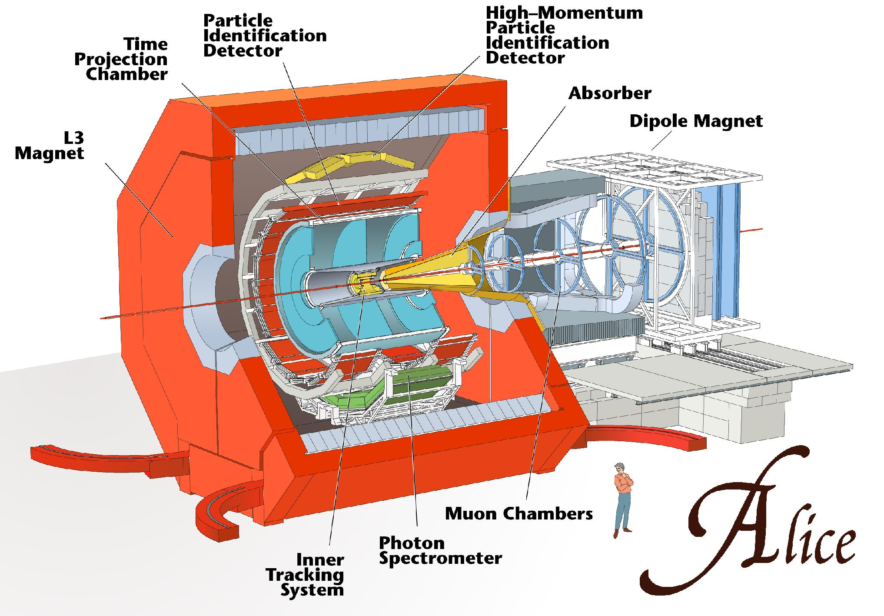
LHC Detectors
General purpose detectors
(good for everything...)
ATLAS
CMS
LHCb
ALICE
dedicated for
Heavy Ion collisions
dedicated for
b-physics

Slide 6
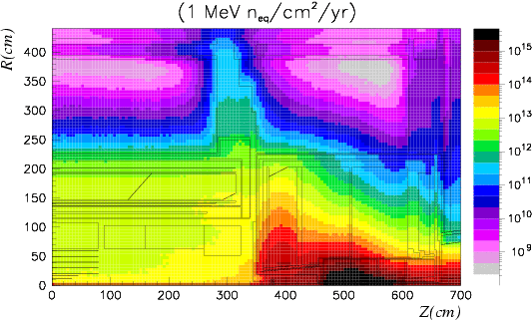
Radiation Doses at LHC
200 MRad
~ 2 x 10⁶ Gray / r_{T}² / year at LHC design luminosity
    where r_{T} [cm] = transverse distance to the beam
Lots of R&D over >10 years to develop rad.-hard silicon detectors, gaseous detectors and electronics
ATLAS
neutron fluences
interaction point

Slide 7
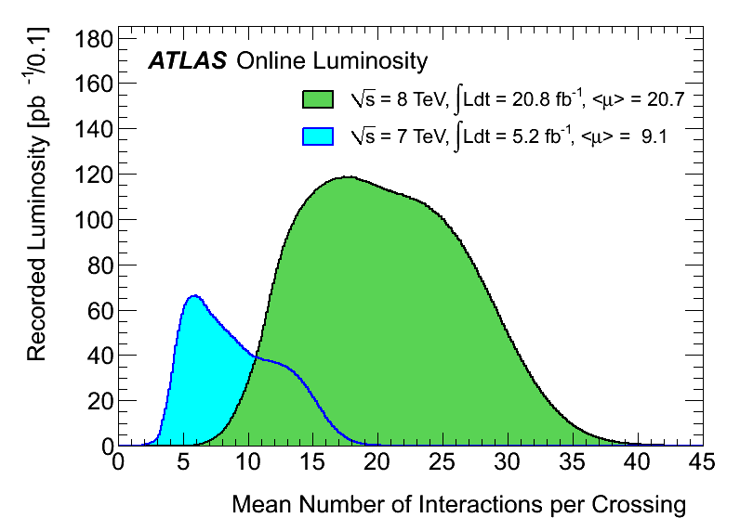
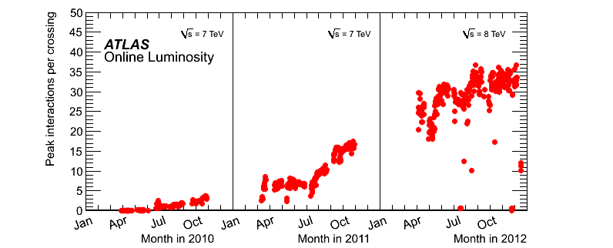
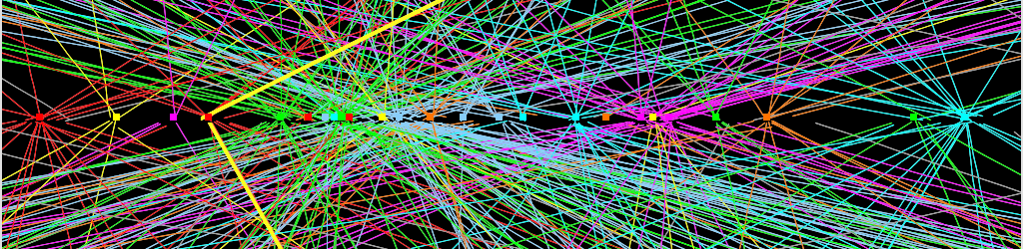
Challenging Conditions: Pile-up
2012 event with pile-up: 25 reconstructed primary vertices
~7 cm

Slide 8
How to Select Interesting Events?
Bunch crossing rate: 40 MHz, ~20 interactions per BX (10⁹ evts/s)
  can only record ~300 event/s (1.5 MB each), still ~450 MB/s data rate
Need highly efficient and highly selective TRIGGER
  raw event data (1 PB/s) are stored in pipeline until trigger decision
ATLAS trigger has 3 levels (CMS similar with 2 levels)
  Level-1: hardware, ~3 µs decision time, 40 MHz → 75 kHz
  Level-2: software, ~40 ms decision time, 75 kHz → 2 kHz
  Level-3: software, ~4 s decision time, 2 kHz → 300 Hz
trigger
YES
save
Detector
PIPELINE
NO
10⁹ evts/s
trash
10² evts/s

Slide 9
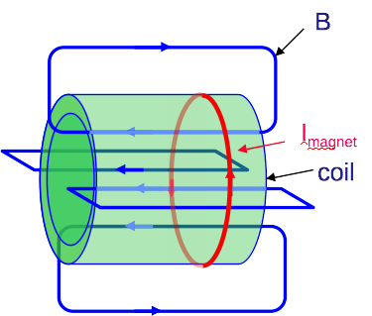
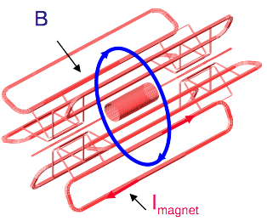
Magnet Concepts at LHC experiments
solenoid
(air-core) toroid
+ can cover large volume
+ air core, no iron, less material
- needs extra small solenoid for general tracking
- non-uniform field
- complex structure
+ large homogenous field inside coil
- needs iron return yoke (magnetic shortcut)
- limited size (cost)
- coil thickness (radiation lengths)
CMS, ALICE, LEP detectors
ATLAS
µ
µ

Slide 10

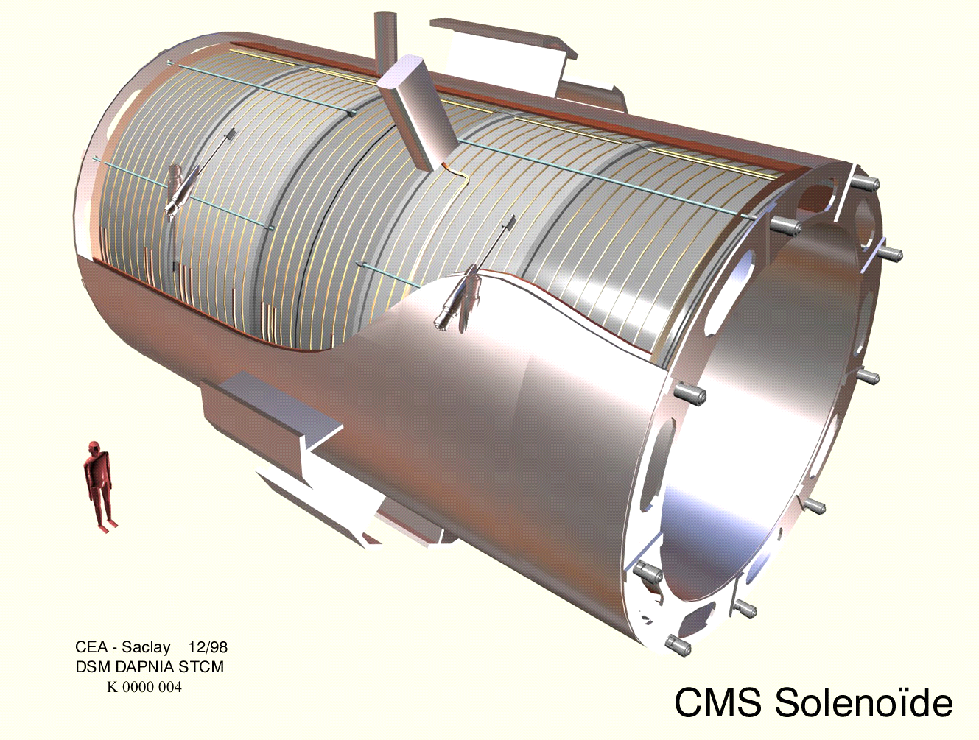
ATLAS and CMS Coils
CMS solenoid
(5 segments)
ATLAS barrel toroid coils
autumn 2005

Slide 11
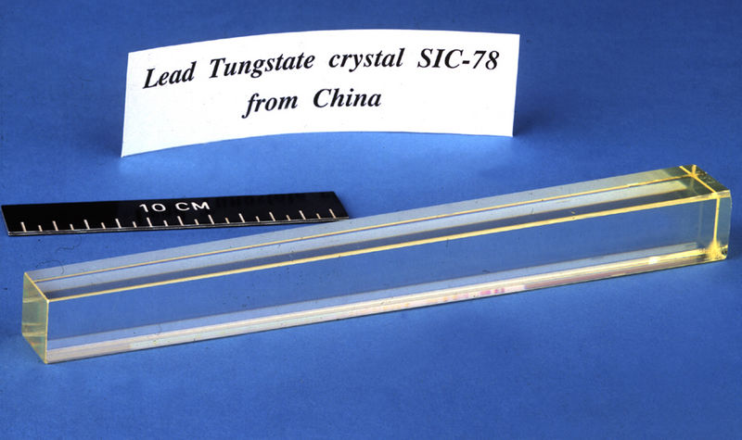
CMS: Homogeneous EM Calorimeter
Clear advantage: good energy resolution
  the entire shower is kept in active detector material
    no shower particle is lost in passive absorber
Disadvantages
  limited granularity, no information on shower shape in longitudinal direction (along particle flight direction)
    position information is useful to resolve near-by energy clusters, e.g. single photons versus two photons from ⁰ decay
Two overlapping
photons from π⁰ decay
CMS PbWO₄ crystal
Single photon
Δϕ x Δθ = 1º x 1º
Δϕ x Δθ = 1º x 1º
dense, transparent materials needed with
short radiation length and high light yield
❒ = 8.28 g/cm³ X₀ = 0.89 cm

Slide 12
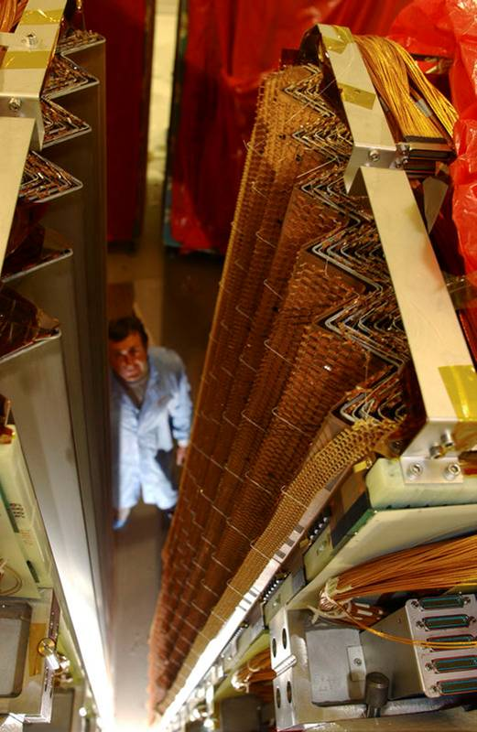
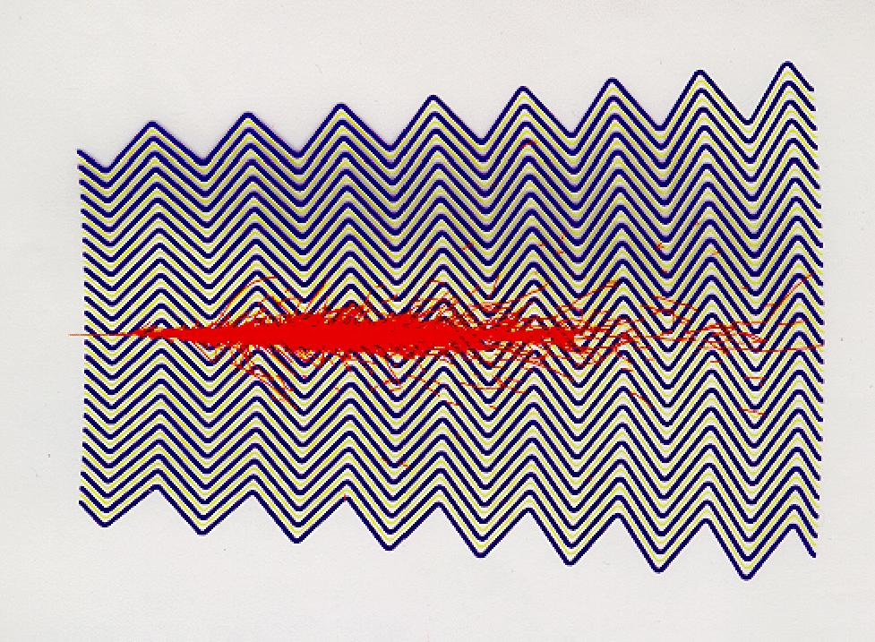
ATLAS: Sampling EM Calorimeter
Typical sampling calorimeters use iron or lead absorber material, variety of detectors in between possible
  gas detectors (MWPCs), plastic scintillators, liquid noble gases (LAr, LKr)
ATLAS is using LAr with “acordeon” shaped steel absorbers
  LAr is ionized by charged shower particles
  Charge collected on pads
    ionization chamber, no “gas” amplification
    pads can be formed as needed  high granularity
  acordeon structure helps to avoid dead zones (cables etc.)
ATLAS LAr calorimeter
simulated shower

Slide 13
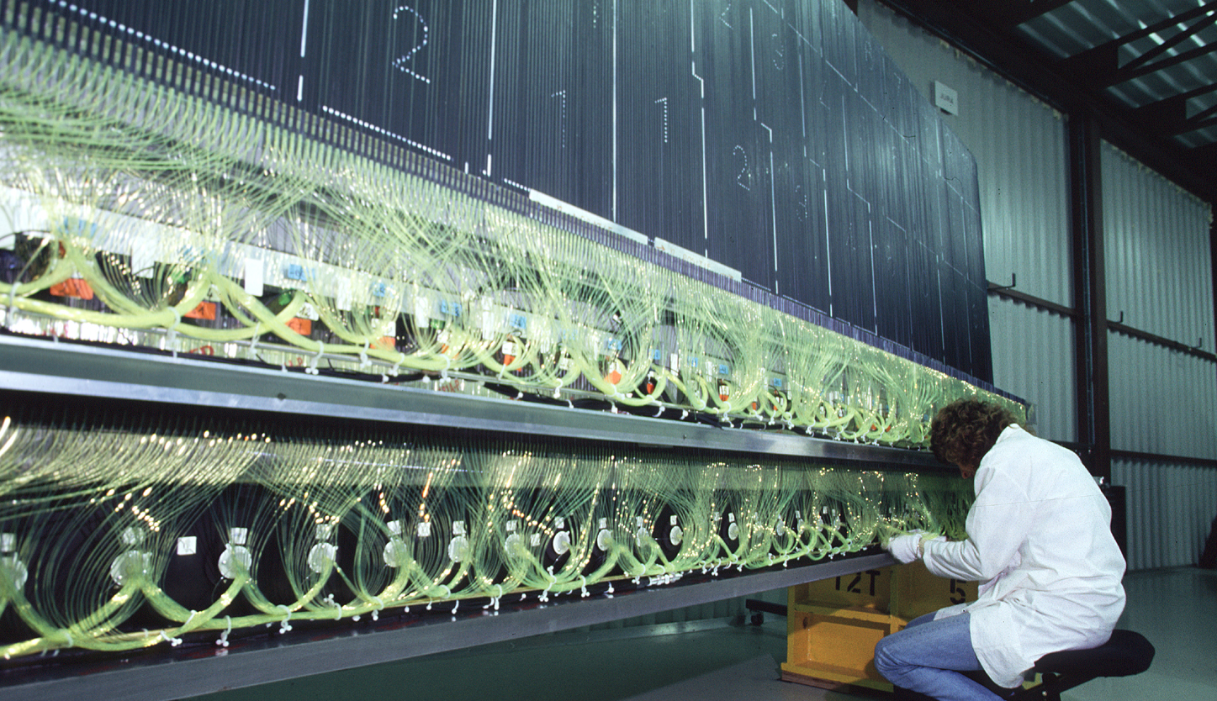
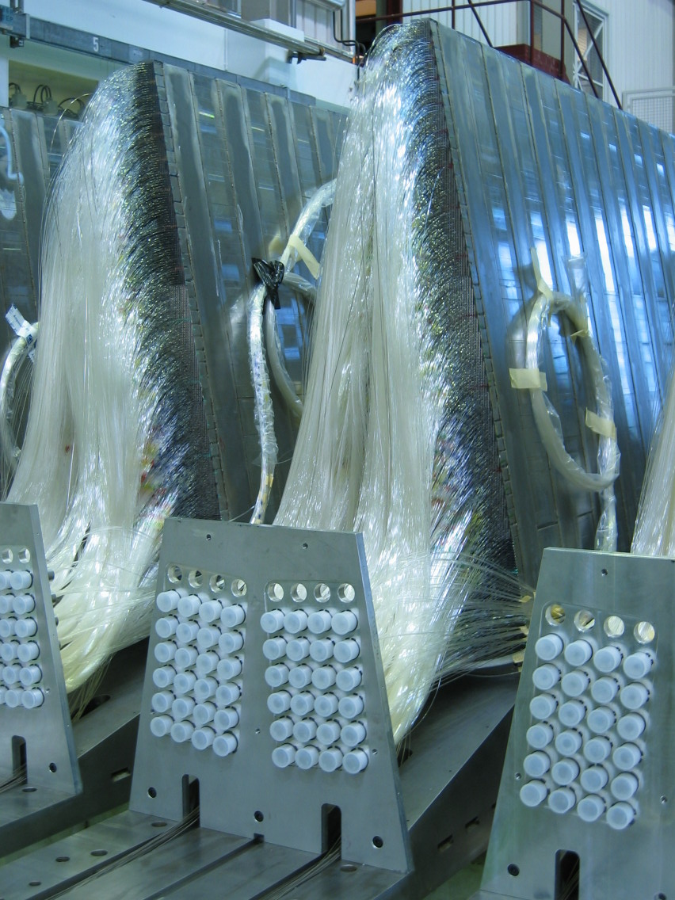
ATLAS/CMS Hadron Calorimeters
Energy resolution much worse than for electromagnetic calorimeters
    larger fluctuations in hadronic shower
    usually only a few nuclear interactions length deep (5 – 6 _{l})
Both ATLAS and CMS use scintillators as detector material
  need many optical fibers to transport light from scintillators to photo detectors
ATLAS
CMS

Slide 14
ATLAS/CMS in detail
ATLAS
CMS
Tracker or Inner Detector
Silicon pixels, Silicon strips, Transition Radiation Tracker, 2 T magnetic field (small solenoid)
Silicon pixels, Silicon strips,
4 T magnetic field (large solenoid)
Electromagnetic calorimeter
Lead plates as absorbers with liquid argon as the active medium
Lead tungstate (PbWO₄) crystals both absorb and respond by scintillation
Hadronic calorimeter
Iron absorber with plastic scintillating tiles as detectors in central region, copper and tungsten absorber with liquid argon in forward regions.
Stainless steel and copper absorber with plastic scintillating tiles as detectors
Muon detector
Large air-core toroid magnets with muon chamber form outer shell of the whole ATLAS
Muon chambers inserted in the magnet return yoke

Slide 15
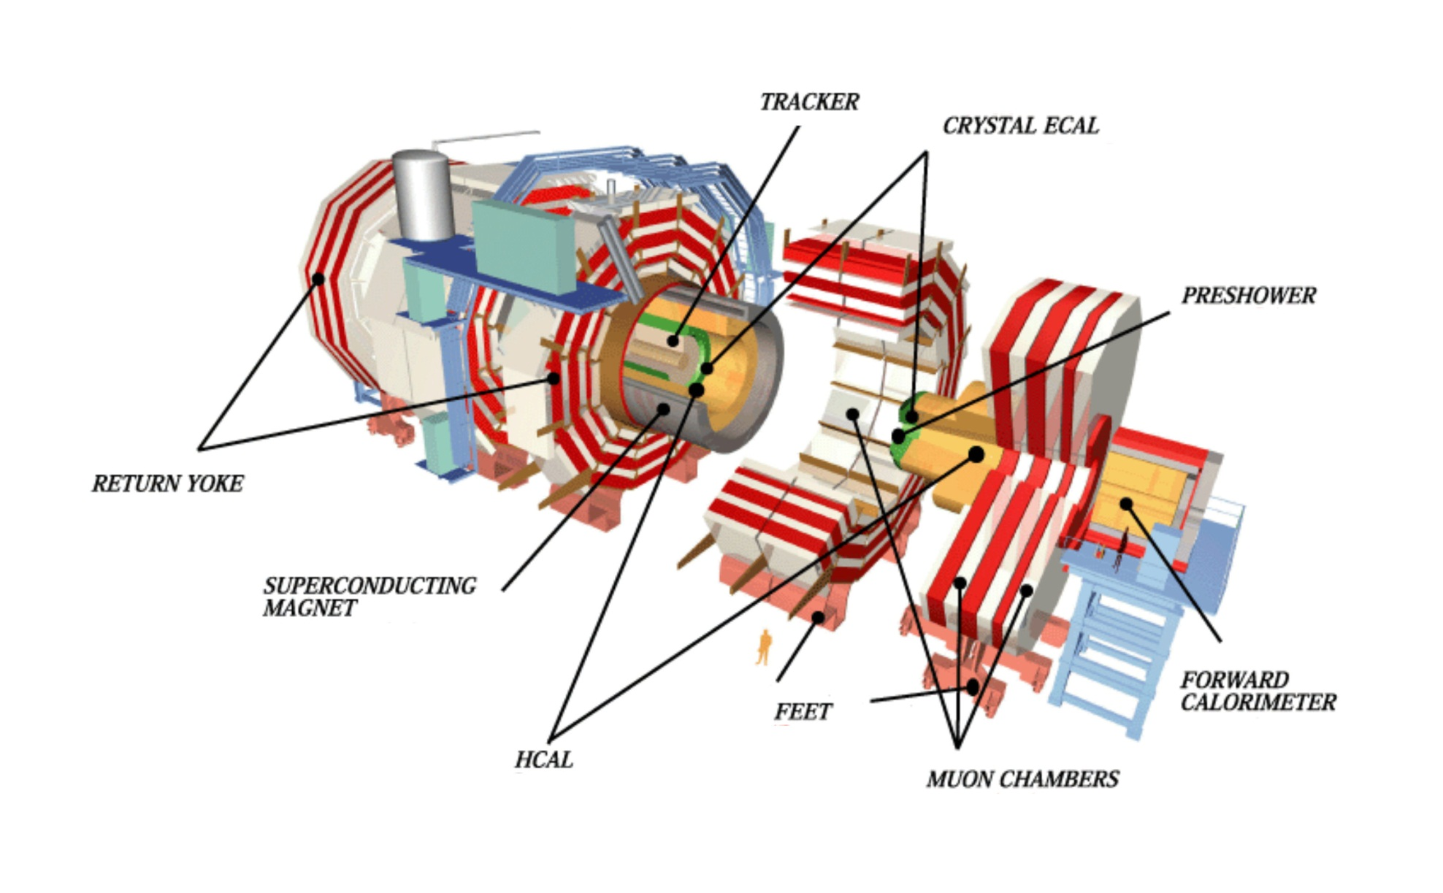
CMS (Compact Muon Spectrometer)
main assembly on surface, then lowering into cavern in 5 big parts by ~2500 t crane
210 m² silicon detectors
15 m
4 T
~12'500 t
22 m

Slide 16
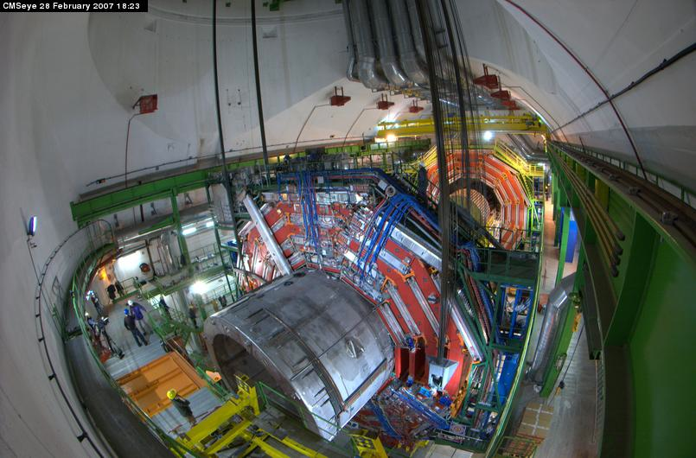
CMS Lowering of 2000 t Central Part

Slide 17
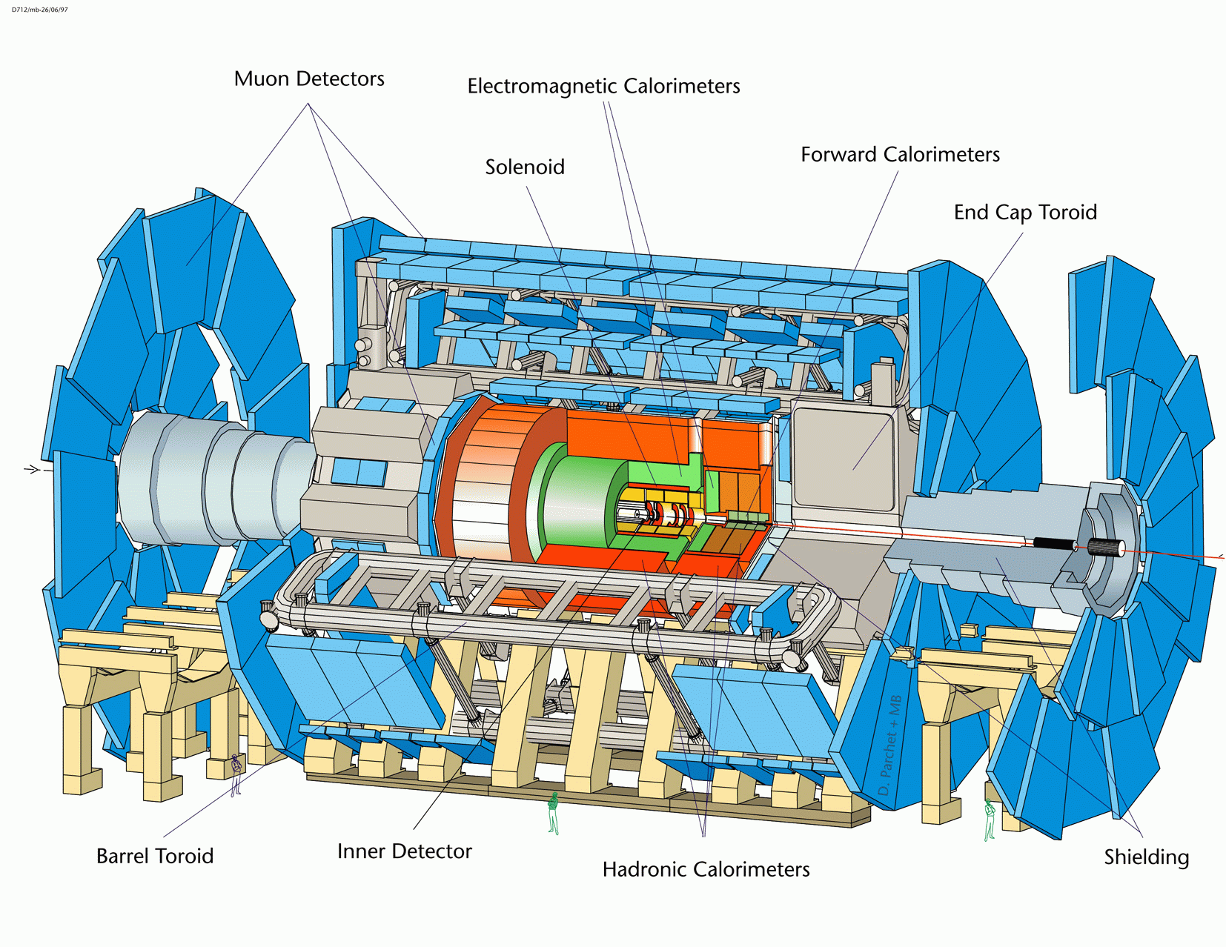
ATLAS (A Toroidal LHC ApparatuS)
~7'000 t
main assembly in cavern
25 m
46 m

Slide 18
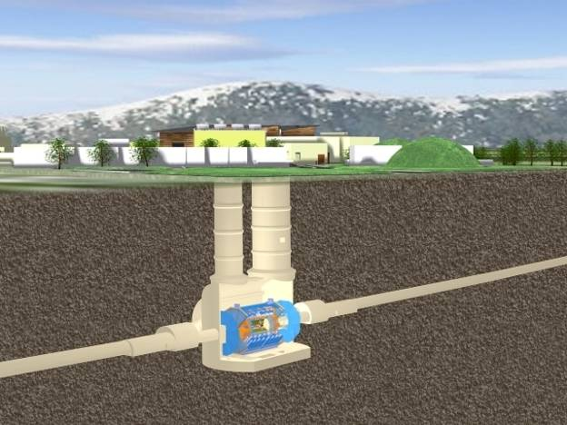
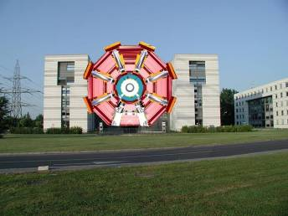
ATLAS Underground Cavern
huge cavern + surface buildings,
2 access shafts 18m + 12m Ø,
2 small shafts for elevators + stairs
Length = 55 m
Width = 32 m
Height = 35 m
ATLAS detector superimposed
on 5-floor main ATLAS+CMS
building at CERN

Slide 19
ATLAS Barrel Toroid Complete (Nov 2005)

Slide 20
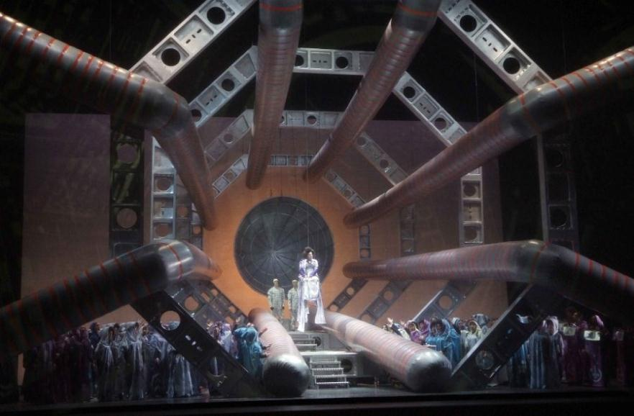
Detector Technology and Arts
Stage Design of Opera “Les Troyens” in Valencia, October 2009

Slide 21
ATLAS/CMS Concept Overview
The two large LHC detectors have somewhat different concepts
  ATLAS
    small inner tracker with moderate field (small 2 T solenoid)
    electron identification by transition radiation tracker
    sampling calorimeter with high granularity outside solenoid
    air-core toroid system for good muon momentum measurement
  CMS
    large inner tracker with high B-field (large 4 T solenoid)
    no dedicated particle identification detector
    homogeneous crystal calorimeter with good energy resolution inside solenoid
However, both detector concepts have very similar performance for Higgs physics (efficiency, mass resolution…)
emphasis on granular calorimeter and good muon measurement
emphasis on good general tracking and good energy resolution

Slide 22
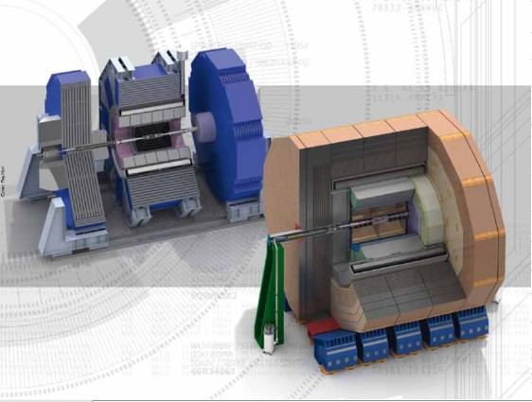
ILC Detector Concepts
ILD
SiD

Slide 23
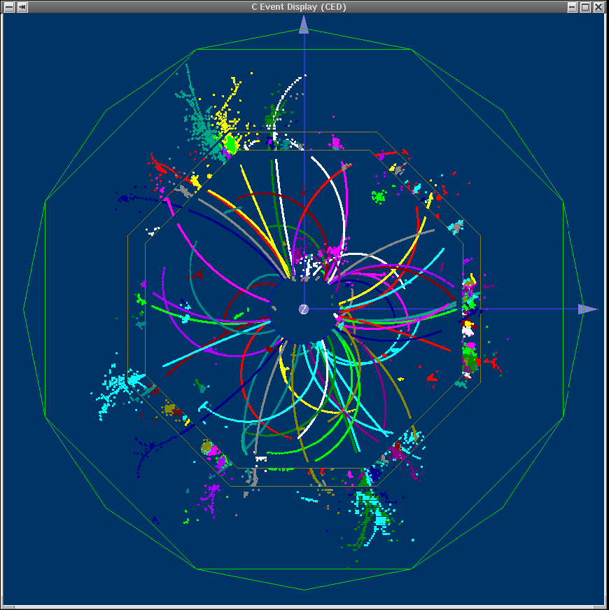
Physics Events at the ILC
Event characteristics
  multi jet final states
  leptons, often in jets
  forward going physics
  jet energy reconstruction plays a central role at the ILC
    need as good jet energy resolution as possible
tt event at the ILC (ILD model)

Slide 24
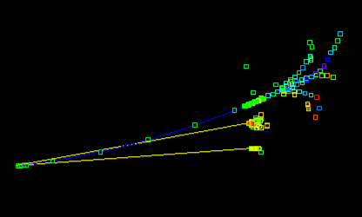
ILC Detector – Design Philosophy
Particle flow as main reconstruction technique for jet energy
  Imaging Calorimeters (CALICE)
  Extreme granularity wins over energy resolution, in particular in the HCAL
    Sampling EM calorimeter
High power tracking
  High efficiency, robust tracking in dense environments
  High precision vertexing for heavy flavour physics
    (very) many pixels

Slide 25
ILC Detector - Performance Needs
Challenging detector performance dictated by physics
  Jet energy resolution 2 x LEP
  Momentum resolution 10 x LEP
  Impact parameter resolution 3 x LEP
  Vtx detector hit resolution 3 x LEP
NOT a simple copy of a LEP detector
NOT a typical LHC detector
  LHC detector
    focus on radiation hardness, (low) occupancy
    trackers have large amount of material

Slide 26
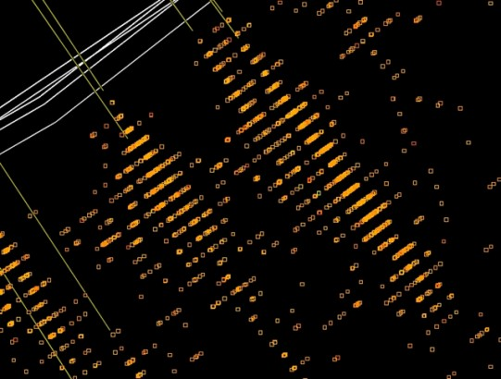
ILC Detectors – Challenges w.r.t. LHC
Calorimeter granularity
  factor of ~200 better than LHC
Pixel size
  factor ~20 smaller than LHC
Material Budget
  as low material budget as possible, lots of photons from beamstrahlung
    factor ~10 less than LHC (barrel)
    factor ~100 less than LHC (forward tracking)
Requirements for timing, data rate and radiation
  very modest compared to LHC
    “no” radiation issues
    “no” trigger, keep all data of a single bunch train, decide later…
    no pile-up, no overlaying physics events in a single bunch crossing

Slide 27
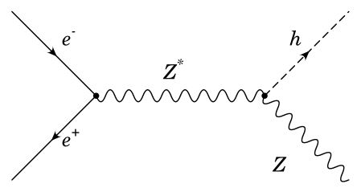
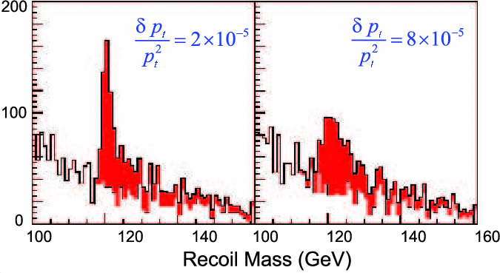
Momentum Resolutions
requires high B + many
high resolution points
Higgs mass
reconstruction
30x LEP
7.5x LEP
e⁺,µ⁺
Higgs-Strahlung
e⁻,µ⁻

Slide 28
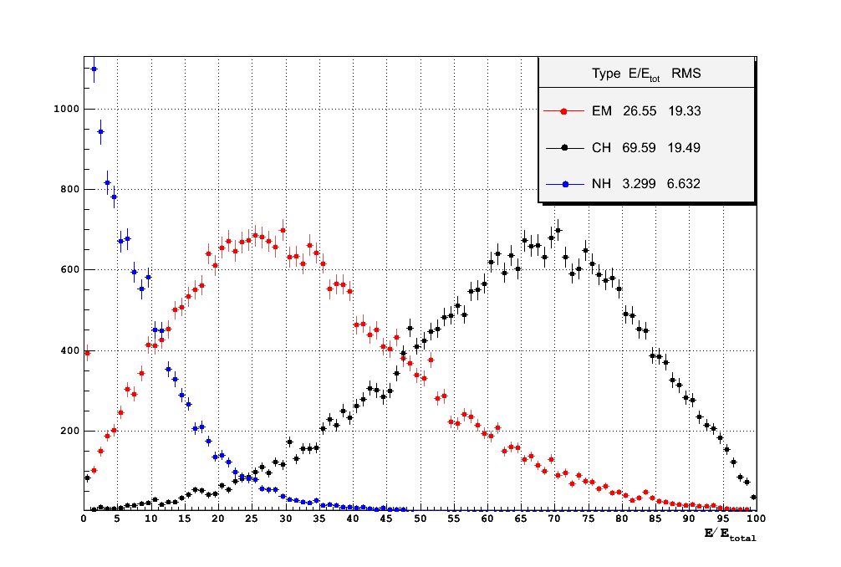
Particle Flow (Algorithm) - PFA
Most precise event reconstruction
  Individual particles are reconstructed: charged and neutrals
Fundamental problem: fluctuations in the calorimeter
  use tracker as much as possible for charged particles
    replace information in calorimeter by tracker information
  use calorimeter for neutral particles (photons, neutral hadrons)
Pushes requirements for calorimeter
  excellent segmentation
      energy resolution is of lesser importance
Goal
  jet energy resolution 3-4% (below 100 GeV)
EM particles
neutral hadrons
charged hadrons

Slide 29
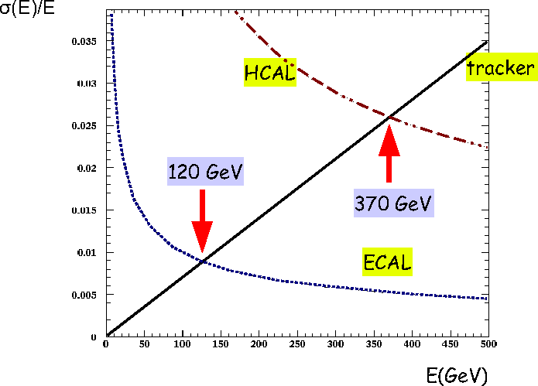
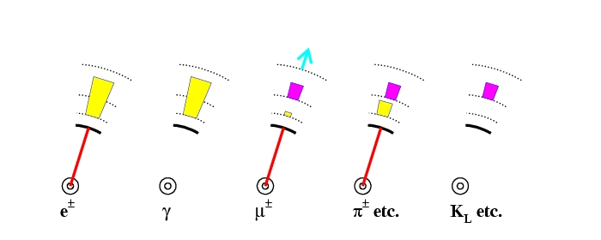
Particle Flow
Many physics signatures have complicated multi-jet final states 6 – 8 jets
  good jet energy resolution required (2x better than at LEP)
    LEP: σ(E_{jet}) ≈ 60%/√E_{jet} ILC: σ(E_{jet}) ≈ 30%/√E_{jet}
  use combined information of tracker, ECAL + HCAL to obtain better jet energy resolution
“Particle Flow” concept (simple but challenging)
keep these
as small as possible
Tracker ECAL HCAL
65% 25% 10%
contributions to E_{jet}

Slide 30
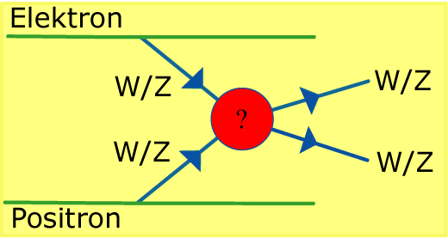
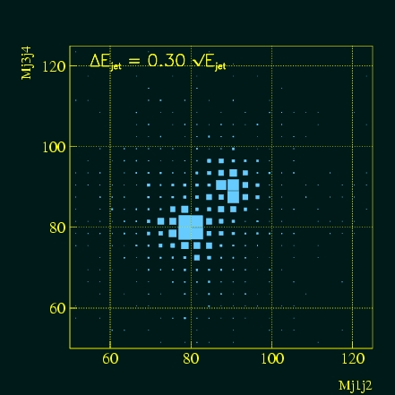
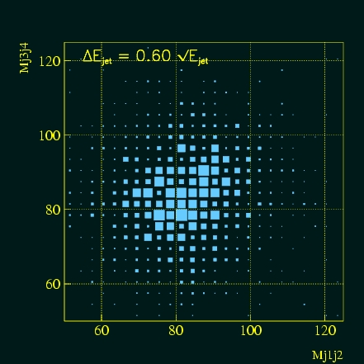
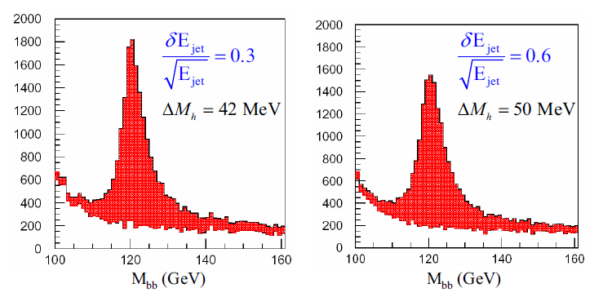
Jet Energy Resolution
Need enough resolution to separate Z and W decaying into jets: e+e- → νν + WW/ZZ → jets
Improvement of σ_{E}/E from 60%/√E to 30%/√E
  equivalent to ~40% luminosity gain in σ(M_{h})
    similar luminosity gain in ΔBR(H → WW*), Δghhh
ΔE_{jet} = 30% / √E_{jet}
ΔE_{jet} = 60% / √E_{jet}
ZZ
WW

Slide 31

ILC Detector Concepts History
SiD is first proposed at ALCPG
LOI phase
TDR/ DBD phase
1998
2001
2003
2004
2006
2007
2009
2009
2013
TESLA and GLD detectors publish first documents
TESLA TDR
Detector concept reports: LDC, GLD,
SiD, 4th
LOI
delivered
DBD/ TDR
delivered
SiD, ILD
validated
WWS starts
concept studies
LDC and GLD merge into ILD

Slide 32
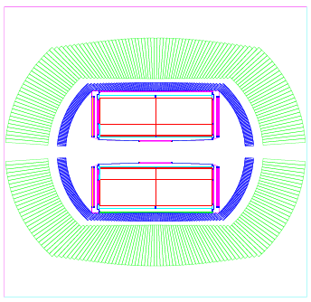
ILC Detector Concept Studies
started in 1990ies, up to 4 different concepts in 2006 (CDRs) (3 old concepts under new names + 1 new concept)
~180 institutes + ~500 authors world-wide (~30% Europe)
4th
SiD
LDC
GLD

Slide 33
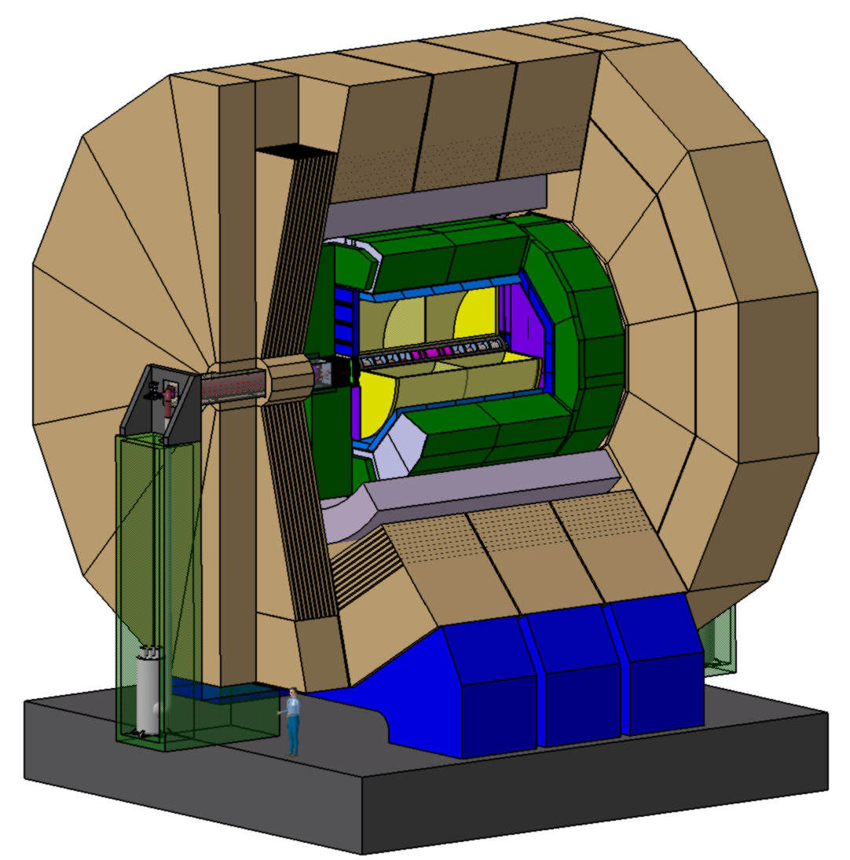

ILC Detector Concept Studies
2 concepts left after LoI validation process finished in 2009
  SiD and ILD
4th
SiD
LDC
GLD

Slide 34
ILD and SiD Detector Philosphies
ILD SiD
Particle flow is the fundamental paradigm for both ILD and SiD
Precision vertexing very close to the IP
Tracking with high redundancy many space points for excellent pattern recognition and background tolerance
Tracking with a focus on few high precision points for robust, stable and easy to calibrate tracking, precision compensates for problems in
pattern recognition.
Highly granular calorimeter, similar pixel sizes, similar level of topological reconstruction
High B-field opens charged shower component and is more cost efficient, some loss of performance in particular at higher energies
Large size improves the separation between charged and neutral particles in the shower

Slide 35
ILD and SiD Main Parameters
 | SiD | ILD
R(in) Vertex | 14 mm | 16 mm
R(out) tracker | 1221 mm | 1808 mm
N(tracker hits) | <12> | <228>
X(0) until ECAL | 12% (barrel), 20% (EC) | 12% (barrel), 42% (EC)
R(out) HCAL | 2493 mm | 3973 mm
Λ (until end of HCAL | 4.5 | 7 (min), 8.5 (max)
Coil inner radius | 2591 mm | 3440 mm
B(coil) | 5 T | 3.5 T
Outer Radius | 6042 mm | 7755 mm
Total length | 5673 mm | 6620 mm
  SiD
    more compact (full silicon tracker), shorter, higher B-field
  ILD
    larger (TPC), thicker, lower B-field

Slide 36
ILC Detector Concepts - Status
Both ILD and SiD:
  mature designs, internationally reviewed
Intense R&D on sub-systems technologies
  R&D collaborations like CALICE or LCTPC, LCFI, etc.
  Major test beam and prototyping campaigns, in Europe supported through programs like EUDET and AIDA
Developments of integrated systems
  First level engineering (looking for show stoppers)
  “Reality checks” have been applied
Costing
  Cost models have been developed
  Some cost optimization has taken place

Slide 37

CLIC Detector Concept
… adapted from ILC detector concepts …
return yoke with
Instrumentation
for muon ID
complex forward region with final beam focusing
e⁻
strong solenoid
4 T - 5 T
fine grained (PFA) calorimetry, 1 + 7.5 Λ_{i},
e⁺
6.5 m
main silicon-based tracker (large pixels and strips)
ultra low-mass
vertex detector
with ~25 μm pixels

Slide 38
CLIC Detector Study
CLIC detector study has started in 2008 at CERN
  starting point: existing SiD and ILD concepts and simulations
  had to modify/adjust concepts to CLIC needs
CLIC detector = “90% ILC detector” + “10% CLIC specifics”
  CLIC has profited a lot from ILC detector R&D and design studies
  but ILC also profits from CLIC studies
    CLIC detector = “extreme” ILC detector → win – win situation for both communities
    common work on Particle Flow Algorithms
    engineering studies (push – pull), also foreseen at CLIC
CDR prepared in 2012
  detector and physics studies
    “SiD-like concept” @ CLIC @ 3 TeV = CLIC_SiD
    “ILD-like concept” @ CLIC @ 3 TeV = CLIC_ILD

Slide 39
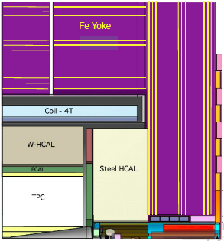
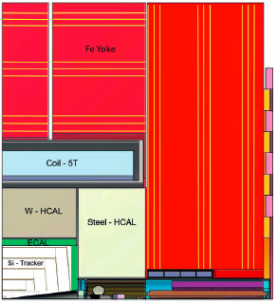
CLIC_ILD and CLIC_SiD
Two general-purpose CLIC detector concepts
Based on initial ILC concepts (ILD and SiD)
Optimised and adapted to CLIC conditions
CLIC_ILD
CLIC_SiD
7 m

Slide 40
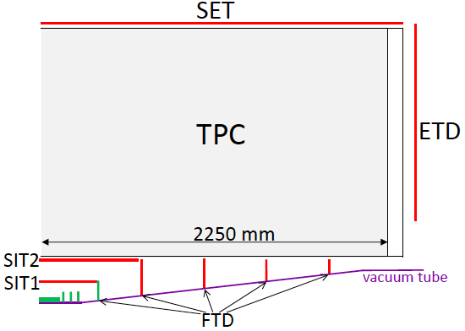
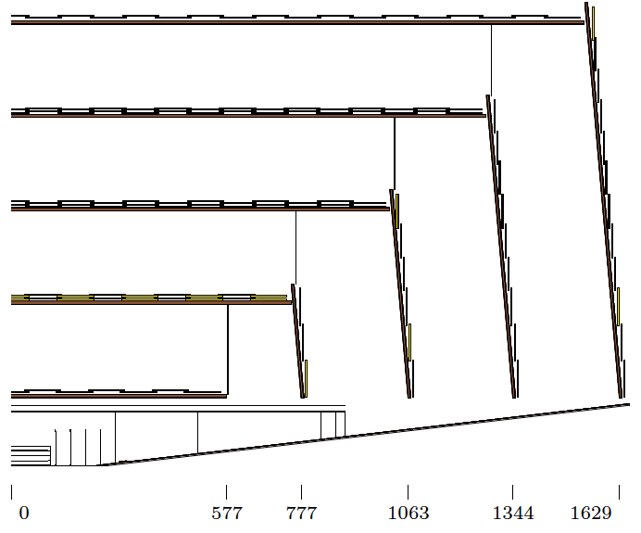
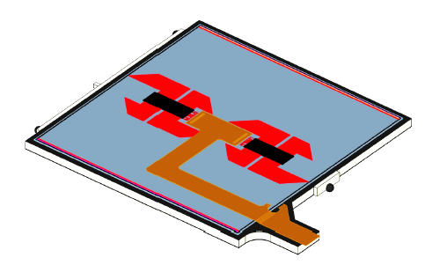
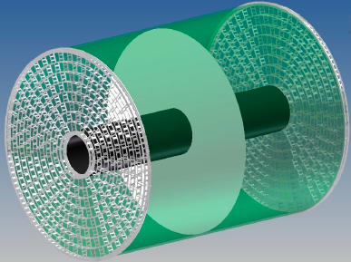
CLIC_ILD  and CLIC_SiD  tracker
TPC + silicon tracker in 4 Tesla field
All-silicon tracker in 5 Tesla field
1.3 m
Time Projection Chamber
(TPC) with MPGD readout
chip on sensor
Silicon-based tracking studies for new CLIC detector model starting

Slide 41
CLIC Bunch Spacing
CLIC study started at CERN about ~20 years ago
    major revision of CLIC parameters made in summer 2007
Basic changes
  30 GHz -> 12 GHz RF frequency
    close to old NLC frequency (11.424 GHz)
      easier to adapt NLC work and experience
    lower frequency allows more relaxed alignment tolerances
  150 MV/m -> 100 MV/m
    reduces breakdown rate and surface damages in RF accelerating structures
    50 km long LINAC allows 2 x 1.5 TeV = 3 TeV CM energy (was 5 TeV)
  0.5 ns bunch spacing, 312 bunches (= 156 ns bunch trains), 50 Hz (3 TeV)
    optimized for maximum luminosity
    was subject of various changes in the past: 0.667 ns -> 0.267 ns -> 0.667 ns -> 0.5 ns
Conceptional design report in 2012
detector challenge

Slide 42
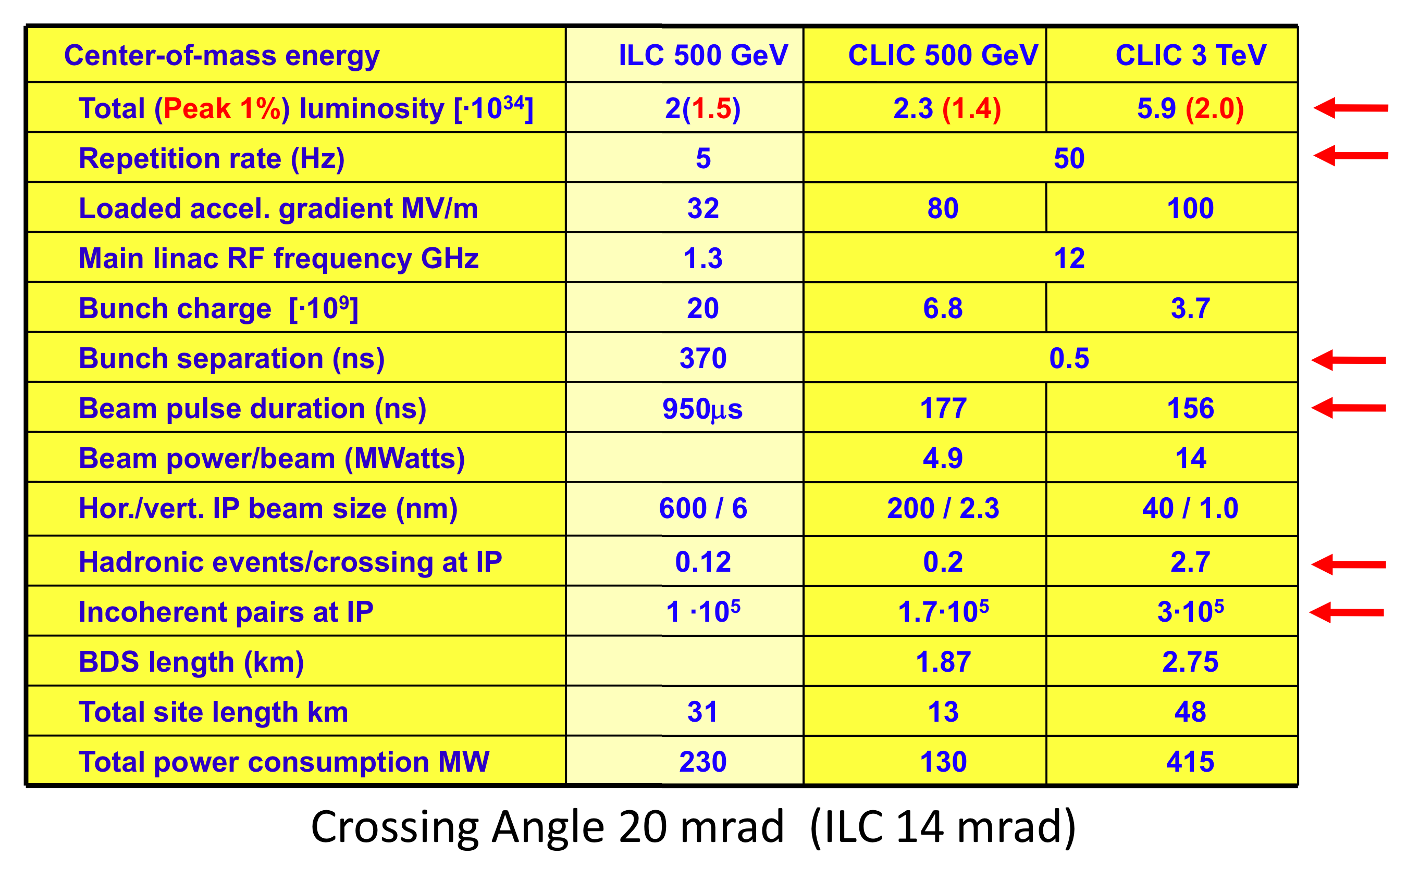
ILC + CLIC Parameters
Luminosity at
500 GeV similar to ILC

Slide 43
Main CLIC – ILC differences
Higher energy → more dense particle jets (independent on machine concept)
  need tracker with better double track resolution
    TPC with good double hit resolution (GEMs, MicroMegas) reconsidered again as CLIC main tracker as alternative to full Si tracker but too much occupancy for a TPC@CLIC
  need calorimeters with larger thickness and higher granularity
    Particle Flow concept requires to identify individual calorimeter EM and hadronic clusters
    alternatively: forget particle flow, build calorimeter with (hardware) compensation = DREAM concept
Much shorter bunch spacing: 0.5 ns (CLIC) vs 337 ns (ILC)
  need “time-stamping”: identification of tracks from individual bunch crossings
    if no time-stamping → overlay of physics events with hadronic background from beamstrahlung
  general time structure also has consequences for pulsed electronics
Smaller beam sizes + higher E → more (severe) background
  need to move innermost layers further out

Slide 44
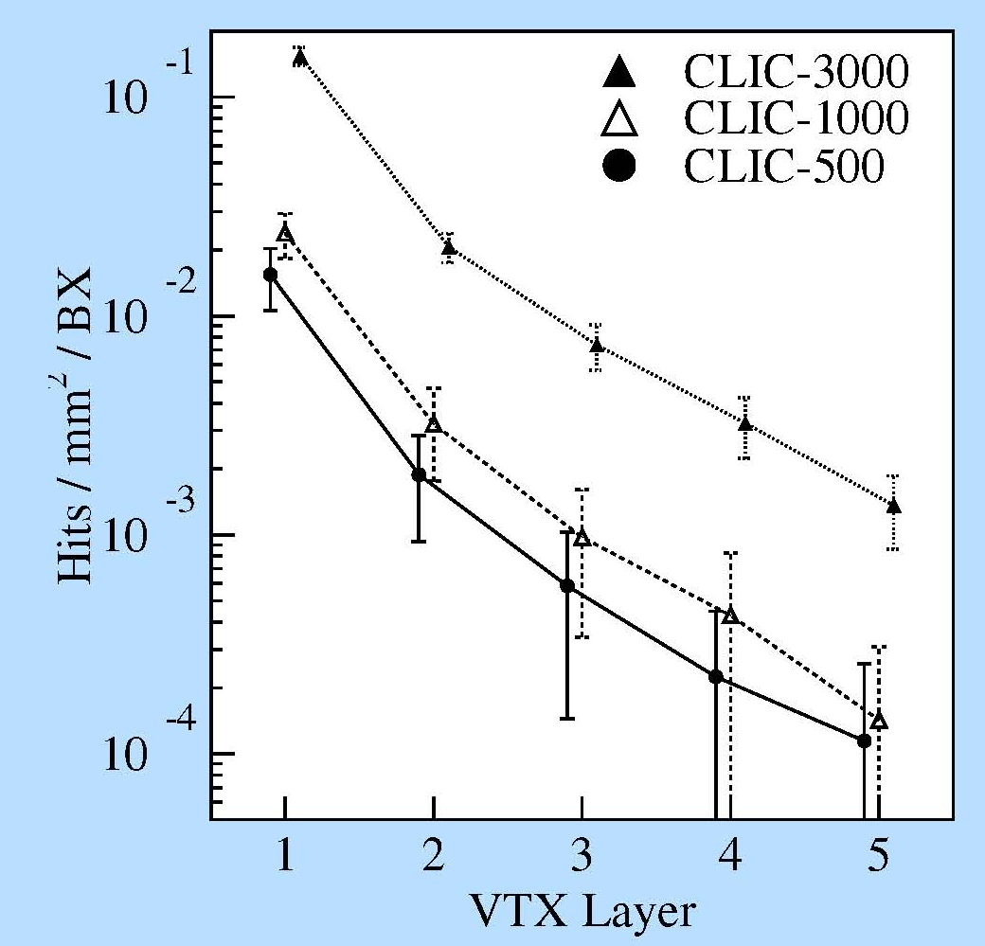
Extrapolation ILC → CLIC
Full LDC detector simulation at 3 TeV
  simulation of e⁺e⁻ pairs from beamstrahlung
Conditions
  ILC: 100 BX used (1/20 bunch train)
  CLIC: 312 BX used (full bunch train)
Conclusions (compared to ILC)
  CLIC VTX
    O(10) times more background
  CLIC TPC
    O(30) times more background

Slide 45


CLIC Time Structure
0.5 ns
...312...
...312...
156 ns
Bunch Spacing
  ILC: 337 ns, enough time to identify events from individual BX
  CLIC: 0.5 ns, extremely difficult to identify events from individual BX
    need short shaping time of pulses
    power cycling with 50 Hz instead 5 Hz at ILC
    larger power dissipation? does silicon tracker need to be cooled? (not cooled in SiD)

Slide 46


Why Time Stamping?
Overlay of physics events with background events from several bunch crossings
  degradation of physics performance
Main background sources from beamstrahlung
  e⁺e⁻ pairs from beamstrahlung photons
    low p_{T}, can be kept inside beam pipe with high magnetic field, B > 3 T
  hadrons from 2-photon collisions (beamstrahlung photons)
    can have high p_{T}, reach main tracker and confuses jet reconstruction
    typically ~O(1) hadronic background event per BX with p_{T} > 5 GeV tracks
Higgs mass
reconstruction
from
HZ → bbqq
reconstruction
of H → τ⁺τ⁻

Slide 47


CLIC Combined p_{T} and Timing Cuts
1.2 TeV
100 GeV
1.2 TeV background in reconstruction time window
100 GeV background after tight cuts

Slide 48
Summary
LHC detector concepts rather complementary
    main challenges: radiation damage, high occupancy (40 MHz BX rate)
  ATLAS: focus on large muon spectrometer, sampling LAr calorimeter
  CMS: large silicon tracker, homogeneous calorimeter
ILC detector concepts
  both concepts based on particle flow reconstruction
    “imaging” sampling calorimeters
  ILD: TPC as main (gaseous) tracker
  SiD: all silicon tracker
CLIC
  similar to ILC concepts: CLIC_ILD, CLIC_SiD
    time stamping required to reduce hadronic background

