Slide 1
Warm vacuum in XTD2 (WP19)
presented by S. Lederer
Notes:
How to edit the title slide
Upper area: Title of your talk, max. 2 rows of the defined size (55 pt)
Lower area (subtitle): Conference/meeting/workshop, location, date, your name and affiliation, max. 4 rows of the defined size (32 pt)
Change the partner logos or add others in the last row.

Slide 2
Outline
Overview
Transfer lines T2+T4
Photon line T9 (until V0)
SASE1
Notes:
Before you start editing the slides of your talk change to the Master Slide view: Menu button “View”, Master, Slide Master:
Edit the following 2 items in the 1st slide: 1) 1st row in the violet header: Delete the existent text and write the title of your talk into this text field 2) The 2 rows in the footer area: Delete the text and write the information regarding your talk (same as on the Title Slide) into this text field.
If you want to use more partner logos position them left beside the DESY logo in the footer area Close Master View

Slide 3
Transfer lines
Two transfer lines in XTD2: T2 (partially) and T4
Design and fabrication of vacuum system by BINP
Standard beam pipes
Outlet chamber
Bellows
Supports
Valves, pumps and control units by DESY

Slide 4
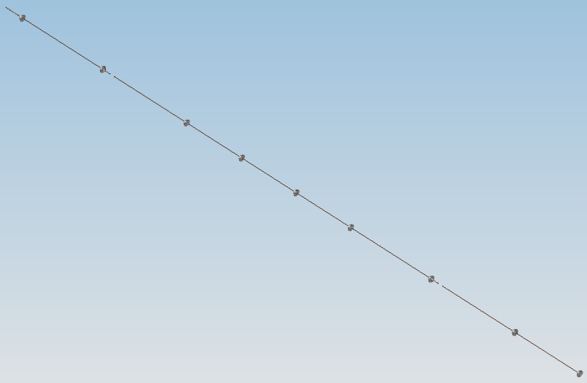
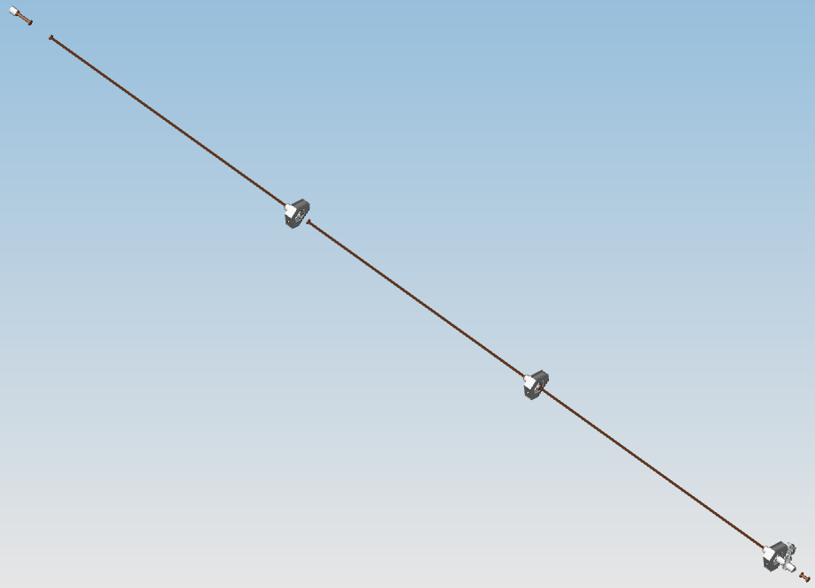
Transfer lines: T2
Design in accordance to pressure profile calculations and Lattice done
Models of the vacuum system (and here really only the WP19 part) handed over to CAD integration
Within the next days new models with supports will arrive and then given handed over to CAD integration
T2 R1
T2 R2

Slide 5
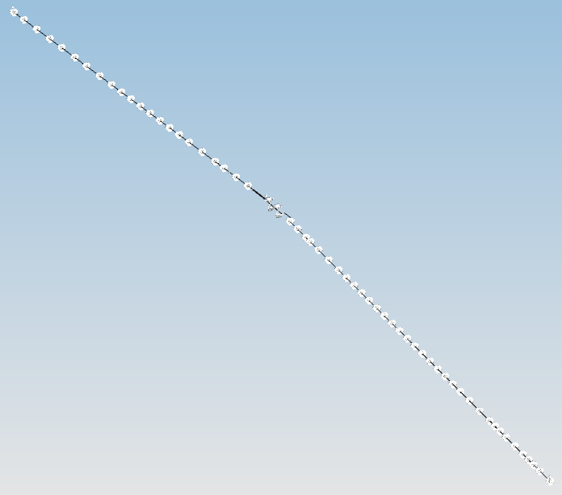
Transfer lines: T4
Design in accordance to pressure profile calculations and Lattice done
Models of the vacuum system (and here really only the WP19 part) handed over to CAD integration
Within the next days new models with supports will arrive and then given handed over to CAD integration

Slide 6
Transfer lines: standard beam pipes
Prototypes of long chambers delivered to DESY Monday last week now under vacuum inspection
Leak check
Residual gas analysis
Beam dynamics requirements in terms of
Roughness
Oxide layer
Relative magnetic permeability
All material available at BINP for production
Production of beam pipes can start after beam line review and/or PRR of XTD2

Slide 7
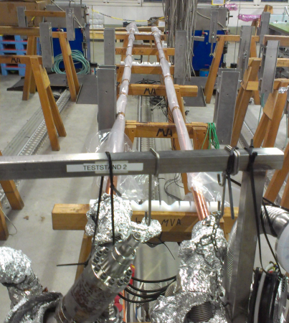
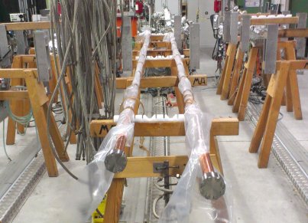
Transfer lines: standard beam pipes
Long prototypes under vacuum test

Slide 8
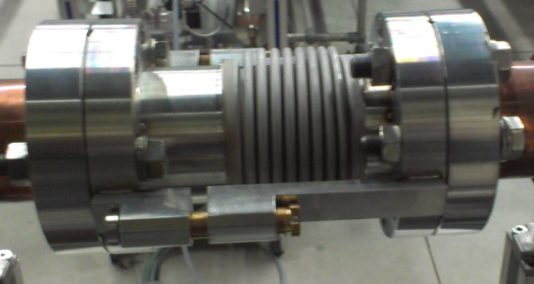
Transfer lines: standard bellow units
Design ready
EDMS procedure of PRR should start within the next days

Slide 9
Transfer lines: supports
Need to be integrated into 3D model
Open is concept for XDT2-R13-R16
Specification from beam dynamics require
Each ~2.5 m an aligned support for the copper pipes to avoid too strong bending
Non-magnetic materials (μ_{r} < 1.05) up to a distance of 200 mm around the beam path
Prototypes available at DESY and test installation is planed within the next days.

Slide 10
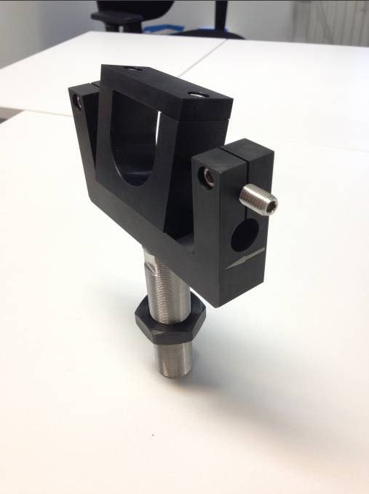
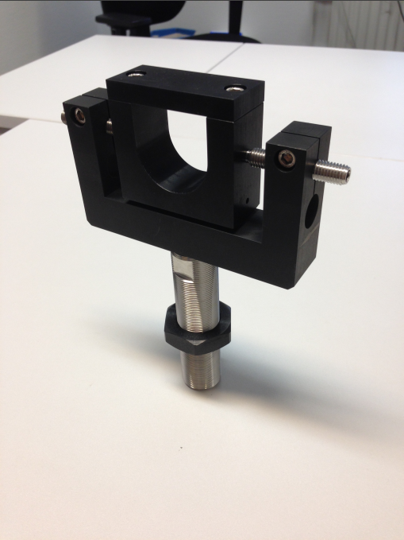
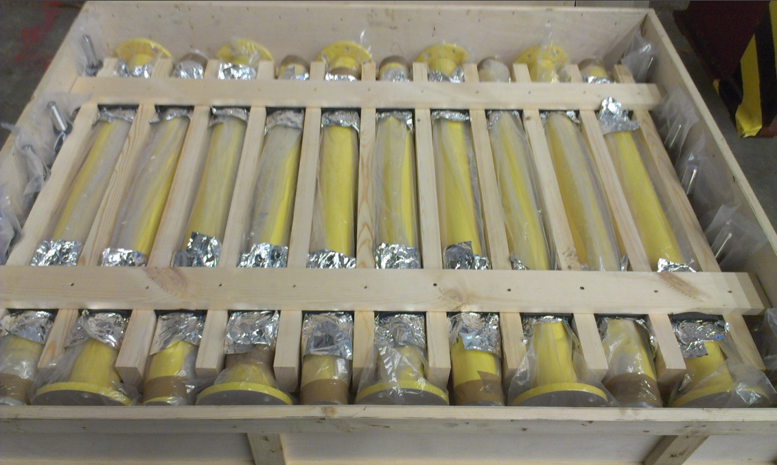
Transfer lines: supports

Slide 11
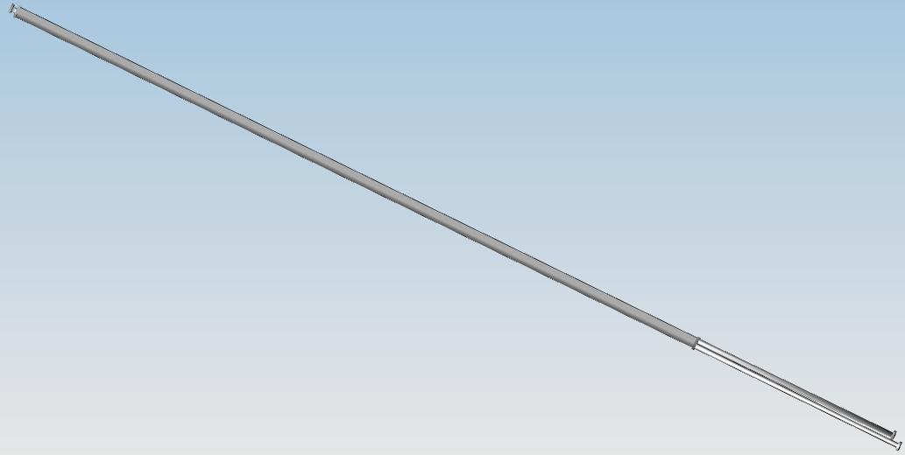
Transfer lines: outlet chamber
Concept end general design ready
Current model needs to be adapted
In accordance to Lattice 8.3.5
A pumping port will be added

Slide 12
Transfer lines: valves, pumps and gauges
Valves:
All required gate valves in house
Control unit (PLC) in production
Pumps
All standard pumps in house
In-Line pumps serial production will start beginning of next year
All needed power supplies in house
HV-cables in house
Control units (PLC’s) in production
Pump carts for installation available
Pressure gauges
Standard type in house
Special type for additional system safety to be produced

Slide 13
Transfer lines: Schedule
The detailed delivery plan from BINP is not fixed up to now, which means:
In general all components should be delivered until end of 2014
Which section when depends on
Progress in beam line reviews
Demands from global installation schedule

Slide 14
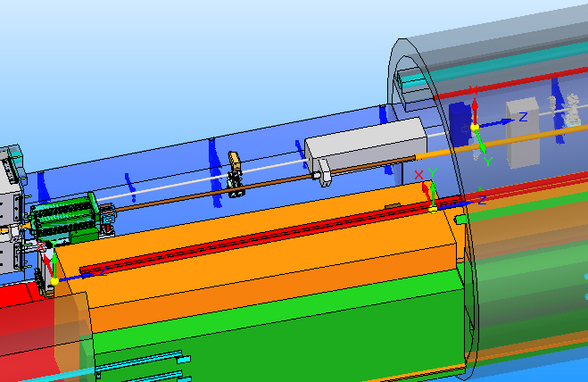
Photon line T9
V0 as hand-over point to WP73
Absorber to protect V0 to allow for operation with a few bunches – design will start soon
Imager from WP74
Imager
V0

Slide 15
SASE1
Undulator vacuum chambers design and production by DESY
Undulator vacuum chambers supports design by DESY and production by BINP
Intersections design and production by BINP
Pumps, manual valves and gauges by DESY

Slide 16
SASE1: Undulator vacuum chambers
Integration into CAD-model via WP71
Production started
Extrusion
Flanges
AFM polishing - started
Milling - will start January 2014
Welding of flanges to chamber
Surface preparation

Slide 17
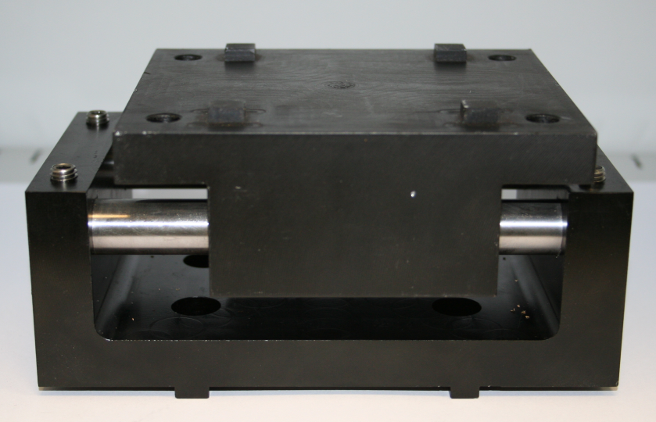
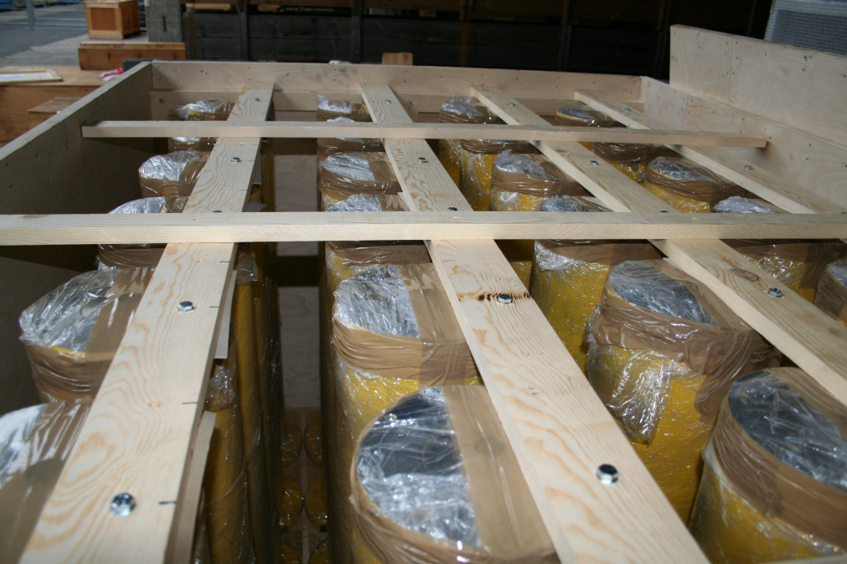
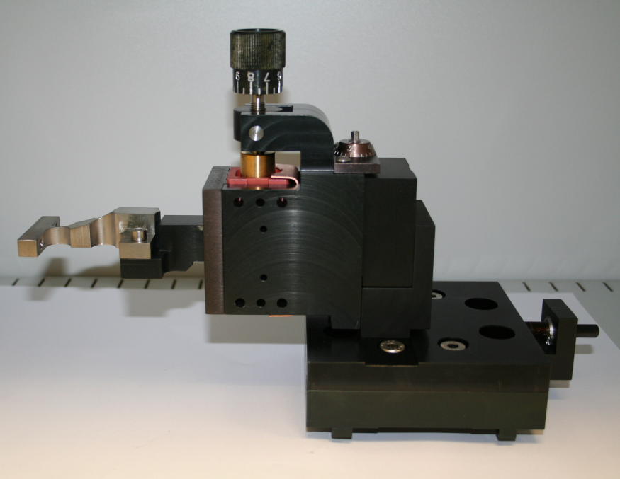
SASE1: Undulator vacuum chamber supports
Integration into CAD-model via WP71
Prototypes arrived at DESY last Monday

Slide 18
SASE1: Intersections
All pumps are in house
Pressure gauges
Standard type in house
Special type for additional system safety to be produced
Manual gate valves to be ordered
CAD-integration via WP71
Here some small discussion is needed:
Up to now all intersections were the same (including valves)
We have to change this in order to have only valves in the model, were they really will be and include pressure gauges.

Slide 19
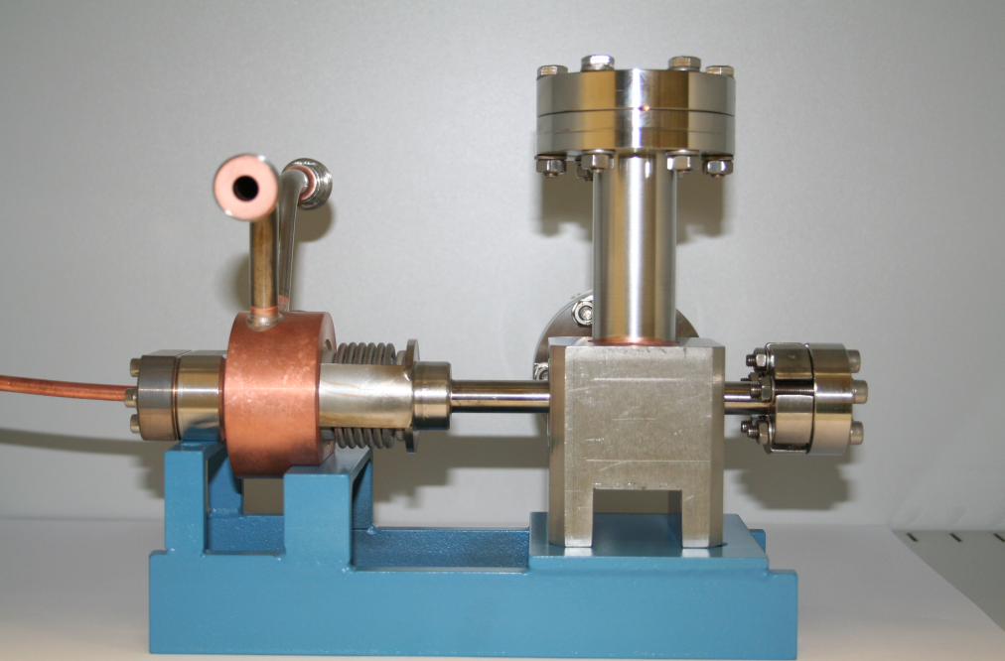
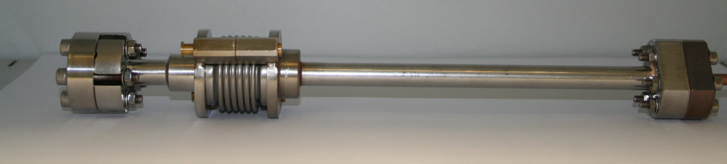
SASE1: Intersections
Next prototype arrived at DESY last Monday, checking procedure started.
Pump cross + absorber
Quadrupole chamber

Slide 20
SASE1: schedule
Undulator vacuum chambers
Current scheduled RFI September 2014
Undulator vacuum chamber supports
Current scheduled delivery start Q2/2014
Current scheduled delivery end Q4/2014
Intersections
Current scheduled delivery start Q2/2014
Current scheduled delivery end Q4/2014

Slide 21
Open points
Support concept XTD2-R13-R16
Installation procedure for SASE1 in agreement with WP71 has to be fixed
Installation sequence for transfer lines to be fixed
This includes all transfer lines, not only XDT2

