Slide 1
Depleted Monolithic ACTIVE PIXELS FOR future HEP experiments
5th March 2014
7th Detector Workshop of the Helmholtz Alliance "Physics at the Terascale"
Y. Fu, M. Havranek, T. Hemperek, T. Kisisita, H. Kruger, T. Oberman

Slide 2
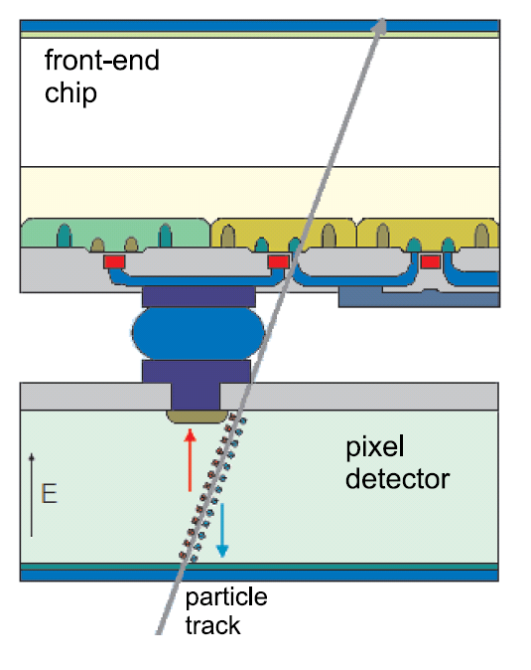
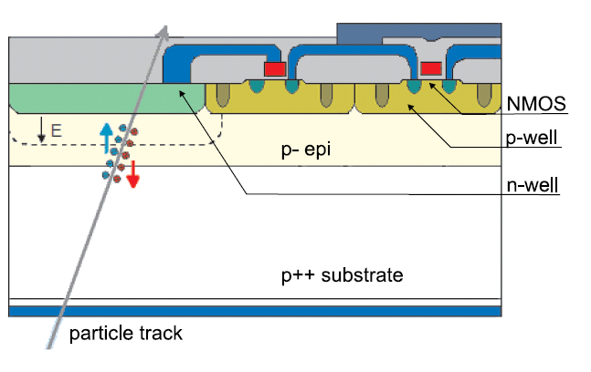
Hybrid Pixel Detectors
Monolithic Pixels
Properties
Properties
Promises
fine pitch flip-chip assembly of:
  CMOS R/O chips (CSA + DSP per pixel)
  Si (planar or 3D) or Diamond detectors
+ high density electronics
+ moderate - good SNR
- high material budget
- high cost (chip + sensor + hybridization)
+ cheap
+ low material
+ good resolution
not very radiation hard
small signal (little depletion)
usually no CMOS in active area

Slide 3
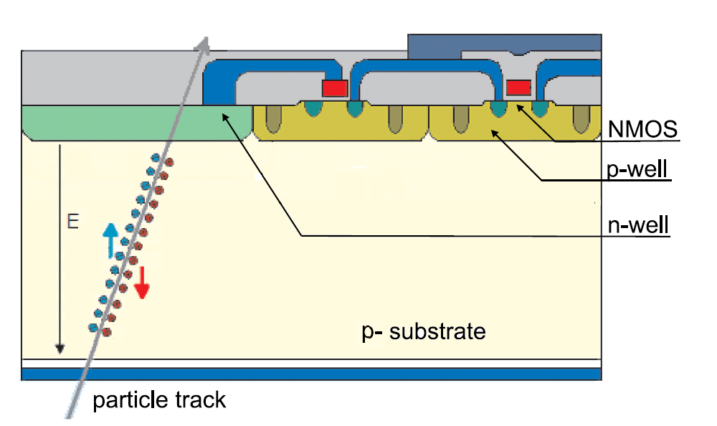
Hybrid Pixel Detectors
Depleted MAPS
Properties
for HL-LHC need
fine pitch flip-chip assembly of:
  CMOS R/O chips (CSA + DSP per pixel)
  Si (planar or 3D) or Diamond detectors
+ high density electronics
+ moderate - good SNR
- high material budget
- high cost (chip + sensor + hybridization)
large depletion depth d ~(ρV)^{1/2}
AND rad. hardness > 10¹⁴⁻¹⁵ /cm²
AND full CMOS
AND low power
AND low cost

Slide 4
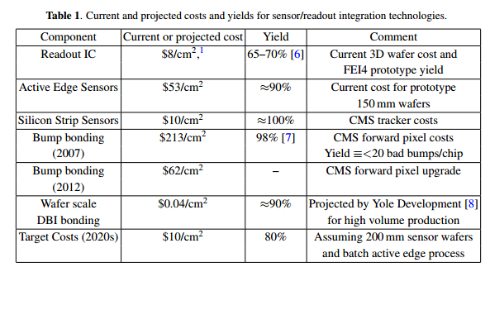
High Luminosity LHC - Cost
ATLAS
90 EUR/cm²
70* EUR/cm²
„Combining the two 3Ds” R. Lipton et al 2012 JINST 7 C12010
* - including thinning -> HL-LHC ~25 EUR/cm2
Monolithic Sensors < 10 EUR/cm²

Slide 5
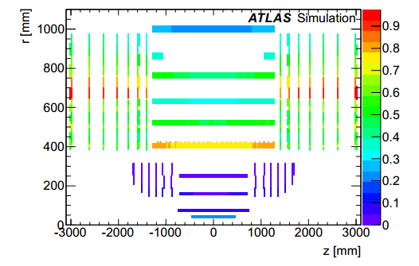
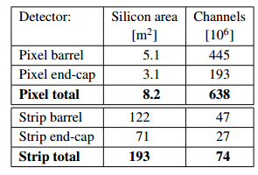
High Luminosity LHC Environment - Requirements
Occupancy [%]
outer
Inner
ATLAS Phase II Letter of Intent
Inner layer
Outer layer
Low power
Low material
Occupancy
Resolution
Low cost
Low power
Low material
Resolution
hybrid pixels (65nm)
low cost hybrid pixels or monolithic

Slide 6

Charge Collection in Depletion Layer
Depletion width d $∝\sqrt{U_{bias}∙r_{substrate} }$
  Q_{MIP} $∝d$
  C_{parallel} _{plate} $∝ \frac{1}{d}$
  High voltage on the r/o node → HV CMOS process
  High resistive substrate material → CMOS on high resistive substrate (“HR CMOS”)
  Something in-between

Slide 7
Options for n-on-p Read-out
CMOS with twin or triple wells
Charge signal
Charge signal
Electronics (NMOS only)
Electronics (NMOS only)
p-substrate
P+
Deep n-well
p-substrate
p-well
P+
n+
p-well
n+
“MAPS” like
CCPD (HVCMOS)
DMAPS-A
CMOS with additional implants
Charge signal
Charge signal
Electronics (full CMOS)
Electronics (full CMOS)
nw
p-substrate
P+
Deep n-well
p-substrate
p-well
P+
n+
p-well
n+
nw
deep p-well
Electronics outside charge collection well
Very small sensor capacitance → low power
Potentially less rad. hard (longer drift lengths)
Full CMOS with additional deep-p implant
Electronics inside charge collection well
Collection node with large fill factor → rad. hard
Large sensor capacitance (DNW/PW junction!) → x-talk, noise & speed (power) penalties
Full CMOS with isolation between NW and DNW

Slide 8
Possible scenarios for Active Sensors
Hybrid Pixels with “smart” diodes:
  HR- or HV-CMOS as a sensor (8”)
  Standard FE chip
  CCPD (HVCMOS) on FE-I4
CMOS Active Sensor + Digital R/O chip
  HR- or HV-CMOS sensor + CSA
  (+Discriminator)
  Dedicated “digital only” FE chip
Monolithic Active Pixel Sensor
  MAPS usually on epi substrate
  → diffusion signal, not suited for HL-LHC
  HR- material (charge collection by drift) ➔ Fully depleted MAPS (DMAPS)
Diode + preamp
FE chip
Diode + full analog processing
Digital only FE chip
Wafer to wafer
bonding
Diode + Amp + Digital

Slide 9
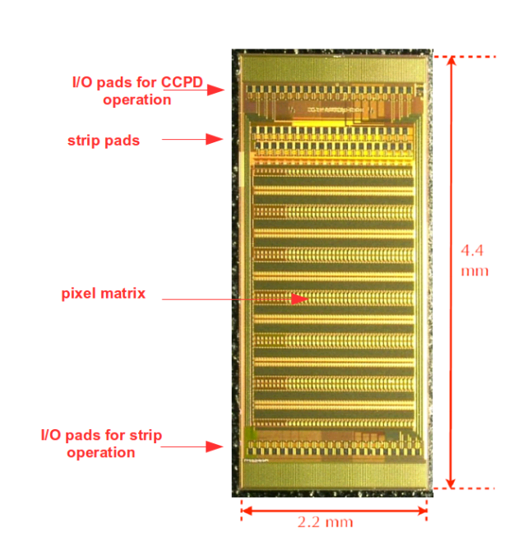
Active Pixel Sensors on HV-CMOS process
Parameters
Depletion (small)
Low leakage
Possible high resolution
Limited use of PMOS
I. Peric

Slide 10
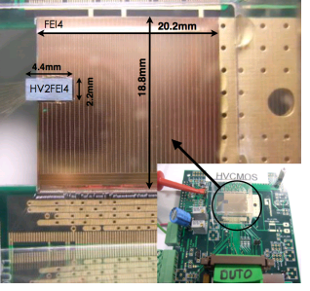
CCPD + FE-I4 (HV2FEI4)
An active sensor!

Slide 11
Monolithic technology requirements for LHC
High-resistive substrate (>1kOhm-cm)
Isolated PMOS and NMOS transistors (deep n-well/p-well)
Good breakdown performance
Thinning
Backside implantation and implant activation
Backside metallization (if needed)

Slide 12
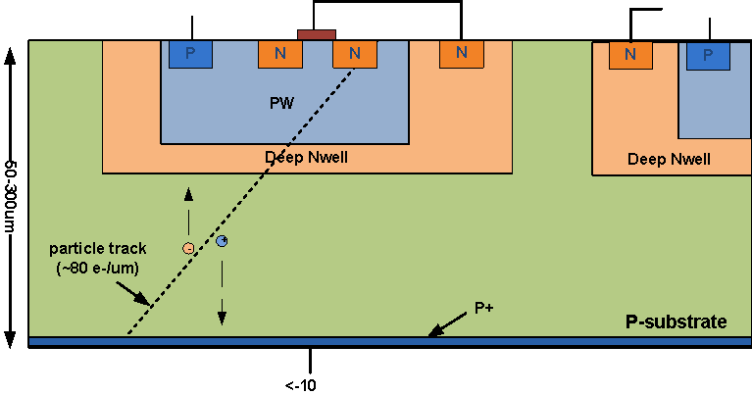
Simple device cross-section
Pros
Cons
High signal (full depletion possible)
Fast (collection by drift)
Small pixels
Only NMOS in active area
Input capacitnce dominated by deep-nwell tp pwell capacitance

Slide 13
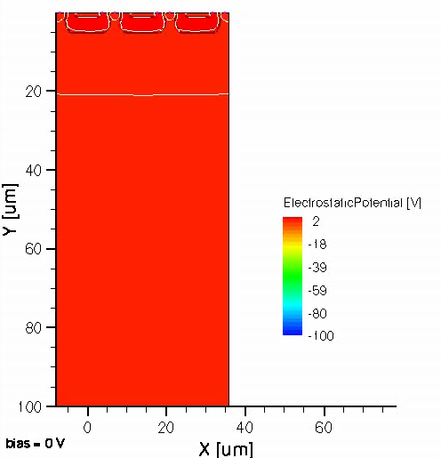
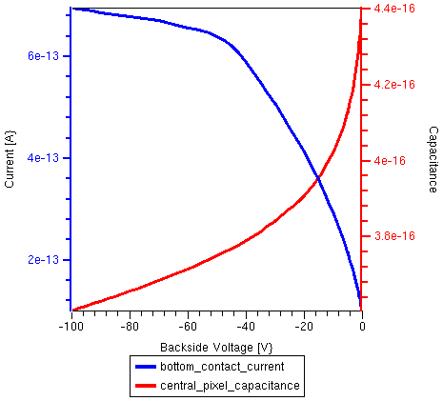
Electrostatic Potential (HV)

Slide 14
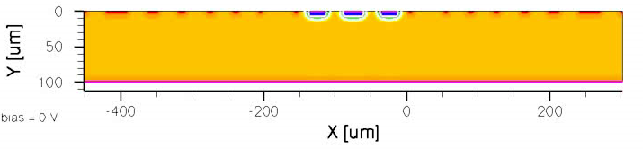

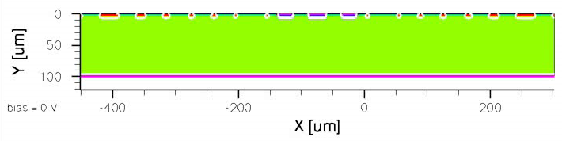
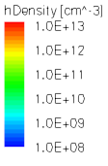
Depletion Evolution with Voltage
Hole Density @ no radiation
Hole Density @ Oxide Charge 1e+12 cm⁻² + Fluence 1e+15 N_{eq}/cm²

Slide 15
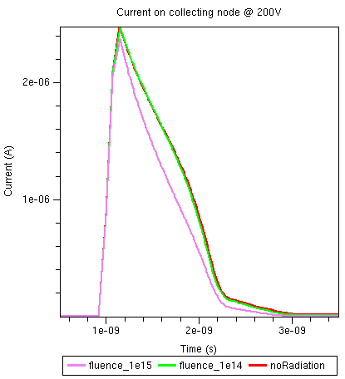
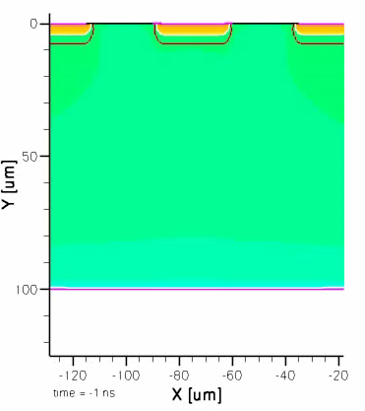
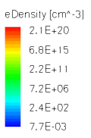
Charge Collections
Current on collecting electrode @200V
Electron Density @ 200V (no radiation)

Slide 16
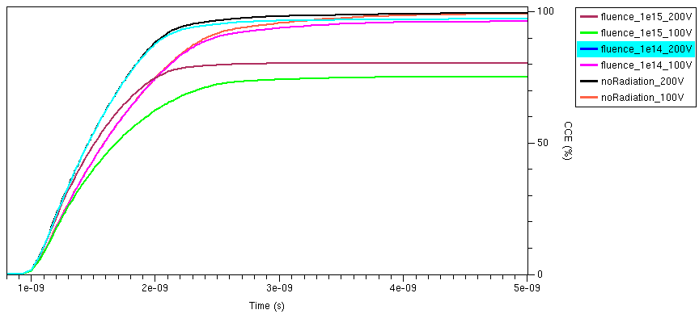
Charge Collections Efficiency
Fluence (N_{eq}/cm²) | Back Voltage [V] | CCE [%]
0 | 100/200 | 100
1e14 | 100 | 96
1e14 | 200 | 97
1e15 | 100 | 75
1e15 | 200 | 80

Slide 17
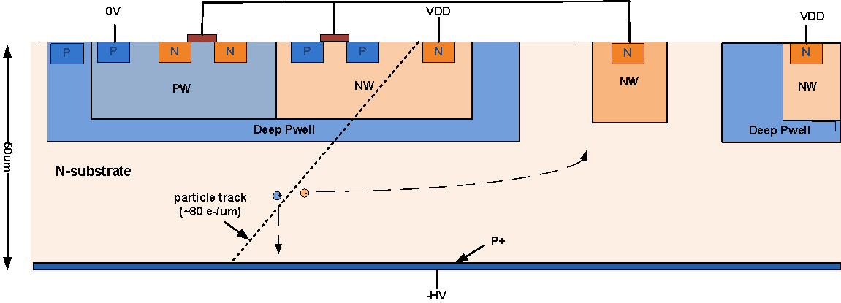
ESPROS Photonic CMOS™ Process
There is more to this in this technology ☺

Slide 18
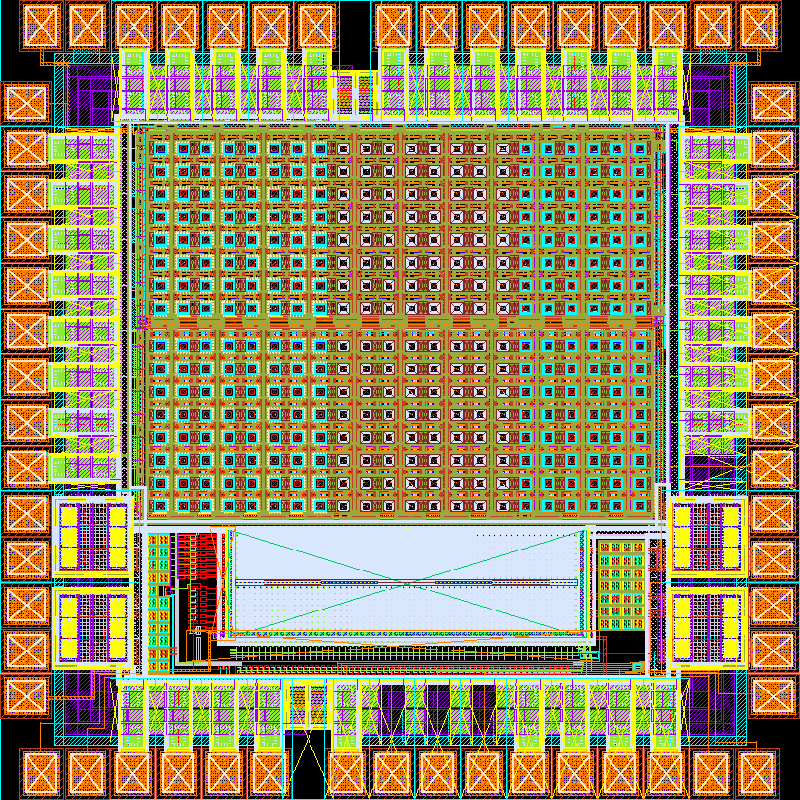
EPCB01 - overview
Design&Testing:
Y. Fu,
M. Havranek,
T. Hemperek,
T. Kisisita,
H. Kruger,
T. Oberman
DMAPS pixels
Deep N-well pixels
Chip size: 1.4×1.4 mm²
First 50um, back side processed, full CMOS, “fully depleted”
(>2kOhm-cm substrate).

Slide 19
EPCB01 - Functional Blocks
Deep N-well pixels
  3T readout
  Analog Output
DMAPS pixels
  Pixel Charge Sensitive Amplifier (CSA)
    continuous discharge
    reset
  Pixel Comparator
    asynchronous
    dynamic
  Tuning DAC
  Digital Sift Register Readout
Custom Pads
Transistors

Slide 20
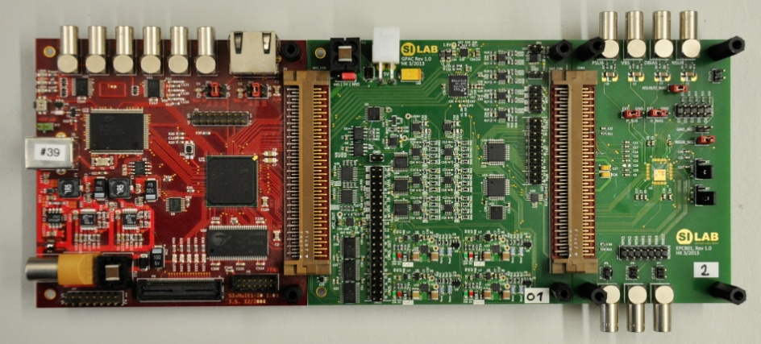
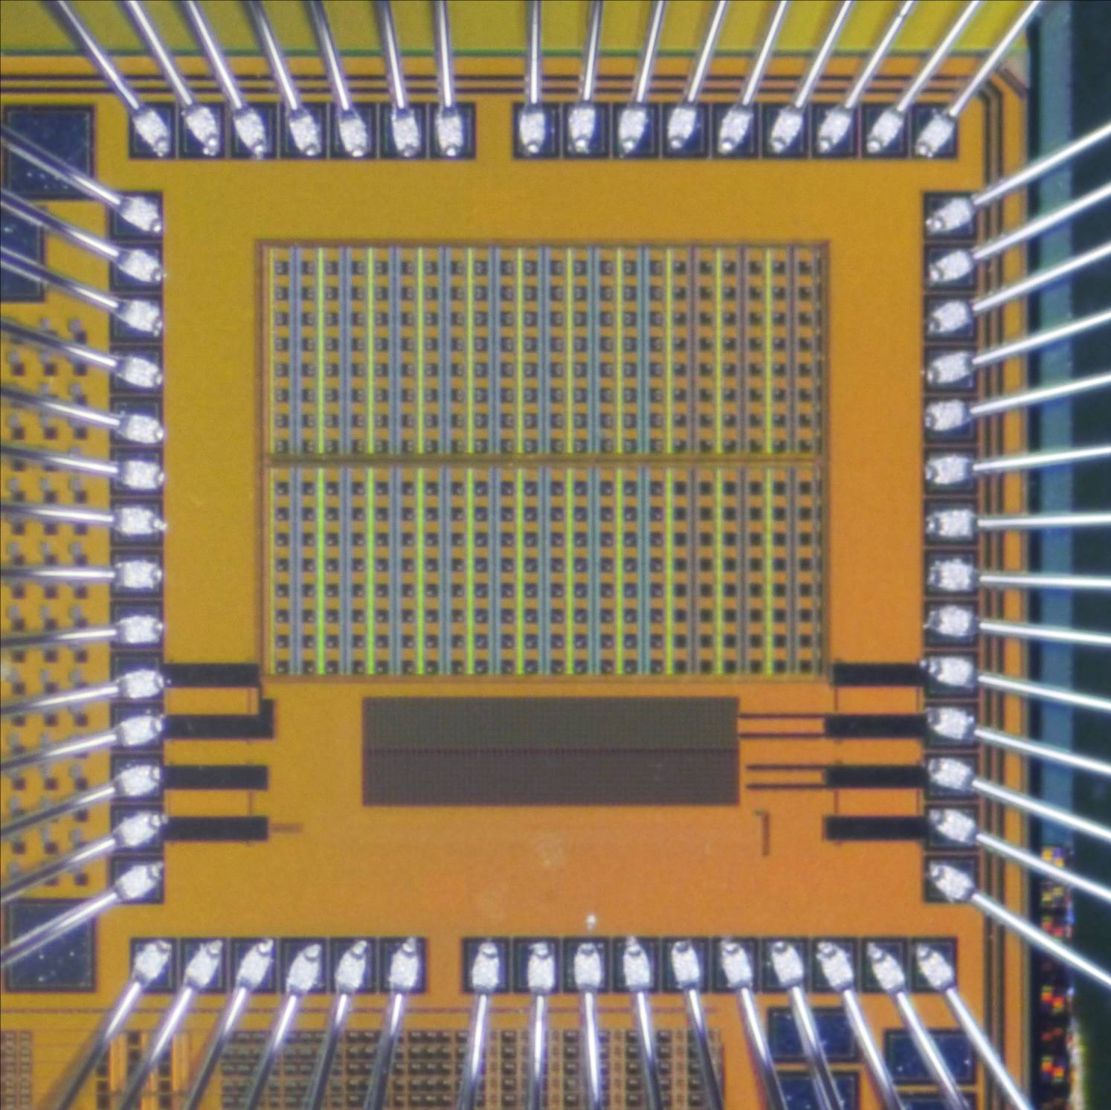
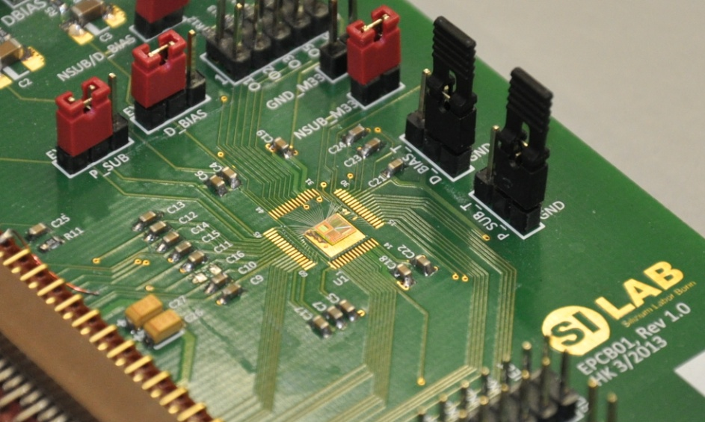
EPCB01 - Test system
FPGA Multi-IO (MIO) board
General Purpose Analog Card
- universality → can be used for other DUTs
- provides bias voltages and currents for DUT
- provides power supply for the DUT
- distributes digital signals from MIO to DUT
Board carrying DUT
MIO
GPAC
DUT
EPCB01
EPCB01

Slide 21
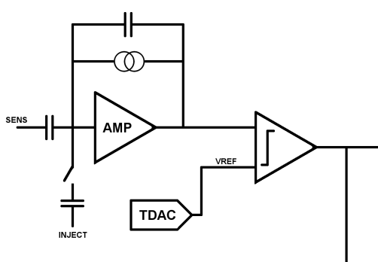
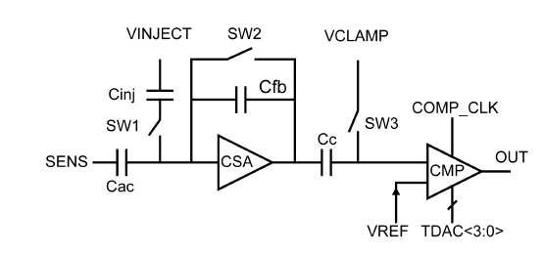
EPCB01 - Pixel Array Readout
CSA- switched reset
dynamic comparator
CSA – continuous discharge asynchronous comparator

Slide 22
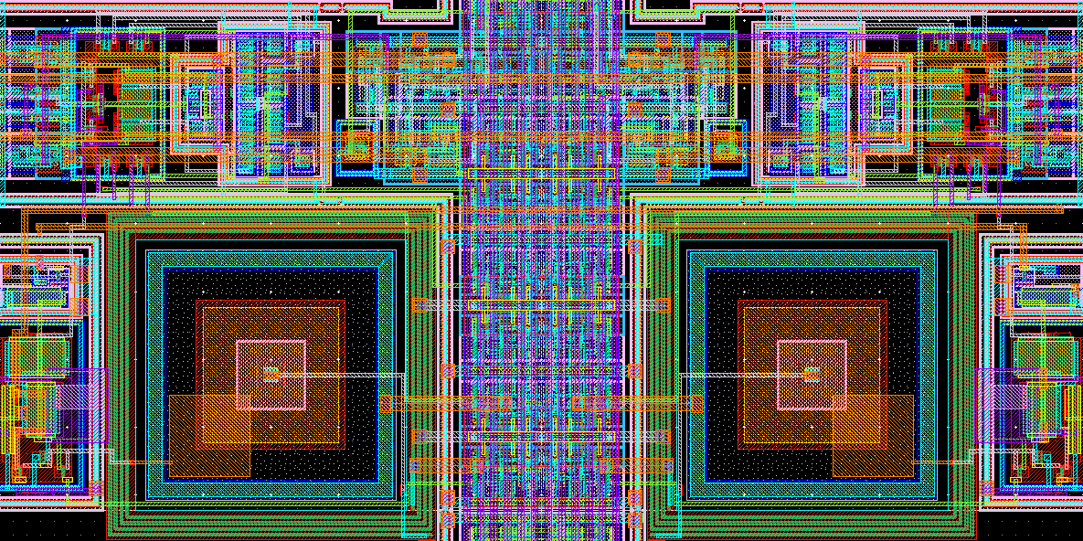
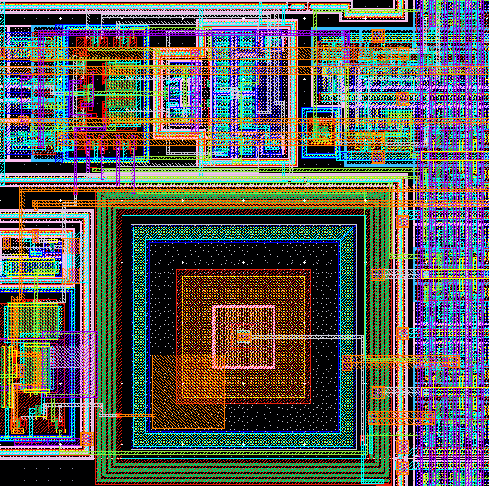
EPCB01 - Pixel Array
Pixel size: 40×40 µm²
Sensing area: 20×20 µm²
SENSOR
RESISTOR
CSA
CDS
PIXEL
Q-INJ.
COMP
TDAC
HIT OR

Slide 23
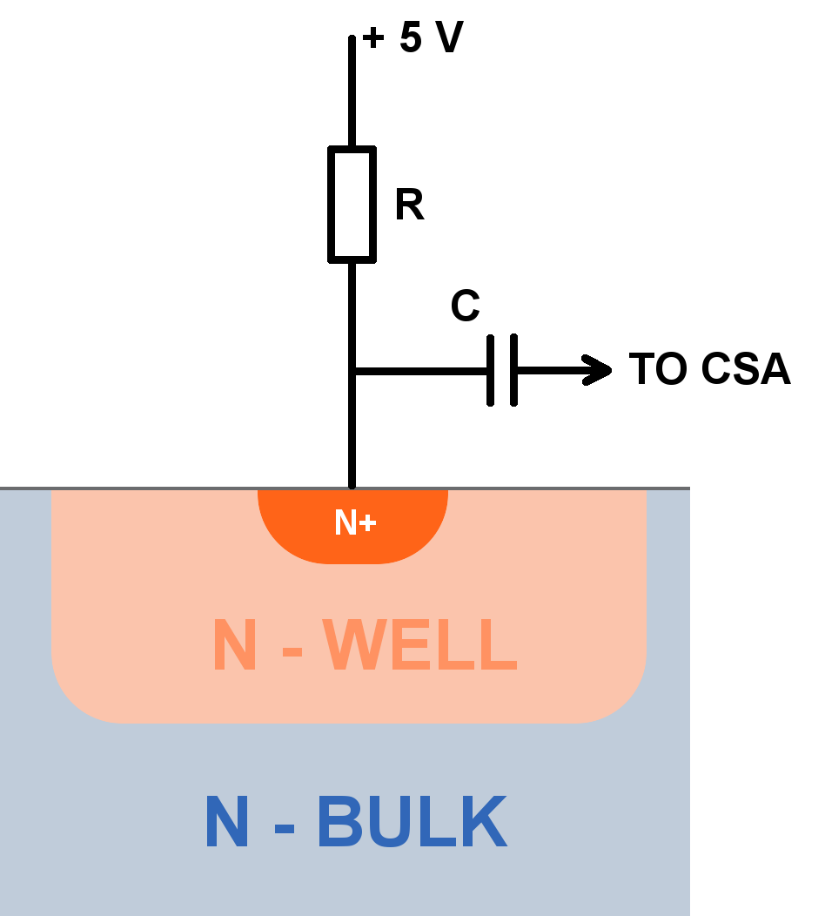
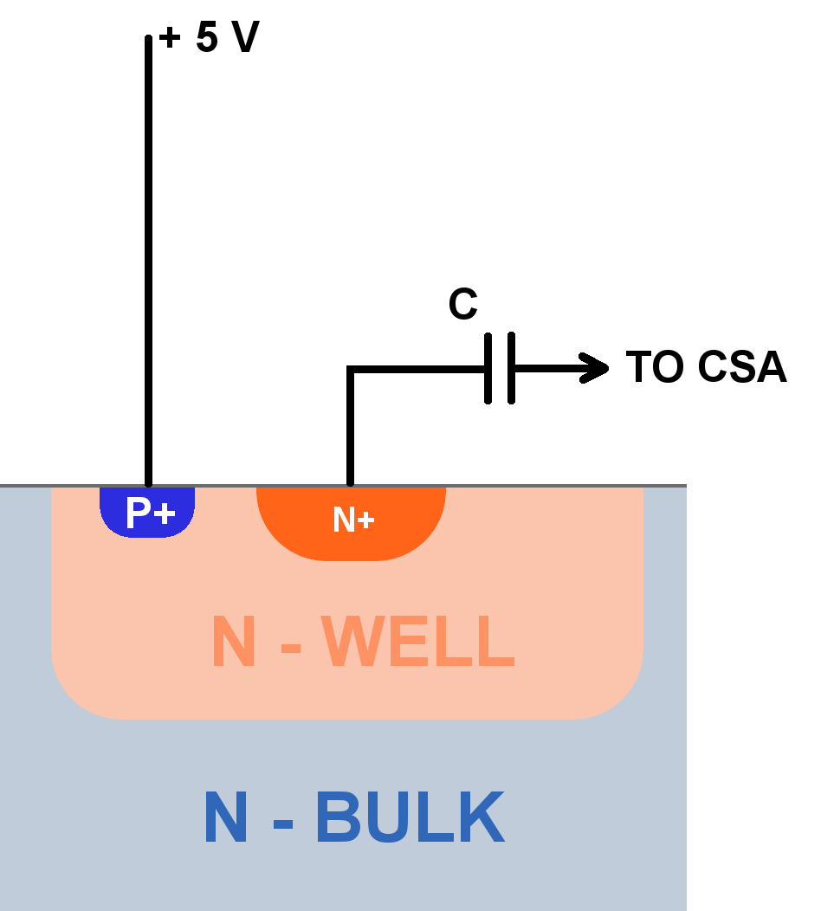
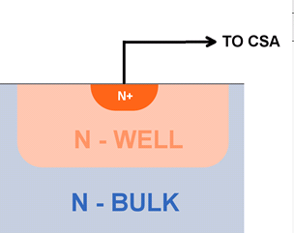
EPCB01 - Pixel Array Bias Configurations
AC coupled
resistor bias
AC coupled
self bias
DC coupled

Slide 24
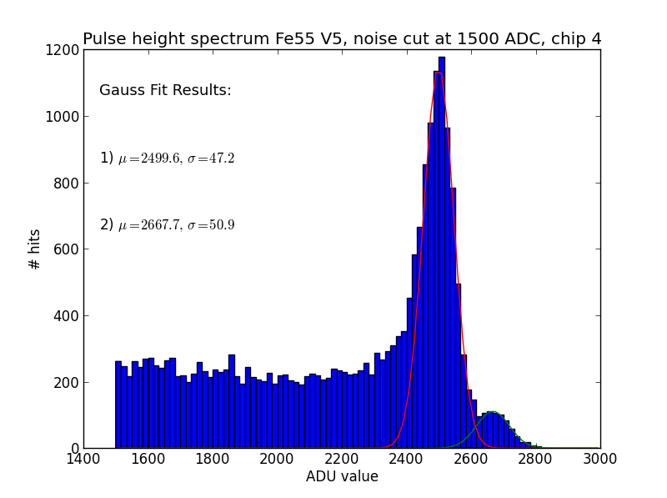
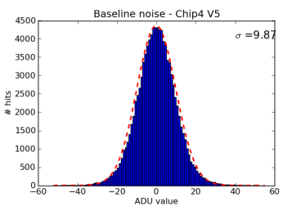
EPCB01

Slide 25
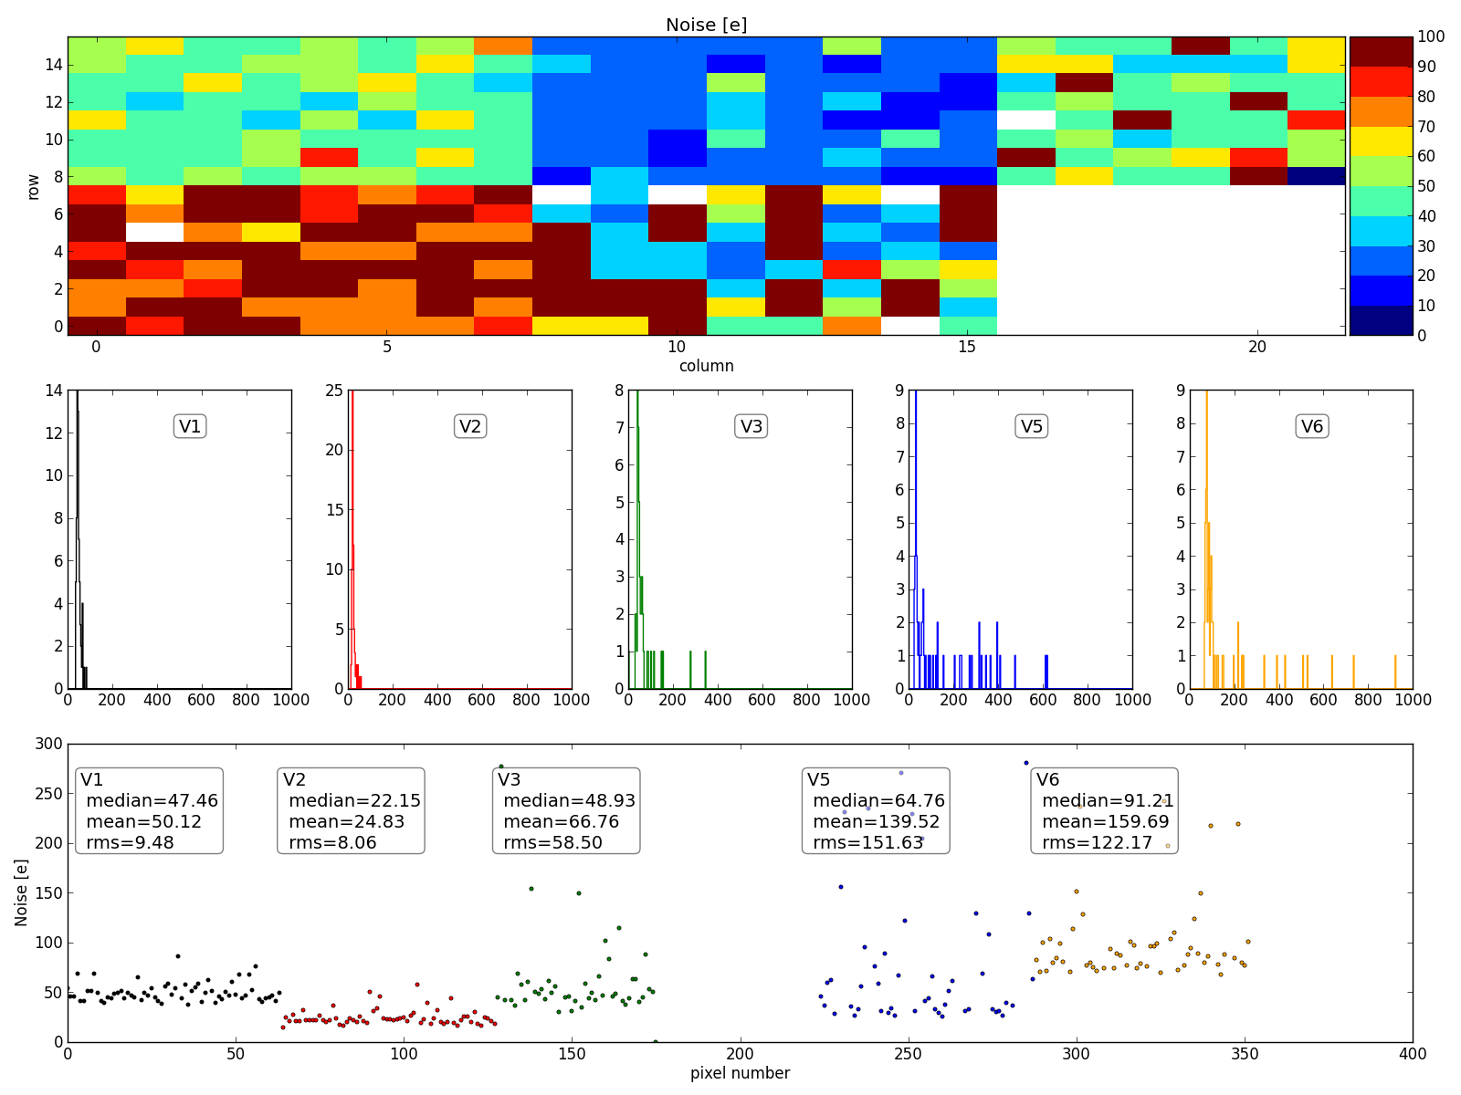
EPCB01 – more measurements

Slide 26
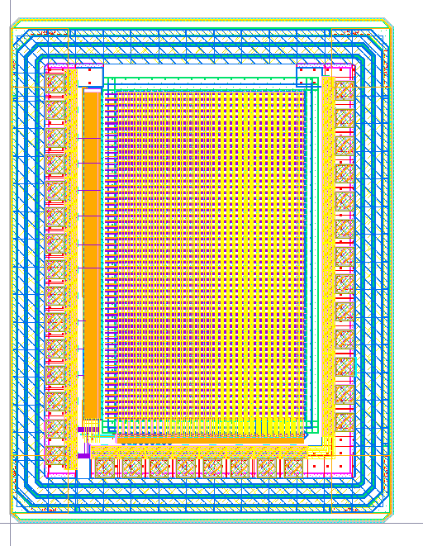
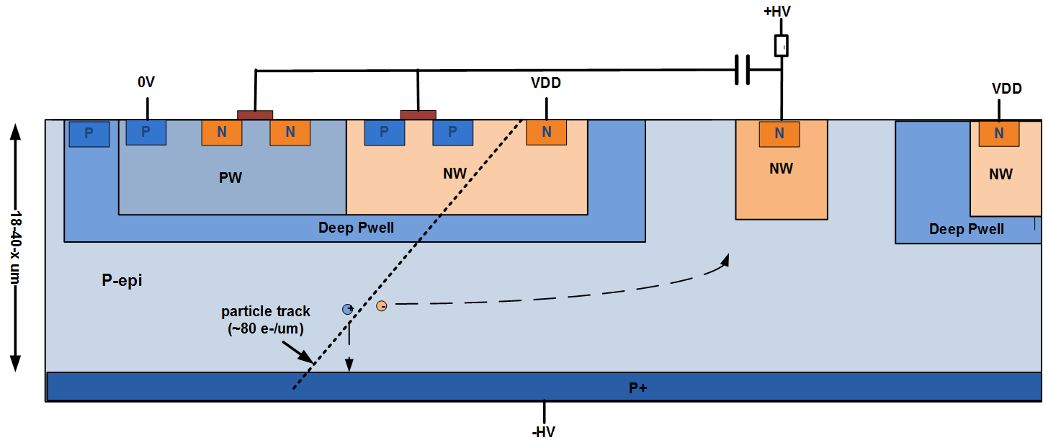
Pegasus
Parameters:
  180nm CMOS (TowerJazz)
  Different wafer materials
    18µm HR epi
    40µm HR epi
    HR bulk
  50 x 50 µm² and 25 x 25µm² pixels
thanks to W. Dulinski, M. Kachel (IPHC)

Slide 27
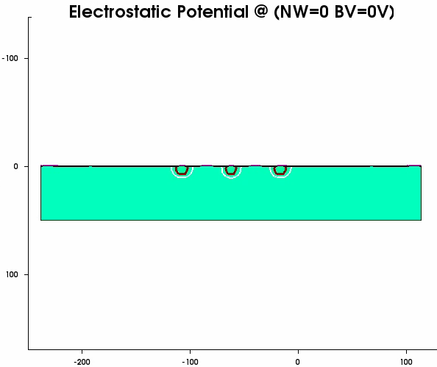
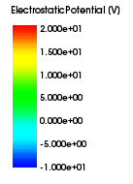
Pegasus - Electrostatic Potential (TCAD example)

Slide 28
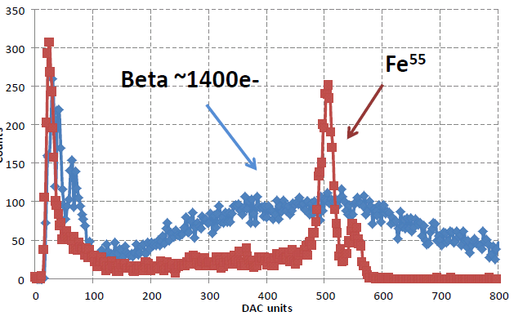
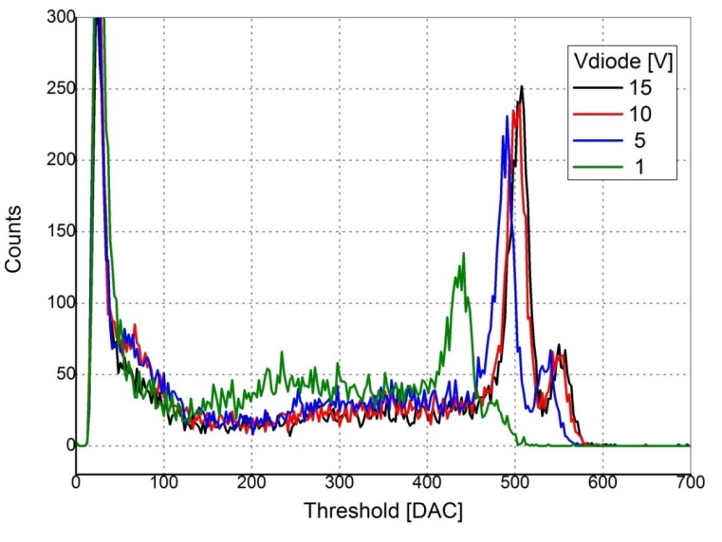
PEGASUS - First signs of life
Sr⁹⁰ and Fe⁵⁵ Spectra for 18µm epi
Fe⁵⁵ Spectra for 18µm epi
M. Kachel (IPHC)

Slide 29
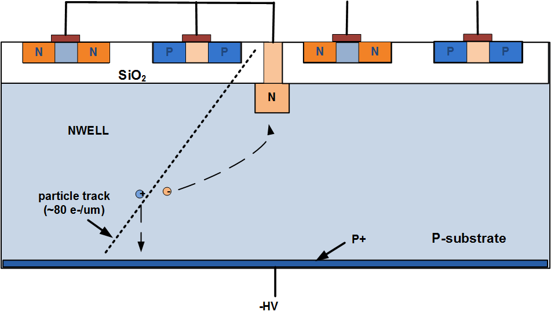
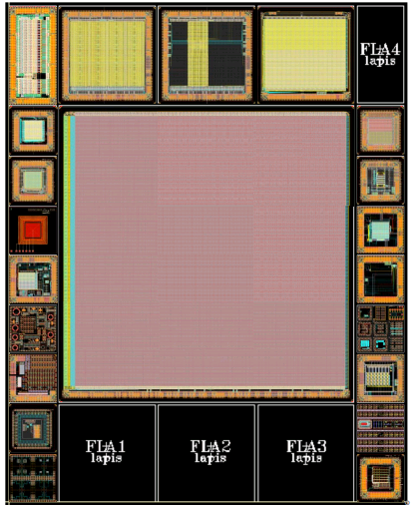
FD-SOI
Parameters
Almost perfect technology but due to back gate effect not radiation hard.

Slide 30
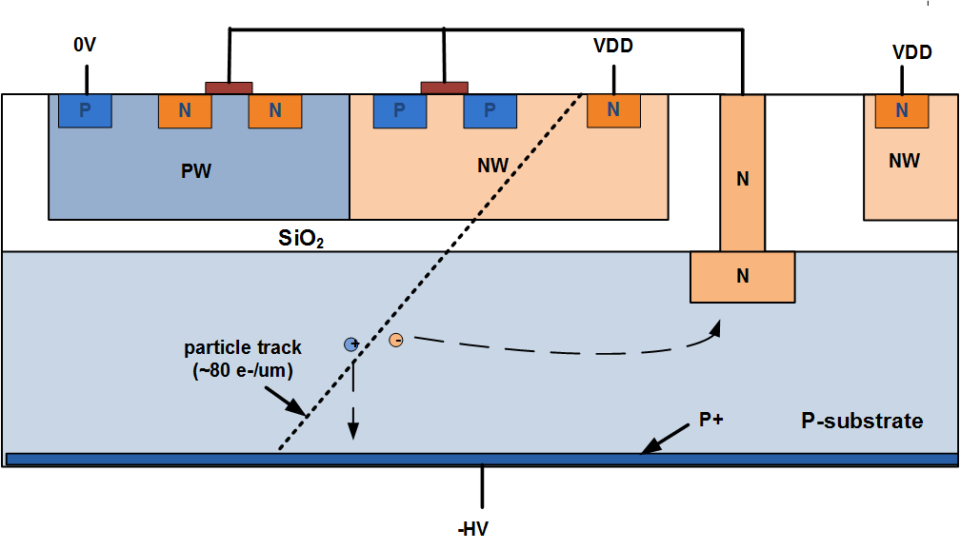
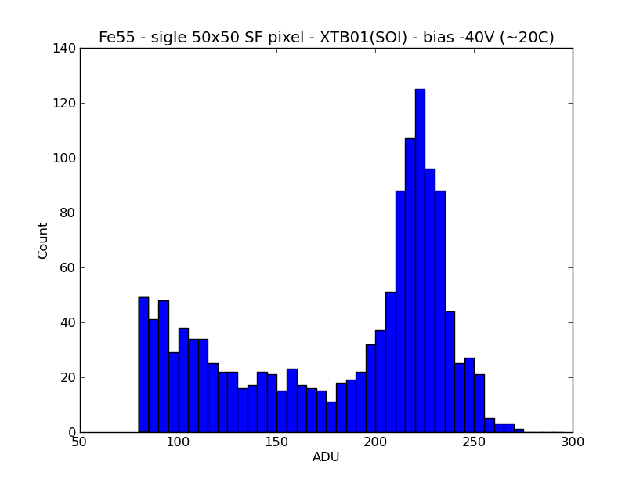
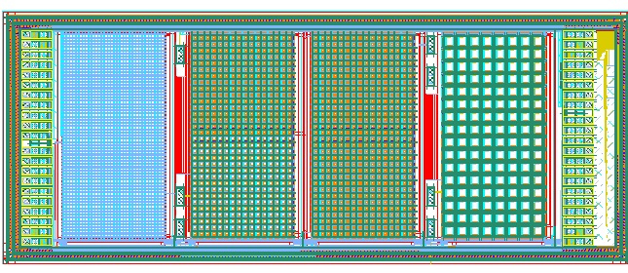
HV-SOI
Concept
First signs of life
Design&Testing:
T. Hemperek,
T. Kisisita,
H. Krueger
Layout

Slide 31
Low cost hybrid
Low cost sensor on 8” process with under bump metallization
Front-end chip with bumps (150um pitch)
Low cost flip chip process
Cost: < 30$ cm²
8” FE-I4 type sensor is planed

Slide 32
More to come
150nm – submitted Q4 2012
  full CMOS
  n-type > 2kOhm-cm substrate
  thinned
  back implanted
180nm – submitted Q1 2013
  full CMOS
  p-type > 1kOhm-cm substrate
  full wafers -> thinning/back implanting possible
180nm - submitted Q1 2013
  full CMOS
  p-type - initially 100 Ohm-cm
  very HV isolation guaranteed
130nm – submission Q4 2013
  HV-CMOS(CCPD)/full CMOS
  p-type >3kOhm-cm
  full wafers -> thinning/back implanting possible
150nm - submission Q1 2014
  HV-CMOS(CCPD)/full CMOS/ possibly T3
  p-type >2kOhm-cm (~4-5k Ohm-cm)
  thinned
  back implanted
  full wafers

Slide 33
Conclusions
Depleted Monolitic Detectors:
- more radiation tolerance
- will take space of hybrids/strips for less dymandingapplication
- as a accitve sensor layer for ultra fast enviroments
First promising results from various technologies
More technologies to be studied and improved.
Question, comments, suggestions:
hemperek@uni-bonn.de

