Slide 1


Forward Calorimetry
Wolfgang Lohmann, BTU and DESY
On behalf of the FCAL Collaboration
AGH University of Science and Technology Cracow, CERN Geneva, DESY Zeuthen, NPPAN Cracow, ISS Bukharest, LAL Orsay, JINR Dubna, NCPHEP Minsk, Pontifica Universidad Catholica Santiago de Chile, SLAC Stanford, Tel Aviv University, Tohoku University Sendai, University of Colorado Boulder, UC California Santa Cruz, Vinca Belgrade

Slide 2
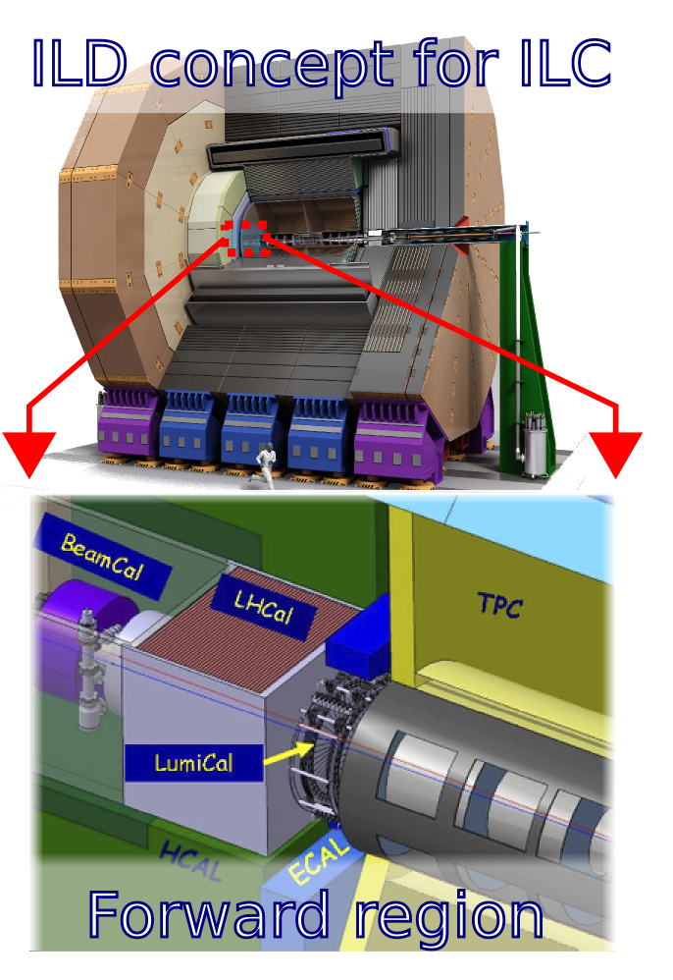
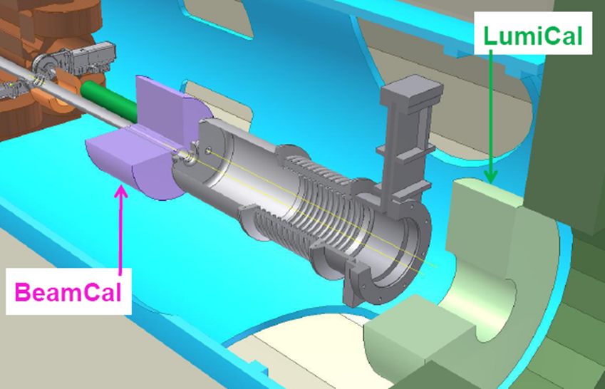
Example Very Forward Region of the ILD and a CLIC Detector
Optimisation of the design of the very forward region of LC detector
Precision luminosity measurement
Fast feedback and beam tuning
Detector hermeticity
Challenge: Fast redout

Slide 3
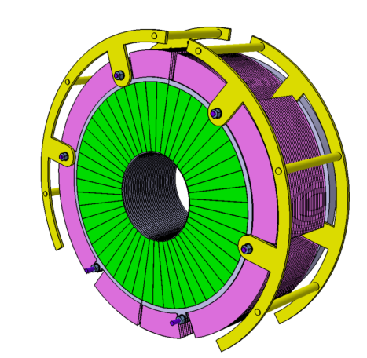
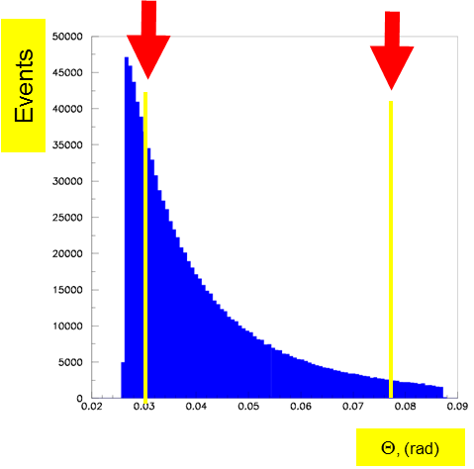
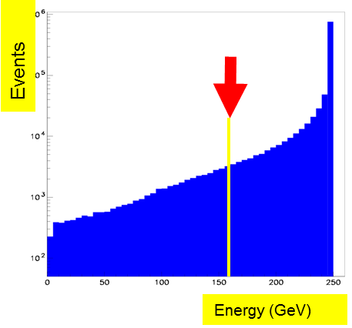
Luminosity Measurement
Precise measurement of the luminosity
(10⁻³ at ILC, 10⁻² at CLIC)
Low angle physics
New challenge: Beamstrahlung
Gauge process for the luminosity measurement: Bhabha scattering
e⁺e⁻ e⁺e⁻ (γ)
L = N / σ
Count Bhabha events
From theory

Slide 4
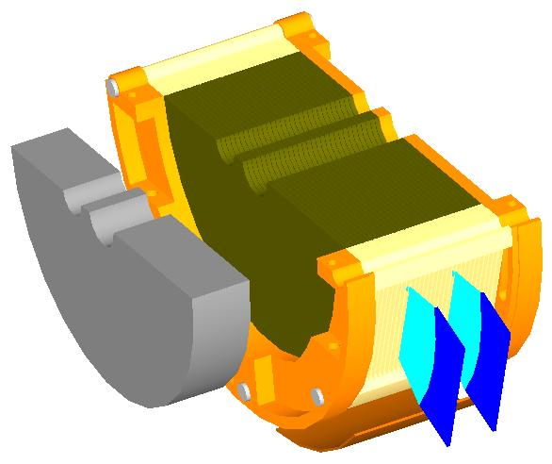
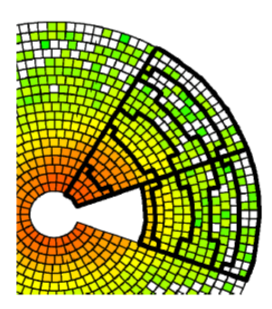
Beam Tuning and electron tagging
BeamCal (+Pair Monitor)
Fast luminosity estimate using beamstrahlung (bunch-by-bunch at ILC)
Beam parameter estimation
Fast feedback to the machine
Low angle electron tagging
Beam parameter determination and fast feed-back
Bunch-by-bunch at ILC

Slide 5
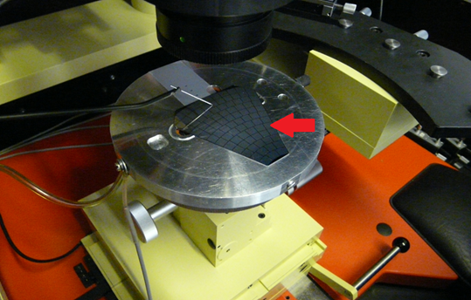
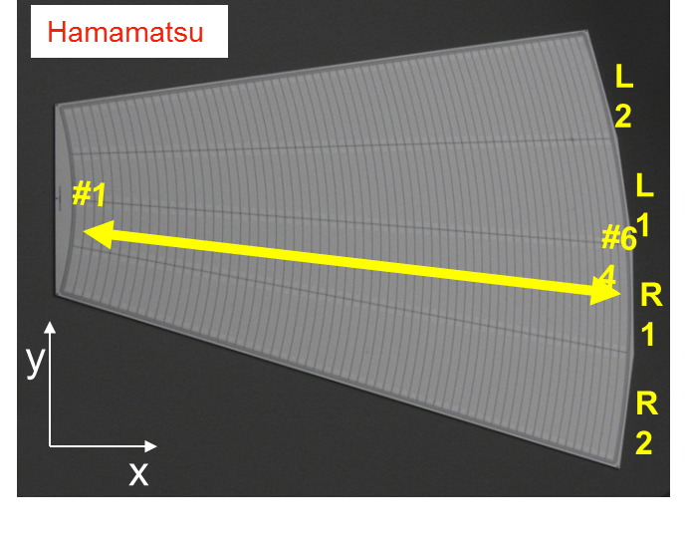
Sensors and ASICs
Characterisation of a GaAs sensor on the probe-station
Silicon sensor prototype for LumiCal
Compensated GaAs
Institute in Tomsk, DESY-JINR collaboration (BMBF supported)
Electrical characterisation at JINR and DESY, 30 sensors of sufficient quality
p in n, strip pitch 2.2 mm
40 sensors, joint effort
IFJ PAN Cracow, DESY, TAU
Electrical characterisation done, matches quality criteria

Slide 6

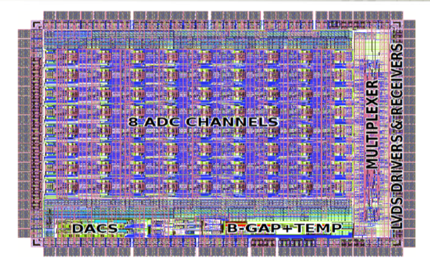
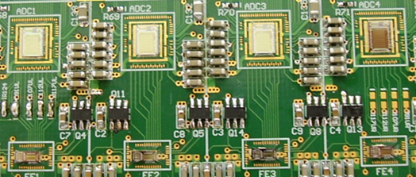

Sensors and ASICs
FE ASICs dedicated to LumiCal, BeamCal
FE ASIC, 8 channels, 4 RC and 4 FET feedback, 350 nm AMS
Currently used in test-beams
ÀDC ASIC, 8 channels, pipeline architecture, 10 bit
PCB instrumented with FE ASICs and 10 bit pipeline ADC ASICs for test-beam studies

Slide 7
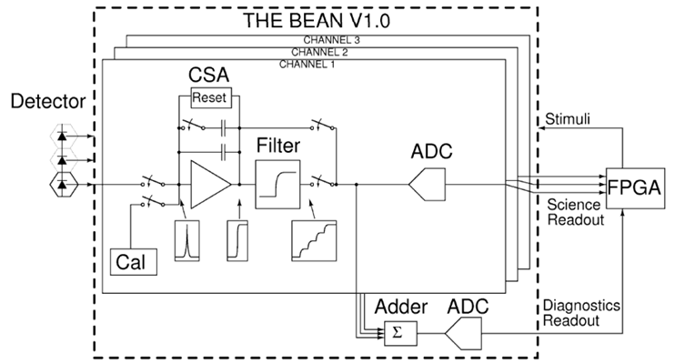
Dedicated BeamCal Readout
180 nm TSMC technology
10 bit SAR ADC
4 channel version in summer 2014
Assembled sensor planes for beam tests after 2015

Slide 8
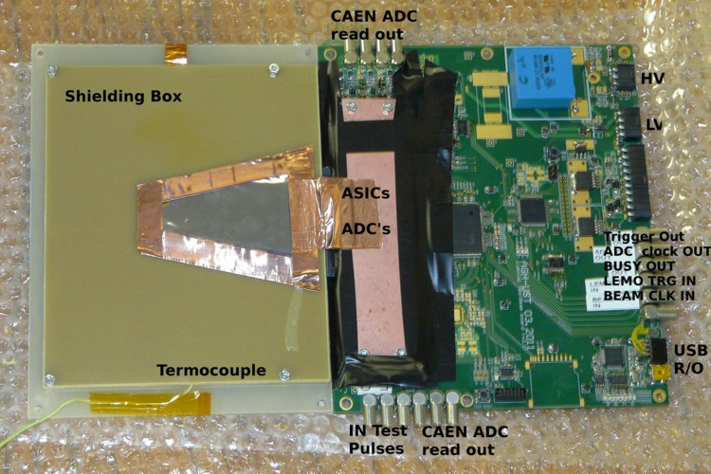
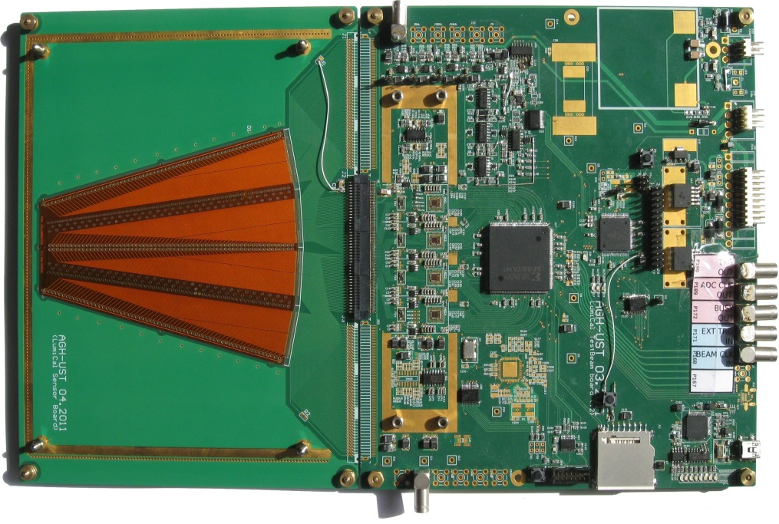
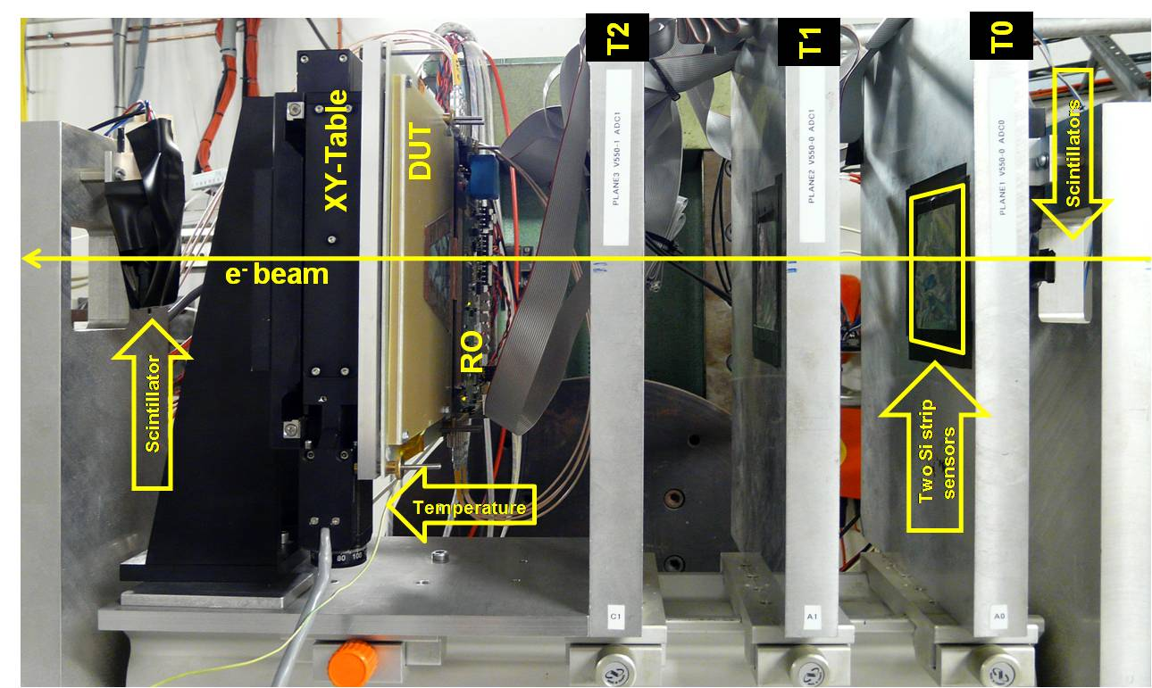
Assembled Sensor Planes
Performance studies in an electron beam 2-4.5 GeV at DESY (2010-2012)
> 50 x 10⁶ trigger

Slide 9
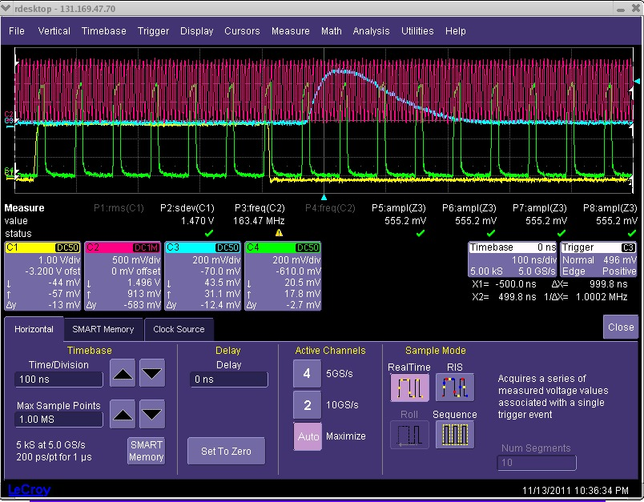
Beam Test Readout and DAQ
32 channels fully equipped
(Sensor + Front-end + ADC)
Signal handshaking with Trigger Logic Unit (TLU)
EUDAQ software
ADC Clock source
  Internal (asynchronous with beam operation) – CLIC mode
  External (beam clock used to
  synchronize with beam) –
  ILC mode
  ADC sampling rate is up to
  20 Ms/s (6.4 Gbps)
Readout synchronized with the beam-clock, ILC timing

Slide 10
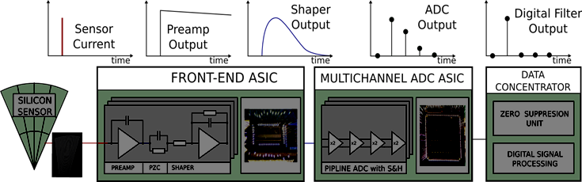
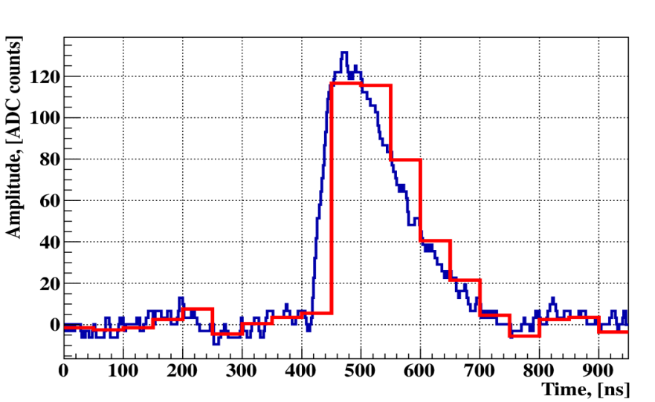
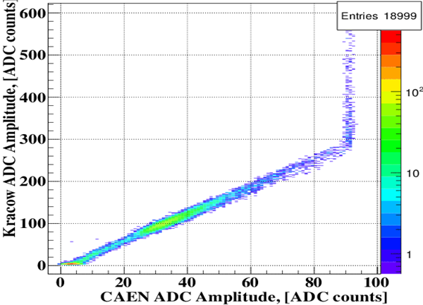
Readout Chain
Example signal:
Signal digitized with ADC ASIC (red) and external ADC (blue )
Comparison of the amplitude measured with the ADC ASIC and a CAEN 500 Ms/s flash ADC
External
500 MS ADC

Slide 11

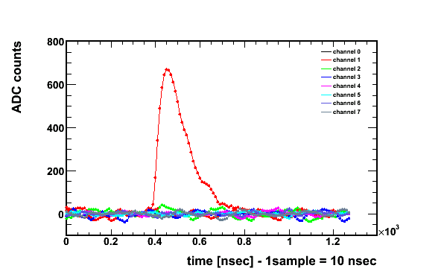
Beam-test Results
Example signal:
Signal digitized with ADC ASIC (red) and external ADC (blue )
Comparison of the amplitude measured with
the ADC ASIC and a CAEN 500 Ms/s flash ADC
Aplitude vs. time for several channels

Slide 12
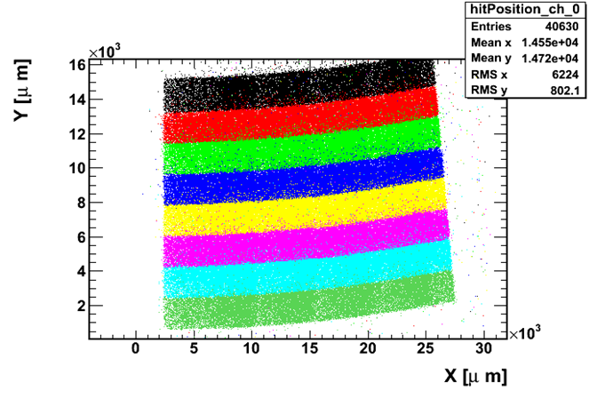
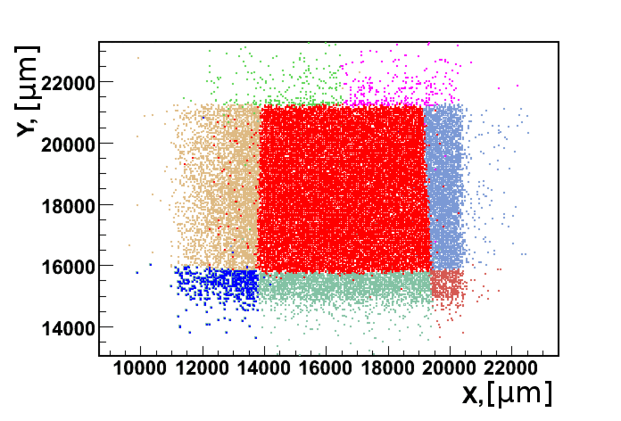
Beam-test Results
Impact point reconstruction using
the beam telescope
LumiCal sensor
Impact point reconstruction using
the beam telescope
BeamCal sensor

Slide 13
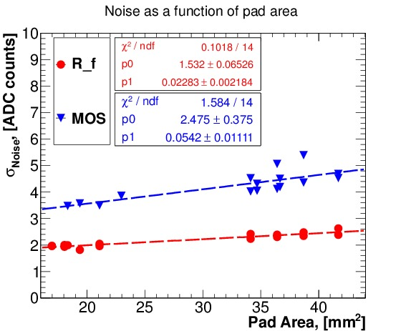
Beam-test Results
S/N from mips vs. channel
both for RC and FET feedback
Sigma(ped) as a function of the pad size

Slide 14
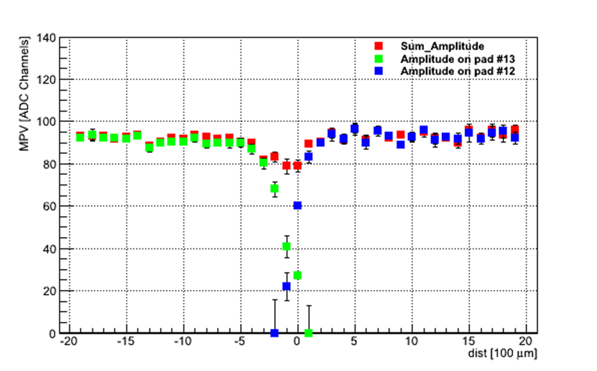
Beam-test Results
Scan across a pad boundary
BeamCal sensor
LumiCal sensor

Slide 15
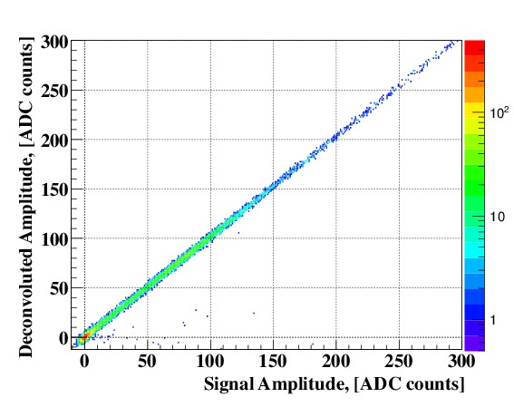
Beam-test Results
Data reduction and pile-up treatment by signal deconvolution
Reconstruction of the deconvoluted amplitude and comparison with full ADC information

Slide 16
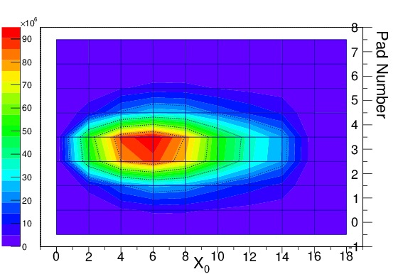
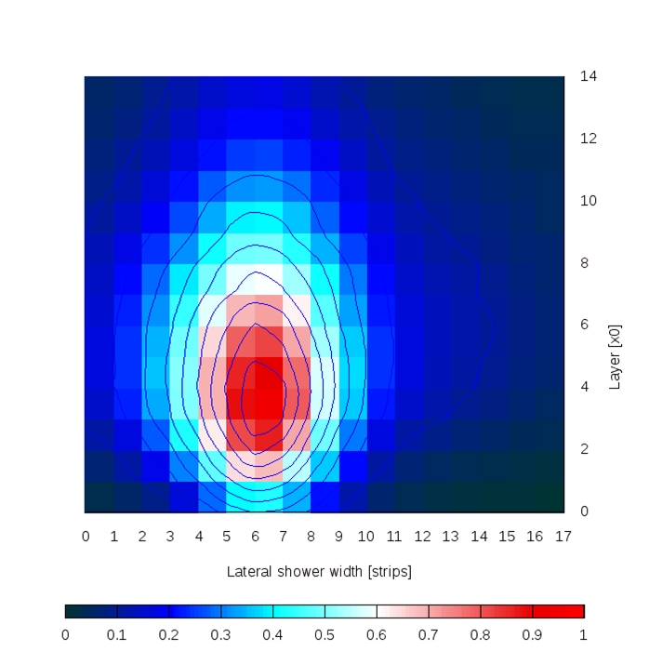
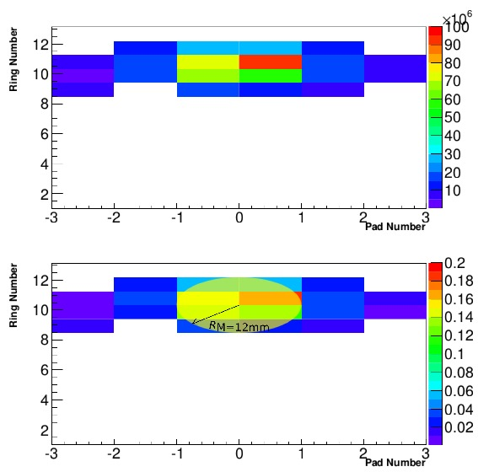
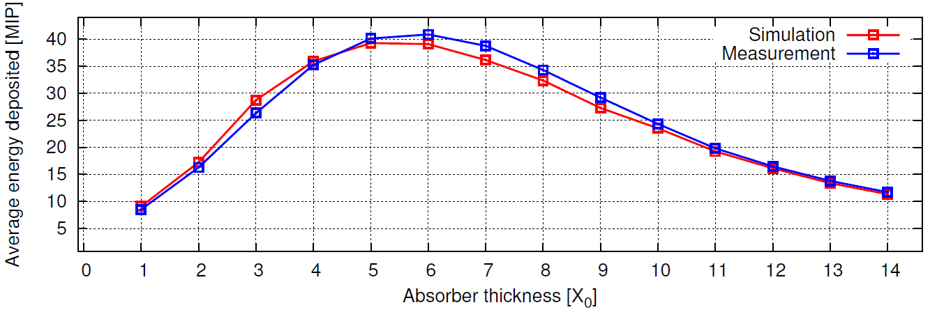
Beam-test Results
Shower profile measurements with n X₀ tungsten blocks in front of the sensors

Slide 17
Future Scientific goals
Construction of a highly compact calorimeter
  novel connectivity technology (e.g. bump bonding, thin fan-out
  PCB)
Construction of a demonstrator calorimeter
  completion of the mechanical structure (+laser alignment)
  production of sufficient ASICs in 130 nm technology
  demonstration of power pulsing
  readout board with data concentrator and data transfer
Beam tests
  Energy resolution (luminosity spectrum)
  spatial resolution (angular spectrum)
  bias in the angular measurements (systematic uncertainty)

Slide 18
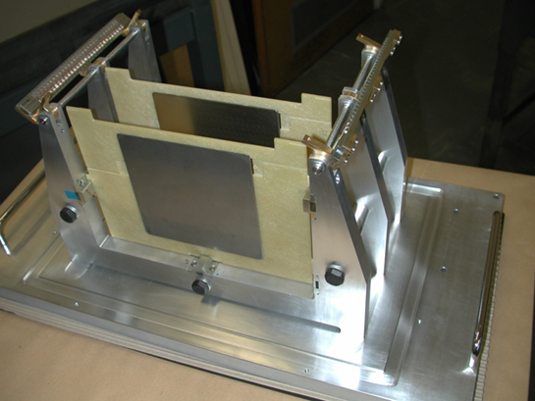
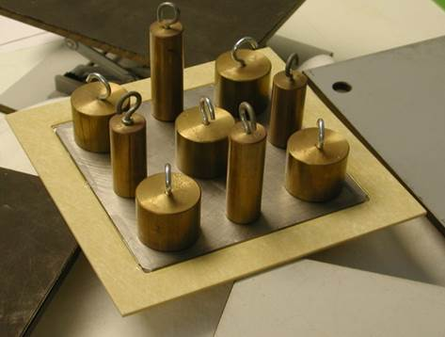
Completion of the Mechanical Structure
Mechanical frame
High Precision Tungsten absorber planes
Status:
10 pieces available
5 match specification
35 needed
For position measurement and position monitoring a laser system is foreseen (semi-transparent Si sensors and FSI)

Slide 19
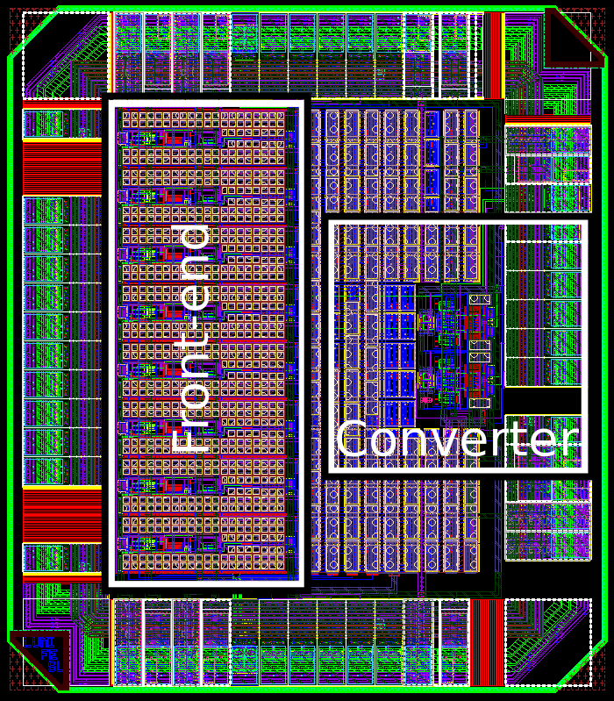
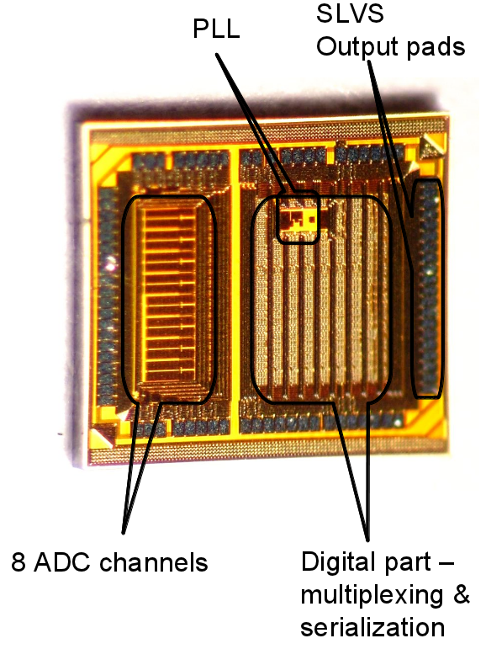
ASICs
Electronics: New FE and ADC ASICs in
130 nm IBM technology
FE ASIC (submitted Feb. 2013)
  8 channels per chip
  FE t_{peak} = 50 ns, dual gain
  1.5 mW/channel, power pulsing
10 bit SAR ADC
  8 channels per chip
  scalable frequency (up to 50 Ms/s)
  1-2 mW at 40 MS/s, power pulsing
  PLL for data serialization
  high speed SLVS interface
  first prototypes 2012
  second submission Feb. 2014

Slide 20
ASIC development, 130 nm
Test results
ADC almost linear over the full expected input signal range
Some codes slightly worse, needs investigation
Next submission: February 2014 (done)

Slide 21
Demonstrator Calorimeter
Thin sensor planes
Miniaturisation of the readout board
  32 (64) channel ASIC,
  combining current FE and ADC ASICs
  power pulsing
Data Concentrator and data acquisition
  zero suppression,
  high speed data transfer,
  preprocessing
Beam test results will be imperative to a detector TDR !!!

Slide 22
backups

Slide 23

Luminosity Spectrum and Beam-Beam Effects
Both for Luminosity measurement and for Physics analyses this spectrum must be known
The strong magnetic field during bunch crossing also changes the direction of Bhabha electrons
Dedicated talks by Andre and Strahinja

Slide 24
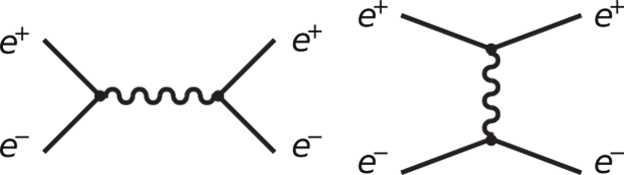
Physics Background
Signal
Background

Slide 25
Summary
FCAL Deliveries
Designs of the very forward region for ILC and CLIC detectors
Monte Carlo estimates of the expected performance of a luminometer for precise luminosity measurement
Feasibility of fast luminosity measurement, beam parameter
determination and electron tagging with BeamCal and Pair
Monitor
Successful development of sensors and dedicated ASICs
Successful prototyping and test of major components in the beam
Unique contributions to the ILC RDR, the CLIC CDR, the ILC TDR and to the detector concepts ILD and SiD

Slide 26
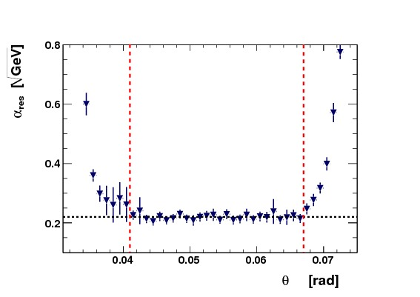
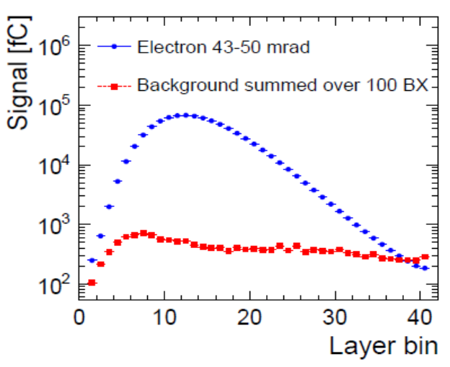
LumiCal
LumiCal Design Studies
Energy resolution vs. polar angle
Energy resolution with and without
gaps between sensor tiles
CLIC, impact of background

Slide 27
Beam-test Results

Slide 28
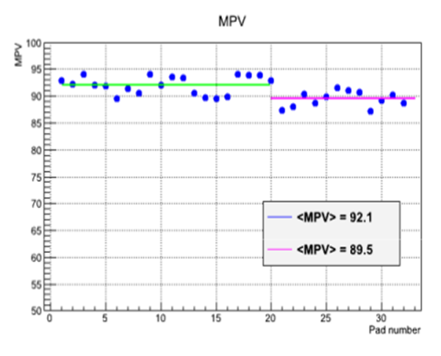
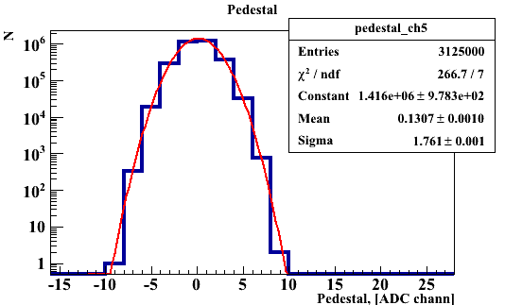
Beam-test Results
Gain vs. channel
Triggered signal spectrum
Pedestal
(taken without signal)

Slide 29
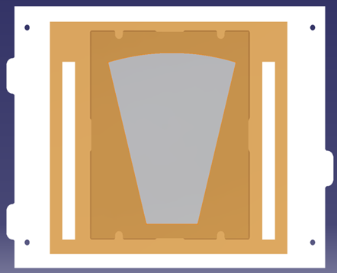
Sensor Planes & Connectivity Scheme
Thin sensor planes
Available:
More than 30 silicon sensors
More than 30 GaAs sensors
Done so far:
PCB fanout (1 mm)
Wire bonding
Needed:
Thin fan-out (50 – 100 μm)
Bump bonding

Slide 30
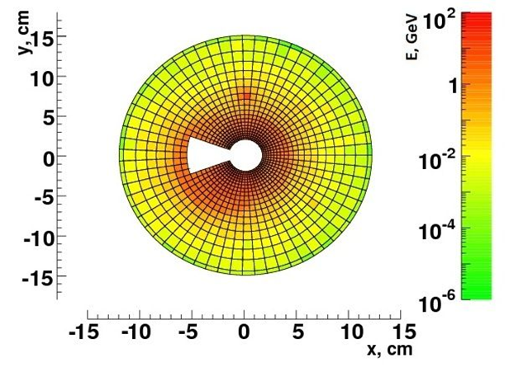
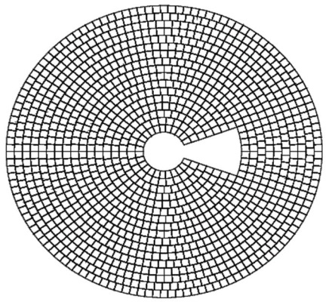
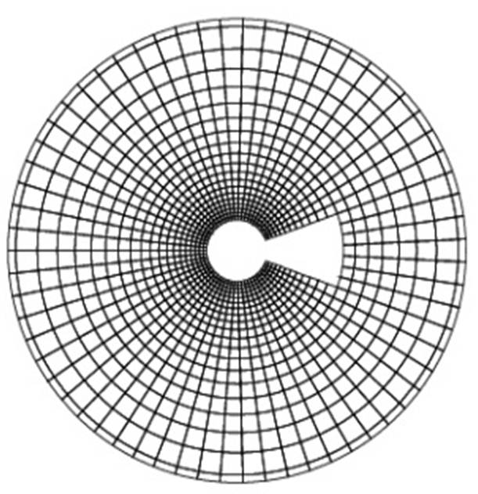
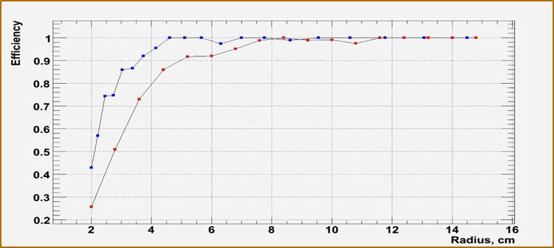
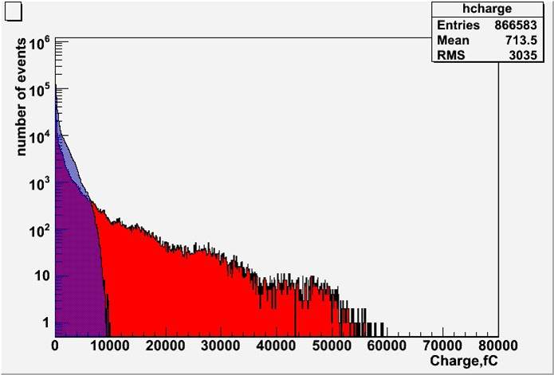
BeamCal
Study of different segmentations 1 TeV
Single high energy electron
Estimate of the signal range, 1 TeV
Red: Equal size pads
Blue: pad size growing with the radius
Red: Equal size pads
Blue: pad size growing with the radius

