Slide 1
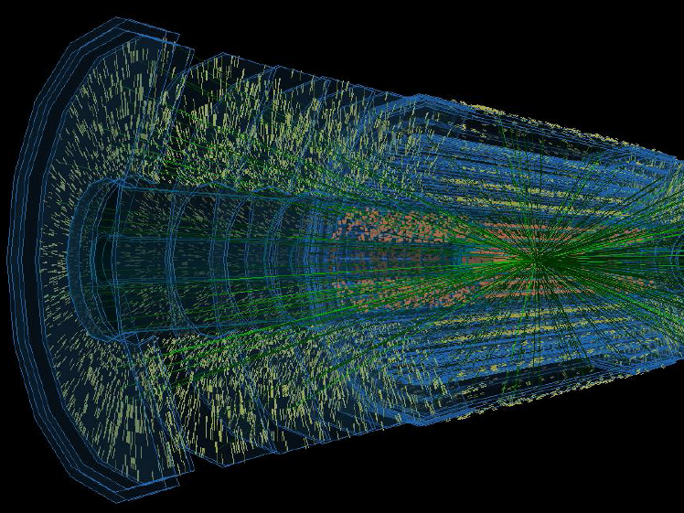
Does the ATLAS Tracker Upgrade apply the WP1 recommendations lessons ?
Ulrich Parzefall
University of Freiburg

Slide 2
Introduction
At Mainz kick-off workshop, WP1 session resulted in a lot of expert recommendations for the HL-LHC strip tracker
As part of WP1 these have been transformed into a “Lessons…” document on Mainz indico page https://indico.desy.de/materialDisplay.py?contribId=0&sessionId=0&materialId=0&confId=7063
This talk will look at some key lessons and if/how they are respected

Slide 3
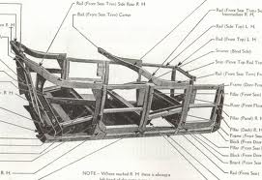
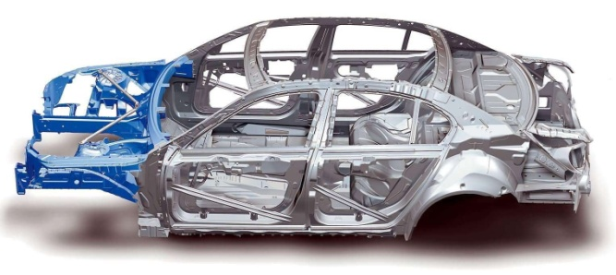
The Key Lessons I - General
Aim for a coherent system development, rather than driven by components.
“Choose “Integration by design” rather than “Integration by assembly”.
Generally respected…
Use COTS solutions where possible
Largely respected, driven by cost & simplicity. Community has to develop some parts (DCDC converters, GBT,…)
By assembly…
By design…

Slide 4
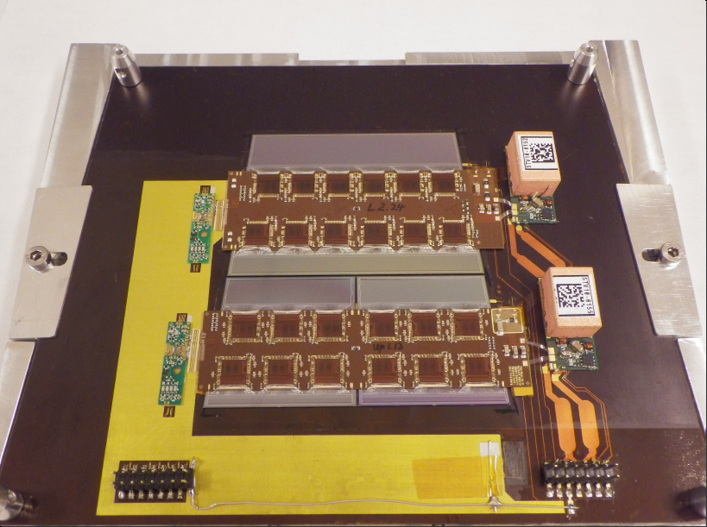
The Key Lessons I - General
When prototyping, have enough parts available. Handle them as one would do to the real thing.
“Babying” rare prototypes is dangerous.
Prototyping done with large number of parts
Could still be more (but community has to pay for and assemble everything)
By design, endcap more problematic than barrel
Assemblies are rare, but not much babying

Slide 5
The Key Lessons I - General
Reduce number of part types to a minimum. “It is really easy to “just” add another hybrid/module/cable type to make something else easier- you will pay for this.”
Two sides of the coin.
People are generally aware of this.
We tend to add parts for getting prototypes working, rather than to the final system (I hope)

Slide 6
The Key Lessons II - Hybrids
Keep hybrids as simple as possible.
Hybrids much simpler than present SCT. Not much room for simplification
Do not get tied to single vendor. Design hybrids with industry, using standard design rules. “If you think custom technology is necessary, think again. “
Lesson understood. Industry advanced since SCT
Include material where needed (ground & power).
The low-mass daemon will always push us…
Bias connections (4x per sensor)
Power
LV
HV
Data Readout

Slide 7
The Key Lessons III - Sensors
Again: Keep them as simple as possible, avoid single vendor cases.
LHC tied to one vendor.
Both CMS & ATLAS try to establish 2nd supplier
Design sensors with industry from the beginning
Watch yield reducers (and hence cost drivers)
Ease of testing
Production
Generally done (sometimes vendor is pushed)
[Which recommendation drives R&D into CMOS?]

Slide 8
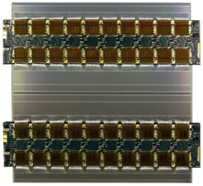
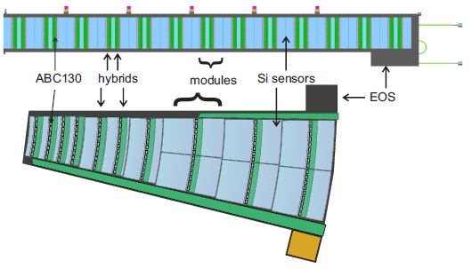
The Key Lessons IV - Modules
Reduce number of part types to a minimum:
Barrel: 2 module types
Endcaps: 6 modules types, 9 hybrids
(consider CMS solution with rectangular barrel modules in EC?)
Module
10cm

Slide 9
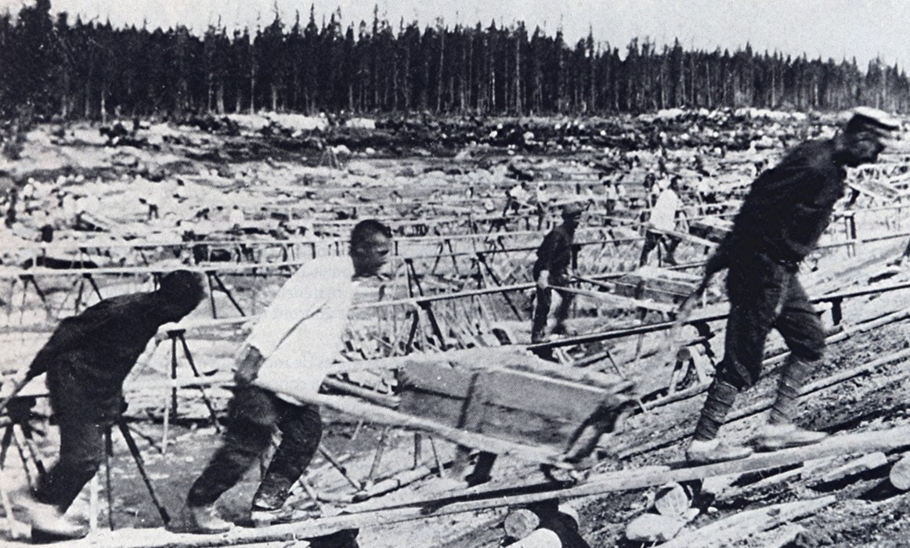
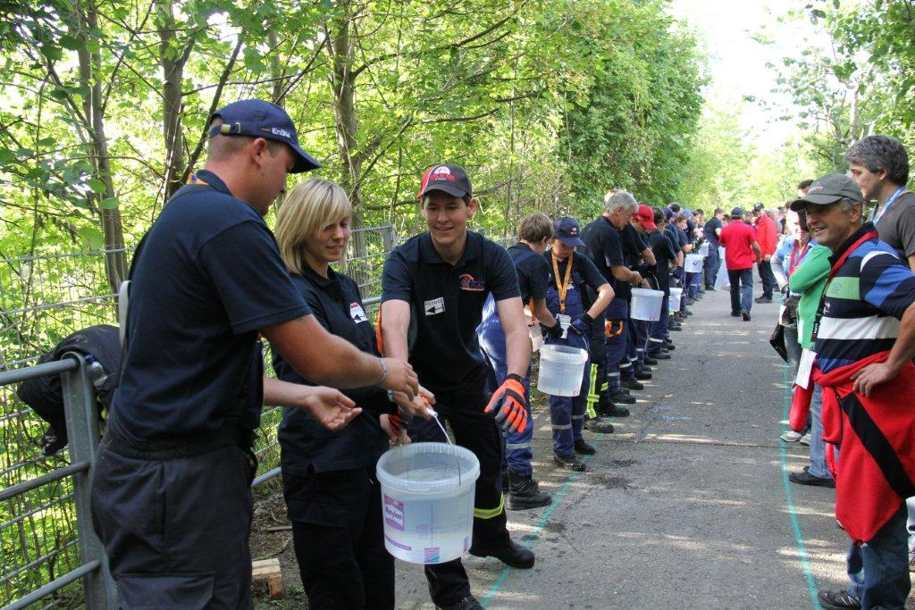
The Key Lessons V - Logistics
The production chain should be simple. Avoid complex logistics.
Beats me: Size of project (number of modules and institutes) already makes for a complex production!
Choice: number of macro-assembly sites vs. module shipping and testing

Slide 10
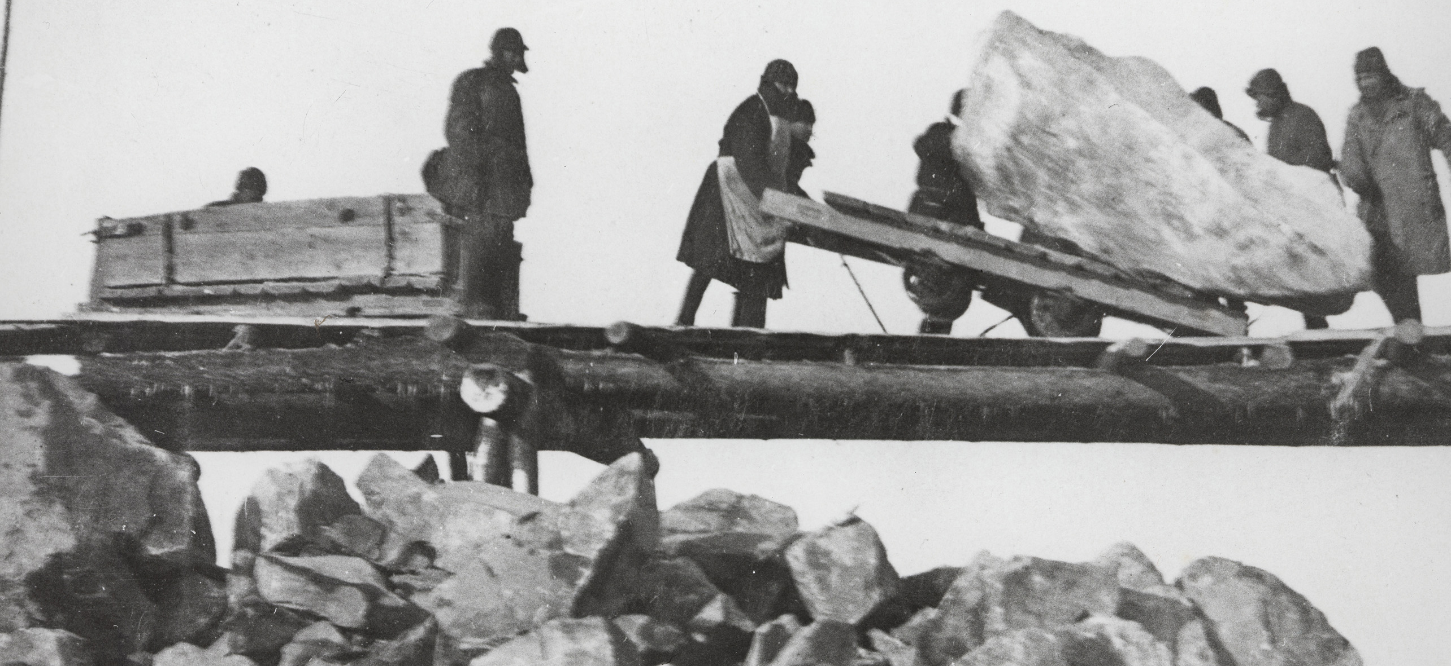
The Key Lessons VI - Shipping
Shipments should be avoided where possible. Transporting is a high-risk enterprise.
Involve professional shipping companies.
Must ship barrel & end cap.
More difficult than SCT (size). Planning already started.

Slide 11
The Key Lessons - QA & Testing
QA automation is mandatory with large through-puts. Needs a database back-end.
We plan to automate, with DB a must. QA details not clear yet, will take high fraction of time. (100hrs long term test?)
Re-check quality at each step (even after a shipment) and track the history of parts.
Tracking of parts via DB. Re-QA to be discussed: increased risk vs. increased time…

Slide 12
The Key Lessons - QA & Testing
Consider visual inspections, destructive tests on samples and the quality of signals.
Visual inspection for sure (time?).
Some limited destructive tests.
Test of signal quality foressen or implemented.
Pay attention to trivial/cheap/low-tech elements.
I hope we do, but we failed on this before...

Slide 13
The Key Lessons - Mounting & Services
Keep it simple. Solutions which might look practical on the bench can become very complex, when scaled to the real thing.
We might have “simple” module assembly, but difficult module-to-structure assembly.
Scalability?
Alternative: could system for mts assembly be simple & cheap?

Slide 14
The Key Lessons - Activation
Very significant activation on contact and at 40cm.
“Taking longer to install the tracker will be a luxury we will just not have.”
After just a few years access for simple repairs will not be possible - we need to think very hard ahead of time.
Plan for rapid installation and removal of detectors, including remote handling.
It is important to qualify models of activation between t=0 and Phase II.
Risk analysis: failure management, extensive QA

Slide 15
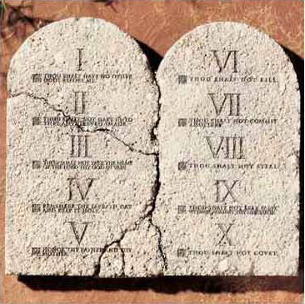
The Rules of the Game
“Though shalt keep it simple”
Integration by design
Plan QA at design stage
Design with industry, using standard design rules (esp. Hybrids)
Avoid single-vendor solutions
Tight tolerances need proper justification
Plan services carefully. Must include planning for installation (limited access (space and time)).
If your readout system has a bottleneck in it, it is much better if it is OFF detector rather than ON detector.

Slide 16
The Key Lessons -
Nnn

