Slide 1
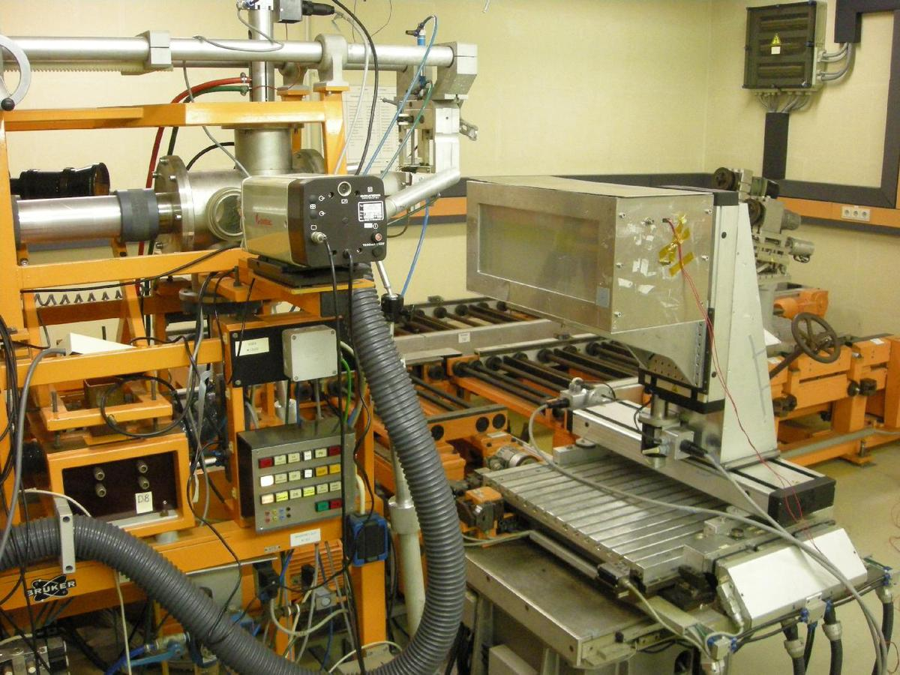
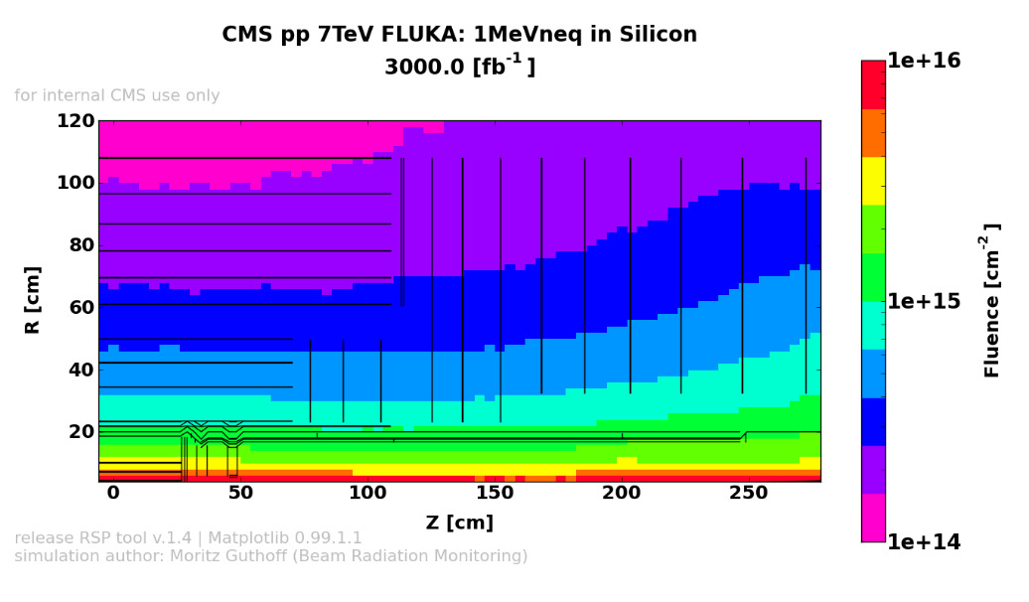
Status WP5
Irradiations

Slide 2
Summary
Title | Contact | Time | Dosimetry | Travel
Materials for DC-DC Powering Phase I | Katja Klein (RWTH Aachen) | 0:30 | 2x75 | −
Glue tests | Luise Poley (HU Berlin) | 3:15 | 2x75 | −
Transistors for ATLAS Tracker | Martin Bessner (DESY) | 1:40 | 75 | −
Irradiation of HPK mini sensors for ATLAS endcap upgrade | Susanne Kühn (Uni Freiburg) | 2:00 | 2x75 | −
Irradiations of surface structures with 800MeV protons | Alexandra Junkes (Uni Hamburg) | − | − | ???
plus costs for shipments

Slide 3
Materials for DC-DC Powering Phase I
Contact: Katja Klein, RWTH Aachen
Abschirmung ohne Paste 3x, 5 Spulenkörper HK, 5 Spulenkörper GT, Radox-Leitung, Sicherungen Schurter 0603-1.5A, Sicherungen Schurter 0603-1.5A auf Platinen, Sicherungen Schurter 3410.0033.01 (8/12), Spulen, Wärmeleitpaste
Fluence aim: 5e14n_{eq}/cm²
Total time: 30min (1 session more…)

Slide 4
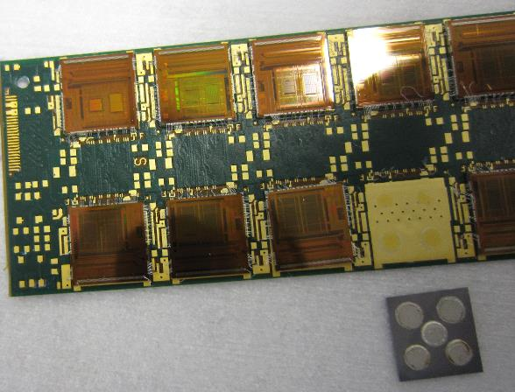
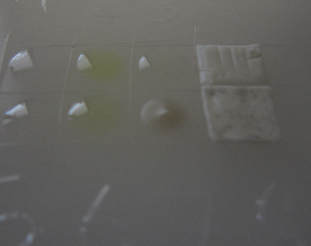
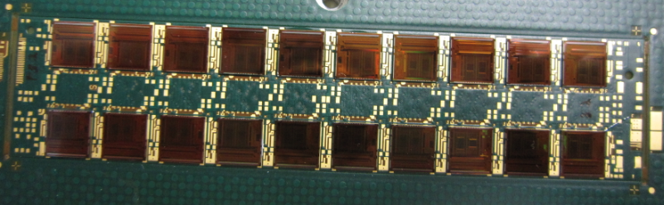
Glue tests
Contact: Luise Poley, HU Berlin
PCBs with glued chips (silver epoxy and seven other glues)
PE plate with glue dots
Fluence aim: 2e15n_{eq}/cm²
1st irrad.:
  Time: 2:40
  Completed
2nd irrad.:
  Time: 0:35
  Completed

Slide 5
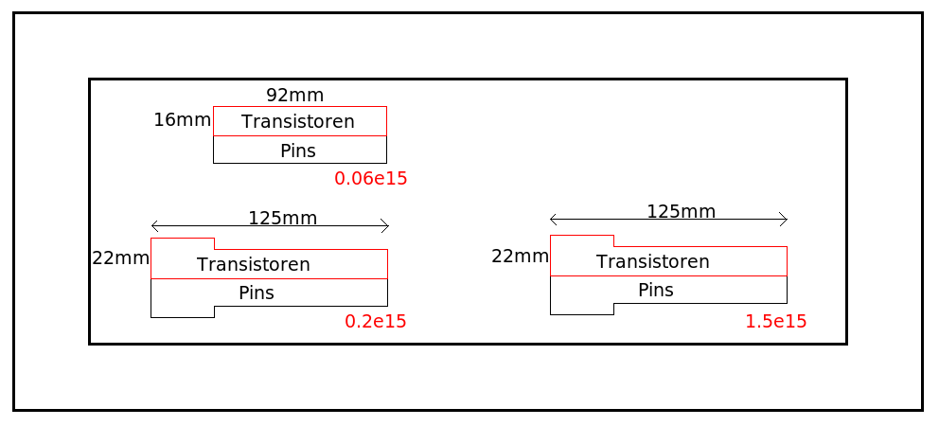
Irradiation of Transistors for ATLAS Tracker
Contact: Martin Bessner, DESY
Transistors for HV switching of silicon strip sensors
  Masks to protect pins
  Transistors need to be irradiated from both sides to get more uniform irradiation
  Transistors need to be powered during irradiation
Time: 1:40
Completed

Slide 6
Irradiation of HPK mini sensors for ATLAS endcap upgrade
Contact: Susanne Kühn, Freiburg
  HPK p-type mini-strip sensors for ATLAS end-cap
    Fluences: 5E14, 1E15, 2E15n_{eq}/cm² (4 sensors each)
    Time: 1:10
    Completed
  2nd irradiation
    lower fluences plus glues
    Time: 0:50
    Completed

Slide 7
Irradiations of surface structures with 800 MeV protons
Contact: Alexandra Junkes, UHH
Request to get funds for travel
  Application received; costs missing

Slide 8
Comments
There are funds left for irradiations!
We need a short written application with
  contact name, affiliation and address
  purpose of the irradiation test
  description of the material (quantity, size, composition)
  requested fluences or expected costs at facilities other than KIT
Projects should be limited to about 4 hours of irradiation time to allow for several different projects
  Funds can cover a total irradiation time at KIT of about 40h

