Slide 1
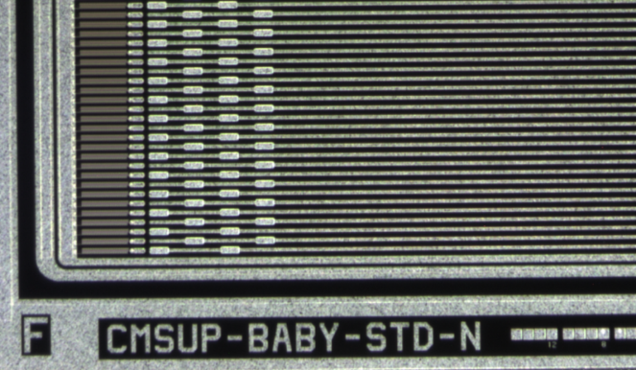
Comparison of the charge collection measurements for sensors from ATLAS and CMS campaigns
Alexander Dierlamm

Slide 2
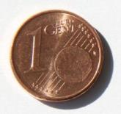
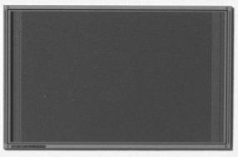

Samples
ATLAS data from
S. Kuehn, et al., Signal and charge collection efficiency of n-in-p strip detectors after mixed irradiation to HL-LHC fluences, NIM A 730 (2013) 58–61.
ATLAS
  n-in-p FZ strip sensors from HPK
    pitch: 74.5µm
    strip length: 8mm
    # of strips: 104
    sensor size: 1cm x 1cm
    thickness: 320µm
    V_{fd}: 175V
    [O]: “standard FZ” …
CMS
  n-in-p FZ strip sensors from HPK
    pitch: 80µm
    strip length: 33mm
    # of strips: 256
    sensor size: 3.5cm x 2.25cm
    thickness: 320µm
    V_{fd}: 250V
    [O]: ~8-9e16cm⁻³
6µm
24µm
80µm

Slide 3
Irradiations
ATLAS
CMS
280MeV pions
23MeV protons (within HHA)
Reactor neutrons
Annealing during pion irradiation ~3weeks@RT
Radius / cm | p fluence / 10¹⁵n_{eq}/cm² | n fluence / 10¹⁵n_{eq}/cm² | Sum / 10¹⁵n_{eq}/cm²
60 | 0.3 | 0.4 | 0.7
20 | 1.0 | 0.5 | 1.5
15 | 1.5 | 0.6 | 2.1
23MeV protons
Reactor neutrons

Slide 4
Charged hadrons – I
Lowest fluence: ~1e15n_{eq}/cm²
p-stop (P) and p-spray (Y) versions quite similar
Quite large difference for low voltages
Probably similar max. signal
BUT:
annealing time much different!
  ATLAS: 3 weeks @ RT
  CMS: 10min @ 60°C (~50h_{eq}@RT)

Slide 5
Charged hadrons – II
Annealing study available by CMS for 1.5e15n_{eq}/cm² mixed irradiation
Looks like ~500h_{eq} is the optimal annealing time generating max. signal at lower voltages
ATLAS and CMS measurements agree for same annealing!
Still, irradiations not same:
ATLAS: MeV p + pions
CMS: MeV p + neutrons
Equivalent
annealing
at RT in h

Slide 6
Mixed
Fluence: 2.1e15n_{eq}/cm²
Good agreement for similar annealing time
Remember:
  ATLAS used mainly pions as charged hadrons
  → minor influence on CC

Slide 7
Annealing
F=2.1e15n_{eq}/cm²
F=1.5e15n_{eq}/cm²
140min
430min
270min
720min
Annealing
@60°C
@60°C
pre-annealing of
3weeks@RT ~ 120min@60°C
Similar trend to drop after long annealing
Drop appears at different times for diff. fluence !?
CM not seen by CMS (too short annealing?)
ATLAS annealing presented by Susanne on 21st RD50 Workshop Nov. 2012:
https://indico.cern.ch/event/200290/session/3/contribution/36/material/slides/0.pdf

Slide 8
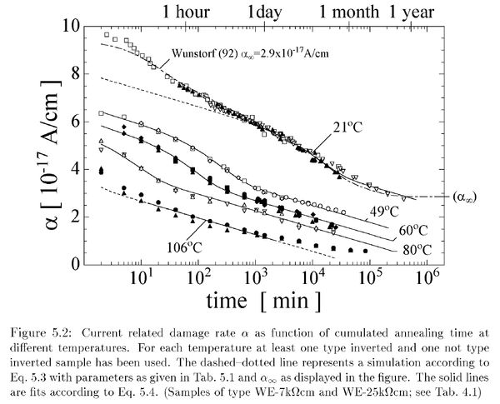
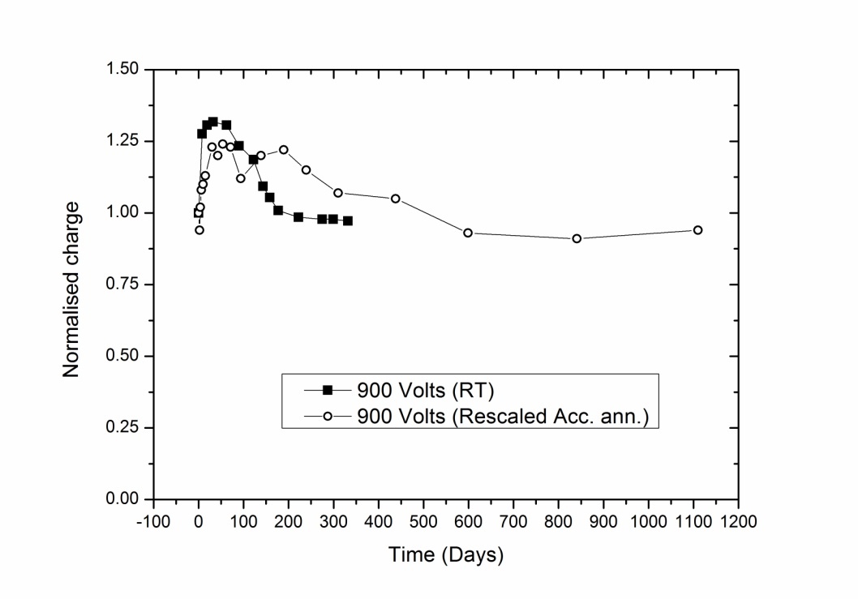
Equivalent annealing – comments
Annealing can be different for
  different parameters (I_{leak}, V_{fd}, CC)
  different materials (FZ, MCz, …)
Unique scaling not possible
  Convention: scale with leakage current
    Reference: PhD of Michael Moll
    Tool:
  Consequence:
    Temperature scaling of CC and V_{fd} annealing can be different due to different defects involved
    Need to check CC annealing close to RT!
    http://ikcms02.fzk.de/irradiation/annealing/EqAnnealingTimeAtRT.php
G. Casse,18th RD50 Workshop, Liverpool 23-25 July 2011

Slide 9
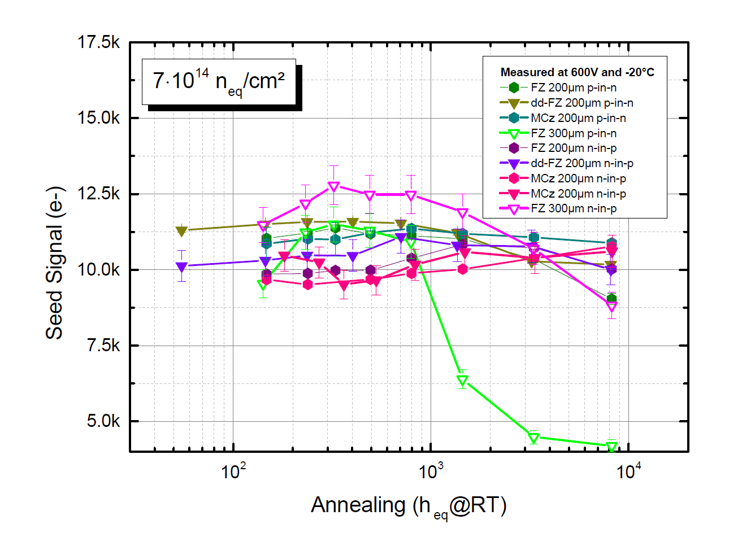
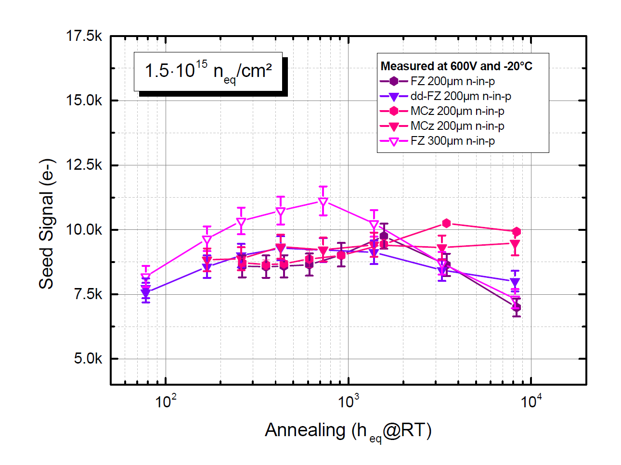
Annealing of different materials
p-in-n type material shows early drop
300µm material shows pronounced maximum at fixed bias voltage (600V)
MCz materials shows almost no effect of CC annealing
CC for GeV () or MeV (▼) proton irradiation similar, but N_{eff} not!
→ Need to study final material!

Slide 10
Comparison to CNM sensors
CNM samples
  pitch: 90µm
  strip length: 10.5mm
  # of strips: 64
  sensor size: 2.57cm x 0.85cm
  thickness: 270µm
  V_{fd}: 60V
  [O]: ???
FZ from CNM without deep-diffusion; expected to have lower [O]
Signal similar to CMS HPK results

Slide 11
protons vs. neutrons
Initially neutron irradiated sensors show less charge than MeV proton irradiated sensors
NIEL violation for FZ with [O]~9e16cm⁻³ ?

Slide 12
Conclusion
Overall quite similar results
Need to be careful with accelerated annealing
Different radiation particle types create different N_{eff}
  can also alter CC, but does not have to
  depends on [O]
  leakage current still scales well with NIEL
Investigate carefully the final material to be built into the detector!
Silicon ≠ Silicon

Slide 13
BACKUP

Slide 14
CMS HPK [O]

Slide 15
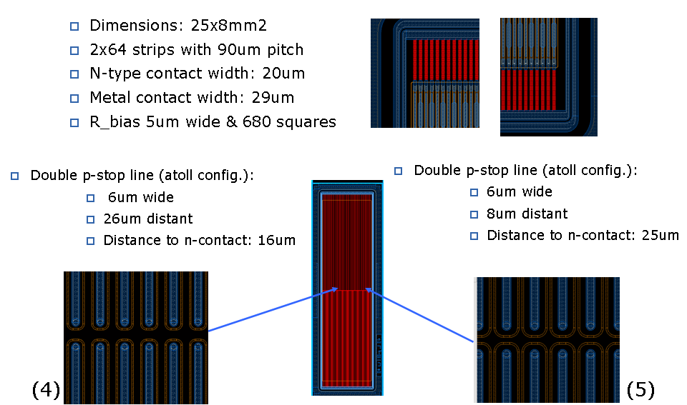
CNM Sensors Layout

