Slide 1
BeamCal Energy and Spatial Resolution for the ILC
Lucia Bortko, DESY – Zeuthen
Group Meeting | DESY - Zeuthen | 13 Dec 2013

Slide 2
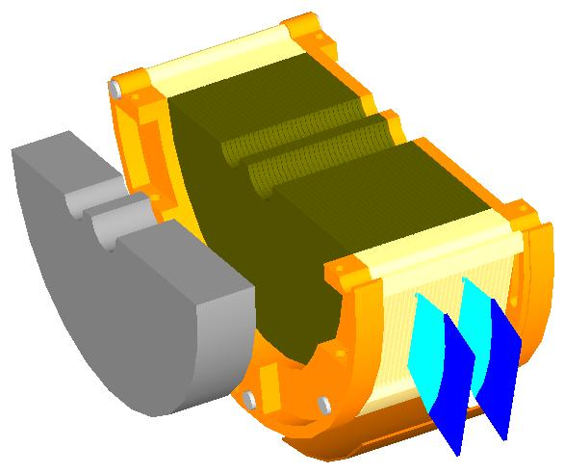
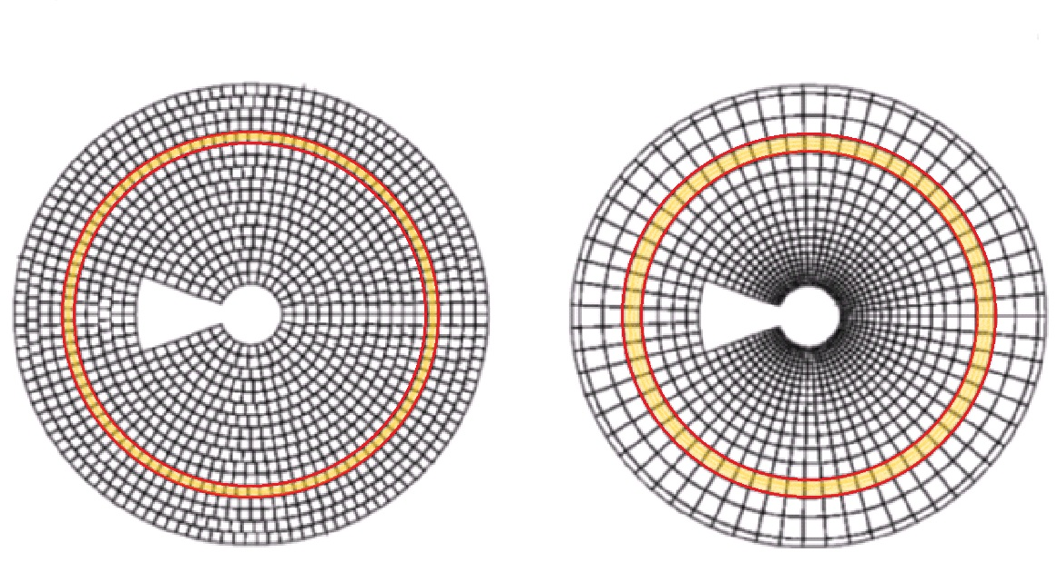
Beam Calorimeter for ILC
Size of pads:
US - similar, ≈7.65x7.65 mm
PS - ~R, min 2.2x2.2, max 14.4x14.4mm
Number of pads:
For US and PS similar
Graphite absorber
FE
30 layers
Selected ring
Tungsten absorber
Diamond sensor
Readout plane/air gap
1 $X_{0}$
US
PS

Slide 3
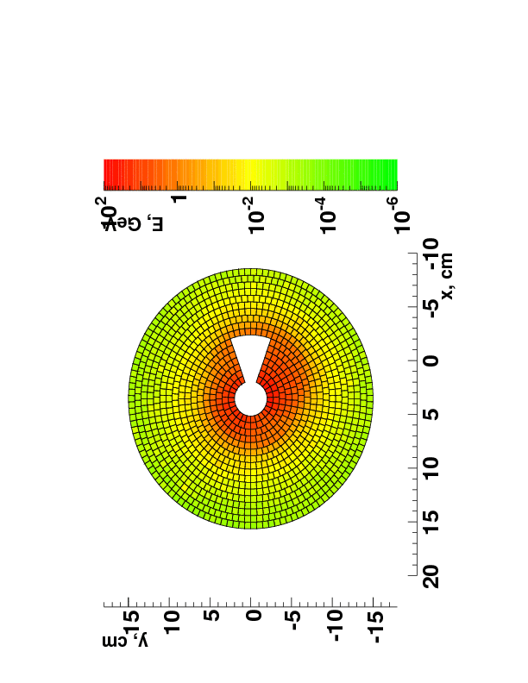
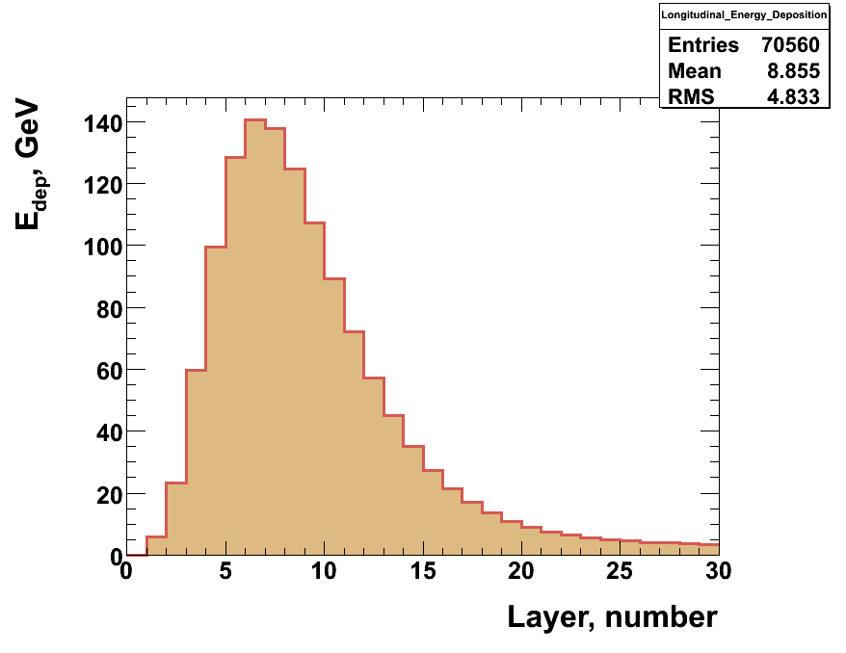
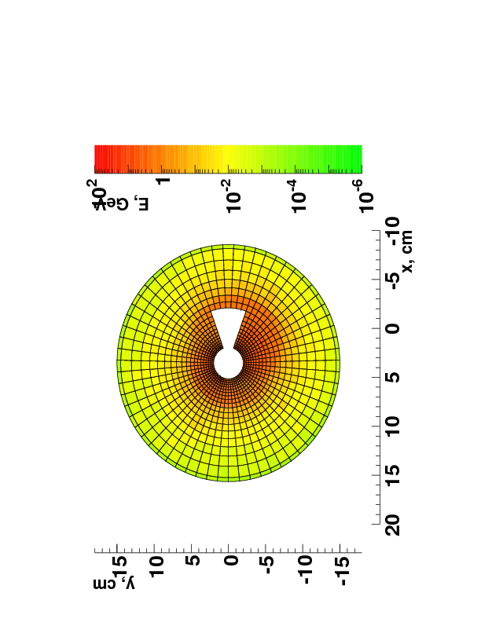
Energy Deposition due to Beamstrahlung
Average
10 BX
Maximum in
7th layer
US
Average
10 BX
Longitudinal background profile
Beamstrahlung (BS) pairs generated with Guinea Pig
Energy deposition in sensors from BS simulated with BeCaS (Geant4) → considered as background (BG)
PS
Notes:
Skazat pro to chto tak kak yadro livnya okolo 2?mm to umenshaya razmer yacheek na malyh radiusah my umenshaem shum ot bg, signal net, sledovatelno ozhidaem luchizhiy SNR
Put pictures for rms?? Or
- Put histo bg(radius) with rms as errors?? For all layers or for layer with maximum energy deposition?

Slide 4
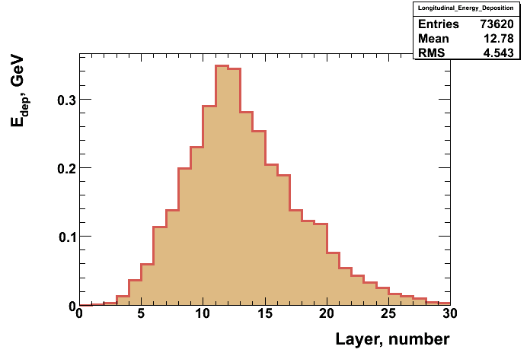
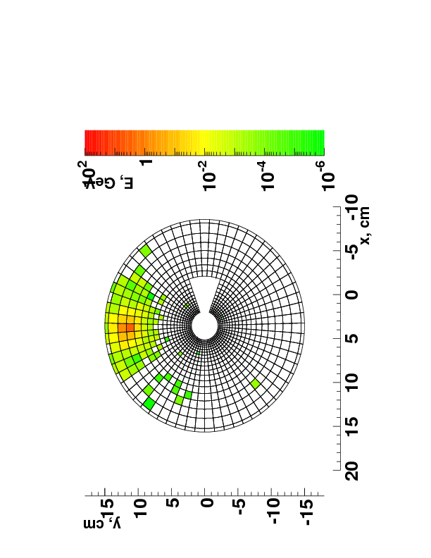
Shower from Single High Energy Electron
Example for 200 GeV electron:
Maximum in
11th layer
Longitudinal shower profile
Electron energy | Shower maximum
10 GeV | 7 layer
20 GeV | 8 layer
50 GeV | 9 layer
100 GeV | 10 layer
Shower from 200- GeV electron

Slide 5
Reconstruction Algorithm
Longitudinal 200GeV- shower profile
Selection layers - from 5th to 20th
Selection pads – only first circle around the maximum
Cluster
Reconsrtuction algorithm output:
$R_{COG}$, $φ_{COG}$, $E_{clu}$
$$φ_{COG}$$
$$R_{COG}$$

Slide 6
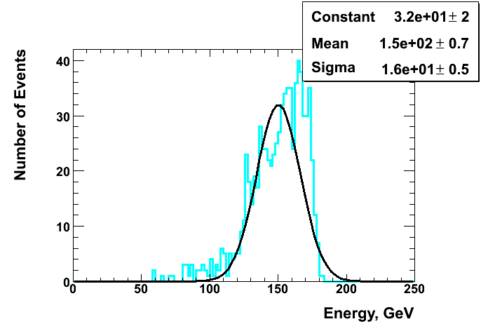
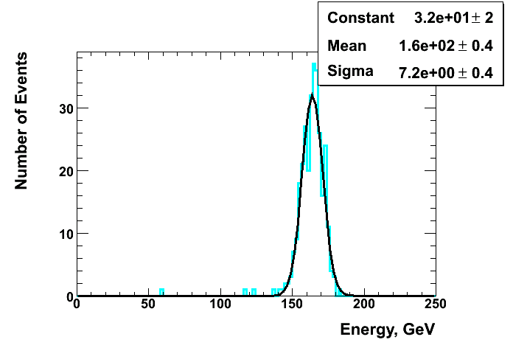
Cluster Energy. PS. wo BG
Reconstructed only showers, without BG
Energy of electron 200 GeV
En_resolution ≈ 11%
En_resolution ≈ 4.5%

Slide 7
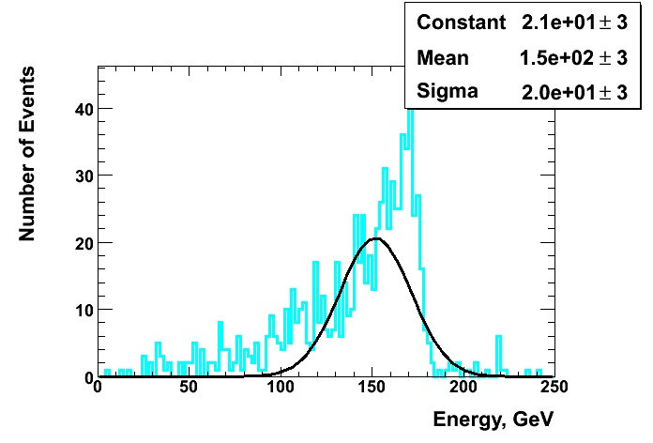
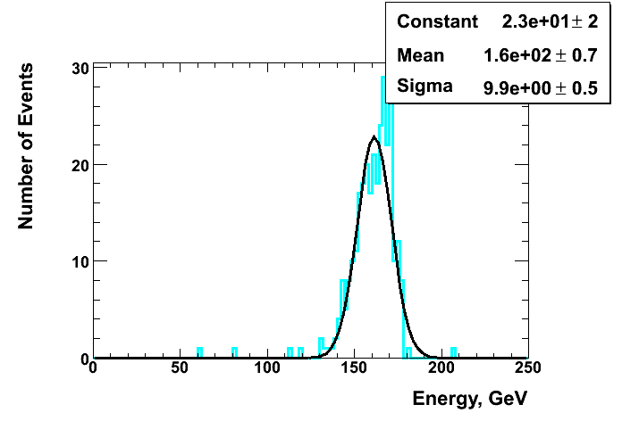
Cluster Energy. PS. with BG
+
Reconstructed showers, considering BG
Energy of electron 200 GeV
En_resolution ≈ 13%
En_resolution ≈ 6%

Slide 8
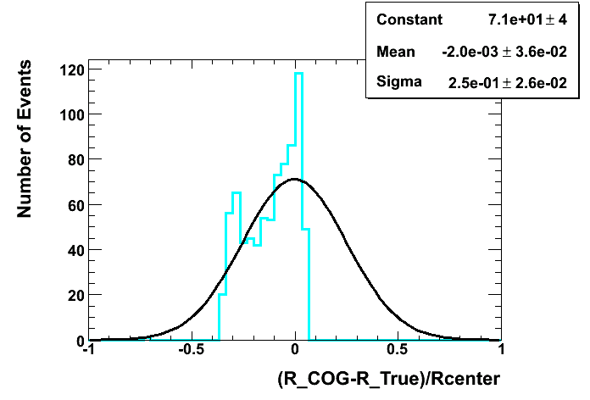
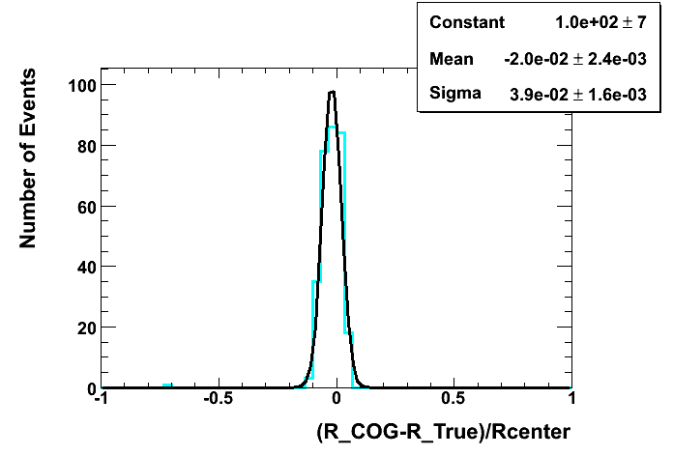
Residual Histo. PS. wo BG
Reconstructed only showers, without BG
Energy of electron 200 GeV

Slide 9
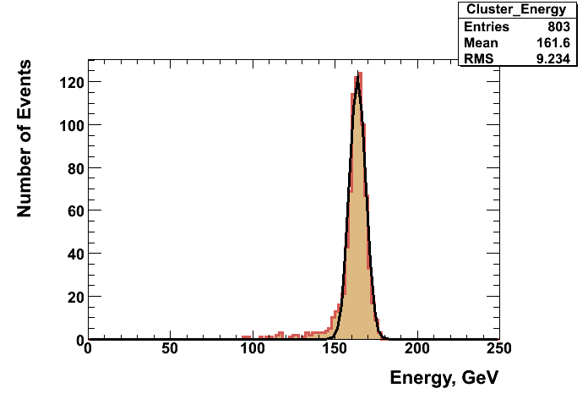
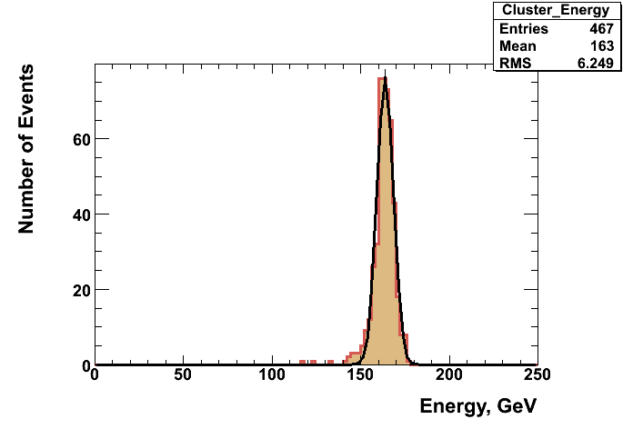
Cluster Energy. US. wo BG
Reconstructed only showers, without BG
Energy of electron 200 GeV
En_resolution ≈ 5.7%
En_resolution ≈ 3.8%

Slide 10
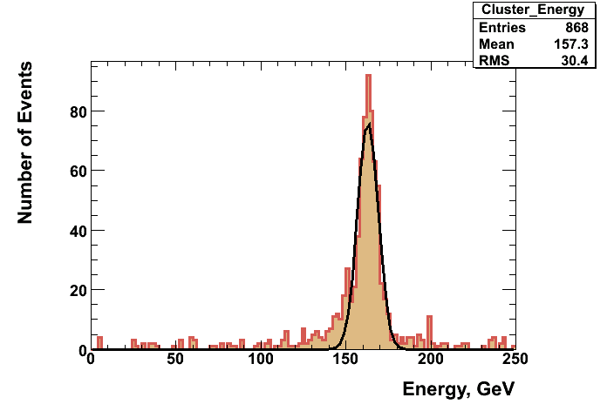
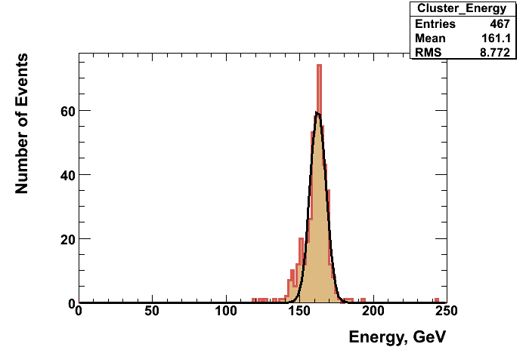
Cluster Energy. US. with BG
+
Reconstructed showers, considering BG
Energy of electron 200 GeV
En_resolution ≈ 6 %
En_resolution ≈ 5.4%

Slide 11
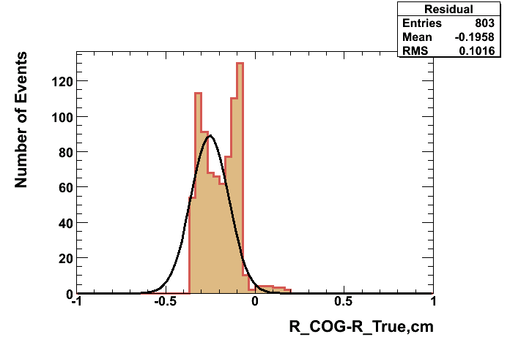
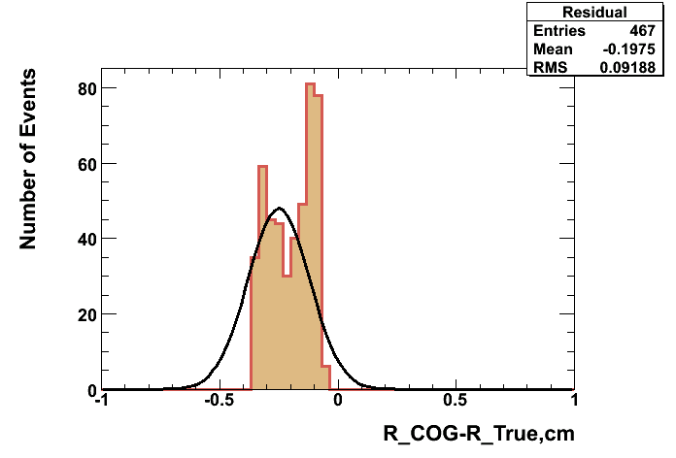
Residual Histo. US. wo BG
Reconstructed only showers, without BG
Energy of electron 200 GeV

Slide 12
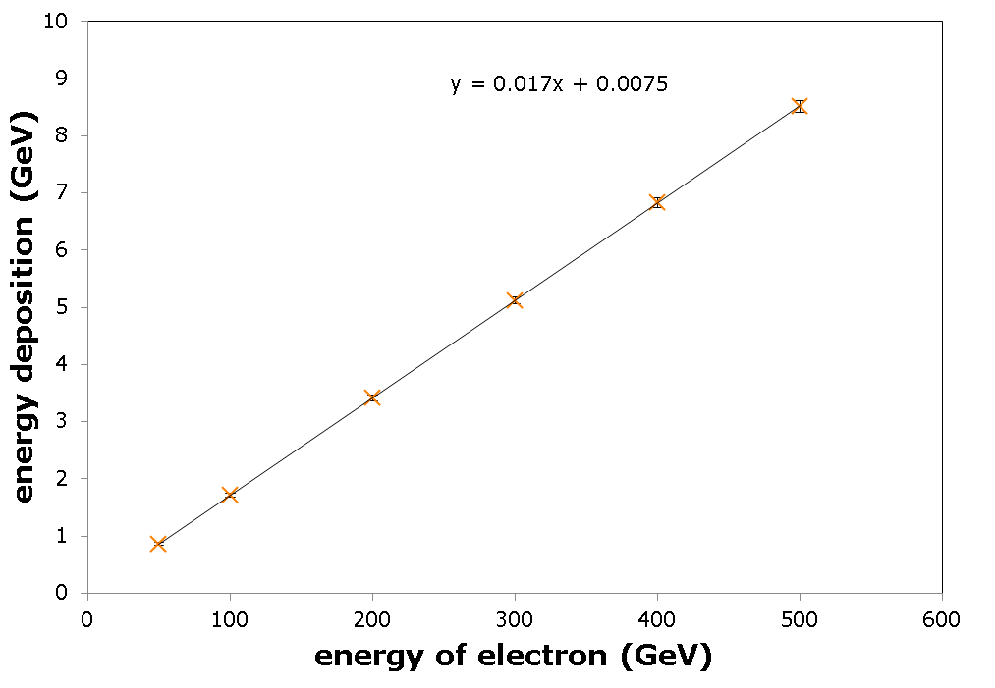
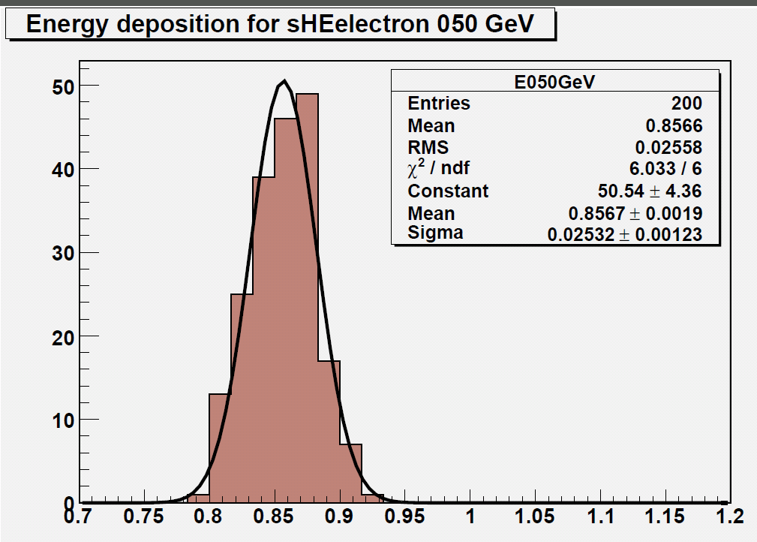
Deposited Energy vs Energy of Electron
y = 0,017x + 0,0051
Number of events
$$E_{e}=A∗E_{dep}−B$$
$$A=58.66±0.03974; B=−0.2972±0.1183$$
Energy deposition (GeV)
Notes:
SDELAT’ v log – shkale!!!!!!

Slide 13
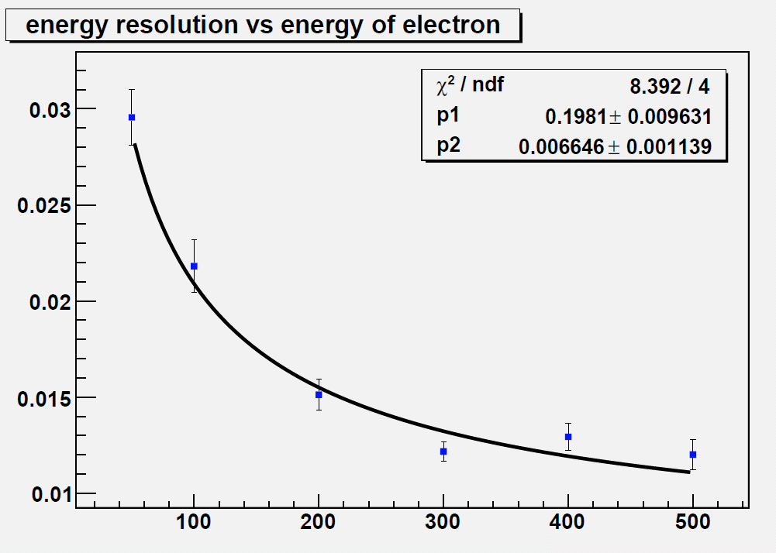
Energy Resolution vs Energy of Electron
Energy Resolution
$$\frac{σE}{E}= \sqrt{\frac{{p_{1}}^{2}}{E}+ {p_{2}}^{2}}$$
$$\frac{σE}{E}= \sqrt{\frac{{0.1981}^{2}}{E}+ {0.006646}^{2}}$$
Energy of Electron (GeV)
Notes:
SDELAT’ v log – shkale!!!!!!

Slide 14
Conclusion and proposals
The small software package was written, which
- goes through reconstruction algorithm and calculate COG coordinates and energy of cluster
- calculate true coordinate and center of corresponding pad coordinate
- calculate residual and plot its histogram. Plot cluster energy histogram.
This software made with options easily switching:
- reconstruct with/without background
- change number events
- choose segmentation
With this software were gotten cluster energy and residual histograms with different parameters: with/wo BG, whole/far-from-edges calorimeter area.
For US energy resolution depends on selected calorimeter area a little and for PS – a lot.
Energy resolution reconstructed (200GeV)showers Energy resolution of calorimeter for
(layer 5-20, 3x3 pads) wo BG, area far from edges: whole shower energy calculated:
PS: 4.5 %, US: 3.8 % 1.5 %
Proposals
Change reconstruction algorithm: only for small radii of PS or for all cases for both segmentations?
Look on the dependence energy resolution vs number discard layers
What else can influence on resolution??...
3x3 pads
Energy resolution
whole shower
Discard layers number

Slide 15
Danke für Ihre Aufmerksamkeit!
☺

Slide 16
Backup slides

Slide 17
Spatial Resolution ( In Process)
US
PS
$σd_{R}= \frac{∆d_{R}}{\sqrt{12}}$ = 2.21 mm
$σR_{in}$ = 0.609 mm
$\frac{σR}{R}= \frac{∆R}{R\sqrt{12}}$ = 2.9%
Estimation
$σR_{out}$ = 3.97 mm
$σd_{C}= \frac{∆d_{C }}{\sqrt{12}}$ = 2.16 mm
$σφ_{in}$ = 5.14 deg
$σ_{φ}= \frac{∆φ}{\sqrt{12}}$ = 1.65 degrees
$σφ_{out}$ = 0.848 deg
y
1
2
$$R_{3}$$
$$E_{R3}$$
6
0
$$R_{2}$$
$$E_{φ1}$$
$$E_{2}$$
$$E_{φ3}$$
COG
3
5
$$R_{1}$$
$$E_{R1}$$
4
x
$$φ_{1}$$
$$φ_{2}$$
$$φ_{3}$$
$$X_{COG}=\frac{\sum_{i=0}^{6}{X_{i}E_{i}}}{\sum_{i=0}^{6}{E_{i}}}$$
$$R_{COG}=\frac{R_{1}E_{R1}+R_{2}E_{2}+R_{3}E_{R3}}{E_{R1}+E_{2}+E_{R3}}$$

Slide 18
Shower from Single High Energy Electron

Slide 19
Spatial Resolution ( In Process)
$$σ_{R}$$
$$R_{COG}$$
$$R_{true}$$
Gaussian fit
$σ_{R}= \frac{A}{\sqrt{E}}$
$$σ_{R}$$
0
$R_{COG}$ - $R_{true}$
Energy of Electron
$$R_{true}$$
∆R
Corrected COG
Parameters
∆R
$$R_{COG}$$

Slide 20
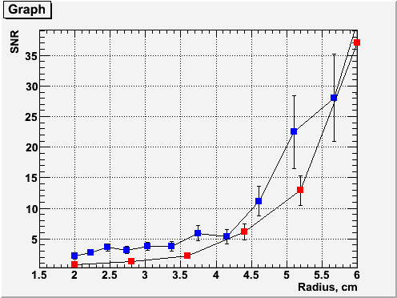
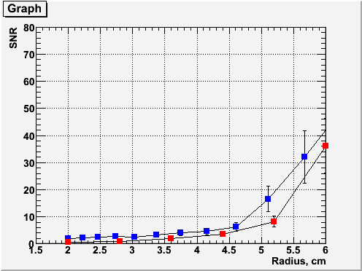
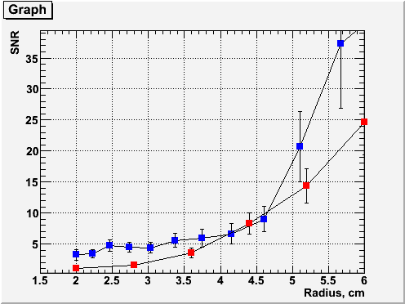
SNR for 50 GeV Electron
SNR in cell with maximum $E_{dep}$
Shower maximum – Layer 9
PS
US
Layer 7
Layer 11
PS
US
PS
US

Slide 21
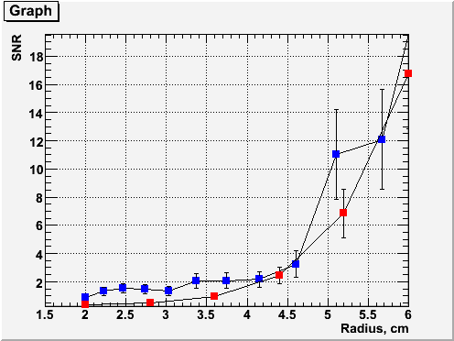
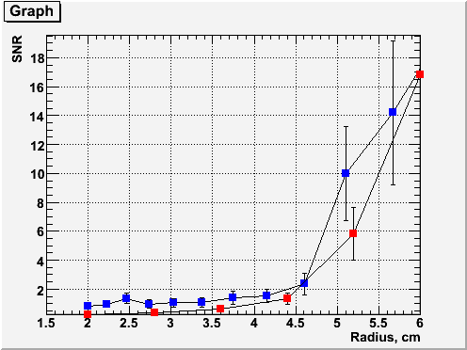
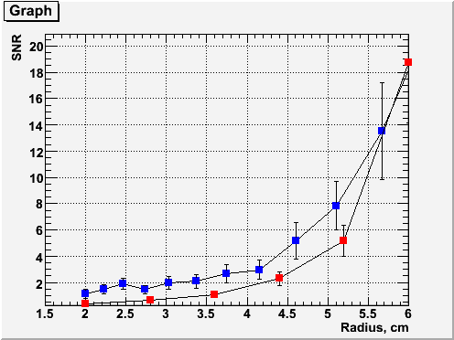
SNR for 20 GeV Electron
Shower maximum – Layer 8
PS
US
Layer 6
Layer 10
PS
US
PS
US

Slide 22
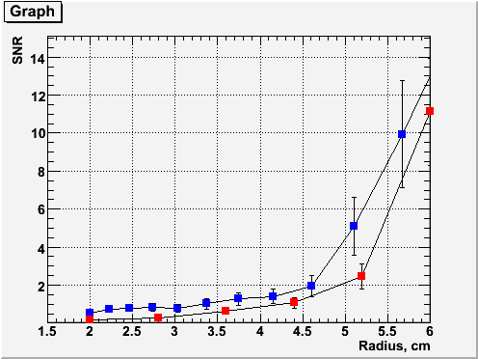
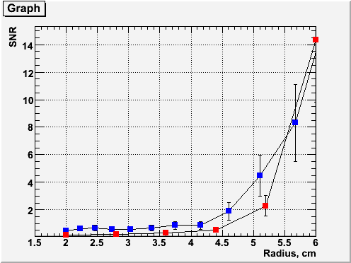
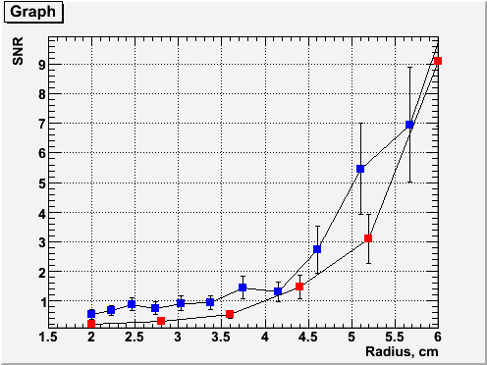
SNR for 10 GeV Electron
Shower maximum – Layer 7
PS
US
Layer 5
Layer 9
PS
US
PS
US
Notes:
+2 -2 layers – it is kind of testing of stability of our result
Dlya nizkih energiy mozhet byt chto snr v 9 sloe luchshe chem v 7 t.k. v 7om sloye bg vnosit bolshiy vklad.
Переделать все графики снр если останется время.

Slide 23
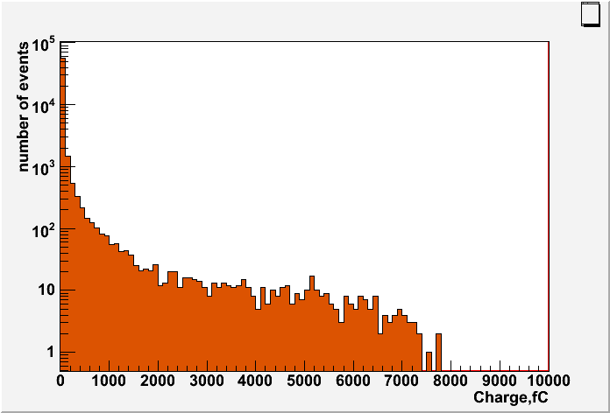
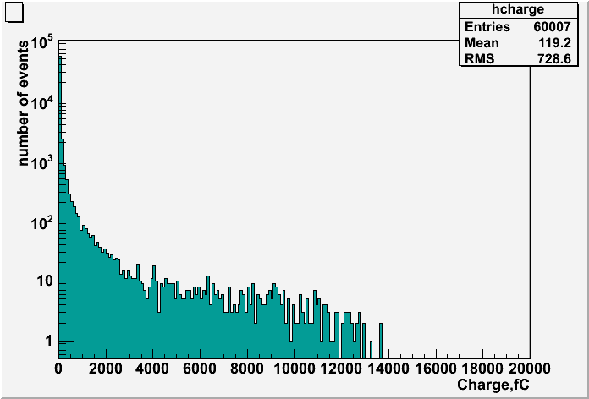
Charge range estimate
Distribution of the collected charge per pad for 500Gev electron showers
Diamond
GaAs
For Diamond sensor pad thickness 300 µm:
- Charge collected from MIP: 2.44 fC
- Maximum charge collected – for shower from 500 GeV electron: 12214 fC
(correspond to about 5000 MIPs)
Notes:
Ukazat kak rasschety provedeny? T.k energovydeleniye na yacheyku rastet (grubo) lineyno. I my znaem enorgovydeleniye dlya 100GeV – nogo electrona
Sdelat bolshe statistiki -> dodelat kod s ringo chtoby mozhno bylo mnogo input failov podavat’ v programmu bgaver_for_thisto_charge_collection…bla-bla-bla….

Slide 24
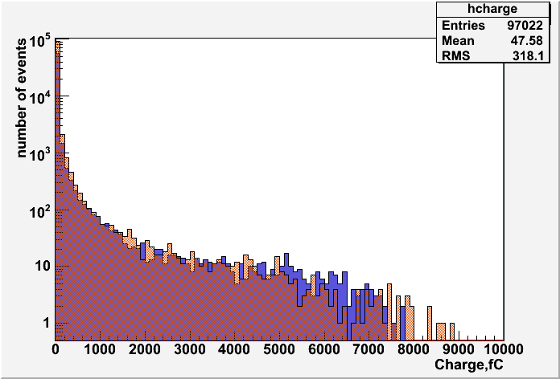
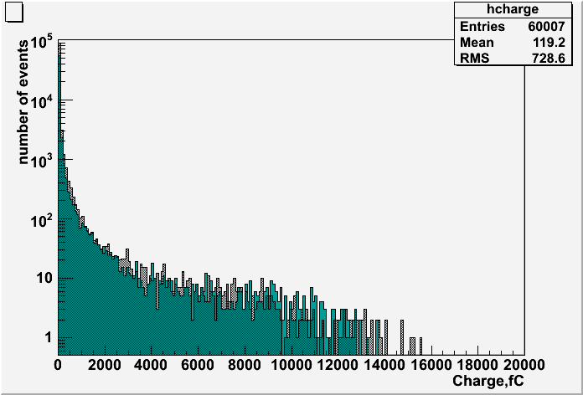
Diamond
Blue – Uniform Segmentation
Orange - Proportional
Distribution of the collected charge per pad for 500Gev electron showers
GaAs
Green – Uniform Segmentation
Blue - Proportional

Slide 25
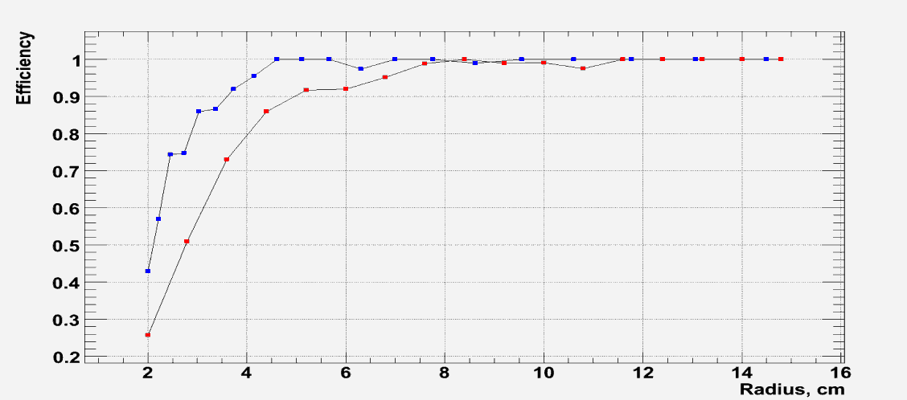
Efficiency of Showers Reconstruction
PS
US
$E_{e}$ = 200 GeV
Efficiency for 50 GeV
Efficiency = $\frac{Reconstructed SH considering BG}{Reconstructed SH without considering BG}$
Notes:
SDELAT’ v log – shkale!!!!!!

Slide 26
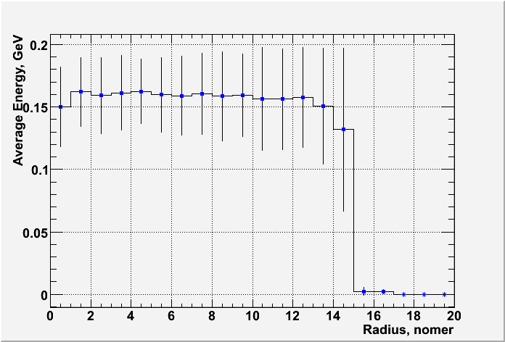
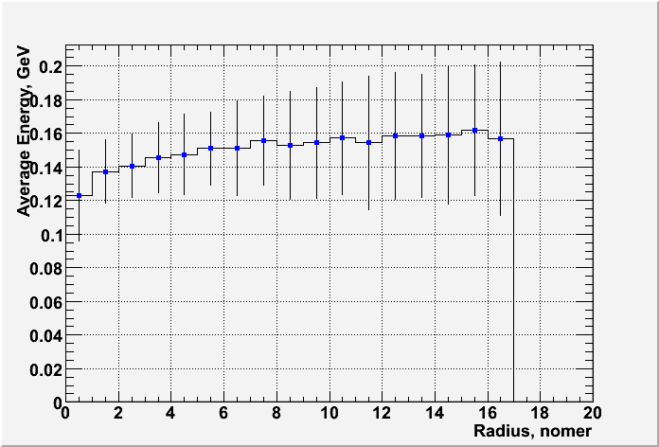
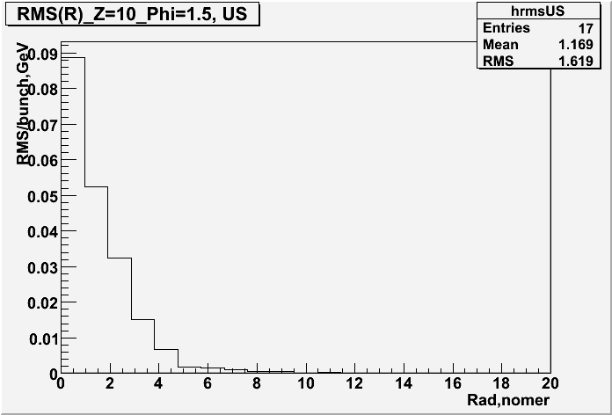
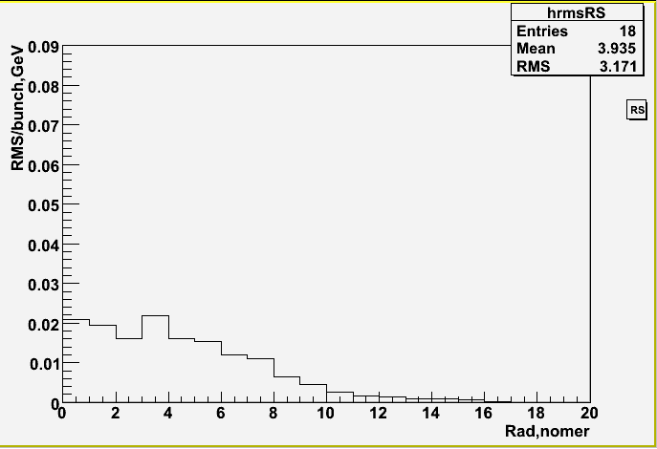
Signal and RMS for both Segmentations
The average energy in the pad of the core of shower
Signal nearly segmentation-independent!
Uniform
Segmentation
Proportional
Segmentation
RMS of the averaged Background
Proportional
Segmentation
Different distributions!
Uniform
Segmentation
20 bunch crossings were given
Notes:
SIGNAL ALMOST INDEPENDET OF SEGMENTATION!!
Peredelat grafik dlya rms chtob y os’ u PS byla takaya zhe kak u US

