Slide 1
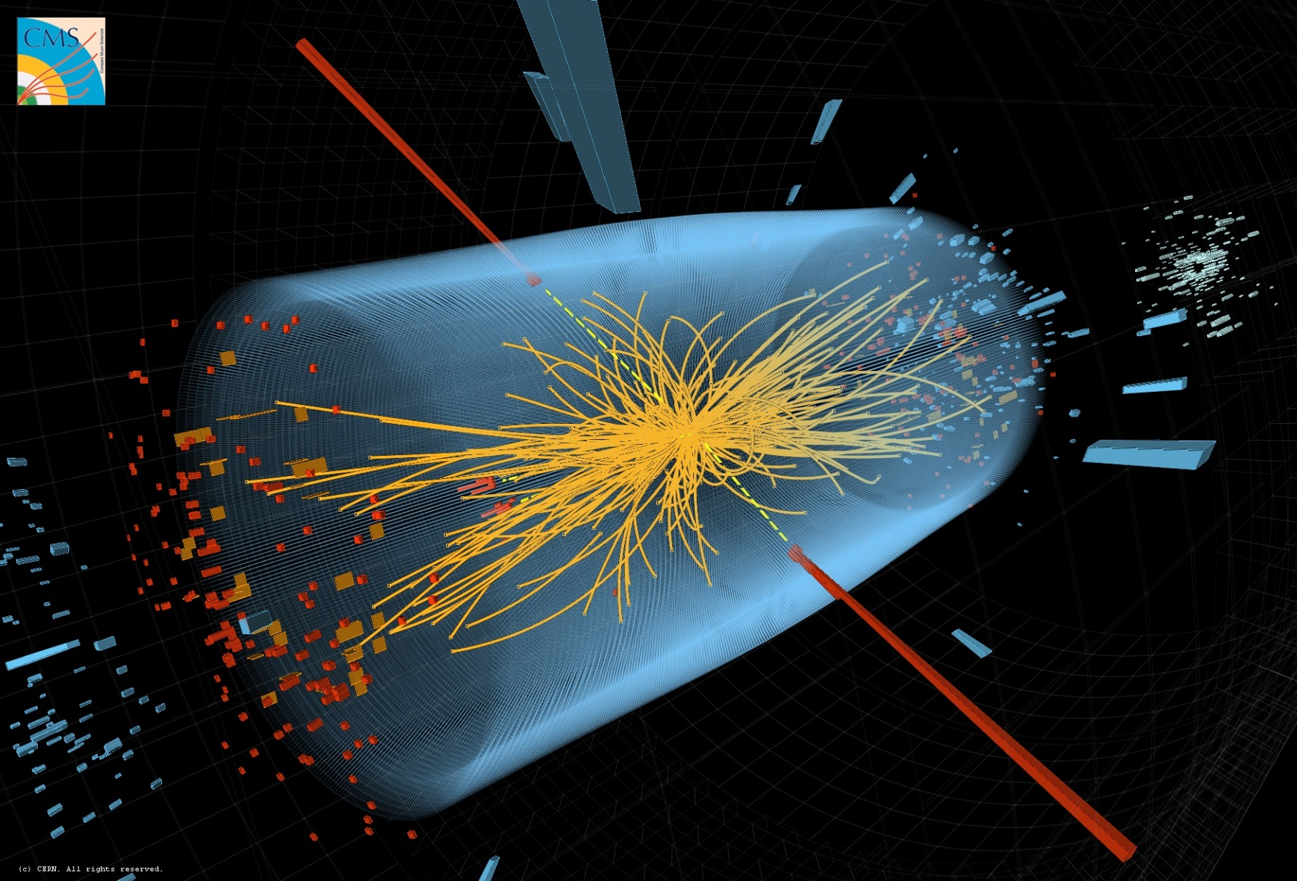
Fundamental Particles and Forces

Slide 2
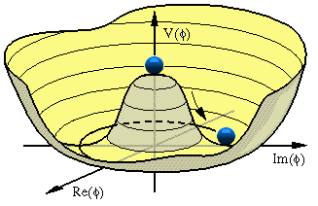
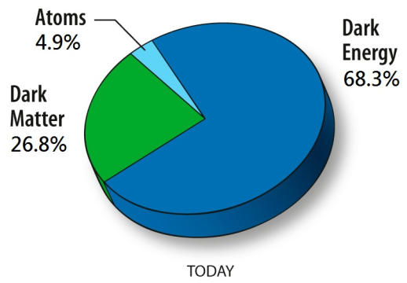
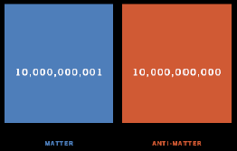
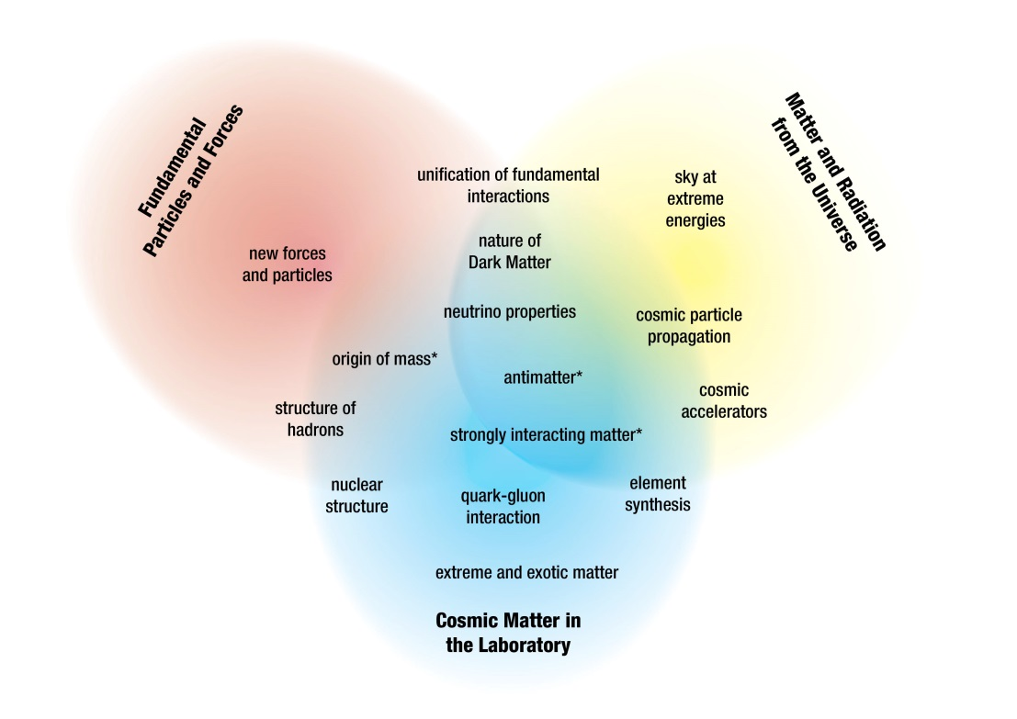
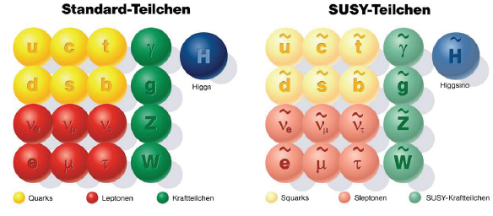
Elementary Particle Physics
The Big Questions:
  Origin of mass
  Nature of Dark Matter
  New forces and particles
  Matter-antimatter asymmetry
  Unification of fundamental forces
  …
Particle Physics in the programme context:

Slide 3

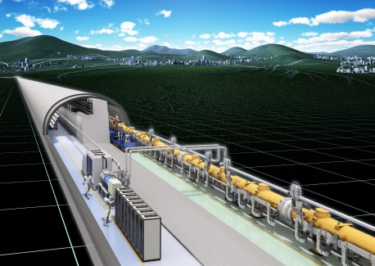
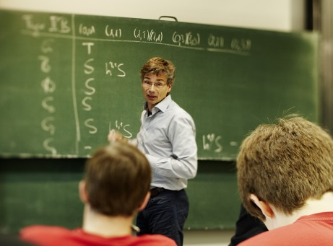
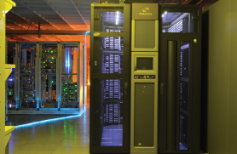
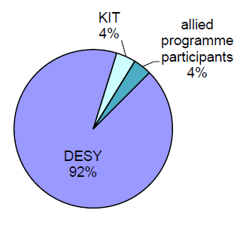

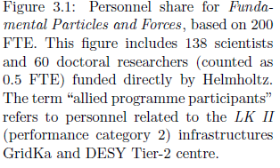

Elementary Particle Physics
The Big Questions require cutting-edge research in the triangle
  Proton-proton physics
  Large Hadron Collider (LHC)
  Electron-Positron Physics
  Belle (II)
  International Linear Collider (ILC)
  Theoretical Particle Physics
Computing Infrastructure
  Tier-1 GridKa
  Tier-2 DESY Grid Centre
Participating Helmholtz Centres
Personnel share financed by Helmholtz
Total 138 scientists plus 60 PhD students

Slide 4
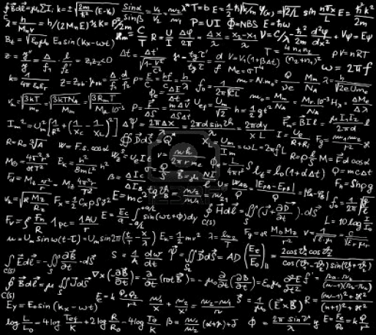
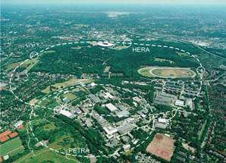
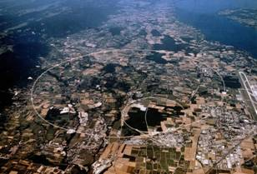
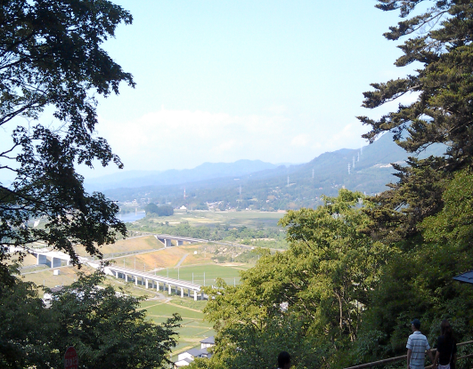
Particle Physics Strategy 2015-19
Maximum discovery potential
Highest sensitivity
Guidance and interpretation by theory
Theory
Strategy in agreement and supported by national and international roadmaps
HERA
LHC
ILC
Computing: Tier 1 & Tier-2, LSDMA
Detector & Accelerator development (→ Matter and Technology)
Testbeam

Slide 5
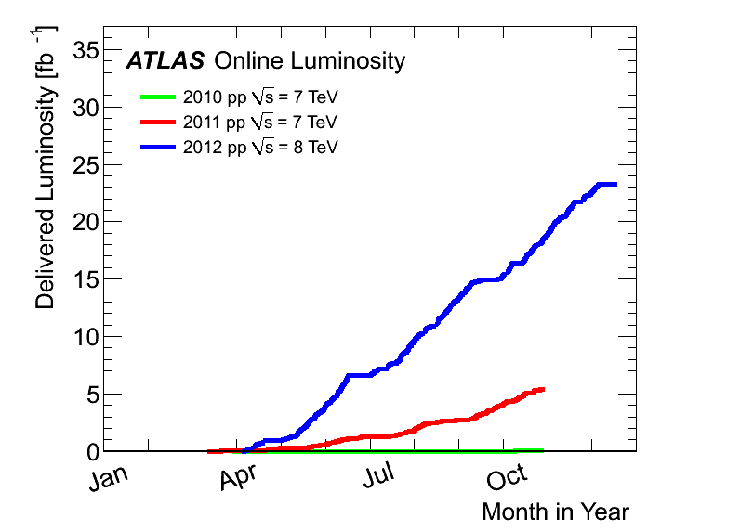
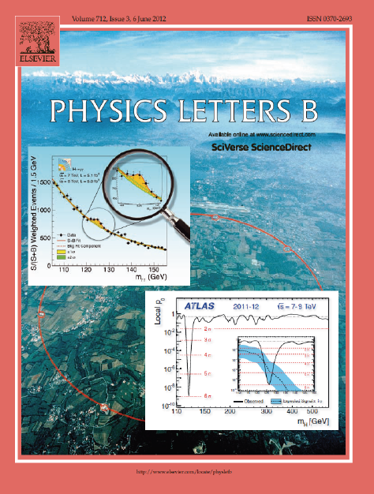
The Large Hadron Collider LHC
Very successful run in 2012 at 8 TeV
> 400 publications so far by each experimemt (ATLAS & CMS)
  Higgs discovery and properties
  Search for new physics
  Physics at 10⁻¹⁹ m
2013/14 consolidation work
  Preparation of LHC and experiments for full energy
  (14 TeV) from 2015
  work progressing on schedule

Slide 6
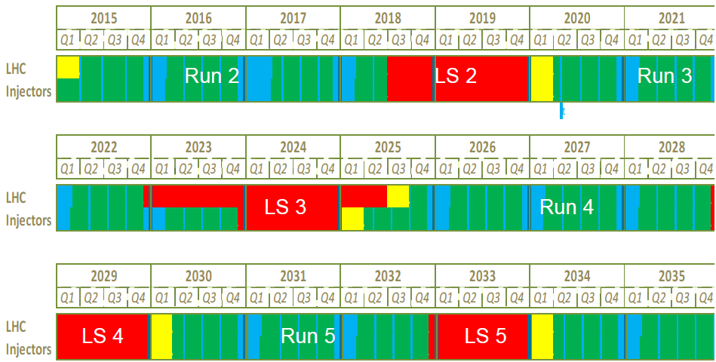
LHC Future
Physics programme until 2035
LHC just started:
  so far just about half the
  maximum energy reached
  8 TeV wrt. 14 TeV
  and 1% of the luminosity
  ≈ 30 fb⁻¹ by end of 2012
  ≈ 3000 fb⁻¹ expected by 2035
2015 ff LHC running at 13-14 TeV
  ≈ 100 fb⁻¹ by 2019
after 2022 High Luminosity LHC
  Increase luminosity beyond 10³⁴/cm²/s by approx factor 5 to 10
F. Bordry, 02.12.2013
Major detector upgrades required
Mainly tracking detectors
Reach end of their lifetime with O(300 fb⁻¹)
Higher luminosity requires finer granularity and trigger capabilities

Slide 7
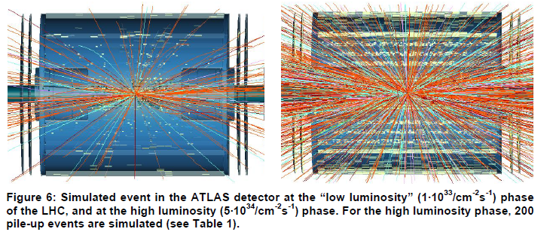
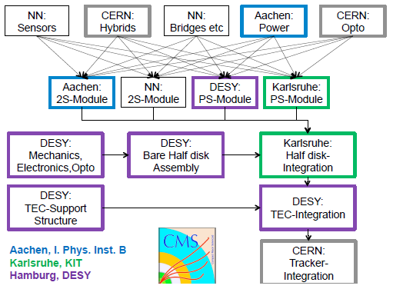
LHC Detector Upgrades
Proposal for Helmholtz Strategic Large Investments
  DESY: 20 M€ for investments into ATLAS & CMS tracker (phase II)
  KIT: 3.8 M€ for CMS electronics
  GSI: 4.2 M€ for ALICE TPC
Proposal in preparation
  To be considered in this evaluation for submission 2nd half 2014
Coherent approach with
national and international
partners
  e.g. plan for CMS tracker endcap

Slide 8

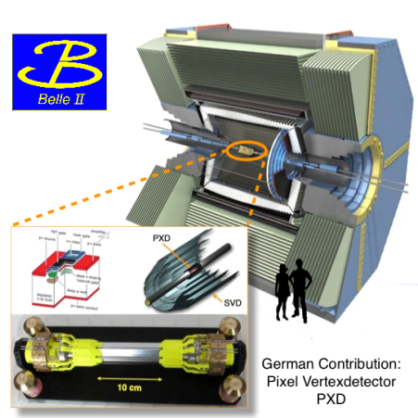

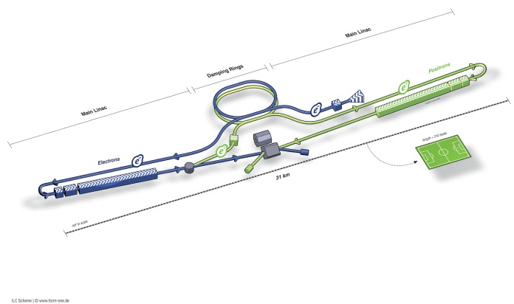
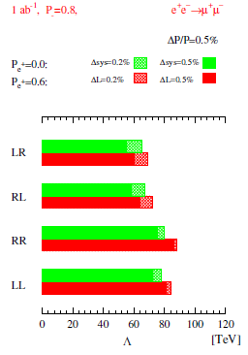
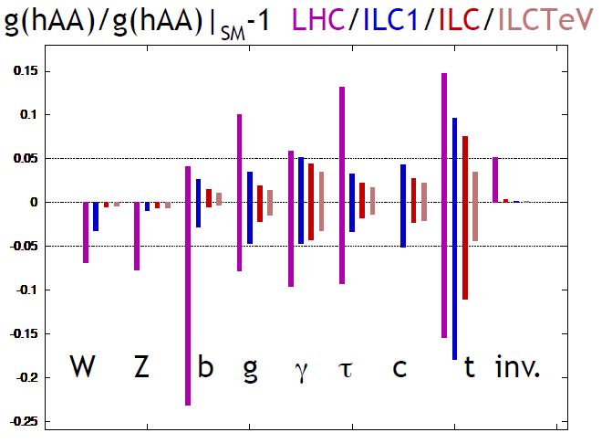
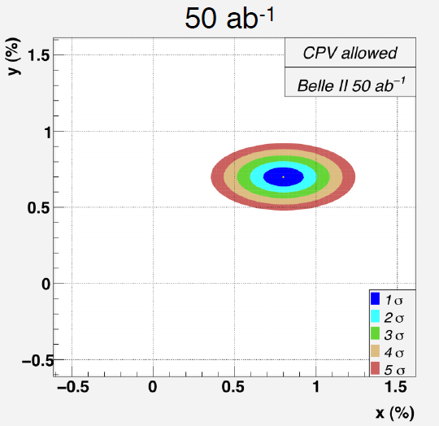
Electron-Positron Physics
Precision physics through collisions of fundamental particles:
Model-independent studies of the Higgs
Indirect signals of New Physics at high mass scales
Matter-Antimatter Asymmetry

Slide 9
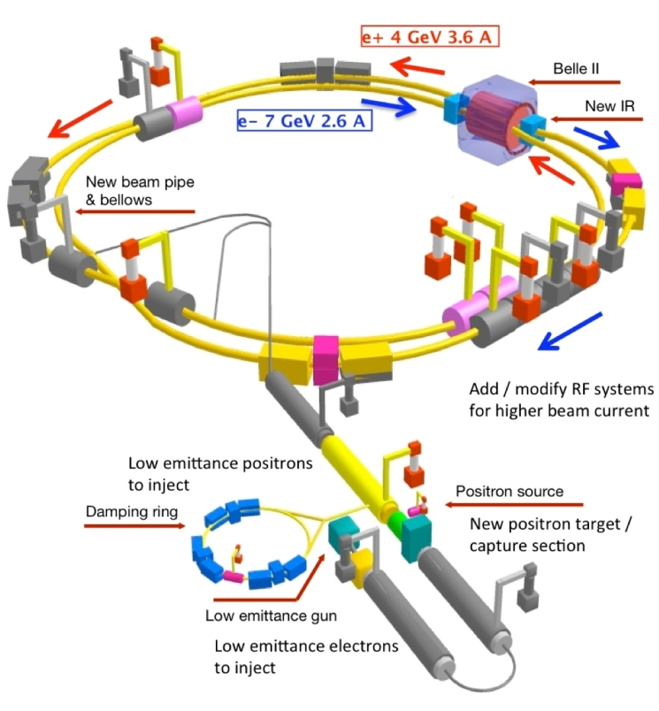
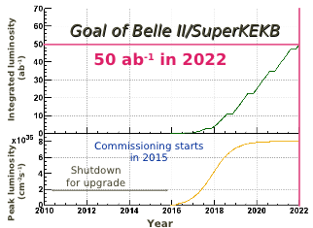

BELLE II at SuperKEKB
German contribution: pixel vertex detector in DEPFET technology
  Germany 2nd largest country in BELLE II, one of the largest HEP projects in D
Helmholtz: support German Belle II groups by exploiting specific infrastructure and expertise available
  Cooling, mechanics, alignment , testbeam, …
Computing
  Tier-1 at GridKa
  Tier-2 at DESY
Install & commission vertex detetor in 2016
Accumulate > 3 ab⁻¹ by 2019

Slide 10
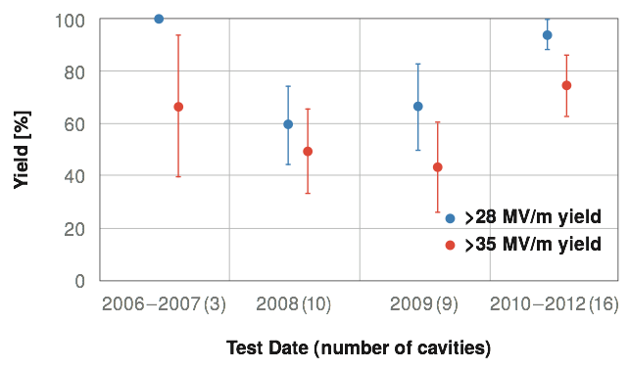
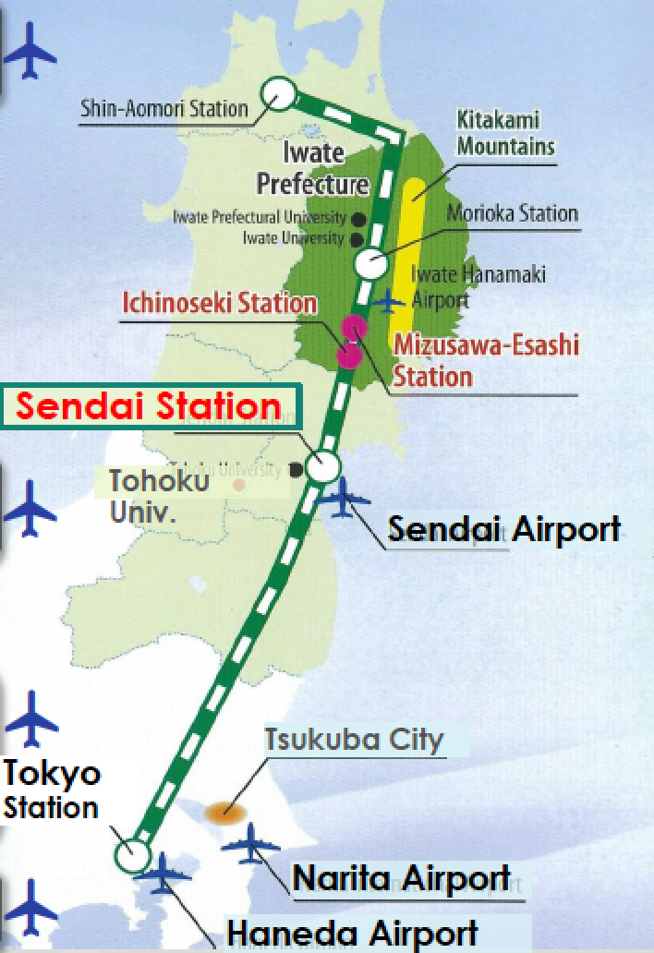
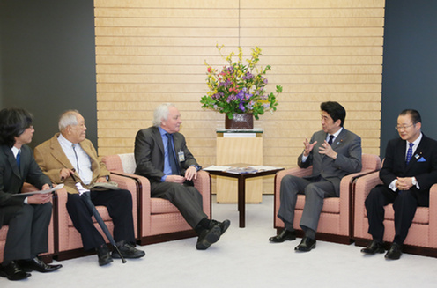
International Linear Collider
From ILC TDR
2013: Technical Design Report submitted and evaluated
  R&D goals reached
  Synergy with XFEL construction
Strong interest by Japanese scientists and politics to host the ILC
  Selection of a site in northern Japan
R&D for accelerator & detector
  Strong synergy with
  Matter & Technology

Slide 11

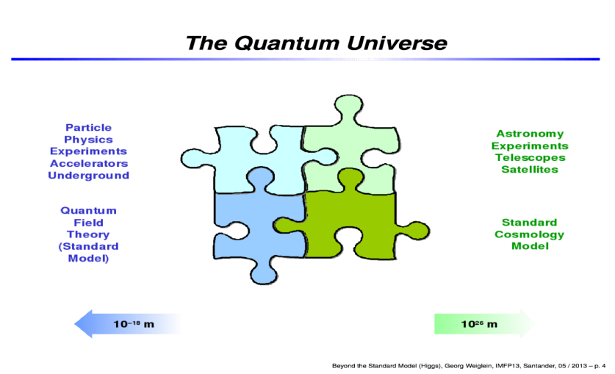
Particle Physics Theory
Maintain and develop strong particle physics theory in Helmholtz with a broad spectrum
  Collider phenomenology
  Particle cosmology
  Lattice field theory
  (Neumann Institute for Computing,
  collab. with Jülich and GSI)
  String theory
The novel activitity of KIT particle physicist in Helmholtz is an element of the strategy to foster the collaboration of different HGF centres.
Deeply rooted in experimental programme
  Analysis Centre of Helmholtz Alliance, SFB
Theory is very closely integrated with local Universities (Hamburg, Berlin, Karlsruhe, theory & exp. groups)

Slide 12
Particle Physics Theory
Shapes theoretical particle physics in Germany & beyond
  Lectures, schools, workshops, …
Pillar of theoretical particle physics in Europe & beyond
  Conferences, fellows, networks, …
  Example: > 50% of theory staff member in Germany have a DESY history
Many cooperation projects:
  Helmholtz Alliance Physics at the Terascale
  DFG: SFB 676, SFB TR 9, Emmy‐Noether YIG
  EU: Higgstools, GATIS, IntGaugeString, LHCphenonet, HadronPhysics III, Flavianet
  Grants: Alexander von Humboldt, Joachim‐Herz‐Stiftung
  Industry: Wolfram Research, Maple Soft, RISC Software GmbH

Slide 13
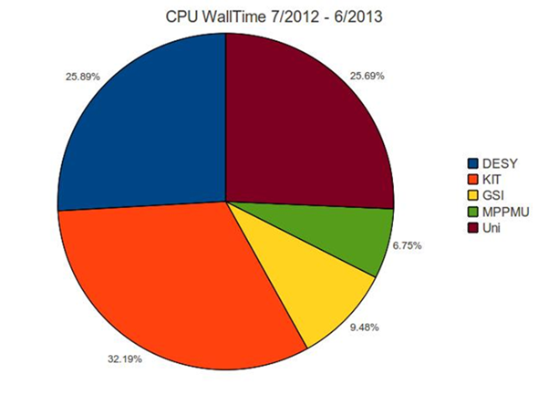
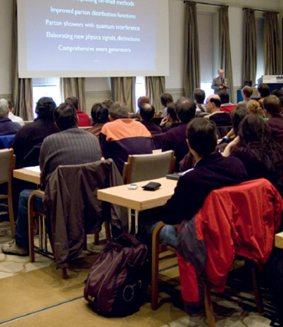
Infrastructure
LK II topics: GridKa and DESY Grid Centre
  German Tier-1 centre at KIT (GridKa)
  DESY operates Tier-2 centres for ATLAS, CMS, LHCb
  NAF as crucial element for LHC analyses in Germany
  Helmholtz provides > 2/3 of the German LHC computing share!
DESY testbeam (→ next slide)
Laboratory for large detectors
  Intended as detector development hub for particle physics (LHC) in Germany
  → LHC Detector Upgrade
Alliance Physics at the Terascale
  Platform for exchange in German HEP community
  physics, detectors, computing
  Analysis Centre at DESY as central hub
  Education: ≈ 15 schools& workshops per year
  attracting many young people
  Common events of the 3 Alliances (→ MUTLINK)
Univer
sities
DESY
MPG
KIT
GSI

Slide 14
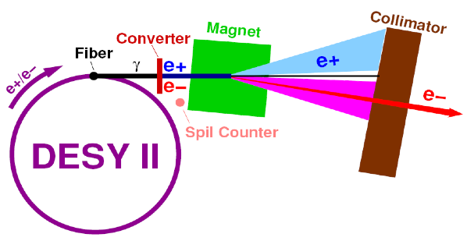
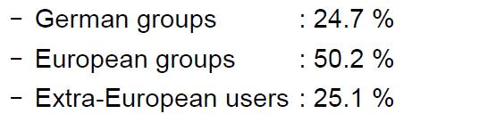
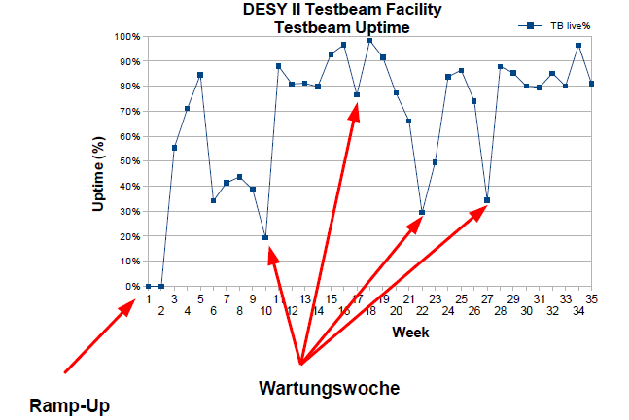
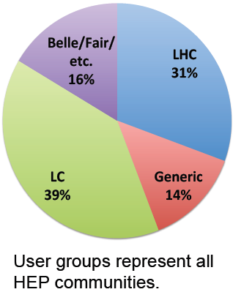

DESY Testbeam
Increasingly important facility for detector R&D
→ Matter & Technology
Used by many projects
  $≈$300 users in 2013

Slide 15
Summary & Conclusions
Exciting times for particle physics
Proton-proton physics at the LHC:
  spectacular discovery of a Higgs boson
  just started and 20 years more to come
Electron-positron physics:
  BELLE II: complementary physics to LHC (precision)
  ILC: strong physics case, encouraging developments in Japan
Theory
  great opportunities for major progress in understanding the fundamental laws of nature
Helmholtz Particle Physics programme 2015-19
  addresses these challenges
  is aligned with national and international roadmaps

Slide 16
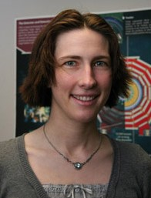
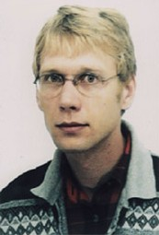
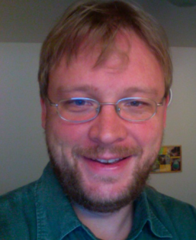
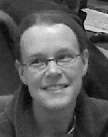
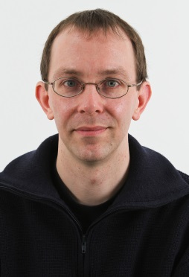
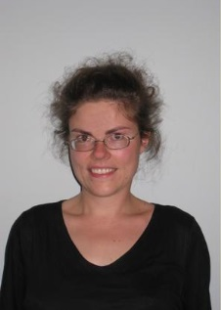
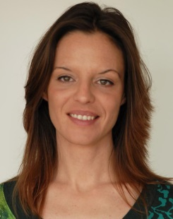
The Guarantors of the Future:
Leaders of Young Investigator Groups
2009 Isabel
Melzer-Pellmann
CMS SUSY
2009 Alexei Rasperezza
CMS Higgs
2010 Alexander Westphal
Theory Cosmology
2011 Kerstin Tackmann
ATLAS Higgs
2012 Frank Tackmann
Theory Phenomenology
(Emmy Noether)
2012 Yvonne Peters
ATLAS top physics
2014 María Aldaya Martín
CMS top physics

