Slide 1
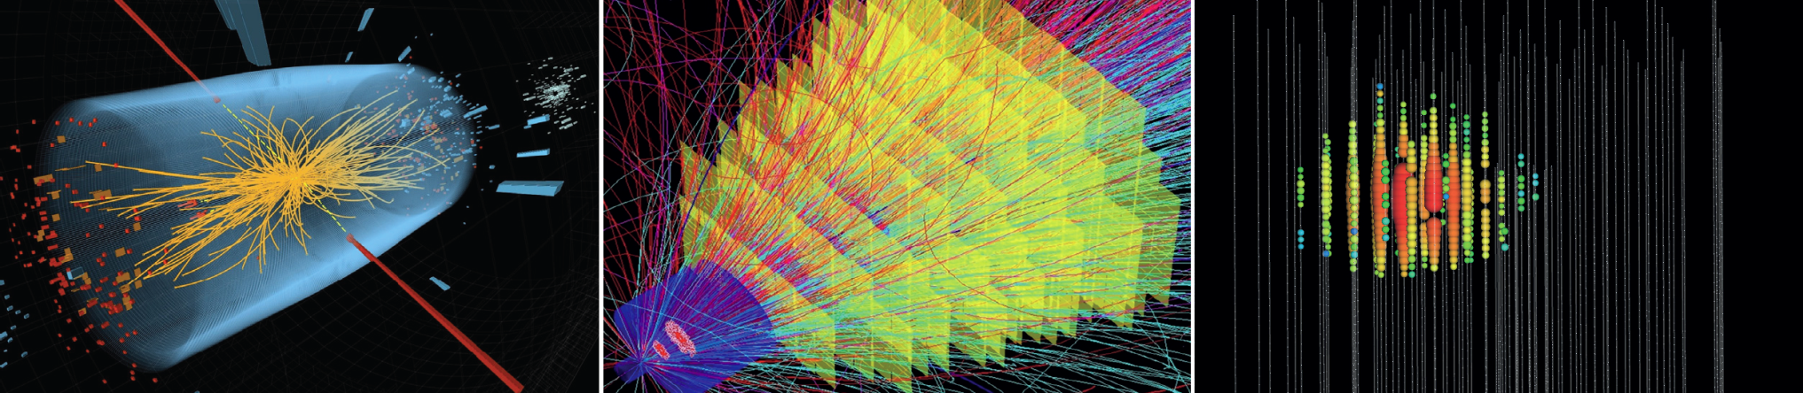

Matter and the Universe
Cosmic Matter in the Laboratory
FZJ, GSI, HIM
Frank Maas – Helmholtz-Institute Mainz

Slide 2
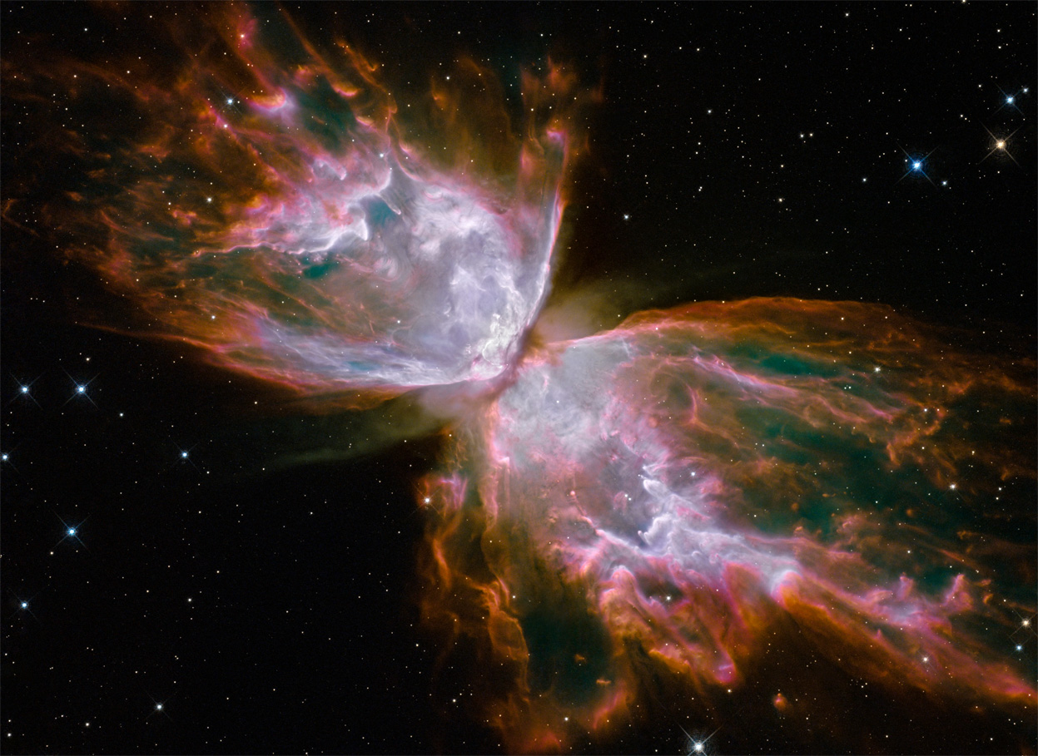
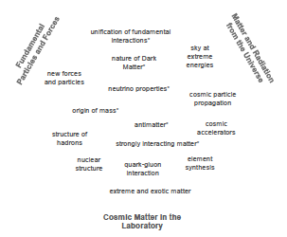
Role of the Strong Force in the Evolution of the Universe
Essential Role in the Early Universe
Evolution of Stars
Synthesis of the Elements
Binds Nuclear Matter
Spectrum and Structure of Hadrons
Generates 98% of Visible Matter
Butterfly Nebula NGC 6302

Slide 3
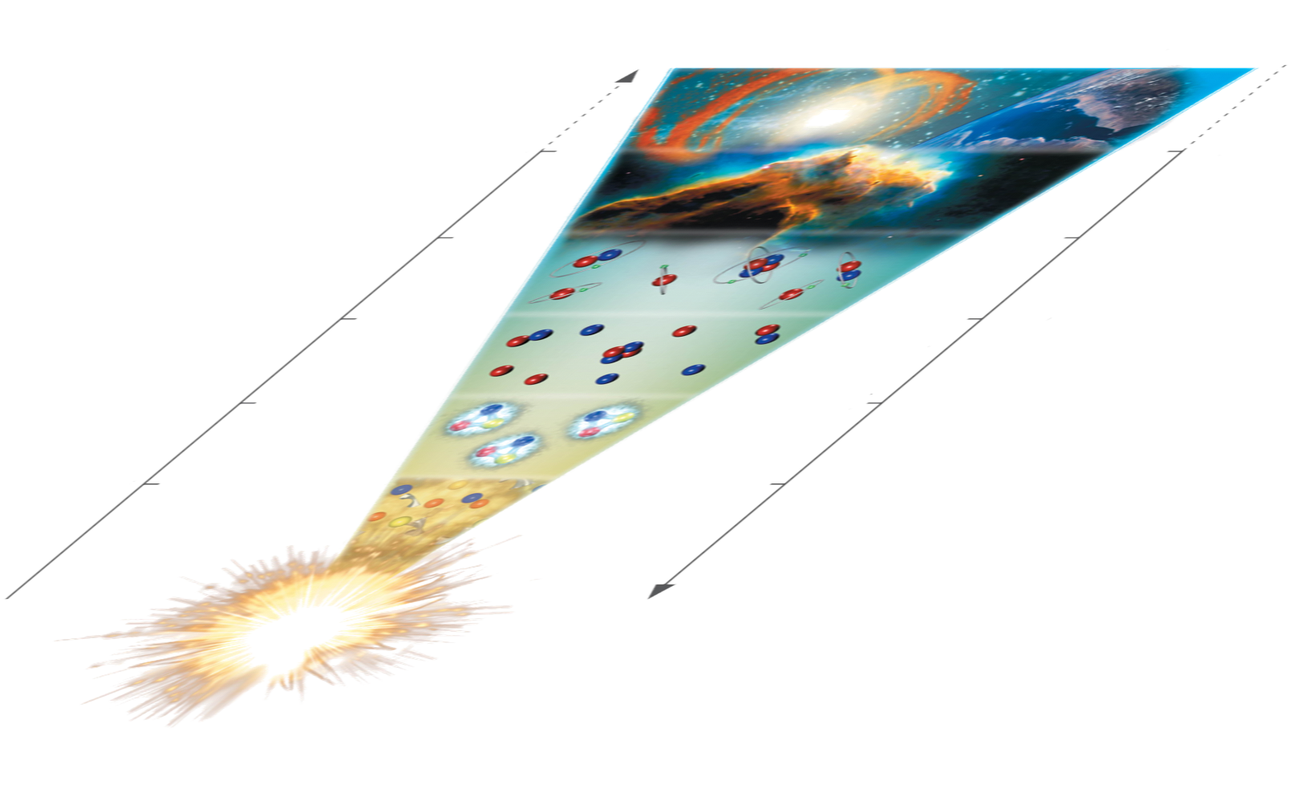
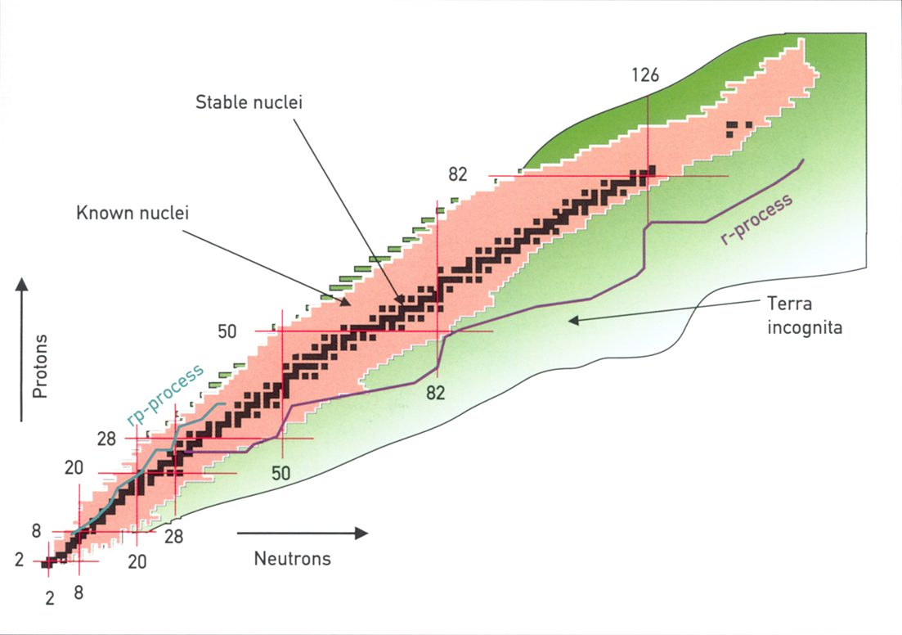
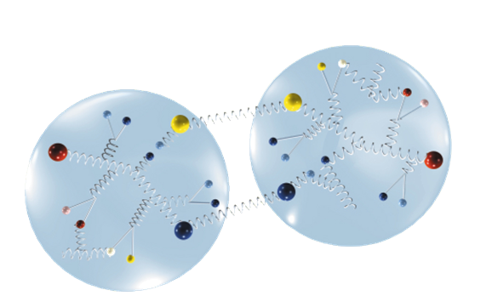
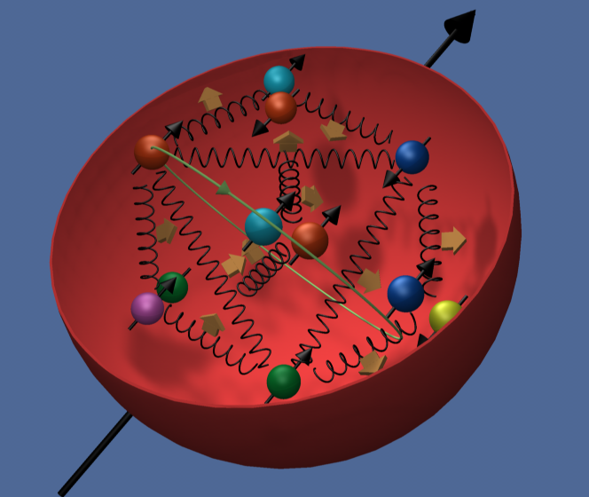
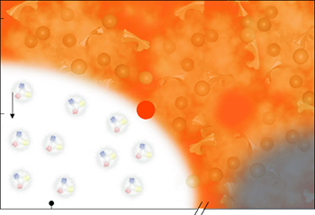
Understanding the universe at the largest and smallest scales and
under extreme
nuclear conditions.
Nuclei
15 billion years
3 K
1 billion years
20 K
Cold Hadrons
300.000 years
3.000 K
3 minutes
Freeze-out
10⁹ K
1 millisec
temperature
10¹² K
time
EDM
Genesis of Quarks
Find a better understanding of matter that is composed of quarks and gluons

Slide 4
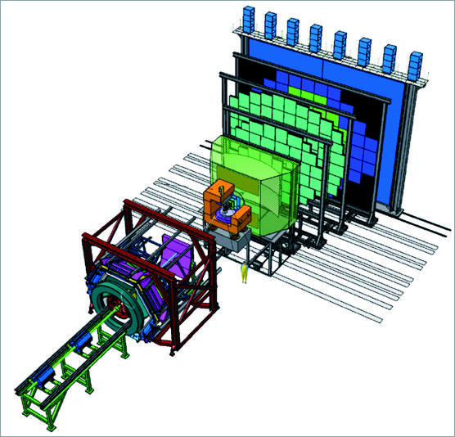
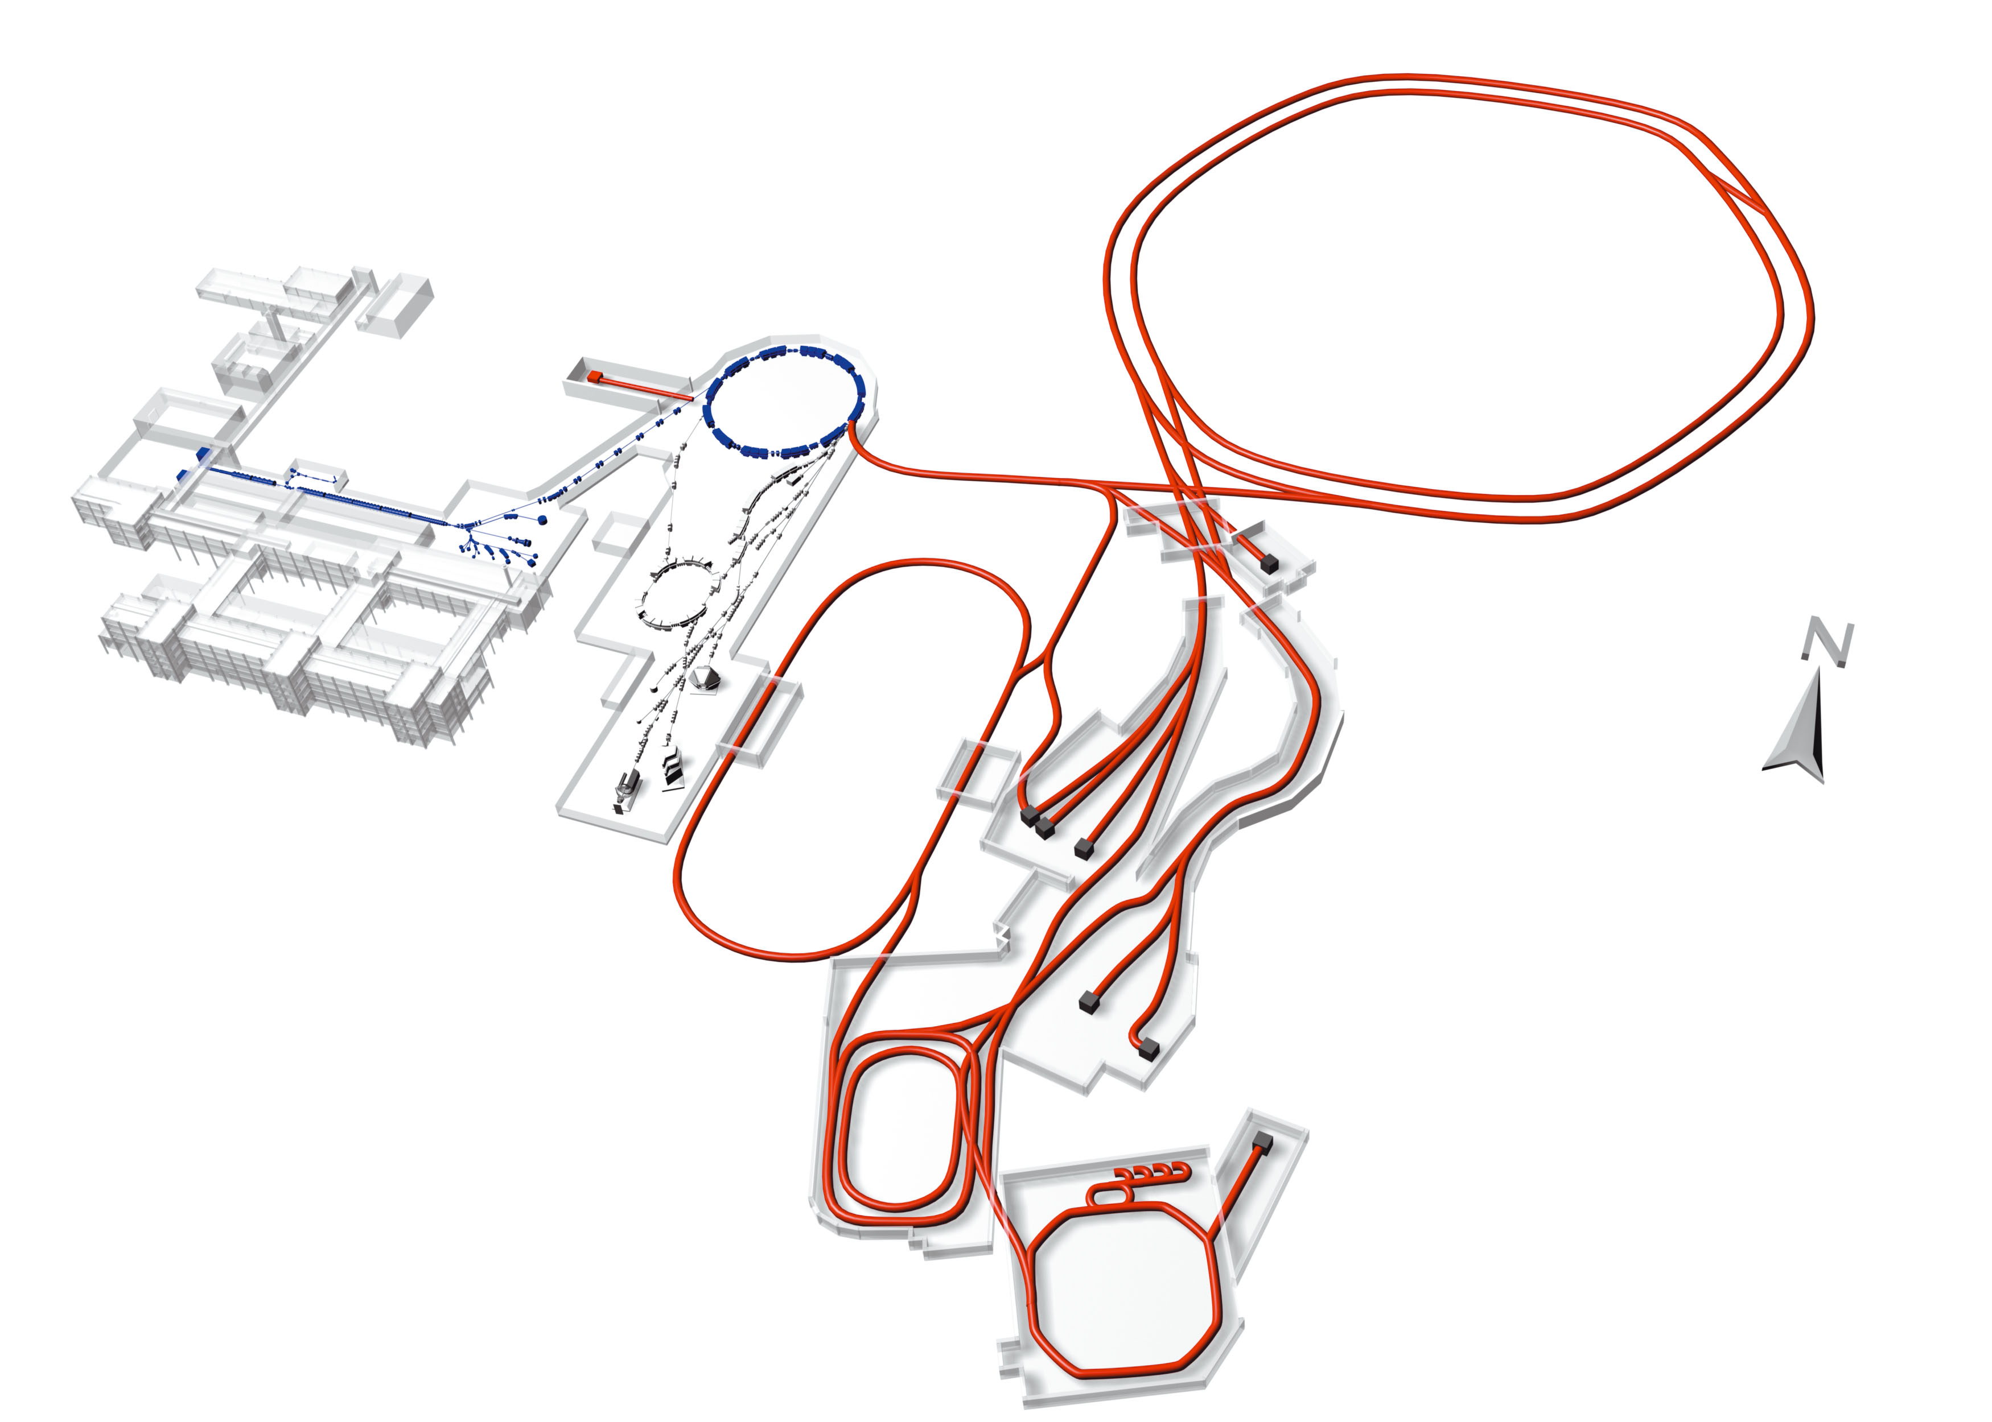

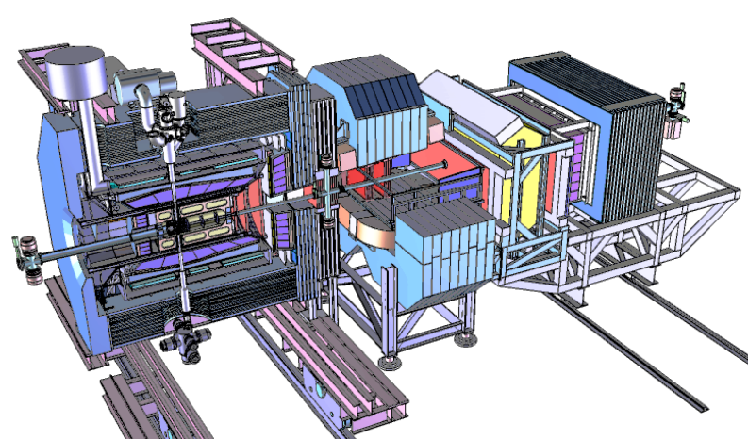

The Future: FAIR
New Quality for Research
Intensity: 100 – 10 000 x
Energy: 20 x
Precision in beam quality by
high brilliance
Antimatter
Synergy: 4x parallel operation
„cost-effectiveness“ !!!
SIS 100/300
SIS 18
CBM
UNILAC
ESR
APPA
HESR
Super
FRS
Super-FRS
Time Schedule, Costs, Users
Building in Modules, starting: modules 0 – 3
Building Costs: appr. 1.027 Bill. €´05
Users: approx. 2000 - 3000 per Year
CR
NuSTAR
PANDA
RESR
NESR
Financing
existing facility
new facility
100 m
65 % Federal Government
10 % State of Hesse
25 % International Partners

Slide 5
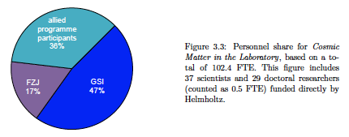
Cosmic Matter in the Laboratory (FZJ, GSI, HIM)
GSI: HIC4FAIR, EMMI,HGShire
HIM
EDM
Fair Construction:
Accelerator and
Experiment
Strong Link to MuT
Fair Construction:
Accelerator and Experiment
FZJ
GSI

Slide 6
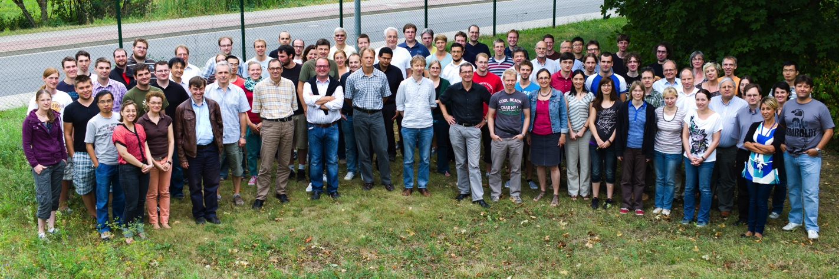
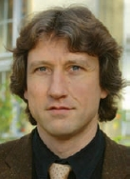

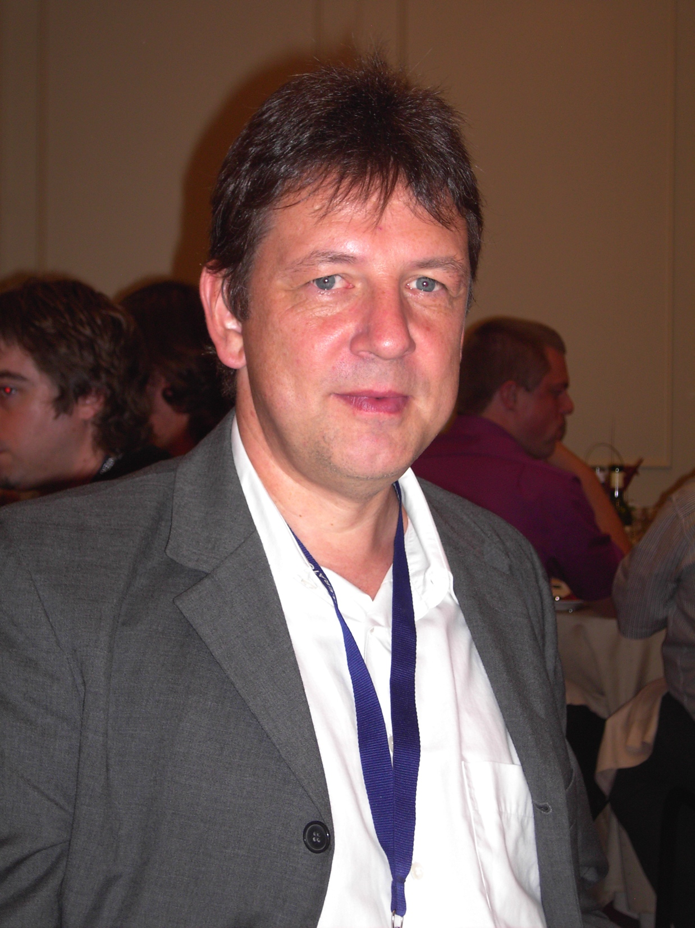


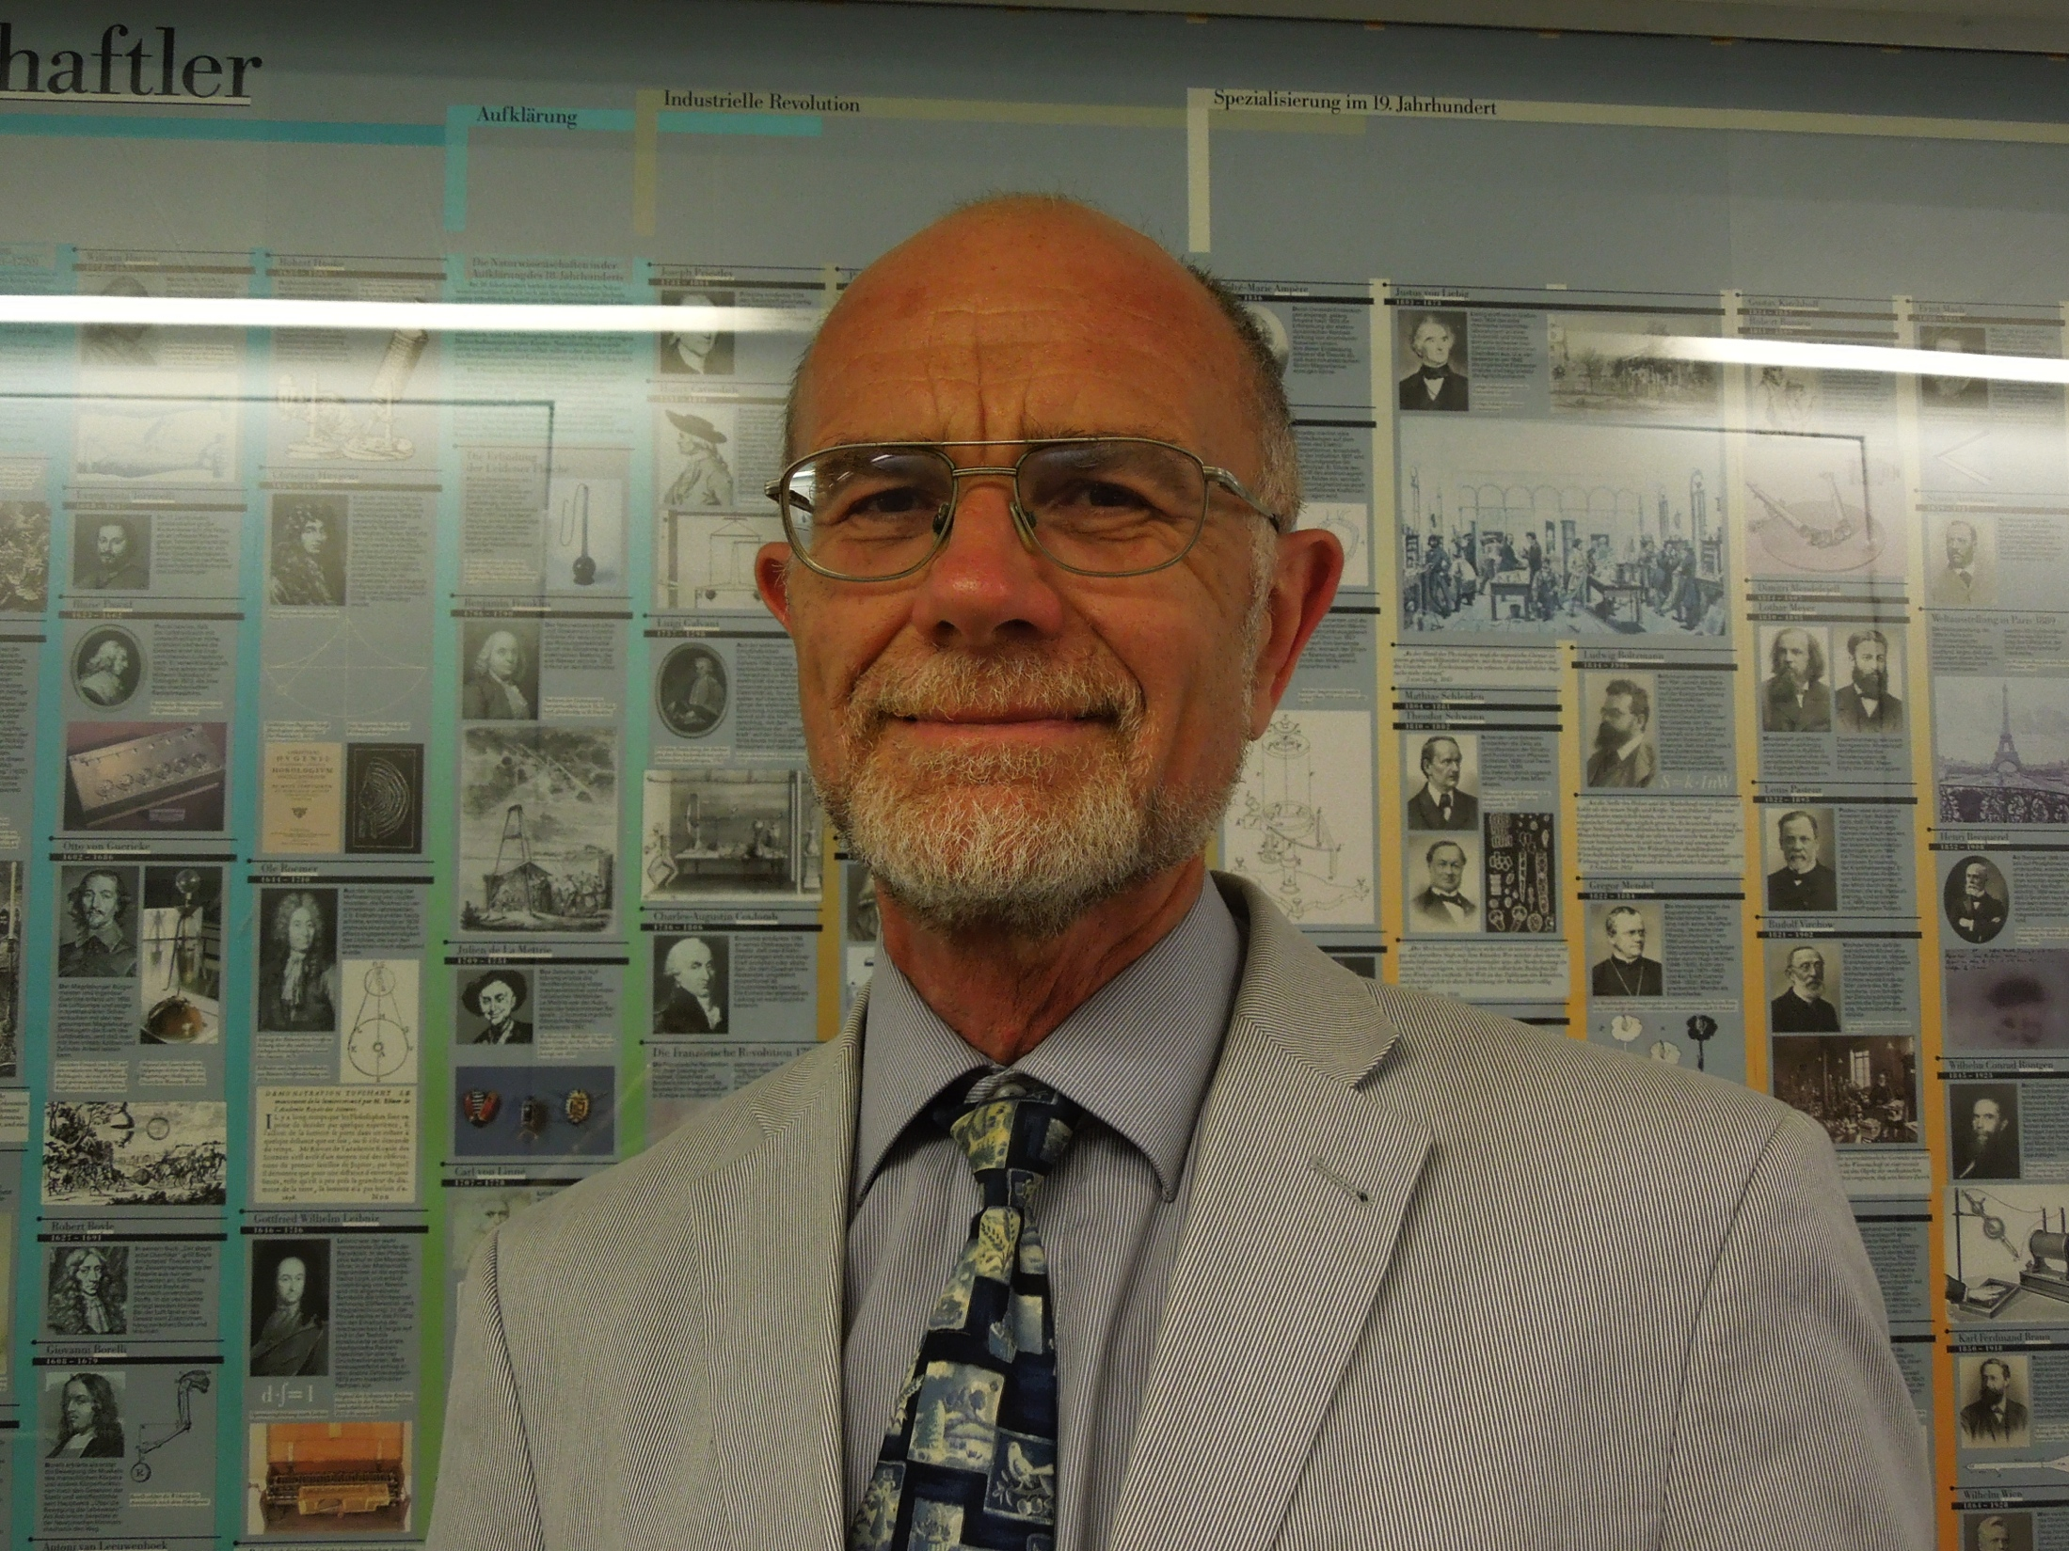


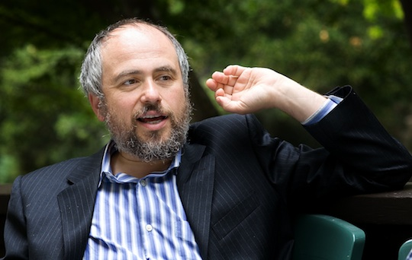
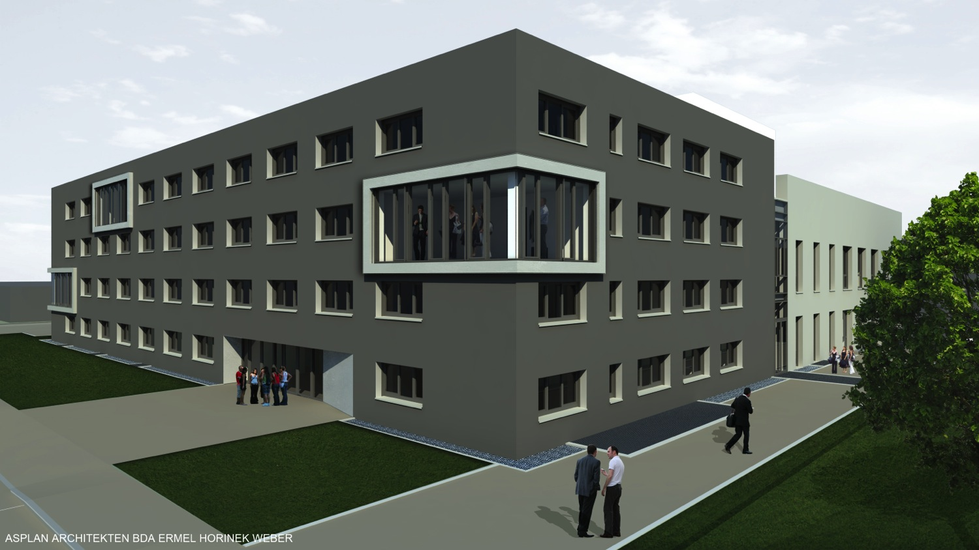
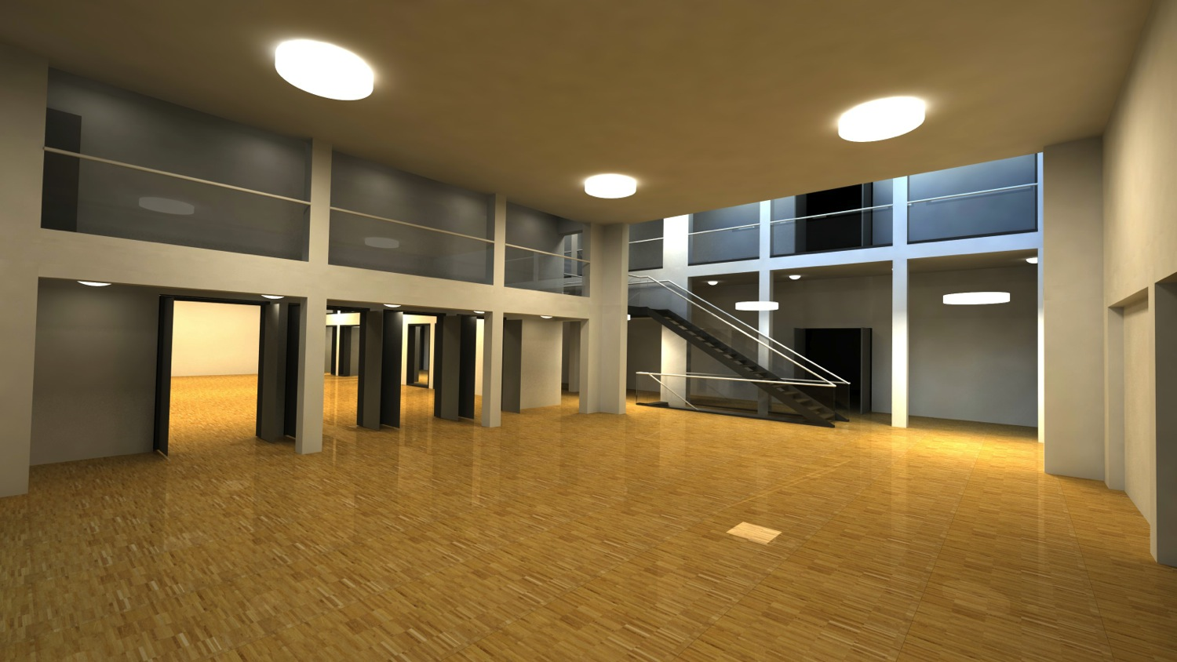


Helmholtz-Institute Mainz (since 2009)
Strategic Alliance with JGU Mainz
Scientists (~70 out of 150)
Leading Scientists
(4 new Professors)
4.95 M€
Mainz University
5.55 M€
Operational Budget
Cluster of Excellence
New Research Building, RLP, (35 M€), Wissenschaftsrat, 2015 finished

Slide 7


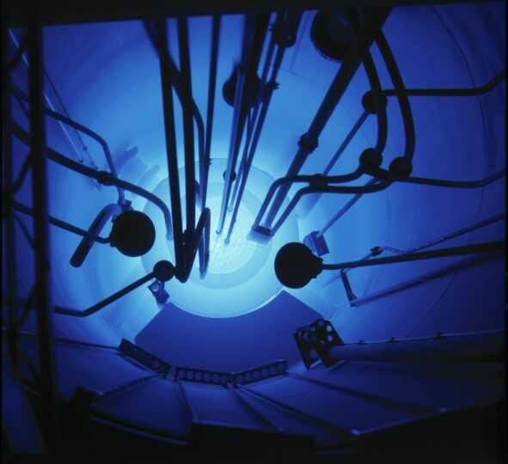
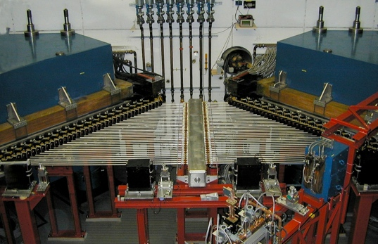


HI Mainz: Structure, Symmetry and Stability of Matter and Antimatter
division of GSI at the campus of the university
founded in 2009
Antiprotons: Hadron Structure and Spectroscopy with PANDA
and Atomic Physics
&
Superheavy Elements (SHE)
Chemistry and Nuclear Physics
Hadron Physics Theory: Nucleon Structure and Charmonium Spectroscopy using Lattice QCD and Phenomenology
Accelerator Science: Electron cooling for antiproton HESR and SRF-CW-Linac
MAMI Mainz
1.6 GeV electrons
TRIGA Mainz
Neutrons, UCN
Cluster of Excellence

Slide 8
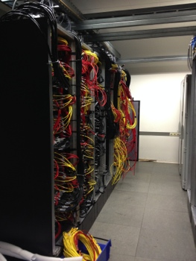
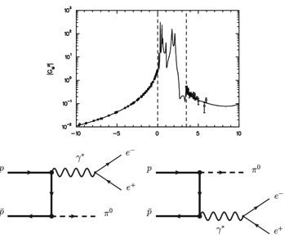
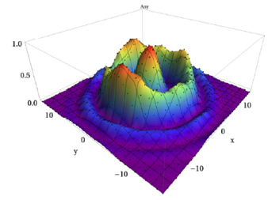
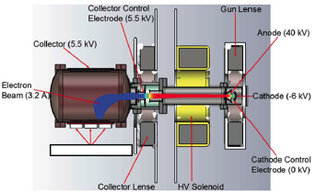
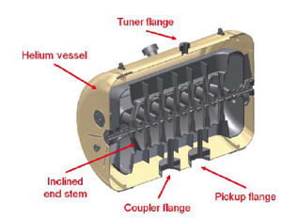
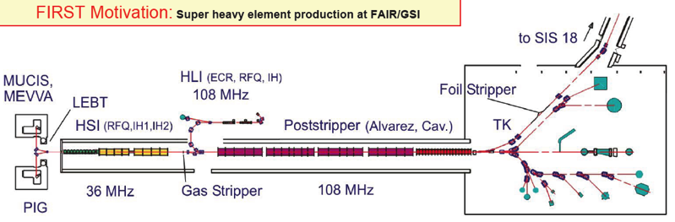
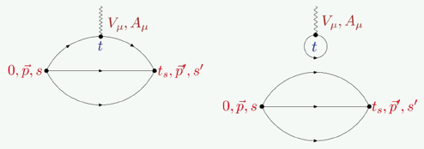
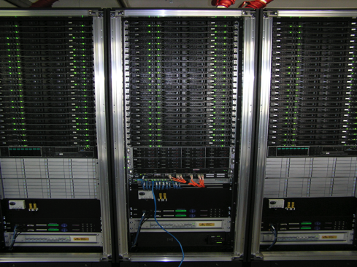
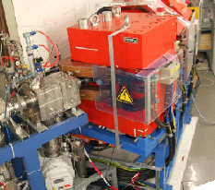
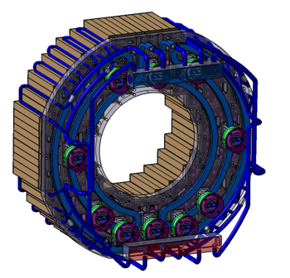
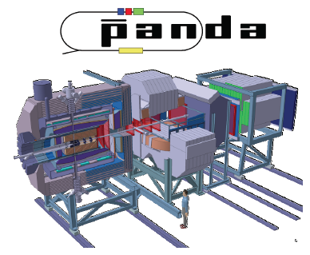
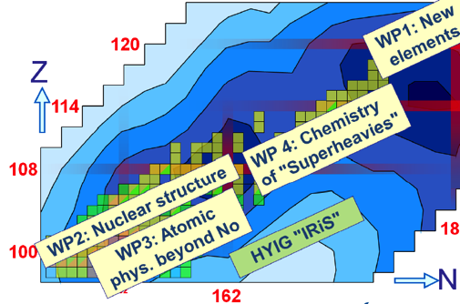
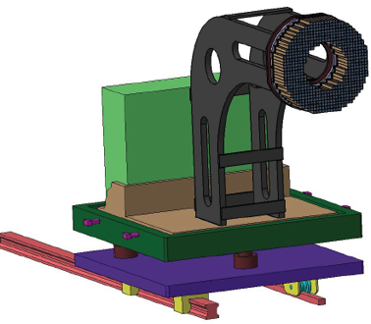
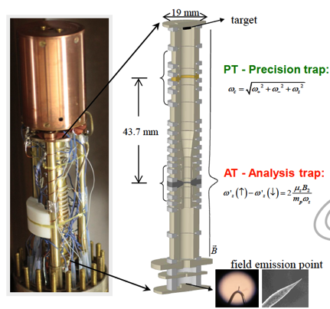
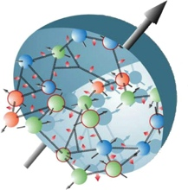
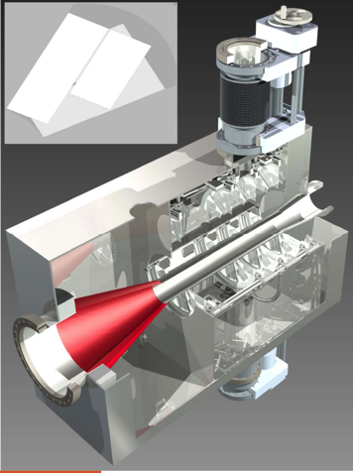
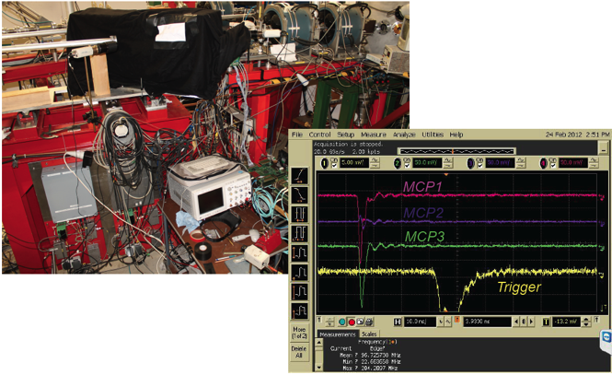
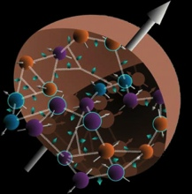


HI Mainz: Structure, Symmetry and Stability of Matter and Antimatter
Theory Floor
Accelerator and
Integrated Detector:
SHE LINAC Demonstrator
HESR Cooler, ENC
THFL
ACID
Electromagnetic Processes in
Antiproton Annihilation:
PANDA, HypHi, ENC
Physics and Chemistry of
Superheavy Elements
Z=120, 119
EMP
SHE
Matter-Antimatter
Symmetry in Atomic Physics:
FLAIR
Spectroscopy and
Flavor:
PANDA, ENC
MAM
SPECF
Cluster of Excellence

Slide 9
HI Mainz: Structure, Symmetry and Stability of Matter and Antimatter
Theory Floor
THFL
ACID
Antiprotons at FAIR
Accelerator Science
SHE LINAC Demonstrator
HESR Cooler, ENC
Nucleon Structure:
PANDA, HypHi, ENC
Physics and Chemistry of
Superheavy Elements
Z=120, 119
EMP
SHE
Superheavy
Elements
MAM
Anti-Hydrogen, Anti-p:
FLAIR
Charmonium
Spectroscopy
PANDA, ENC
SPECF

Slide 10
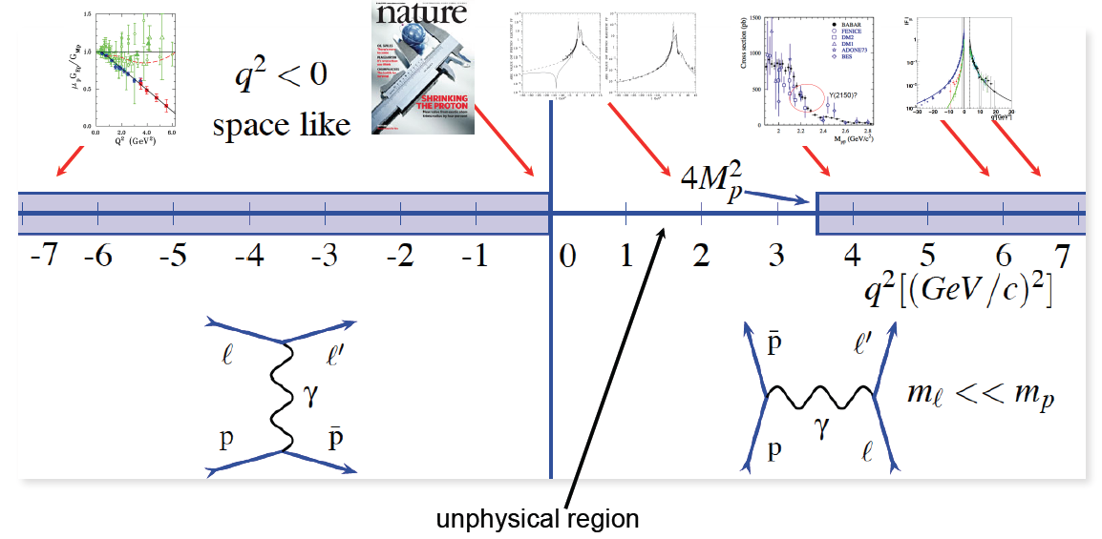
Example: Electromagnetic Form Factors of the Nucleon

Slide 11
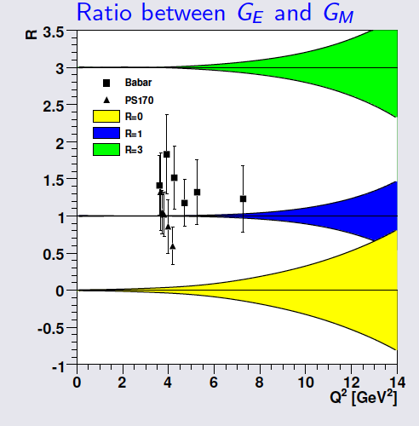
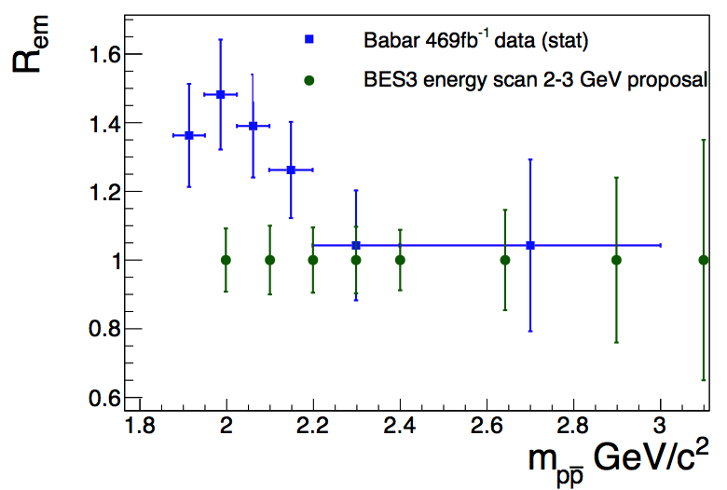

Sensitivity fpr the Electromagnetic Form Factors of the Nucleon
Simulations
Simulations
Goal: Same Accuracy as in Space-like Regime
(electron scattering)

Slide 12
Helmholtz-Institute Mainz
Detectors for PANDA
Backward EndCap Calorimeter
Luminosity Monitor
Hypernuclear Germanium Detector
Planar Tracker GEM
Online Trigger
In close collaboration with FZJ and GSI-Da

Slide 13
Cosmic Matter in the Laboratory (FZJ, GSI, HIM)
GSI: HIC4FAIR, EMMI,HGShire
HIM
EDM
Fair Construction:
Accelerator and Experiment
Fair Construction:
Accelerator and Experiment
FZJ
GSI

Slide 14




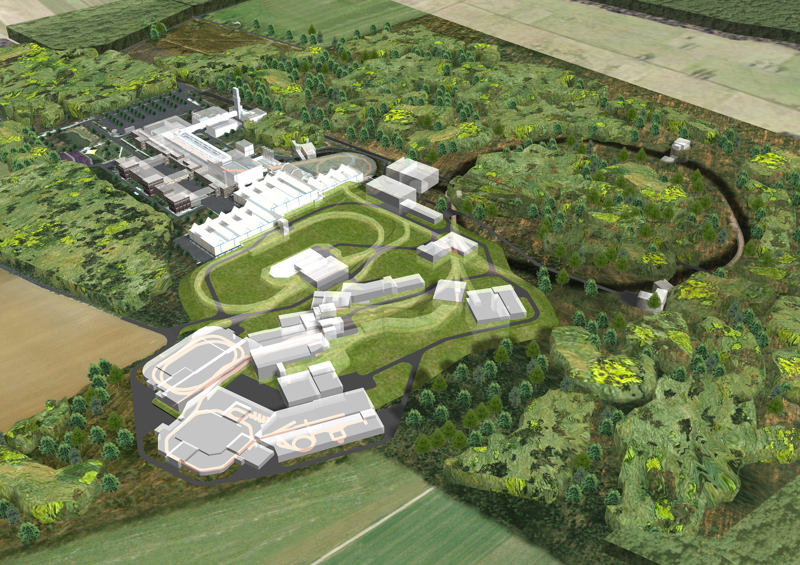





HIM: Synergy between Mainz University and GSI
Cluster of Excellence
Triga
GSI-Contribution
See Parallel Session Networking

Slide 15
Cosmic Matter in the Laboratory (FZJ, GSI, HIM)
GSI: HIC4FAIR, EMMI,HGShire
HIM
EDM
Fair Construction:
Accelerator and Experiment
Fair Construction:
Accelerator and Experiment
FZJ
GSI

Slide 16
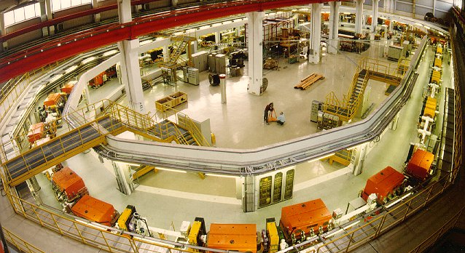
FZJ: From COSY at Jülich to HESR at FAIR
Hadron physics program at COSY is coming to an end
after 23 years
COSY as test facility for FAIR and for EDM-experiment

Slide 17
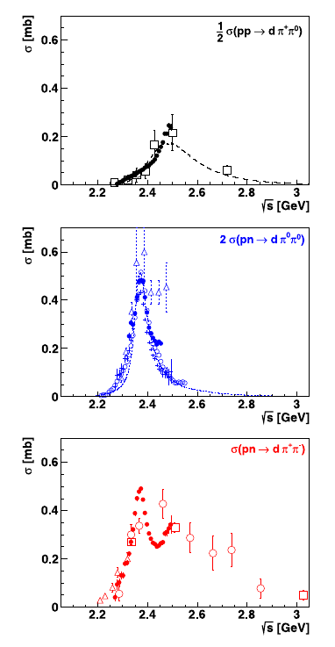



COSY highlight: Observation of a possible six-quark state at WASA
isovector
Isospin decomposition of ABC resonance structure
Phys. Lett. B 721 (2013) 229
→ pure isoscalar effect
If resonance in np system:
→ effect should be present in np scattering
Most sensitive observable in np scattering:
analyzing power A_{y} and its energy dependence
near θ_{CM} ≈ 90°
First result:
corresponding signal
at resonance position
WASA
isoscalar
WASA
→
np → np
θ_{CM} ≈ 90°
isovector
+
isoscalar
WASA
SAID
WASA

Slide 18
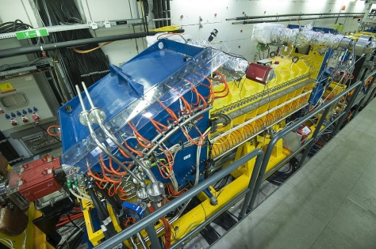
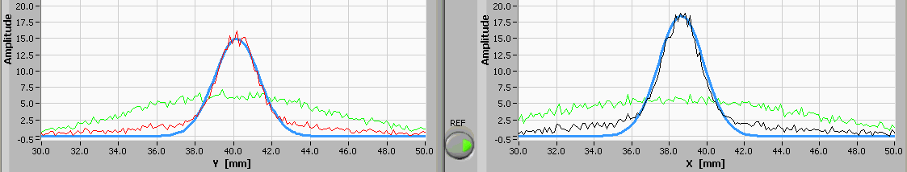
2MeV Electron Cooler at COSY as a Test for HESR at FAIR
Built at BINP, joint commissioning by BINP and COSY teams,
to be installed at HESR
Parameters demonstrated so far:
300mA @ 109kV
250mA @ 192kV
20mA @ 315kV
Voltage up to 1.3MV (5bar SF6)
Electron cooling achieved:
for 200MeV Protons with
e-beam up to 200mA @ 109kV
Initial beam profile | Vert. after cooling | Hor. after cooling | Gaussian fits | 10⁸ protons in the Ring

Slide 19
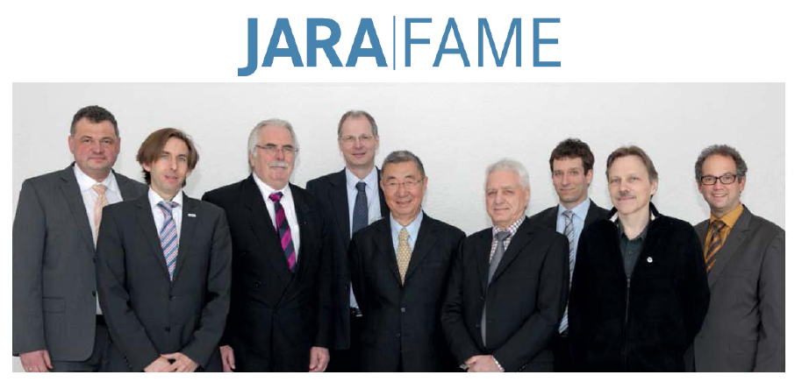

FZJ: Strategic Alliances with TU Aachen
Strategic Alliance for the EDM-Experiment: 2 new Professorships

Slide 20
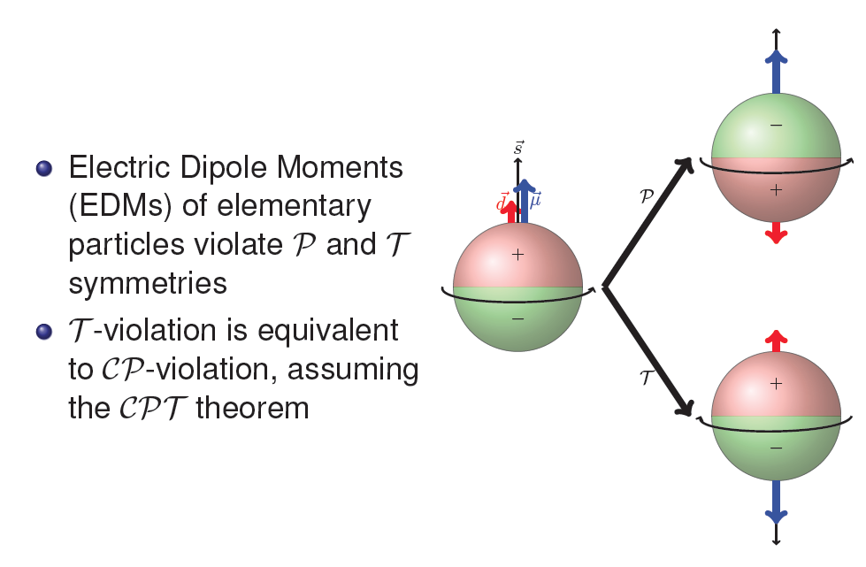
EDM of an Elementary Particle

Slide 21
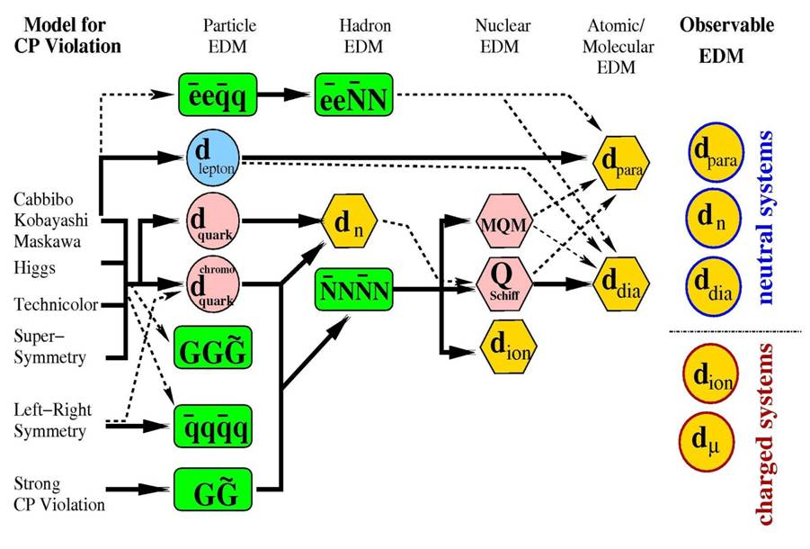
Possible Sources for an Electric Dipole Moment (EDM): need for EDM of a charged particles

Slide 22

EDM activities around the world
JEDI Collaboration at FZJ
100 physicists in JEDI collaboration at FZJ, 10 PhD

Slide 23

EDM-measurement and Experimental Method
The COoler SYnchrotron COSY with its capability to
provide polarized protons and deuterons up to 3.7 GeV/c
is an ideal starting point

Slide 24

Staged Approach at FZ Jülich

Slide 25
Summary/Plans for the POF-III with Milestones

