Slide 1
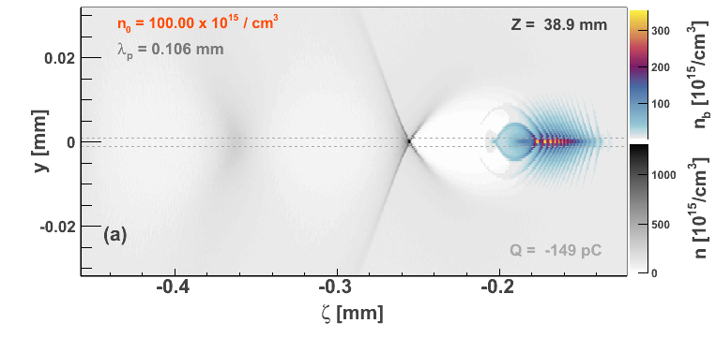
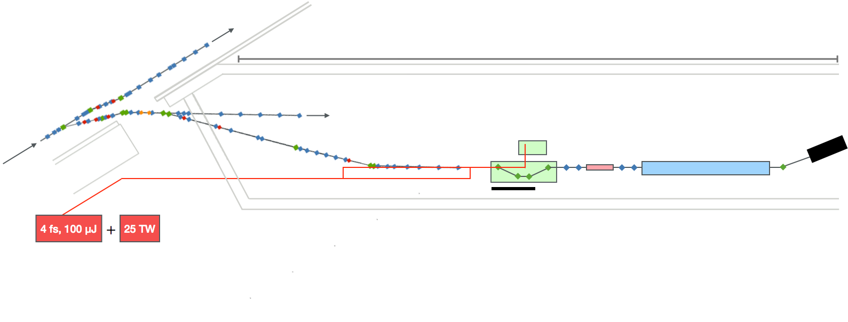
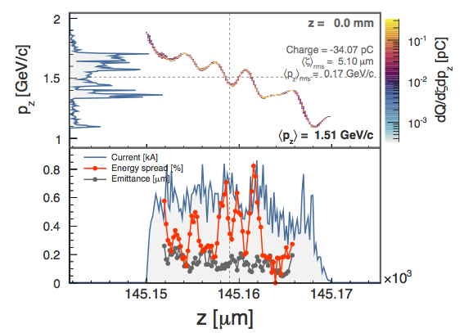
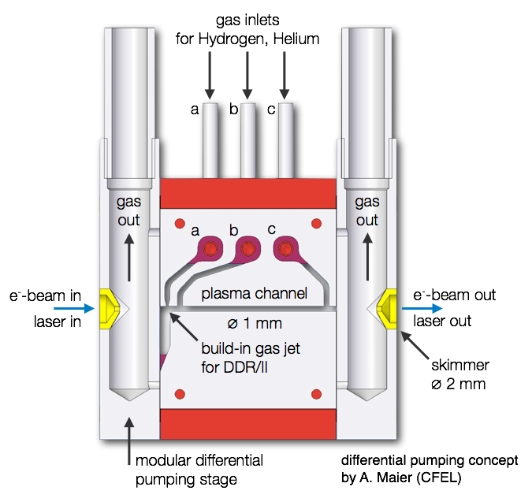
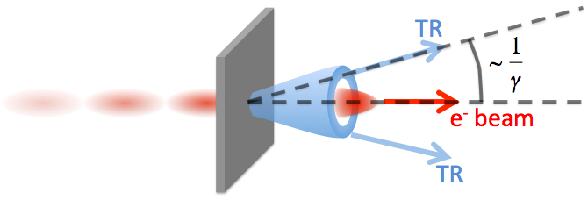
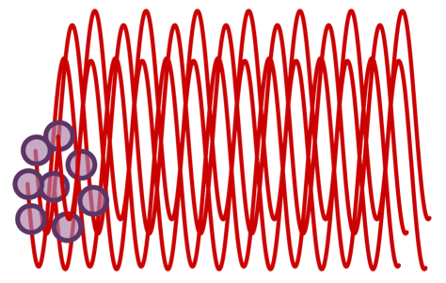
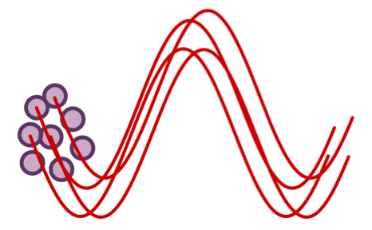
High-quality electron bunches accelerated in plasma wakefields
Charlotte Palmer, Lucas Schaper, Julia Grebenyuk, Alberto Martinez de la Ossa, John Dale, Vladyslav Libov, Johann Zemella, Christopher Behrens, Matthew Streeter, Tobias Kleinwächter, Timon Mehrling, Jan-Patrick Schwinkendorf, Steffen Wunderlich, Lars Goldberg, Olena Kononenko, Alexander Aschikhin, Halil Tarik Olgun,
Carlos Entrena, Bernhard Schmidt and Jens Osterhoff
Plasma-based particle acceleration
FLASHForward‣‣
Future-oriented wakefield-accelerator research and development at FLASH
New beamline dedicated to the study of beam-driven plasma wakefield acceleration.
2. Charge separation fields pull electrons back.
4. Witness bunch accelerated and focused.
+
+
+
Main goals:
Novel witness-bunch generation for unprecedented bunch quality: Energies > 4 GeV, Duration ~ fs, Current > 1 kA
Transformer ratios of greater than 2 using triangular driver bunch.
Use of plasma accelerated beams in an undulator to generate photons at energies beyond the water window.
FLASH bunch parameters
Energy ~ 1.6 GeV
Energy spread = 0.1%
Trans. emittance = 1 μm
Duration 20 – 500 fs
Charge 20 – 500 pC
Repetition rate 10 Hz
3. Electrons overshoot and oscillate forming wakefield.
1. Driver bunch pushes electrons aside.
Medium is a plasma
Accelerating gradient not limited by breakdown
Typically ~ 10s GV/m
FLASH 1 FEL
~ 80 m
Witness bunch duration intrinsically short
Measurements indicate duration of < 10 fs
FLASH 1 accelerator
FLASH 2 FEL
Plasma cell
Laser/plasma photon diagnostics
Witness dump
Why use a particle driver rather than a laser?
Lower normalised emittance ~ 100s nm
Higher average power
High efficiency
Extraction
Differential
pumping
Beam matching and focusing section
Beam diagnostics section
X-ray diagnostics
required for good luminocity
Probe/Ionization lasers
Driver dump
TDS (optional)
Undulator
Controlled injection of electrons from the background plasma
Techniques may require specialised targets, synchronised lasers etc.
Controlled injection
i.e. laser triggered ionisation,
Wake-triggered ionisation and
Final electron bunch properties depend on injection of bunch into accelerating structure
External injection
i.e. Two pulses from photo-gun
Plasma must be ‘matched’ to injected bunch parameters to avoid emittance growth
Density Downramp Injection
Self-injection of background plasma electrons (longitudinal wave-breaking) facilitated due to a plasma density gradient;
Allows for controllable stable particle injection of high-quality beams which was experimentally demonstrated in laser-driven schemes;
Ramp hight/length variations provide control over beam charge, emittance, length.
Figure right: Example of electron beam induced due to a density down-ramp: longitudinal phase space (top) and slice properties (bottom) after 15 mm of propagation in plasma.
What bunch parameters are expected:
Strongly correlated longitudinal phase-space as shown in plots (right)
Excellent slice properties:
Energy spread < 0.5%,
Normalised emittance < 0.2 μm
Peak current 〜0.8 kA.
Tailored plasma targets to allow control of electron bunch properties
Electron bunch diagnostics
Measurement of duration of ultra-short (fs) electron bunches poses a challenge:
Gas-jet for injection control fed by inlet a
The embedded gas-jet allows introduction of
very confined and localized variations, e.g.
1. A density peak allowing for density downramp injection.
2. Introduction of a different gas species at constant electron density, important for ionisation injection.
Plasma channel fed by inlets b & c
A flat profile with adjustable electron density is formed within the plasma channel and allows for stable acceleration conditions.
The target design allows for full transverse access of injection as well as acceleration region, allowing probing of the generated wakefield and its spatial evolution
Transition Radiation as a high resolution longitudinal diagnostic:
Generated by charge crossing interface between materials with different ε₀.
Single charge broad flat spectrum.
Bunch of charges adding of fields
INCOHERENT
COHERENT
e⁻ beam in
Laser in
e⁻ beam out
Laser out
Spectral intensity related to bunch shape
Current diagnostic testing:
Broadband spectrometer under testing 400 – 20,000 nm.
Statistical variation of spikes in incoherent spectra bunch duration.
Imaging of incoherent radiation to determine transverse profile and charge.
References

