Slide 1
The DESY Grid Centre A LKII infrastructure
Volker Guelzow
DESY

Slide 2
overview
The DESY Tier 2 centre
The NAF
Beside LHC
Resources

Slide 3
The Tier 2 Structure in Germany
T2 Shares Germany:
CMS: 8%
Atlas: 10%
LHCb: 7%
The DESY Grid&Cloud Centre:
~ 12.000 cores in the Grid
~ 8 PB disk (dCache)
~ 4000 cores in the NAF
~ 1 PB disk in the NAF
Tape storage

Slide 4
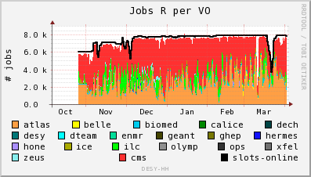
DESY Tier 2 usage (Hamburg)

Slide 5
LHC wall clock time distribution Germany

Slide 6
LHC wall clock Tier 2 only delivered, Germany

Slide 7
The DESY Tier 2 site availability (source: wlcg monitoring)

Slide 8
HEP is data centric: A very simplified view of Grid and NAF
DESY-Grid
NAF
Data

Slide 9
The National Analysis Facility (NAF)
Complement Grid resources
Allows interactive work
Offer best possible analysis infrastructure for LHC physicists from German institutes
Offer additional access possibilities to data hosted on DESY-Tier2 – but be strongly integrated into Grid
Make all needed data available on the NAF at DESY
Driven by the users demands (usermeeting, user committee)
Upgrade the NAF 1.0 into NAF 2.0 by adding features
Adjust to changes in LHC computing models, further adapt the NAF to the needs of the experiments – both in terms of computing and storage capacity and quality of the service
NAF 2.0 a blue-print for other scientific communities (eg Belle I+II) at DESY and their needs!
More on the NAF poster

Slide 10
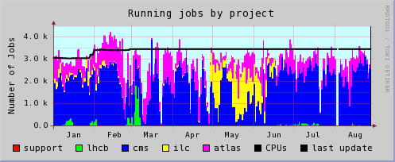
Usage and resources
Legende

Slide 11
Other contributions to WLCG
dCache
LHCone
Through LSDMA
See second talk and poster

Slide 12
Computing beside LHC
Belle I+II
Astroparticle Very much like LHC
ILC (grid&cloud, big data, streaming)
Photon Science cloud style
(open stack, big data, bursty)

Slide 13
Resources
Finanzen Tier 2
Personal

Slide 14
Future Strategy
We will continue to enable outstanding scientific research against the increasing demands by:
Open the DGCC for all relevant communities
Benefit from resource sharing
Highly optimized&flexible big data management
High bandwidth/low latency networks
Data preservation
Coordination of computing activities in MATTER
Major player in Matter for cooperation with LSDM
Applying for 3rd party funding
Education and training

Slide 15
Summary
The DESY Tier 2 is among the best worldwide delivering cycles&TB well above the pledges
The NAF plays an essential role for LHC analysis in Germany
The concept of shared resources significantly improves the overall efficiency
The excellent performance of the LK II facility attracts an increasingly diverse user community
DESY will continue to develope next generation IT solutions in collaboration with scientific and industrial partners
Attracting young people

