Slide 1
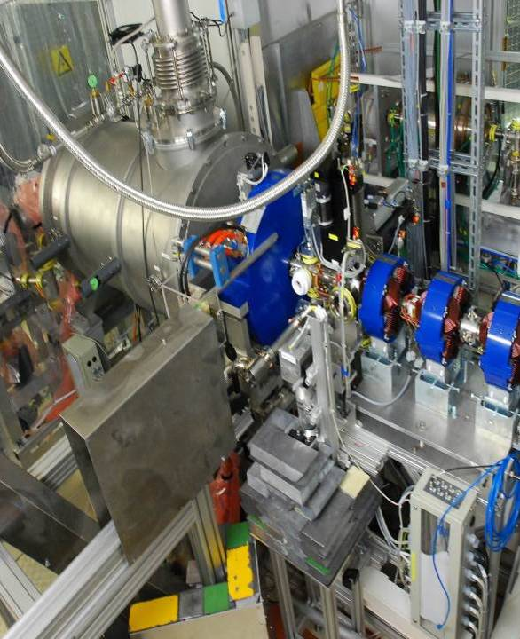
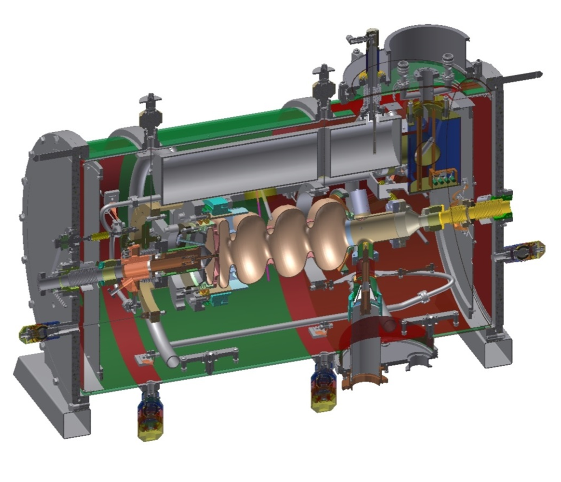
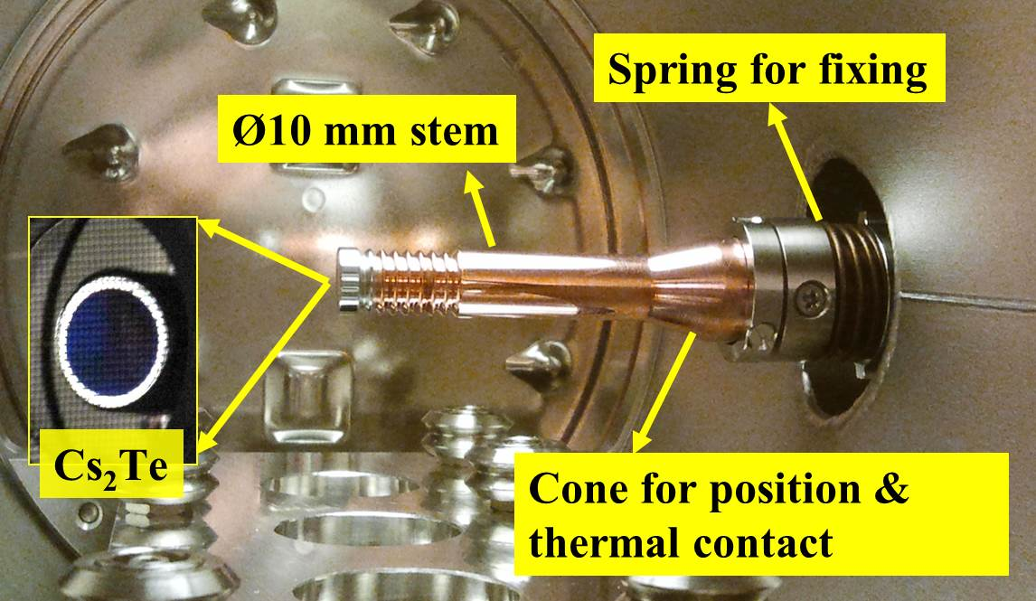
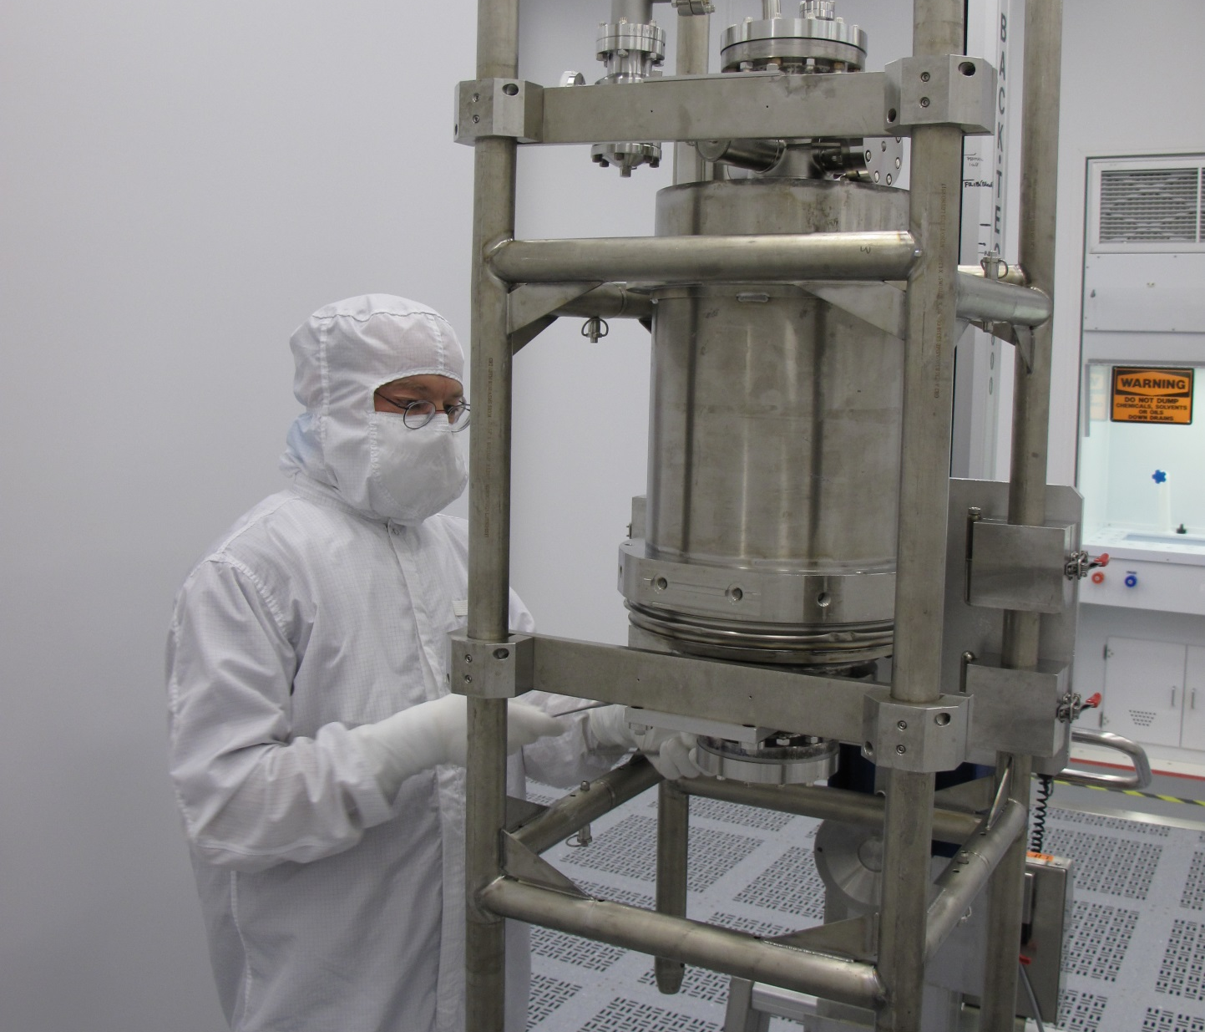
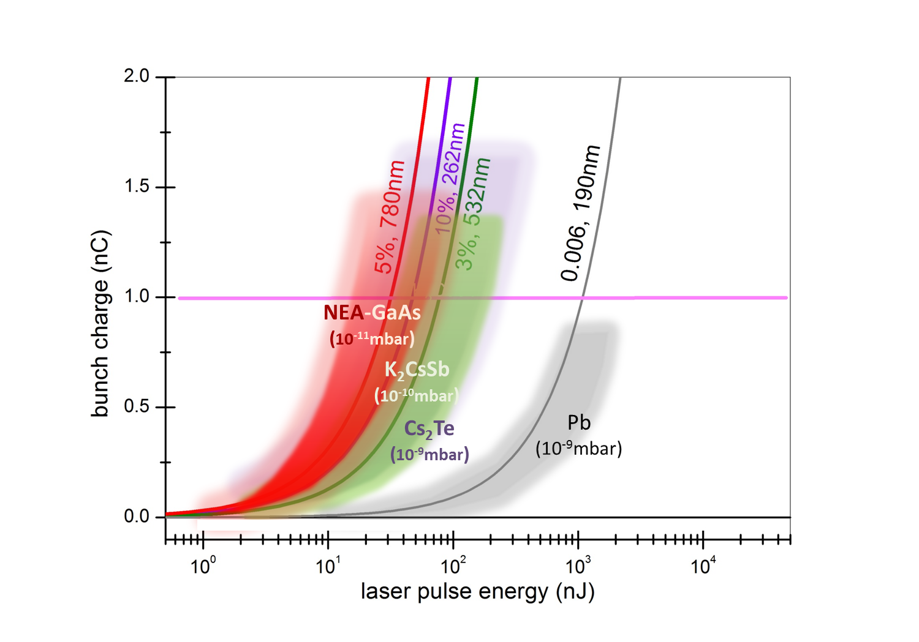
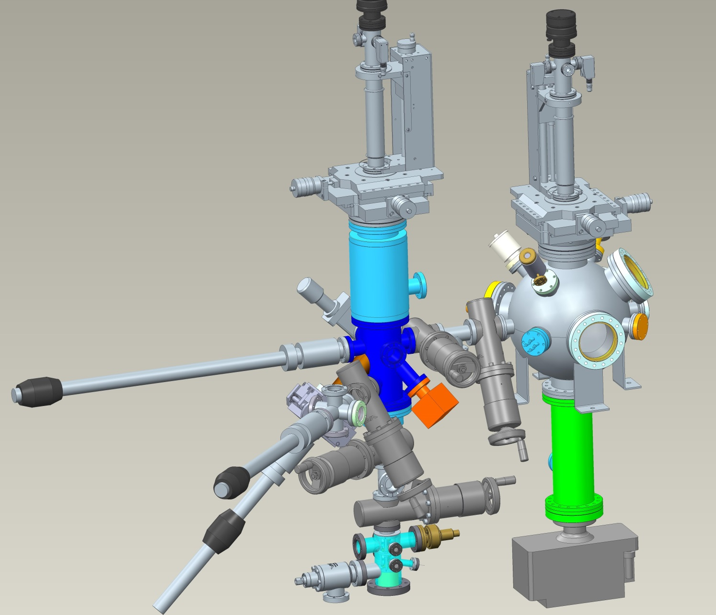
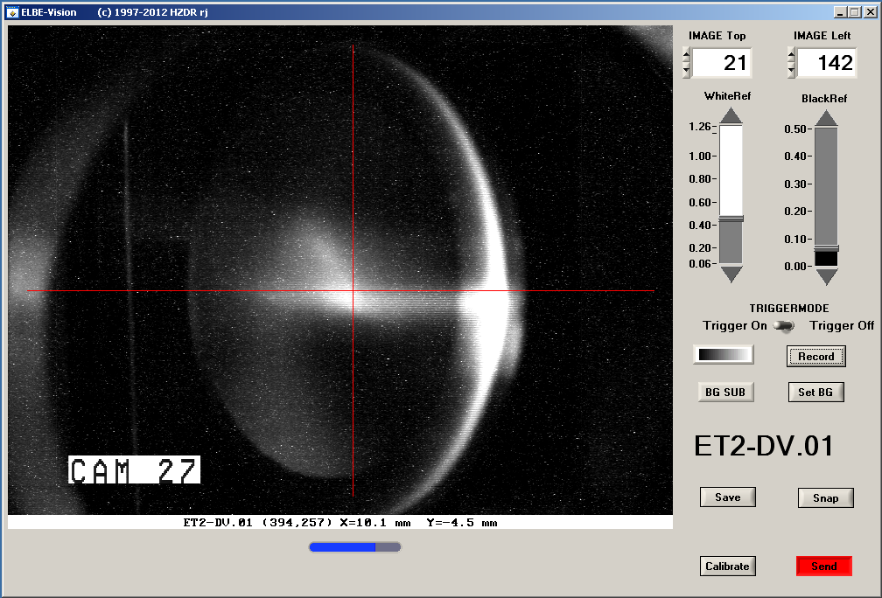
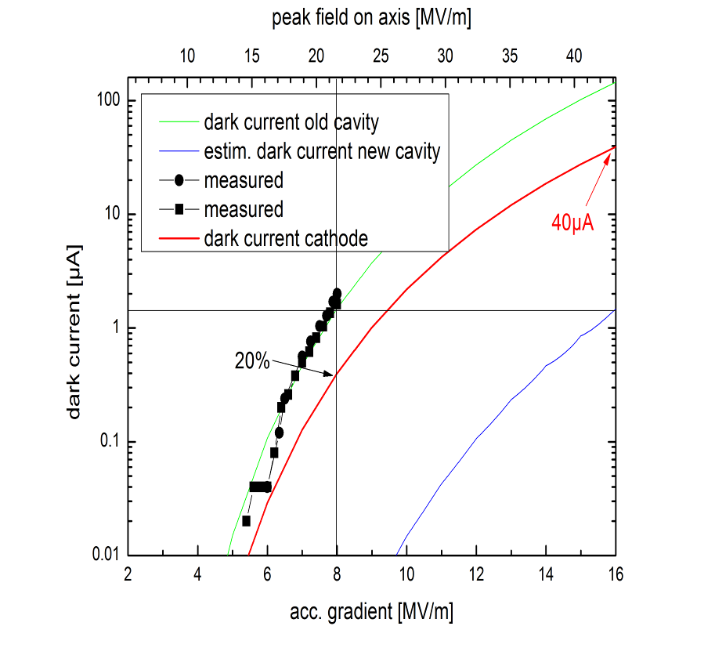
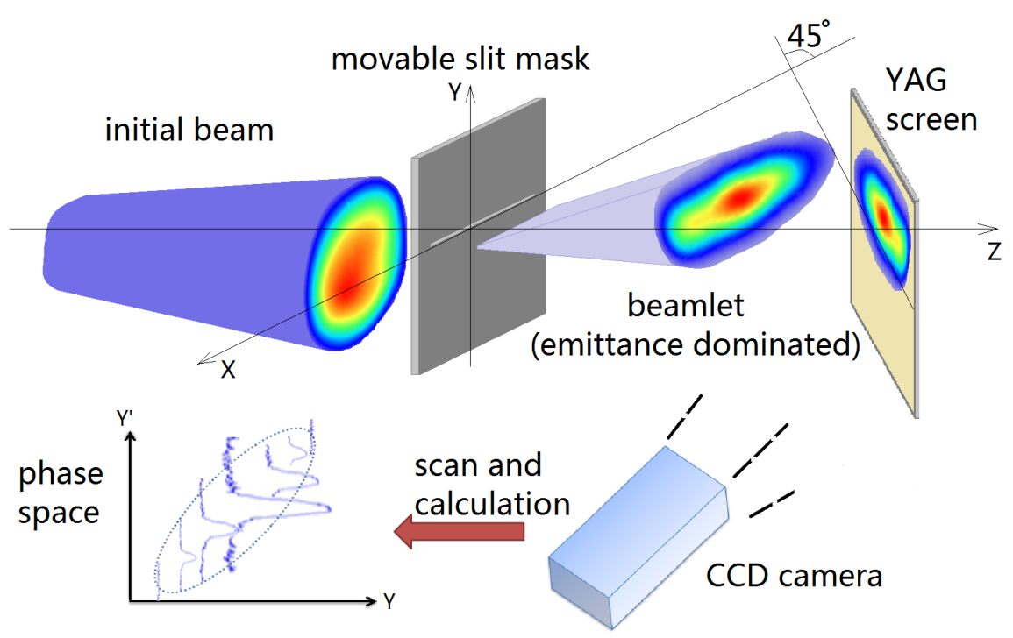
Nanocoulomb Bunch Charges from Superconducting Photo-injectors
ARD - ST1 / SRF Science & Technology
Rong Xiang ( HZDR )
Motivation
world-leading
Helmholtz - “Gun cluster”
SRF photo-injector
1 nC bunch charge
1 μm low emittance
high energy
high reliability
new applications
Compton gamma-ray sources, free-electron-laser, electron-hadron collider, THz radiation, …
pushing
wanted
international partners
universities
industry partners
R&D challenges
full potential of SRF technology, high efficient cathodes, …
world-wide first SRF photo-injector in ELBE beam line
SRF Structures
Cathode Development
high Q₀ for low RF power consumption
high field on cathode for low emittance
HOM suppression
NC cathode inserting mechanism
multipacting study
K₂CsSb, GaAs, superconducting Pb
high QE, low φ, robust, fast response
integration into SC RF cavity
thermal emittance – morphology
efficiency – layer formation
new cavity within cooperation
of HZDR-JLab
transport system for cooperation
of HZDR-HZB-Uni.Mainz
new cavity
present gun cavity
Controlling Unwanted-beam
Beam Characterization
research on field emission from cavity and cathode
dark current kicker
beam halo control
excellent field stability required
transverse emittance, phase space reconstruction
slice emittance
longitudinal emittance
bunch length & profile characterization
photobeam
darkcurrent
screen shot for energy measurement after Linac acceleration
dark current estimation based on Fowler-Nordheim theory

