Slide 1
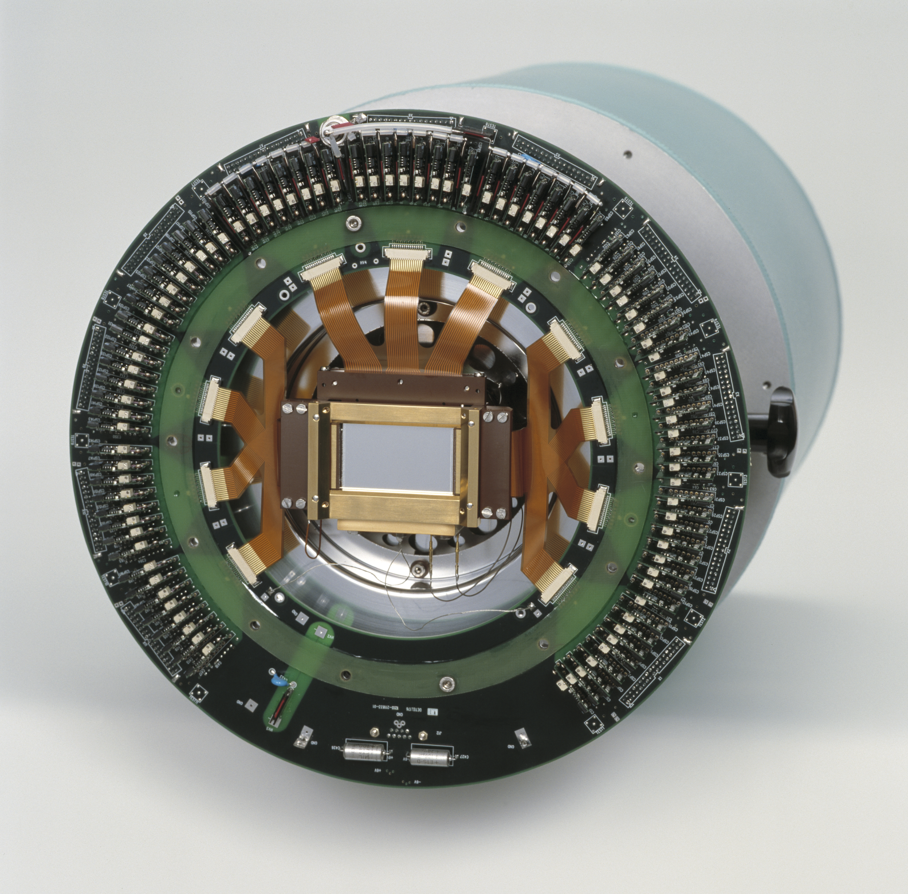
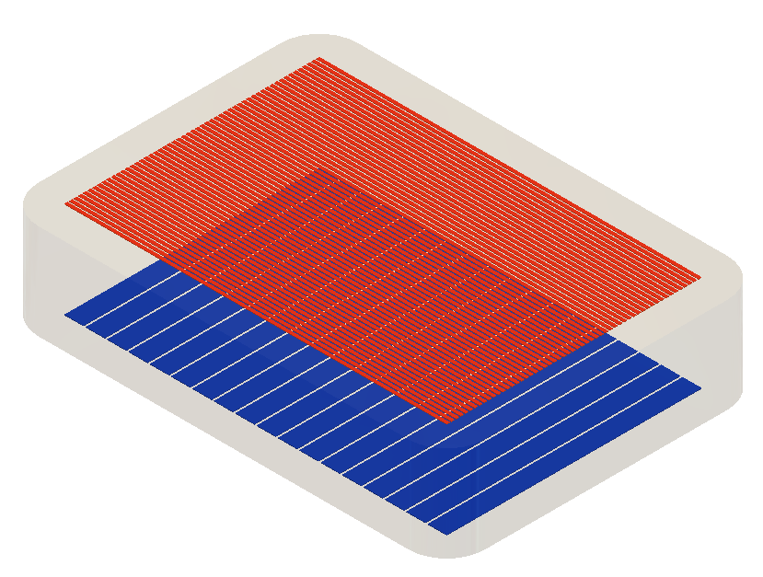
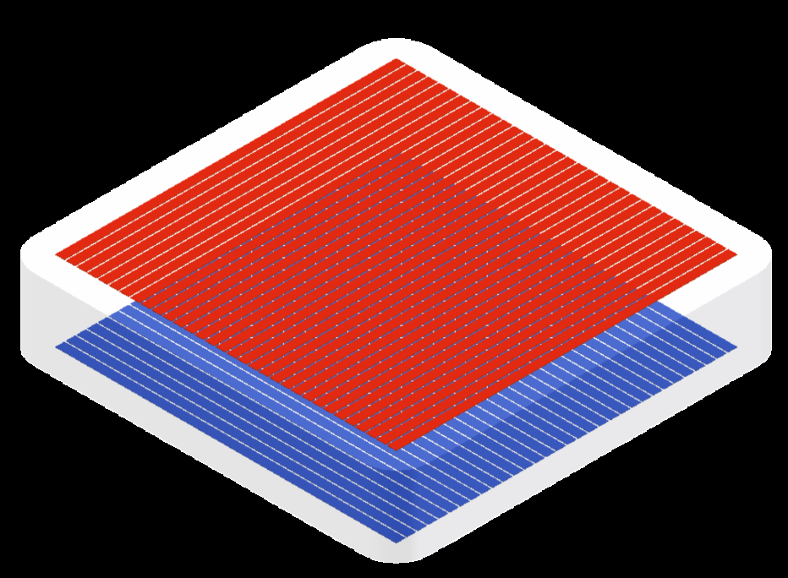
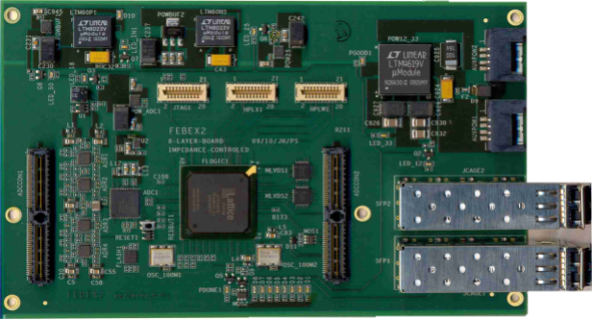
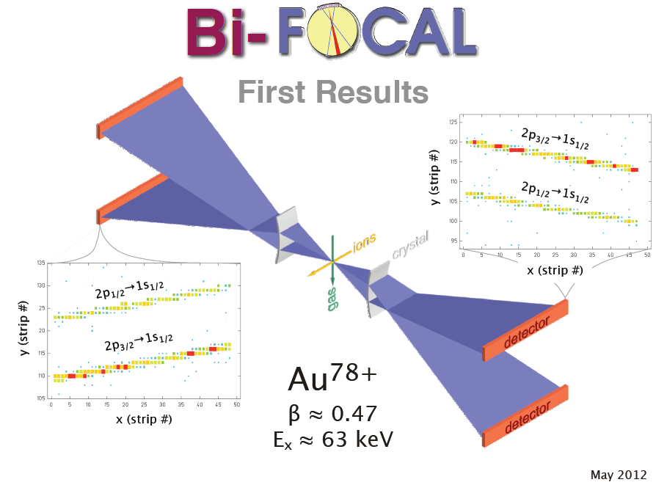
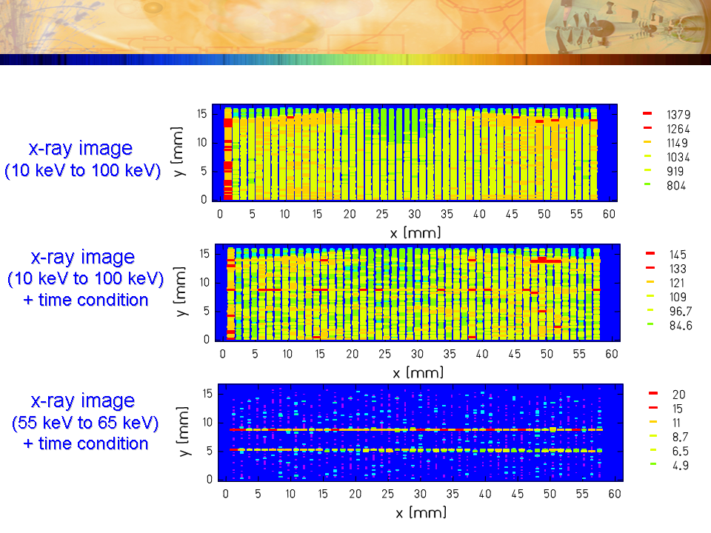
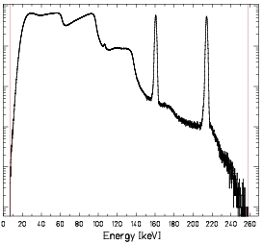
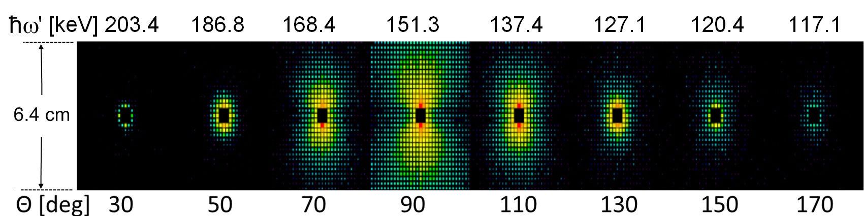
Double-Sided Segmented Solid State Detectors
Position-, Energy-, and Timesensitive Detectors applied to X-ray Imaging and Compton Polarimetry
Karl-Heinz Blumenhagen (HI-Jena)
Ge(i) Detector for X-ray Imaging and Compton Polarimetry
Digital Readout
Crystal: n-type Germanium, thickness: 11 mm
Segmentation: 48 strips (1167 µm wide) x 128 strips (220 µm wide)
Current development: Si(Li)- Polarimeter with FEBEX2-based DSP-electronics to replace classical electronics. FEBEX2 features:
56 mm
p⁺ contact (128 strips)
65 Msamples/s, 12 bit resolution for each channel
2.5 Gbit/s data transfer rate
Trigger and time stamp logic with onboard FPGA
Easily scalable due to “chaining“
11 mm
a-Ge contact (48 strips)
32 mm
Si(Li) Detector for Compton Polarimetry
Crystal: p-type Silicon, thickness: 7 mm
Segmentation: 32 strips (2 mm wide) x 32 strips
(2 mm wide)
8 analog
inputs per FEBEX2
“chaining“
FEBEX2
FEBEX2
64 mm
FEBEX2
p⁺ contact (32 strips)
7 mm
...
64 mm
Digitized data to PC
Li doped contact (32 strips)
(In the framework of HDRI)
2D-Strip Detectors in the Cystal Spectrometer FOCAL
Principle: energy is measured via the position using Bragg reflection.
2012 run: setup and preliminary results.
2006 test run: 2D-detector images with:
time condition (top)
time and energy condition (bottom)
with time condition
with time and energy condition
Characterization of the Si(Li) Compton polarimeter at PETRA III (DESY)
Dedicated detector test beamtime
Highly polarized hard x-rays available
Goal: determination of polarimeter quality
counts
2nd
3rd
4th
harmonic
Energy [keV]
Spatial intensity distributions for different polar scattering angles at ħω = 214.8 keV.
Energy spectrum of the incident synchrotron radiation.

