Slide 1
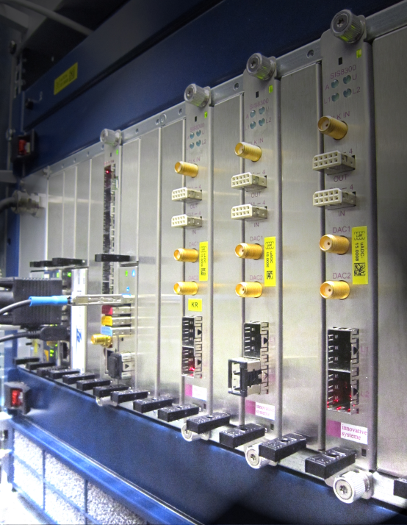
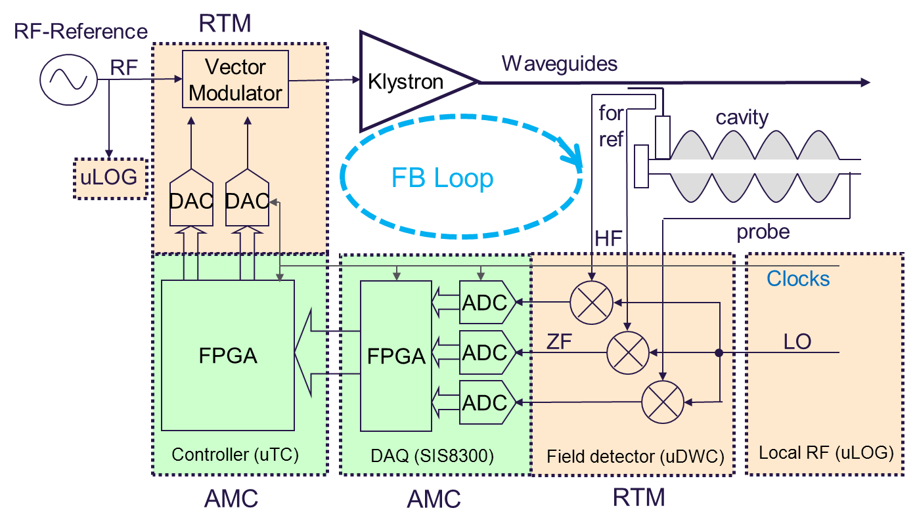
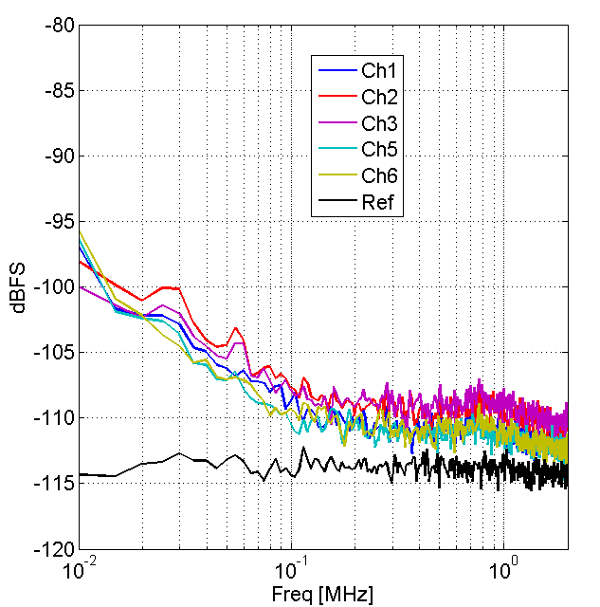
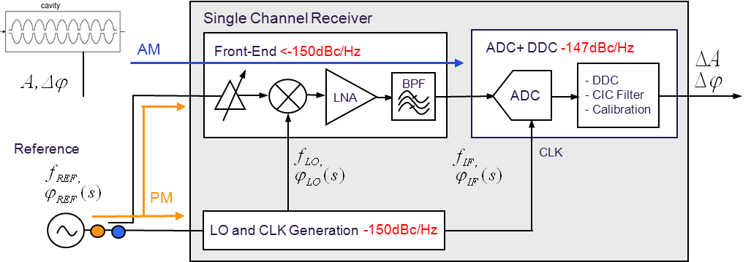
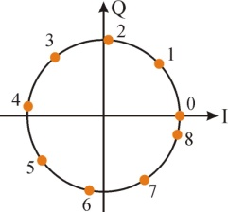
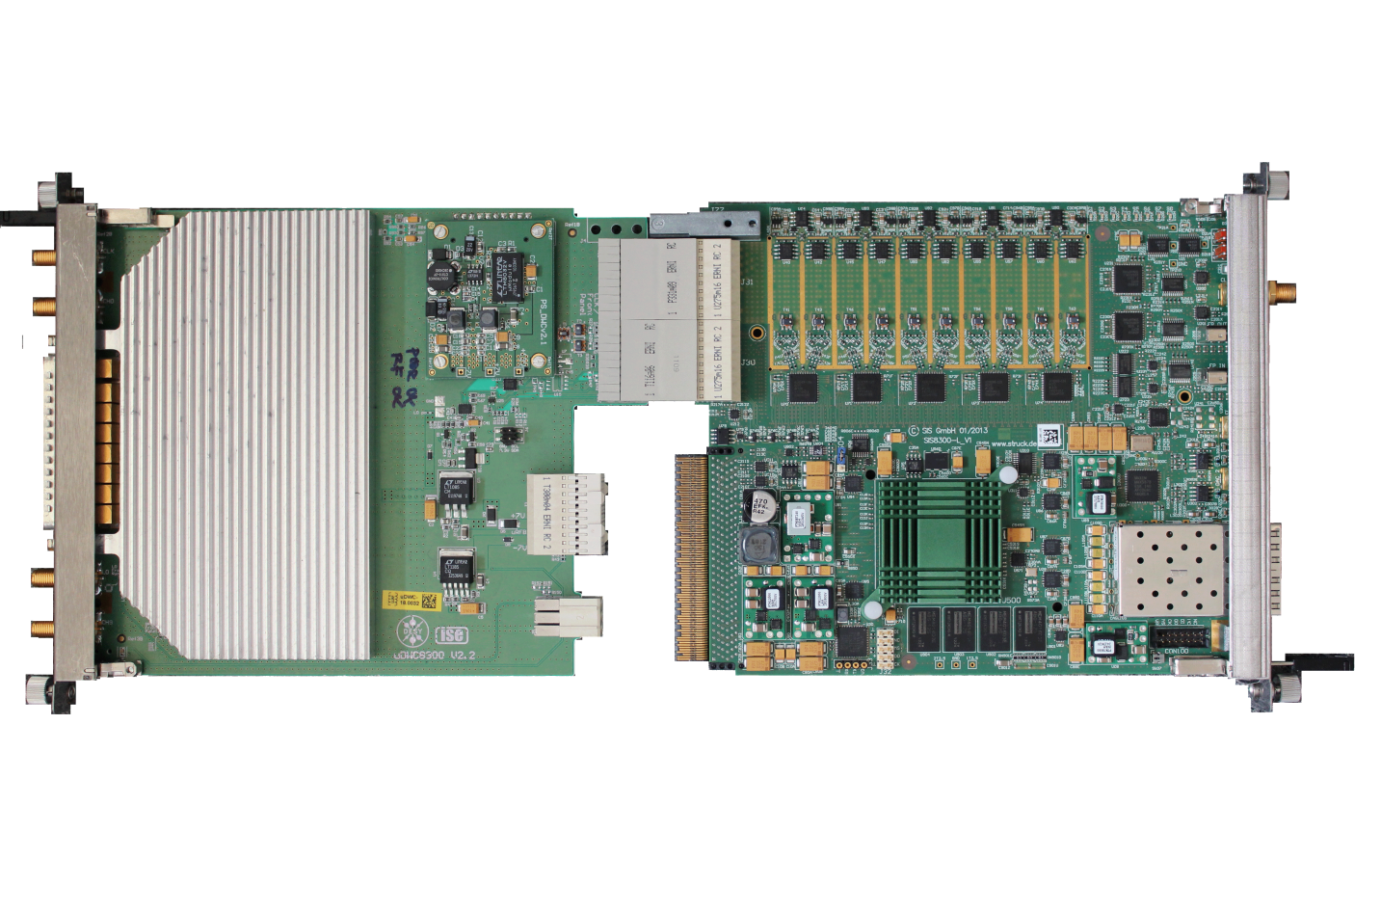
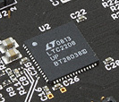
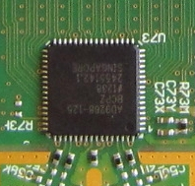
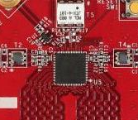
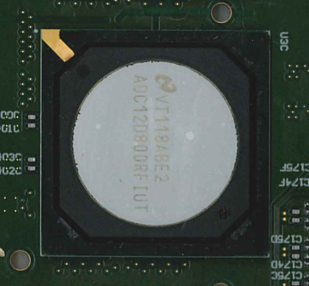
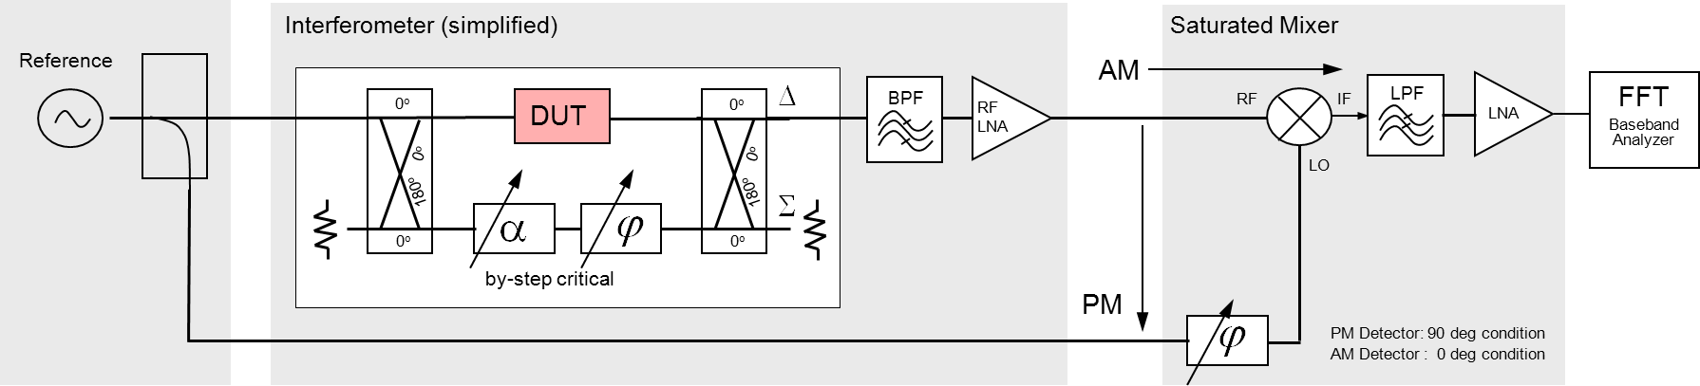
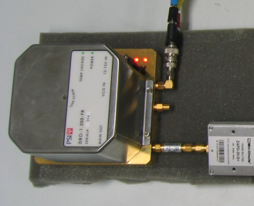
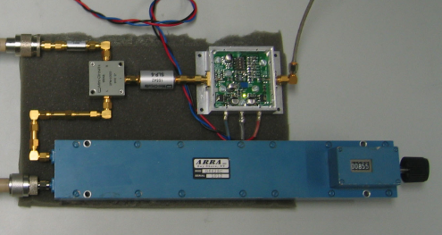
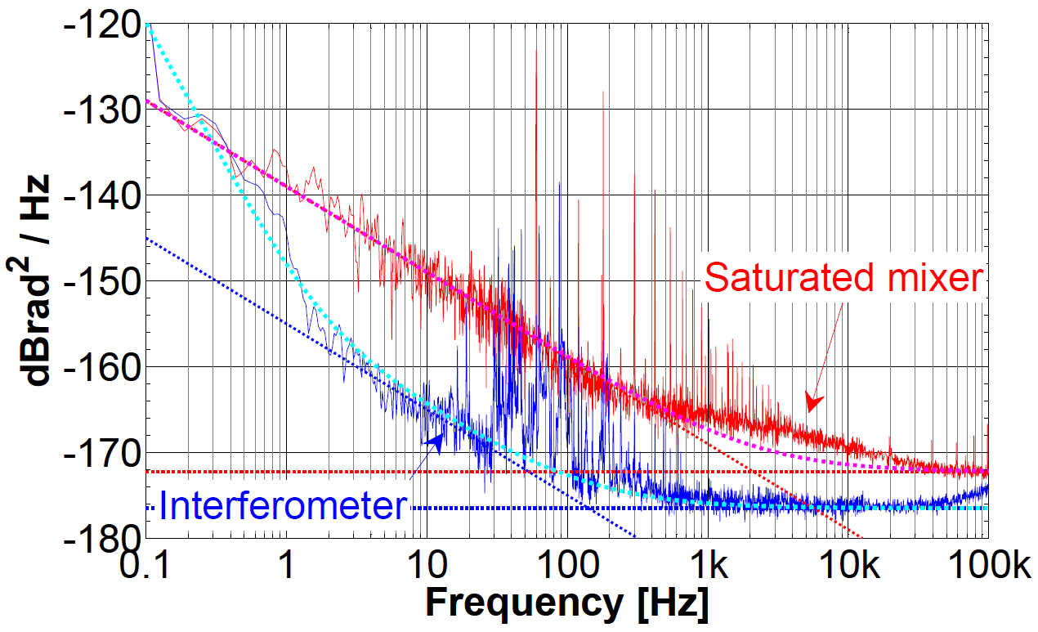
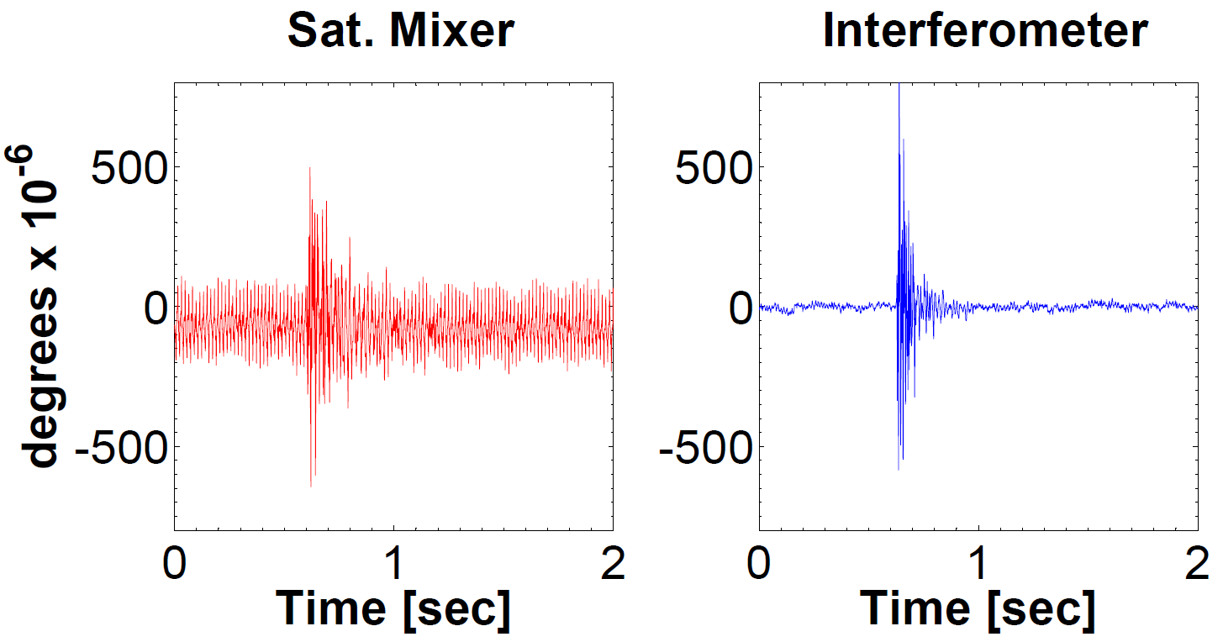
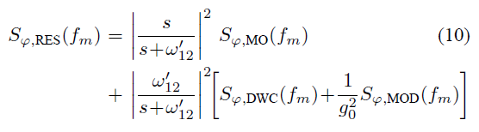

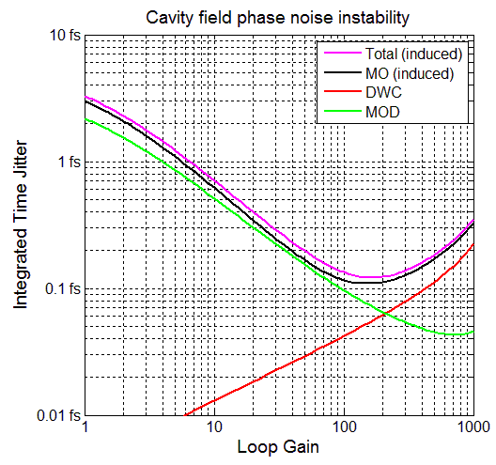
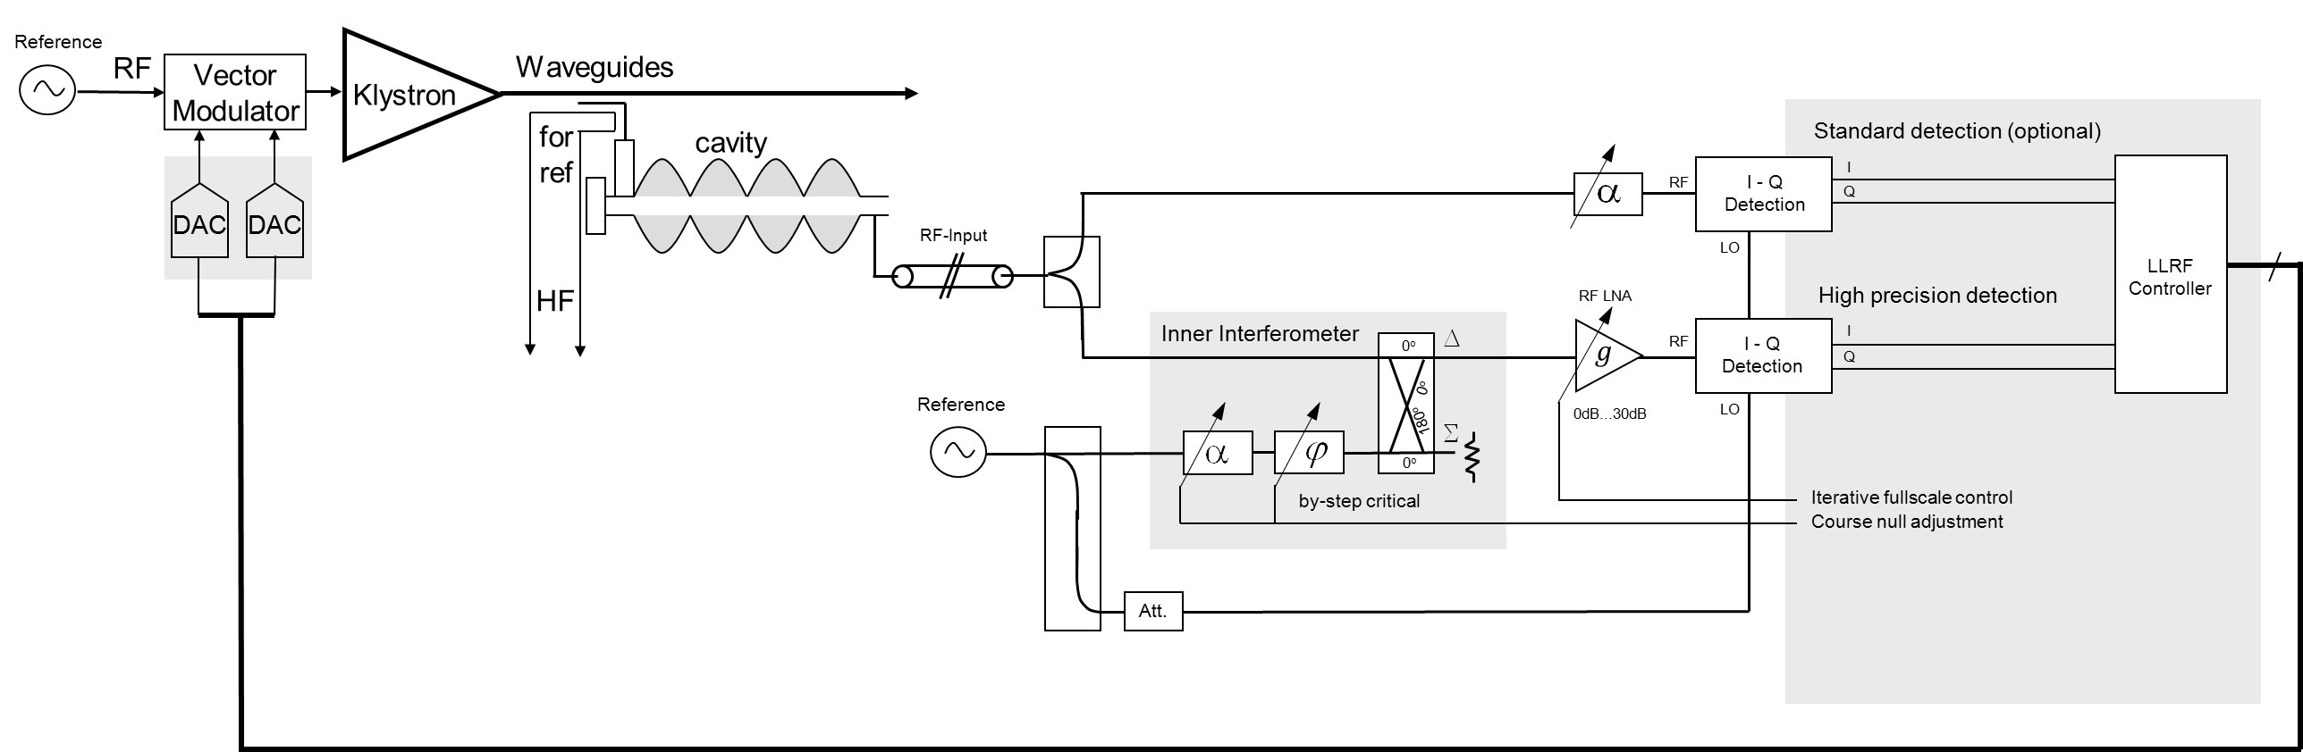
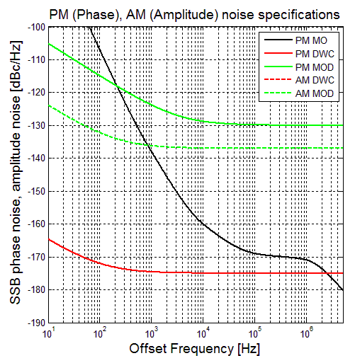
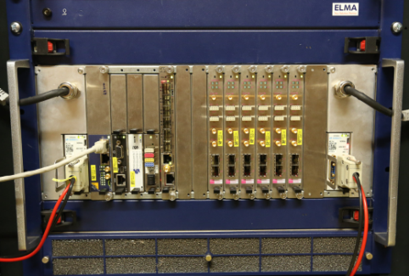

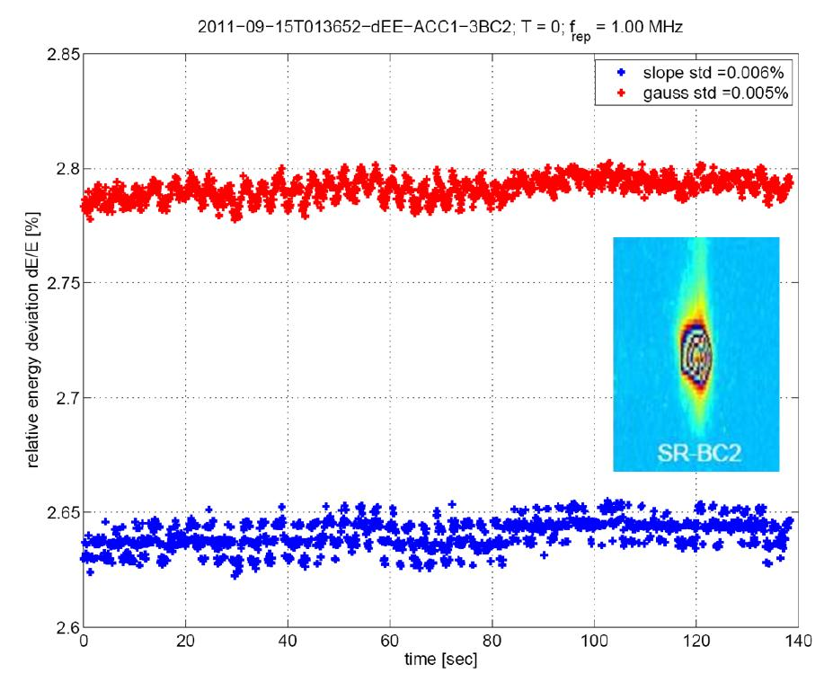

Towards Attosecond
RF Controls for Accelerators
ARD-ST3 Picosecond and Femtosecond Electron and Photon Beams
Matthias Hoffmann, DESY
State of the Art LLRF controls
State of the art digital LLRF (low-level radio frequency) controls
Single detector performance : Phase resolution < 1.5mº (3fs) (Short-term, 1.3GHz)
Amplitude resolution < 2.6E-5 (Short-term, 1.3GHz)
Beam energy stability : 5E-5 (Shot-to-shot)
Arrival time jitter : <30fs (Intra-bunch)
General limitations of todays field detectors
Non-IQ field detector (noise balanced)
Limited spectral density of available best ADCs
MTCA.4 ACC1 installation
Simplified modular LLRF regulation scheme
Single receiver performance
Beam energy stability (out of loop)
4.3fs [10Hz,1MHz]
dE/E < 0.005% (rms)
PM: < 1.5m°, 3fs
AM: < 2.6E-5
dE/E<0.005%(rms)
1.6fs [10Hz,1MHz]
360° phase detection :
RTM
AMC
Q
$$A$$
$$∆φ$$
I
- 10 channel field detection
- S-band (700MHz - 4.0GHz)
- Resolution, 0.003%, 0.003deg, < 10fs
- 10 channel ADCs (125Msps, 16-Bits)
- FPGA (V6) pre-processing partial cavity vectors
- Low latency links via MTCA-backplane
Detectors for Attosecond LLRF controls
Apply substantial new detector concepts for 1/f-noise reduction
Overcome ADC noise limitation by RF amplification before IQ-detection using a carrier suppression
Linear Technology (2007)
LTC220x, 10nV/Hz
Analog Devices (2009)
AD9268-125, 9nV/Hz
Texas Instruments, (2012)
ADS42LB69 , 14nV/Hz
Texas Instruments, (2012)
ADC12D800RF, 9nV/Hz
General Requirements
Attosecond LLRF controls
Feedback model for cavity
phase jitter simulations
‘E. Rubiola et. al. “Advanced Interferometric Phase and Amplitude Noise Measurement,” Rev. Sci. Instrum., vol. 73 no.6 pp 2445-2457, 2002.
S-Band 2.815GHz, 100kHz BW
Saturated mixer :
-165dBc/Hz, <0.5fs resolution, 0.5V/rad
Interferometer :
-176dBc/Hz, < 50as resolution, 15V/rad
Carrier suppression
-> reduced 1/f-noise of the rf-amplifier
PM: < 0.032m°,31as
AM: < 0.6E-6
knock
on table
high-pass filtered
low-pass filtered
F.Ludwig et. al. ‘Phase Stability of the Next Generation RF Field Control for VUV- and X-ray Free Electron Laser’, EPAC 2006, Edinburgh, UK.
Courtesy of T. Berenc
Courtesy of T. Berenc
Courtesy of T. Berenc
Subcomponent contributions
T. Berenc et. al. “An Interferometric Residual Phase Noise Measurement System at S-Band”, Low Level RF Workshop 2013, Lake Tahoe, California, USA.
How to use analog small signal detectors in a digital LLRF system?
→ Automated carrier suppression tracking (compensates small drifts, gradients)
→ Combine interferometer and non-IQ detector (AM, PM 360º detection)
→ Iteratively or using complementary filters
→ Needs drift calibration, efficient for continuous wave (CW) operations
→ Single cavities: Analog bypassed digital system (hybrids) using complementary filters
→ Multi cavities: ~√3 (passive receivers) x √8 (VS-scaling) x √8 (8 receivers per cavity)
Field instability:
<200as (rms)
RF-virtual gnd
null Re & Im
1.3GHz
time
Attosecond LLRF subcomponent requirements
Master reference:
→ -10dB…-15dB above unity gain
→ DRO, SCLOs + passive filtering
High power actuator chain:
→ -10dB by removing spurious
→ -10dB by IOTs, semiconductors
Field detectors:
→ -15dB…-25dB
→ Interferometer
→ Superscaling
→ Analog and digital hybrids
Simplified block diagram
Special acknowledgments to: Frank Ludwig, Uros Mavric, Holger Schlarb, Christian Schmidt, Sven Pfeiffer, Tim Berenc

