Slide 1
Heavy Ion high intensity linac developments
Winfried Barth, GSI&HIM

Slide 2
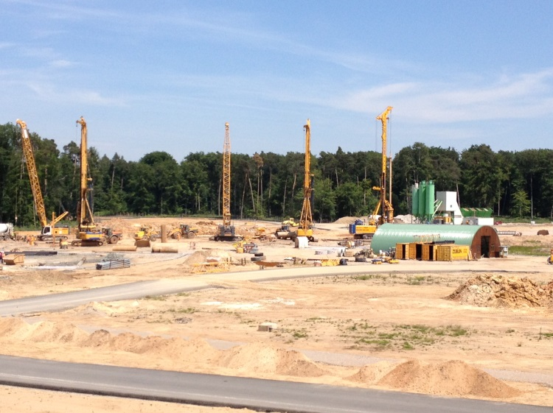
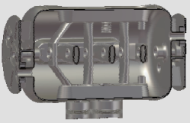
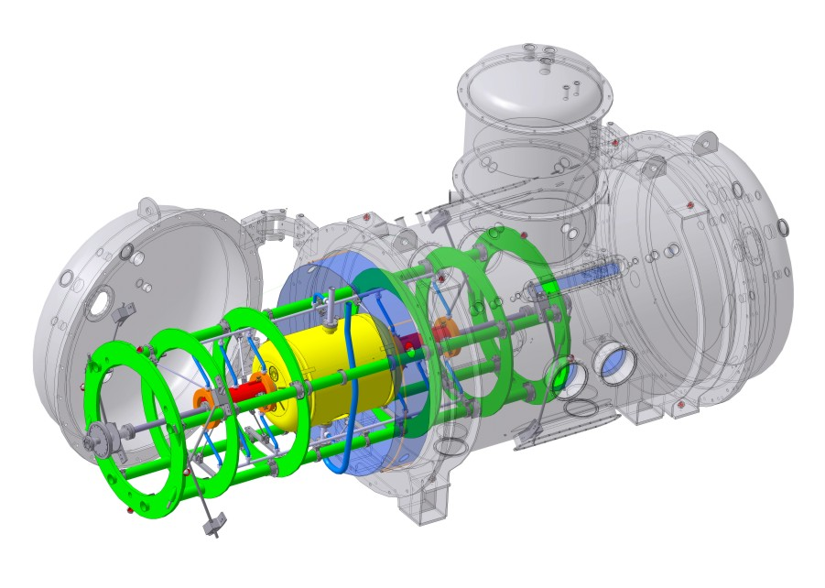
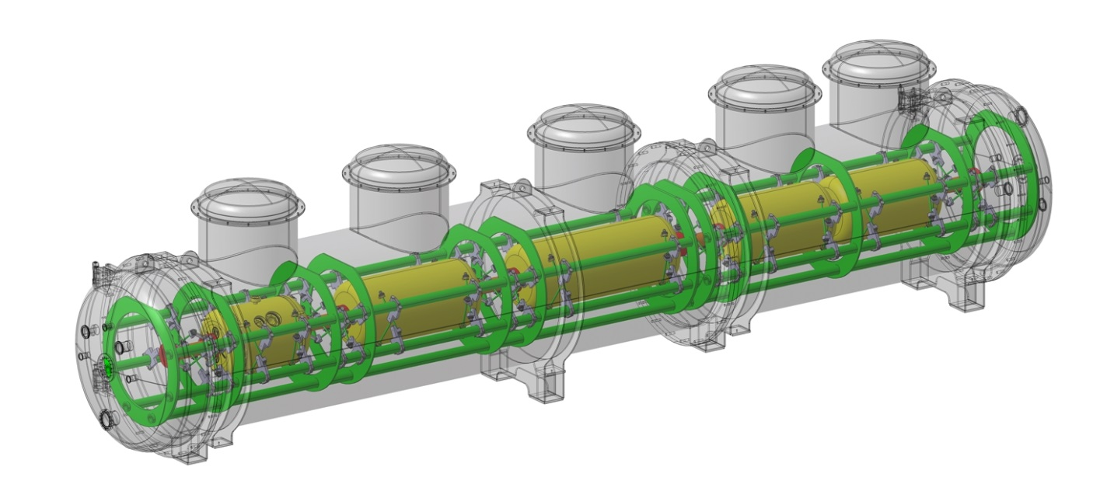
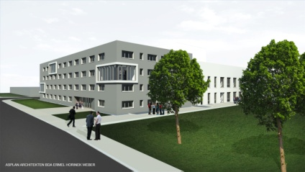
Heavy Ion high intensity linac developments
Motivation
28 GHz-ECR ion source (ST2)
H-type Cavity Developments (ST1, ST2)
cw-LINAC-Demonstrator (POF2)
Pushing the limits: cw-heavy ion beams at Coulomb barrier (ST1)
Outlook
Heavy ion high intensity linac developments, W. Barth, 4.2.14

Slide 3
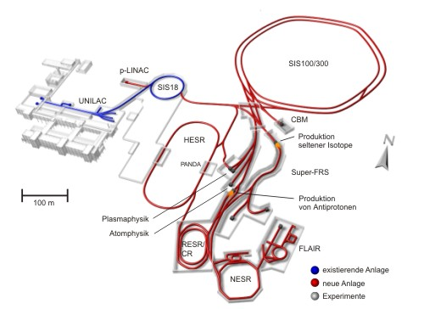
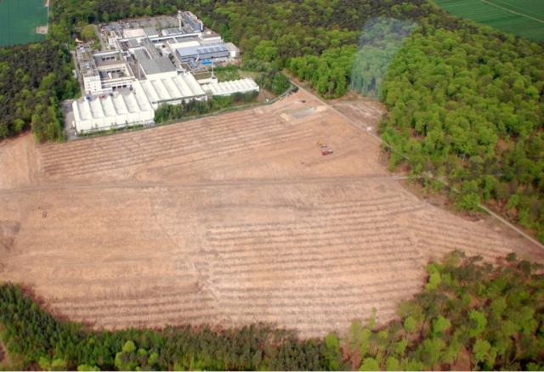
Motivation
(Upgraded) existing facility... provides
ion-beam source and injector for FAIR
Secondary beams: RIBs, pbars
Preperation for civil construction, 2012
Primary beams:
protons to ²³⁸U
Accelerator Components & Key Characteristics
Ring/Device Beam Energy Intensity
SIS 100 (100Tm) protons 30 GeV 4x10¹³
²³⁸U 1 GeV/u 5x10¹¹
(intensity factor 100 over present)
SIS 300 (300Tm) ⁴⁰Ar 45 GeV/u 2x10⁹
²³⁸U 34 GeV/u 2x10¹⁰
CR/RESR/NESR ion and antiproton storage and
experiment rings
HESR antiprotons 14 GeV ~10¹¹
Super-FRS rare isotope beams 1 GeV/u <10⁹
Preperation base plate with pillars, 2013
New future facility: ... provides ion and anti-matter
beams of highest intensities and up to high energies
Heavy ion high intensity linac developments, W. Barth, 4.2.14

Slide 4
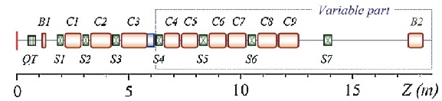
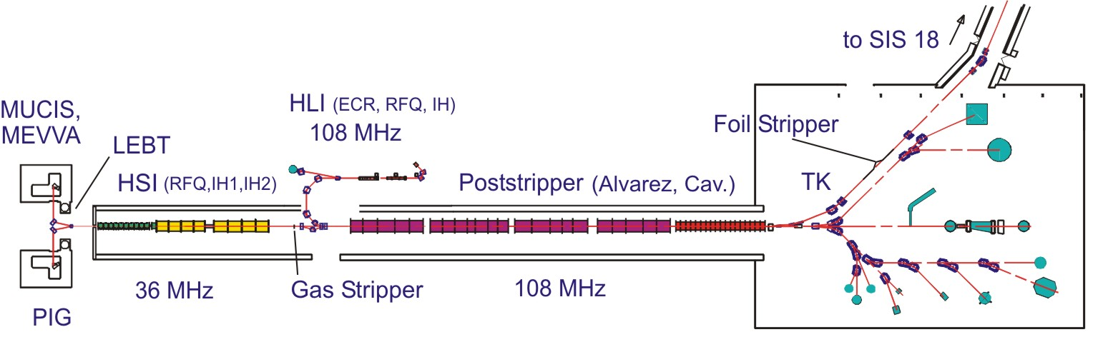
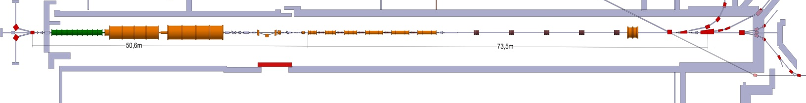
Ultimate heavy ion intensities...
7.5 MeV/u cw- heavy ion linac
Recent status:
0.1 pmA, p (from MUCIS)
1 pμA, ⁴⁸Ca (from ECR)
1 pμA, ⁵⁰Ti (from PIG/ECR)
0.2 pmA, ²³⁸U (from MeVVa)
28 GHz-ECR
ion source
HLI
Alvarez (1975)
108 MHz HE-Linac
36 MHz HSI
U28+
Transport Line
(Space for Future Upgrades)
U4+
(Booster LINAC -> FAIR-SIS100-Direct Injection)
Heavy ion high intensity linac developments, W. Barth, 4.2.14

Slide 5
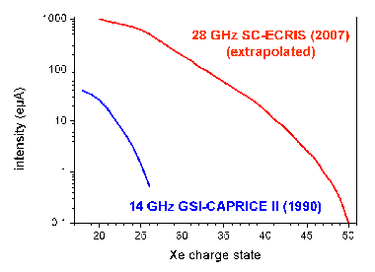
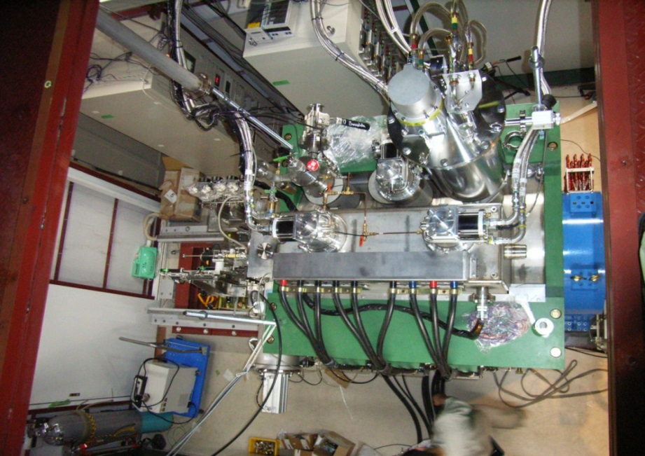

28 GHz-ECR ion source
Upgrade to increase pulse intensities for medium and heavy ions (FAIR and cw-heavy ion beams) by a factor of 10-15!
I(A^{q+}) ∼ ω_{ECR}²
  Increase of ω_{RF} = ω_{ECR} ∼ B
  Higher magn. flux density (sc magnets; up to 4.5 T)
SCECRIS – High Versatility
  Adjustable axial and radial magnetic fields ➔ adaptation to different working points
  High charge state beams ➔ LINAC-injection without postacceleration
  Cw-mode/special pulsed mode for high pulse intensities
  Low material consumption ➔ high efficiency
  High stability and low beam noise
GM-refrigerator
RF injection side
Beam extraction side
Roadmap
  Acquisition of SC-magnet system, …
  Commissioning/Optimization existing test facility
  Further R&D@test facility; achieving optimum operating conditions
  Transfer to the GSI-HLI
Iron yoke
Solenoid coil
Courtesy of T. Nakagawa, RIKEN Nishina Center, Japan
Heavy ion high intensity linac developments, W. Barth, 4.2.14

Slide 6
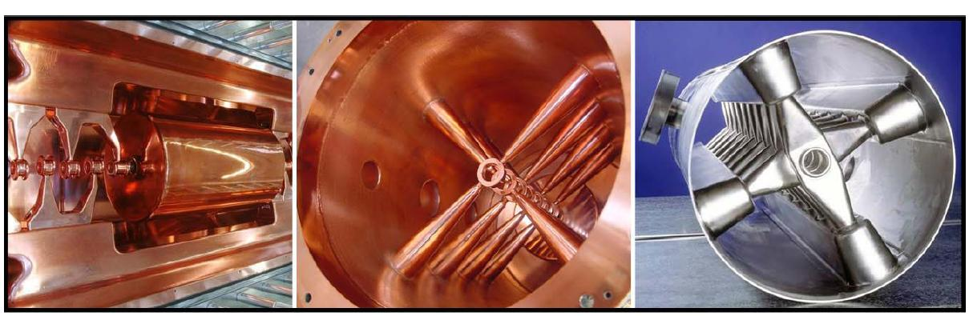

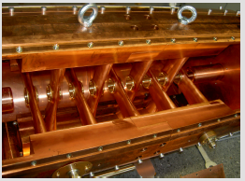
H-type Cavity Developments I
325 MHz-CH-prototype (nc), commissioning@FAIR-p-LINAC test stand (2014)
Prototyping of HE-LINAC and cw-LINAC H-type accelerator cavities
325 MHZ-Crossbar H-cavity (HE-LINAC-Booster)
nc-IH-cavity
nc-CH-cavity
sc-CH-cavity
β=0.1565
sc-prototype
Cold model
Heavy ion high intensity linac developments, W. Barth, 4.2.14

Slide 7

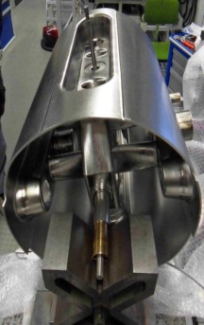
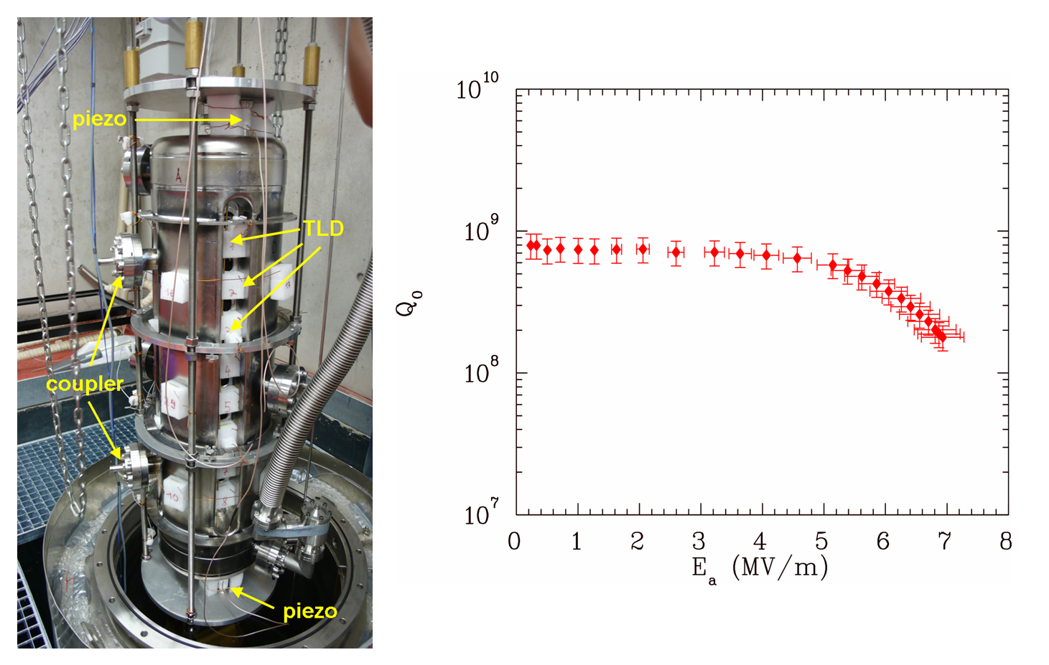
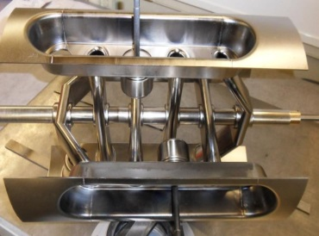
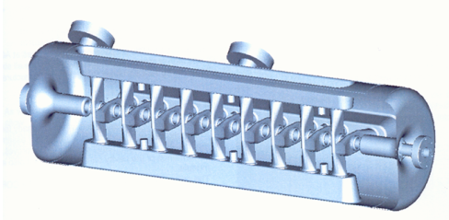
H-type Cavity Developments II superconducting Crossbar H-mode cavity (CH)
217 MHz CH (cw linac)
325 MHz CH (Booster linac)
Vertical test setup of the sc-CH-prototype cavity
Measured Q-value as function of the accelerating gradient
CH-prototype cavity (360 MHz, β = 0.1, 19 cells)
U. Ratzinger, H. Podlech (Univ. of Frankfurt)
Heavy ion high intensity linac developments, W. Barth, 4.2.14

Slide 8
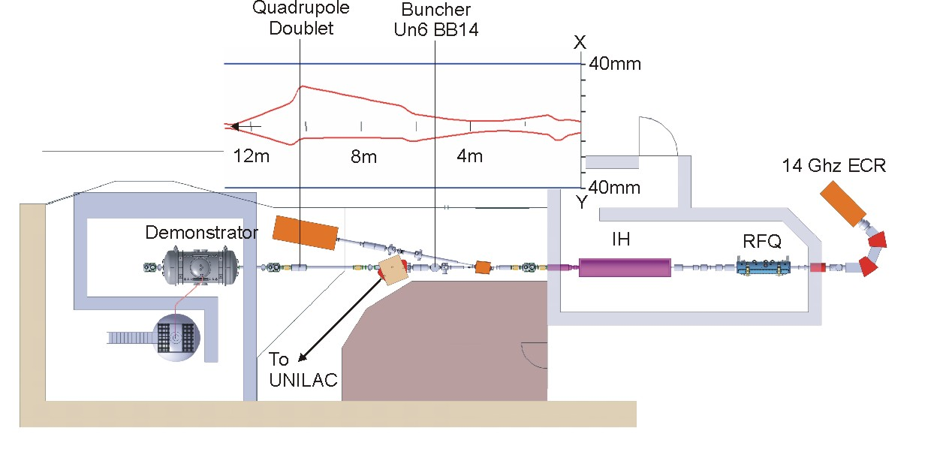
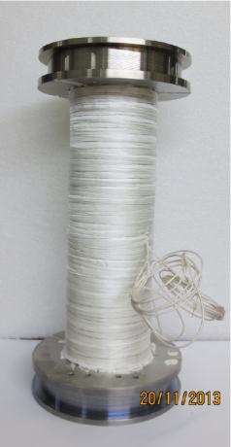
cw-LINAC-Demonstrator
2013: Test environment assembled
2014: 1st tests (warm & cold)
2015: First beam tests @GSI
High Charge State Injector (existing)
CH-cavity (5.1 MV/m
sc solenoids (9.3 T)
Cryostat
delivered
2014 (delivery)
2014 (delivery)
Heavy ion high intensity linac developments, W. Barth, 4.2.14

Slide 9
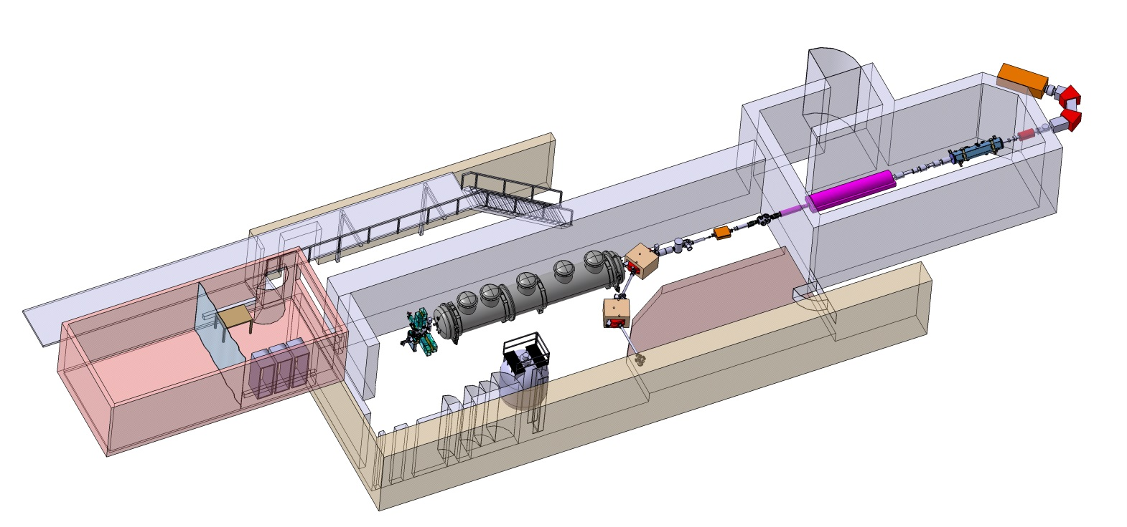
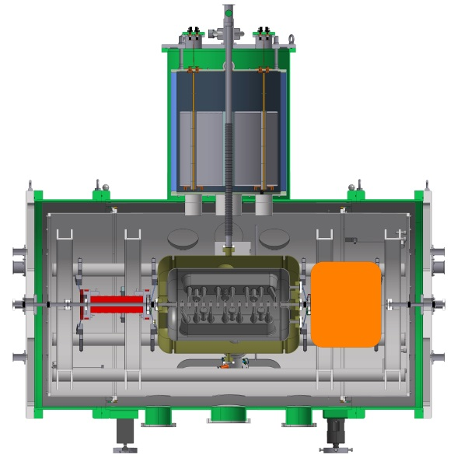
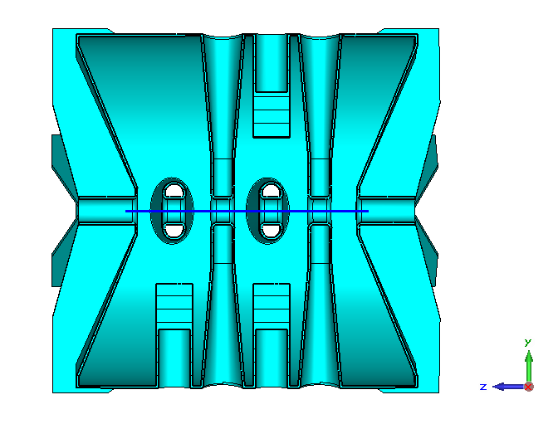
Pushing the limits: cw-heavy ion beams@coulomb barrier
Advanced Demonstrator
W_{kin} = 4.6 MeV/u (heavy ions)
W_{kin} ≈ 5.8 MeV/u (medium ions)
Step 1 (2016)
High Charge State Injector
Power Supplies, rf-amplifiers and controls
He-reservoir
VENUS/Berkeley: 400 µA, Ca11+ (CAPRICE/GSI: 50 µA, Ca10+)
SuSI (MSU), 18 GHz): 200 µA Ni12+, 180 µA, Ni17+ (CAPRICE(GSI: 50 µA, Ni9+)
SECRAL/IMP Lanzhou, 24 GHz: 40µA, Ni19+ ), limited by oven technology
Step 2 (2019)
Heavy ion high intensity linac developments, W. Barth, 4.2.14

Slide 10

Outlook
New HIM building@campus/JGU-Mainz provides Infrastructure (>2016):
preparation of superconducting rf-cavities
rf testing (warm&cold cavities)
cleanroom environment for entire mounting of accelerator string
infrastructure available for different accelerator facilities
Heavy ion high intensity linac developments, W. Barth, 4.2.14

Slide 11
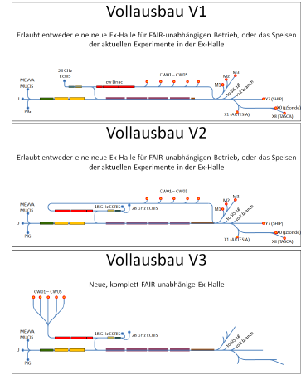
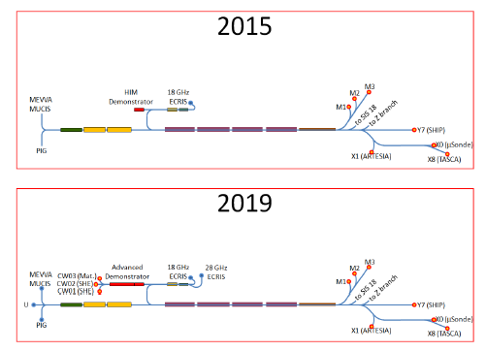
Backup:
Integration studies/cw-linac@FAIR/GSI

Slide 12
Backup
Budget
Personell
Heavy ion high intensity linac developments, W. Barth, 4.2.14

